Slide 1
The Battle of neighborhood
XYZ Company Ltd

Slide 2
INTRODUCTION
New York city review for XYZ Company.
Optimum location for new Restaurant business.
Business Problem :
Choice of first neighborhood to start restaurant business.
Easy to replicate.
Low competition.
High demand.
Choice of Menu
Success Criteria :
-Best neighborhood which meets above criteria.

Slide 3
NEW YORK CITY - FACTS
Most populous city in the United States.
It is diverse and is the financial capital of USA.
It is multicultural.
Provides lot of business opportunities.
Business friendly environment.
Attracted many different players into the market.
Global hub of business and commerce.
The city is a major center for banking and finance, retailing, world trade, transportation, tourism, real estate, new media, traditional media, advertising, legal services, accountancy, insurance, theatre, fashion, and the arts in the United States.

Slide 4
NEW YORK CITY – BUSINESS ENVIORMENT
Market is highly competitive.
Highly developed city so cost of doing business is also one of the highest.
New business venture or expansion needs to be analyzed carefully.
One should strategically targeting the market in order to.
-This will help in reduction of risk.
-The Return on Investment will be reasonable.

Slide 5
NEW YORK CITY – CUISINE
The City of New York is famous for its excellent cuisine. It's food culture includes an array of international cuisines influenced by the city's immigrant history.
Central and Eastern European immigrants, especially Jewish immigrants - bagels, cheesecake, hot dogs, knishes, and delicatessens.
Italian immigrants - New York-style pizza and Italian cuisine.
Jewish immigrants and Irish immigrants - pastrami and corned beef.
Chinese and other Asian restaurants, sandwich joints, trattorias, diners, and coffeehouses are ubiquitous throughout the city.
Mobile food vendors - Some 4,000 licensed by the city.
Middle Eastern foods such as falafel and kebabs examples of modern New York street food.
Famous for fine dining Michelin starred restaurants. The city is home to "nearly one thousand of the finest and most diverse haute cuisine restaurants in the world", according to Michelin.
So it is evident that to survive in such competitive market it is very important to strategically plan.

Slide 6
FACTOR TO STUDY TO DECIDE ON RESTURANT LOCATION
New York Population.
New York City Demographics.
Are there any Farmers Markets, Wholesale markets etc nearby so that the ingredients can be purchased fresh to maintain quality and cost?.
Are there any venues like Gyms, Entertainment zones, Parks etc nearby where floating population is high etc.
Who are the competitors in that location?.
Cuisine served / Menu of the competitors.
Segmentation of the Borough.
Untapped markets.
Saturated markets etc The list can go on...

Slide 7
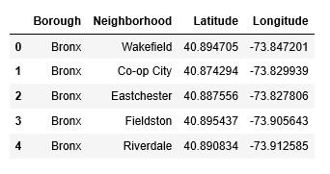
DATA DESCRIPTION - 1
Data 1 : Neighborhood has a total of 5 boroughs and 306 neighborhoods. In order to segment the neighborhoods and explore them, we will essentially need a dataset that contains the 5 boroughs and the neighborhoods that exist in each borough as well as the latitude and longitude coordinates of each neighborhood.
This dataset exists for free on the web. Link to the dataset is : https://geo.nyu.edu/catalog/nyu_2451_34572

Slide 8
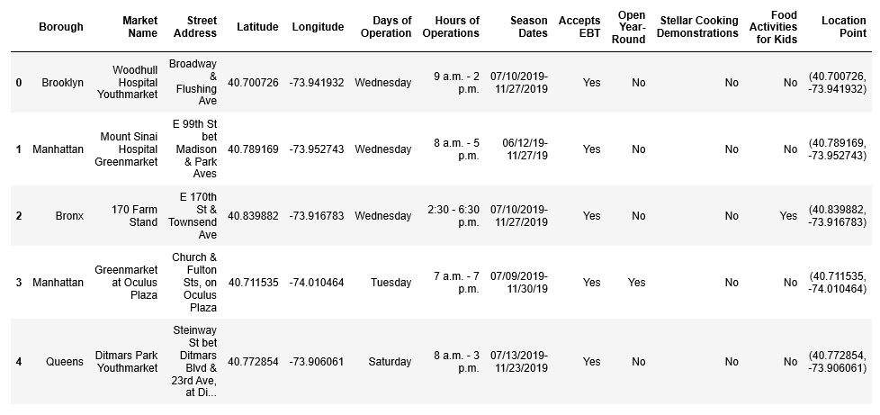
DATA DESCRIPTION - 2
Data 2 : Farmers Markets data
https://data.cityofnewyork.us/dataset/DOHMH-Farmers-Markets-andFood-Boxes/8vwk-6iz2
A farmers' market is often defined as a public site used by two or more local or regional producers for the direct sale of farm products to consumers. In addition to fresh fruits and vegetables, markets may sell dairy products, fish, meat, baked goods, and other minimally processed foods.

Slide 9
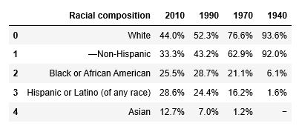
DATA DESCRIPTION - 3
Data 3 : Data from Wikipedia pages as given below :
New York Population.
New York City Demographics.
Cuisine of New York city. https://en.wikipedia.org/wiki/New_York_City https://en.wikipedia.org/wiki/Economy_of_New_York_City https://en.wikipedia.org/wiki/Portal:New_York_City https://en.wikipedia.org/wiki/Cuisine_of_New_York_City

Slide 10
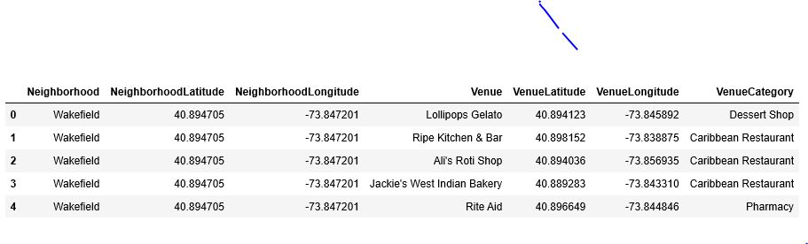
DATA DESCRIPTION - 4
Data from foursquare.com
New York city geographical coordinates data will be utilized as input for the Foursquare API, that will be leveraged to provision venues information for each neighborhood. We will use the Foursquare API to explore neighborhoods in New York City. The below is image of the Foursquare API data.

Slide 11
ANALYTIC APPROACH
New York city neighborhood has a total of 5 boroughs and 306 neighborhoods.
PART 1 - Clustering of Manhattan and Brooklyn.
PART 2 - Clustering of Bronx, Queens and Staten Island.
Only restaurant data is filtered from foursquare.com venues data and utilized for this project.
This is done because of the following Exploratory data analysis

Slide 12
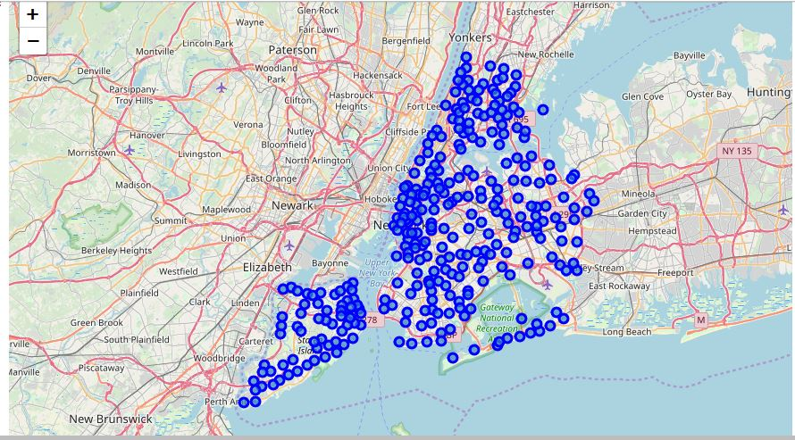
METHODOLOGY - 1
Data 1- New York city Geographical Coordinates Data.
Load the data and explore data - newyork_data.json.
Transform the data of nested python dictionaries into a pandas dataframe.
Dataframe contains the geographical coordinates of New York city neighborhoods.
Data will used to get Venues data from Foursquare.
Geopy and folium libraries used to create a map of New York city with neighborhoods superimposed on top

Slide 13
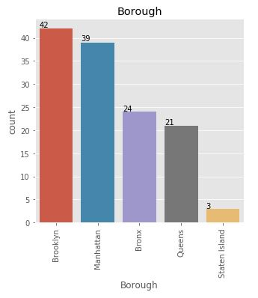
METHODOLOGY - 2
Data 2- DOHMH Farmers Markets and Food Boxes dataset.
In this we will be using the data of Farmers Markets.
Highest number are in Manhattan and Brooklyn.And lowest in Queens, Bronx and Staten Island.

Slide 14
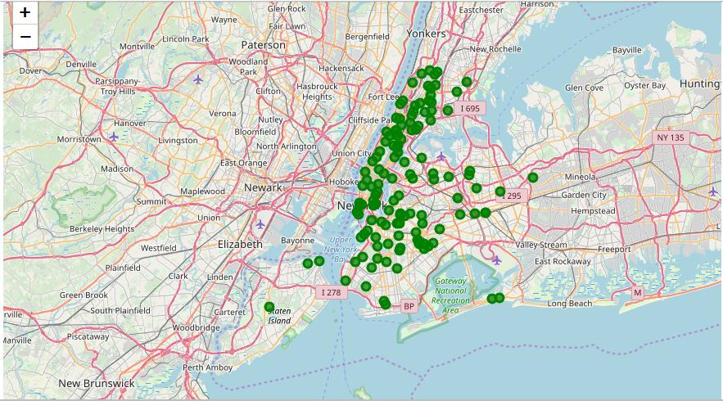
METHODOLOGY - 2
Farmers Market visualization-New York City.

Slide 15
METHODOLOGY - 3
Data 3 : To analyze New York city Population, Demographics and Cuisine , scrapped the data from Wikipedia pages given above in the data section.
We used BeautifulSoup python library.
Beautiful Soup is a Python package for parsing HTML and XML documents (including having malformed markup, i.e. non-closed tags, so named after tag soup).
It creates a parse tree for parsed pages that can be used to extract data from HTML, which is useful for web scraping.

Slide 16
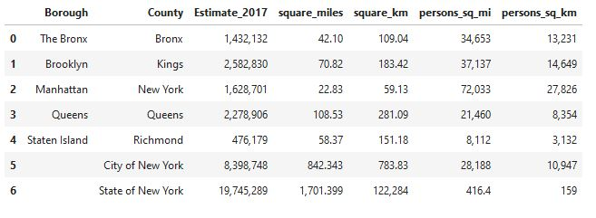
METHODOLOGY - 3 – NEW YORK POPULATION
Manhattan (New York County) is the geographically smallest and most densely populated borough.
Manhattan's (New York County's) population density of 72,033 people per square mile (27,812/km²) in 2015 makes it the highest of any county in the United States and higher than the density of any individual American city.
Brooklyn (Kings County), on the western tip of Long Island, is the city's most populous borough.
Queens (Queens County), on Long Island north and east of Brooklyn, is geographically the largest borough.

Slide 17
METHODOLOGY- 3 –NEW YORK CITY DEMOGRAPHICS
New York City is the most populous city in the United States , with an estimated record high of 8,622,698 residents as of 2017,incorporating more immigration into the city than outmigration since the 2010 United States Census.
The racial composition is as given below. This is the reason New York city has restaurants serving cuisine from many countries such as India, Africa, Japan etc. This also increases the scope for restaurants business in New York City.

Slide 18

METHODOLOGY- 3 – cuisine of New York city
This data has been manually prepared.
Data is taken from Wikipedia page - https://en.wikipedia.org/wiki/Cuisine_of_New_York_City
Data used to create word cloud.
NEW YORK CITY CUISINE : Most Preferred Food in New York City –Italian, Purto Rican, Mexican, Jewish, Indian, Pakistani & Dominican

Slide 19
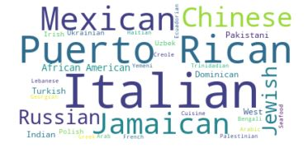
METHODOLOGY- 3 – cuisine of New York city
BROOKLYN CUISINE -Most Preferred Food in Brooklyn is – Italian, Purto Rican & Mexican
MANHATTAN CUISINE - Most Preferred Food in Manhattan is – Italian, American, Puerto Rican and Indian.

Slide 20

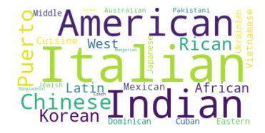
METHODOLOGY- 3 – cuisine of New York city
QUEENS CUISINE - Most Preferred Food in Queens is – Indian, Irish, Pakistani and Mexican.
THE BRONX CUISINE - Most Preferred Food in The Bronx is – Italian, Puerto Rican, Albanian and Dominican.

Slide 21
METHODOLOGY- 4 – foursquare.com
New York city geographical coordinates data has be utilized as input for the Foursquare API, that has been leveraged to provision venues information for each neighborhood.
We used the Foursquare API data to explore neighborhoods in New York City.
Using the geographical coordinates of each neighborhood foursquare API calls are made to get top 200 venues in a radius of 1000 meters
PART – 1 Brooklyn and Manhattan
PART – 2 Bronx, Queens and Staten Island

Slide 22
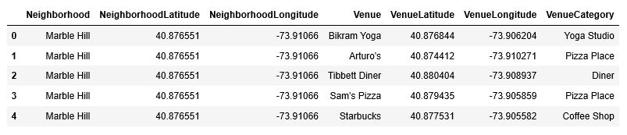
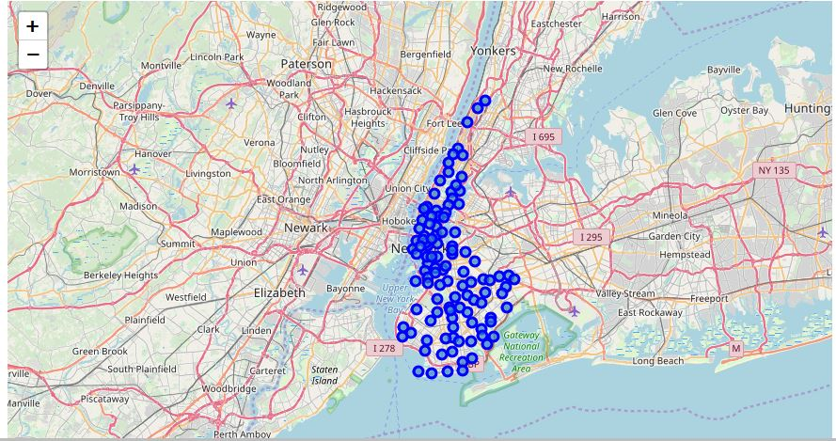
METHODOLOGY- 4 – PART- 1 – Brooklyn and Manhattan
Brooklyn and Manhattan Venues data.
Brooklyn and Manhattan Visualization.

Slide 23
METHODOLOGY- 4 – PART- 2 – Bronx, Queens and Staten Island
Bronx, Queens and Staten Island Venues Visualization : The "BQS_venues" dataframe has 10805 venues and 387 unique venue types.

Slide 24
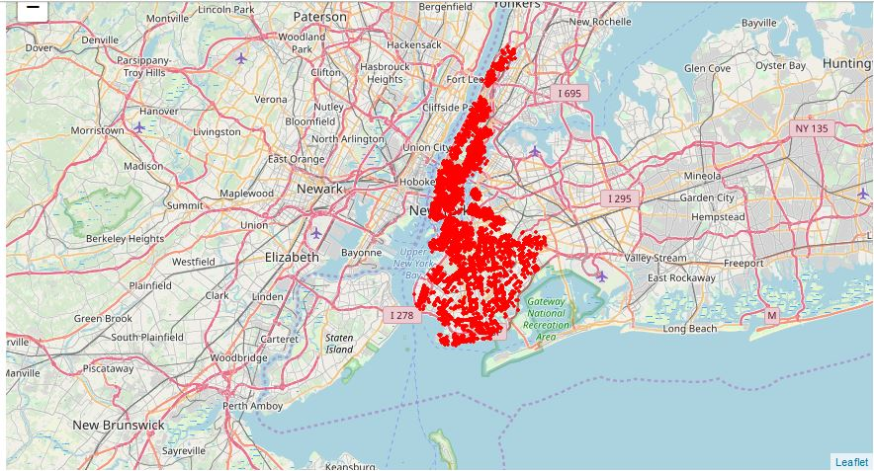
METHODOLOGY- 4 – PART- 1 – Brooklyn and Manhattan
Brooklyn and Manhattan Venues Visualization : Generated the below Brooklyn and Manhattan Venues Visualization. The "BM_venues" dataframe has 9708 venues and 397 unique venue types.

Slide 25
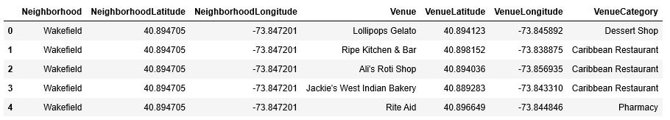
METHODOLOGY- 4 – PART- 2 – Bronx, Queens and Staten Island
Bronx, Queens and Staten Island Venues data
Bronx, Queens and Staten Island Visualization

Slide 26
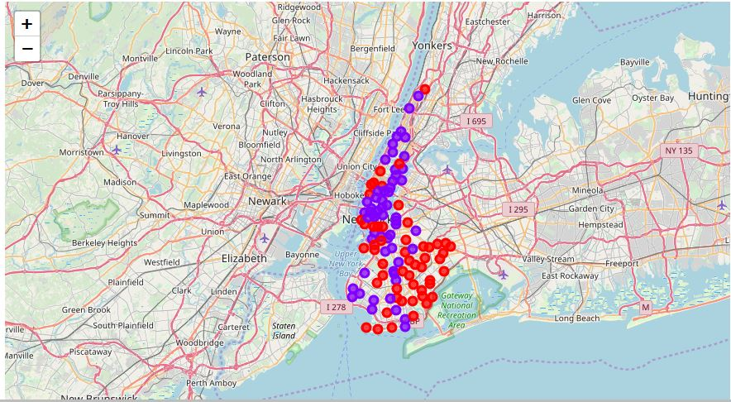
RESULTS PART- 1 – Brooklyn and Manhattan
Segmenting and Clustering Neighborhoods
Cluster 0 : The Total and Total Sum of cluster0 has smallest value. It shows that the market is not saturated.
Cluster 1 : The Total and Total Sum is very high. Lot of competition. Saturated neighborhoods.

Slide 27
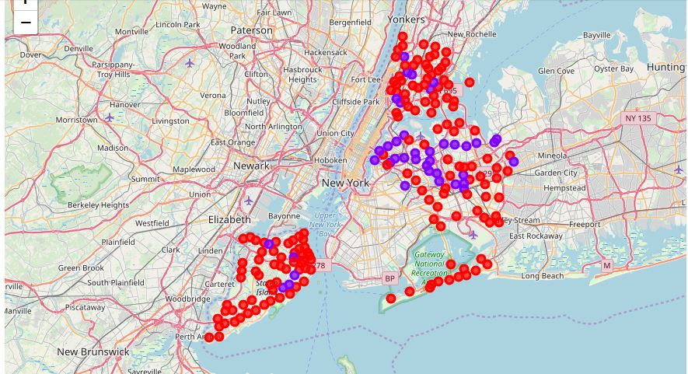
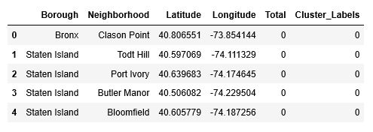
RESULTS PART- 2 – Bronx, Queens and Staten Island
Segmenting and Clustering Neighborhoods
Cluster 0 : The Total and Total Sum of cluster0 has smallest value. It shows that the market is not saturated. There are untapped markets.
Cluster 1 : The Total and Total Sum is very high. Lot of competition. Saturated neighborhoods.

Slide 28
DISCUSSION
Scope to explore cuisines of various countries in Bronx, Queens and Staten Island.
In Manhattan and Brooklyn restaurants , cuisines of many countries are part of their Menu. Risk can be taken with great menu on board. It also shows people love and explore cuisines of various countries.
Scope to increase Farmers markets in Bronx, Queens and Staten Island.
Region - Cluster0
Neighborhood – Staten Island – Tod Hill, Port Ivory, Bloomfield

Slide 29
CONCLUSION
Analysis performed on limited data
Re-run program with updated information.
Brooklyn and Manhattan has high concentration of restaurant business. Very competitive market.
Bronx, Queens and Staten Island also has good number of restaurants but not as many as required. So this can be explored.
As per the neighbourhood or restaurant type mentioned like Indian Restaurant, analysis can be checked. A venue with lowest risk and competition can be identified

