Slide 1










Boosting Privacy Online
The time is ticking...
Anonymous Credentials in the Browser
Piriya Saengsuwarn
INFO 343 Summer 2012 A-Term

Slide 2
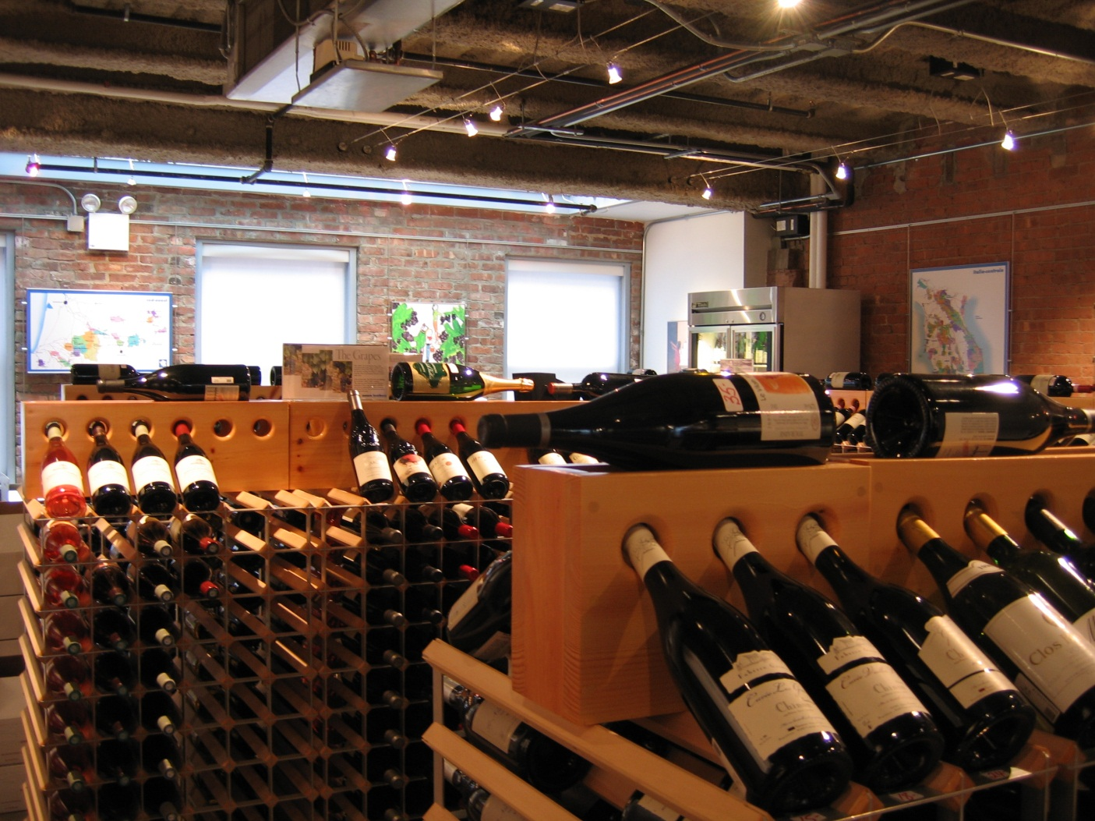
Scenario

Slide 3
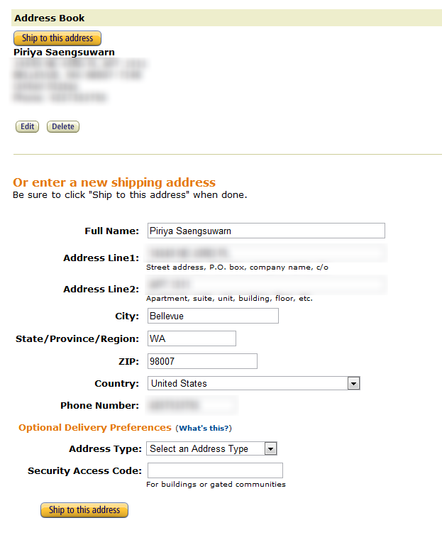
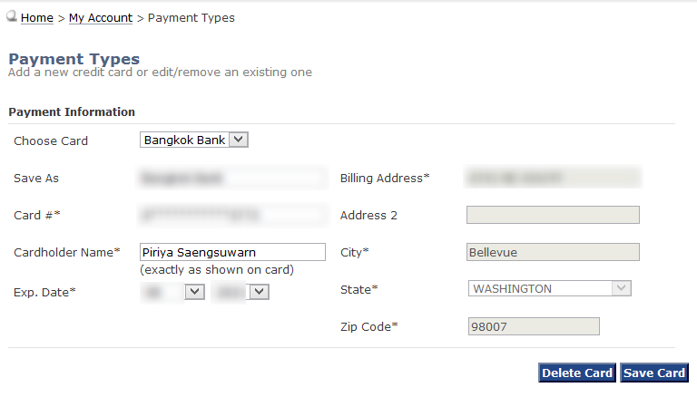
What if?

Slide 4
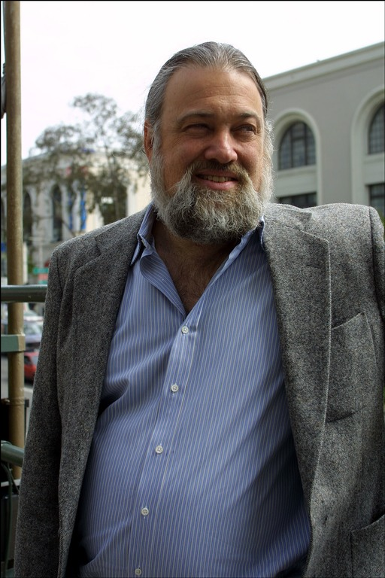
David Chaum
Published the idea in 1985
Some purposed AC characteristics:
Selective Attribute Showing
Zero-Knowledge Proof
Untraceability
Pseudonym System (Username)

Slide 5

What is this?
This is a part cut from a bigger picture, can you tell that it is a cat?

Slide 6
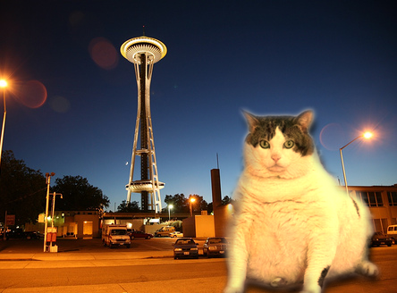
Selective Attribute Showing
Location=“Seattle”
Only face of the cat is required to show that this is picture of a cat = Selective Attribute Showing!
Name=“Poptart”
Weight=“9001 lbs.”
spicies=“cat”
isMammal=“true”

Slide 7
Zero-Knowledge Proof
“Verifies that a statement is true without revealing anything other than the veracity of the statement.”

Slide 8



Scenario Communication Model
User
(Customer)
Issuer
(Government, Bank)
Verifier
(Stores)

Slide 9
Traditional Model
Government issues age verification to store
Customer
Stores
Government
3
1
2
Customer submits credentials to store
fname=“Piriya” : for age verification & payment
lname=“Saengsuwarn” : for age verification & payment
birthdate=“01/01/1989” : for age verification
address=”Awesome St. , Bellevue 98007” : for delivery
creditcard=“0101-0101-0101-1337” : for payment
Store verifies given customer age with government using given credentials
Stores have personal information. Less privacy!

Slide 10
Traditional Model
Ignite hacked!
Government issues age verification to store
Customer
Stores
Government
3
1
2
Customer submits credentials to store
fname=“Piriya” : for age verification & payment
lname=“Saengsuwarn” : for age verification & payment
birthdate=“01/01/1989” : for age verification
address=”Awesome St. , Bellevue 98007” : for delivery
creditcard=“0101-0101-0101-1337” : for payment
Store verifies given customer age with government using given credentials
Stores have personal information. Less privacy!

Slide 11





Selected attributes are sent to the store
address=”Awesome St. , Bellevue 98007” : for delivery
payment=“$20” : money is transferred to the store isLegalToDrink=“true” : age verified
Zero Knowledge Proof!
Mailing
Delivery
Customer
Stores
Anonymous Protocol
eBanking
2
Login: Username=“piriys”
Pseudonym System!
Payment
1
Government
Customer select which attribute to show to store
Selective Attribute Showing!
Age Verification
Minimum personal information is stored online = Untracability!

Slide 12
Ignite hacked!
Selected attributes are sent to the store
address=”Awesome St. , Bellevue 98007” : for delivery
payment=“$20” : money is transferred to the store isLegalToDrink=“true” : age verified
Zero Knowledge Proof!
Mailing
Delivery
Customer
Stores
Anonymous Protocol
eBanking
2
Login: Username=“piriys”
Pseudonym System!
Payment
1
Government
Customer select which attribute to show to store
Selective Attribute Showing!
Age Verification
Minimum personal information is stored online = Untracability!

Slide 13
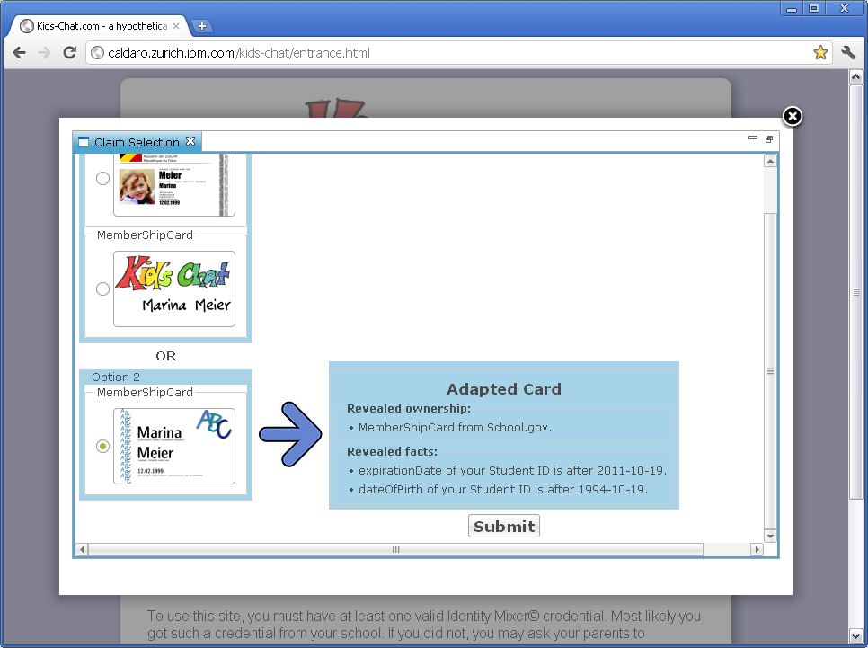


Technology
IDEMix (Identity Mixer)

Slide 14

Technology
PRIMECore

Slide 15




Prompt
Server displays dialog if any disclosure is needed
5
Select credential disclosure
User
Webpage
PRIMECore Server
1
4
User enters a webpage, traffic is intercepted.
Server sends back webpage information
PRIMECore Client
Traffic is redirect by client to encrypted proxy.
2
3
Client requests webpage from server
Firefox Extension

Slide 16
Ignite hacked!
Prompt
Server displays dialog if any disclosure is needed
5
Select credential disclosure
User
Webpage
PRIMECore Server
1
4
User enters a webpage, traffic is intercepted.
Server sends back webpage information
PRIMECore Client
Traffic is redirect by client to encrypted proxy.
2
3
Client requests webpage from server
Firefox Extension

Slide 17

Possible Implementations
Voting

Slide 18
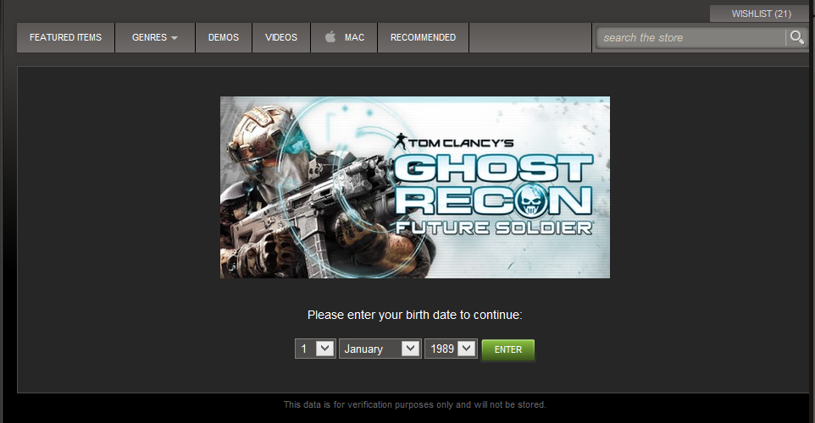
Possible Implementations
Age-Restricted Services

Slide 19

Why should we care?
W3C – P3P

Slide 20
Why should we care?
Ignite hacked!
W3C – P3P

Slide 21
Extra Slides (not included in Ignite)

Slide 22
References
https://www.prime-project.eu/
http://www.ted.com/talks/david_birch_identity_without_a_name.html
http://www.zurich.ibm.com/security/idemix/
http://idemix.wordpress.com/2009/08/18/quick-intro-to-credentials/
http://www.chaum.com/articles/Security_Wthout_Identification.htm
http://www.w3.org/2011/D1.2.3/
http://www.w3.org/QA/2010/11/boosting_privacy_online_-_anon.html
http://www.technologyreview.com/article/401902/a-more-anonymous-internet/
http://youtu.be/kn6Ti5Uknyo
http://youtu.be/qp6Al8Z0nNA
http://techie-buzz.com/tech-news/microsoft-google-p3p-breaches-facebook.html
http://en.wikipedia.org/wiki/Zero-knowledge_proof

