Slide 1




MOVIE Rental Store DATABASE MANAGEMENT
INFO 245 Summer 2013
Piriya Saengsuwarn
Peifeng Jing
Mehdi JaagouB

Slide 2
Introduction
Business CONTEXT

Slide 3

Business Context
Similar to Redbox or Blockbuster
12 hours store operating time per day
24 hours web application/database operating time per day

Slide 4

Business Context
Approximate average number of movie disc rented out per hour (calculated from Redbox statistics*):
1.86
Approximate average number of movie disc rented out per week (calculated from Redbox statistics*):
156.24

Slide 5






PHYSICAL
DISK
STORE
CUSTOMER
RENTAL
WEB APP
SERVER
MANAGEMENT
WEB APP
STORE
MANAGER
SYSTEM
ADMINISTRATOR

Slide 6
SECURITY AND MAINTENANCE DEFINITION
D1-1
Protections against Database vulnerabilities

Slide 7

PROTECTIONS
CHECK Constraints
Guard against SQL Injection in the backend
Maintain data integrity
Alerts
Guard against brute force attack in the backend
Warn system administrator about unusual activities or performance issues

Slide 8

PROTECTIONS
Execute Permissions
Minimize 80% of threats from human errors

Slide 9
SECURITY AND MAINTENANCE DEFINITION
D1-2
Database ROLES and permissions

Slide 10
System Administrator
Backend
SQL Management
Studio
+More
Permission
Store Manager
Frontend
Management Web App
Customer
Frontend
Rental Web App
Public
-Less
Permission
Frontend
Rental Web App

Slide 11
ROLES
Public
Create an account

Slide 12
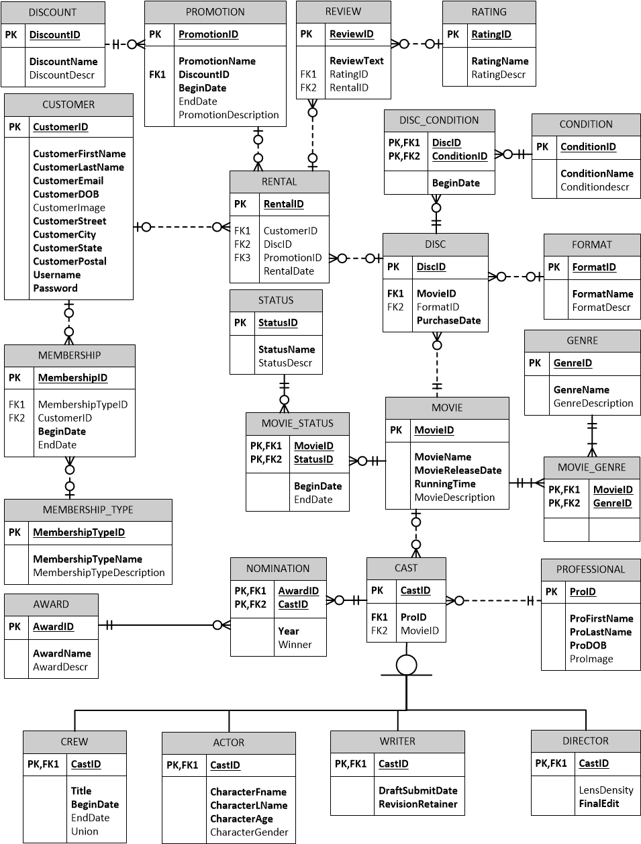
PUBLIC
C
Create Permission

Slide 13
ROLES
Customer
View/edit personal information
Search movies
Write a review for movies

Slide 14
CUSTOMER
C
Create Permission

Slide 15
Customer
U
Update Permission

Slide 16
Customer
D
Delete Permission

Slide 17
ROLES
Store Manager
Check disc conditions
Restock movie discs
Update movie information
Moderate customer review

Slide 18
STORE MANAGER
C
Create Permission

Slide 19
STORE Manager
U
Update Permission

Slide 20
STORE MANAGER
D
Delete Permission

Slide 21
ROLES
System Administrator
Full permission

Slide 22
View Permission samples
View Name | Public Access | Customer Access | Store Manager Access
vwAllMovie | YES | YES | YES
vwDiscCondition | NO | NO | YES
vwInactiveCustomer | NO | NO | YES
vwNewDisc | NO | NO | YES
vwBrokenDisc | NO | NO | YES
vwMostRentedMovie | NO | YES | YES

Slide 23
Stored Procedure Permission samples
SP Name | Public Access | Customer Access | Store Manager Access
uspRegisterCustomer | YES | NO | NO
uspAddMovie | NO | NO | YES
uspUpdateCustomer | NO | YES | NO
uspSearchMovie | NO | YES | YES
uspWriteReview | NO | YES | NO
uspDeleteReview | NO | YES | YES

Slide 24
SECURITY AND MAINTENANCE DEFINITION
D1-3
DATABASE Maintenance Plans and Schedule

Slide 25

DATABASE Maintenance Plan
Check integrity
Reorganize and rebuild index
Update statistics
Clean up history
Backup
Maintenance cleanup

Slide 26
DATA MOVEMENT AND SYSTEM MONITORING
D2
Alerts

Slide 27

Performance Condition Alerts
Low disk space
Long average wait time
Server fatal error
Notes:
Email to sysadmin

Slide 28

Event Alerts
Low movie disc available in stock
Rental overdue
Inactive customer account (last login longer than 6 months)
Notes:
Email to manager, customer

Slide 29
High-Availability and Disaster Recovery
D3-1
Architecture Overview

Slide 30
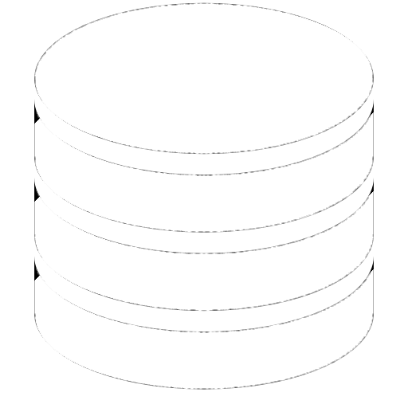

environment architecture
Development and Test
Production
PRINCIPAL
STORE_DB
STORE_DB
WITNESS
STORE_DB
MIRROR
STORE_DB

Slide 31
High-Availability and Disaster Recovery
D3-2
Availability and scalability Optimization

Slide 32

Scalability Optimization
Multiple points of read
Browsing (Window Shopping)
High performance key for better user experience
3 Instances per server: allow replication
Scaling up on Hardware
Notes:
Email to manager, customer

Slide 33

High Availability Optimization
Failover
High availability key for product reputation

Slide 34
High Availability Optimization
Mirroring RAID 1
PRINCIPAL
STORE_DB
WITNESS
MIRROR
STORE_DB

Slide 35

Internal customers
Provide technical support to technical teams
Maintain the use of storage
Monitoring space requirements
Development environment restores across environments
Data movement
Log shipping
Notes:
Email to manager, customer

Slide 36
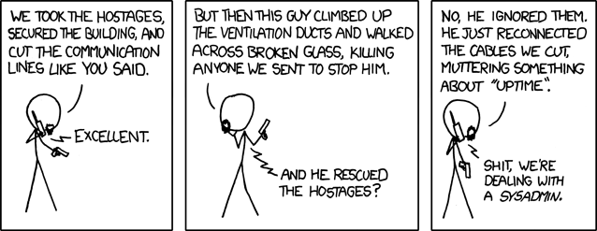
Devotion to duty (XKCD)

Slide 37
Thank you

