Slide 1
CURRENT SELECTION
Human and dog CTA evidence
573 human CTA proteins
615 loci / 18,031 Unsafe / 725 Neither
534 unassigned; dog selection remains unassessed
Sources, expression profiles, single-cutoff filtering and measured tissue evidence.
OncoRef CTA evidence walkthrough • 30 October 2026
01
Notes:
Human and dog CTA evidence
One RNA ceiling. Neither is the assessed normal-pass, noncandidate fallback. Unassigned is an assessment status, not a biological category.
Report: https://pirl-unc.github.io/oncoref/audits/cta-source-walkthrough-20261028/
Policy: oncoref.cta-selection.2026-10-30.1
Decision snapshot SHA256: 6b390e742c2d5adfa7350cc382f3323e411bff47eacc37e7b3ece7a39ed09ece

Slide 2
INDEPENDENT QUESTIONS
Safety, cancer and Reproductive evidence
Assessment | Question | Current rule
Safety | Concerning normal expression? | Absolute RNA / IHC and clinical rules
Cancer expression | Expressed in a measured cancer? | One sample ≥2 TPM or pTPM
Reproductive evidence | Expression in a qualifying branch? | Reproductive ≥5 nTPM, reliable positive IHC, or supported embryonic ≥5 TPM
Coverage | Are required panels measured? | All GTEx core contexts and existing HPA panels
Only safety establishes Unsafe. Missing core data remain unassigned. RNA is not a direct protein measurement.
OncoRef CTA evidence walkthrough • 30 October 2026
02
Notes:
Safety, cancer and Reproductive evidence
Only safety supplies Unsafe evidence. Reproductive is the umbrella for adult reproductive, placental, extraembryonic, embryonic and fetal contexts.
Report: https://pirl-unc.github.io/oncoref/audits/cta-source-walkthrough-20261028/
Policy: oncoref.cta-selection.2026-10-30.1
Decision snapshot SHA256: 6b390e742c2d5adfa7350cc382f3323e411bff47eacc37e7b3ece7a39ed09ece

Slide 3
HPA PROFILE IDENTITY
Diffuse expression is an identity question
Term | Meaning
N | HPA v23 normal-tissue nTPM
R | Highest Reproductive nTPM in HPA v23 (adult/placental)
N / (N + R) | Average across 29 organs / 38 contexts; thymus excluded
Active boundary | Average >10%, with a supported positive R and complete comparison
MTCP1 moves to Neither: 24.53%. Thymus is excluded. Embryonic concentration remains unassessed.
OncoRef CTA evidence walkthrough • 30 October 2026
03
Notes:
Diffuse expression is an identity question
The old normal-maximum veto is removed. Diffuseness averages N/(N+R) across fixed weighted normal contexts, including Disposable. The active 10% adult/placental identity boundary requires complete HPA measurements and an RNA- or IHC-supported positive reference. Thymus is Permissive and excluded. Supported embryonic evidence retains its separate route with unassessed concentration.
Report: https://pirl-unc.github.io/oncoref/audits/cta-source-walkthrough-20261028/
Policy: oncoref.cta-selection.2026-10-30.1
Decision snapshot SHA256: 6b390e742c2d5adfa7350cc382f3323e411bff47eacc37e7b3ece7a39ed09ece

Slide 4
COVERAGE
A fixed GTEx core for every protein
Requirement | Interpretation
GTEx v11: 52 bulk contexts | Same contexts for every protein; measured zero counts
All member loci measured | Missing identities are not replaced by paralogs
Missing core coverage | Blocks CTA; unassigned unless independent Unsafe evidence
Optional DICE / cornea | Missing coverage allowed; observed safety evidence counts
GTEx does not cover every organ, fetal stage or rare cell. Existing HPA cell / immune coverage requirements also apply.
OncoRef CTA evidence walkthrough • 30 October 2026
04
Notes:
A fixed GTEx core for every protein
GTEx v11 uses 52 native bulk contexts, 9 Reproductive and 43 other. Every member locus must be measured. 19,119 / 19,863 proteins have full coverage; no intermediate coverage profiles occur.
Report: https://pirl-unc.github.io/oncoref/audits/cta-source-walkthrough-20261028/
Policy: oncoref.cta-selection.2026-10-30.1
Decision snapshot SHA256: 6b390e742c2d5adfa7350cc382f3323e411bff47eacc37e7b3ece7a39ed09ece

Slide 5
CALCULATION AUDIT
ZNF730: panel composition matters
Calculation | HPA v23 | GTEx v11
Reproductive reference (testis) | 4.9 nTPM | 4.91414 TPM
Full source panel | 9.53%: 29 anatomy units | 1.65%: 23 anatomy units
Same 20 anatomy units | 6.36% | 1.71%
Thymus is Permissive: excluded from both sides of the score
Thymus exclusion changes HPA 10.34% → 9.53%. Independent safety evidence keeps ZNF730 Unsafe.
OncoRef CTA evidence walkthrough • 30 October 2026
05
Notes:
ZNF730: panel composition matters
Full tissue tables: https://pirl-unc.github.io/oncoref/audits/cta-unassigned-20261029/znf730/ . Original panels differ; scores are not a controlled assay comparison.
Report: https://pirl-unc.github.io/oncoref/audits/cta-source-walkthrough-20261028/
Policy: oncoref.cta-selection.2026-10-30.1
Decision snapshot SHA256: 6b390e742c2d5adfa7350cc382f3323e411bff47eacc37e7b3ece7a39ed09ece

Slide 6
HUMAN ANNOTATIONS
Published candidate lists
Paper | Proteins | CTA | Unsafe | Neither | Unassigned
da Silva et al. (2017) | 1,017 | 403 | 401 | 189 | 24
Wang et al. (2016) | 988 | 282 | 640 | 57 | 9
Chang et al. (2019) | 985 | 296 | 639 | 40 | 10
Gong et al. (2021) | 729 | 350 | 306 | 66 | 7
Bruggeman et al. (2018) | 692 | 23 | 663 | 1 | 5
Jamin et al. (2021) | 469 | 37 | 427 | 3 | 2
Loriot et al. (2025) | 202 | 86 | 101 | 13 | 2
Carter et al. (2023) | 103 | 59 | 37 | 6 | 1
Hirbo et al. (2015) | 78 | 13 | 64 | 0 | 1
Seager et al. (2024) | 15 | 12 | 2 | 0 | 1
Sasaroli et al. (2011) | 13 | 0 | 13 | 0 | 0
Garg et al. (2007) | 5 | 3 | 2 | 0 | 0
Union: 2,514 proteins / 2,570 loci. 472 selected proteins have an annotation; 101 do not.
OncoRef CTA evidence walkthrough • 30 October 2026
06
Notes:
Published candidate lists
da Silva et al. (2017): https://doi.org/10.18632/oncotarget.21715
Wang et al. (2016): https://doi.org/10.1038/ncomms10499
Chang et al. (2019): https://doi.org/10.1002/cam4.2223
Gong et al. (2021): https://doi.org/10.1038/s41467-021-22695-y
Bruggeman et al. (2018): https://doi.org/10.1038/s41388-018-0357-2
Jamin et al. (2021): https://doi.org/10.1002/1878-0261.12900
Loriot et al. (2025): https://doi.org/10.1371/journal.pgen.1011734
Carter et al. (2023): https://doi.org/10.1136/jitc-2023-007935
Hirbo et al. (2015): https://doi.org/10.1371/journal.pone.0144155
Seager et al. (2024): https://doi.org/10.1186/s12967-024-04918-0
Sasaroli et al. (2011): https://doi.org/10.4161/cbt.12.3.16260
Garg et al. (2007): https://doi.org/10.1158/1078-0432.CCR-06-2340
Report: https://pirl-unc.github.io/oncoref/audits/cta-source-walkthrough-20261028/
Policy: oncoref.cta-selection.2026-10-30.1
Decision snapshot SHA256: 6b390e742c2d5adfa7350cc382f3323e411bff47eacc37e7b3ece7a39ed09ece

Slide 7
PUBLICATION SCOPE
Broader published nominations
Paper | Published scope | Identity accounting
Sasaroli et al. (2011) | 13 detailed tumor-vascular candidates | 13 matched genes
Hirbo et al. (2015) | 86 placenta-enriched genes, including 30 fast-evolving | 82 matched, 4 unresolved
Compact source view | Bai, Boël and Bradley covered by larger sets | All memberships retained
Garg et al. (2007) | Still uniquely contributes SPAG9 | Retained in main view
Vascular and placental nominations retain their scope. Paper membership never bypasses the quantitative funnel.
OncoRef CTA evidence walkthrough • 30 October 2026
07
Notes:
Broader published nominations
Sasaroli et al. (2011) https://doi.org/10.4161/cbt.12.3.16260 . Hirbo et al. (2015) https://doi.org/10.1371/journal.pone.0144155 . Exact extracted rows and matching receipts accompany the report.
Report: https://pirl-unc.github.io/oncoref/audits/cta-source-walkthrough-20261028/
Policy: oncoref.cta-selection.2026-10-30.1
Decision snapshot SHA256: 6b390e742c2d5adfa7350cc382f3323e411bff47eacc37e7b3ece7a39ed09ece

Slide 8
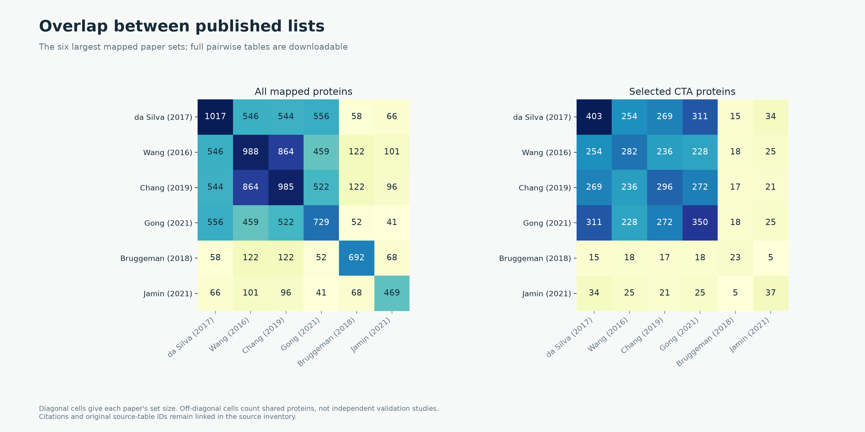
HUMAN ANNOTATIONS
Overlap between published lists
OncoRef CTA evidence walkthrough • 30 October 2026
08
Notes:
Overlap between published lists
Tables and author-recognized prior antigens within the same paper are unioned. Evidence roles, source IDs and pairwise counts accompany the report.
Report: https://pirl-unc.github.io/oncoref/audits/cta-source-walkthrough-20261028/
Policy: oncoref.cta-selection.2026-10-30.1
Decision snapshot SHA256: 6b390e742c2d5adfa7350cc382f3323e411bff47eacc37e7b3ece7a39ed09ece

Slide 9
POSITIVE EXPRESSION CONTEXTS
Reproductive evidence: measured branches
Qualifying route | Entrants | Final CTA
Adult/placental evidence only | 3,138 | 342
Embryonic-only evidence | 1,433 | 141
Both measured routes | 11,572 | 90
RNA and reliable reproductive IHC establish association
Entrants count positive expression before the other admission gates. Reproductive presence and profile concentration are separate questions.
OncoRef CTA evidence walkthrough • 30 October 2026
09
Notes:
Reproductive evidence: measured branches
Tyser et al. (2021): https://doi.org/10.1038/s41586-021-04158-y . HPA v23 https://v23.proteinatlas.org/about/download .
Report: https://pirl-unc.github.io/oncoref/audits/cta-source-walkthrough-20261028/
Policy: oncoref.cta-selection.2026-10-30.1
Decision snapshot SHA256: 6b390e742c2d5adfa7350cc382f3323e411bff47eacc37e7b3ece7a39ed09ece

Slide 10
HUMAN EVIDENCE
Normal and cancer measurement sources
Evidence | Source | Quantity
Normal / reproductive bulk | HPA v23 consensus / brain + GTEx v11 | nTPM / TPM
Normal tissue cells | HPA v23 clusters, at least 20 reads | nTPM
Immune cells | HPA v23 / Monaco / original DICE | Native nTPM / TPM
Adult cornea | Collin et al., GSE155683 | CP10K
Normal protein | HPA v23 + curated external IHC | Staining / reagent confidence
Cancer | 132 compatible OncoRef cohort views + HPA | TPM / protein-coding TPM
Developmental | Tyser gastrulation + Petropoulos preimplantation | Stage / lineage mean TPM
DICE and corneal coverage are optional. Measured counterevidence still contributes.
OncoRef CTA evidence walkthrough • 30 October 2026
10
Notes:
Normal and cancer measurement sources
HPA https://v23.proteinatlas.org/about/download ; DICE https://dice-database.org/ ; cornea https://www.ncbi.nlm.nih.gov/geo/query/acc.cgi?acc=GSE155683 ; Tyser https://doi.org/10.1038/s41586-021-04158-y . Full URLs and sample lineage accompany the report.
Report: https://pirl-unc.github.io/oncoref/audits/cta-source-walkthrough-20261028/
Policy: oncoref.cta-selection.2026-10-30.1
Decision snapshot SHA256: 6b390e742c2d5adfa7350cc382f3323e411bff47eacc37e7b3ece7a39ed09ece

Slide 11
CURRENT POLICY
RNA cutoffs
Ceiling | Missing / unusable | Approved − | Supported − | Enhanced −
Vital | 4 | 8 | 16 | 32
Protected | 8 | 16 | 32 | 64
Manageable | 16 | 32 | 64 | 128
One boundary: above-cutoff Vital / Protected is Unsafe
Manageable excess blocks CTA. Bowel epithelium and identified fibroblasts use Manageable. Equality passes.
OncoRef CTA evidence walkthrough • 30 October 2026
11
Notes:
RNA cutoffs
The same nominal values apply across native TPM/nTPM assays. CP10K uses nominal /100, not a TPM conversion. Values are screening-policy choices, not measured toxicity limits.
Report: https://pirl-unc.github.io/oncoref/audits/cta-source-walkthrough-20261028/
Policy: oncoref.cta-selection.2026-10-30.1
Decision snapshot SHA256: 6b390e742c2d5adfa7350cc382f3323e411bff47eacc37e7b3ece7a39ed09ece

Slide 12
TCR-T EVIDENCE
Clinical evidence adjusts RNA ceilings
With clinical credit | Missing / unusable | Approved − | Supported − | Enhanced −
Vital | 8 | 16 | 32 | 32
Protected | 16 | 32 | 64 | 64
Manageable | 32 | 64 | 128 | 128
IHC grades stay unchanged. Trials do not stack.
Protein and clinical-injury exclusions remain. This is protein-profile credit with tested epitope limitations, not clinical clearance.
OncoRef CTA evidence walkthrough • 30 October 2026
12
Notes:
Clinical evidence adjusts RNA ceilings
One step for reviewed treated-cohort evidence without identified grade 4-5 specificity-related toxicity; cap at Enhanced. Unknown or suspected specificity injury blocks product credit. Exact peptide/HLA/receptor limits remain. Clinical trial and SAE review: https://pirl-unc.github.io/oncoref/audits/cta-tcr-trials-20261029/
Report: https://pirl-unc.github.io/oncoref/audits/cta-source-walkthrough-20261028/
Policy: oncoref.cta-selection.2026-10-30.1
Decision snapshot SHA256: 6b390e742c2d5adfa7350cc382f3323e411bff47eacc37e7b3ece7a39ed09ece

Slide 13
CLINICAL SAFETY
Serious events and antigen specificity
Targeted CTA epitope | Important event | Specificity attribution
MAGE-A3 / a3a | Two fatal cardiac injuries | Titin cross-recognition implicated
MAGE-A3/A9 / NCI receptor | Three neurological cases; two deaths | MAGE-A12 brain recognition implicated
NY-ESO-1 / LAGE-1A, c259 | Late cardiac death; two GBS cases | Peptide-specific mechanism not established
NY-ESO-1 / TBI-1301 | Grade 3 lung injury | Unresolved; no credit for this product
MAGE-A4 / afami-cel | Aplasia and stroke deaths in phase 1 | No demonstrated antigen-specific mechanism
MAGE-A10 / ADP-A2M10 | Grade 4 CRS; fatal aplasia after repeat treatment | Conditioning favored for marrow injury
Clinical trial and SAE review. Seriousness differs from severity; this is a selected summary, not a pooled event rate.
OncoRef CTA evidence walkthrough • 30 October 2026
13
Notes:
Serious events and antigen specificity
Letetresgene Autoleucel in Advanced/Metastatic Myxoid/Round Cell Liposarcoma: https://doi.org/10.1200/JCO-24-01466
Autologous T cell therapy for PRAME+ advanced solid tumors in HLA-A*02+ patients: a phase 1 trial: https://doi.org/10.1038/s41591-025-03650-6
Autologous T cell therapy for MAGE-A4+ solid cancers in HLA-A*02+ patients: a phase 1 trial: https://doi.org/10.1038/s41591-022-02128-z
SPEARHEAD-1: a single-arm phase 2 trial of afamitresgene autoleucel in advanced synovial sarcoma and myxoid/round cell liposarcoma: https://doi.org/10.1016/S0140-6736(24)00319-2
Identification of a Titin-Derived HLA-A1-Presented Peptide as a Cross-Reactive Target for Engineered MAGE A3-Directed T Cells: https://doi.org/10.1126/scitranslmed.3006034
Guillain-Barre syndrome observed with adoptive transfer of lymphocytes genetically engineered with an NY-ESO-1 reactive T-cell receptor: https://doi.org/10.1186/s40425-019-0759-x
NCT03709706 protocol: NY-ESO-1/LAGE-1A shared peptide and c259 receptor: https://cdn.clinicaltrials.gov/large-docs/06/NCT03709706/Prot_000.pdf
NCT03132922 protocol: MAGE-A4 c1032 target peptide: https://cdn.clinicaltrials.gov/large-docs/22/NCT03132922/Prot_000.pdf
First-in-human dose escalation trial to evaluate the clinical safety and efficacy of an anti-MAGEA1 autologous TCR-transgenic T cell therapy in relapsed and refractory solid tumors: https://doi.org/10.1136/jitc-2023-008668
Phase I clinical trial evaluating the safety and efficacy of ADP-A2M10 SPEAR T cells in patients with MAGE-A10+ advanced non-small cell lung cancer: https://doi.org/10.1136/jitc-2021-003581
NY-ESO-1-specific redirected T cells with endogenous TCR knockdown mediate tumor response and cytokine release syndrome: https://doi.org/10.1136/jitc-2021-003811
Cancer regression and neurological toxicity following anti-MAGE-A3 TCR gene therapy: https://pubmed.ncbi.nlm.nih.gov/23377668/
Report: https://pirl-unc.github.io/oncoref/audits/cta-source-walkthrough-20261028/
Policy: oncoref.cta-selection.2026-10-30.1
Decision snapshot SHA256: 6b390e742c2d5adfa7350cc382f3323e411bff47eacc37e7b3ece7a39ed09ece

Slide 14
CATEGORY DEFINITIONS
Neither is the normal-pass fallback
Profile | Description | Proteins
Low normal expression | Measured normal RNA <2 and no detected normal protein | 321
Manageable expression | Multiple Manageable contexts; every normal gate still passes | 3
Diffuse reproductive | HPA score >10%; no qualifying route remains | 1
Other normal-pass | No candidate subtype qualifies; includes permitted-normal profiles | 400
Missing cancer or reproductive evidence does not imply missing normal evidence.
OncoRef CTA evidence walkthrough • 30 October 2026
14
Notes:
Neither is the normal-pass fallback
Complete required normal coverage and resolved evidence are required. Cancer expression may be high, low or missing. No profile overrides a normal ceiling.
Report: https://pirl-unc.github.io/oncoref/audits/cta-source-walkthrough-20261028/
Policy: oncoref.cta-selection.2026-10-30.1
Decision snapshot SHA256: 6b390e742c2d5adfa7350cc382f3323e411bff47eacc37e7b3ece7a39ed09ece

Slide 15
SEPARATE CANDIDATE SUBTYPE
Tumor-restricted candidates
Requirement | Rule
Tumor RNA | >=10 TPM in two distinct samples; duplicate source views do not count
Protein alternative | Reviewed tumor protein evidence; aggregate IHC counts alone are insufficient
Outside cancer | Low measured normal/developmental expression; all normal safety gates pass
Coverage review | Relevant rare normal cells and states must be assessed before admission
66 numerical leads await coverage review and remain Neither. They are not labelled tumor-only.
OncoRef CTA evidence walkthrough • 30 October 2026
15
Notes:
Tumor-restricted candidates
Two distinct tumor samples at >=10 native TPM, or reviewed reliable tumor protein. Restriction also requires low measured normal/developmental expression and adequate coverage of relevant rare cells and states.
Report: https://pirl-unc.github.io/oncoref/audits/cta-source-walkthrough-20261028/
Policy: oncoref.cta-selection.2026-10-30.1
Decision snapshot SHA256: 6b390e742c2d5adfa7350cc382f3323e411bff47eacc37e7b3ece7a39ed09ece

Slide 16
HUMAN FUNNEL
Every filtering layer can contribute
Final: 573 CTA / 18,031 Unsafe / 725 Neither / 534 unassigned.
OncoRef CTA evidence walkthrough • 30 October 2026
16
Notes:
Every filtering layer can contribute
The gray segment is held/unassigned evidence, not Neither. The final profile check assigns Neither. All layers evaluate every protein; final categories are independent of display order.
Report: https://pirl-unc.github.io/oncoref/audits/cta-source-walkthrough-20261028/
Policy: oncoref.cta-selection.2026-10-30.1
Decision snapshot SHA256: 6b390e742c2d5adfa7350cc382f3323e411bff47eacc37e7b3ece7a39ed09ece

Slide 17
HUMAN FUNNEL
Removals at each filter
Layer | First removals | Eligible | Unsafe
Association | 3,720 | 16,143 | 0
Tumor sample ≥2 TPM/pTPM | 14 | 16,129 | 0
HPA normal protein | 11,599 | 4,530 | 10,094
Required RNA coverage | 191 | 4,339 | 10,094
Reproductive concentration | 225 | 4,114 | 10,094
Normal bulk | 3,322 | 792 | 17,500
HPA tissue clusters | 186 | 606 | 17,914
HPA immune | 8 | 598 | 17,944
Monaco immune | 4 | 594 | 17,961
DICE immune | 15 | 579 | 18,016
Adult cornea | 3 | 576 | 18,028
Accepted normal-protein evidence | 2 | 574 | 18,030
Clinical safety exclusion | 1 | 573 | 18,031
External validated normal protein | 0 | 573 | 18,031
Candidate subtypes and Neither fallback | 0 | 573 | 18,031
Only MTCP1 changes category; other concentration failures also fail other gates.
OncoRef CTA evidence walkthrough • 30 October 2026
17
Notes:
Removals at each filter
Sequential first removals depend on the displayed order; the independent-layer table reports overlaps.
Report: https://pirl-unc.github.io/oncoref/audits/cta-source-walkthrough-20261028/
Policy: oncoref.cta-selection.2026-10-30.1
Decision snapshot SHA256: 6b390e742c2d5adfa7350cc382f3323e411bff47eacc37e7b3ece7a39ed09ece

Slide 18
ANATOMY AND EVIDENCE
IHC matching to measured RNA compartments
Context | Evidence and current ceiling
PRAME colon epithelial cells | 20.3 nTPM / 96 reads; Enhanced-negative glandular IHC; Manageable 128
PRAME adrenal bulk | 3.6 nTPM; incomplete IHC coverage; Vital 4 → 8 with IMA203 credit
CTAG2 bronchial basal cells | 24.9 nTPM / 58 reads; Enhanced-negative respiratory IHC; Vital 32
Unrelated cells in the same tissue | No negative-IHC credit without exact or declared compartment coverage
PRAME and CTAG2 pass this policy. Parent-compartment sensitivity and PRAME’s Low adrenal protein remain explicit limitations.
OncoRef CTA evidence walkthrough • 30 October 2026
18
Notes:
IHC matching to measured RNA compartments
HPA colon https://www.proteinatlas.org/learn/dictionary/normal/colon ; bronchus https://www.proteinatlas.org/learn/dictionary/normal/bronchus . Parent-compartment credit is a declared anatomical interpretation, not proof that all rare cells were sampled.
Report: https://pirl-unc.github.io/oncoref/audits/cta-source-walkthrough-20261028/
Policy: oncoref.cta-selection.2026-10-30.1
Decision snapshot SHA256: 6b390e742c2d5adfa7350cc382f3323e411bff47eacc37e7b3ece7a39ed09ece

Slide 19
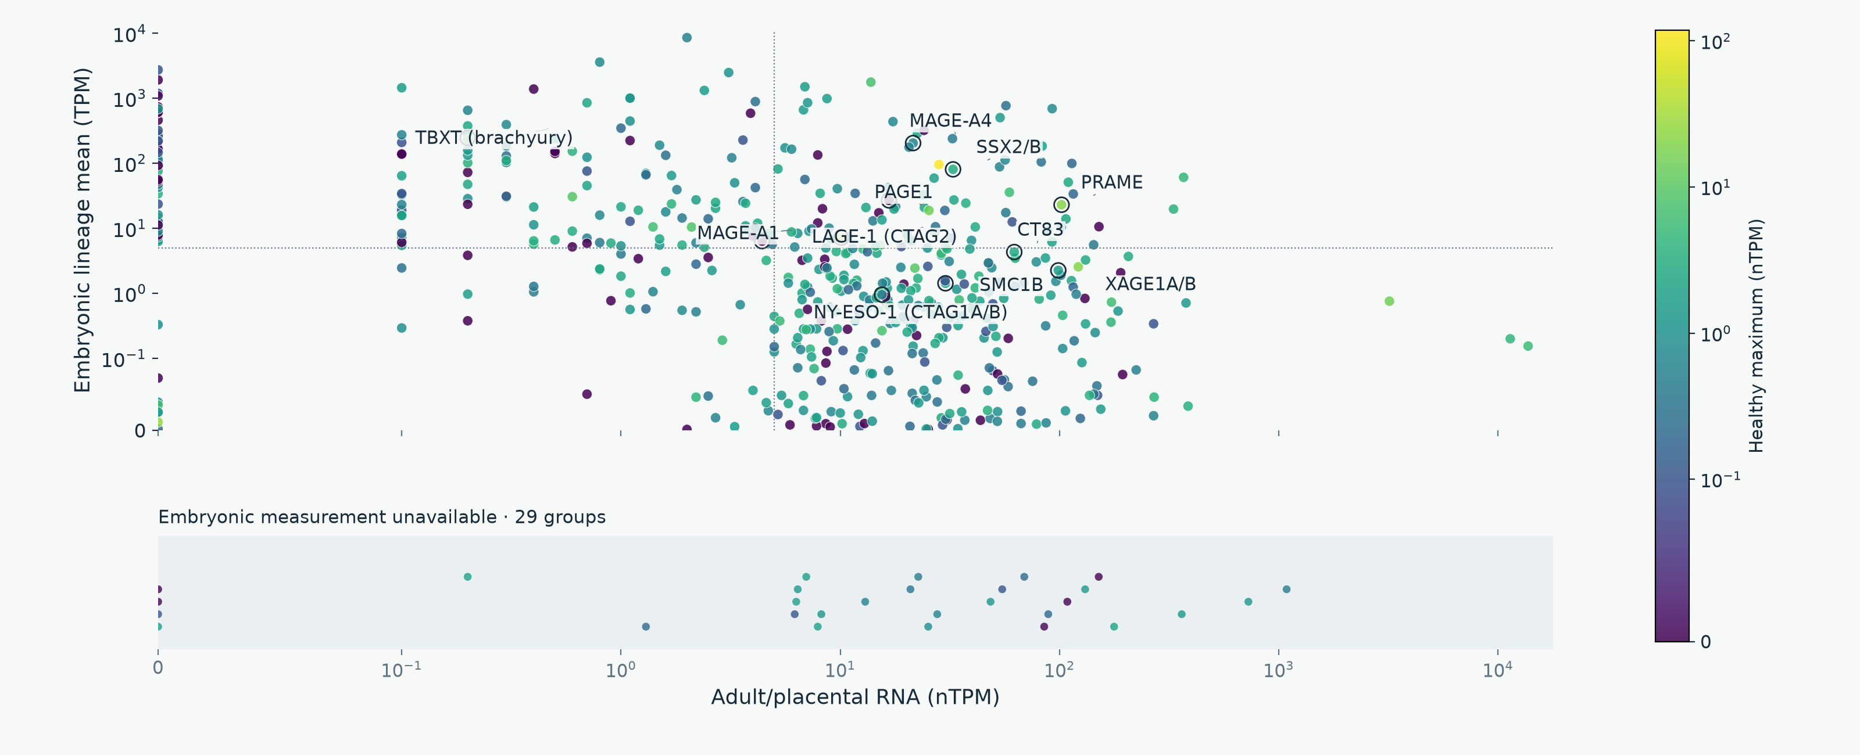
EXPRESSION DISTRIBUTIONS
Selected CTA: adult/placental versus embryonic RNA
Gray: healthy measurement unavailable. The lower band has no embryonic-expression value.
OncoRef CTA evidence walkthrough • 30 October 2026
19
Notes:
Selected CTA: adult/placental versus embryonic RNA
Color uses the highest supported non-disposable healthy expression within the stated native unit. There is no mixed-unit maximum. Labels include widely studied antigens with mapped values. Companion panels label all selected proteins ≥5 on both axes. Missing embryonic measurements appear in a separate categorical band; every selected protein is represented without zero filling.
Report: https://pirl-unc.github.io/oncoref/audits/cta-source-walkthrough-20261028/
Policy: oncoref.cta-selection.2026-10-30.1
Decision snapshot SHA256: 6b390e742c2d5adfa7350cc382f3323e411bff47eacc37e7b3ece7a39ed09ece

Slide 20
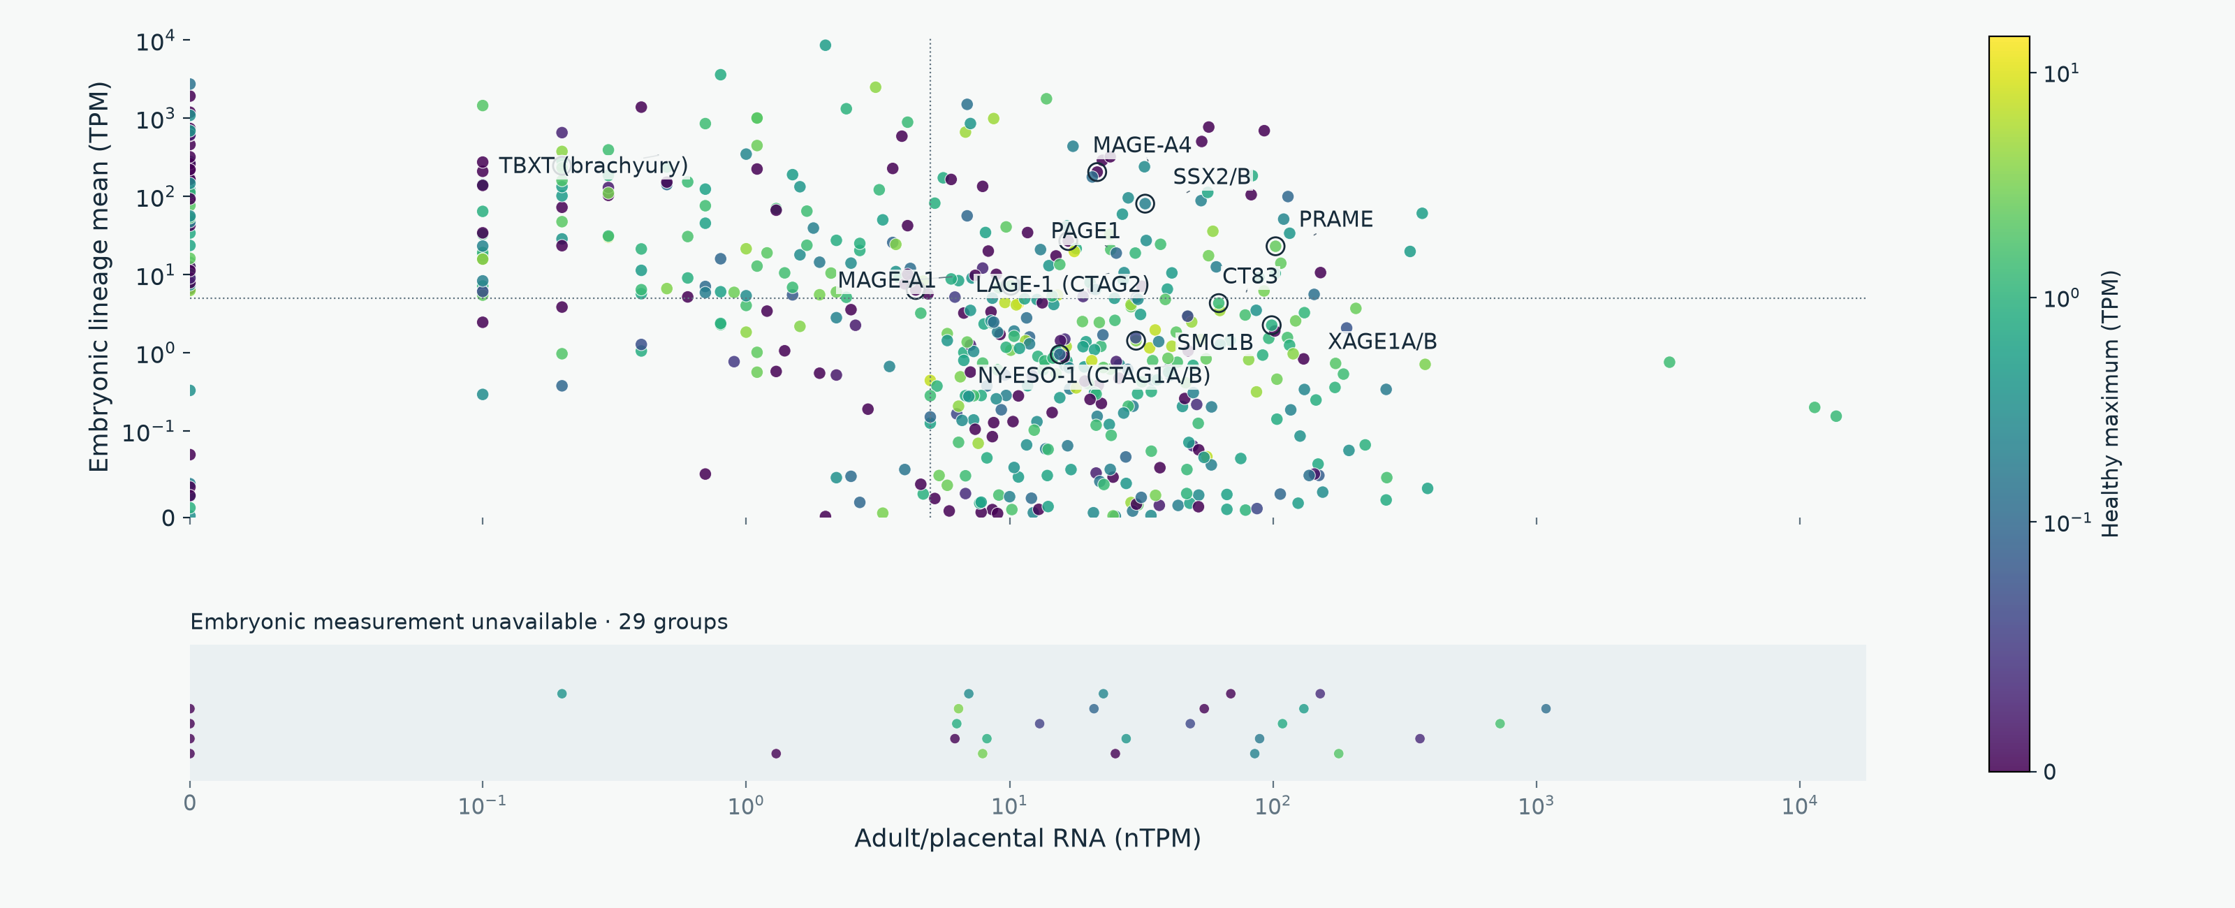
EXPRESSION DISTRIBUTIONS
Selected CTA: healthy RNA in TPM
Gray: healthy measurement unavailable. The lower band has no embryonic-expression value.
OncoRef CTA evidence walkthrough • 30 October 2026
20
Notes:
Selected CTA: healthy RNA in TPM
Color uses the highest supported non-disposable healthy expression within the stated native unit. There is no mixed-unit maximum. Labels include widely studied antigens with mapped values. Companion panels label all selected proteins ≥5 on both axes. Missing embryonic measurements appear in a separate categorical band; every selected protein is represented without zero filling.
Report: https://pirl-unc.github.io/oncoref/audits/cta-source-walkthrough-20261028/
Policy: oncoref.cta-selection.2026-10-30.1
Decision snapshot SHA256: 6b390e742c2d5adfa7350cc382f3323e411bff47eacc37e7b3ece7a39ed09ece

Slide 21
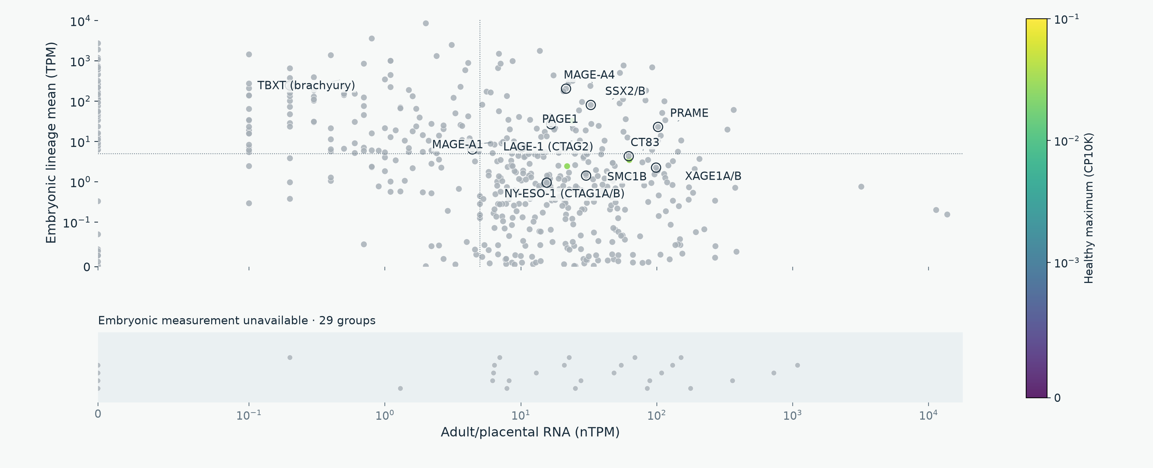
EXPRESSION DISTRIBUTIONS
Selected CTA: normal corneal RNA
Gray: healthy measurement unavailable. The lower band has no embryonic-expression value.
OncoRef CTA evidence walkthrough • 30 October 2026
21
Notes:
Selected CTA: normal corneal RNA
Color uses the highest supported non-disposable healthy expression within the stated native unit. There is no mixed-unit maximum. Labels include widely studied antigens with mapped values. Companion panels label all selected proteins ≥5 on both axes. Missing embryonic measurements appear in a separate categorical band; every selected protein is represented without zero filling.
Report: https://pirl-unc.github.io/oncoref/audits/cta-source-walkthrough-20261028/
Policy: oncoref.cta-selection.2026-10-30.1
Decision snapshot SHA256: 6b390e742c2d5adfa7350cc382f3323e411bff47eacc37e7b3ece7a39ed09ece

Slide 22
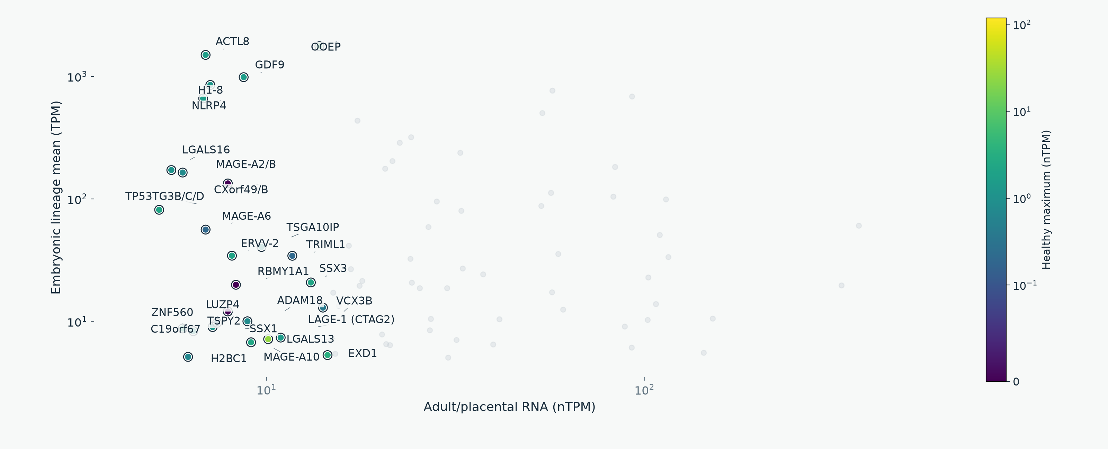
SELECTED CTA DETAIL
High adult/placental and embryonic RNA: labels 1 of 3
OncoRef CTA evidence walkthrough • 30 October 2026
22
Notes:
High adult/placental and embryonic RNA: labels 1 of 3
The three panels use identical axes and together label all selected proteins with reproductive nTPM ≥5 and measured embryonic lineage-mean TPM ≥5. This descriptive threshold does not replace developmental cell-support requirements. Color is the highest non-disposable healthy nTPM.
Report: https://pirl-unc.github.io/oncoref/audits/cta-source-walkthrough-20261028/
Policy: oncoref.cta-selection.2026-10-30.1
Decision snapshot SHA256: 6b390e742c2d5adfa7350cc382f3323e411bff47eacc37e7b3ece7a39ed09ece

Slide 23
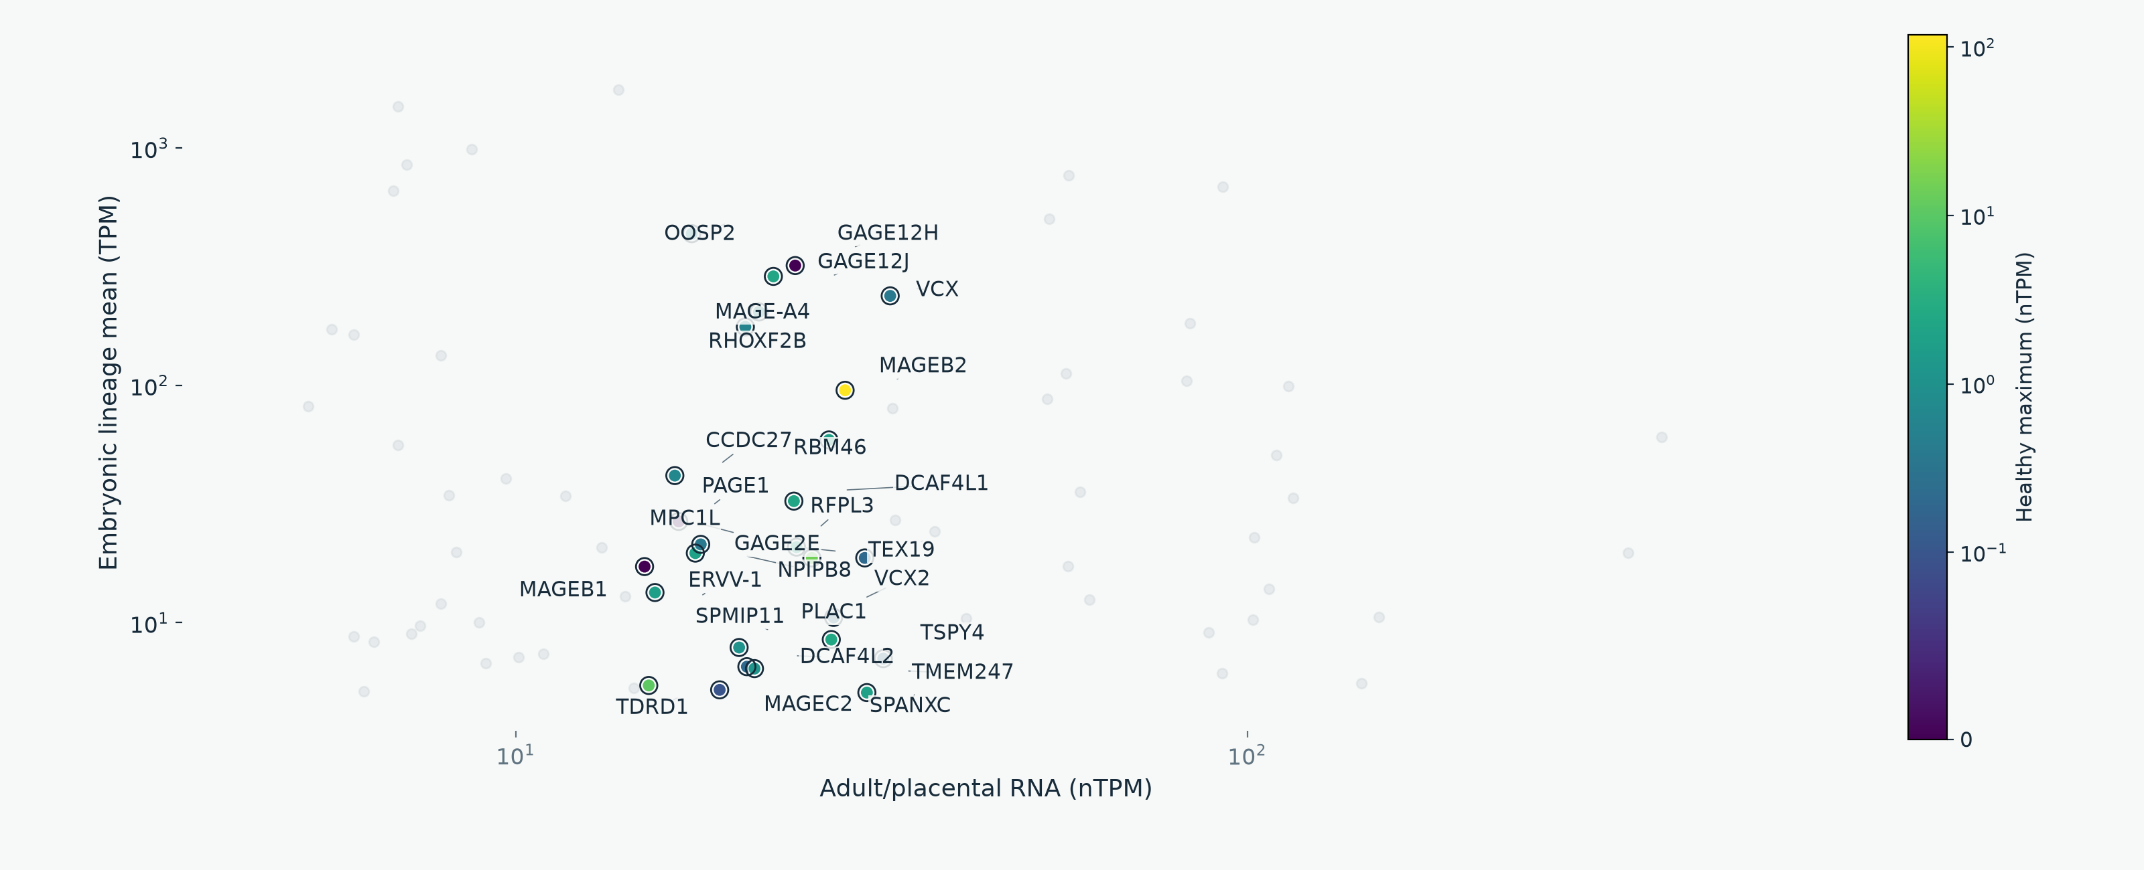
SELECTED CTA DETAIL
High adult/placental and embryonic RNA: labels 2 of 3
OncoRef CTA evidence walkthrough • 30 October 2026
23
Notes:
High adult/placental and embryonic RNA: labels 2 of 3
The three panels use identical axes and together label all selected proteins with reproductive nTPM ≥5 and measured embryonic lineage-mean TPM ≥5. This descriptive threshold does not replace developmental cell-support requirements. Color is the highest non-disposable healthy nTPM.
Report: https://pirl-unc.github.io/oncoref/audits/cta-source-walkthrough-20261028/
Policy: oncoref.cta-selection.2026-10-30.1
Decision snapshot SHA256: 6b390e742c2d5adfa7350cc382f3323e411bff47eacc37e7b3ece7a39ed09ece

Slide 24
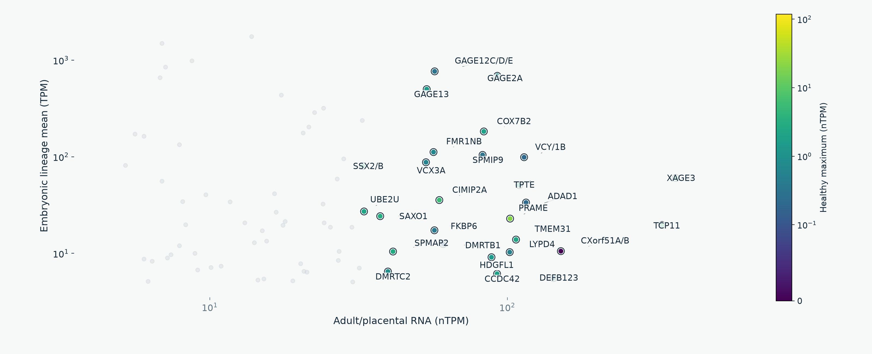
SELECTED CTA DETAIL
High adult/placental and embryonic RNA: labels 3 of 3
OncoRef CTA evidence walkthrough • 30 October 2026
24
Notes:
High adult/placental and embryonic RNA: labels 3 of 3
The three panels use identical axes and together label all selected proteins with reproductive nTPM ≥5 and measured embryonic lineage-mean TPM ≥5. This descriptive threshold does not replace developmental cell-support requirements. Color is the highest non-disposable healthy nTPM.
Report: https://pirl-unc.github.io/oncoref/audits/cta-source-walkthrough-20261028/
Policy: oncoref.cta-selection.2026-10-30.1
Decision snapshot SHA256: 6b390e742c2d5adfa7350cc382f3323e411bff47eacc37e7b3ece7a39ed09ece

Slide 25
DEVELOPMENTAL COVERAGE
Complementary embryonic measurements
Source | Measured cells / embryos | Developmental scope
Tyser et al. (2021) | 1,195 cells / 1 embryo | Gastrulation, Carnegie stage 7
Petropoulos et al. (2016) | 1,519 cells / 88 embryos | Preimplantation, days 3–7
Recovered coverage | 683 of 1,006 earlier missing groups | Measured TPM, including familiar CTAs
PRAME, MAGE-A4, CTAG1A/B, XAGE1A/B and CT83 now have TPM rows
Each source keeps its own stages. Neither atlas covers all fetal or pediatric development.
OncoRef CTA evidence walkthrough • 30 October 2026
25
Notes:
Complementary embryonic measurements
Tyser E-MTAB-9388 https://doi.org/10.1038/s41586-021-04158-y . Petropoulos E-MTAB-3929 https://www.ebi.ac.uk/gxa/sc/experiments/E-MTAB-3929/Results . Sources retain their own stage, cell support and donor counts.
Report: https://pirl-unc.github.io/oncoref/audits/cta-source-walkthrough-20261028/
Policy: oncoref.cta-selection.2026-10-30.1
Decision snapshot SHA256: 6b390e742c2d5adfa7350cc382f3323e411bff47eacc37e7b3ece7a39ed09ece

Slide 26
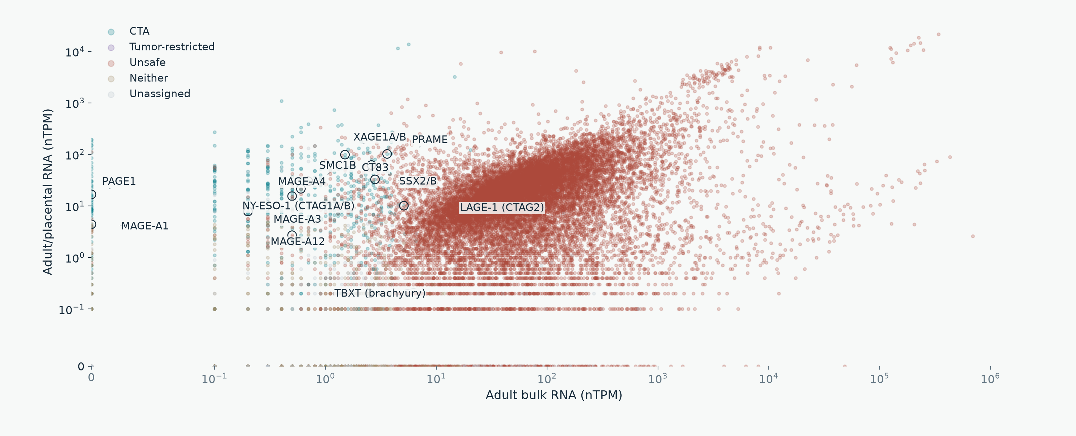
CURRENT ASSIGNMENTS
Widely studied antigens: adult/placental RNA
OncoRef CTA evidence walkthrough • 30 October 2026
26
Notes:
Widely studied antigens: adult/placental RNA
MAGE-A1 and MAGE-A3 are comparators, not admission controls. Full-width figures highlight PRAME, NY-ESO-1 (CTAG1A/B), XAGE1A/B, MAGE-A4, CT83, SSX2/B and TBXT. Missing embryonic measurements are in a separate band.
Report: https://pirl-unc.github.io/oncoref/audits/cta-source-walkthrough-20261028/
Policy: oncoref.cta-selection.2026-10-30.1
Decision snapshot SHA256: 6b390e742c2d5adfa7350cc382f3323e411bff47eacc37e7b3ece7a39ed09ece

Slide 27
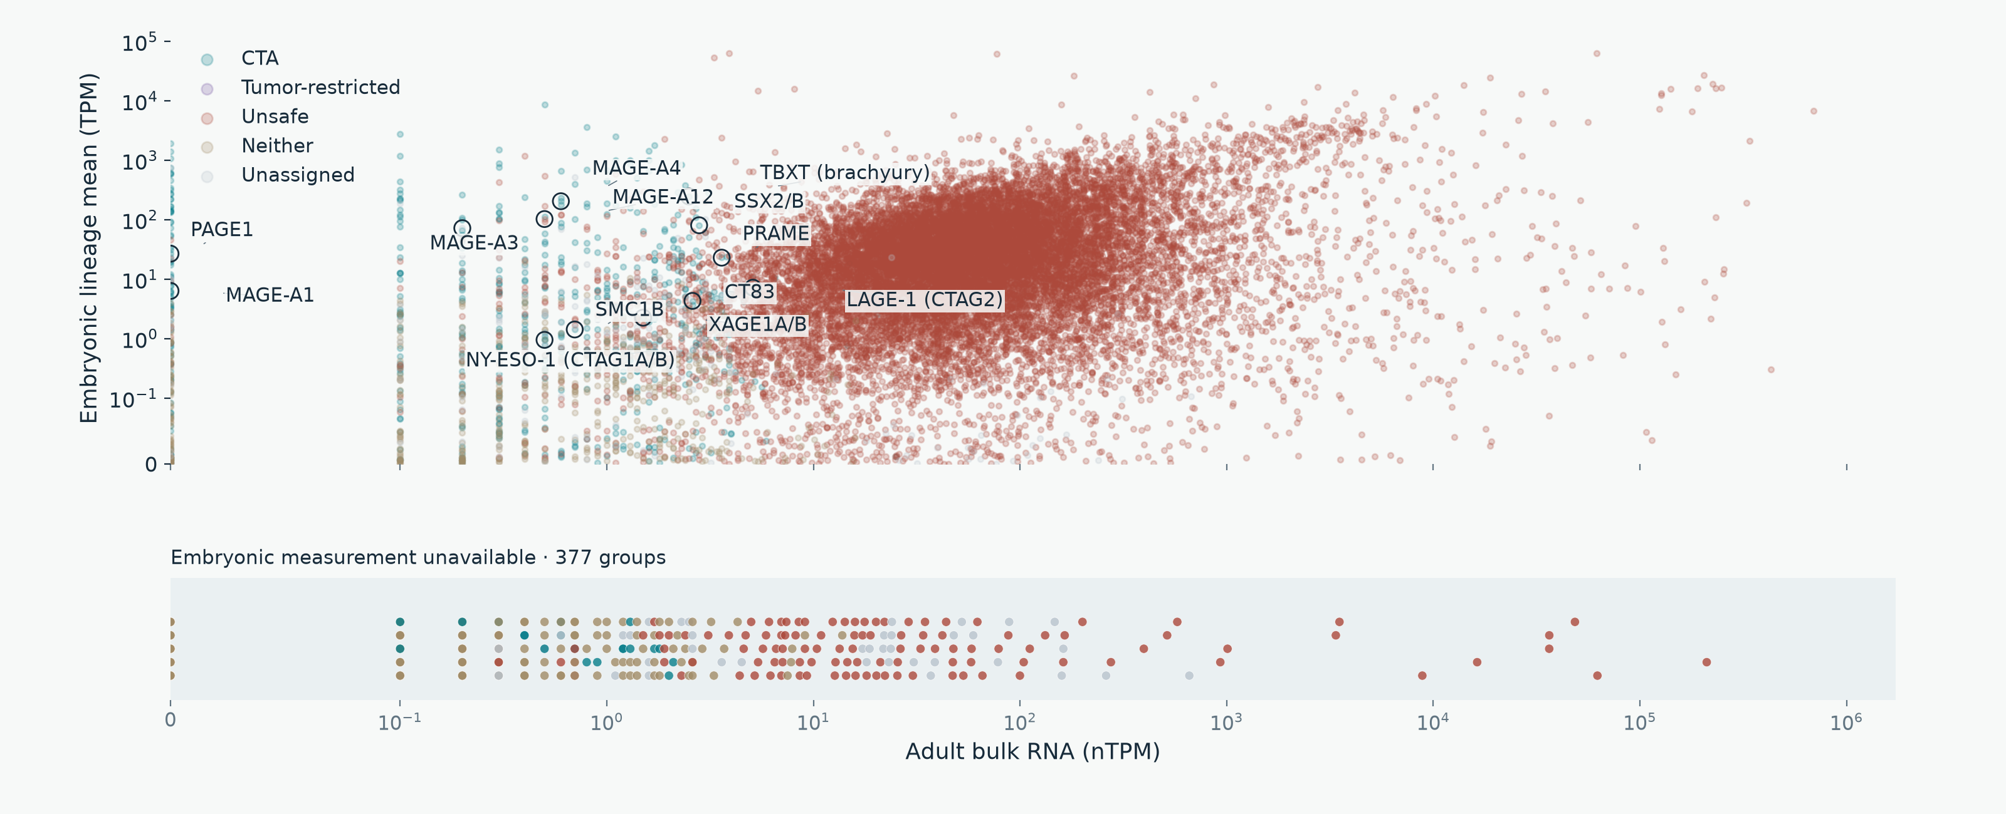
CURRENT ASSIGNMENTS
Widely studied antigens: embryonic RNA
OncoRef CTA evidence walkthrough • 30 October 2026
27
Notes:
Widely studied antigens: embryonic RNA
MAGE-A1 and MAGE-A3 are comparators, not admission controls. Full-width figures highlight PRAME, NY-ESO-1 (CTAG1A/B), XAGE1A/B, MAGE-A4, CT83, SSX2/B and TBXT. Missing embryonic measurements are in a separate band.
Report: https://pirl-unc.github.io/oncoref/audits/cta-source-walkthrough-20261028/
Policy: oncoref.cta-selection.2026-10-30.1
Decision snapshot SHA256: 6b390e742c2d5adfa7350cc382f3323e411bff47eacc37e7b3ece7a39ed09ece

Slide 28
READING THE RESULTS
Assessment status is separate from category
API status | Meaning | Human proteins
screened | Candidate, Unsafe or Neither assigned | 19,329
incomplete_evidence | Unassigned with missing coverage or unresolved evidence | 475
normal_evidence_hold | Required normal coverage passes; a normal-screen hold remains | 59
unassessed | No species-specific selection policy applied | 0
Neither requires a complete, resolved normal screen. Unassigned does not mean Unsafe or low expression.
OncoRef CTA evidence walkthrough • 30 October 2026
28
Notes:
Assessment status is separate from category
A category can be assigned despite gaps in optional or irrelevant sources. Screened does not mean clinically safe or fully measured. MAGE-A3 has measured colon counterevidence. An independent developmental measurement cannot erase it.
Report: https://pirl-unc.github.io/oncoref/audits/cta-source-walkthrough-20261028/
Policy: oncoref.cta-selection.2026-10-30.1
Decision snapshot SHA256: 6b390e742c2d5adfa7350cc382f3323e411bff47eacc37e7b3ece7a39ed09ece

Slide 29
COVERAGE AUDIT
Which sources have incomplete evidence
Source or unresolved evidence | Proteins
HPA v23 consensus bulk | 374
Combined normal bulk: HPA consensus + HPA brain + direct GTEx | 366
HPA v23 tissue-cell clusters | 335
HPA v23 immune cells | 304
Monaco immune cells via HPA v23 | 304
Required GTEx v11 bulk panel (52 contexts) | 413
Combined Tyser + Petropoulos TPM | 86
No tumor measurement: OncoRef + HPA | 34
Measured tumor, incomplete group profile | 3
HPA v23 Uncertain normal-tissue IHC | 28
Overlapping gaps within 475 unassigned proteins. DICE and corneal coverage are optional.
OncoRef CTA evidence walkthrough • 30 October 2026
29
Notes:
Which sources have incomplete evidence
Source versions, complete missing tissue/cell contexts, member ENSG IDs, historical IDs, synonyms and tumor cohort coverage: https://pirl-unc.github.io/oncoref/audits/cta-source-walkthrough-20261028/coverage/ . Counts overlap and do not sum to a total.
Report: https://pirl-unc.github.io/oncoref/audits/cta-source-walkthrough-20261028/
Policy: oncoref.cta-selection.2026-10-30.1
Decision snapshot SHA256: 6b390e742c2d5adfa7350cc382f3323e411bff47eacc37e7b3ece7a39ed09ece

Slide 30
SPECIES-SPECIFIC EVIDENCE
Dog evidence and integration gaps
Layer | Available evidence / remaining gap
Nominations | 5 + 10 − 1 shared = 14 native nominations
Identity | 13 unique mappings; one ambiguous MAGE-family assay
Normal / developmental RNA | Bgee TPM and BarkBase TMM-CPM need reference reconciliation
Tumor RNA | GSE304066 count/FPKM and reference conflicts remain unresolved
Normal protein | Limited study IHC; Pfizer pooled iBAQ is not cell-resolved IHC
Selection | All 14 unassigned / unassessed; no canine quantitative policy
Human thresholds, antibody grades and normal-tissue absence never transfer by orthology.
OncoRef CTA evidence walkthrough • 30 October 2026
30
Notes:
Dog evidence and integration gaps
Nemec et al. (2019) https://doi.org/10.1111/vco.12475 ; Hindriks et al. (2025) https://doi.org/10.1016/j.vetimm.2025.110946 . Issues https://github.com/pirl-unc/oncoref/issues/574 and https://github.com/pirl-unc/oncoref/issues/585 .
Report: https://pirl-unc.github.io/oncoref/audits/cta-source-walkthrough-20261028/
Policy: oncoref.cta-selection.2026-10-30.1
Decision snapshot SHA256: 6b390e742c2d5adfa7350cc382f3323e411bff47eacc37e7b3ece7a39ed09ece

Slide 31
DEVELOPMENTAL NOMINATIONS
Curated oncofetal sources
Source | Scope and integration status
Tyser + Petropoulos | Current gastrulation and preimplantation TPM sources
Shaw et al. (2024) | 157 cancer-specific targets; six oncofetal annotations. Exon-specific scope retained
TRIM71 liver study (2024) | Liver oncofetal signature; requires identity and measurement ingestion
Cardoso-Moreira et al. (2019) | Developmental organ trajectories with child/adult comparisons; not integrated
Published nominations need independent normal/tumor filtering and postnatal coverage.
OncoRef CTA evidence walkthrough • 30 October 2026
31
Notes:
Curated oncofetal sources
Shaw et al. (2024) https://doi.org/10.1038/s41467-024-47649-y ; TRIM71 liver study https://pmc.ncbi.nlm.nih.gov/articles/PMC11388079/ ; Cardoso-Moreira et al. (2019) https://pmc.ncbi.nlm.nih.gov/articles/PMC6658352/ . Newly identified sources are not in current selection counts.
Report: https://pirl-unc.github.io/oncoref/audits/cta-source-walkthrough-20261028/
Policy: oncoref.cta-selection.2026-10-30.1
Decision snapshot SHA256: 6b390e742c2d5adfa7350cc382f3323e411bff47eacc37e7b3ece7a39ed09ece

Slide 32
API
Common API with native evidence underneath
results = cta_selection.results(species="human")
audit = cta_selection.audit(species="human")
audit.sources audit.overlaps audit.funnel
audit.explain("PRAME")
Field | Meaning
category | CTA / Tumor-restricted / Unsafe / Neither, or null
assessment_status | Screened, incomplete evidence, normal hold, or unassessed
gene_ids / gene_identities | All member loci, stable IDs, history and curated synonyms
Source-specific native units, tissue/cell context, confidence and coverage remain inspectable.
OncoRef CTA evidence walkthrough • 30 October 2026
32
Notes:
Common API with native evidence underneath
Human, dog and mouse share schema and explicit unavailable states. Data are offline and checksum-verified. Frozen release reports remain unchanged.
Report: https://pirl-unc.github.io/oncoref/audits/cta-source-walkthrough-20261028/
Policy: oncoref.cta-selection.2026-10-30.1
Decision snapshot SHA256: 6b390e742c2d5adfa7350cc382f3323e411bff47eacc37e7b3ece7a39ed09ece

Slide 33
DATA API
Every source resolves to a concrete version
catalog.ensure("gtex_tissue_rna") # v11
catalog.ensure("gtex_tissue_rna", version="v10")
catalog.provenance("gtex_tissue_rna", "v11")
Shared choice | Source-specific meaning
Default / latest | Newest registered release; saved runs keep explicit pins
Concrete version | GTEx v11; HPA v25.1; a study snapshot or OncoRef build
Provenance | Version, content checksum, native unit, annotation and pipeline
Species | The same selector applies to native dog and mouse assets
This analysis pins GTEx v11 and HPA v23 normal panels. A newer public default does not rewrite it.
OncoRef CTA evidence walkthrough • 30 October 2026
33
Notes:
Every source resolves to a concrete version
Data version API: https://pirl-unc.github.io/oncoref/data-versions/ . GTEx versions and pipelines: https://github.com/broadinstitute/gtex-pipeline/blob/master/rnaseq/README.md . HPA current RNA snapshot: https://github.com/pirl-unc/oncoref/releases/tag/reference-hpa-v25.1-20261028 .
Report: https://pirl-unc.github.io/oncoref/audits/cta-source-walkthrough-20261028/
Policy: oncoref.cta-selection.2026-10-30.1
Decision snapshot SHA256: 6b390e742c2d5adfa7350cc382f3323e411bff47eacc37e7b3ece7a39ed09ece

