Slide 1
SOURCES AND DECISIONS
Human and dog CTA evidence
463 human CTA groups
481 loci / 17,388 Unsafe groups / 2,012 Neither groups
Dog: 14 native nominations, quantitative selection unassessed
Source contributions, overlaps, measured contexts and explicitly labeled policy comparisons.
OncoRef 1.21.0 evidence walkthrough • 28 October 2026
01
Notes:
Human and dog CTA evidence
Current human selection is unchanged. Dog nomination counts are not a genome-wide selection.
Report: https://pirl-unc.github.io/oncoref/audits/cta-release-1.21.0/
Policy: oncoref.cta-selection.1.21.0
Frozen decision report SHA256: 79a0247b8c94d853e76a4270a5c93f2d758a879a08f5b9d336c476feddcd2b8f

Slide 2
HUMAN NOMINATIONS
Published candidate lists
Paper | Groups | CTA | Unsafe | Neither
da Silva et al. (2017) | 1,017 | 356 | 276 | 385
Wang et al. (2016) | 988 | 264 | 521 | 203
Chang et al. (2019) | 985 | 311 | 519 | 155
Gong et al. (2021) | 729 | 360 | 201 | 168
Bruggeman et al. (2018) | 692 | 25 | 622 | 45
Jamin et al. (2021) | 469 | 32 | 412 | 25
Loriot et al. (2025) | 202 | 79 | 67 | 56
Carter et al. (2023) | 103 | 58 | 20 | 25
Seager et al. (2024) | 15 | 8 | 3 | 4
Bradley et al. (2020) | 9 | 1 | 8 | 0
Bai et al. (2016) | 1 | 0 | 1 | 0
Garg et al. (2007) | 1 | 0 | 1 | 0
Boël et al. (1995) | 0 | 0 | 0 | 0
Union: 2,482 groups / 2,538 loci. 418 selected groups have an annotation; 45 do not.
OncoRef 1.21.0 evidence walkthrough • 28 October 2026
02
Notes:
Published candidate lists
da Silva et al. (2017): https://doi.org/10.18632/oncotarget.21715
Wang et al. (2016): https://doi.org/10.1038/ncomms10499
Chang et al. (2019): https://doi.org/10.1002/cam4.2223
Gong et al. (2021): https://doi.org/10.1038/s41467-021-22695-y
Bruggeman et al. (2018): https://doi.org/10.1038/s41388-018-0357-2
Jamin et al. (2021): https://doi.org/10.1002/1878-0261.12900
Loriot et al. (2025): https://doi.org/10.1371/journal.pgen.1011734
Carter et al. (2023): https://doi.org/10.1136/jitc-2023-007935
Seager et al. (2024): https://doi.org/10.1186/s12967-024-04918-0
Bradley et al. (2020): https://doi.org/10.1038/s41467-020-19141-w
Bai et al. (2016): https://doi.org/10.1158/0008-5472.CAN-16-0225
Garg et al. (2007): https://doi.org/10.1158/1078-0432.CCR-06-2340
Boël et al. (1995): https://doi.org/10.1016/s1074-7613(95)80053-0
Report: https://pirl-unc.github.io/oncoref/audits/cta-release-1.21.0/
Policy: oncoref.cta-selection.1.21.0
Frozen decision report SHA256: 79a0247b8c94d853e76a4270a5c93f2d758a879a08f5b9d336c476feddcd2b8f

Slide 3
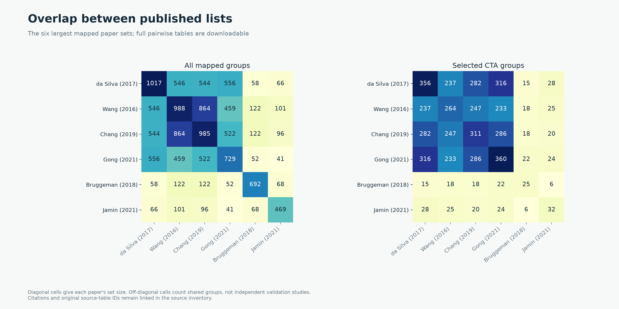
HUMAN NOMINATIONS
How published lists overlap
OncoRef 1.21.0 evidence walkthrough • 28 October 2026
03
Notes:
How published lists overlap
Paper tables are unioned. Counts represent mapped protein-equivalence groups. Full source IDs and pairwise matrix: human-overlaps.csv.gz in the walkthrough.
Report: https://pirl-unc.github.io/oncoref/audits/cta-release-1.21.0/
Policy: oncoref.cta-selection.1.21.0
Frozen decision report SHA256: 79a0247b8c94d853e76a4270a5c93f2d758a879a08f5b9d336c476feddcd2b8f

Slide 4
POSITIVE EXPRESSION CONTEXTS
Why 12,139 groups enter the funnel
Qualifying route | Entrants | Final CTA
Reproductive only | 1,231 | 425
Developmental only | 9,481 | 29
Both | 1,427 | 9
Total | 12,139 | 463
Whole-reference RNA measurements create this set
One early embryo supplies the developmental route. Later fetal atlases remain outside the current policy.
OncoRef 1.21.0 evidence walkthrough • 28 October 2026
04
Notes:
Why 12,139 groups enter the funnel
Tyser et al. (2021): https://doi.org/10.1038/s41586-021-04158-y . The complete reference has 19,863 groups. HPA supplies reproductive nTPM. Developmental presence alone is not restriction.
Report: https://pirl-unc.github.io/oncoref/audits/cta-release-1.21.0/
Policy: oncoref.cta-selection.1.21.0
Frozen decision report SHA256: 79a0247b8c94d853e76a4270a5c93f2d758a879a08f5b9d336c476feddcd2b8f

Slide 5
HUMAN EVIDENCE
Normal and cancer expression sources
Evidence | Source | Quantity
Normal / reproductive bulk | HPA consensus with GTEx | nTPM
Normal tissue-cell clusters | HPA tissue clusters | nTPM with read support
Normal immune cells | HPA / Monaco / original DICE | Native nTPM / TPM
Adult cornea | Collin et al., GSE155683 | CP10K
Normal protein | HPA + curated external IHC | Staining and reagent confidence
Cancer | 132 compatible OncoRef cohort views + HPA | TPM / protein-coding TPM
Developmental | Tyser et al. (2021), one embryo | Lineage mean TPM
14,452 namespace-deduplicated tumor sample IDs. Patient independence and source overlap remain explicit.
OncoRef 1.21.0 evidence walkthrough • 28 October 2026
05
Notes:
Normal and cancer expression sources
URLs and versions: oncoref/data/cta-selection-sources.csv. HPA v23 https://v23.proteinatlas.org/about/download ; DICE https://dice-database.org/ ; cornea https://www.ncbi.nlm.nih.gov/geo/query/acc.cgi?acc=GSE155683 ; tumor registry and sample lineage in the frozen report.
Report: https://pirl-unc.github.io/oncoref/audits/cta-release-1.21.0/
Policy: oncoref.cta-selection.1.21.0
Frozen decision report SHA256: 79a0247b8c94d853e76a4270a5c93f2d758a879a08f5b9d336c476feddcd2b8f

Slide 6
RELEASED POLICY
Active RNA cutoffs
Candidate ceiling | Unmatched IHC | Approved − | Supported − | Enhanced −
Vital | 4 | 8 | 16 | 32
Protected | 8 | 16 | 32 | 64
Manageable | 16 | 32 | 64 | 128
Specified bowel cells | 32 | 64 | 128 | 256
Above ceiling: hold. At least 2× ceiling: Unsafe evidence.
Negative-IHC credit requires verified tissue/cell coverage. Same-tissue staining alone cannot establish that match.
OncoRef 1.21.0 evidence walkthrough • 28 October 2026
06
Notes:
Active RNA cutoffs
The second RNA boundary is a policy multiplier, not an antibody grade or a measured toxicity limit. Cornea CP10K uses nominal limits /100, not a TPM conversion.
Report: https://pirl-unc.github.io/oncoref/audits/cta-release-1.21.0/
Policy: oncoref.cta-selection.1.21.0
Frozen decision report SHA256: 79a0247b8c94d853e76a4270a5c93f2d758a879a08f5b9d336c476feddcd2b8f

Slide 7
RELEASED POLICY
Rules applied before final assignment
Gate | Current rule
Positive context | Reproductive ≥5 nTPM and > adult maximum, OR supported embryonic mean ≥5 TPM
Tumor | ≥2 TPM / pTPM in at least one compatible sample
Coverage | Required bulk / cell / immune panels. DICE and cornea optional
Normal RNA | Tissue- and IHC-dependent ceilings
Normal protein | Low retains a flag. Accepted stronger positive evidence excludes
Final decision | Unsafe evidence takes precedence. Remaining holds give Neither
These are active research-policy cutoffs. Adult normal panels do not establish pediatric safety.
OncoRef 1.21.0 evidence walkthrough • 28 October 2026
07
Notes:
Rules applied before final assignment
All sources retain native units and missingness. RNA candidate equality passes. Every layer can contribute after a prior hold.
Report: https://pirl-unc.github.io/oncoref/audits/cta-release-1.21.0/
Policy: oncoref.cta-selection.1.21.0
Frozen decision report SHA256: 79a0247b8c94d853e76a4270a5c93f2d758a879a08f5b9d336c476feddcd2b8f

Slide 8
HUMAN FUNNEL
Every filtering layer can contribute
19,863 groups at every stage. Final: 463 CTA / 17,388 Unsafe / 2,012 Neither.
OncoRef 1.21.0 evidence walkthrough • 28 October 2026
08
Notes:
Every filtering layer can contribute
Eligible so far becomes a final CTA category only at the last stage. Sequential removals depend on display order; final decisions do not.
Report: https://pirl-unc.github.io/oncoref/audits/cta-release-1.21.0/
Policy: oncoref.cta-selection.1.21.0
Frozen decision report SHA256: 79a0247b8c94d853e76a4270a5c93f2d758a879a08f5b9d336c476feddcd2b8f

Slide 9
HUMAN FUNNEL
Counts at each filtering choice
Stage | Removed | Eligible* | Unsafe | Neither
Association | 7,724 | 12,139 | 0 | 7,724
Tumor ≥2 | 7 | 12,132 | 0 | 7,731
HPA protein | 8,850 | 3,282 | 10,172 | 6,409
Required coverage | 90 | 3,192 | 10,172 | 6,499
Normal bulk | 2,288 | 904 | 15,870 | 3,089
HPA tissue clusters | 396 | 508 | 17,242 | 2,113
HPA immune | 8 | 500 | 17,273 | 2,090
Monaco immune | 11 | 489 | 17,308 | 2,066
DICE immune | 21 | 468 | 17,369 | 2,026
Adult cornea | 4 | 464 | 17,383 | 2,016
Curated protein | 1 | 463 | 17,387 | 2,013
Clinical safety | 0 | 463 | 17,388 | 2,012
External IHC | 0 | 463 | 17,388 | 2,012
*Eligible so far until the final row. Later evidence can change Neither to Unsafe.
OncoRef 1.21.0 evidence walkthrough • 28 October 2026
09
Notes:
Counts at each filtering choice
These are sequential first-removal counts, not independent marginal effects. Full source decisions remain available after an earlier failure.
Report: https://pirl-unc.github.io/oncoref/audits/cta-release-1.21.0/
Policy: oncoref.cta-selection.1.21.0
Frozen decision report SHA256: 79a0247b8c94d853e76a4270a5c93f2d758a879a08f5b9d336c476feddcd2b8f

Slide 10
CURRENT ASSIGNMENTS
Widely studied antigens
Antigen / group | Decision | Reason / retained context
PAGE1 | CTA | Passes all current gates
SMC1B | CTA | Passes all current gates
CTAG2 | Unsafe | Bronchial basal cells 24.9 nTPM, Unsafe boundary 8
MAGE-A4 | CTA | Passes all current gates
TBXT | CTA | Embryonic 245.1 TPM. Adult-disc / IHC review retained
PRAME | CTA | Adrenal 3.6, heart fibroblasts 12, colon cells 20.3 nTPM
MAGE-A1 | Neither | Reproductive 4.4 nTPM is below association floor 5
CT83 | CTA | Quantitative gates pass. External-IHC review retained
MAGE-A12 | Unsafe | Reviewed clinical injury with attribution uncertainty
MAGE-A3 | Neither | Colon undifferentiated cells 53.1 nTPM, ceiling 32
NY-ESO-1 | CTA | Passes all current gates
SSX2/B | CTA | Passes all current gates
XAGE1A/B | CTA | Passes all current gates
Known CTA loci receive current decisions: 162 CTA / 16 Unsafe / 35 Neither.
OncoRef 1.21.0 evidence walkthrough • 28 October 2026
10
Notes:
Widely studied antigens
Comparison genes are not forced positive controls. NY-ESO-1 is CTAG1A/B; LAGE-1 is CTAG2. Evidence includes retained flags.
Report: https://pirl-unc.github.io/oncoref/audits/cta-release-1.21.0/
Policy: oncoref.cta-selection.1.21.0
Frozen decision report SHA256: 79a0247b8c94d853e76a4270a5c93f2d758a879a08f5b9d336c476feddcd2b8f

Slide 11
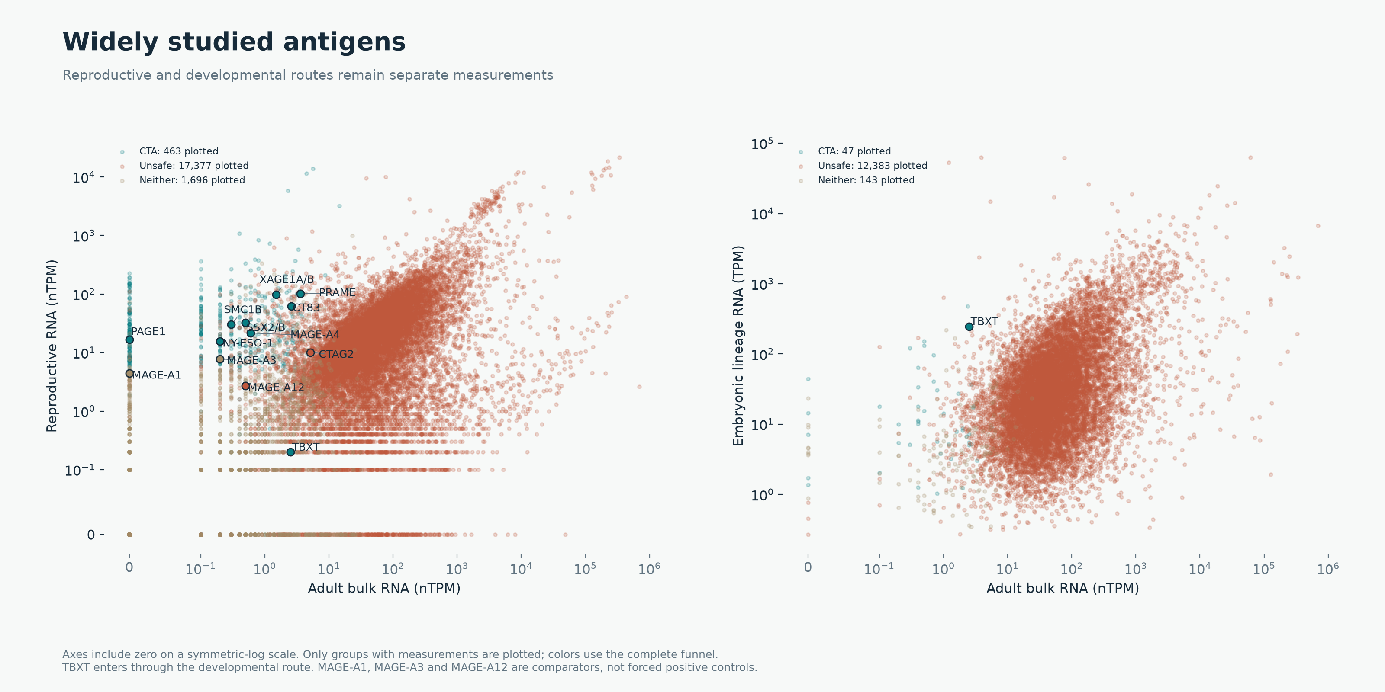
WIDELY STUDIED ANTIGENS
Reproductive and developmental expression
OncoRef 1.21.0 evidence walkthrough • 28 October 2026
11
Notes:
Reproductive and developmental expression
Axes include zero using a symmetric-log scale. Missing measurements are omitted. Classification uses the full funnel. Embryonic and reproductive measurements retain separate units.
Report: https://pirl-unc.github.io/oncoref/audits/cta-release-1.21.0/
Policy: oncoref.cta-selection.1.21.0
Frozen decision report SHA256: 79a0247b8c94d853e76a4270a5c93f2d758a879a08f5b9d336c476feddcd2b8f

Slide 12
CELL-TYPE COVERAGE
PRAME has colon IHC
Observation | Measured evidence
Colon RNA | Undifferentiated cells: 20.3 nTPM, 96 reads
Colon IHC | Enhanced Not detected: glandular, endothelial, nerve/ganglion
Current ceiling | 32 without matched negative-IHC credit
Bowel moved to Manageable 16 | PRAME would become Neither
Matched negative IHC, if verified | Approved would give 32; Enhanced would give 128
Same-tissue negatives are retained. Assigning cell-type coverage requires a supported anatomical match.
OncoRef 1.21.0 evidence walkthrough • 28 October 2026
12
Notes:
PRAME has colon IHC
HPA v23 PRAME: https://v23.proteinatlas.org/ENSG00000185686-PRAME/tissue/colon . The frozen table reports Enhanced Not detected glandular, endothelial and peripheral nerve/ganglion cells. Exact undifferentiated-cluster coverage remains unresolved.
Report: https://pirl-unc.github.io/oncoref/audits/cta-release-1.21.0/
Policy: oncoref.cta-selection.1.21.0
Frozen decision report SHA256: 79a0247b8c94d853e76a4270a5c93f2d758a879a08f5b9d336c476feddcd2b8f

Slide 13
DOG EVIDENCE
Dog nominations and funnel coverage
Stage | Evidence / gap
Published nominations | Nemec 5 + Hindriks 10 − shared NT5C1B 1 = 14
Identity | 13 unique nominations, one ambiguous MAGE family assay
Normal / developmental RNA | Native matrices available. Reference / scale reconciliation needed
Tumor RNA | GSE304066 count/FPKM and annotation conflicts unresolved
Normal protein | Limited study IHC and pooled Pfizer iBAQ
Quantitative selection | Unassessed. All 14 nominations remain Neither
No genome-wide canine CTA or Unsafe count has been established.
OncoRef 1.21.0 evidence walkthrough • 28 October 2026
13
Notes:
Dog nominations and funnel coverage
Nemec et al. (2019): https://doi.org/10.1111/vco.12475 ; Hindriks et al. (2025): https://doi.org/10.1016/j.vetimm.2025.110946 . Nomination rows can represent ambiguous assay families.
Report: https://pirl-unc.github.io/oncoref/audits/cta-release-1.21.0/
Policy: oncoref.cta-selection.1.21.0
Frozen decision report SHA256: 79a0247b8c94d853e76a4270a5c93f2d758a879a08f5b9d336c476feddcd2b8f

Slide 14
DOG EVIDENCE
Dog data sources and tracked integration
Role | Source and status
Normal / developmental RNA | Bgee native TPM; BarkBase 37,149 features × 150 TMM-CPM columns
Additional RNA | DoGA and Pfizer RNA: metadata registered, full matrices not integrated
Tumor cohorts | GSE304066 provenance blocked; more cohorts tracked in #574
Normal MS protein | Pfizer 9,929 reported groups × 38 tissue pools; integration #585
Normal IHC / cell atlases | Limited study IHC. Systematic IHC and cell coverage remain gaps
46 Bgee/BarkBase libraries overlap. Pooled MS cannot identify individual donors or cell types.
OncoRef 1.21.0 evidence walkthrough • 28 October 2026
14
Notes:
Dog data sources and tracked integration
Source issues https://github.com/pirl-unc/oncoref/issues/574 and https://github.com/pirl-unc/oncoref/issues/585 . Pfizer https://doi.org/10.1038/s41597-026-07512-9 ; DoGA https://doi.org/10.1038/s41467-024-52798-1 ; BarkBase https://pubmed.ncbi.nlm.nih.gov/31181663/ .
Report: https://pirl-unc.github.io/oncoref/audits/cta-release-1.21.0/
Policy: oncoref.cta-selection.1.21.0
Frozen decision report SHA256: 79a0247b8c94d853e76a4270a5c93f2d758a879a08f5b9d336c476feddcd2b8f

Slide 15
PROPOSED POLICY, NOT RELEASED
Neither can have a simpler definition
Category | Proposed meaning
Unsafe | Credible expression above the single vital/protected cutoff, or accepted clinical harm evidence
CTA / oncofetal | Tumor + permitted-context association + adequate coverage + acceptable normal expression
Neither | No tumor or association, low expression, other-compartment expression, or unresolved evidence
A missing measurement differs from a low measurement. Every layer still evaluates every gene.
OncoRef 1.21.0 evidence walkthrough • 28 October 2026
15
Notes:
Neither can have a simpler definition
This removes the arbitrary intermediate RNA band. It requires replaying RNA and protein with the same anatomy policy, not only relabeling plots. Missingness and uncertainty remain separate reason/status fields.
Report: https://pirl-unc.github.io/oncoref/audits/cta-release-1.21.0/
Policy: oncoref.cta-selection.1.21.0
Frozen decision report SHA256: 79a0247b8c94d853e76a4270a5c93f2d758a879a08f5b9d336c476feddcd2b8f

Slide 16
DEVELOPMENTAL SOURCES
Curated oncofetal nominations can mirror CTA curation
Source | Contribution and scope
Shaw et al. (2024) | 157 cancer-specific targets, six oncofetal annotations. Retain exon-specific FN1/TNC scope
TRIM71 liver study (2024) | Top-200 oncofetal expression signature. Liver-specific comparison
Cardoso-Moreira et al. (2019) | Seven-organ developmental trajectories with child/adult measurements
Current Tyser route | Measured embryonic expression. Does not itself establish restriction
Published nominations still need independent normal/tumor filtering and explicit postnatal coverage.
OncoRef 1.21.0 evidence walkthrough • 28 October 2026
16
Notes:
Curated oncofetal nominations can mirror CTA curation
Shaw et al. (2024): https://doi.org/10.1038/s41467-024-47649-y ; TRIM71 study (2024): https://pmc.ncbi.nlm.nih.gov/articles/PMC11388079/ ; Cardoso-Moreira et al. (2019): https://pmc.ncbi.nlm.nih.gov/articles/PMC6658352/ . These newly identified sources are not in current selection counts.
Report: https://pirl-unc.github.io/oncoref/audits/cta-release-1.21.0/
Policy: oncoref.cta-selection.1.21.0
Frozen decision report SHA256: 79a0247b8c94d853e76a4270a5c93f2d758a879a08f5b9d336c476feddcd2b8f

Slide 17
API
A shared audit API across species
audit = cta_selection.audit(species="human")
audit.sources audit.overlaps audit.funnel
audit.criteria audit.explain("CTAG2")
Species | Assessment
Human | Released decisions with detailed measured contexts
Dog | Native nominations and explicit unassessed stages
Mouse | Stable schema with unavailable curation
Offline, checksum-verified tables. Human RNA cutoffs do not transfer by orthology.
OncoRef 1.21.0 evidence walkthrough • 28 October 2026
17
Notes:
A shared audit API across species
The same schema retains native units, references and evidence gaps. Existing cta_selection.results and cta_selection.sources remain unchanged. Audit sources count published-list contributions; the existing sources function inventories measurement resources.
Report: https://pirl-unc.github.io/oncoref/audits/cta-release-1.21.0/
Policy: oncoref.cta-selection.1.21.0
Frozen decision report SHA256: 79a0247b8c94d853e76a4270a5c93f2d758a879a08f5b9d336c476feddcd2b8f

