Slide 1
CURRENT SELECTION
Human and dog CTA evidence
602 human CTA proteins
646 loci / 18,255 Unsafe / 1,006 Other
Every human protein classified. Dog selection remains unassessed.
Sources, expression profiles, single-cutoff filtering and measured tissue evidence.
OncoRef CTA evidence walkthrough • 5 November 2026
01
Notes:
Human and dog CTA evidence
Every human protein has a category. Other includes unmet identity, sequence and review-hold gates. Assessment status records remaining evidence limitations.
Report: https://pirl-unc.github.io/oncoref/audits/cta-source-walkthrough-20261028/
Policy: oncoref.cta-selection.2026-11-05.1
Decision snapshot SHA256: d9b4b9cd2367dc60cf755b7daa9c8e3325e09efb1e33d7de3aa3bc34673e49a3

Slide 2
INDEPENDENT QUESTIONS
Safety, cancer and Reproductive evidence
Assessment | Question | Current rule
Safety | Concerning normal expression? | Absolute RNA / IHC and clinical rules
Cancer expression | Expressed in a measured cancer? | One sample >0 TPM/pTPM or reviewed tumor protein
Reproductive evidence | Expression in a qualifying branch? | Bulk/cell RNA ≥5, reliable reproductive protein, or embryonic RNA
Coverage | Are required panels measured? | Combined HPA bulk / brain and GTEx for every locus
Only safety establishes Unsafe. Coverage and normal review holds remain explicit in assessment_status.
OncoRef CTA evidence walkthrough • 5 November 2026
02
Notes:
Safety, cancer and Reproductive evidence
Only safety supplies Unsafe evidence. Reproductive is the umbrella for adult reproductive, placental, extraembryonic, embryonic and fetal contexts.
Report: https://pirl-unc.github.io/oncoref/audits/cta-source-walkthrough-20261028/
Policy: oncoref.cta-selection.2026-11-05.1
Decision snapshot SHA256: d9b4b9cd2367dc60cf755b7daa9c8e3325e09efb1e33d7de3aa3bc34673e49a3

Slide 3
HPA PROFILE IDENTITY
Diffuse expression is an identity question
Term | Meaning
N | HPA v23 normal-tissue nTPM
R | Highest Reproductive nTPM in HPA v23 (adult/placental)
N / (N + R) | Average across 29 organs / 38 contexts; thymus excluded
Active boundary | Average >10%, with a supported positive R and complete comparison
MTCP1: Unsafe (Rare vital-tissue cell expression); diffuseness 24.53%. Embryonic concentration remains unassessed.
OncoRef CTA evidence walkthrough • 5 November 2026
03
Notes:
Diffuse expression is an identity question
The old normal-maximum veto is removed. Diffuseness averages N/(N+R) across fixed weighted normal contexts, including Disposable. The active 10% adult/placental identity boundary requires complete HPA measurements and an RNA- or IHC-supported positive reference. Thymus is excluded from concentration; its hazard tier remains Protected. Supported embryonic evidence retains its separate route with unassessed concentration.
Report: https://pirl-unc.github.io/oncoref/audits/cta-source-walkthrough-20261028/
Policy: oncoref.cta-selection.2026-11-05.1
Decision snapshot SHA256: d9b4b9cd2367dc60cf755b7daa9c8e3325e09efb1e33d7de3aa3bc34673e49a3

Slide 4
COVERAGE
Required and optional RNA coverage
Requirement | Interpretation
Combined normal bulk | HPA consensus / brain and GTEx; measured zero counts
All member loci measured | Missing identities are not replaced by paralogs
Missing required coverage | Blocks CTA; assessment status records the gap
Cell / immune / cornea panels | Missing coverage allowed; measured evidence counts
The fixed GTEx core is an inspectable profile, not a separate admission gate. Rare-cell coverage remains incomplete.
OncoRef CTA evidence walkthrough • 5 November 2026
04
Notes:
Required and optional RNA coverage
Combined bulk HPA consensus, HPA brain and GTEx coverage is required for every member locus. Cell, immune and corneal panels contribute measured evidence without imposing coverage requirements.
Report: https://pirl-unc.github.io/oncoref/audits/cta-source-walkthrough-20261028/
Policy: oncoref.cta-selection.2026-11-05.1
Decision snapshot SHA256: d9b4b9cd2367dc60cf755b7daa9c8e3325e09efb1e33d7de3aa3bc34673e49a3

Slide 5
CALCULATION AUDIT
ZNF730: panel composition matters
Calculation | HPA v23 | GTEx v11
Reproductive reference (testis) | 4.9 nTPM | 4.91414 TPM
Full source panel | 9.53%: 29 anatomy units | 1.65%: 23 anatomy units
Same 20 anatomy units | 6.36% | 1.71%
Thymus is excluded from both sides of the concentration score
Thymus exclusion changes HPA 10.34% → 9.53%. Independent safety evidence keeps ZNF730 Unsafe.
OncoRef CTA evidence walkthrough • 5 November 2026
05
Notes:
ZNF730: panel composition matters
Full tissue tables: https://pirl-unc.github.io/oncoref/audits/cta-unassigned-20261029/znf730/ . Original panels differ; scores are not a controlled assay comparison.
Report: https://pirl-unc.github.io/oncoref/audits/cta-source-walkthrough-20261028/
Policy: oncoref.cta-selection.2026-11-05.1
Decision snapshot SHA256: d9b4b9cd2367dc60cf755b7daa9c8e3325e09efb1e33d7de3aa3bc34673e49a3

Slide 6
HUMAN ANNOTATIONS
All registered nomination papers
Paper | Proteins | CTA | Unsafe | Other
da Silva et al. (2017) | 1,017 | 411 | 466 | 140
Wang et al. (2016) | 988 | 269 | 683 | 36
Chang et al. (2019) | 985 | 281 | 676 | 28
Gong et al. (2021) | 729 | 346 | 343 | 40
Bruggeman et al. (2018) | 692 | 12 | 679 | 1
Jamin et al. (2021) | 469 | 33 | 429 | 7
Loriot et al. (2025) | 202 | 83 | 113 | 6
Carter et al. (2023) | 103 | 53 | 47 | 3
Hirbo et al. (2015) | 78 | 8 | 67 | 3
Seager et al. (2024) | 15 | 10 | 3 | 2
Sasaroli et al. (2011) | 13 | 0 | 13 | 0
Bradley et al. (2020) | 9 | 0 | 9 | 0
Garg et al. (2007) | 5 | 3 | 2 | 0
Boël et al. (1995) | 2 | 1 | 1 | 0
Bai et al. (2016) | 1 | 0 | 1 | 0
Union: 2,514 proteins / 2,570 loci. 480 selected proteins have an annotation; 122 do not.
OncoRef CTA evidence walkthrough • 5 November 2026
06
Notes:
All registered nomination papers
da Silva et al. (2017): https://doi.org/10.18632/oncotarget.21715
Scope: At least 90% normal-tissue RNA attributable to testis; tumor positivity not required; Gene-labelled tumor proteomics; unique-locus peptide assignment is not established; RSEM >1 in at least 10% of samples in a tumor type; RNA nomination
Wang et al. (2016): https://doi.org/10.1038/ncomms10499
Scope: Cancer-associated RNA nomination; no antigen validation asserted
Chang et al. (2019): https://doi.org/10.1002/cam4.2223
Scope: Testis-specific coding gene expressed in at least 1% of TGCT; no broad somatic-cancer claim
Gong et al. (2021): https://doi.org/10.1038/s41467-021-22695-y
Scope: Normal reproductive-tissue enrichment; no tumor validation; Placental RNA enrichment; no tumor-antigen validation
Bruggeman et al. (2018): https://doi.org/10.1038/s41388-018-0357-2
Scope: GC RNA nomination across cancer types; no antigen validation asserted; GC RNA nomination; inclusion depends on TGCT under this study's thresholds
Jamin et al. (2021): https://doi.org/10.1002/1878-0261.12900
Scope: CT-pattern microarray nomination; tumor upregulation with no corresponding normal-tissue detection; Core CT annotation; underlying microarray probes may recognize several loci
Loriot et al. (2025): https://doi.org/10.1371/journal.pgen.1011734
Scope: Cancer-germline RNA nomination; strict and preferential classes remain distinct
Carter et al. (2023): https://doi.org/10.1136/jitc-2023-007935
Scope: Final CT-expression set without detectable thymic expression; functional vaccination evidence is not assigned to every gene
Hirbo et al. (2015): https://doi.org/10.1371/journal.pone.0144155
Scope: HPA v13 placenta-enriched nominations; 30/86 fast-evolving subset retained as metadata; not tumor validation
Seager et al. (2024): https://doi.org/10.1186/s12967-024-04918-0
Scope: Member of the published 17-target CTA profiling panel; includes differentiation antigen MLANA
Sasaroli et al. (2011): https://doi.org/10.4161/cbt.12.3.16260
Scope: Tumor-vascular candidate list; includes secreted and transmembrane proteins; not a CTA-restricted list
Bradley et al. (2020): https://doi.org/10.1038/s41467-020-19141-w
Scope: CPA expression nominations; HLA peptide and antigen-specific T-cell validation for VGLL1
Garg et al. (2007): https://doi.org/10.1158/1078-0432.CCR-06-2340
Scope: Ovarian-cancer RNA/protein expression and patient antibody responses; no HLA presentation or T-cell validation claimed
Boël et al. (1995): https://doi.org/10.1016/s1074-7613(95)80053-0
Scope: Original BAGE tumor-antigen nomination and autologous CTL recognition; contemporary paralog resolution is not inferred
Bai et al. (2016): https://doi.org/10.1158/0008-5472.CAN-16-0225
Scope: Ovarian-tumor and vascular expression/function; no normal-tissue exclusivity claim
Report: https://pirl-unc.github.io/oncoref/audits/cta-source-walkthrough-20261028/
Policy: oncoref.cta-selection.2026-11-05.1
Decision snapshot SHA256: d9b4b9cd2367dc60cf755b7daa9c8e3325e09efb1e33d7de3aa3bc34673e49a3

Slide 7
PUBLICATION SCOPE
Broader published nominations
Paper | Published scope | Identity accounting
Sasaroli et al. (2011) | 13 detailed tumor-vascular candidates | 13 matched genes
Hirbo et al. (2015) | 86 placenta-enriched genes, including 30 fast-evolving | 82 matched, 4 unresolved
Overlapping small lists | Bai, Boël and Bradley covered by larger sets | All shown in the funnel
Garg et al. (2007) | Uniquely contributes SPAG9 in the registry | Retained with its scope
Vascular and placental nominations retain their scope. Paper membership never bypasses the quantitative funnel.
OncoRef CTA evidence walkthrough • 5 November 2026
07
Notes:
Broader published nominations
Sasaroli et al. (2011) https://doi.org/10.4161/cbt.12.3.16260 . Hirbo et al. (2015) https://doi.org/10.1371/journal.pone.0144155 . Exact extracted rows and matching receipts accompany the report.
Report: https://pirl-unc.github.io/oncoref/audits/cta-source-walkthrough-20261028/
Policy: oncoref.cta-selection.2026-11-05.1
Decision snapshot SHA256: d9b4b9cd2367dc60cf755b7daa9c8e3325e09efb1e33d7de3aa3bc34673e49a3

Slide 8
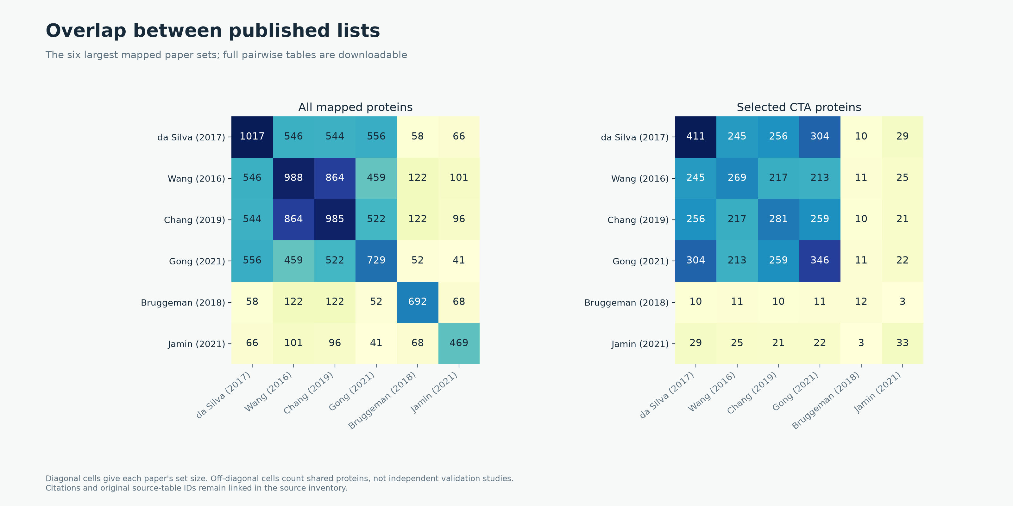
HUMAN ANNOTATIONS
Overlap between published lists
OncoRef CTA evidence walkthrough • 5 November 2026
08
Notes:
Overlap between published lists
Tables and author-recognized prior antigens within the same paper are unioned. Evidence roles, source IDs and pairwise counts accompany the report.
Report: https://pirl-unc.github.io/oncoref/audits/cta-source-walkthrough-20261028/
Policy: oncoref.cta-selection.2026-11-05.1
Decision snapshot SHA256: d9b4b9cd2367dc60cf755b7daa9c8e3325e09efb1e33d7de3aa3bc34673e49a3

Slide 9
POSITIVE EXPRESSION CONTEXTS
Reproductive evidence: measured branches
Qualifying route | Entrants | Final CTA
Adult/placental evidence only | 4,686 | 400
Embryonic-only evidence | 459 | 92
Both measured routes | 12,546 | 110
RNA and reliable reproductive IHC establish association
Entrants count positive expression before the other admission gates. Reproductive presence and profile concentration are separate questions.
OncoRef CTA evidence walkthrough • 5 November 2026
09
Notes:
Reproductive evidence: measured branches
Tyser et al. (2021): https://doi.org/10.1038/s41586-021-04158-y . HPA v23 https://v23.proteinatlas.org/about/download .
Report: https://pirl-unc.github.io/oncoref/audits/cta-source-walkthrough-20261028/
Policy: oncoref.cta-selection.2026-11-05.1
Decision snapshot SHA256: d9b4b9cd2367dc60cf755b7daa9c8e3325e09efb1e33d7de3aa3bc34673e49a3

Slide 10
HUMAN EVIDENCE
Normal and cancer measurement sources
Evidence | Source | Quantity
Normal / reproductive bulk | HPA v23 consensus / brain + GTEx v11 | nTPM / TPM
Normal tissue cells | HPA v23 clusters, at least 20 reads | nTPM
Immune cells | HPA v23 / Monaco / original DICE | Native nTPM / TPM
Adult cornea | Collin et al., GSE155683 | CP10K
Normal protein | HPA v23 + curated external IHC | Staining / reagent confidence
Cancer | 132 compatible OncoRef cohort views + HPA | TPM / protein-coding TPM
Developmental | Tyser gastrulation + Petropoulos preimplantation | Stage / lineage mean TPM
DICE and corneal coverage are optional. Measured counterevidence still contributes.
OncoRef CTA evidence walkthrough • 5 November 2026
10
Notes:
Normal and cancer measurement sources
HPA https://v23.proteinatlas.org/about/download ; DICE https://dice-database.org/ ; cornea https://www.ncbi.nlm.nih.gov/geo/query/acc.cgi?acc=GSE155683 ; Tyser https://doi.org/10.1038/s41586-021-04158-y . Full URLs and sample lineage accompany the report.
Report: https://pirl-unc.github.io/oncoref/audits/cta-source-walkthrough-20261028/
Policy: oncoref.cta-selection.2026-11-05.1
Decision snapshot SHA256: d9b4b9cd2367dc60cf755b7daa9c8e3325e09efb1e33d7de3aa3bc34673e49a3

Slide 11
CURRENT POLICY
RNA cutoffs
Ceiling | Missing / unusable | Approved − | Supported − | Enhanced −
Vital | 4 | 8 | 16 | 32
Protected | 8 | 16 | 32 | 64
Manageable | 16 | 32 | 64 | 128
One boundary: above-cutoff Vital / Protected is Unsafe
Differentiated bowel cells and fibroblasts use Protected. Crypt progenitors use Vital. Equality passes.
OncoRef CTA evidence walkthrough • 5 November 2026
11
Notes:
RNA cutoffs
The same nominal values apply across native TPM/nTPM assays. CP10K uses nominal /100, not a TPM conversion. Values are screening-policy choices, not measured toxicity limits.
Report: https://pirl-unc.github.io/oncoref/audits/cta-source-walkthrough-20261028/
Policy: oncoref.cta-selection.2026-11-05.1
Decision snapshot SHA256: d9b4b9cd2367dc60cf755b7daa9c8e3325e09efb1e33d7de3aa3bc34673e49a3

Slide 12
BULK AND CELLULAR CONSEQUENCE
Normal-tissue hazard ontology
Tier | Examples | Key interpretation
Vital | AT1/AT2, club/basal, crypt progenitors | Function and regenerative reserve
Protected | Ciliated/goblet, fibroblasts, skin | Persistent injury and uncertain control
Manageable | Thyroid, mature B cells | Defined compensation precedent
Disposable | Cutaneous pigment, hair follicles | Narrow anatomical allowance
Bulk retains organ concern. Recognition and reproductive membership are separate. Protected rare-cell findings create a review hold.
OncoRef CTA evidence walkthrough • 5 November 2026
12
Notes:
Normal-tissue hazard ontology
Central registry and full evidence ledger: https://pirl-unc.github.io/oncoref/audits/tissue-hazards-1.29.0/ . Adult human qualitative policy. AT2 evidence: https://pmc.ncbi.nlm.nih.gov/articles/PMC4821031/ . Club-cell depletion: https://pmc.ncbi.nlm.nih.gov/articles/PMC3056226/ . Ciliated-cell depletion: https://pmc.ncbi.nlm.nih.gov/articles/PMC4521991/ .
Report: https://pirl-unc.github.io/oncoref/audits/cta-source-walkthrough-20261028/
Policy: oncoref.cta-selection.2026-11-05.1
Decision snapshot SHA256: d9b4b9cd2367dc60cf755b7daa9c8e3325e09efb1e33d7de3aa3bc34673e49a3

Slide 13
TCR-T EVIDENCE
Clinical evidence adjusts RNA ceilings
With clinical credit | Missing / unusable | Approved − | Supported − | Enhanced −
Vital | 8 | 16 | 32 | 32
Protected | 16 | 32 | 64 | 64
Manageable | 32 | 64 | 128 | 128
IHC grades stay unchanged. Trials do not stack.
Protein and clinical-injury exclusions remain. This is protein-profile credit with tested epitope limitations, not clinical clearance.
OncoRef CTA evidence walkthrough • 5 November 2026
13
Notes:
Clinical evidence adjusts RNA ceilings
One step for reviewed treated-cohort evidence without identified grade 4-5 specificity-related toxicity; cap at Enhanced. Unknown or suspected specificity injury blocks product credit. Exact peptide/HLA/receptor limits remain. Clinical trial and SAE review: https://pirl-unc.github.io/oncoref/audits/cta-tcr-trials-20261029/
Report: https://pirl-unc.github.io/oncoref/audits/cta-source-walkthrough-20261028/
Policy: oncoref.cta-selection.2026-11-05.1
Decision snapshot SHA256: d9b4b9cd2367dc60cf755b7daa9c8e3325e09efb1e33d7de3aa3bc34673e49a3

Slide 14
CLINICAL SAFETY
Serious events and antigen specificity
Targeted CTA epitope | Important event | Specificity attribution
MAGE-A3 / a3a | Two fatal cardiac injuries | Titin cross-recognition implicated
MAGE-A3/A9 / NCI receptor | Three neurological cases; two deaths | MAGE-A12 / EPS8L2 attribution unresolved
NY-ESO-1 / LAGE-1A, c259 | Late cardiac death; two GBS cases | Peptide-specific mechanism not established
NY-ESO-1 / TBI-1301 | Grade 3 lung injury | Unresolved; no credit for this product
MAGE-A4 / afami-cel | Aplasia and stroke deaths in phase 1 | No demonstrated antigen-specific mechanism
MAGE-A10 / ADP-A2M10 | Grade 4 CRS; fatal aplasia after repeat treatment | Conditioning favored for marrow injury
Clinical trial and SAE review. Seriousness differs from severity; this is a selected summary, not a pooled event rate.
OncoRef CTA evidence walkthrough • 5 November 2026
14
Notes:
Serious events and antigen specificity
Letetresgene Autoleucel in Advanced/Metastatic Myxoid/Round Cell Liposarcoma: https://doi.org/10.1200/JCO-24-01466
Autologous T cell therapy for PRAME+ advanced solid tumors in HLA-A*02+ patients: a phase 1 trial: https://doi.org/10.1038/s41591-025-03650-6
Autologous T cell therapy for MAGE-A4+ solid cancers in HLA-A*02+ patients: a phase 1 trial: https://doi.org/10.1038/s41591-022-02128-z
SPEARHEAD-1: a single-arm phase 2 trial of afamitresgene autoleucel in advanced synovial sarcoma and myxoid/round cell liposarcoma: https://doi.org/10.1016/S0140-6736(24)00319-2
Identification of a Titin-Derived HLA-A1-Presented Peptide as a Cross-Reactive Target for Engineered MAGE A3-Directed T Cells: https://doi.org/10.1126/scitranslmed.3006034
Guillain-Barre syndrome observed with adoptive transfer of lymphocytes genetically engineered with an NY-ESO-1 reactive T-cell receptor: https://doi.org/10.1186/s40425-019-0759-x
NCT03709706 protocol: NY-ESO-1/LAGE-1A shared peptide and c259 receptor: https://cdn.clinicaltrials.gov/large-docs/06/NCT03709706/Prot_000.pdf
NCT03132922 protocol: MAGE-A4 c1032 target peptide: https://cdn.clinicaltrials.gov/large-docs/22/NCT03132922/Prot_000.pdf
First-in-human dose escalation trial to evaluate the clinical safety and efficacy of an anti-MAGEA1 autologous TCR-transgenic T cell therapy in relapsed and refractory solid tumors: https://doi.org/10.1136/jitc-2023-008668
Phase I clinical trial evaluating the safety and efficacy of ADP-A2M10 SPEAR T cells in patients with MAGE-A10+ advanced non-small cell lung cancer: https://doi.org/10.1136/jitc-2021-003581
NY-ESO-1-specific redirected T cells with endogenous TCR knockdown mediate tumor response and cytokine release syndrome: https://doi.org/10.1136/jitc-2021-003811
Cancer regression and neurological toxicity following anti-MAGE-A3 TCR gene therapy: https://pubmed.ncbi.nlm.nih.gov/23377668/
Re-examination of MAGE-A3 as a T-cell Therapeutic Target: https://pmc.ncbi.nlm.nih.gov/articles/PMC7946352/
Report: https://pirl-unc.github.io/oncoref/audits/cta-source-walkthrough-20261028/
Policy: oncoref.cta-selection.2026-11-05.1
Decision snapshot SHA256: d9b4b9cd2367dc60cf755b7daa9c8e3325e09efb1e33d7de3aa3bc34673e49a3

Slide 15
CATEGORICAL DECISIONS
Other records an unmet admission gate
Reason | Meaning | Proteins
Nonreproductive | No qualifying reproductive evidence | 570
Translation | Selected primary translation requires review | 362
Nested | Nested short reference-CDS product | 28
Held | Target gates pass; normal review hold remains | 27
Contained | At least 95% of 9-mers occur in Unsafe proteins | 15
Diffuse | Reproductive concentration fails | 4
Normal RNA level, tumor support and Disposable expression remain separate attributes.
OncoRef CTA evidence walkthrough • 5 November 2026
15
Notes:
Other records an unmet admission gate
Safety and coverage are assessed independently. Other reasons use reproductive presence, cancer presence, then concentration. No gene is admitted or excluded by an abundance label.
Report: https://pirl-unc.github.io/oncoref/audits/cta-source-walkthrough-20261028/
Policy: oncoref.cta-selection.2026-11-05.1
Decision snapshot SHA256: d9b4b9cd2367dc60cf755b7daa9c8e3325e09efb1e33d7de3aa3bc34673e49a3

Slide 16
INSPECT EACH PROTEIN
Evidence attributes stay independent
Question | Fields / interpretation
How high in cancer? | Native TPM / HPA pTPM maxima; two identified tumors >=10 TPM is a support flag
How high in adult normal? | Separate nTPM / TPM / CP10K summaries; raw unsupported observations remain visible
Adult Disposable pattern? | Permitted adult expression with low measured adult expression elsewhere
Developmental expression? | Separate lineage RNA and measured-stage coverage; never changes adult tissue permission
cta_selection.profiles() exposes these fields. Low / Weak / Normal are no longer competing classes.
OncoRef CTA evidence walkthrough • 5 November 2026
16
Notes:
Evidence attributes stay independent
The profiles() API preserves native RNA units, supporting samples, adult Disposable pattern and developmental evidence independently of the final decision.
Report: https://pirl-unc.github.io/oncoref/audits/cta-source-walkthrough-20261028/
Policy: oncoref.cta-selection.2026-11-05.1
Decision snapshot SHA256: d9b4b9cd2367dc60cf755b7daa9c8e3325e09efb1e33d7de3aa3bc34673e49a3

Slide 17
POSITIVE ASSOCIATION
Reproductive cell evidence
Route | Positive evidence | Additional requirements
Identified lineage | ≥5 nTPM with ≥20 reads | Mapped reproductive lineage; all protein loci measured
Indirect site | Generic/immune cell in reproductive tissue | Complete outside cluster panel; every value <5 nTPM; no normal-induction conflict
Examples | CAGE1 208.9; PRDM9 61.8; FOXR2 5.2 nTPM | Spermatids / spermatocytes / spermatogonia
Counterexample | IFNA2 and IFNA14 in breast macrophages | Reviewed normal immune protein → Unsafe
Indirect support identifies the sample site, not the producing cell. Normal and bulk-concentration gates still apply.
OncoRef CTA evidence walkthrough • 5 November 2026
17
Notes:
Reproductive cell evidence
HPA v23 https://v23.proteinatlas.org/about/download ; passenger transcripts: https://pmc.ncbi.nlm.nih.gov/articles/PMC7459098/ ; normal interferon induction: https://pmc.ncbi.nlm.nih.gov/articles/PMC6457222/
Report: https://pirl-unc.github.io/oncoref/audits/cta-source-walkthrough-20261028/
Policy: oncoref.cta-selection.2026-11-05.1
Decision snapshot SHA256: d9b4b9cd2367dc60cf755b7daa9c8e3325e09efb1e33d7de3aa3bc34673e49a3

Slide 18
LITERATURE EVIDENCE
Reviewed normal-cell knowledge
Evidence | Consequence
Established normal production | Vital/Protected protein or localized RNA plus orthogonal cell function can establish Unsafe
Unresolved normal findings | Sparse RNA, uncertain species/stage or isoforms remain review holds
Reproductive protein | Supplies presence below the RNA floor; safety and concentration still apply
Search and curation | All 611 baseline Other genes searched; accepted findings remain separate from search leads
Rare normal cells and activation states count. Expression exclusions do not assert clinical injury.
OncoRef CTA evidence walkthrough • 5 November 2026
18
Notes:
Reviewed normal-cell knowledge
OncoRef 1.26.0: https://pirl-unc.github.io/oncoref/audits/cta-other-literature-20261030/ ; pDC protein: https://www.frontiersin.org/journals/immunology/articles/10.3389/fimmu.2022.814627/full ; human olfactory atlas: https://pmc.ncbi.nlm.nih.gov/articles/PMC7065961/
Report: https://pirl-unc.github.io/oncoref/audits/cta-source-walkthrough-20261028/
Policy: oncoref.cta-selection.2026-11-05.1
Decision snapshot SHA256: d9b4b9cd2367dc60cf755b7daa9c8e3325e09efb1e33d7de3aa3bc34673e49a3

Slide 19
EVIDENCE MIGRATION
Historical findings retain explicit dispositions
Case | Current result | Reason retained
MAGEC2 | Other:Held | Purkinje-cell reagent specificity remains unresolved
LGALS13 | Other:Held | Adult/fetal and galectin identity remain unresolved
PLCZ1 | Other:Held | Pancreatic RNA is unresolved; CFTR staining is not PLCZ1 protein
MAGEA12 | Unsafe | Independent rare-cell exclusion; clinical peptide attribution remains unresolved
A completed review can retain uncertainty. Unresolved evidence requires review without establishing Unsafe.
OncoRef CTA evidence walkthrough • 5 November 2026
19
Notes:
Historical findings retain explicit dispositions
All historical findings and prior adjudications: https://pirl-unc.github.io/oncoref/audits/cta-evidence-migration-20261104/ . MAGE-A12/EPS8L2 counterevidence: https://pmc.ncbi.nlm.nih.gov/articles/PMC7946352/ .
Report: https://pirl-unc.github.io/oncoref/audits/cta-source-walkthrough-20261028/
Policy: oncoref.cta-selection.2026-11-05.1
Decision snapshot SHA256: d9b4b9cd2367dc60cf755b7daa9c8e3325e09efb1e33d7de3aa3bc34673e49a3

Slide 20
COMPLETE INVENTORY
Every candidate receives a classification
Candidate records | Count | Current treatment
Previously classified | 19,604 | All previous classifications unchanged
Restored: Other:Translation | 247 | Translation admission fails; sequence review required
Restored: Unsafe | 12 | Normal exclusion takes precedence
Complete inventory | 19,863 | All records enter the same assessment
Translation is a CTA admission gate. Insufficient support cannot hide normal-tissue evidence.
OncoRef CTA evidence walkthrough • 5 November 2026
20
Notes:
Every candidate receives a classification
Full record-level audit and historical omission ledger: https://pirl-unc.github.io/oncoref/audits/cta-inventory-20261105/ . Qualifying coding annotation is not experimental proof of protein production.
Report: https://pirl-unc.github.io/oncoref/audits/cta-source-walkthrough-20261028/
Policy: oncoref.cta-selection.2026-11-05.1
Decision snapshot SHA256: d9b4b9cd2367dc60cf755b7daa9c8e3325e09efb1e33d7de3aa3bc34673e49a3

Slide 21
CANCER RESTRICTION
Expression-screen matches and counterevidence
Numerical screen | Count | Interpretation
Low normal expression profile | 66 | Preliminary matches; every independent exclusion still applies
Normal-cell counterevidence | 6 | Unsafe despite a routine-panel profile match
Stored adult/reproductive RNA = 0 | 40 | Cancer present and required normal bulk coverage complete
Also developmental RNA = 0 | 0 | 18 adult-zero records lack developmental measurements
Stored RNA zeros do not establish protein absence. CTA counts are not cancer-only protein counts.
OncoRef CTA evidence walkthrough • 5 November 2026
21
Notes:
Expression-screen matches and counterevidence
Record-level matches, review statuses, counterevidence and stored-zero RNA audit: https://pirl-unc.github.io/oncoref/audits/cta-inventory-20261105/ . Normal findings for IFNW1, IFNA4, MRGPRX4, CNGA2, SCN10A and GFRAL are retained with original sources.
Report: https://pirl-unc.github.io/oncoref/audits/cta-source-walkthrough-20261028/
Policy: oncoref.cta-selection.2026-11-05.1
Decision snapshot SHA256: d9b4b9cd2367dc60cf755b7daa9c8e3325e09efb1e33d7de3aa3bc34673e49a3

Slide 22
REFERENCE SEQUENCE
Selected translations require qualification
Record | Current classification | Selected translation
SERPINA2 | Other:Translation | Incomplete primary LoF record; alternate locus cannot rescue it
MROH5 | Unsafe | Interrupted primary record; normal exclusion still takes precedence
SELENOV | Other:Translation | Selenocysteine requires review under the AA20 contract
Qualification reviews the selected reference sequence. Original interrupted and alternate records remain available.
OncoRef CTA evidence walkthrough • 5 November 2026
22
Notes:
Selected translations require qualification
Exact reference records and qualification rules: https://pirl-unc.github.io/oncoref/audits/translation-qualification-20261104/ . Conservative AA20 support does not establish absent biological production.
Report: https://pirl-unc.github.io/oncoref/audits/cta-source-walkthrough-20261028/
Policy: oncoref.cta-selection.2026-11-05.1
Decision snapshot SHA256: d9b4b9cd2367dc60cf755b7daa9c8e3325e09efb1e33d7de3aa3bc34673e49a3

Slide 23
VERIFIED SEQUENCE BUNDLE
Sequence roles preserve every occurrence
Role | Source records | Meaning
Exclude | 230,648 | Applicable normal exclusion takes precedence
Review | 13,512 | Unresolved decision, isoform or translation
Allow | 1,375 | Qualified assessed representative under this policy
245,535 original records and all source occurrences survive. AA20 segments retain coordinates and never bridge ambiguity.
OncoRef CTA evidence walkthrough • 5 November 2026
23
Notes:
Sequence roles preserve every occurrence
Verified loader, coverage gaps and historical transition: https://pirl-unc.github.io/oncoref/sequence-bundle/ . Bundle identity: oncoref:sequence-bundle:v1:sha256:607c4ede9af40e33657ce84b58eff11087e66be7942a9a156a81480e8d06335a
Report: https://pirl-unc.github.io/oncoref/audits/cta-source-walkthrough-20261028/
Policy: oncoref.cta-selection.2026-11-05.1
Decision snapshot SHA256: d9b4b9cd2367dc60cf755b7daa9c8e3325e09efb1e33d7de3aa3bc34673e49a3

Slide 24
FOUR REQUESTED PROTEINS
High tumor expression does not establish CTA identity
Protein | Cancer TPM | Adult atlas nTPM | Current reasoning
DBX1 | 297.5 | 0.8; thymic T cells | No qualifying reproductive evidence
OR2B2 | 246.3 | 0.5; pons | No qualifying reproductive evidence
KRTAP20-2 | 147.6 | 1.4; skin | Skin expression; reproductive identity unestablished
OR10A4 | 138.0 | 1.9; basal ganglia | Normal nasal RNA requires review
Disposable describes allowed adult tissues. Developmental expression is a separate measurement.
OncoRef CTA evidence walkthrough • 5 November 2026
24
Notes:
High tumor expression does not establish CTA identity
Pinned normal atlas peaks are source-supported summaries, not exhaustive rare-cell or donor maxima. OR10A4 also has normal human nasal RNA in two primary studies.
Report: https://pirl-unc.github.io/oncoref/audits/cta-source-walkthrough-20261028/
Policy: oncoref.cta-selection.2026-11-05.1
Decision snapshot SHA256: d9b4b9cd2367dc60cf755b7daa9c8e3325e09efb1e33d7de3aa3bc34673e49a3

Slide 25
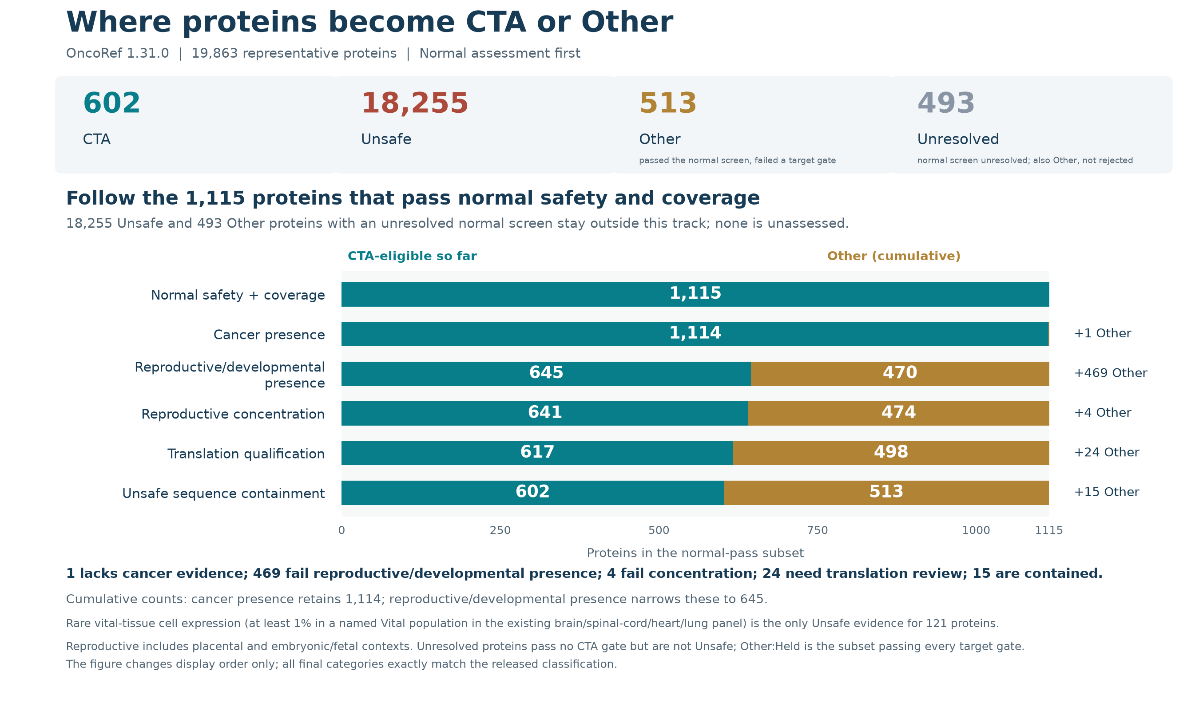
COARSE CATEGORY FUNNEL
Other accumulates as identity gates fail
OncoRef CTA evidence walkthrough • 5 November 2026
25
Notes:
Other accumulates as identity gates fail
Normal assessment is displayed first. Identity requirements move proteins into Other without creating Unsafe evidence. All final categories match the released classifier.
Report: https://pirl-unc.github.io/oncoref/audits/cta-source-walkthrough-20261028/
Policy: oncoref.cta-selection.2026-11-05.1
Decision snapshot SHA256: d9b4b9cd2367dc60cf755b7daa9c8e3325e09efb1e33d7de3aa3bc34673e49a3

Slide 26
CANDIDATE PROVENANCE
Candidates with and without prior nominations
Provenance | Input | Normal | Cancer | Repro. / dev. | Final CTA
Registered-paper union | 2,514 | 592 | 592 | 505 | 480
No registered-paper annotation | 17,349 | 523 | 522 | 140 | 122
Complete inventory | 19,863 | 1,115 | 1,114 | 645 | 602
The paper union and unannotated complement partition every stage. Overlapping paper rows must not be added.
OncoRef CTA evidence walkthrough • 5 November 2026
26
Notes:
Candidates with and without prior nominations
All registered publication memberships are retained. A prior nomination is not required for CTA admission. Absence from this finite registry does not establish novelty. Counts use the same cumulative gates as the coarse funnel.
Report: https://pirl-unc.github.io/oncoref/audits/cta-source-walkthrough-20261028/
Policy: oncoref.cta-selection.2026-11-05.1
Decision snapshot SHA256: d9b4b9cd2367dc60cf755b7daa9c8e3325e09efb1e33d7de3aa3bc34673e49a3

Slide 27
PUBLICATION FUNNEL
Registered papers through admission: 1 of 2
Paper | Input | Normal | Cancer | Repro. / dev. | Final CTA
da Silva et al. (2017) | 1,017 | 512 | 512 | 432 | 411
Wang et al. (2016) | 988 | 292 | 292 | 279 | 269
Chang et al. (2019) | 985 | 292 | 292 | 289 | 281
Gong et al. (2021) | 729 | 370 | 370 | 357 | 346
Bruggeman et al. (2018) | 692 | 12 | 12 | 12 | 12
Jamin et al. (2021) | 469 | 39 | 39 | 38 | 33
Loriot et al. (2025) | 202 | 86 | 86 | 86 | 83
Carter et al. (2023) | 103 | 54 | 54 | 54 | 53
Each row follows the same cumulative gates. Final CTA also requires concentration, translation and sequence qualification.
OncoRef CTA evidence walkthrough • 5 November 2026
27
Notes:
Registered papers through admission: 1 of 2
da Silva et al. (2017): https://doi.org/10.18632/oncotarget.21715
Scope: At least 90% normal-tissue RNA attributable to testis; tumor positivity not required; Gene-labelled tumor proteomics; unique-locus peptide assignment is not established; RSEM >1 in at least 10% of samples in a tumor type; RNA nomination
Wang et al. (2016): https://doi.org/10.1038/ncomms10499
Scope: Cancer-associated RNA nomination; no antigen validation asserted
Chang et al. (2019): https://doi.org/10.1002/cam4.2223
Scope: Testis-specific coding gene expressed in at least 1% of TGCT; no broad somatic-cancer claim
Gong et al. (2021): https://doi.org/10.1038/s41467-021-22695-y
Scope: Normal reproductive-tissue enrichment; no tumor validation; Placental RNA enrichment; no tumor-antigen validation
Bruggeman et al. (2018): https://doi.org/10.1038/s41388-018-0357-2
Scope: GC RNA nomination across cancer types; no antigen validation asserted; GC RNA nomination; inclusion depends on TGCT under this study's thresholds
Jamin et al. (2021): https://doi.org/10.1002/1878-0261.12900
Scope: CT-pattern microarray nomination; tumor upregulation with no corresponding normal-tissue detection; Core CT annotation; underlying microarray probes may recognize several loci
Loriot et al. (2025): https://doi.org/10.1371/journal.pgen.1011734
Scope: Cancer-germline RNA nomination; strict and preferential classes remain distinct
Carter et al. (2023): https://doi.org/10.1136/jitc-2023-007935
Scope: Final CT-expression set without detectable thymic expression; functional vaccination evidence is not assigned to every gene
Report: https://pirl-unc.github.io/oncoref/audits/cta-source-walkthrough-20261028/
Policy: oncoref.cta-selection.2026-11-05.1
Decision snapshot SHA256: d9b4b9cd2367dc60cf755b7daa9c8e3325e09efb1e33d7de3aa3bc34673e49a3

Slide 28
PUBLICATION FUNNEL
Registered papers through admission: 2 of 2
Paper | Input | Normal | Cancer | Repro. / dev. | Final CTA
Hirbo et al. (2015) | 78 | 10 | 10 | 10 | 8
Seager et al. (2024) | 15 | 11 | 11 | 11 | 10
Sasaroli et al. (2011) | 13 | 0 | 0 | 0 | 0
Bradley et al. (2020) | 9 | 0 | 0 | 0 | 0
Garg et al. (2007) | 5 | 3 | 3 | 3 | 3
Boël et al. (1995) | 2 | 1 | 1 | 1 | 1
Bai et al. (2016) | 1 | 0 | 0 | 0 | 0
Each row follows the same cumulative gates. Final CTA also requires concentration, translation and sequence qualification.
OncoRef CTA evidence walkthrough • 5 November 2026
28
Notes:
Registered papers through admission: 2 of 2
Hirbo et al. (2015): https://doi.org/10.1371/journal.pone.0144155
Scope: HPA v13 placenta-enriched nominations; 30/86 fast-evolving subset retained as metadata; not tumor validation
Seager et al. (2024): https://doi.org/10.1186/s12967-024-04918-0
Scope: Member of the published 17-target CTA profiling panel; includes differentiation antigen MLANA
Sasaroli et al. (2011): https://doi.org/10.4161/cbt.12.3.16260
Scope: Tumor-vascular candidate list; includes secreted and transmembrane proteins; not a CTA-restricted list
Bradley et al. (2020): https://doi.org/10.1038/s41467-020-19141-w
Scope: CPA expression nominations; HLA peptide and antigen-specific T-cell validation for VGLL1
Garg et al. (2007): https://doi.org/10.1158/1078-0432.CCR-06-2340
Scope: Ovarian-cancer RNA/protein expression and patient antibody responses; no HLA presentation or T-cell validation claimed
Boël et al. (1995): https://doi.org/10.1016/s1074-7613(95)80053-0
Scope: Original BAGE tumor-antigen nomination and autologous CTL recognition; contemporary paralog resolution is not inferred
Bai et al. (2016): https://doi.org/10.1158/0008-5472.CAN-16-0225
Scope: Ovarian-tumor and vascular expression/function; no normal-tissue exclusivity claim
Report: https://pirl-unc.github.io/oncoref/audits/cta-source-walkthrough-20261028/
Policy: oncoref.cta-selection.2026-11-05.1
Decision snapshot SHA256: d9b4b9cd2367dc60cf755b7daa9c8e3325e09efb1e33d7de3aa3bc34673e49a3

Slide 29
HUMAN FUNNEL
Every filtering layer can contribute
Eligible so far
Unsafe
Other
Pending
Final: 602 CTA / 18,255 Unsafe / 1,006 Other.
OncoRef CTA evidence walkthrough • 5 November 2026
29
Notes:
Every filtering layer can contribute
The gray segment contains proteins pending final assignment. All layers evaluate every protein. Final human categories contain no unassigned proteins.
Report: https://pirl-unc.github.io/oncoref/audits/cta-source-walkthrough-20261028/
Policy: oncoref.cta-selection.2026-11-05.1
Decision snapshot SHA256: d9b4b9cd2367dc60cf755b7daa9c8e3325e09efb1e33d7de3aa3bc34673e49a3

Slide 30
HUMAN FUNNEL
Removals at each filter: 1 of 2
Layer | First removals | Eligible | Unsafe
Association | 2,175 | 17,688 | 0
Cancer expression | 8 | 17,680 | 0
HPA normal protein | 12,044 | 5,636 | 10,161
Required RNA coverage | 102 | 5,534 | 10,161
Reproductive concentration | 1,007 | 4,527 | 10,161
Translation qualification | 118 | 4,409 | 10,161
Normal bulk | 3,434 | 975 | 17,639
HPA tissue clusters | 232 | 743 | 18,004
HPA immune | 12 | 731 | 18,031
Monaco immune | 11 | 720 | 18,052
Sequential removals overlap. Final categories use every applicable evidence layer.
OncoRef CTA evidence walkthrough • 5 November 2026
30
Notes:
Removals at each filter: 1 of 2
Sequential first removals depend on the displayed order; the independent-layer table reports overlaps.
Report: https://pirl-unc.github.io/oncoref/audits/cta-source-walkthrough-20261028/
Policy: oncoref.cta-selection.2026-11-05.1
Decision snapshot SHA256: d9b4b9cd2367dc60cf755b7daa9c8e3325e09efb1e33d7de3aa3bc34673e49a3

Slide 31
HUMAN FUNNEL
Removals at each filter: 2 of 2
Layer | First removals | Eligible | Unsafe
DICE immune | 15 | 705 | 18,096
Adult cornea | 2 | 703 | 18,101
Accepted normal-protein evidence | 3 | 700 | 18,103
Reviewed normal-cell knowledge | 3 | 697 | 18,134
Clinical safety exclusion | 0 | 697 | 18,134
Rare vital-tissue cell expression | 74 | 623 | 18,255
Rare Protected-cell expression review | 6 | 617 | 18,255
External validated normal protein | 0 | 617 | 18,255
Unsafe sequence containment | 15 | 602 | 18,255
CTA and Other assignments | 0 | 602 | 18,255
Sequential removals overlap. Final categories use every applicable evidence layer.
OncoRef CTA evidence walkthrough • 5 November 2026
31
Notes:
Removals at each filter: 2 of 2
Sequential first removals depend on the displayed order; the independent-layer table reports overlaps.
Report: https://pirl-unc.github.io/oncoref/audits/cta-source-walkthrough-20261028/
Policy: oncoref.cta-selection.2026-11-05.1
Decision snapshot SHA256: d9b4b9cd2367dc60cf755b7daa9c8e3325e09efb1e33d7de3aa3bc34673e49a3

Slide 32
ANATOMY AND EVIDENCE
IHC matching to measured RNA compartments
Context | Evidence and current ceiling
PRAME colon undifferentiated cells | 20.3 nTPM / 96 reads; Enhanced-negative glandular IHC; Vital 32
PRAME adrenal bulk | 3.6 nTPM; incomplete IHC coverage; Vital 4 → 8 with IMA203 credit
CTAG2 bronchial basal cells | 24.9 nTPM / 58 reads; Enhanced-negative respiratory IHC; Vital 32
Unrelated cells in the same tissue | No negative-IHC credit without exact or declared compartment coverage
PRAME and CTAG2 pass this policy. Parent-compartment sensitivity and PRAME’s Low adrenal protein remain explicit limitations.
OncoRef CTA evidence walkthrough • 5 November 2026
32
Notes:
IHC matching to measured RNA compartments
HPA colon https://www.proteinatlas.org/learn/dictionary/normal/colon ; bronchus https://www.proteinatlas.org/learn/dictionary/normal/bronchus . Parent-compartment credit is a declared anatomical interpretation, not proof that all rare cells were sampled.
Report: https://pirl-unc.github.io/oncoref/audits/cta-source-walkthrough-20261028/
Policy: oncoref.cta-selection.2026-11-05.1
Decision snapshot SHA256: d9b4b9cd2367dc60cf755b7daa9c8e3325e09efb1e33d7de3aa3bc34673e49a3

Slide 33
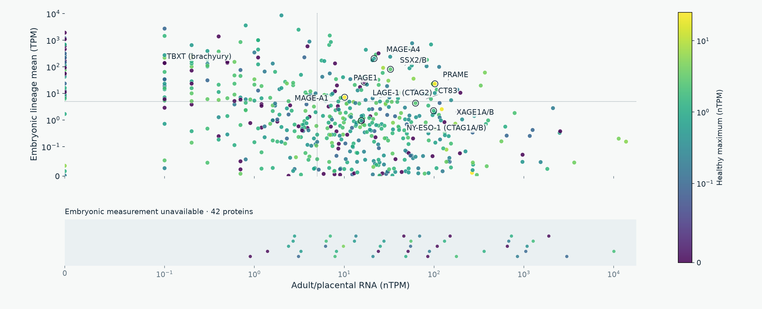
EXPRESSION DISTRIBUTIONS
Selected CTA: adult/placental versus embryonic RNA
Gray: healthy measurement unavailable. The lower band has no embryonic-expression value.
OncoRef CTA evidence walkthrough • 5 November 2026
33
Notes:
Selected CTA: adult/placental versus embryonic RNA
Color uses the highest supported non-disposable healthy expression within the stated native unit. There is no mixed-unit maximum. Labels include widely studied antigens with mapped values. Companion panels label all selected proteins ≥5 on both axes. Missing embryonic measurements appear in a separate categorical band; every selected protein is represented without zero filling.
Report: https://pirl-unc.github.io/oncoref/audits/cta-source-walkthrough-20261028/
Policy: oncoref.cta-selection.2026-11-05.1
Decision snapshot SHA256: d9b4b9cd2367dc60cf755b7daa9c8e3325e09efb1e33d7de3aa3bc34673e49a3

Slide 34

EXPRESSION DISTRIBUTIONS
Selected CTA: healthy RNA in TPM
Gray: healthy measurement unavailable. The lower band has no embryonic-expression value.
OncoRef CTA evidence walkthrough • 5 November 2026
34
Notes:
Selected CTA: healthy RNA in TPM
Color uses the highest supported non-disposable healthy expression within the stated native unit. There is no mixed-unit maximum. Labels include widely studied antigens with mapped values. Companion panels label all selected proteins ≥5 on both axes. Missing embryonic measurements appear in a separate categorical band; every selected protein is represented without zero filling.
Report: https://pirl-unc.github.io/oncoref/audits/cta-source-walkthrough-20261028/
Policy: oncoref.cta-selection.2026-11-05.1
Decision snapshot SHA256: d9b4b9cd2367dc60cf755b7daa9c8e3325e09efb1e33d7de3aa3bc34673e49a3

Slide 35
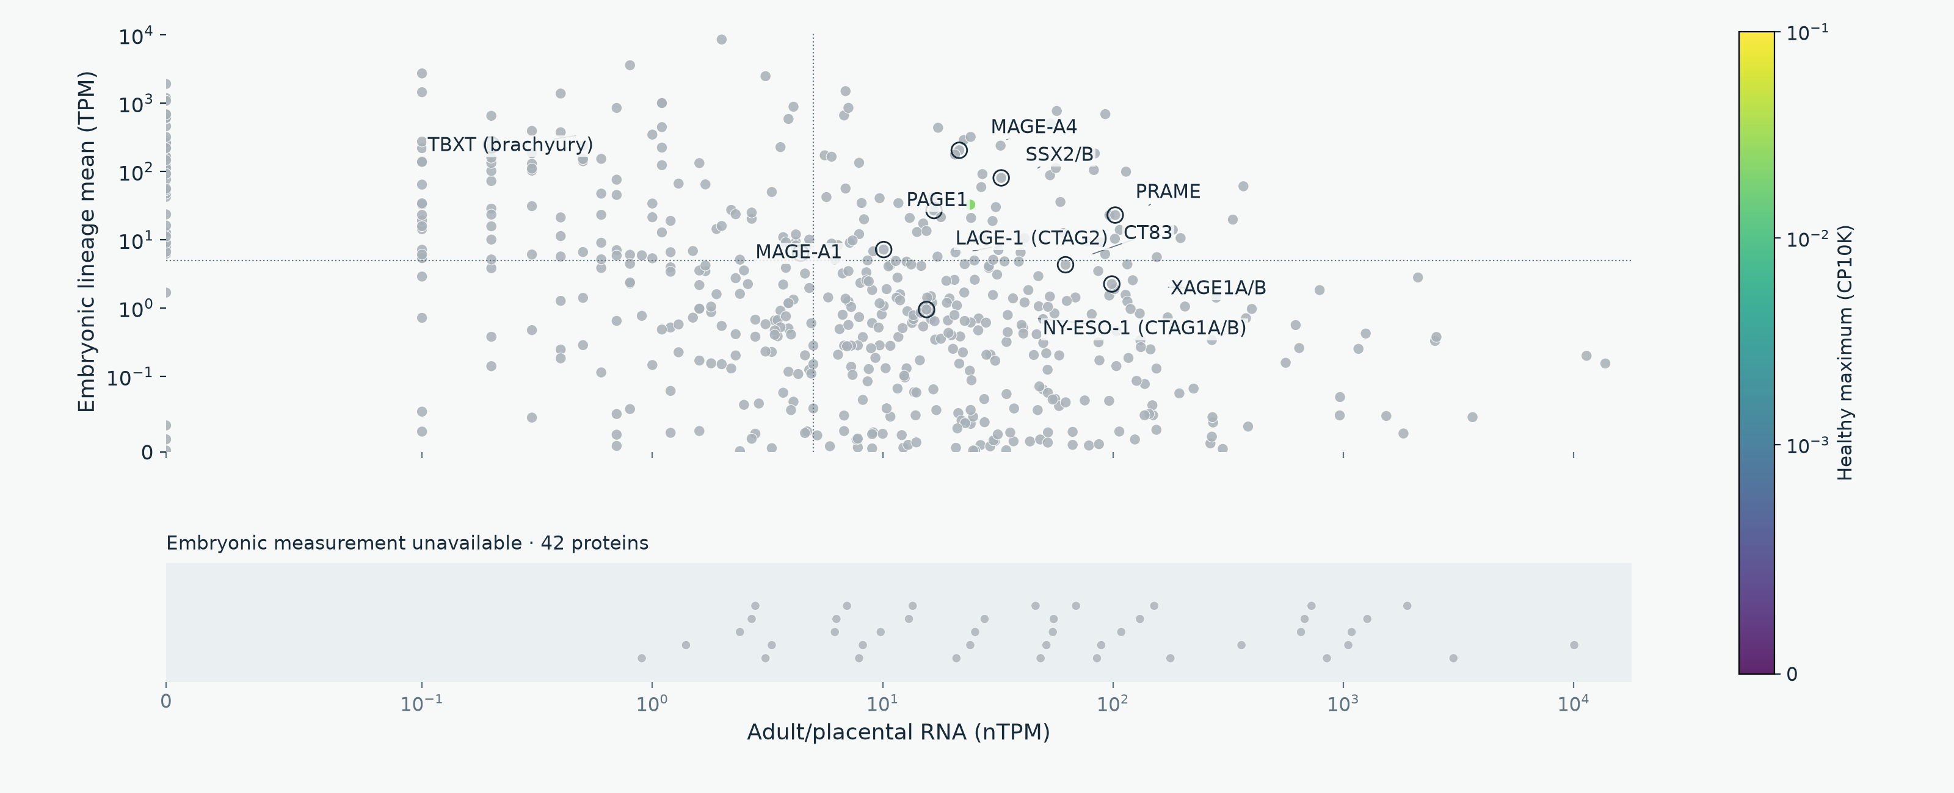
EXPRESSION DISTRIBUTIONS
Selected CTA: normal corneal RNA
Gray: healthy measurement unavailable. The lower band has no embryonic-expression value.
OncoRef CTA evidence walkthrough • 5 November 2026
35
Notes:
Selected CTA: normal corneal RNA
Color uses the highest supported non-disposable healthy expression within the stated native unit. There is no mixed-unit maximum. Labels include widely studied antigens with mapped values. Companion panels label all selected proteins ≥5 on both axes. Missing embryonic measurements appear in a separate categorical band; every selected protein is represented without zero filling.
Report: https://pirl-unc.github.io/oncoref/audits/cta-source-walkthrough-20261028/
Policy: oncoref.cta-selection.2026-11-05.1
Decision snapshot SHA256: d9b4b9cd2367dc60cf755b7daa9c8e3325e09efb1e33d7de3aa3bc34673e49a3

Slide 36
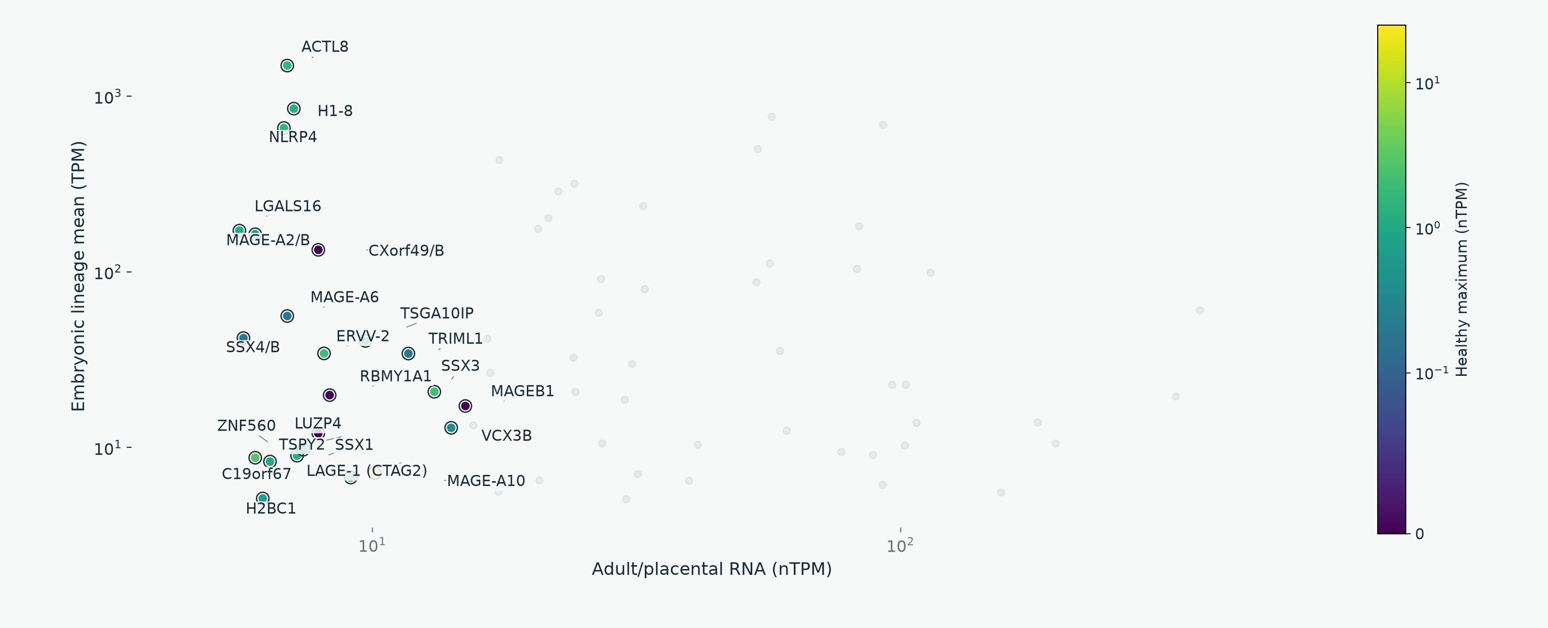
SELECTED CTA DETAIL
High adult/placental and embryonic RNA: labels 1 of 3
OncoRef CTA evidence walkthrough • 5 November 2026
36
Notes:
High adult/placental and embryonic RNA: labels 1 of 3
The three panels use identical axes and together label all selected proteins with reproductive nTPM ≥5 and measured embryonic lineage-mean TPM ≥5. This descriptive threshold does not replace developmental cell-support requirements. Color is the highest non-disposable healthy nTPM.
Report: https://pirl-unc.github.io/oncoref/audits/cta-source-walkthrough-20261028/
Policy: oncoref.cta-selection.2026-11-05.1
Decision snapshot SHA256: d9b4b9cd2367dc60cf755b7daa9c8e3325e09efb1e33d7de3aa3bc34673e49a3

Slide 37
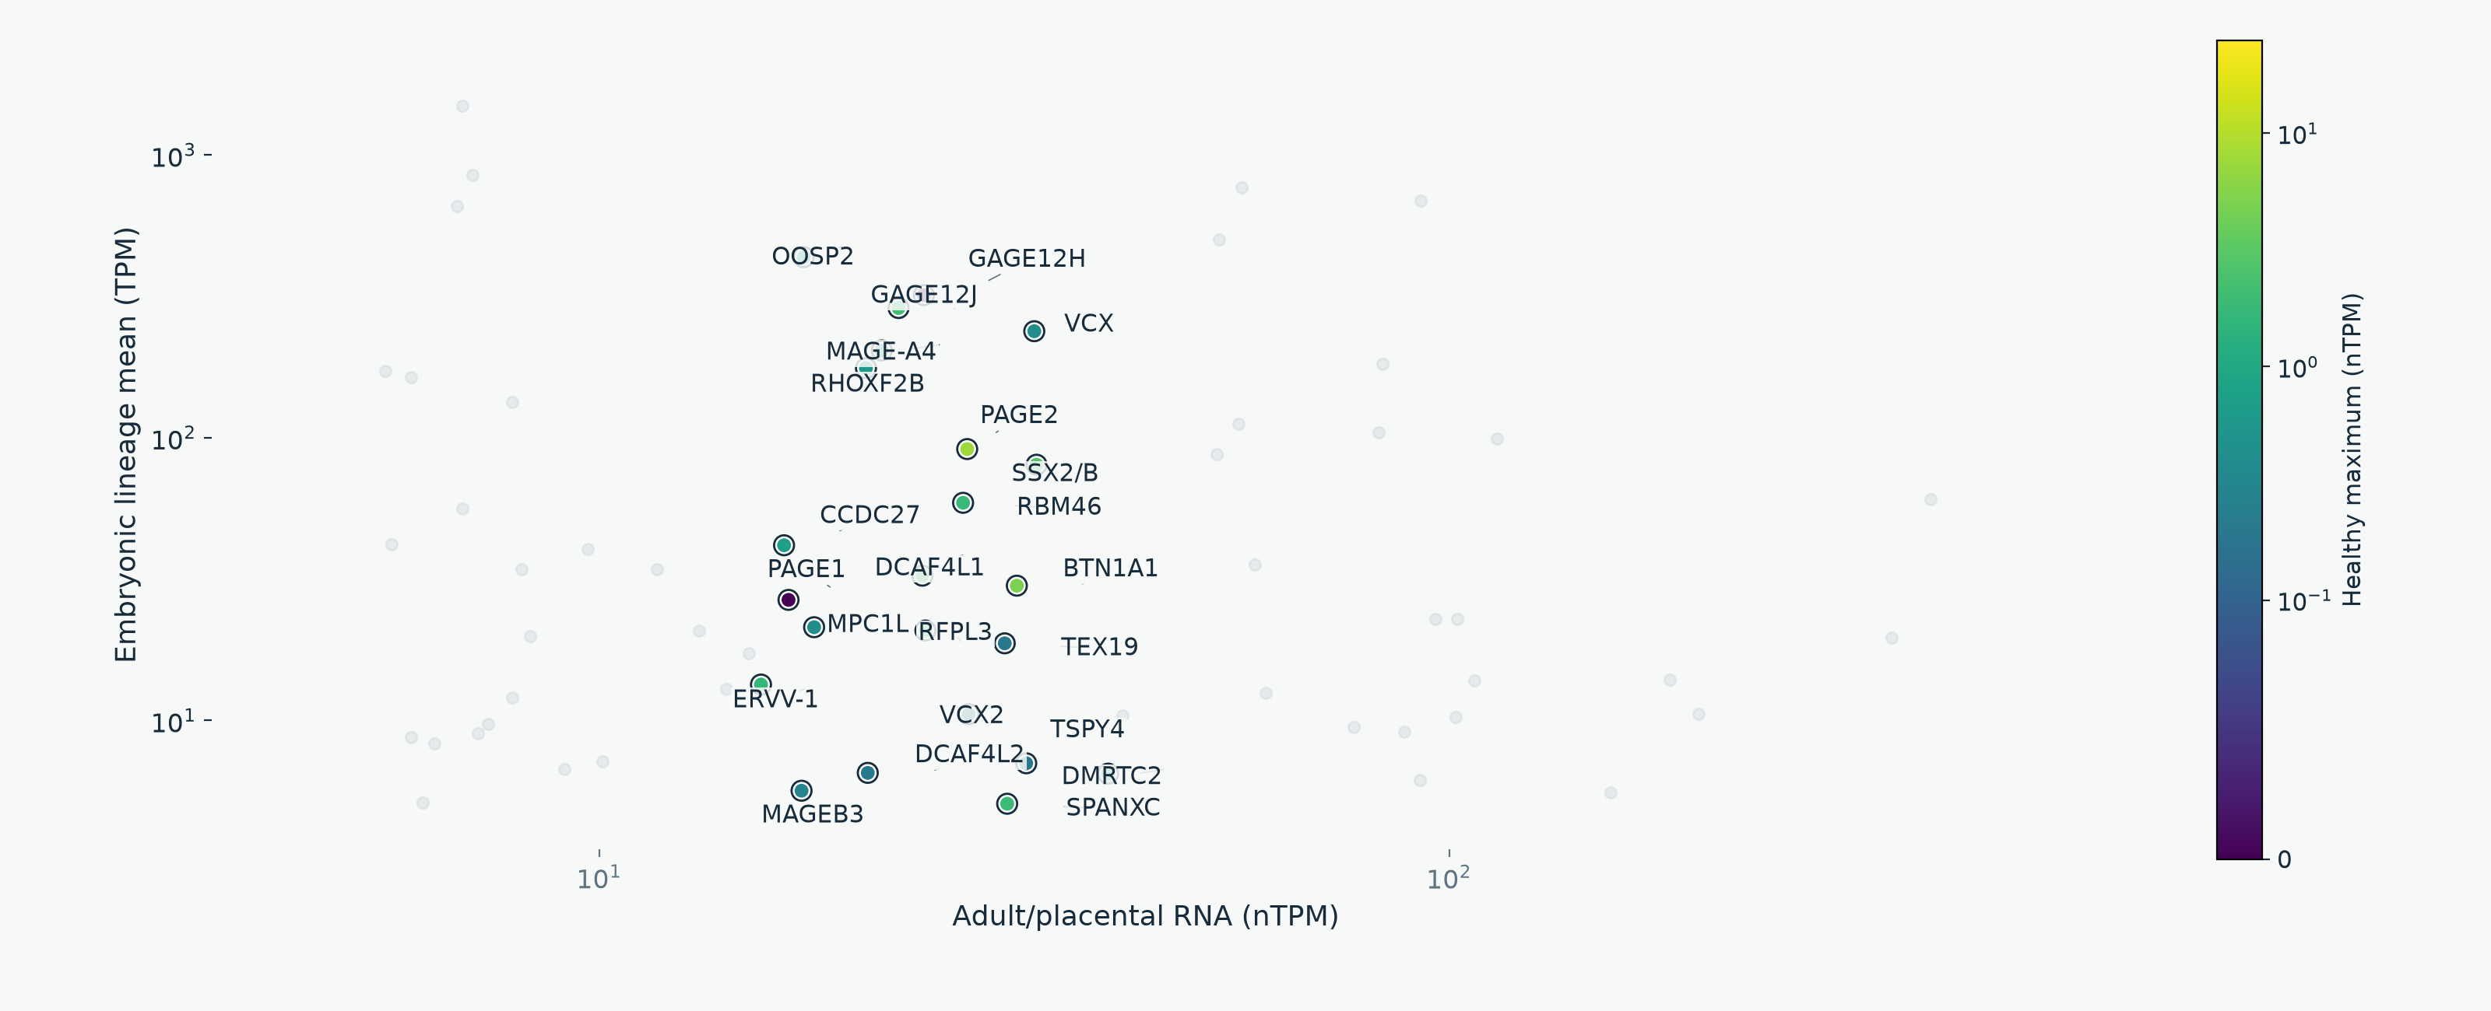
SELECTED CTA DETAIL
High adult/placental and embryonic RNA: labels 2 of 3
OncoRef CTA evidence walkthrough • 5 November 2026
37
Notes:
High adult/placental and embryonic RNA: labels 2 of 3
The three panels use identical axes and together label all selected proteins with reproductive nTPM ≥5 and measured embryonic lineage-mean TPM ≥5. This descriptive threshold does not replace developmental cell-support requirements. Color is the highest non-disposable healthy nTPM.
Report: https://pirl-unc.github.io/oncoref/audits/cta-source-walkthrough-20261028/
Policy: oncoref.cta-selection.2026-11-05.1
Decision snapshot SHA256: d9b4b9cd2367dc60cf755b7daa9c8e3325e09efb1e33d7de3aa3bc34673e49a3

Slide 38
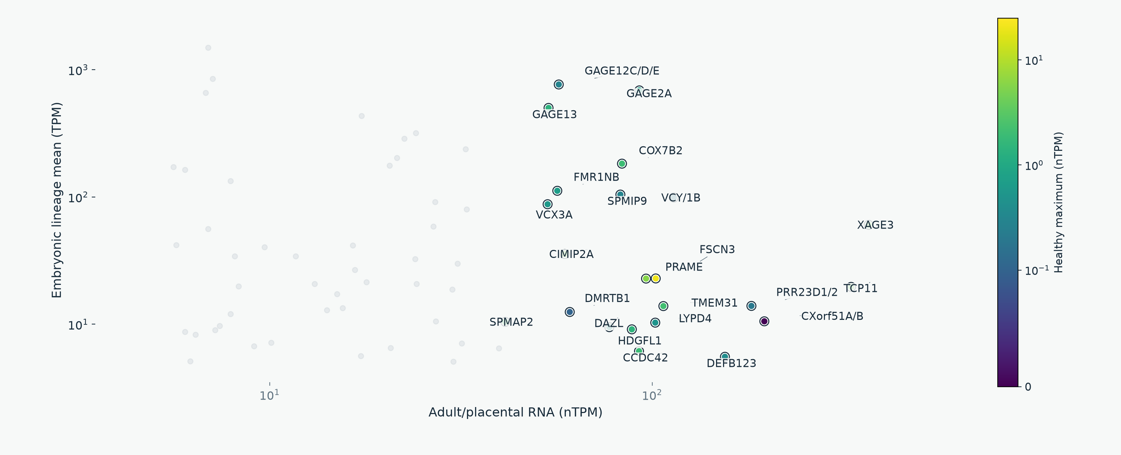
SELECTED CTA DETAIL
High adult/placental and embryonic RNA: labels 3 of 3
OncoRef CTA evidence walkthrough • 5 November 2026
38
Notes:
High adult/placental and embryonic RNA: labels 3 of 3
The three panels use identical axes and together label all selected proteins with reproductive nTPM ≥5 and measured embryonic lineage-mean TPM ≥5. This descriptive threshold does not replace developmental cell-support requirements. Color is the highest non-disposable healthy nTPM.
Report: https://pirl-unc.github.io/oncoref/audits/cta-source-walkthrough-20261028/
Policy: oncoref.cta-selection.2026-11-05.1
Decision snapshot SHA256: d9b4b9cd2367dc60cf755b7daa9c8e3325e09efb1e33d7de3aa3bc34673e49a3

Slide 39
DEVELOPMENTAL COVERAGE
Complementary embryonic measurements
Source | Measured cells / embryos | Developmental scope
Tyser et al. (2021) | 1,195 cells / 1 embryo | Gastrulation, Carnegie stage 7
Petropoulos et al. (2016) | 1,519 cells / 88 embryos | Preimplantation, days 3–7
Recovered coverage | 683 of 1,006 earlier missing proteins | Measured TPM, including familiar CTAs
PRAME, MAGE-A4, CTAG1A/B, XAGE1A/B and CT83 now have TPM rows
Each source keeps its own stages. Neither atlas covers all fetal or pediatric development.
OncoRef CTA evidence walkthrough • 5 November 2026
39
Notes:
Complementary embryonic measurements
Tyser E-MTAB-9388 https://doi.org/10.1038/s41586-021-04158-y . Petropoulos E-MTAB-3929 https://www.ebi.ac.uk/gxa/sc/experiments/E-MTAB-3929/Results . Sources retain their own stage, cell support and donor counts.
Report: https://pirl-unc.github.io/oncoref/audits/cta-source-walkthrough-20261028/
Policy: oncoref.cta-selection.2026-11-05.1
Decision snapshot SHA256: d9b4b9cd2367dc60cf755b7daa9c8e3325e09efb1e33d7de3aa3bc34673e49a3

Slide 40
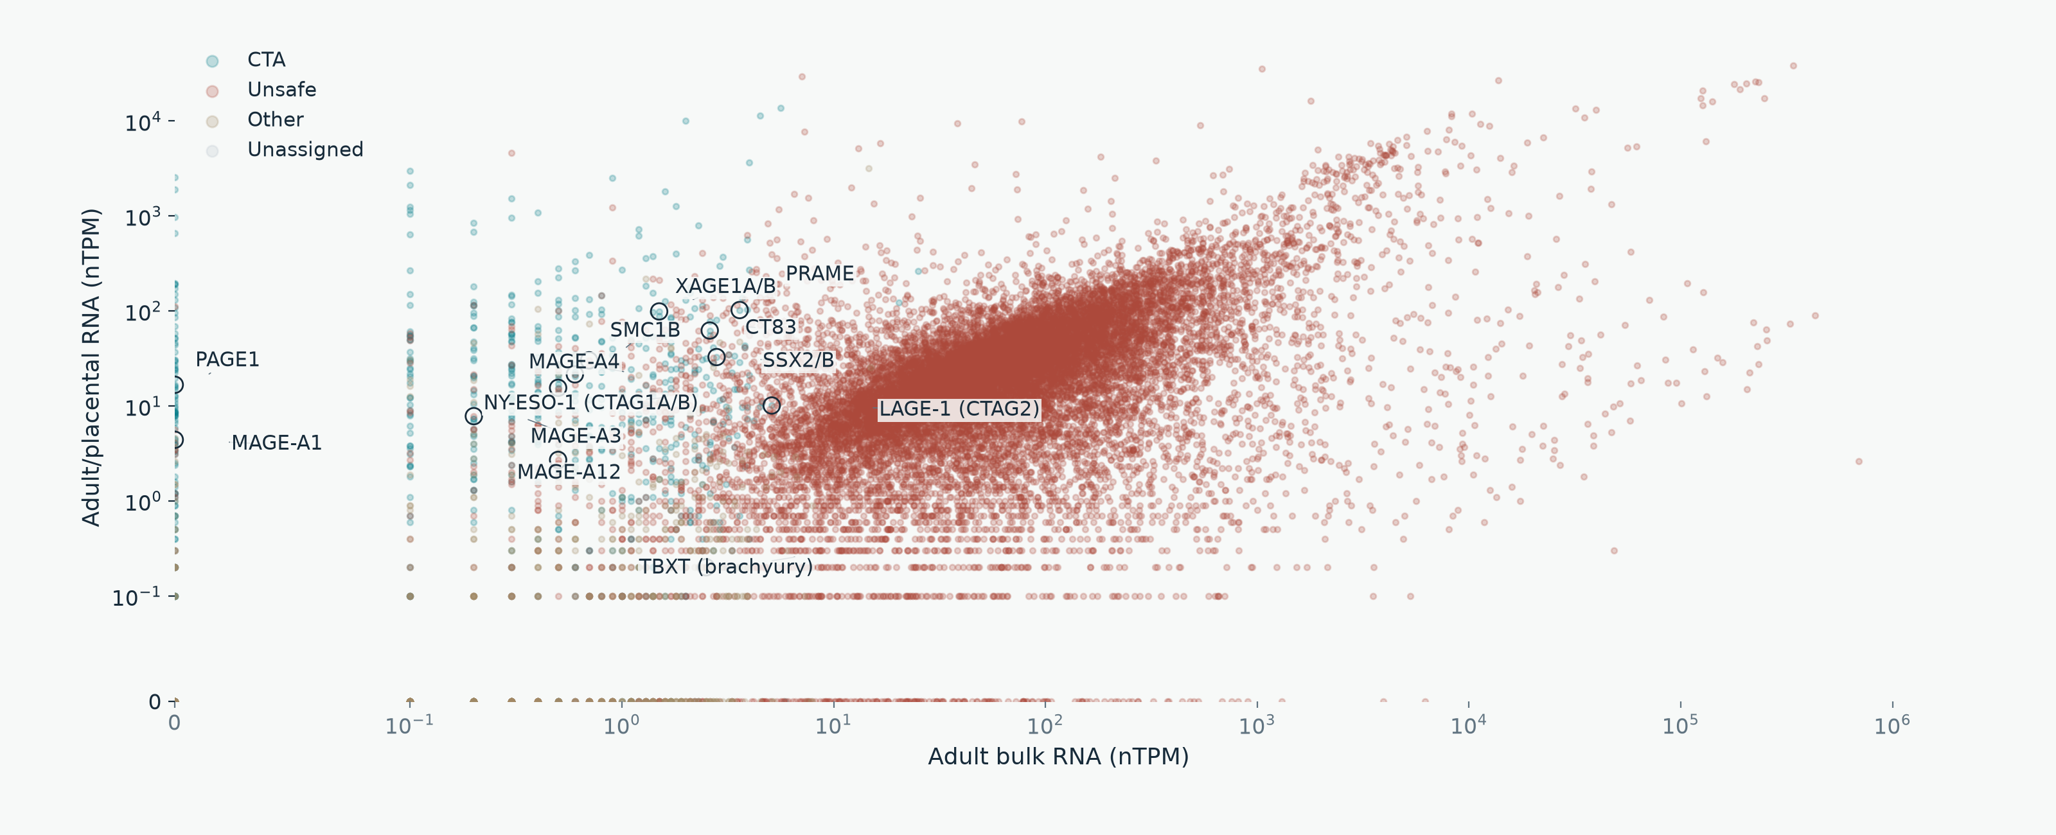
CURRENT ASSIGNMENTS
Widely studied antigens: adult/placental RNA
OncoRef CTA evidence walkthrough • 5 November 2026
40
Notes:
Widely studied antigens: adult/placental RNA
MAGE-A1 and MAGE-A3 are comparators, not admission controls. Full-width figures highlight PRAME, NY-ESO-1 (CTAG1A/B), XAGE1A/B, MAGE-A4, CT83, SSX2/B and TBXT. Missing embryonic measurements are in a separate band.
Report: https://pirl-unc.github.io/oncoref/audits/cta-source-walkthrough-20261028/
Policy: oncoref.cta-selection.2026-11-05.1
Decision snapshot SHA256: d9b4b9cd2367dc60cf755b7daa9c8e3325e09efb1e33d7de3aa3bc34673e49a3

Slide 41
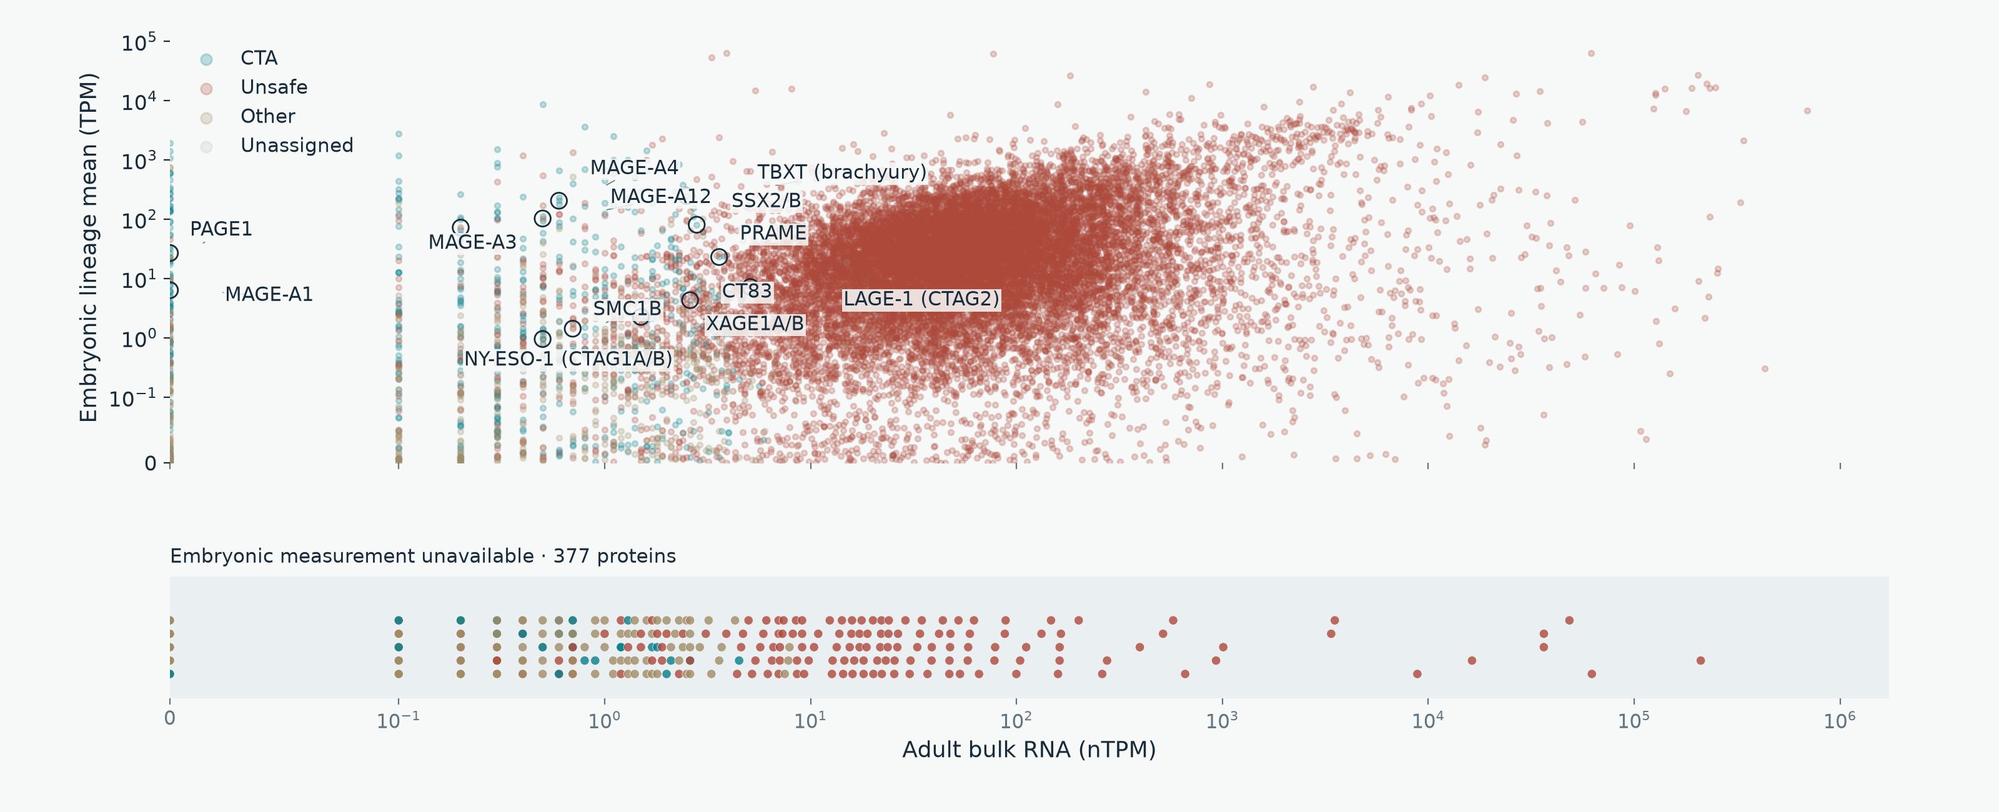
CURRENT ASSIGNMENTS
Widely studied antigens: embryonic RNA
OncoRef CTA evidence walkthrough • 5 November 2026
41
Notes:
Widely studied antigens: embryonic RNA
MAGE-A1 and MAGE-A3 are comparators, not admission controls. Full-width figures highlight PRAME, NY-ESO-1 (CTAG1A/B), XAGE1A/B, MAGE-A4, CT83, SSX2/B and TBXT. Missing embryonic measurements are in a separate band.
Report: https://pirl-unc.github.io/oncoref/audits/cta-source-walkthrough-20261028/
Policy: oncoref.cta-selection.2026-11-05.1
Decision snapshot SHA256: d9b4b9cd2367dc60cf755b7daa9c8e3325e09efb1e33d7de3aa3bc34673e49a3

Slide 42
READING THE RESULTS
Assessment status is separate from category
API status | Meaning | Human proteins
screened | Classification with a resolved applicable screen | 19,277
incomplete_evidence | Classified with disclosed evidence gaps | 105
normal_evidence_hold | Required normal coverage passes; a normal-screen hold remains | 118
translation_review | Selected primary translation needs qualification | 363
unassessed | No species-specific selection policy applied | 0
Other includes review holds and sequence rules. No human protein has a null category.
OncoRef CTA evidence walkthrough • 5 November 2026
42
Notes:
Assessment status is separate from category
A category can be assigned despite gaps in optional or irrelevant sources. Screened does not mean clinically safe or fully measured. MAGE-A3 has measured colon counterevidence. An independent developmental measurement cannot erase it.
Report: https://pirl-unc.github.io/oncoref/audits/cta-source-walkthrough-20261028/
Policy: oncoref.cta-selection.2026-11-05.1
Decision snapshot SHA256: d9b4b9cd2367dc60cf755b7daa9c8e3325e09efb1e33d7de3aa3bc34673e49a3

Slide 43
COVERAGE AUDIT
Which sources have incomplete evidence
Source or unresolved evidence | Proteins
HPA v23 consensus bulk | 88
Combined normal bulk: HPA consensus + HPA brain + direct GTEx | 85
HPA v23 tissue-cell clusters | 69
HPA v23 immune cells | 45
Monaco immune cells via HPA v23 | 45
GTEx v11 core panel (52 contexts; informational, not required) | 58
Combined Tyser + Petropoulos TPM | 57
No tumor measurement: OncoRef + HPA | 28
Measured tumor, incomplete member coverage | 1
HPA v23 Uncertain normal-tissue IHC | 20
Overlapping gaps within 105 proteins with incomplete evidence. DICE and corneal coverage are optional.
OncoRef CTA evidence walkthrough • 5 November 2026
43
Notes:
Which sources have incomplete evidence
Source versions, complete missing tissue/cell contexts, member ENSG IDs, historical IDs, synonyms and tumor cohort coverage: https://pirl-unc.github.io/oncoref/audits/cta-source-walkthrough-20261028/coverage/ . Counts overlap and do not sum to a total.
Report: https://pirl-unc.github.io/oncoref/audits/cta-source-walkthrough-20261028/
Policy: oncoref.cta-selection.2026-11-05.1
Decision snapshot SHA256: d9b4b9cd2367dc60cf755b7daa9c8e3325e09efb1e33d7de3aa3bc34673e49a3

Slide 44
SPECIES-SPECIFIC EVIDENCE
Dog evidence and integration gaps
Layer | Available evidence / remaining gap
Nominations | 5 + 10 − 1 shared = 14 native nominations
Identity | 13 unique mappings; one ambiguous MAGE-family assay
Normal / developmental RNA | Bgee TPM and BarkBase TMM-CPM need reference reconciliation
Tumor RNA | GSE304066 count/FPKM and reference conflicts remain unresolved
Normal protein | Limited study IHC; Pfizer pooled iBAQ is not cell-resolved IHC
Selection | All 14 unassigned / unassessed; no canine quantitative policy
Human thresholds, antibody grades and normal-tissue absence never transfer by orthology.
OncoRef CTA evidence walkthrough • 5 November 2026
44
Notes:
Dog evidence and integration gaps
Nemec et al. (2019) https://doi.org/10.1111/vco.12475 ; Hindriks et al. (2025) https://doi.org/10.1016/j.vetimm.2025.110946 . Issues https://github.com/pirl-unc/oncoref/issues/574 and https://github.com/pirl-unc/oncoref/issues/585 .
Report: https://pirl-unc.github.io/oncoref/audits/cta-source-walkthrough-20261028/
Policy: oncoref.cta-selection.2026-11-05.1
Decision snapshot SHA256: d9b4b9cd2367dc60cf755b7daa9c8e3325e09efb1e33d7de3aa3bc34673e49a3

Slide 45
DEVELOPMENTAL NOMINATIONS
Curated oncofetal sources
Source | Scope and integration status
Tyser + Petropoulos | Current gastrulation and preimplantation TPM sources
Shaw et al. (2024) | 157 cancer-specific targets; six oncofetal annotations. Exon-specific scope retained
TRIM71 liver study (2024) | Liver oncofetal signature; requires identity and measurement ingestion
Cardoso-Moreira et al. (2019) | Developmental organ trajectories with child/adult comparisons; not integrated
Published nominations need independent normal/tumor filtering and postnatal coverage.
OncoRef CTA evidence walkthrough • 5 November 2026
45
Notes:
Curated oncofetal sources
Shaw et al. (2024) https://doi.org/10.1038/s41467-024-47649-y ; TRIM71 liver study https://pmc.ncbi.nlm.nih.gov/articles/PMC11388079/ ; Cardoso-Moreira et al. (2019) https://pmc.ncbi.nlm.nih.gov/articles/PMC6658352/ . Newly identified sources are not in current selection counts.
Report: https://pirl-unc.github.io/oncoref/audits/cta-source-walkthrough-20261028/
Policy: oncoref.cta-selection.2026-11-05.1
Decision snapshot SHA256: d9b4b9cd2367dc60cf755b7daa9c8e3325e09efb1e33d7de3aa3bc34673e49a3

Slide 46
API
Common API with native evidence underneath
results = cta_selection.results(species="human")
audit = cta_selection.audit(species="human")
audit.sources audit.overlaps audit.funnel
audit.explain("PRAME")
Field | Meaning
category | CTA / Unsafe / Other; classification gives the named category
assessment_status | Screened, evidence/translation review, or unassessed
classification / subtype | One categorical label; Other subtype always populated
Source-specific native units, tissue/cell context, confidence and coverage remain inspectable.
OncoRef CTA evidence walkthrough • 5 November 2026
46
Notes:
Common API with native evidence underneath
Human, dog and mouse share schema and explicit unavailable states. Data are offline and checksum-verified. Frozen release reports remain unchanged.
Report: https://pirl-unc.github.io/oncoref/audits/cta-source-walkthrough-20261028/
Policy: oncoref.cta-selection.2026-11-05.1
Decision snapshot SHA256: d9b4b9cd2367dc60cf755b7daa9c8e3325e09efb1e33d7de3aa3bc34673e49a3

Slide 47
DATA API
Every source resolves to a concrete version
catalog.ensure("gtex_tissue_rna") # v11
catalog.ensure("gtex_tissue_rna", version="v10")
catalog.provenance("gtex_tissue_rna", "v11")
Shared choice | Source-specific meaning
Default / latest | Newest registered release; saved runs keep explicit pins
Concrete version | GTEx v11; HPA v25.1; a study snapshot or OncoRef build
Provenance | Version, content checksum, native unit, annotation and pipeline
Species | The same selector applies to native dog and mouse assets
This analysis pins GTEx v11 and HPA v23 normal panels. A newer public default does not rewrite it.
OncoRef CTA evidence walkthrough • 5 November 2026
47
Notes:
Every source resolves to a concrete version
Data version API: https://pirl-unc.github.io/oncoref/data-versions/ . GTEx versions and pipelines: https://github.com/broadinstitute/gtex-pipeline/blob/master/rnaseq/README.md . HPA current RNA snapshot: https://github.com/pirl-unc/oncoref/releases/tag/reference-hpa-v25.1-20261028 .
Report: https://pirl-unc.github.io/oncoref/audits/cta-source-walkthrough-20261028/
Policy: oncoref.cta-selection.2026-11-05.1
Decision snapshot SHA256: d9b4b9cd2367dc60cf755b7daa9c8e3325e09efb1e33d7de3aa3bc34673e49a3

