Slide 1
CURRENT SELECTION
Human and dog CTA evidence
548 human CTA groups
584 loci / 18,031 Unsafe / 20 Neither
1,264 unassigned; dog selection remains unassessed
Sources, expression profiles, single-cutoff filtering and measured tissue evidence.
OncoRef CTA evidence walkthrough • 28 October 2026
01
Notes:
Human and dog CTA evidence
One RNA ceiling. Neither requires an affirmative expression profile. Unassigned is an assessment status, not a biological category.
Report: https://pirl-unc.github.io/oncoref/audits/cta-source-walkthrough-20261028/
Policy: oncoref.cta-selection.2026-10-28
Decision snapshot SHA256: 7ef01de6115fb0cbe7220f8ebeea9ed457214731b637b2672399f87376e9f3a0

Slide 2
HUMAN ANNOTATIONS
Published candidate lists
Paper | Groups | CTA | Unsafe | Neither | Unassigned
da Silva et al. (2017) | 1,017 | 376 | 401 | 1 | 239
Wang et al. (2016) | 988 | 264 | 640 | 1 | 83
Chang et al. (2019) | 985 | 285 | 639 | 0 | 61
Gong et al. (2021) | 729 | 337 | 306 | 0 | 86
Bruggeman et al. (2018) | 692 | 23 | 663 | 0 | 6
Jamin et al. (2021) | 469 | 34 | 427 | 0 | 8
Loriot et al. (2025) | 202 | 81 | 101 | 0 | 20
Carter et al. (2023) | 103 | 57 | 37 | 0 | 9
Hirbo et al. (2015) | 78 | 12 | 64 | 0 | 2
Seager et al. (2024) | 15 | 11 | 2 | 0 | 2
Sasaroli et al. (2011) | 13 | 0 | 13 | 0 | 0
Garg et al. (2007) | 5 | 3 | 2 | 0 | 0
Union: 2,514 groups / 2,570 loci. 438 selected groups have an annotation; 110 do not.
OncoRef CTA evidence walkthrough • 28 October 2026
02
Notes:
Published candidate lists
da Silva et al. (2017): https://doi.org/10.18632/oncotarget.21715
Wang et al. (2016): https://doi.org/10.1038/ncomms10499
Chang et al. (2019): https://doi.org/10.1002/cam4.2223
Gong et al. (2021): https://doi.org/10.1038/s41467-021-22695-y
Bruggeman et al. (2018): https://doi.org/10.1038/s41388-018-0357-2
Jamin et al. (2021): https://doi.org/10.1002/1878-0261.12900
Loriot et al. (2025): https://doi.org/10.1371/journal.pgen.1011734
Carter et al. (2023): https://doi.org/10.1136/jitc-2023-007935
Hirbo et al. (2015): https://doi.org/10.1371/journal.pone.0144155
Seager et al. (2024): https://doi.org/10.1186/s12967-024-04918-0
Sasaroli et al. (2011): https://doi.org/10.4161/cbt.12.3.16260
Garg et al. (2007): https://doi.org/10.1158/1078-0432.CCR-06-2340
Report: https://pirl-unc.github.io/oncoref/audits/cta-source-walkthrough-20261028/
Policy: oncoref.cta-selection.2026-10-28
Decision snapshot SHA256: 7ef01de6115fb0cbe7220f8ebeea9ed457214731b637b2672399f87376e9f3a0

Slide 3
PUBLICATION SCOPE
Broader published nominations
Paper | Published scope | Identity accounting
Sasaroli et al. (2011) | 13 detailed tumor-vascular candidates | 13 matched genes
Hirbo et al. (2015) | 86 placenta-enriched genes, including 30 fast-evolving | 82 matched, 4 unresolved
Compact source view | Bai, Boël and Bradley covered by larger sets | All memberships retained
Garg et al. (2007) | Still uniquely contributes SPAG9 | Retained in main view
Vascular and placental nominations retain their scope. Paper membership never bypasses the quantitative funnel.
OncoRef CTA evidence walkthrough • 28 October 2026
03
Notes:
Broader published nominations
Sasaroli et al. (2011) https://doi.org/10.4161/cbt.12.3.16260 . Hirbo et al. (2015) https://doi.org/10.1371/journal.pone.0144155 . Exact extracted rows and matching receipts accompany the report.
Report: https://pirl-unc.github.io/oncoref/audits/cta-source-walkthrough-20261028/
Policy: oncoref.cta-selection.2026-10-28
Decision snapshot SHA256: 7ef01de6115fb0cbe7220f8ebeea9ed457214731b637b2672399f87376e9f3a0

Slide 4
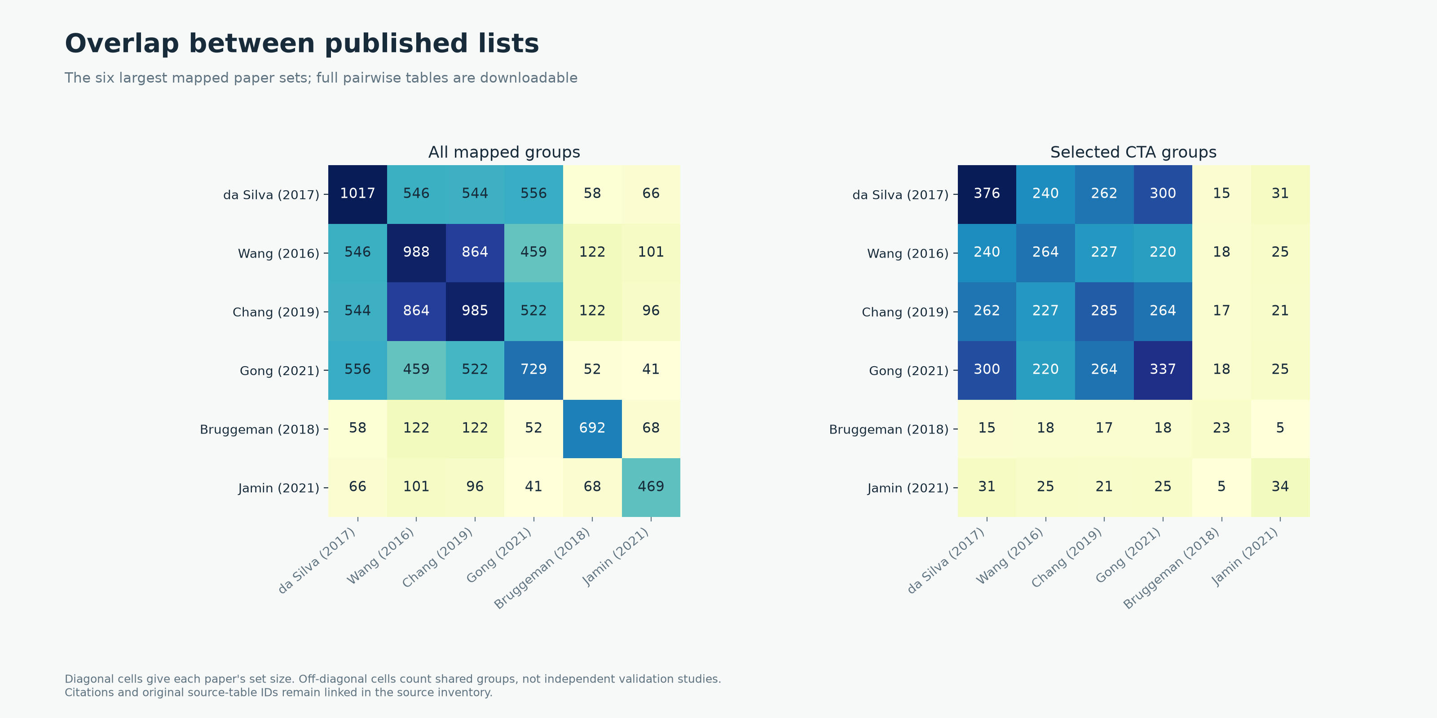
HUMAN ANNOTATIONS
Overlap between published lists
OncoRef CTA evidence walkthrough • 28 October 2026
04
Notes:
Overlap between published lists
Tables and author-recognized prior antigens within the same paper are unioned. Evidence roles, source IDs and pairwise counts accompany the report.
Report: https://pirl-unc.github.io/oncoref/audits/cta-source-walkthrough-20261028/
Policy: oncoref.cta-selection.2026-10-28
Decision snapshot SHA256: 7ef01de6115fb0cbe7220f8ebeea9ed457214731b637b2672399f87376e9f3a0

Slide 5
POSITIVE EXPRESSION CONTEXTS
Reproductive and developmental association
Qualifying route | Entrants | Final CTA
Reproductive only | 759 | 298
Developmental only | 11,717 | 172
Both | 1,288 | 78
Whole-reference RNA measurements create this set
This is not a 12,000-gene literature list. Embryonic presence does not establish developmental restriction.
OncoRef CTA evidence walkthrough • 28 October 2026
05
Notes:
Reproductive and developmental association
Tyser et al. (2021): https://doi.org/10.1038/s41586-021-04158-y . HPA v23 https://v23.proteinatlas.org/about/download .
Report: https://pirl-unc.github.io/oncoref/audits/cta-source-walkthrough-20261028/
Policy: oncoref.cta-selection.2026-10-28
Decision snapshot SHA256: 7ef01de6115fb0cbe7220f8ebeea9ed457214731b637b2672399f87376e9f3a0

Slide 6
HUMAN EVIDENCE
Normal and cancer measurement sources
Evidence | Source | Quantity
Normal / reproductive bulk | HPA consensus + HPA brain + direct GTEx | nTPM / TPM
Normal tissue cells | HPA clusters, at least 20 reads | nTPM
Immune cells | HPA / Monaco / original DICE | Native nTPM / TPM
Adult cornea | Collin et al., GSE155683 | CP10K
Normal protein | HPA + curated external IHC | Staining / reagent confidence
Cancer | 132 compatible OncoRef cohort views + HPA | TPM / protein-coding TPM
Developmental | Tyser gastrulation + Petropoulos preimplantation | Stage / lineage mean TPM
DICE and corneal coverage are optional. Measured counterevidence still contributes.
OncoRef CTA evidence walkthrough • 28 October 2026
06
Notes:
Normal and cancer measurement sources
HPA https://v23.proteinatlas.org/about/download ; DICE https://dice-database.org/ ; cornea https://www.ncbi.nlm.nih.gov/geo/query/acc.cgi?acc=GSE155683 ; Tyser https://doi.org/10.1038/s41586-021-04158-y . Full URLs and sample lineage accompany the report.
Report: https://pirl-unc.github.io/oncoref/audits/cta-source-walkthrough-20261028/
Policy: oncoref.cta-selection.2026-10-28
Decision snapshot SHA256: 7ef01de6115fb0cbe7220f8ebeea9ed457214731b637b2672399f87376e9f3a0

Slide 7
CURRENT POLICY
RNA cutoffs
Ceiling | Missing / unusable | Approved − | Supported − | Enhanced −
Vital | 4 | 8 | 16 | 32
Protected | 8 | 16 | 32 | 64
Manageable | 16 | 32 | 64 | 128
One boundary: above-cutoff Vital / Protected is Unsafe
Manageable excess blocks CTA. Bowel epithelium and identified fibroblasts use Manageable. Equality passes.
OncoRef CTA evidence walkthrough • 28 October 2026
07
Notes:
RNA cutoffs
The same nominal values apply across native TPM/nTPM assays. CP10K uses nominal /100, not a TPM conversion. Values are screening-policy choices, not measured toxicity limits.
Report: https://pirl-unc.github.io/oncoref/audits/cta-source-walkthrough-20261028/
Policy: oncoref.cta-selection.2026-10-28
Decision snapshot SHA256: 7ef01de6115fb0cbe7220f8ebeea9ed457214731b637b2672399f87376e9f3a0

Slide 8
CATEGORY DEFINITIONS
Neither requires a measured expression profile
Profile | Required evidence | Groups
Low expression | RNA below 2 across measured normal / reproductive / embryonic / tumor panels; no detected protein | 9
Diffuse Manageable | No association route; RNA ≥2 in at least two Manageable tissue concepts; no Vital / Protected exclusion | 11
Both require complete normal RNA coverage and resolved evidence. Other failures remain unassigned.
OncoRef CTA evidence walkthrough • 28 October 2026
08
Notes:
Neither requires a measured expression profile
Low means below the common 2-unit expression floor in every measured source, with required normal panels and tumor/developmental measurements. Missing optional DICE/cornea is disclosed. No detected protein is not proof of absence in every unmeasured tissue.
Report: https://pirl-unc.github.io/oncoref/audits/cta-source-walkthrough-20261028/
Policy: oncoref.cta-selection.2026-10-28
Decision snapshot SHA256: 7ef01de6115fb0cbe7220f8ebeea9ed457214731b637b2672399f87376e9f3a0

Slide 9
HUMAN FUNNEL
Every filtering layer can contribute
Final: 548 CTA / 18,031 Unsafe / 20 Neither / 1,264 unassigned.
OncoRef CTA evidence walkthrough • 28 October 2026
09
Notes:
Every filtering layer can contribute
The gray segment is held/unassigned evidence, not Neither. The final profile check assigns Neither. All layers evaluate every group; final categories are independent of display order.
Report: https://pirl-unc.github.io/oncoref/audits/cta-source-walkthrough-20261028/
Policy: oncoref.cta-selection.2026-10-28
Decision snapshot SHA256: 7ef01de6115fb0cbe7220f8ebeea9ed457214731b637b2672399f87376e9f3a0

Slide 10
HUMAN FUNNEL
Removals at each filter
Layer | First removals | Eligible | Unsafe
Association | 6,099 | 13,764 | 0
Tumor sample ≥2 TPM/pTPM | 10 | 13,754 | 0
HPA normal protein | 9,838 | 3,916 | 10,094
Required RNA coverage | 96 | 3,820 | 10,094
Normal bulk | 3,054 | 766 | 17,500
HPA tissue clusters | 185 | 581 | 17,914
HPA immune | 9 | 572 | 17,944
Monaco immune | 3 | 569 | 17,961
DICE immune | 16 | 553 | 18,016
Adult cornea | 3 | 550 | 18,028
Accepted normal-protein evidence | 1 | 549 | 18,030
Clinical safety exclusion | 1 | 548 | 18,031
External validated normal protein | 0 | 548 | 18,031
Neither expression profiles | 0 | 548 | 18,031
Every group remains available to every later evidence layer.
OncoRef CTA evidence walkthrough • 28 October 2026
10
Notes:
Removals at each filter
Sequential first removals depend on the displayed order; the independent-layer table reports overlaps.
Report: https://pirl-unc.github.io/oncoref/audits/cta-source-walkthrough-20261028/
Policy: oncoref.cta-selection.2026-10-28
Decision snapshot SHA256: 7ef01de6115fb0cbe7220f8ebeea9ed457214731b637b2672399f87376e9f3a0

Slide 11
ANATOMY AND EVIDENCE
IHC matching to measured RNA compartments
Context | Evidence and current ceiling
PRAME colon epithelial cells | 20.3 nTPM / 96 reads; Enhanced-negative glandular IHC; Manageable 128
PRAME adrenal bulk | 3.6 nTPM; incomplete compartment IHC coverage; Vital 4
CTAG2 bronchial basal cells | 24.9 nTPM / 58 reads; Enhanced-negative respiratory IHC; Vital 32
Unrelated cells in the same tissue | No negative-IHC credit without exact or declared compartment coverage
PRAME and CTAG2 pass this policy. Parent-compartment sensitivity and PRAME’s Low adrenal protein remain explicit limitations.
OncoRef CTA evidence walkthrough • 28 October 2026
11
Notes:
IHC matching to measured RNA compartments
HPA colon https://www.proteinatlas.org/learn/dictionary/normal/colon ; bronchus https://www.proteinatlas.org/learn/dictionary/normal/bronchus . Parent-compartment credit is a declared anatomical interpretation, not proof that all rare cells were sampled.
Report: https://pirl-unc.github.io/oncoref/audits/cta-source-walkthrough-20261028/
Policy: oncoref.cta-selection.2026-10-28
Decision snapshot SHA256: 7ef01de6115fb0cbe7220f8ebeea9ed457214731b637b2672399f87376e9f3a0

Slide 12
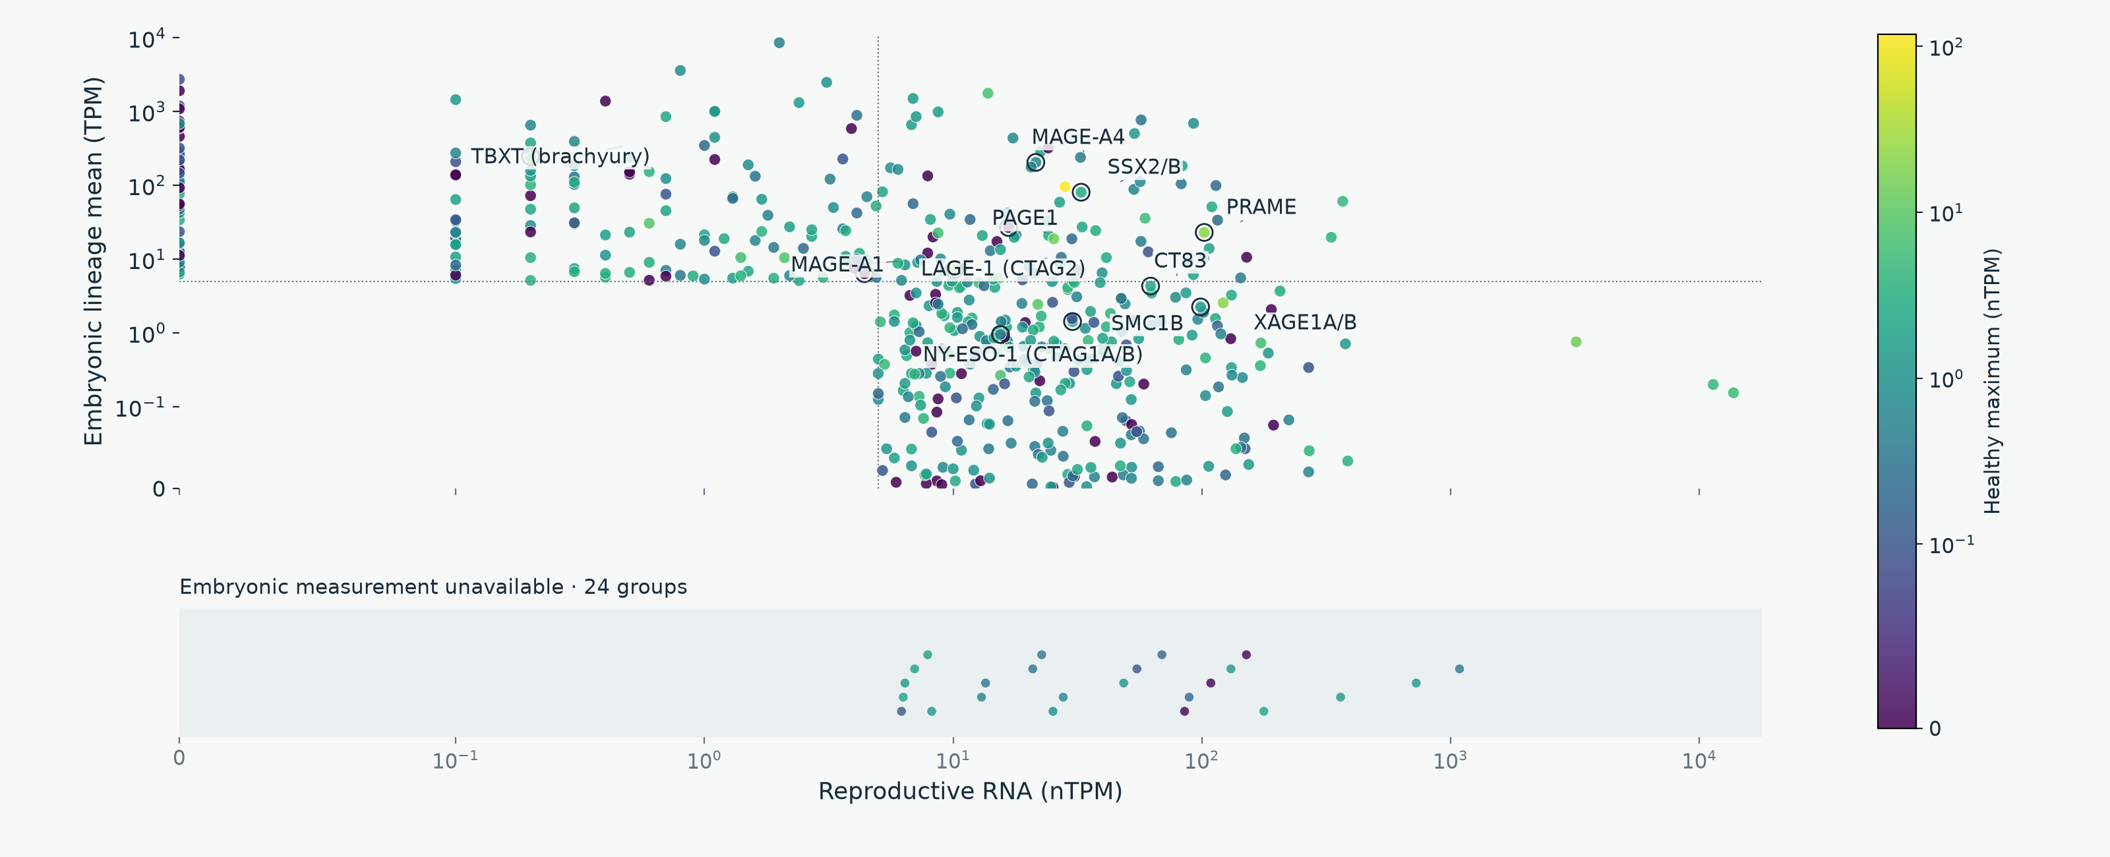
EXPRESSION DISTRIBUTIONS
Selected CTA: reproductive versus embryonic RNA
Gray: healthy measurement unavailable. The lower band has no embryonic-expression value.
OncoRef CTA evidence walkthrough • 28 October 2026
12
Notes:
Selected CTA: reproductive versus embryonic RNA
Color uses the highest supported non-disposable healthy expression within the stated native unit. There is no mixed-unit maximum. Labels include widely studied antigens with mapped values. Companion panels label all selected groups ≥5 on both axes. Missing embryonic measurements appear in a separate categorical band; every selected group is represented without zero filling.
Report: https://pirl-unc.github.io/oncoref/audits/cta-source-walkthrough-20261028/
Policy: oncoref.cta-selection.2026-10-28
Decision snapshot SHA256: 7ef01de6115fb0cbe7220f8ebeea9ed457214731b637b2672399f87376e9f3a0

Slide 13
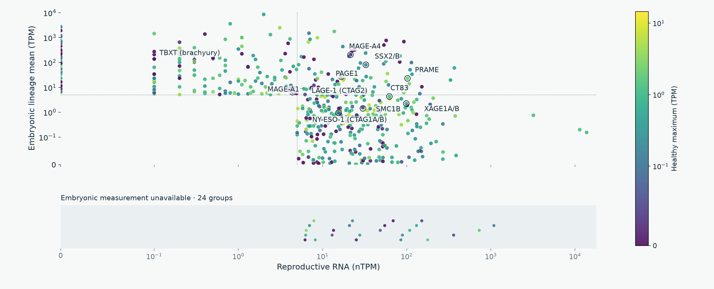
EXPRESSION DISTRIBUTIONS
Selected CTA: healthy RNA in TPM
Gray: healthy measurement unavailable. The lower band has no embryonic-expression value.
OncoRef CTA evidence walkthrough • 28 October 2026
13
Notes:
Selected CTA: healthy RNA in TPM
Color uses the highest supported non-disposable healthy expression within the stated native unit. There is no mixed-unit maximum. Labels include widely studied antigens with mapped values. Companion panels label all selected groups ≥5 on both axes. Missing embryonic measurements appear in a separate categorical band; every selected group is represented without zero filling.
Report: https://pirl-unc.github.io/oncoref/audits/cta-source-walkthrough-20261028/
Policy: oncoref.cta-selection.2026-10-28
Decision snapshot SHA256: 7ef01de6115fb0cbe7220f8ebeea9ed457214731b637b2672399f87376e9f3a0

Slide 14
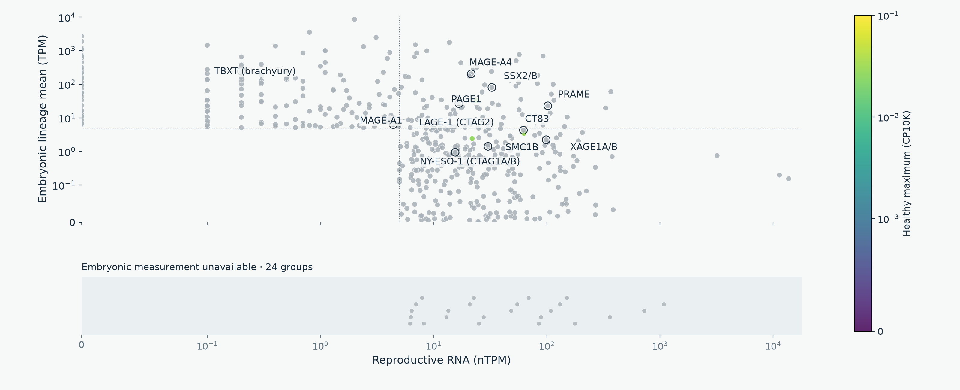
EXPRESSION DISTRIBUTIONS
Selected CTA: normal corneal RNA
Gray: healthy measurement unavailable. The lower band has no embryonic-expression value.
OncoRef CTA evidence walkthrough • 28 October 2026
14
Notes:
Selected CTA: normal corneal RNA
Color uses the highest supported non-disposable healthy expression within the stated native unit. There is no mixed-unit maximum. Labels include widely studied antigens with mapped values. Companion panels label all selected groups ≥5 on both axes. Missing embryonic measurements appear in a separate categorical band; every selected group is represented without zero filling.
Report: https://pirl-unc.github.io/oncoref/audits/cta-source-walkthrough-20261028/
Policy: oncoref.cta-selection.2026-10-28
Decision snapshot SHA256: 7ef01de6115fb0cbe7220f8ebeea9ed457214731b637b2672399f87376e9f3a0

Slide 15
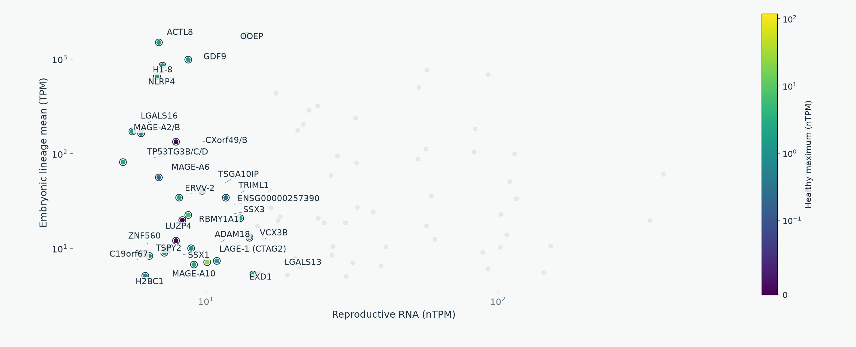
SELECTED CTA DETAIL
High reproductive and embryonic RNA: labels 1 of 3
OncoRef CTA evidence walkthrough • 28 October 2026
15
Notes:
High reproductive and embryonic RNA: labels 1 of 3
The three panels use identical axes and together label all selected groups with reproductive nTPM ≥5 and measured embryonic lineage-mean TPM ≥5. This descriptive threshold does not replace developmental cell-support requirements. Color is the highest non-disposable healthy nTPM.
Report: https://pirl-unc.github.io/oncoref/audits/cta-source-walkthrough-20261028/
Policy: oncoref.cta-selection.2026-10-28
Decision snapshot SHA256: 7ef01de6115fb0cbe7220f8ebeea9ed457214731b637b2672399f87376e9f3a0

Slide 16
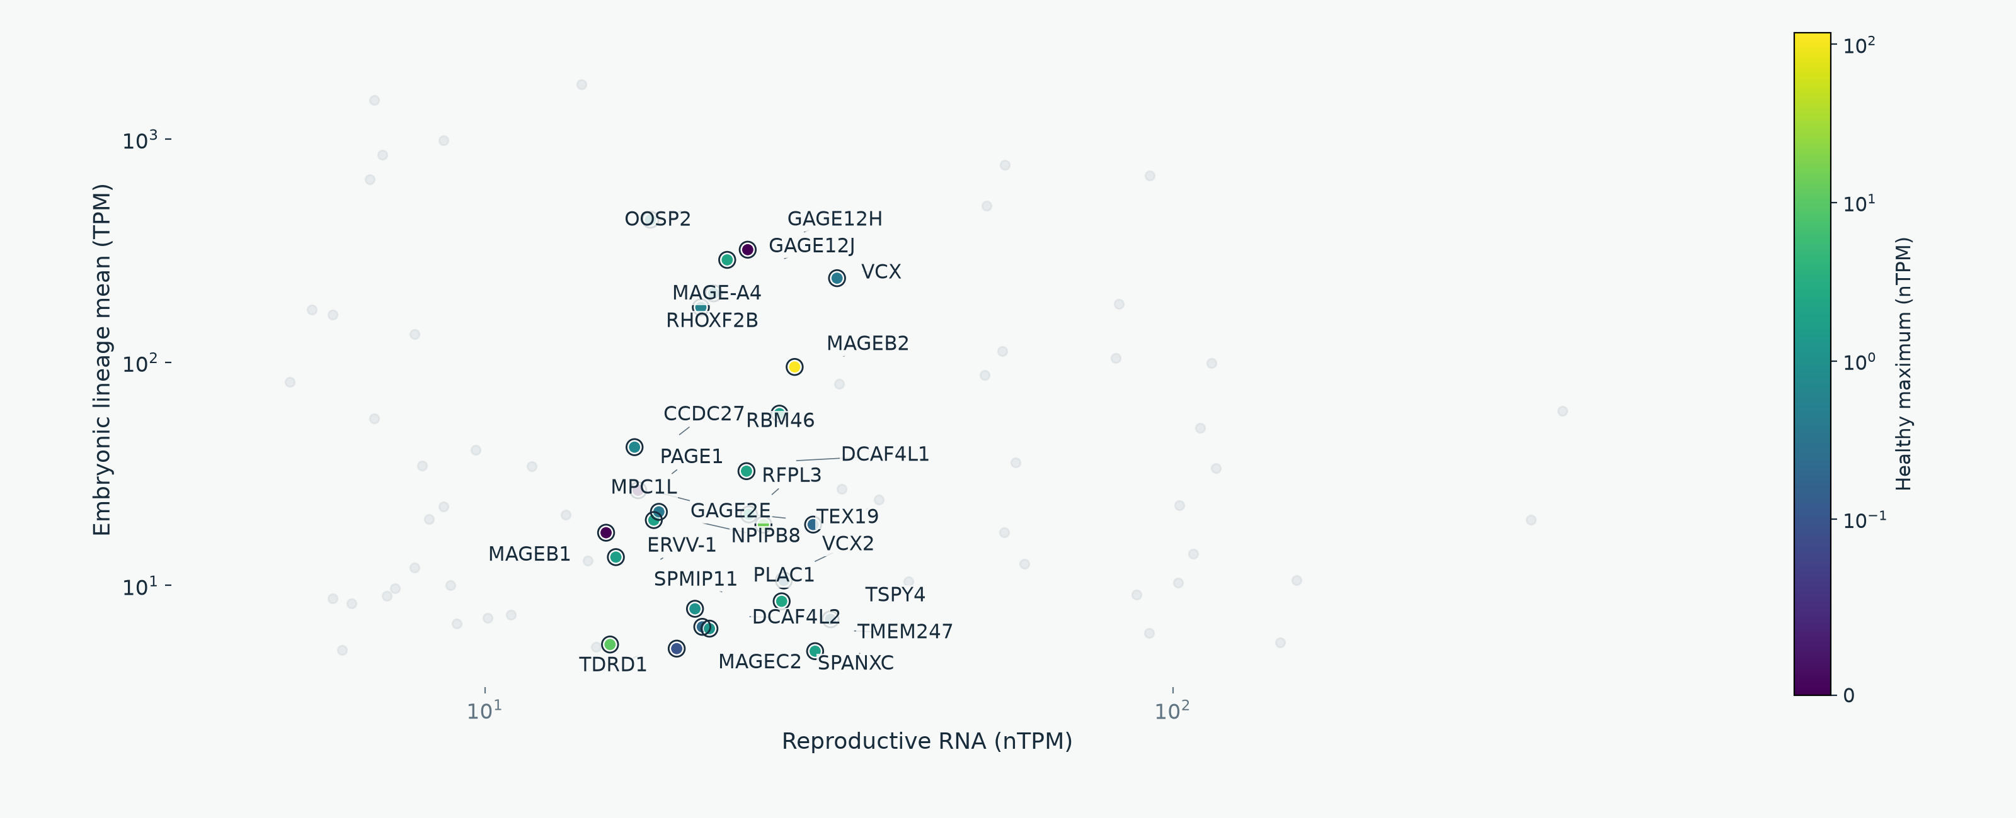
SELECTED CTA DETAIL
High reproductive and embryonic RNA: labels 2 of 3
OncoRef CTA evidence walkthrough • 28 October 2026
16
Notes:
High reproductive and embryonic RNA: labels 2 of 3
The three panels use identical axes and together label all selected groups with reproductive nTPM ≥5 and measured embryonic lineage-mean TPM ≥5. This descriptive threshold does not replace developmental cell-support requirements. Color is the highest non-disposable healthy nTPM.
Report: https://pirl-unc.github.io/oncoref/audits/cta-source-walkthrough-20261028/
Policy: oncoref.cta-selection.2026-10-28
Decision snapshot SHA256: 7ef01de6115fb0cbe7220f8ebeea9ed457214731b637b2672399f87376e9f3a0

Slide 17
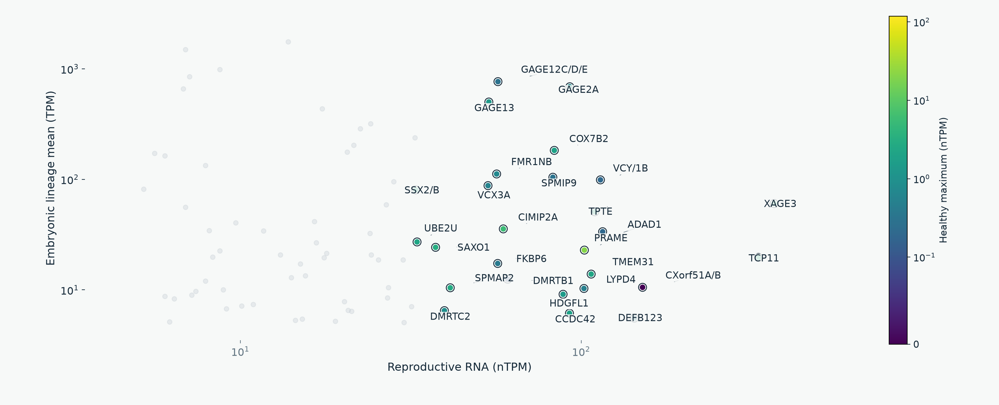
SELECTED CTA DETAIL
High reproductive and embryonic RNA: labels 3 of 3
OncoRef CTA evidence walkthrough • 28 October 2026
17
Notes:
High reproductive and embryonic RNA: labels 3 of 3
The three panels use identical axes and together label all selected groups with reproductive nTPM ≥5 and measured embryonic lineage-mean TPM ≥5. This descriptive threshold does not replace developmental cell-support requirements. Color is the highest non-disposable healthy nTPM.
Report: https://pirl-unc.github.io/oncoref/audits/cta-source-walkthrough-20261028/
Policy: oncoref.cta-selection.2026-10-28
Decision snapshot SHA256: 7ef01de6115fb0cbe7220f8ebeea9ed457214731b637b2672399f87376e9f3a0

Slide 18
DEVELOPMENTAL COVERAGE
Complementary embryonic measurements
Source | Measured cells / embryos | Developmental scope
Tyser et al. (2021) | 1,195 cells / 1 embryo | Gastrulation, Carnegie stage 7
Petropoulos et al. (2016) | 1,519 cells / 88 embryos | Preimplantation, days 3–7
Recovered coverage | 683 of 1,006 earlier missing groups | Measured TPM, including familiar CTAs
PRAME, MAGE-A4, CTAG1A/B, XAGE1A/B and CT83 now have TPM rows
Each source keeps its own stages. Neither atlas covers all fetal or pediatric development.
OncoRef CTA evidence walkthrough • 28 October 2026
18
Notes:
Complementary embryonic measurements
Tyser E-MTAB-9388 https://doi.org/10.1038/s41586-021-04158-y . Petropoulos E-MTAB-3929 https://www.ebi.ac.uk/gxa/sc/experiments/E-MTAB-3929/Results . Sources retain their own stage, cell support and donor counts.
Report: https://pirl-unc.github.io/oncoref/audits/cta-source-walkthrough-20261028/
Policy: oncoref.cta-selection.2026-10-28
Decision snapshot SHA256: 7ef01de6115fb0cbe7220f8ebeea9ed457214731b637b2672399f87376e9f3a0

Slide 19
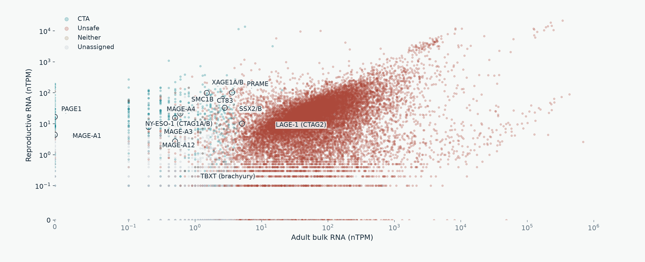
CURRENT ASSIGNMENTS
Widely studied antigens: reproductive RNA
OncoRef CTA evidence walkthrough • 28 October 2026
19
Notes:
Widely studied antigens: reproductive RNA
MAGE-A1 and MAGE-A3 are comparators, not admission controls. Full-width figures highlight PRAME, NY-ESO-1 (CTAG1A/B), XAGE1A/B, MAGE-A4, CT83, SSX2/B and TBXT. Missing embryonic measurements are in a separate band.
Report: https://pirl-unc.github.io/oncoref/audits/cta-source-walkthrough-20261028/
Policy: oncoref.cta-selection.2026-10-28
Decision snapshot SHA256: 7ef01de6115fb0cbe7220f8ebeea9ed457214731b637b2672399f87376e9f3a0

Slide 20
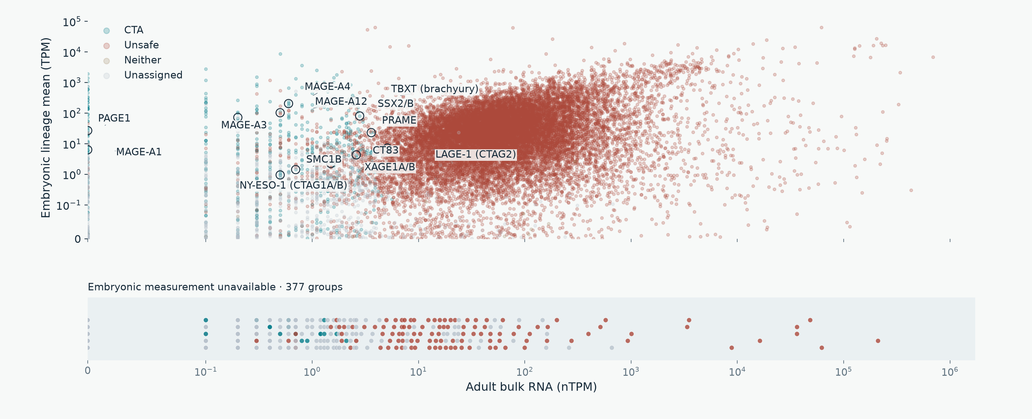
CURRENT ASSIGNMENTS
Widely studied antigens: embryonic RNA
OncoRef CTA evidence walkthrough • 28 October 2026
20
Notes:
Widely studied antigens: embryonic RNA
MAGE-A1 and MAGE-A3 are comparators, not admission controls. Full-width figures highlight PRAME, NY-ESO-1 (CTAG1A/B), XAGE1A/B, MAGE-A4, CT83, SSX2/B and TBXT. Missing embryonic measurements are in a separate band.
Report: https://pirl-unc.github.io/oncoref/audits/cta-source-walkthrough-20261028/
Policy: oncoref.cta-selection.2026-10-28
Decision snapshot SHA256: 7ef01de6115fb0cbe7220f8ebeea9ed457214731b637b2672399f87376e9f3a0

Slide 21
READING THE RESULTS
Assessment status is separate from category
API status | Meaning | Human groups
screened | CTA, Unsafe or Neither assigned | 18,599
incomplete_evidence | Unassigned with missing coverage or unresolved evidence | 617
outside_category_definitions | Tracked coverage checks pass; no definition fits | 647
unassessed | No species-specific selection policy applied | 0
Neither requires a measured biological profile. Unassigned does not mean Unsafe or low expression.
OncoRef CTA evidence walkthrough • 28 October 2026
21
Notes:
Assessment status is separate from category
A category can be assigned despite gaps in optional or irrelevant sources. Screened does not mean clinically safe or fully measured. MAGE-A3 has measured colon counterevidence. An independent developmental measurement cannot erase it.
Report: https://pirl-unc.github.io/oncoref/audits/cta-source-walkthrough-20261028/
Policy: oncoref.cta-selection.2026-10-28
Decision snapshot SHA256: 7ef01de6115fb0cbe7220f8ebeea9ed457214731b637b2672399f87376e9f3a0

Slide 22
COVERAGE AUDIT
Which sources have incomplete evidence
Source or unresolved evidence | Groups
HPA v23 consensus bulk | 414
Combined normal bulk: HPA consensus + HPA brain + direct GTEx | 366
HPA v23 tissue-cell clusters | 335
HPA v23 immune cells | 304
Monaco immune cells via HPA v23 | 304
Combined Tyser + Petropoulos TPM | 296
No tumor measurement: OncoRef + HPA | 34
Measured tumor, incomplete group profile | 17
HPA v23 Uncertain normal-tissue IHC | 28
Overlapping gaps within 617 unassigned groups. DICE and corneal coverage are optional.
OncoRef CTA evidence walkthrough • 28 October 2026
22
Notes:
Which sources have incomplete evidence
Source versions, complete missing tissue/cell contexts, member ENSG IDs, historical IDs, synonyms and tumor cohort coverage: https://pirl-unc.github.io/oncoref/audits/cta-source-walkthrough-20261028/coverage/ . Counts overlap and do not sum to a total.
Report: https://pirl-unc.github.io/oncoref/audits/cta-source-walkthrough-20261028/
Policy: oncoref.cta-selection.2026-10-28
Decision snapshot SHA256: 7ef01de6115fb0cbe7220f8ebeea9ed457214731b637b2672399f87376e9f3a0

Slide 23
SPECIES-SPECIFIC EVIDENCE
Dog evidence and integration gaps
Layer | Available evidence / remaining gap
Nominations | 5 + 10 − 1 shared = 14 native nominations
Identity | 13 unique mappings; one ambiguous MAGE-family assay
Normal / developmental RNA | Bgee TPM and BarkBase TMM-CPM need reference reconciliation
Tumor RNA | GSE304066 count/FPKM and reference conflicts remain unresolved
Normal protein | Limited study IHC; Pfizer pooled iBAQ is not cell-resolved IHC
Selection | All 14 unassigned / unassessed; no canine quantitative policy
Human thresholds, antibody grades and normal-tissue absence never transfer by orthology.
OncoRef CTA evidence walkthrough • 28 October 2026
23
Notes:
Dog evidence and integration gaps
Nemec et al. (2019) https://doi.org/10.1111/vco.12475 ; Hindriks et al. (2025) https://doi.org/10.1016/j.vetimm.2025.110946 . Issues https://github.com/pirl-unc/oncoref/issues/574 and https://github.com/pirl-unc/oncoref/issues/585 .
Report: https://pirl-unc.github.io/oncoref/audits/cta-source-walkthrough-20261028/
Policy: oncoref.cta-selection.2026-10-28
Decision snapshot SHA256: 7ef01de6115fb0cbe7220f8ebeea9ed457214731b637b2672399f87376e9f3a0

Slide 24
DEVELOPMENTAL NOMINATIONS
Curated oncofetal sources
Source | Scope and integration status
Tyser + Petropoulos | Current gastrulation and preimplantation TPM sources
Shaw et al. (2024) | 157 cancer-specific targets; six oncofetal annotations. Exon-specific scope retained
TRIM71 liver study (2024) | Liver oncofetal signature; requires identity and measurement ingestion
Cardoso-Moreira et al. (2019) | Developmental organ trajectories with child/adult comparisons; not integrated
Published nominations need independent normal/tumor filtering and postnatal coverage.
OncoRef CTA evidence walkthrough • 28 October 2026
24
Notes:
Curated oncofetal sources
Shaw et al. (2024) https://doi.org/10.1038/s41467-024-47649-y ; TRIM71 liver study https://pmc.ncbi.nlm.nih.gov/articles/PMC11388079/ ; Cardoso-Moreira et al. (2019) https://pmc.ncbi.nlm.nih.gov/articles/PMC6658352/ . Newly identified sources are not in current selection counts.
Report: https://pirl-unc.github.io/oncoref/audits/cta-source-walkthrough-20261028/
Policy: oncoref.cta-selection.2026-10-28
Decision snapshot SHA256: 7ef01de6115fb0cbe7220f8ebeea9ed457214731b637b2672399f87376e9f3a0

Slide 25
API
Common API with native evidence underneath
results = cta_selection.results(species="human")
audit = cta_selection.audit(species="human")
audit.sources audit.overlaps audit.funnel
audit.explain("PRAME")
Field | Meaning
category | CTA / Unsafe / Neither, or null when unassigned
assessment_status | Screened, incomplete evidence, outside definitions, or unassessed
gene_ids / gene_identities | All group members, stable IDs, history and curated synonyms
Source-specific native units, tissue/cell context, confidence and coverage remain inspectable.
OncoRef CTA evidence walkthrough • 28 October 2026
25
Notes:
Common API with native evidence underneath
Human, dog and mouse share schema and explicit unavailable states. Data are offline and checksum-verified. Frozen release reports remain unchanged.
Report: https://pirl-unc.github.io/oncoref/audits/cta-source-walkthrough-20261028/
Policy: oncoref.cta-selection.2026-10-28
Decision snapshot SHA256: 7ef01de6115fb0cbe7220f8ebeea9ed457214731b637b2672399f87376e9f3a0

Slide 26
DATA API
Every source resolves to a concrete version
catalog.ensure("gtex_tissue_rna") # v11
catalog.ensure("gtex_tissue_rna", version="v10")
catalog.provenance("gtex_tissue_rna", "v11")
Shared choice | Source-specific meaning
Default / latest | Newest registered release; saved runs keep explicit pins
Concrete version | GTEx v11; HPA v25.1; a study snapshot or OncoRef build
Provenance | Version, content checksum, native unit, annotation and pipeline
Species | The same selector applies to native dog and mouse assets
This analysis pins GTEx v11 and HPA v23 normal panels. A newer public default does not rewrite it.
OncoRef CTA evidence walkthrough • 28 October 2026
26
Notes:
Every source resolves to a concrete version
Data version API: https://pirl-unc.github.io/oncoref/data-versions/ . GTEx versions and pipelines: https://github.com/broadinstitute/gtex-pipeline/blob/master/rnaseq/README.md . HPA current RNA snapshot: https://github.com/pirl-unc/oncoref/releases/tag/reference-hpa-v25.1-20261028 .
Report: https://pirl-unc.github.io/oncoref/audits/cta-source-walkthrough-20261028/
Policy: oncoref.cta-selection.2026-10-28
Decision snapshot SHA256: 7ef01de6115fb0cbe7220f8ebeea9ed457214731b637b2672399f87376e9f3a0

