Slide 1
OncoRef
CTA and oncofetal
selection
Sources, filtering evidence and tissue-specific RNA thresholds
215 genes in the current research selection
Exploratory cell-RNA calibration shown separately
Notes:
Snapshot 26 October 2026. Current policy is the 215-gene research selection on draft PR #642. No gene-wide clinical safety claim. https://github.com/pirl-unc/oncoref/pull/642

Slide 2
Two cutoffs, set by tissue and IHC evidence
Illustrative baseline cutoffs with absent or unusable IHC
Source / tissue tier | Unit | CTA | Reference
HPA cluster / vital | nTPM | 2 | 5
HPA cluster / protected | nTPM | 5 | 10
HPA cluster / manageable | nTPM | 10 | 20
HPA immune / vital | nTPM | 2 | 5
DICE or Monaco / vital | TPM | 2 | 5
Adult cornea / vital | CP10K | 1 | 2
Below CTA cutoff
Passes this RNA gate only
Between the cutoffs
Exclude from CTA selection
Retain as uncertain self evidence
At or above reference cutoff
RNA-supported exclusion review
Negative IHC: missing/uncertain ×1; Approved ×1.25; Supported ×1.5; Enhanced ×2
Relax only for matching tissue and cell type with a positive assay control. Reliable positive normal IHC excludes independently.
Support guards: clusters ≥20 reads; DICE ≥3 reported values; cornea ≥5 positive cells and ≥20 counts in ≥2 distinct groups.
Notes:
Illustrative calibration, not validated limits. Exact boundary equality excludes. Numbers are independent hypotheses by assay, not transfers from bulk RNA. IHC factors 1,1.25,1.5,2 apply to both cutoffs only for exact adult tissue and cell labels, negative staining, a reliable positive profile control, and no unresolved antibody concern. No IHC relaxation for activated immune states or unmatched corneal subtypes. No reproductive maximum rescue. An RNA exclusion is reference-review evidence, not confirmed protein or peptide presentation. https://www.proteinatlas.org/about/disclaimer
Audit and downloadable data: https://github.com/pirl-unc/oncoref/tree/cta-clinical-policy-1.21.0/docs/audits/cta-cell-thresholds-20261026

Slide 3
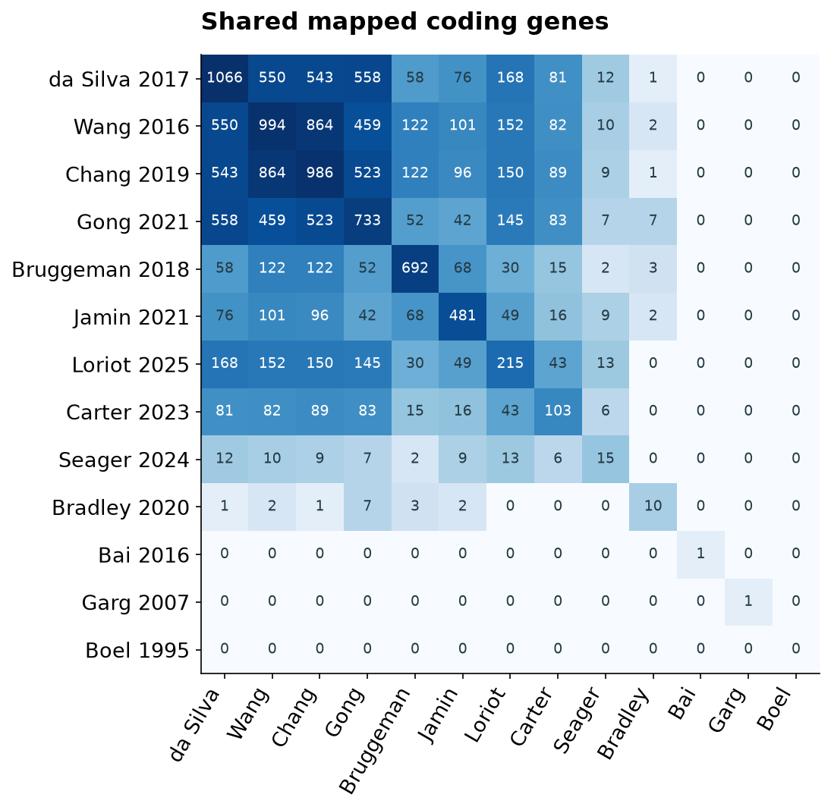
Nomination sources and their overlaps
Paper | Mapped | Selected
da Silva 2017 | 1066 | 187
Wang 2016 | 994 | 140
Chang 2019 | 986 | 162
Gong 2021 | 733 | 167
Bruggeman 2018 | 692 | 7
Jamin 2021 | 481 | 29
Loriot 2025 | 215 | 50
Carter 2023 | 103 | 30
Seager 2024 | 15 | 6
Bradley 2020 | 10 | 0
Bai 2016 | 1 | 0
Garg 2007 | 1 | 0
Boel 1995 | 0 | 0
2,538 paper nominees + 2 trial nominees = 2,540 unique genes
CLDN6 is explicitly oncofetal in the trial registry. Broad oncofetal signatures and developmental atlases are not yet ingested.
Notes:
Counts are deduplicated mapped coding genes per paper. Nested tables within a paper are unioned, not summed. The 13 registered papers yield 2,538 genes from 12 with mapped eligible identities. Boel BAGE remains an unresolved historical identity and contributes zero mapped loci. Trial evidence contributes two extra nominations, KIF20A and CLDN6, giving 2,540. The heatmap gives pairwise intersections including the diagonal. Source DOI links and complete membership are in nomination-sources.csv and nomination-membership.csv.gz.
Audit and downloadable data: https://github.com/pirl-unc/oncoref/tree/cta-clinical-policy-1.21.0/docs/audits/cta-cell-thresholds-20261026

Slide 4
Evidence used for normal-expression filtering
Evidence | Coverage / unit | Role
HPA bulk RNA | 2,534 genes / nTPM | Ceiling, reproductive selectivity, breadth
HPA IHC + primary antibodies | Tissue / cell reliability | Protein and assay conflicts
HPA tissue / cell clusters | 1,095 genes / nTPM | Rare-cell RNA, ≥20 reads
HPA and Monaco immune | 1,095 each / native nTPM or TPM | Sorted immune-cell RNA
Original DICE distributions | 2,537 genes / TPM, 15 groups | Recurrence and activated T cells
Adult corneal atlas | 1,071 genes / CP10K | Ocular cell types and sample groups
Donors, literature and clinical | Source and uncertainty records | Variability, protein and clinical context
Missing coverage remains unknown. RNA, protein staining and clinical outcomes retain separate meanings.
HPA DICE summaries are descriptive only. The current audit is a selected source extract, not complete atlas coverage.
Notes:
Coverage counts refer to the 2,540 current nominations in the pinned audit, not the full source databases. Bulk expression comes from HPA v23 consensus. Curated and primary antibody data must be distinguished. DICE summary and original DICE measurements are the same study, never independent replication. The adult corneal source is GSE155683, Collin et al. Donor summaries currently cover CTAG2 heart only, four donors. Clinical evidence qualifies development selection but does not prove normal expression absent. https://v23.proteinatlas.org/about/download https://pmc.ncbi.nlm.nih.gov/articles/PMC6289654/ https://pmc.ncbi.nlm.nih.gov/articles/PMC8343164/
Audit and downloadable data: https://github.com/pirl-unc/oncoref/tree/cta-clinical-policy-1.21.0/docs/audits/cta-cell-thresholds-20261026

Slide 5
The current filtering funnel
1,585 normal exclusions
Protein 845
RNA 603
High RNA 128
Other normal / safety 9
740 unresolved or ineligible
Assay and literature conflicts,
low admission evidence, cellular
RNA, selectivity or missing data
Historical selections: 740, 589, 436, 399, 213, then 215
215 = 204 expression passes + 9 supported admissions + 2 clinically qualified genes, PRAME and MAGE-A4. Historical steps are policy revisions.
Notes:
Current disjoint final categories: 2,540 nominations = 1,585 Unsafe + 740 Neither + 215 CTA. Unsafe detail: Protein 845, RNA 603, High RNA 128, Normal 8, Safety 1. Neither detail: Antibody 199, Low 196, Conflict 179, Cellular 70, Selectivity 64, Unassessed 31, Variable 1. These are assigned final reasons, not independent filter counts. Historical counts describe policy versions, not a single nested funnel: 758 pilot, 740 tightened selectivity and CTAG2 donor hold, 589 admission floor, 436 new evidence with one readmission, 399 high-RNA cap, 213 cell/protein review, 215 clinical qualification. The 436 transition removed 154 and readmitted CT55.
Audit and downloadable data: https://github.com/pirl-unc/oncoref/tree/cta-clinical-policy-1.21.0/docs/audits/cta-cell-thresholds-20261026

Slide 6
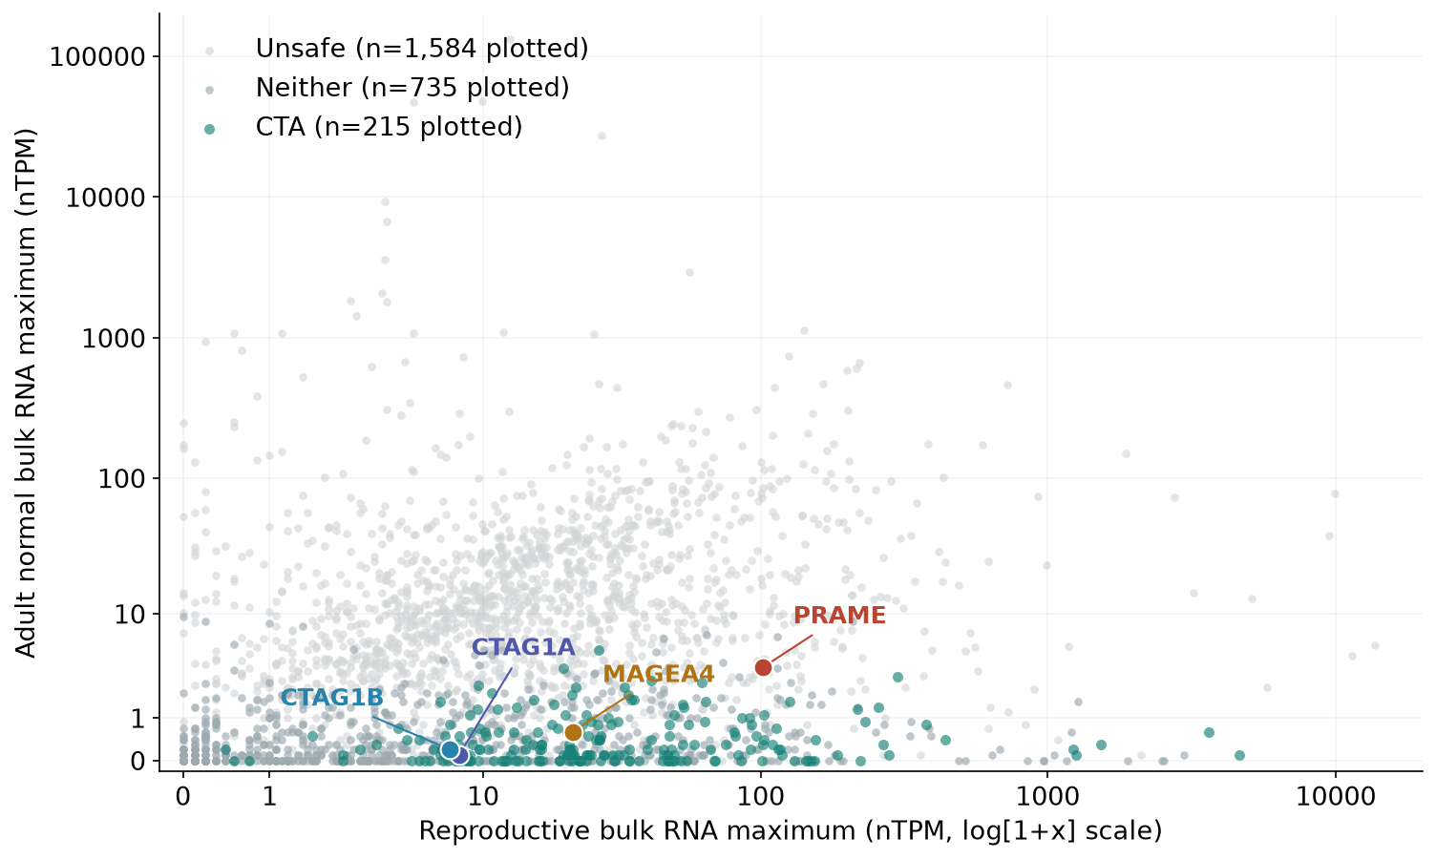
Where the named CTAs sit in bulk RNA
Gene | Repro. | Adult
PRAME | 102.2 | 3.6
MAGEA4 | 21.5 | 0.6
CTAG1A | 8.1 | 0.1
CTAG1B | 7.4 | 0.2
NY-ESO-1 is represented
by CTAG1A and CTAG1B.
Bulk averages can miss
cell-specific signals.
Both axes use bulk nTPM. Cell-cluster nTPM, immune TPM and corneal CP10K are evaluated separately.
Notes:
Source: HPA v23 bulk consensus, same source on both axes. Adult maximum is across vital, protected and manageable bulk compartments. Plotted missing values are omitted and plotted n is shown in the legend. Axes use log10(1+x) with raw nTPM tick labels. This display alone is not the selection rule. PRAME reproductive 102.2/adult 3.6; MAGEA4 21.5/0.6; CTAG1A 8.1/0.1; CTAG1B 7.4/0.2. Clinical qualification retains normal-expression caveats.
Audit and downloadable data: https://github.com/pirl-unc/oncoref/tree/cta-clinical-policy-1.21.0/docs/audits/cta-cell-thresholds-20261026

Slide 7
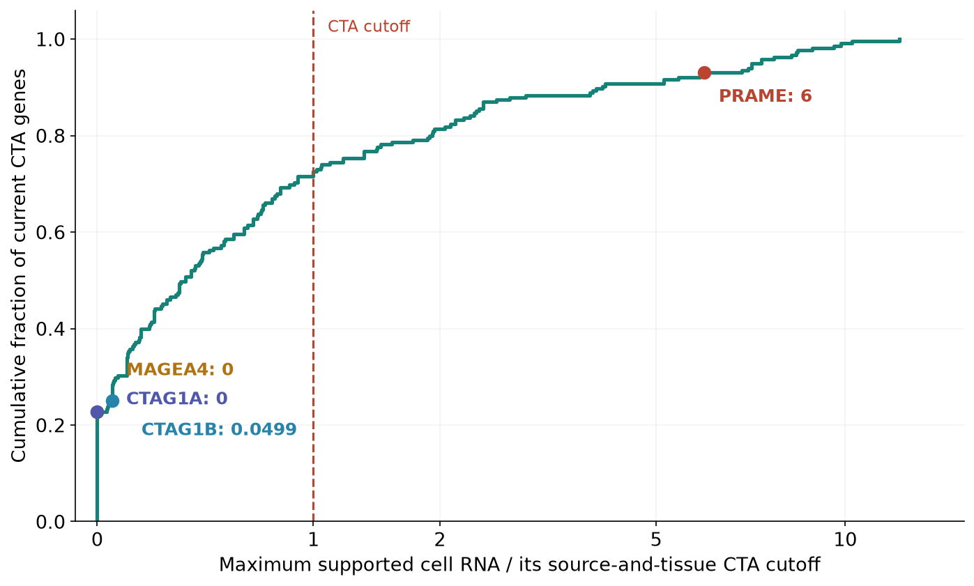
The stricter cell gate changes the shortlist
Illustrative overlay | N
Current selection | 215
Below added exclusion gate | 154
Middle zone | 33
Stronger RNA / protein layer | 28
PRAME crosses both cutoffs.
MAGE-A4 and NY-ESO-1
remain below the added gate.
Threshold sensitivity: 123 to 168 of 215 retained when the lower cutoffs vary from 0.5× to 1.5×.
Only 2,849 of 314,586 screened cell contexts have exact tissue/cell IHC matches. Stronger IHC quality cannot repair a missing cell-type match.
Notes:
Illustrative overlay only; current 215-gene membership is unchanged. 61 current targets cross the lower boundary: 33 middle-zone and 28 upper-layer exclusions. PRAME: heart fibroblasts 12 nTPM with cutoffs 2/5, colon undifferentiated cells 20.3 with cutoffs 5/10, vascular fibroblasts 2.8 with cutoffs 2/5. No exact matched negative IHC for these cells. MAGEA4 and CTAG1A/B remain below the supported cell-RNA cutoffs. The maximum normalized ratio is a screening display across separately evaluated assays; it is not pooled RNA expression or a validated risk score. All 215 have at least some supported normal-cell measurements, but coverage is incomplete.
Audit and downloadable data: https://github.com/pirl-unc/oncoref/tree/cta-clinical-policy-1.21.0/docs/audits/cta-cell-thresholds-20261026

Slide 8
Oncofetal intake and brachyury follow-up
Source / target | Current status | What it adds
CLDN6 clinical trial evidence | Included as a nomination | Explicit oncofetal target, product-specific outcomes
Su 2024 oncofetal liver signature | 200 reported genes, not imported | A broader fetal / tumor expression program
Gastrulation and organogenesis atlases | Assessed as sources, not ingested | Embryonic stage and lineage expression
Cao / DESCARTES fetal atlas | Assessed as a source, not ingested | Fetal organs, cell types and coverage
TBXT / brachyury | Not selected or currently nominated | Requires fetal admission and adult disc review
Developmental expression can expand nomination and admission, once measured in a calibrated source.
The adult normal-expression gate still applies. A high fetal signal cannot erase adult cell expression.
Su 2024 DOI: 10.7150/thno.99633. Its 200 genes are expression-program leads; overlap with the current intake is not yet computed.
Notes:
Current nomination registry has CLDN6 trial evidence explicitly labelled oncofetal but no general oncofetal signature intake. Su et al. 2024 identify a 200-gene oncofetal liver expression program, Table S1; these are nomination leads, not established restricted antigens. https://www.thno.org/v14p4948.htm DOI 10.7150/thno.99633. Developmental data sources: Tyser gastrulation https://www.nature.com/articles/s41586-021-04158-y ; Cao fetal organ atlas https://pubmed.ncbi.nlm.nih.gov/33184181/ ; organogenesis sources and stage metadata in docs/developmental-targets.md. TBXT is not among the 2,540 current nominees and is Neither in canonical results. Adult nucleus-pulposus evidence: https://pubmed.ncbi.nlm.nih.gov/28473691/ . Fetal corneal annotations exist in the registry but are not used as admission measurements. No direct nTPM threshold transfer to counts or CP10K.
Audit and downloadable data: https://github.com/pirl-unc/oncoref/tree/cta-clinical-policy-1.21.0/docs/audits/cta-cell-thresholds-20261026

