Slide 1
Pattern Theory
Presentation By Sahar Pirmoradian
Adapted from Ulf Grenander, Brown University

Slide 2
Pattern Theory
Not Pattern Recognition
  Not just classifying objects
A mathematical formalism, A pattern Algebra
  reconstructing the processes and events that produced real structures
  The genesis of the observation = Transformation of some ideal images using various transformations

Slide 3
Generators
Building blocks
  Generating observed signal
  Denoted by g
Generator Space: G
  The set of all generators

Slide 4

Similarity Group
To represent symmetries and invariance of patterns:
  Similarity Group S (Group of Transformations)
    s: elements of this group
    s is a bijective mapping:
    g₁ and g₂ are similar IF there exists a similarity s such that g₂ = sg₁

Slide 5
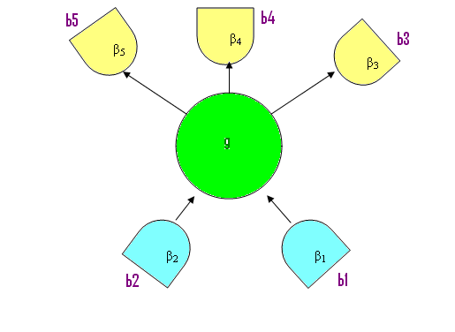
Bonds
  To build larger structures:
    Generators’ interfaces: Bonds (b)
      In the example: b1, b2, b3, b4, b5

Slide 6
Bonds
  Arity (ω(g)), the number of bonds of generator g
    In the example: ω (g)= 5
    ω_{in} (g) = 2
    ω_{out} (g) = 3

Slide 7
Bonds
  bond value (β):
    Assigned to each bond
    In the example:{β₁, β₂, β₃, β₄, β₅}
    IMPORTANT IN COMBINATION OF GENERATORS

Slide 8
Bonds
  Bond Structure is S-invariant:
    If g₁ and g₂ are similar => they have the same bond structure
  Bond Value is not S-invariant.

Slide 9
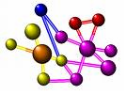
Configurations
Generators ~ Atoms
Configurations ~ Molecules

Slide 10
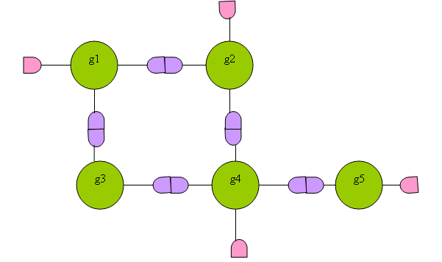
Configuration Diagram
Configuration c = σ(g₁, … g₅)
Internal bonds: connected bonds
External bonds

Slide 11
Bond Value Relation
In a connector graph σ
  ρ : Bond value relation
    ρ:B_{v} X B_{v} -> {True, False}
      B_{v}: set of bond values
    IF ρ (β_{i}, β_{j})= True => Pair (β_{i}, β_{j}) is REGULAR.
    IF ρ (β_{i}, β_{j})=False => Pair (β_{i}, β_{j}) is IRREGULAR.

Slide 12
Connection Type
Connection type: Σ
  The family of connector graphs σ(g₁, … g_{n})
    Σ = LINEAR
    Σ = TREE
    Σ = LATTICE

Slide 13

Regularity
A Configuration c is:
  Locally regular
    If all ρ of internal bonds are true
  Globally regular
If c is both Locally & Globally regular
  => c is Regular

Slide 14
Configuration Space
C(R): configuration space
  The set of all Regular Configurations
  Where R=<G, S, ρ, Σ >
  Referred to as a Regularity

Slide 15
Probabilities
ρ is binary
We should define:
  A continuum valued function
    Acceptor Function,
    A(.,.) on B x B, non-negative real value
  Q(.), non-negative weight function
    Making probabilities depend on generators themselves
  Z: partition function

Slide 16
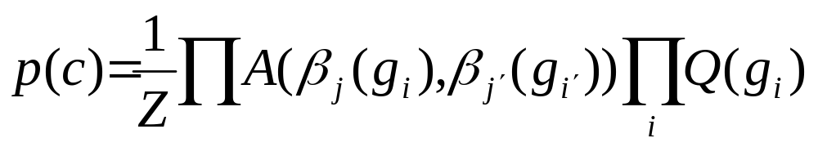
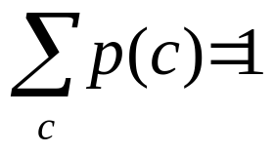
Probability
The probability of configuration c with the connector graph σ(g₁, … g_{n})

Slide 17
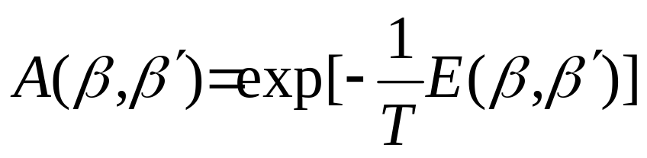
Energy
E: interaction energy
T: temperature, positive constant

Slide 18
Appendix

Slide 19
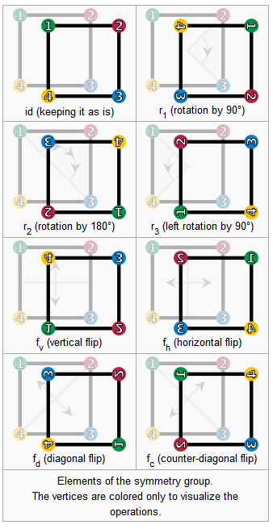
Symmetry Group
Symmetry =
  Rotation & Reflection
Elements:
  id, r1, r2, r3, fv, fh, fd, fc

Slide 20
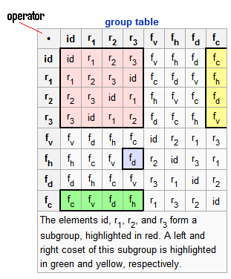
Symmetry Group
Closure
Associativity
Identity Element
Inverse Element

Slide 21
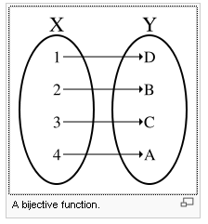
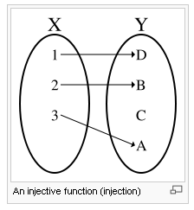
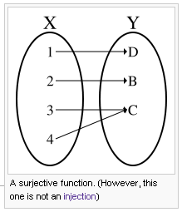
Bijective Function
bijective function is a function f from a set X to a set Y with the property that, for every y in Y, there is exactly one x in X such that
f(x) = y.

Slide 22
Permutation Group
permutation group is a group G whose elements are permutations of a given set M, and whose group operation is the composition of permutations in G (which are thought of as bijective functions from the set M to itself);

Slide 23
Permutation Group- Sample
e = (1)(2)(3)(4)
This is the identity, the trivial permutation which fixes each element.
a = (1 2)(3)(4) = (1 2)
This permutation interchanges 1 and 2, and fixes 3 and 4.
b = (1)(2)(3 4) = (3 4)
Like the previous one, but exchanging 3 and 4, and fixing the others.
ab = (1 2)(3 4)
This permutation, which is the composition of the previous two, exchanges simultaneously 1 with 2, and 3 with 4.

Slide 24
Permutation Group
the relationship is often written as (G,M). Note that the group of all permutations of a set is the symmetric group; the term permutation group is usually restricted to mean a subgroup of the symmetric group. The symmetric group of n elements is denoted by Sn.

Slide 25
Euclidean Space
A Sample of Euclidean Space:
  the sum of the angles in a triangle is always 180 degrees.
The surface of a sphere is not a Euclidean Space:
  The sum of the angles of a triangle on a sphere is greater than 180.

Slide 26
Euclidean Space
There is only one Euclidean space of each dimension.
While there are many non-Euclidean spaces of each dimension.

