Slide 1
Patterns of Thought
An application of Pattern Theory

Slide 2
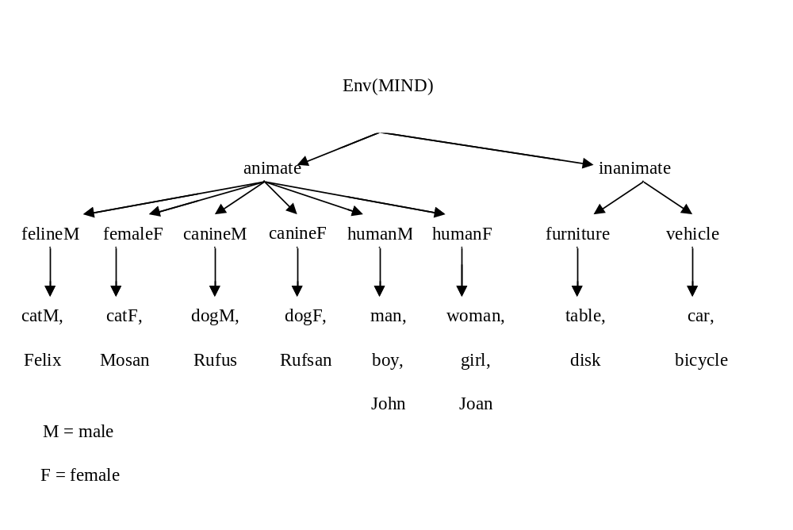
Patterns of Thought
Generators: physical things, non-physical things, events

Slide 3
Modality
G is partitioned into subsets:
  Modalities
  Color, Movement, …

Slide 4
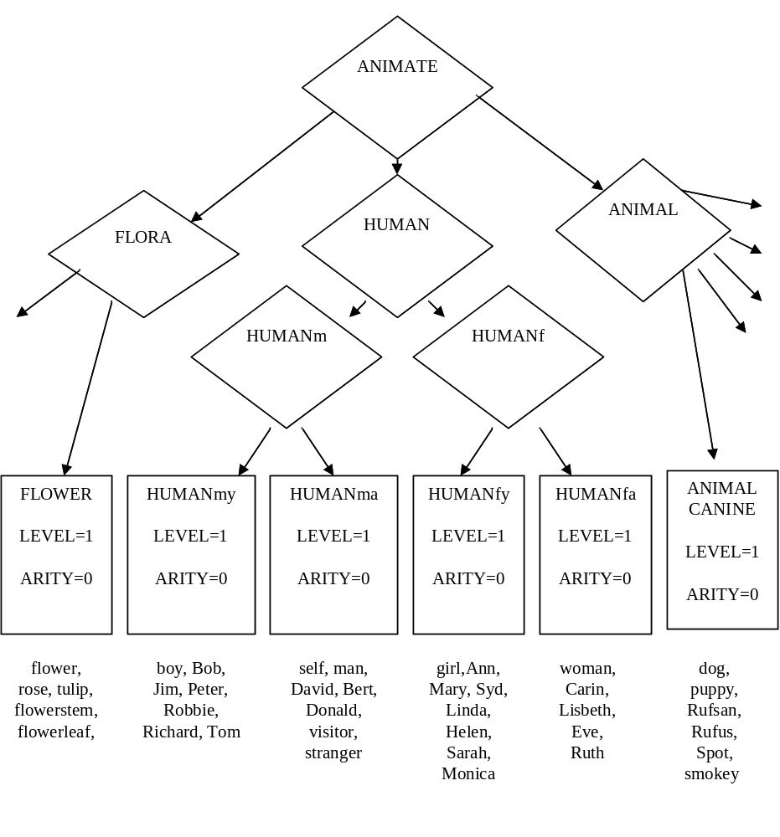
Modality

Slide 5
Thought
Configurations: Thoughts
  Regular thoughts
  Completely regular thoughts
MIND(R): The set of all (completely) regular thoughts

Slide 6
Modality Group
Similarity Group:
  Modality Group
  Generators in a same modality are similar
  Generators can be substituted

Slide 7

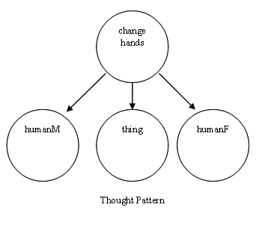
Thought Pattern
A subset is called a thought pattern if it is invariant with respect to the modality group S

Slide 8
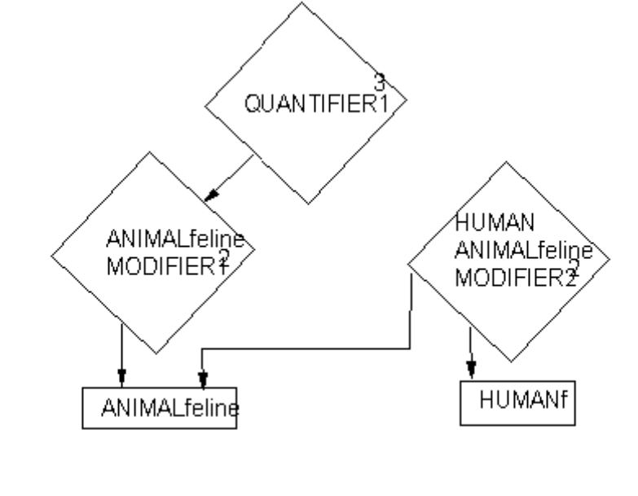
Thought Pattern
Example:
  Mary strokes the very happy cat

Slide 9
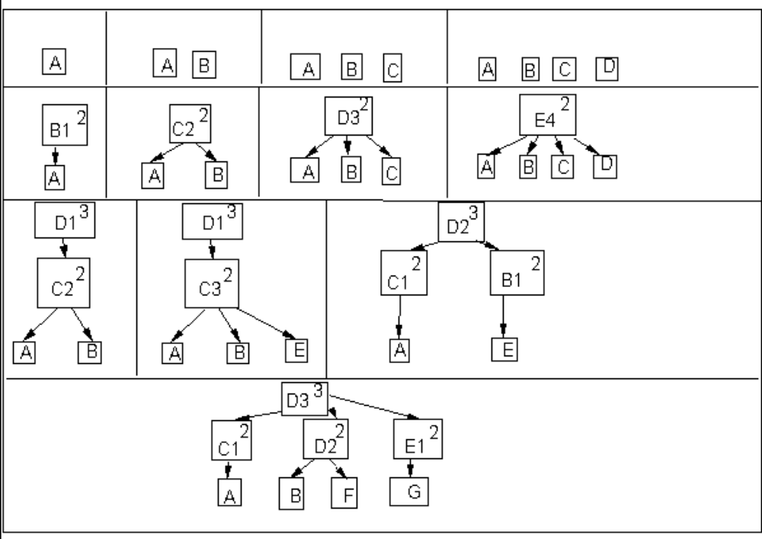
Thought Pattern
Different Topologies of Thought Patterns

Slide 10
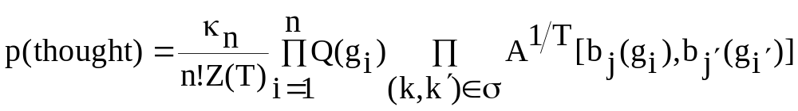
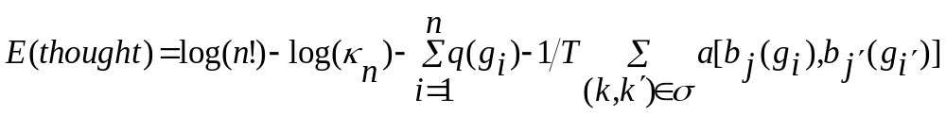
Probabilities of Thought
Energy
  Conscious thoughts, unconscious thoughts

Slide 11
Mental Dynamics
Simple Moves:
  Add a new generator
  Delete a generator and its connections
  Delete a connection
  Create a connection
  Replace a generator by another generator

Slide 12
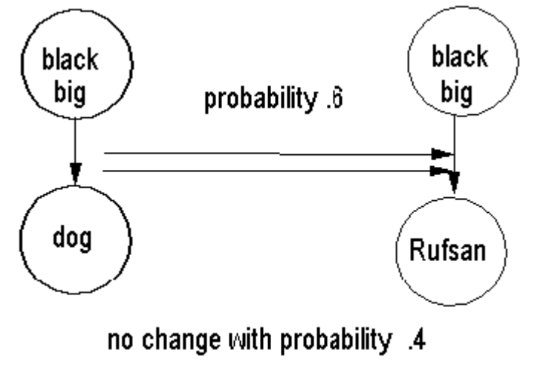
Mental Dynamics
Replace

Slide 13
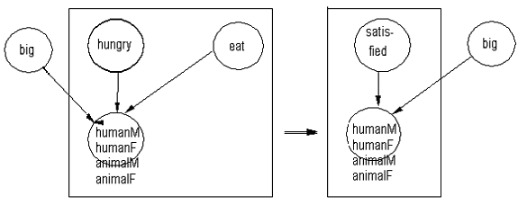
Composite Moves
Delete + Replace

Slide 14
ABSTRACTION
  If a thought occurs more than occasionally:
thought = (married ↓humanM and humanF)
g = marriage

Slide 15
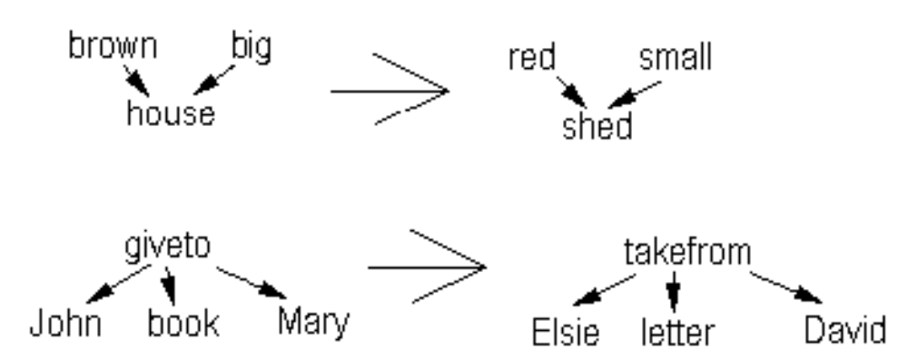
SIMILARITY

Slide 16
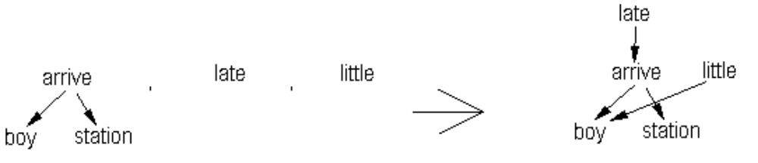
COMPOSITION

Slide 17
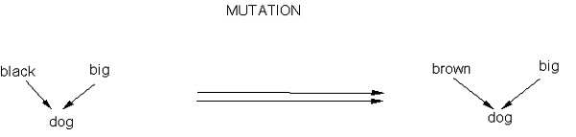
MUTATION

Slide 18
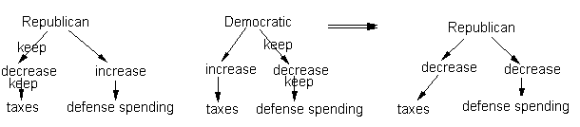
CROSSOVER

Slide 19
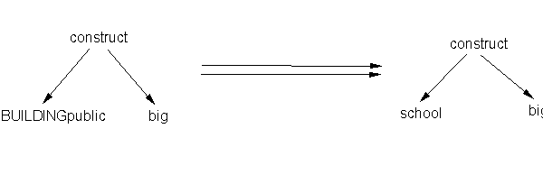
SPECIALAZION

Slide 20

Generalization
  MOD(bark↓Rufus) = (animal_sound↓animalM)

Slide 21
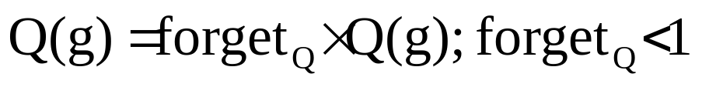
Mind Development (memory)

Slide 22
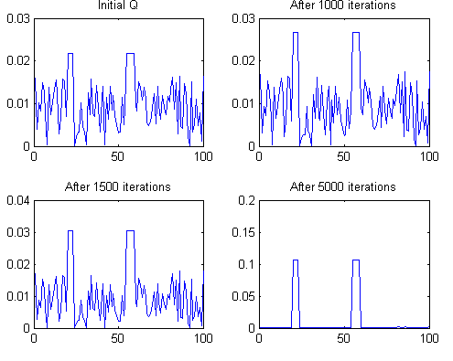
Living alone
Without any Input

Slide 23
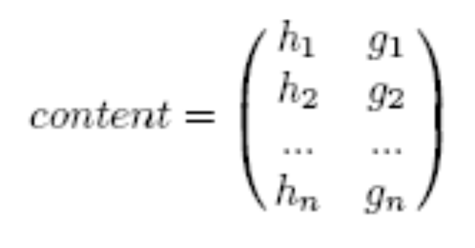
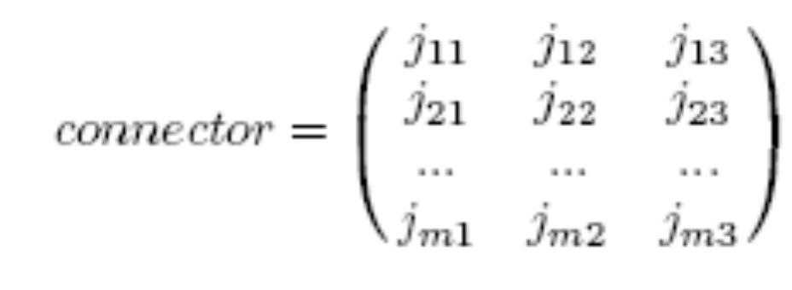
Data Structure

Slide 24
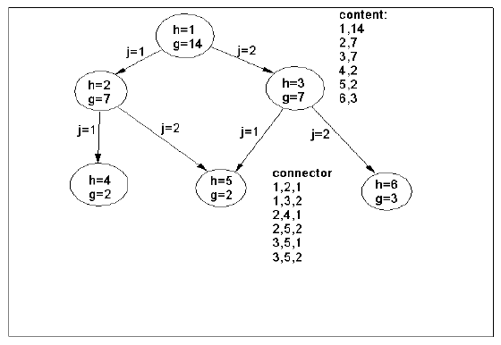

Slide 25
Themes of a person suffering from schizotypal personality disorder:
Ideas of reference Magical thinking Unusual perceptual experience Eccentric behavior | Odd speech Paranoid ideation No close friend Constricted affect Social anxiety

Slide 26
Flow chart
start
thinking1
Time?
Changing
Theme
thinking2
Remembrance
thinking3
yes
no
end

Slide 27
Thinking1
Think3.m
Add generators in L3
Show conscious thought
Save top_3_ideas and top_2_ideas
Update memory
Show idea

Slide 28
Thinking2
Composite moves (composite_moves1.m)
Connect open down bonds
Add generators in L3
Show conscious thought
Save top_3_ideas and top_2_ideas
Update memory
Show idea

Slide 29
Thinking3
Composite moves (composite_moves2.m)
Connect open down bonds
Add generators in L3
Show conscious thought
Save top_3_ideas and top_2_ideas
Update memory
Show idea

Slide 30
Think3
Think3.m
  Content = build_thought_2.m
  Add_generator_new.m
  connecting down bonds
    Find_open_down_bond.m
    Connect_down_bond.m

Slide 31
Composite-move1
add_generator_up_Q(content,connector,theme);
add_generator_new(content,connector,Q_theme);
delete_generator_connections_2(content,connector)
add_generator_up_Q(content,connector,theme);
delete_generator_connections_2(content,connector)
delete_generator_connections_2(content,connector)

Slide 32
Composite-move2
delete_generator_connections_2(content,connector);
add_generator_up_Q(content,connector,theme);
add_generator_new(content,connector,Q_theme);
add_generator_up_Q(content,connector,theme);
add_generator_up_Q(content,connector,theme);
delete_generator_connections_2(content,connector);
delete_generator_connections_2(content,connector);
add_generator_up_Q(content,connector,theme);
delete_generator_connections_2(content,connector);

Slide 33
Build_thought_2
build_thought_2.m:
    Select a random theme
    Select related modalities to the theme
    Select related generators to the modalities
    Set Q(g) = 20 else Q=1
    Selecting generators in different levels:
      With a high probability just one of generators in level 1 is selected.
      More than one, with same probability are selected
      Probability of generators in level4 is zero!
    Content =
1 | 626
2 | 26
3 | 433
Backgammon (modality: Plays )
Dance (modality: Move)
Lose (modality: Outcome)

Slide 34
Add_generator_new
Add_generator_new.m
  Select a generator regarding Q
  Probability of adding the selected generator g: (mu=2)
    P = mu/(n+1) * Q(g)
    P = p / (p+1)
    If select (p, 1-p) == 1 then add g to content

Slide 35
Find_open_down_bond
Find_open_down_bond.m
  Returning found = 1 if there’s still a generator not connected
  Returning the unconnected generator

Slide 36
Connect_down_bond
Connect_down_bond.m:
  Find all of generators may be connected to the unconnected generator
    Finding the modality of the g
    Finding the acceptable modalities for down bond connection of the g
    Finding all the generators of the acceptable modalities
    Search the acceptable generators in the mind

Slide 37
Connect_down_bond
Connect_down_bond.m:
    Probability of selection for connecting to down bond:
      Select(prob1, prob2, ...)
      Prob_i=Q(v(nu))*n/(n+1)*A(g,v(nu))^(1/T)
      T=1
      g: the open down bond generator
      v(nu): acceptable generators in the mind (in the lower level of g)

Slide 38
Connect_down_bond
Connect_down_bond.m
  If not valid generator in mind or already a connector between the generator and the selected generator, a valid generator is connected to the content with probability:
      Prob_i=Q(v(nu))*n/(n+1)*A(g,v(nu))^(1/T)
  in adding a related generator to the mind there's not any condition.
    the mind can think 'bert buy bert ring'.

Slide 39
Get_top_2ideas
Get_top_2ideas.m
  Finding top generators in level 2
  Finding the downward connectors from the top to find the connected generators in level 1
  Comparing omega of the top and the number of connected generators to it

Slide 40
Add_generator_up_Q
Add_generator_up_Q:
  Selecting randomly one of generators in content
  Finding valid generators to be connected upward to the selected generator, regardless of mind
  Computing the probability of each valid generator based on their Qs and As.
  Connecting two selected generators with each other on the valid omega.

Slide 41
Delete_generator_connection_2
Delete_generator_connection_2:
  If connector is empty, delete first member of content with the probability: (mu = 2)
    g = content(1,2)
    prob_del=(n/mu)/Q(g); %check this!
    prob_del=prob_del/(1+prob_del);
    if select([prob_del,1-prob_del]), delete, end
  All the downward and upward connections from the content(1,2) will be found

Slide 42
Delete_generator_connection_2:
  The generator and all the connected generators -gk- be deleted with the probability:
    p=n/(mu*Q(g)) * multiply(A(g,gk)^(-1/T))
    p = p/p+1
    Select(p,1-p)
    A is greater -> the probability of delete is more less

