Slide 1
Introduction to Statistical Learning with Applications
CM3: Cross-validation, model selection,
and bias-variance
Pedro L. C. Rodrigues

Slide 2
IN OUR PREVIOUS EPISODES…
Our current worflow
1
We want to estimate the values of based on predictors
2
We are given a set of N examples of with corresponding
3
We estimate parameters that minimize
4
We do statistical inference on the values of the

Slide 3
IN OUR PREVIOUS EPISODES…
We do statistical inference on the values of
1
2
We are given a dataset
We assume that each data point is
3
We assume the noise is Gaussian IID

Slide 4
IN OUR PREVIOUS EPISODES…
We do statistical inference on the values of
Note that even if we had data generated with our estimate is a RV
Very likely that
Therefore, we would like to check whether the number that we get for this estimate is one that could indeed come from such distribution
If it is a number too far off from the confidence interval,
then it might in fact mean that the distribution with
zero-mean is not a good one to describe the data
This is the intuition behind the statistical tests!

Slide 5
IN OUR PREVIOUS EPISODES…
However, in practice we’re often mostly interested in the predictions…
Q: Is there a natural way of describing the statistics of the predicted values?

Slide 6
IN OUR PREVIOUS EPISODES…
However, in practice we’re often mostly interested in the predictions…
Q: Is there a natural way of describing the statistics of the predicted values?
Remember that if we assume a linear model for the data, then
Using our limited dataset, we can build
with

Slide 7
IN OUR PREVIOUS EPISODES…
But what if we can’t assume a linear model? Nor Gaussian?

Slide 8
IN OUR PREVIOUS EPISODES…
But what if we can’t assume a linear model? Nor Gaussian?

Slide 9
IN OUR PREVIOUS EPISODES…
But what if we can’t assume a linear model? Nor Gaussian?

Slide 10
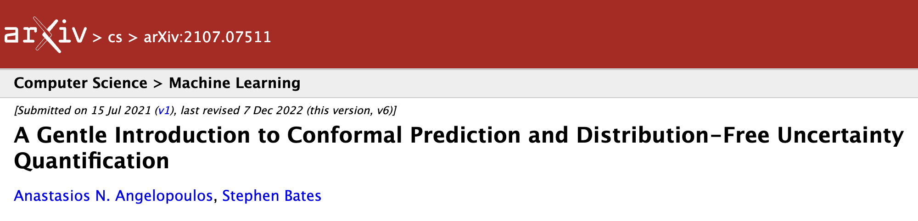
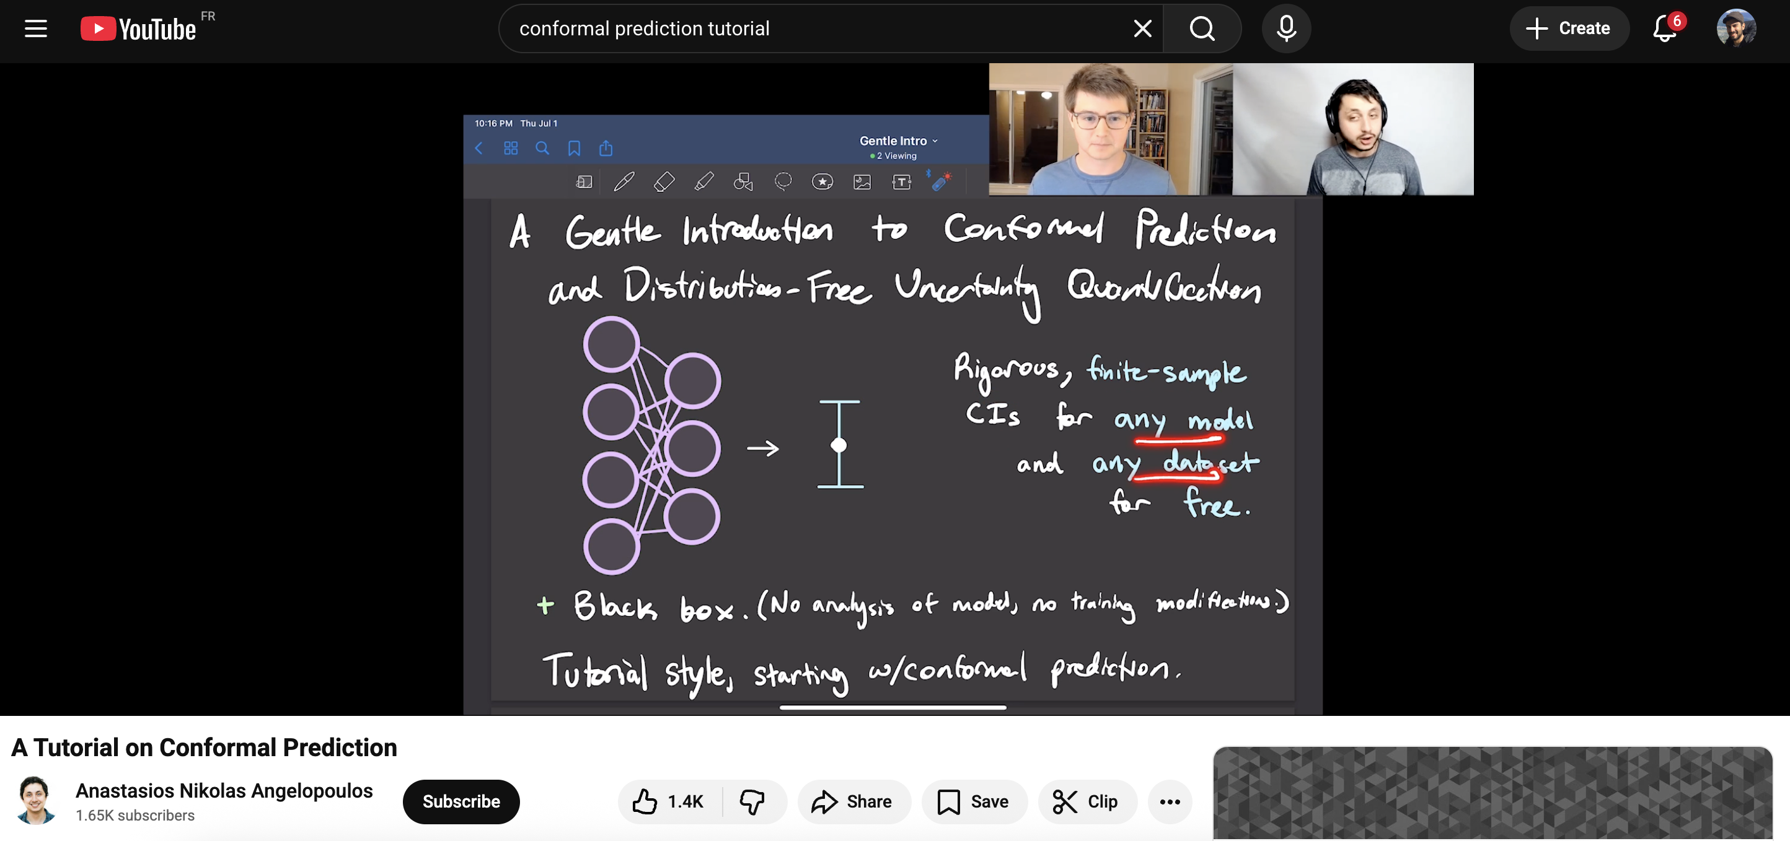
IN OUR PREVIOUS EPISODES…
But what if we can’t assume a linear model? Nor Gaussian?
https://www.youtube.com/watch?v=nql000Lu_iE&t=18s

Slide 11
IN OUR PREVIOUS EPISODES…
Our current worflow
1
We want to estimate the values of based on predictors
2
We are given a set of N examples of with corresponding
3
We estimate parameters that minimize
4
We do statistical inference on the values of the
5
How can we assess the quality of a model?

Slide 12

What makes a model good?
Estimating the quality of a model
Comparing and selecting models

Slide 13
What makes a model good?
Suppose our data is generated as
we can run multiple linear regression with
What’s the best choice for d ?

Slide 14
What makes a model good?
Suppose our data is generated as
we can run multiple linear regression with
What’s the best choice for d ?

Slide 15
What makes a model good?
Suppose our data is generated as
we can run multiple linear regression with
What’s the best choice for d ?

Slide 16
What makes a model good? – The generalization error
Remember that our goal in regression is to minimize the generalization error:
This error can be decomposed into a few informative parts:
The irreducible error: can we ever predict Y from X with zero prediction error? Probably not, since we always assume having some observation error ε in the data model.
The estimation bias: when estimating the conditional expectation, we always have to choose a family of approximators, which may not be sufficiently flexible.
The estimation variance: for families of approximators that are too flexible, it might happen that for every small change in the observed data points, the estimates change a lot.

Slide 17
What makes a model good?
Estimation variance. The same model fit on two slightly different datasets.

Slide 18
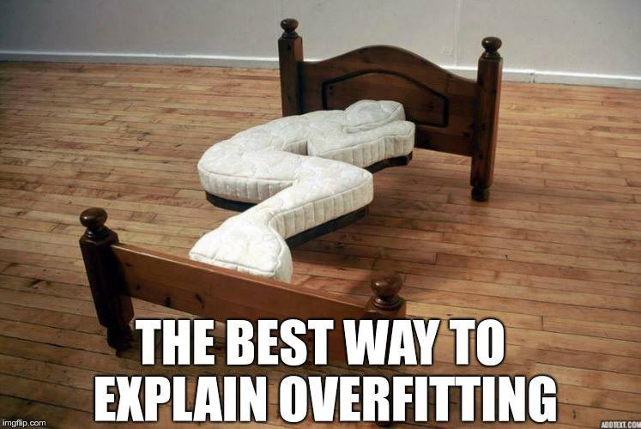
What makes a model good?

Slide 19
What makes a model good? – The bias-variance tradeoff
Remember that the data model is assumed to be with
We use a training dataset to estimate
For new observation we write the bias-variance decomposition conditioned on as
Irreducible error
Squared estimation bias
Estimation variance

Slide 20
What makes a model good?
Estimating the quality of a model
Comparing and selecting models

Slide 21
Estimating the quality of a model
How can we estimate the generalization error of an approximator in practice?
We don’t know the

Slide 22
Estimating the quality of a model
How can we estimate the generalization error of an approximator in practice?
with
We don’t know the
So we approximate it with M data points
Recall that for
we have
We want to minimize one quantity but can only estimate a proxy of it

Slide 23
One-slide reminder of the law of large numbers (LLN)
Whenever we want to approximate an expectation, we can use the LLN
with N independent and identically distributed samples
This result will be useful many times in our class and is ubiquitous in machine learning
This is also used in computer graphics, statistical physics, econometry, etc.
Approximate weighted integral
Average of random IID samples

Slide 24
Estimating the quality of a model
How can we estimate the generalization error of an approximator in practice?
with
We don’t know the
So we approximate it with M data points
Recall that for
we have
We want to minimize one quantity but can only estimate a proxy of it
Question:
Can we say that ?
⚠️
ABSOLUTELY NOT!
In fact i.e. the true generalization error is larger than the estimated one

Slide 25
The optimism of the training error
Different ways of seeing the problem:
Intuitively, since then will always look small…

Slide 26
The optimism of the training error
Different ways of seeing the problem:
Intuitively, since then will always look small…
Consider our example with polynomials
Increasing the degree improves training error
But the testing error grows!
is the training error
with
is the testing error
Error on unseen data

Slide 27
The optimism of the training error
Different ways of seeing the problem:
Intuitively, since then will always look small…
Consider our example with polynomials
Increasing the degree improves training error
But the testing error grows!
Mathematical illustration on linear regression
(same predictors but different observations because of noise)

Slide 28
The optimism of the training error
1
We are given a dataset

Slide 29
The optimism of the training error
1
2
We are given a dataset
We train regressor on that minimizes

Slide 30
The optimism of the training error
1
2
We are given a dataset
We train regressor on that minimizes
3
We want to estimate the generalization error of which is defined as per

Slide 31
The optimism of the training error
1
2
We are given a dataset
We train regressor on that minimizes
3
We want to estimate the generalization error of which is defined as per
4
But we can only obtain an approximation
such that

Slide 32
The optimism of the training error
1
2
We are given a dataset
We train regressor on that minimizes
3
We want to estimate the generalization error of which is defined as per
4
But we can only obtain an approximation
!
Beware the optimism of training error!
such that
This was the criterion used during the training

Slide 33
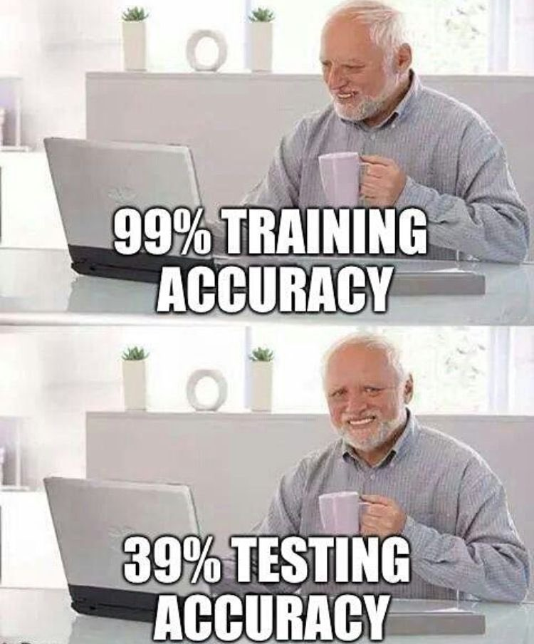
The optimism of the training error
Conclusion:
We can only know if a model is good or not if we correctly evaluate its performance
The objective function that we minimize when training a model (training error) is never the same as the one we are actually interested in minimizing (test error)

Slide 34
Cross-validation
We are given a dataset with N datapoints
How can we estimate the generalization error of a model we train on this dataset?
Remember: We should evaluate the model on samples that were not used for training

Slide 35
Cross-validation
We are given a dataset with N datapoints
How can we estimate the generalization error of a model we train on this dataset?
Remember: We should evaluate the model on samples that were not used for training
Strategy 1 : Single hold-out test point
We fit a model on the first N-1 training samples, calling it
Treat the last sample as a test sample and estimate generalization error as
The estimator is easy to calculate but we can expect a rather large variance.

Slide 36
Cross-validation
We are given a dataset with N datapoints
How can we estimate the generalization error of a model we train on this dataset?
Remember: We should evaluate the model on samples that were not used for training
Strategy 2 : Leave one out cross-validation (LOOCV)
We fit N models on N-1 training samples, holding out at each time to get
The test error is approximate as
The variance decreases, but the computational burden is much higher

Slide 37
Cross-validation
We are given a dataset with N datapoints
How can we estimate the generalization error of a model we train on this dataset?
Remember: We should evaluate the model on samples that were not used for training
Strategy 3 : K-Fold cross-validation
Split the training dataset randomly into K folds so to have
For k=1,…,K fit a model on a training set except that excludes
Take average over folds
Estimate test error for each fold

Slide 38

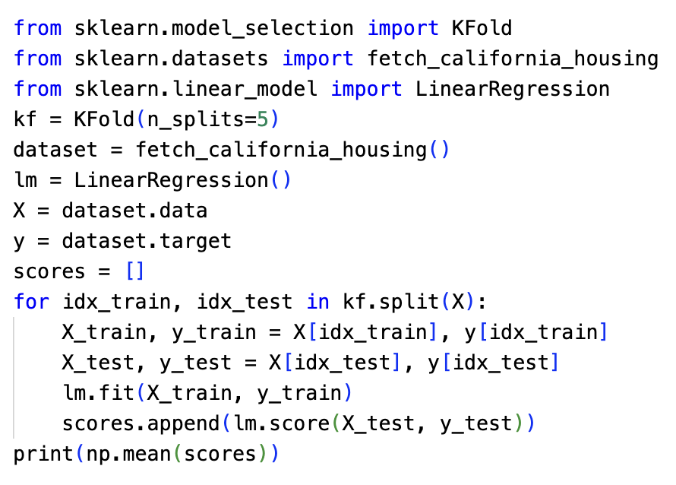
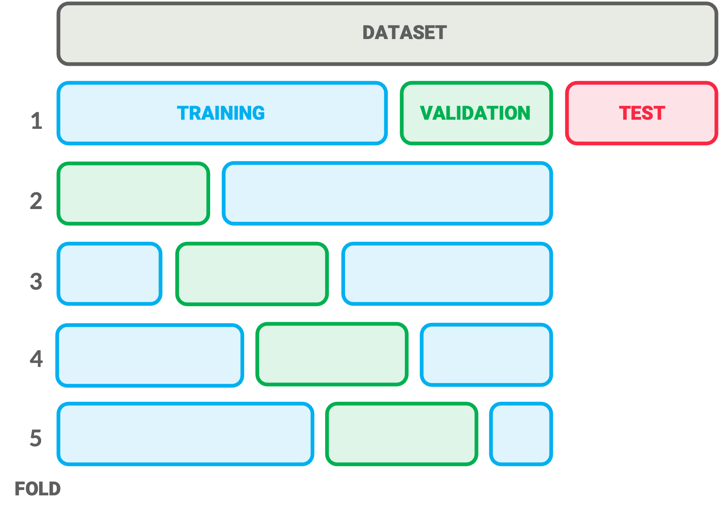
Cross-validation
Strategy 3 : K-Fold cross-validation
Using
Note that the errors calculated in each fold are not IID random variables, since the models share some of their data points.
Question: What does this imply?
See the documentation for more details

Slide 39
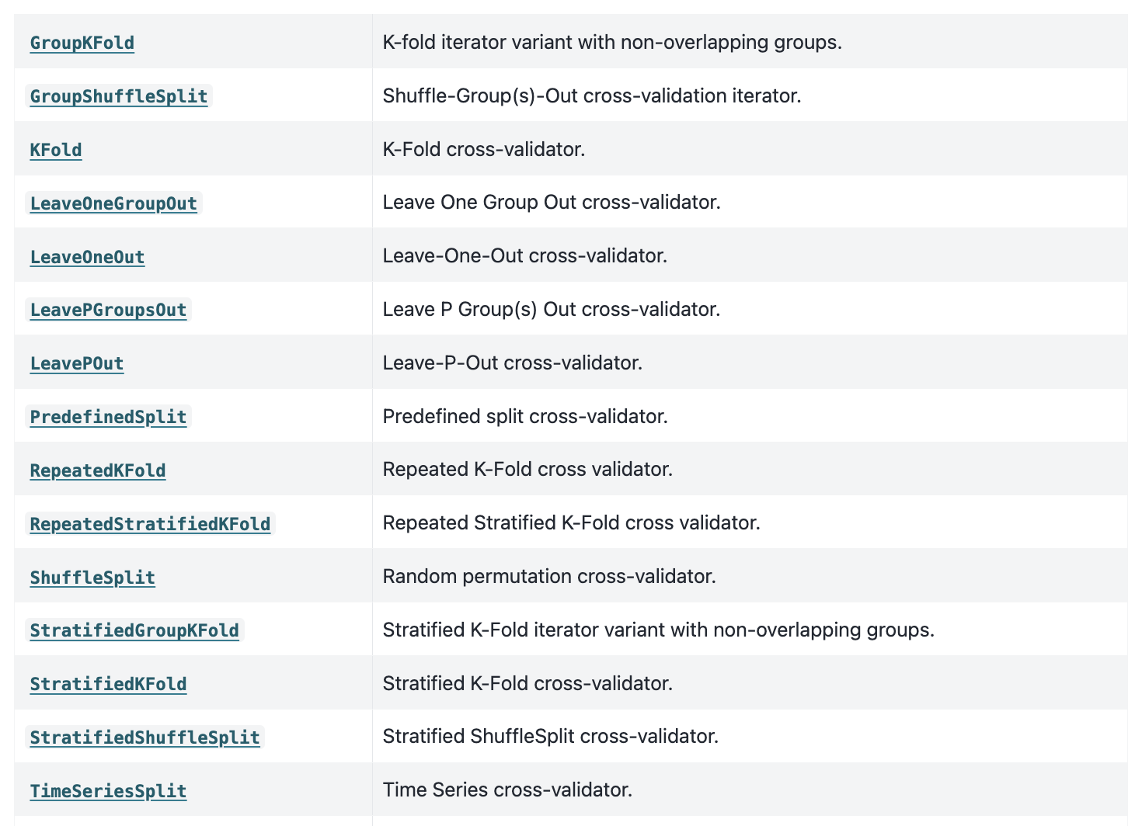
Cross-validation
But there are several other strategies!
and more…

Slide 40
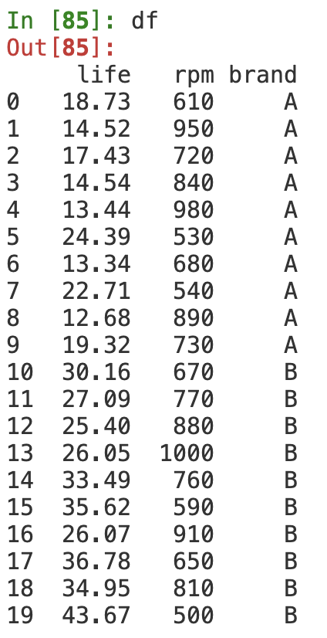
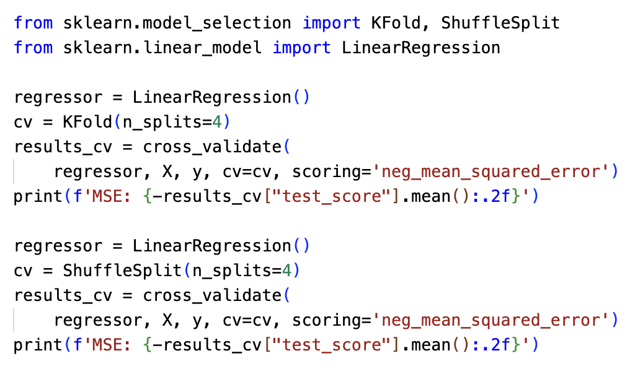
Cross-validation
(1) Example with the categorical variables from last week
17.50
4.60
What is going on? 😅

Slide 41
Cross-validation
(2) Example with financial time series: predict CVX’s quotes based on other quotes

Slide 42
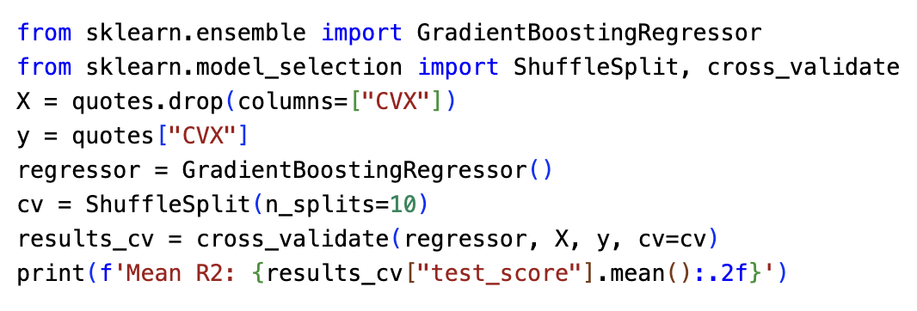
Cross-validation
(2) Example with financial time series: predict CVX’s quotes based on other quotes
0.95
This looks like an almost perfect prediction! 💸 Does it sound right to you?

Slide 43
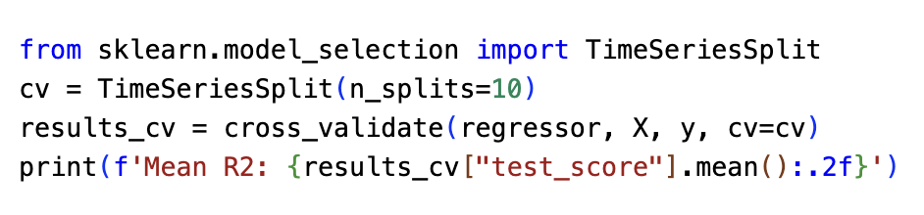
Cross-validation
(2) Example with financial time series: predict CVX’s quotes based on other quotes
0.95
This looks like an almost perfect prediction! 💸 Does it sound right to you?
-3.10
Disappointing, but closer to reality…

Slide 44
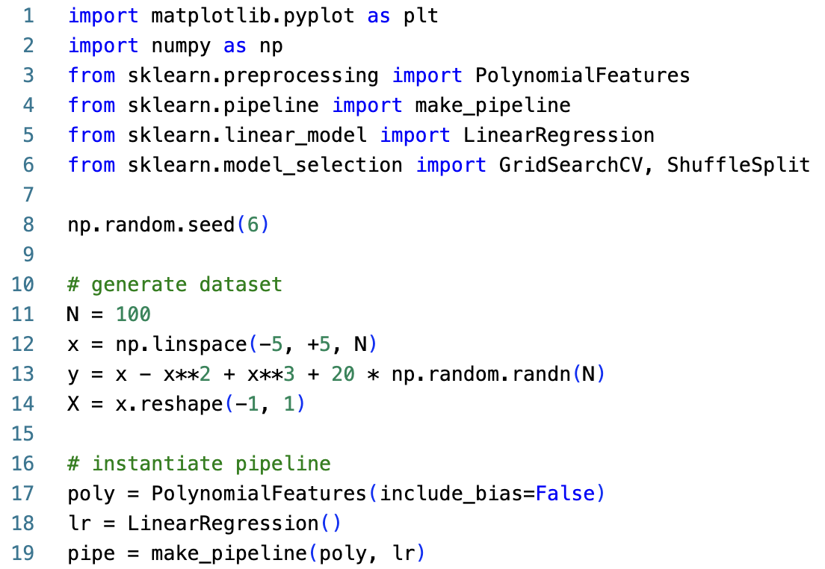
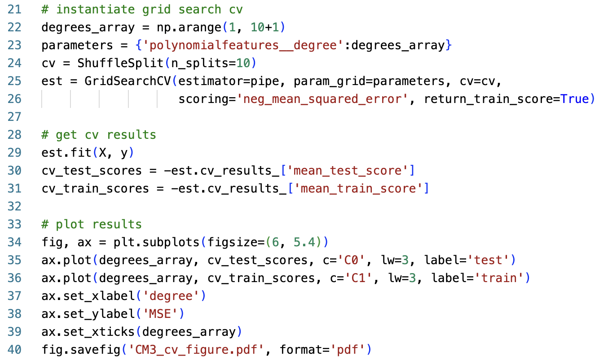
Cross-validation
(3) Choosing the best order for the polynomial approximating a dataset
We’re using several scikit-learn important concepts : transformers, pipelines, grid search

Slide 45
Cross-validation
(3) Choosing the best order for the polynomial approximating a dataset
We’re using several scikit-learn important concepts : transformers, pipelines, grid search

Slide 46
What makes a model good?
Estimating the quality of a model
Comparing and selecting models

Slide 47
Comparing and selecting models
Suppose we are given a dataset with p predictors.
We want to estimate a linear model with only a subset of them.
There are mainly three strategies for doing this properly:
Shrinkage fits a model with all p predictors but using a modified loss function that drives some parameters to zero automatically. (Razan will talk about this)
We can use dimensionality reduction techniques to project the p predictors to a lower-dimensional subspace. (We will see how to do this in CM4 and TP2)
In subset selection we identify a subset of the predictors that seems the most adequate and then fit a model with them.

Slide 48
Comparing and selecting models
When p is large, testing all 2^{p} possible models can be very time consuming…
So we prefer to proceed greedily with e.g. forward stepwise selection
(1)
Let denote a model with no predictors (i.e. just the intercept)
(2)
For
(a)
Consider all models that augment the predictors in by one extra predictor
(b)
Choose the best among these models and call it
(3)
Select single best model among using cross-validated
prediction error

Slide 49
Example:
Consider the mtcars dataset – we want to predict mpg

Slide 50
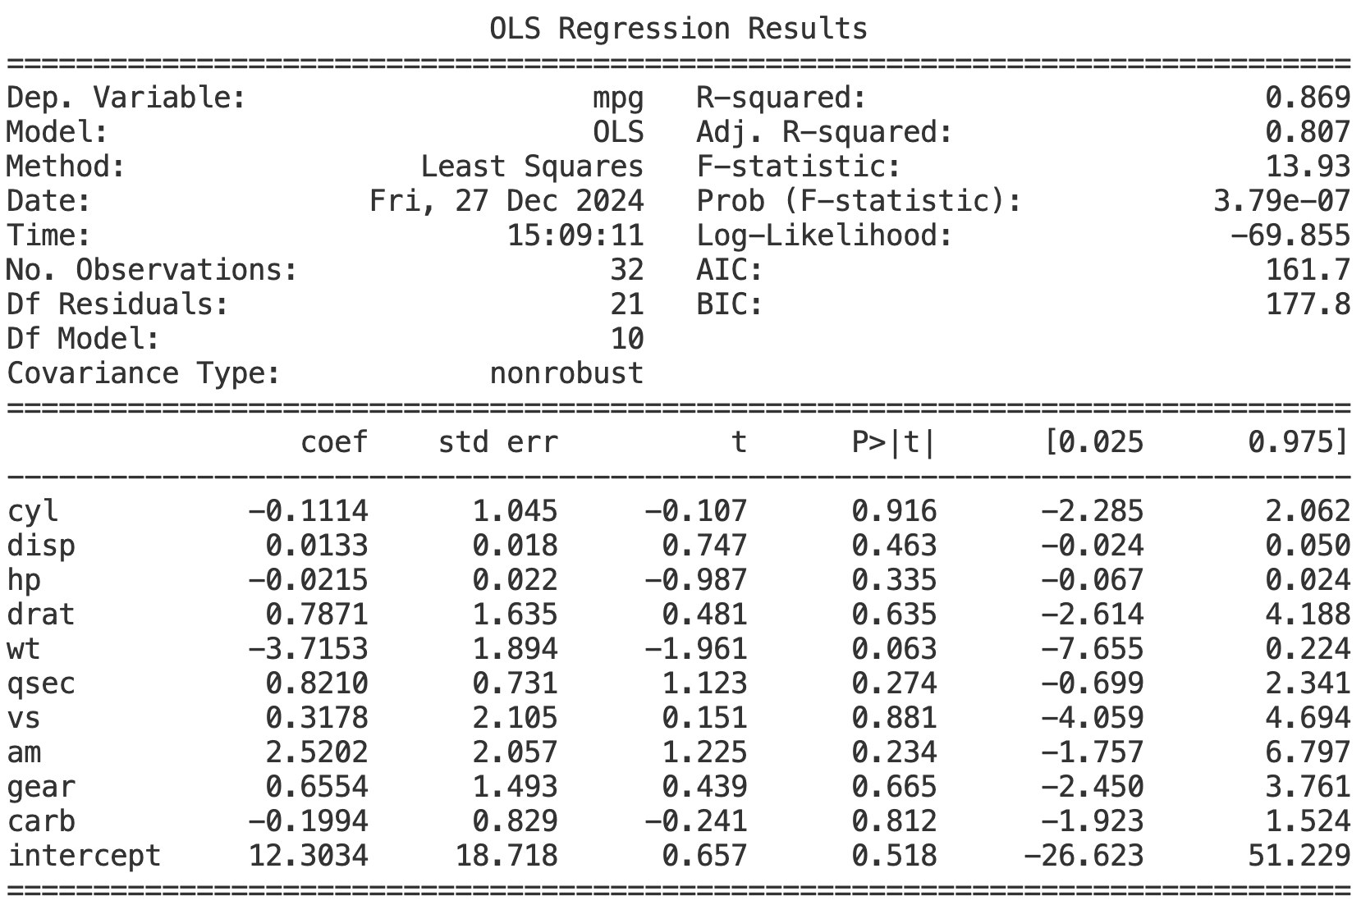

Slide 53
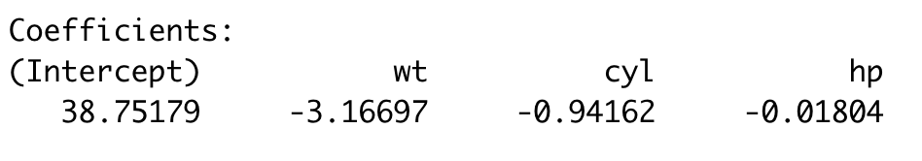
sweetspot

Slide 54

Challenge 1 : Epiclock
https://www.codabench.org/competitions/13881/
Challenge starts 23-February and goes until 22-March

