Slide 1
Introduction to Statistical Learning with Applications
CM4: Principal component analysis
Pedro L. C. Rodrigues

Slide 2
Exercise from Carnegie Mellon University (CMU) 11-601 course
The figure depicts training and validation curves with increasing model complexity
Which curve is more likely to be the training error ? and the testing error?
Where in the graph are bias/variance low/high?
In which regions does the model overfit or underfit?
Prediction error
Model complexity

Slide 3
Exercise from Carnegie Mellon University (CMU) 11-601 course
The figure depicts training and validation curves with increasing model complexity
High bias
Low variance
Low bias
High variance
Which curve is more likely to be the training error ? and the testing error?
Where in the graph are bias/variance low/high?
In which regions does the model overfit or underfit?
Underfits
Overfits
Prediction error
Test error
Training error
Model complexity

Slide 4
Motivation
In TP2 you will be given a dataset with:
494 rows representing different individuals
5709 columns containing their genetic markers
And asked to train a linear regression model that predicts:
The latitude
The longitude
of the tribe to which each individual belongs.
But
is not invertible
(Why?)
😱
How can we get the coefficients for a linear regression model?
Principal component analysis (PCA) can reduce the dimensionality of the data

Slide 5
Motivation
In other words, we look for a way to transform the data matrix…
with
…so that the linear regression model becomes viable and numerically stable
(We would also like to easily relate the coefficients from each regression model)

Slide 6

Some important mathematical tools
Principal Component Analysis (PCA)
Principal Component Regression (PCR)
Some practical issues

Slide 7
Important tools from Linear Algebra
Given two vectors with
The projection of onto is the vector
score
For data matrix
Two vectors are orthogonal if
the projection over is

Slide 8
Important tools from Linear Algebra
Matrix is symmetric positive semi-definite (SPSD) matrix if
For any we have
Equivalently, we have that the eigenvalues and eigenvectors of are such that
and
And we can write its eigenvalue decomposition as

Slide 9
Some important mathematical tools
Principal Component Analysis (PCA)
Principal Component Regression (PCR)
Some practical issues

Slide 10
Principal Component Analysis
We want to define a linear transformation on our (zero-mean) data matrix:
Matrix should minimize the following objective function:
such that
Reconstruction error

Slide 11
Principal Component Analysis
But where does that come from? Let’s start from the beginning with
Each coordinate of the projection (score) is
with
and we want to minimize reconstruction error
such that
How do we minimize this objective function?

Slide 12
Principal Component Analysis
How do we minimize this objective function? First note that
Therefore

Slide 13
Principal Component Analysis
We augment the loss function to encode the constraint
then take its gradient and equalize to zero. But first, note that
So we have
covariance of the data
(remember data is zero-mean)
Conclusion
is an eigenvector of the covariance matrix

Slide 14
Principal Component Analysis
Remember is a SPSD matrix, so we should take since
The actual value of the reconstruction error is then
total variance of the data
(remember data is zero-mean)
And the coordinates (aka scores) of the projected data points are

Slide 15
Principal Component Analysis
What if we want more coordinates to project?
Coming back to the original loss function
and solving in a similar way as before, we get that

Slide 16
Principal Component Analysis
The projected data points are, therefore,
And the error is
why?
What would be a good choice for q?
We may want to control the error as in
Notes:
The r

Slide 17
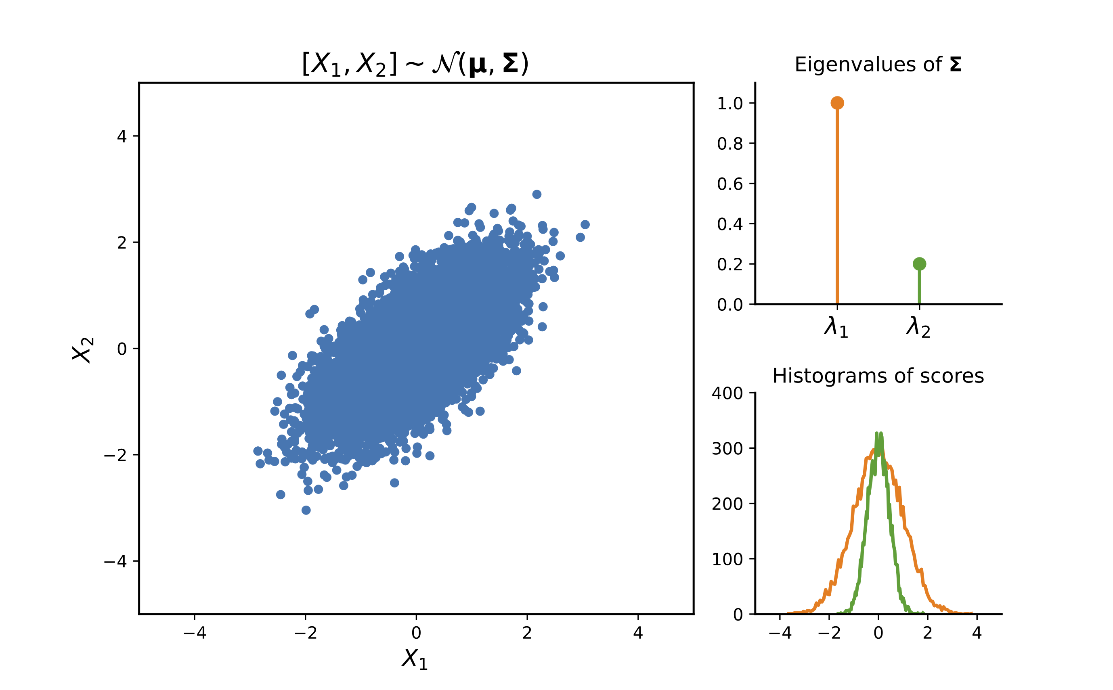
Principal Component Analysis
Notes:
The r

Slide 18
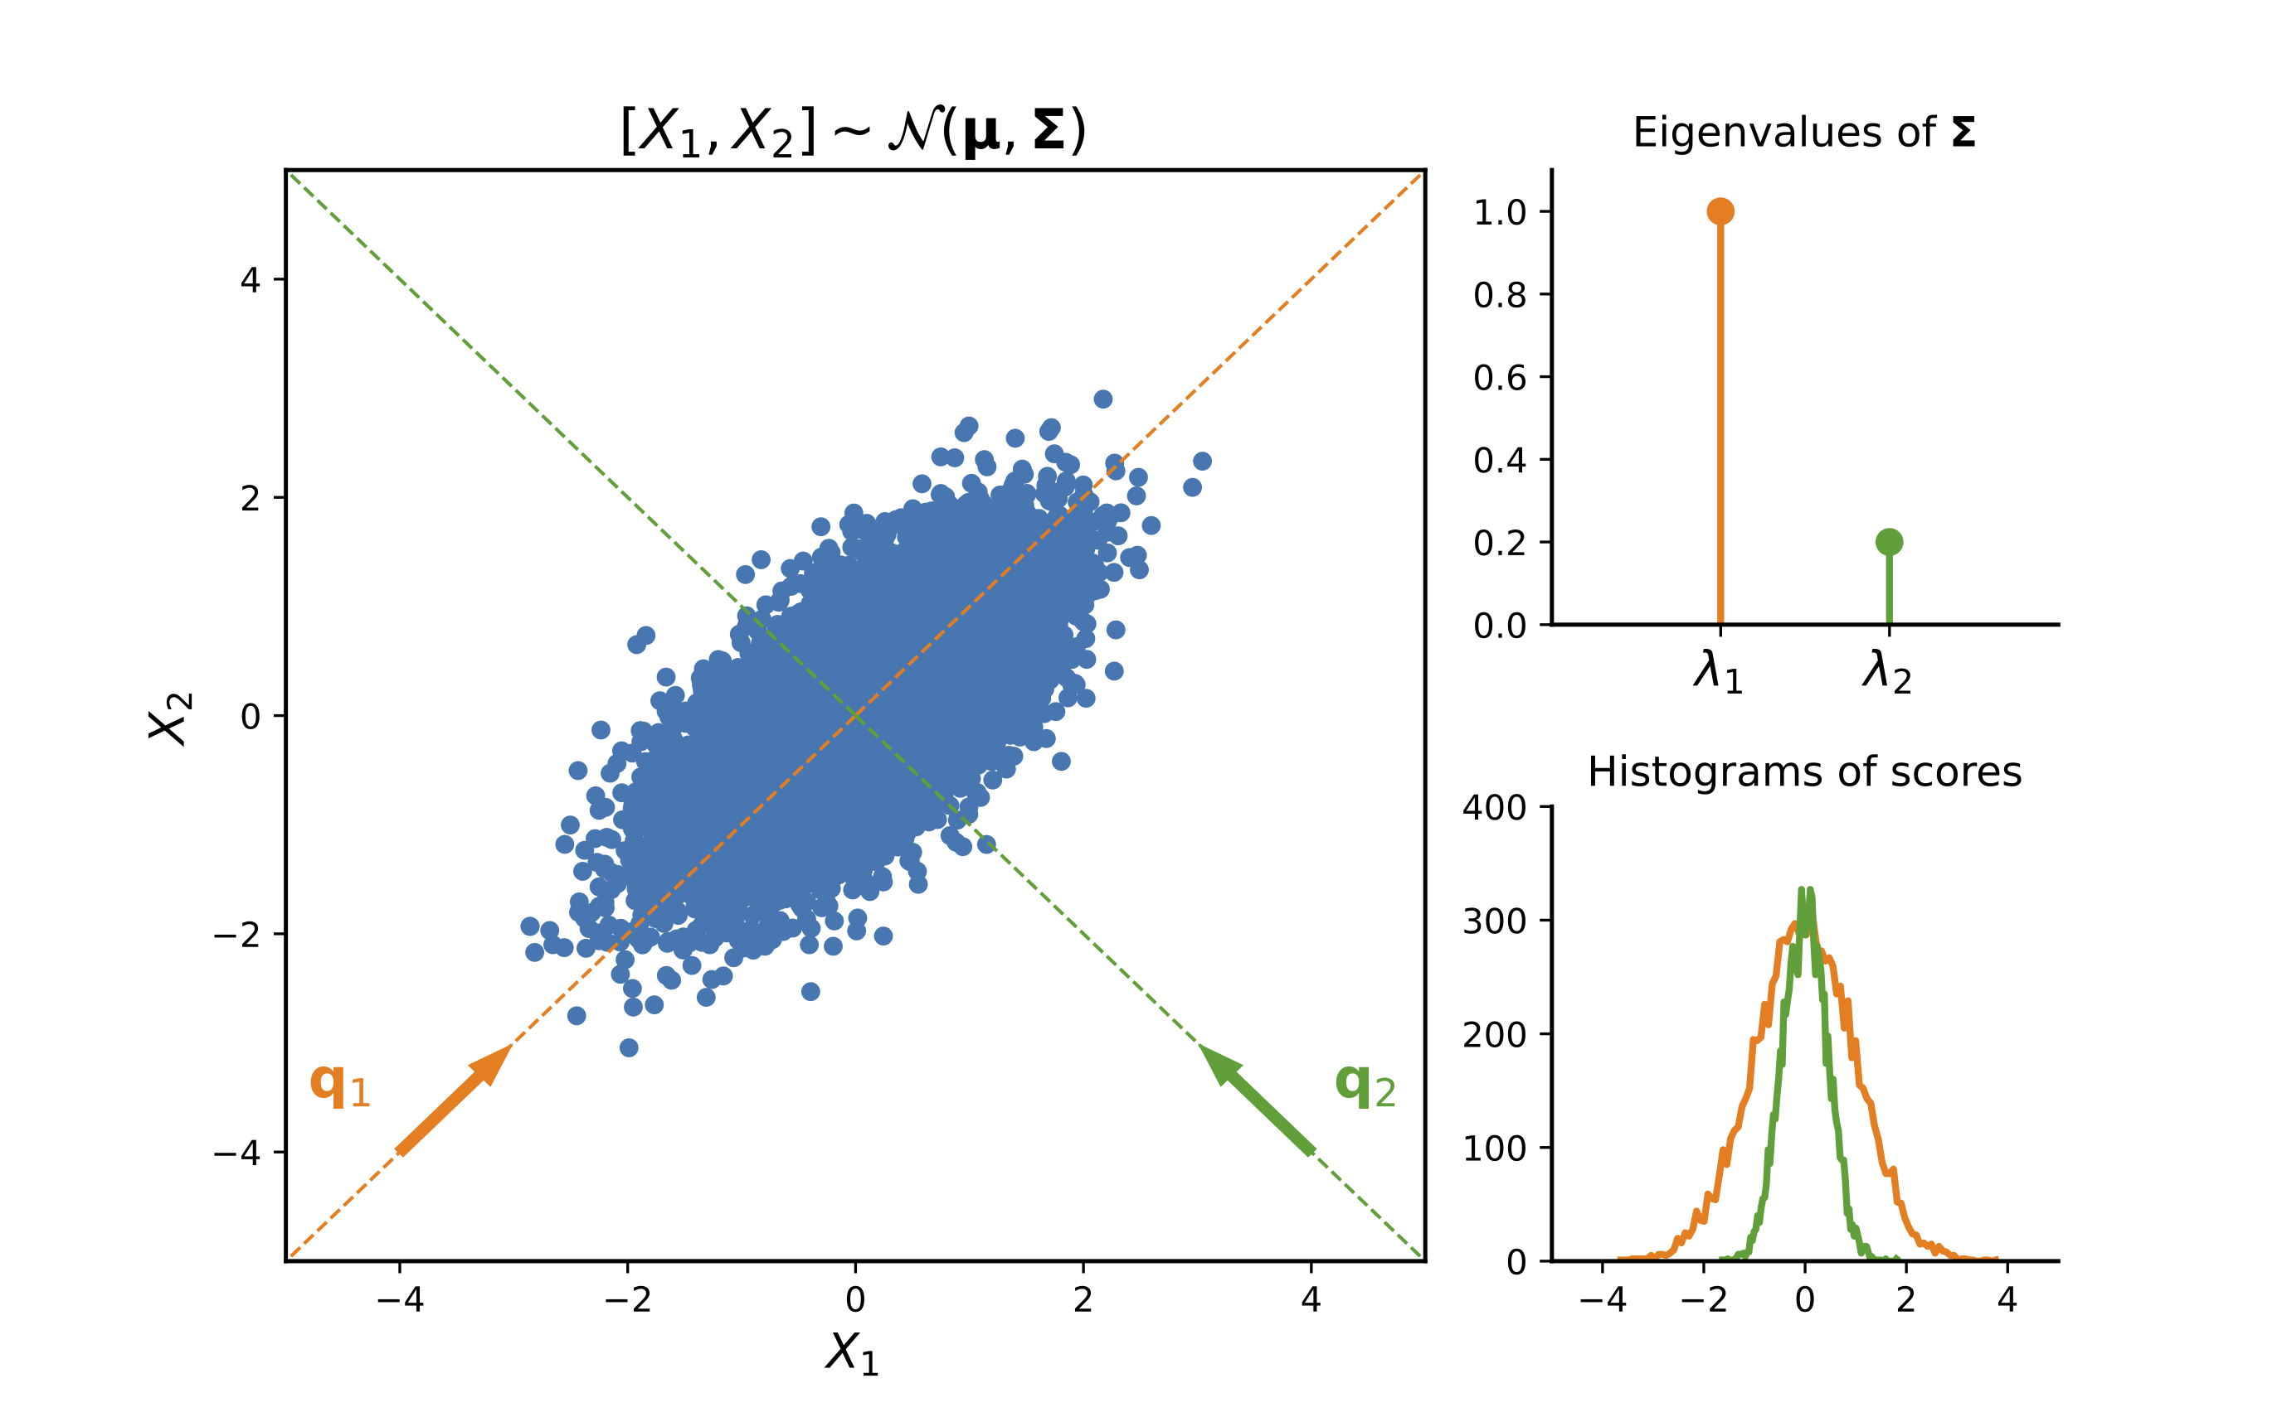
Principal Component Analysis
Notes:
The r

Slide 19
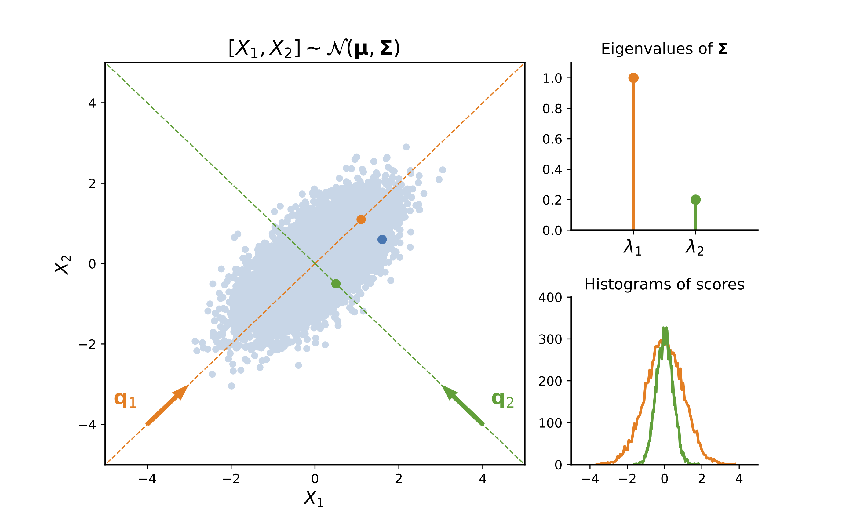
Principal Component Analysis
Notes:
The r

Slide 20
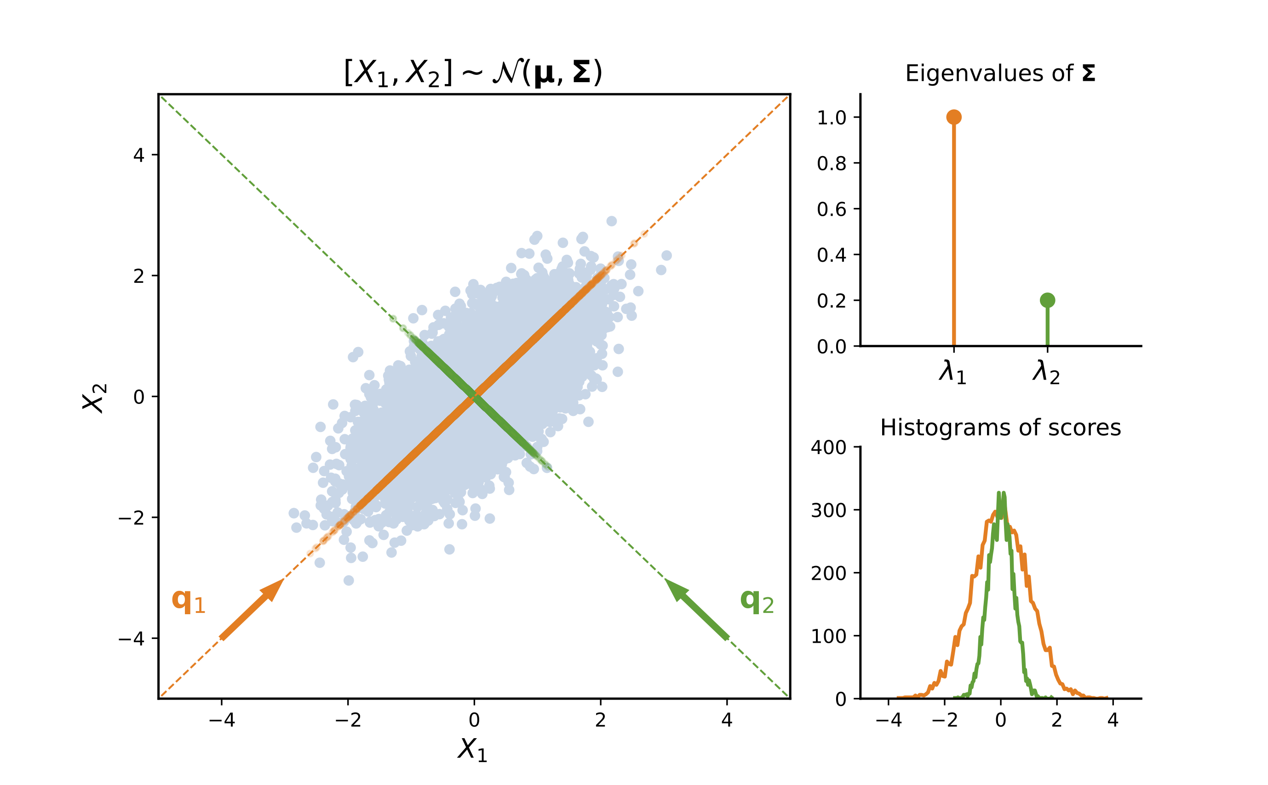
Principal Component Analysis
Notes:
The r

Slide 21
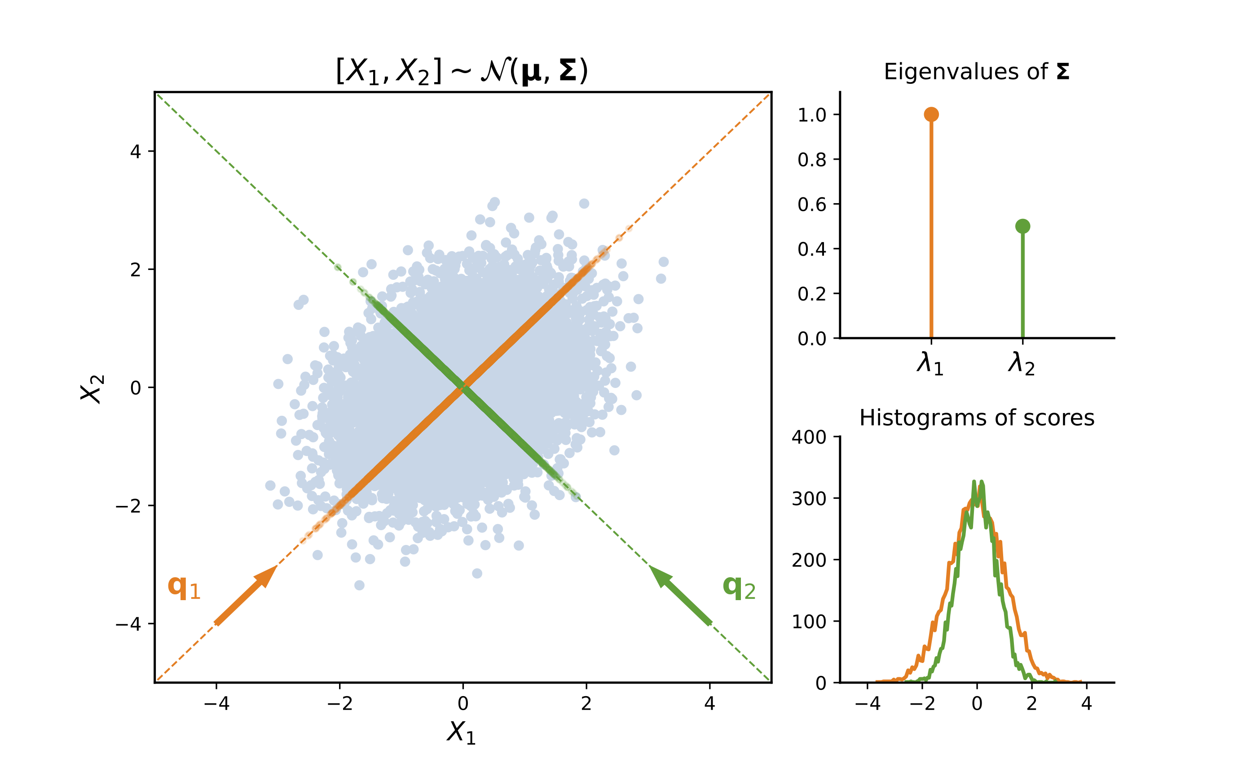
Principal Component Analysis
Notes:
The r

Slide 22
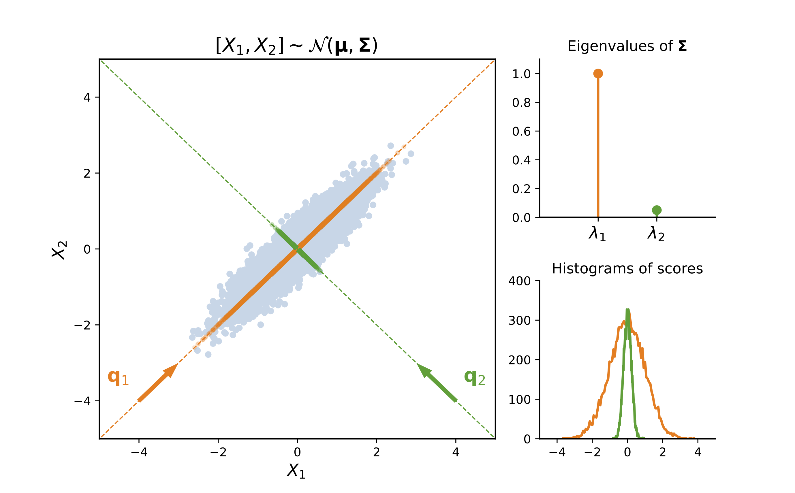
Principal Component Analysis
Notes:
The r

Slide 23
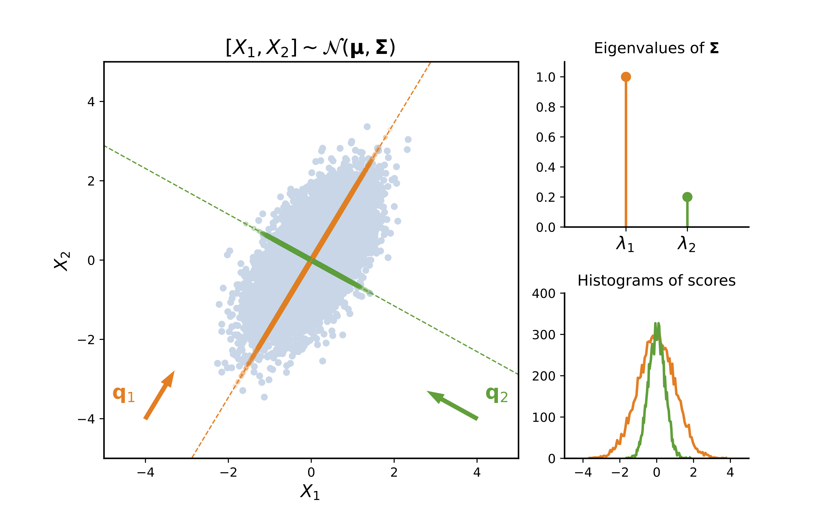
Principal Component Analysis
Notes:
The r

Slide 24
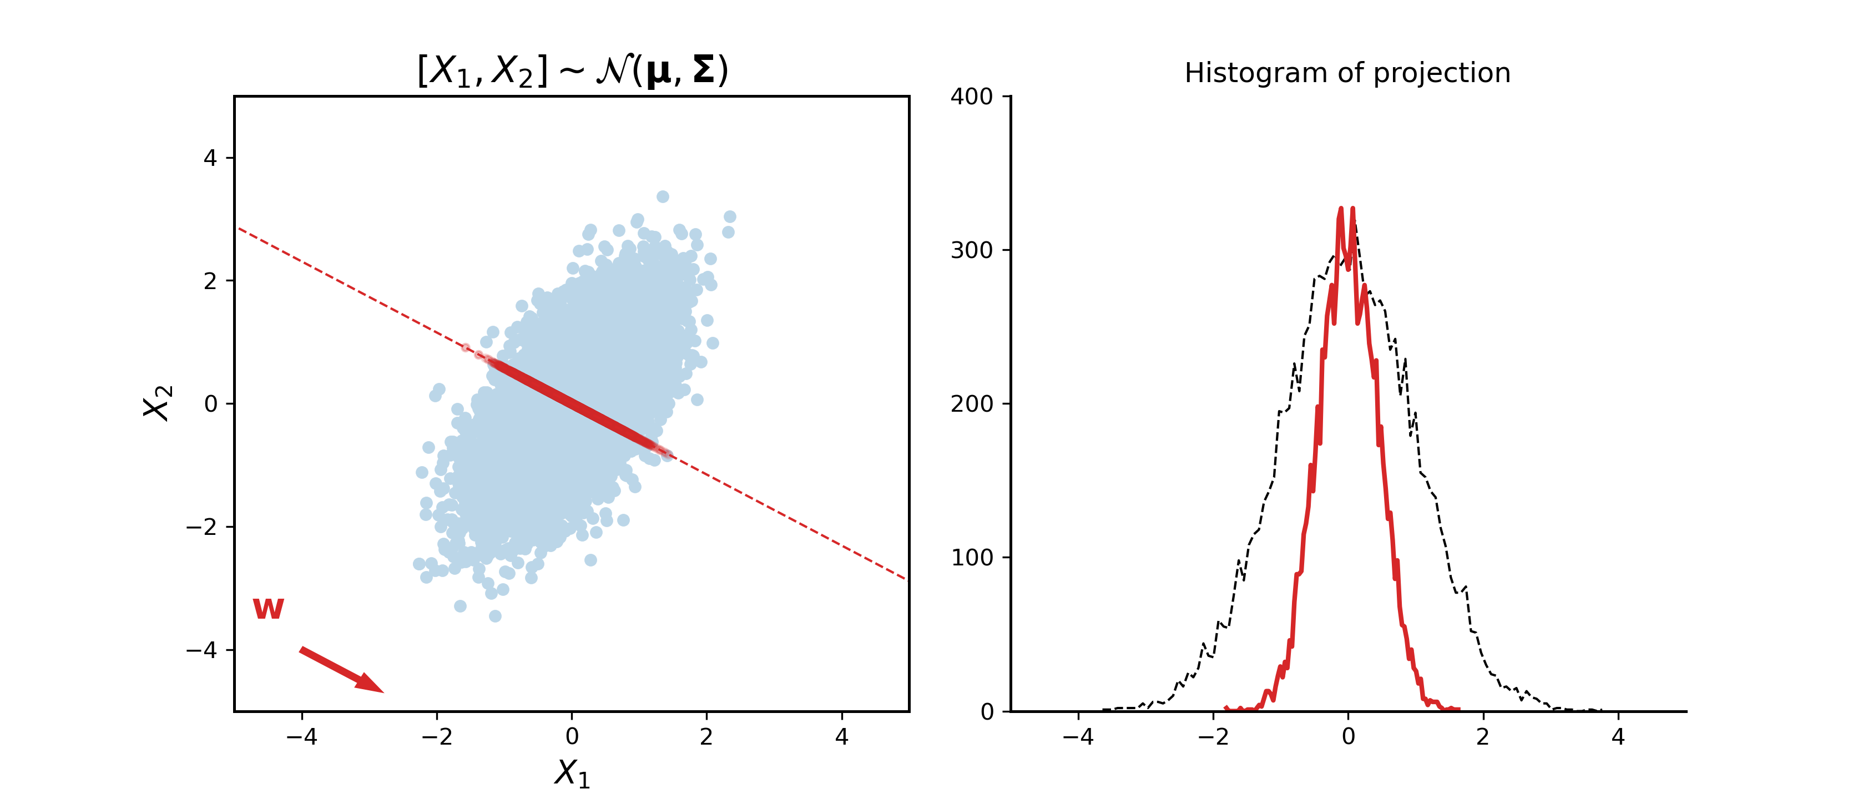
Principal Component Analysis
Minimize reconstruction error is the same maximizing the variance of the projections
remember data is zero-mean
Notes:
The r

Slide 25
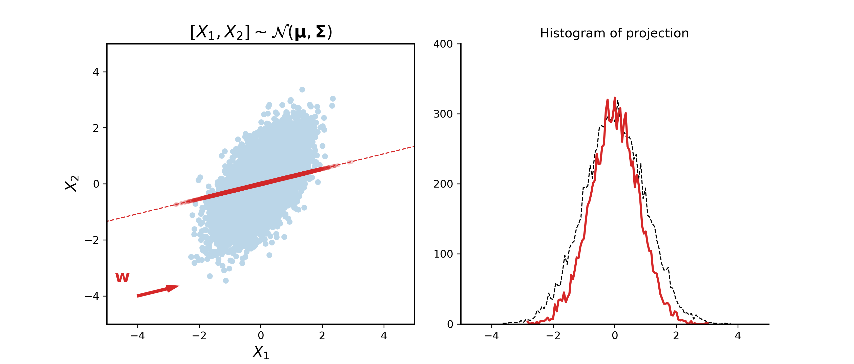
Principal Component Analysis
Minimize reconstruction error is the same maximizing the variance of the projections
remember data is zero-mean
Notes:
The r

Slide 26
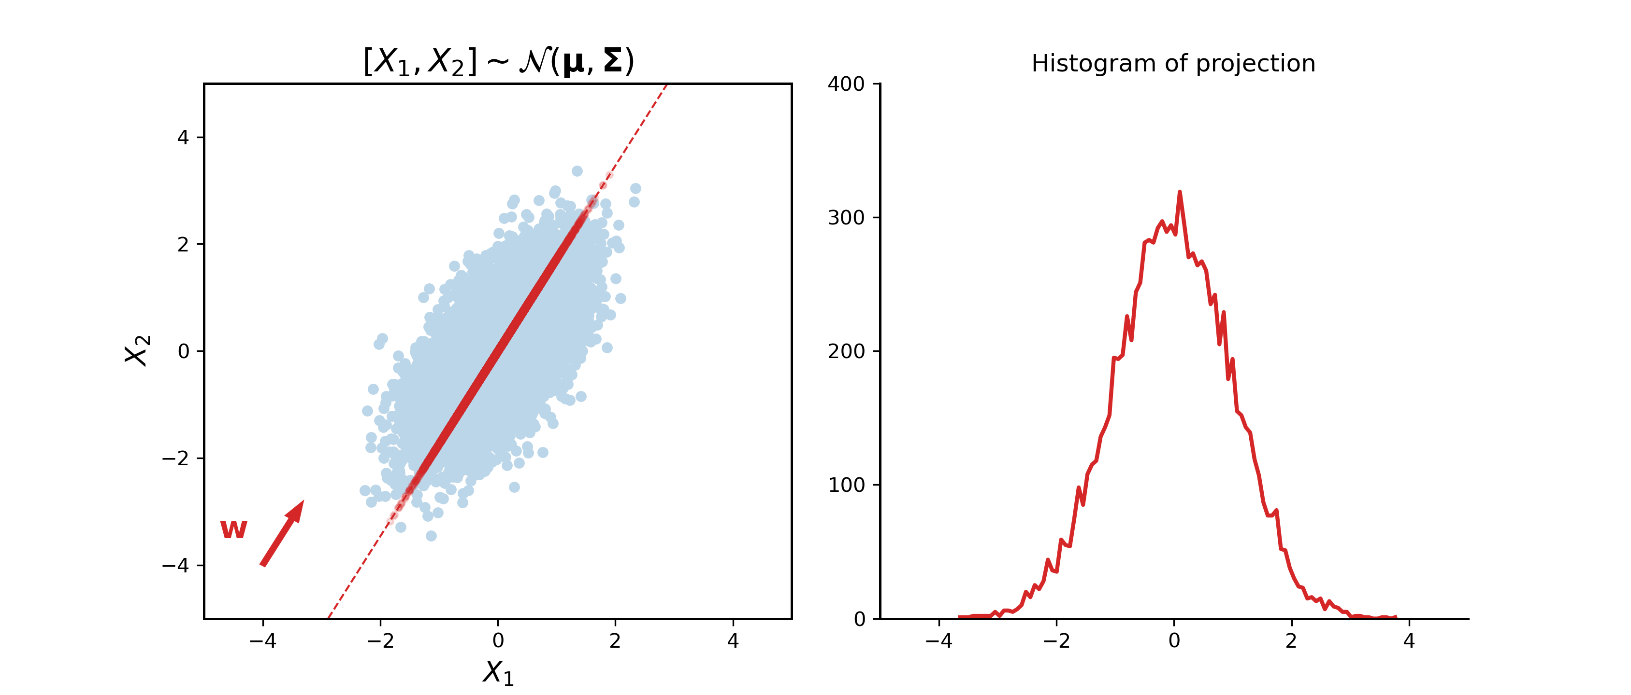
Principal Component Analysis
Minimize reconstruction error is the same maximizing the variance of the projections
remember data is zero-mean
Notes:
The r

Slide 27
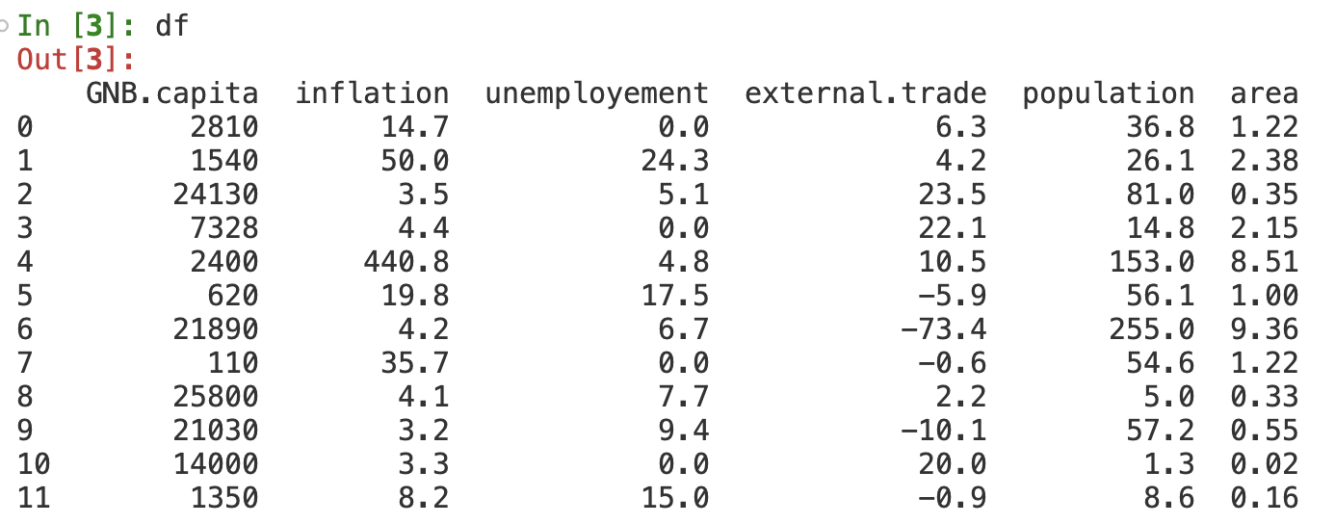
Principal Component Analysis
PCA is often used as a tool for visualizing data with many predictors.
The “Economics” dataset describes 12 countries with 6 economic indicators from 1991
observations
features

Slide 28
Principal Component Analysis
We can plot on a 2D plane the coordinates of the projections on the first two PC

Slide 29
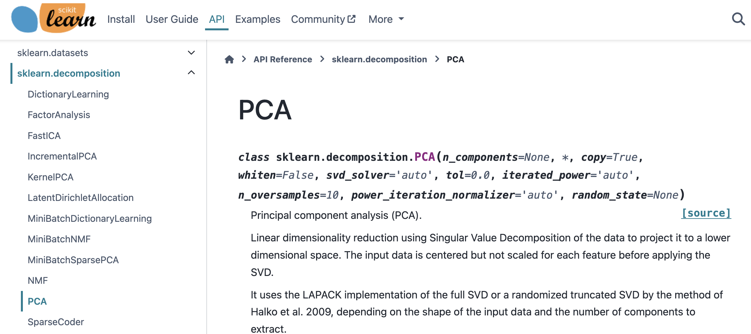
Principal Component Analysis
This can be very easily done using scikit-learn

Slide 30
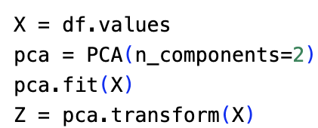
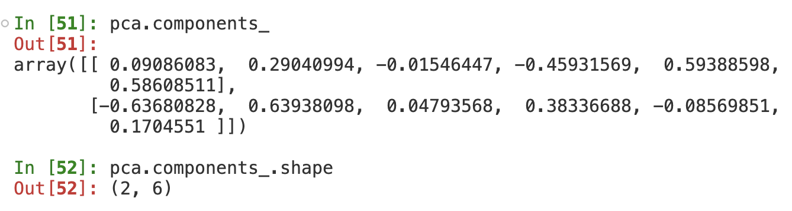
Principal Component Analysis
This can be very easily done using scikit-learn
We can also get the values of the projection matrix for the PCA

Slide 31
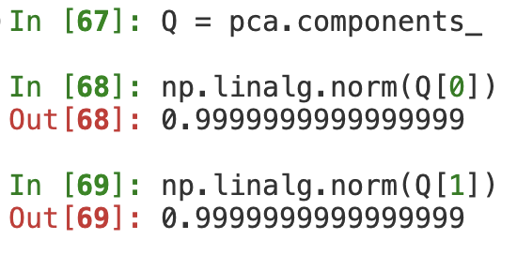
Principal Component Analysis
Remember that the components are unit vectors, i.e. directions
W
W[0]
W[1]
We can inspect how each feature decomposes along the principal components

Slide 32
Principal Component Analysis
Remember that the components are unit vectors, i.e. directions
W
W[0]
W[1]
We can inspect how each feature decomposes along the principal components
However, matrix W only conveys direction information. How to include the importance of each PC?

Slide 33
Principal Component Analysis : the correlation plot
It is common to define the notion of loadings of the PCA as per
which describes how much the variable i is correlated to the principal component j
p variables
q principal components

Slide 34
Principal Component Analysis : the correlation plot
It is common to define the notion of loadings of the PCA as per
which describes how much the variable i is correlated to the principal component j
W
L

Slide 35
Principal Component Analysis
We can use both plots to make some qualitative observations about the data:
🇧🇷 Brazil is a large country (big area and big population) with a very high inflation (especially in 1991)
🇺🇸 USA is also a large country but with controlled inflation
🇪🇺 The European countries are small and have a high GNB per capita
🇺🇸 USA has a very negative external trade, so is on the opposite direction to EXTTR

Slide 36






A practical example : Eigenfaces
Suppose we had a dataset with all photos from a class trombinoscope :
Flattening the matrices, we end up with
128x128 pixels
Can we use PCA to get lower-dimensional representations of the photos?
We can calculate the covariance matrix and get its eigenvectors, which are “eigenfaces”

Slide 37
A practical example : Eigenfaces
Then, we would like to check if we can write
Note that if this turns out to be a good approximation, then it means that each photo can be encoded with just 4 numbers (i.e., the weights) instead of 16384
But what would be the most appropriate values for these weights? The projection!
We should then compare the reconstruction based on 4 eigenfaces vs original photo

Slide 38
A practical example : Eigenfaces
The result with only four eigenfaces is disappointing…
But what if we tested with more?

Slide 39
A practical example : Eigenfaces
The result with only four eigenfaces is disappointing… but what if had more?
It is interesting to note that although the eigenvalues decay very quickly, we need to add many components in the decomposition to get a good visible result

Slide 40
Some important mathematical tools
Principal Component Analysis (PCA)
Principal Component Regression (PCR)
Some practical issues

Slide 41
Principal components regression
We will also suppose has been re-centered so that the intercept is zero (why?)
We can do linear regression using a few principal components as features
and can relate the parameters of each model:

Slide 42
Principal components regression
Workflow for doing PCR on a dataset with
Choose the dimension q of the subspace to project the datapoints
Re-center data points

Slide 43
Principal components regression
Workflow for doing PCR on a dataset with
Choose the dimension q of the subspace to project the datapoints
Re-center data points
⚠️
DATA LEAKAGE
🚰
You’re using information from the whole dataset!

Slide 44
Principal components regression
Workflow for doing PCR on a dataset with
Choose the dimension q of the subspace to project the datapoints
Split the dataset into training and test partitions
Learn to re-center data points using only the training set
⚠️
(By definition)
(By assumption)

Slide 45
Principal components regression
Workflow for doing PCR on a dataset with
Choose the dimension q of the subspace to project the datapoints
Split the dataset into training and test partitions
Learn to re-center data points using only the training set
⚠️
Estimate the covariance matrix of the re-centered samples from
Get q-top eigenvectors of and use to define the projector matrix
Project data points from to get the corresponding
Regress on the observations to get and then the

Slide 46
Principal components regression
Workflow for doing PCR on a dataset with
Evaluate the MSE on being careful to use the pre-processing learned in training set
⚠️
both learned from training dataset
Be sure to follow this procedure, otherwise you risk having exceedingly optimistic results

Slide 47
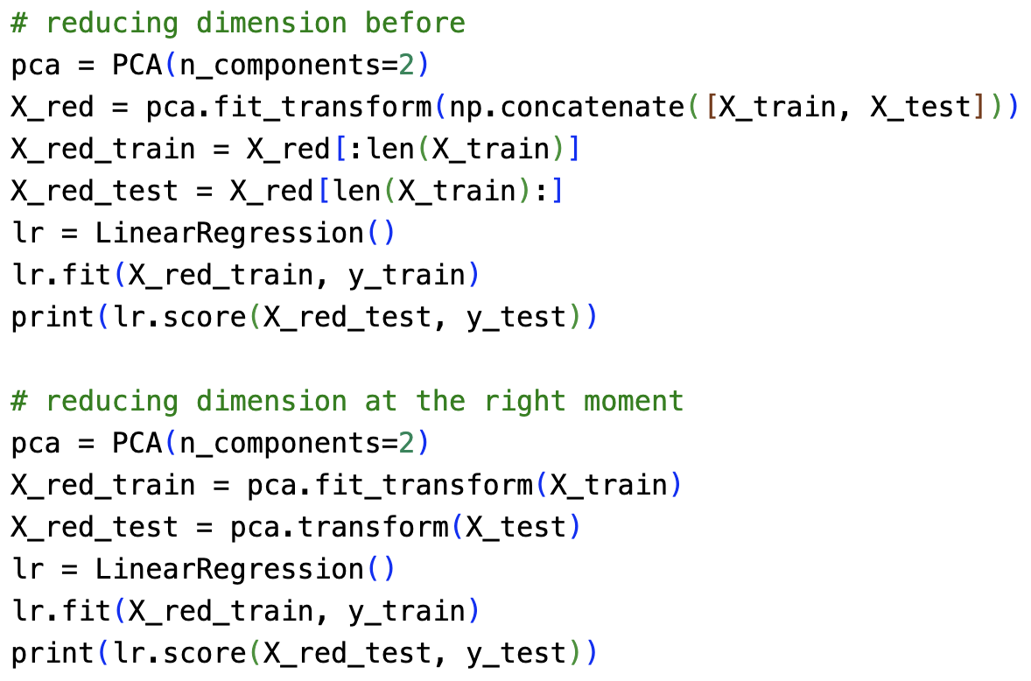
Principal components regression
Example of a PCR with data leakage
0.97
0.01

Slide 48
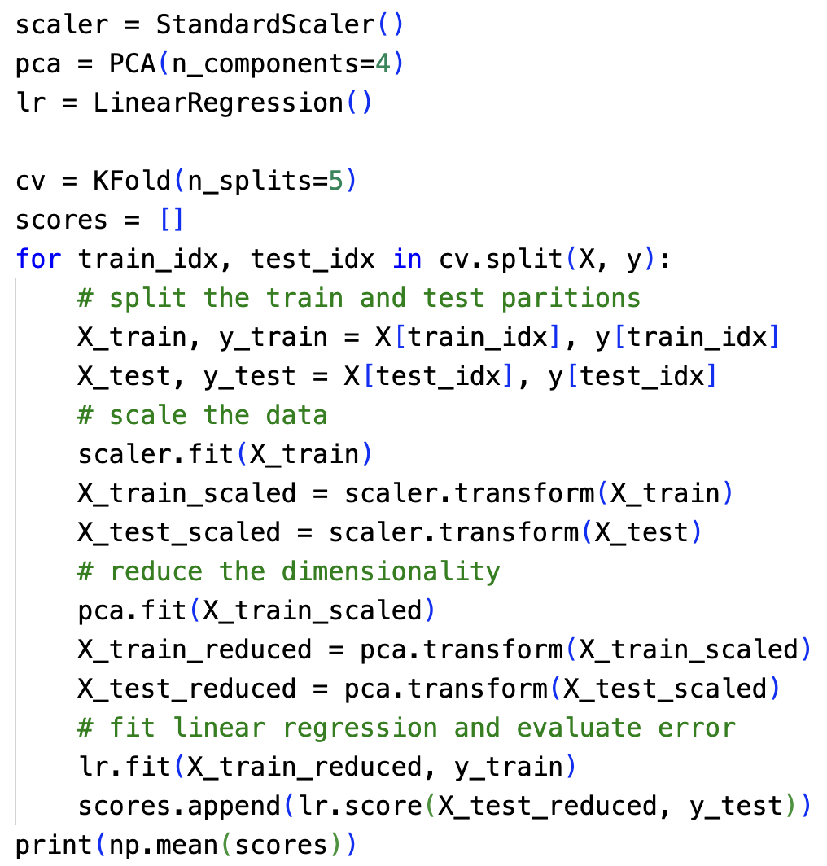
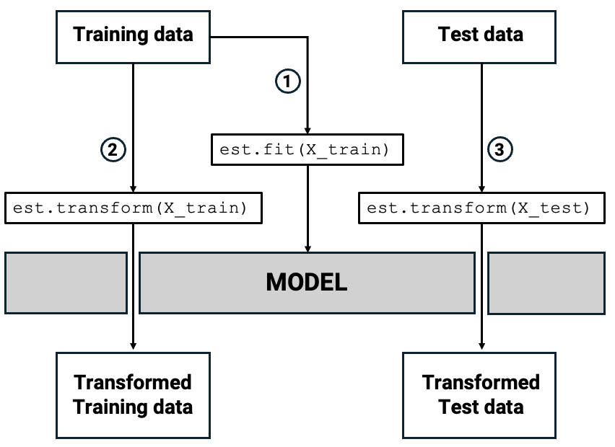
Principal components regression : in practice
The transformer API in scikit-learn

Slide 49
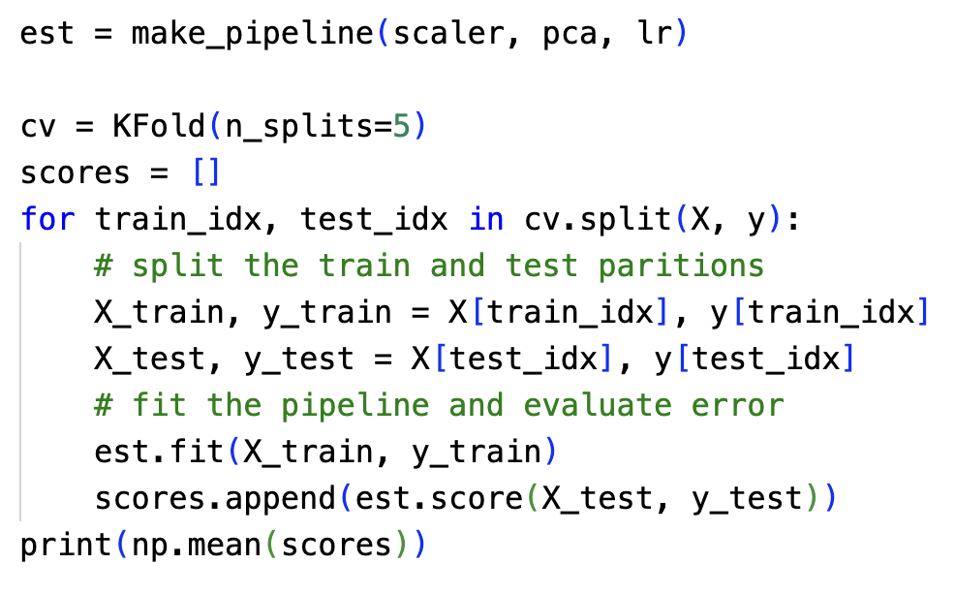
Principal components regression : in practice
Pipelines make things much less error prone!
🙏

Slide 50
Some important mathematical tools
Principal Component Analysis (PCA)
Principal Component Regression (PCR)
Some practical issues

Slide 51
Some practical issues
What happens when ? i.e. when we have less samples than features
Some information we can use:
The rank of a matrix is the dimension of the column space
It is easy to show that
-- use the null space to show this!
We have that is p minus the number of zero eigenvalues
Therefore, if then
And there are at least zero eigenvalues in the covariance matrix!
Notes:
The r

Slide 52
Some practical issues
What happens if the features have different scales? i.e. different variances
We know that the total variance of the data is split along the different eigenvalues
If feature F have much more variance than the others, then:
The first component of PCA will be mostly aligned with the values of F, since it contains most of the total variance from the dataset
Therefore, PC1 will have nearly zero loadings on all of its coordinates except the one for F
Notes:
The r

Slide 53
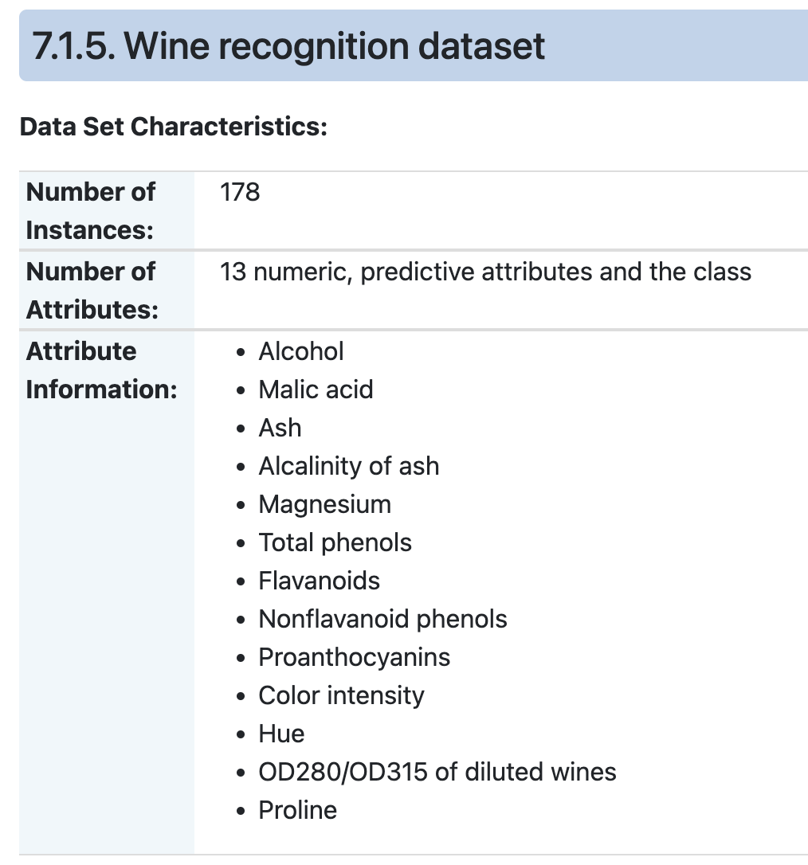
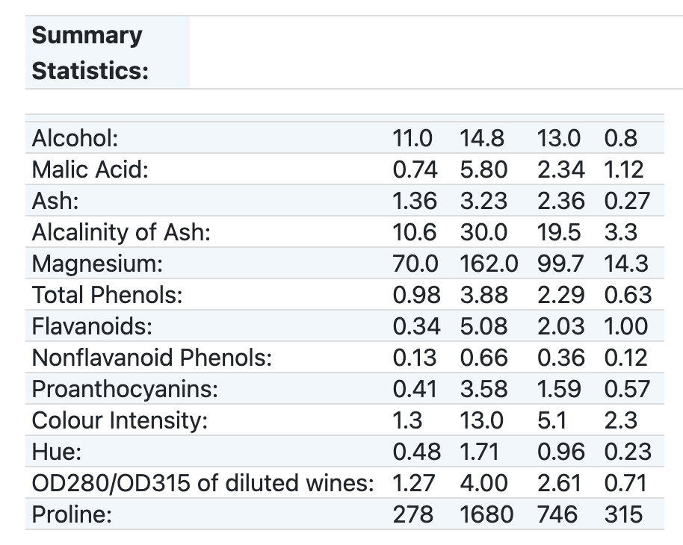
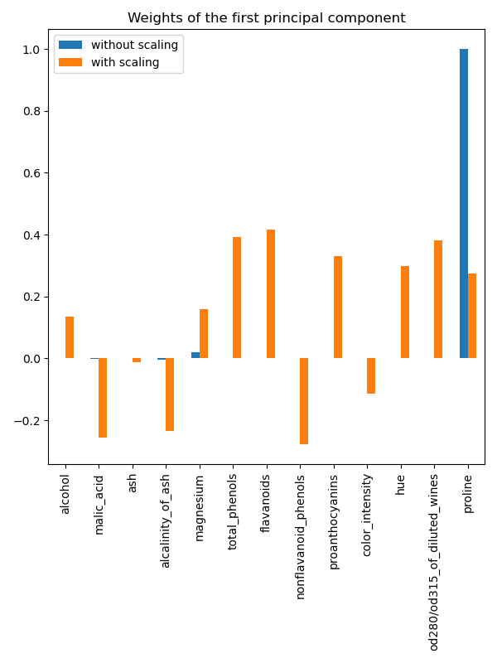
Some practical issues
What happens if the features have different scales? i.e. different variances
Note the difference in scale among the features for this dataset
Source: sklearn’s documentation
Notes:
The r

Slide 54
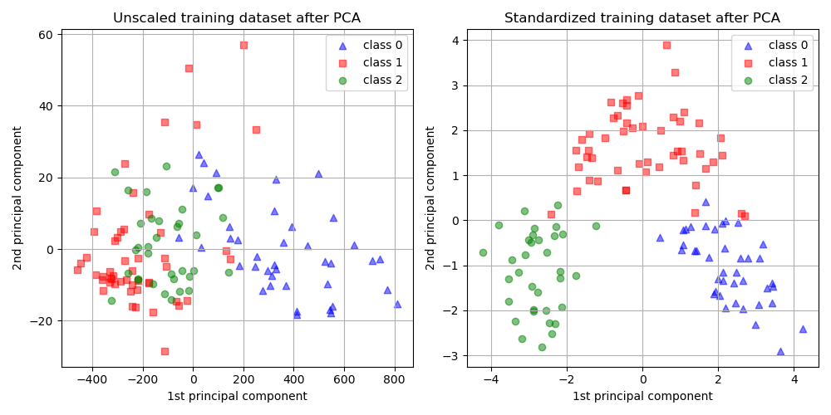
Some practical issues
What happens if the features have different scales? i.e. different variances
Note the difference in scale among the features for this dataset
Source: sklearn’s documentation
Notes:
The r

Slide 55
Some practical issues
What happens if the features have different scales? i.e. different variances
Without scaling
With scaling
Notes:
The r

Slide 56
Some practical issues
How do we calculate the PCA in practice?
Use singular value decomposition!
Every matrix can be decomposed as:
Where with
Matrices and have orthonormal columns.
the variance explained by
(always remember to re-center the data matrix!)
principal components
normalized principal scores
Notes:
The r

Slide 57

Another practical example
Consider the foodOfTheWorld dataset
Three cooking websites were scraped to form a database with ~13k recipes
Each row contains the ingredients of a recipe
Notes:
The r

Slide 58
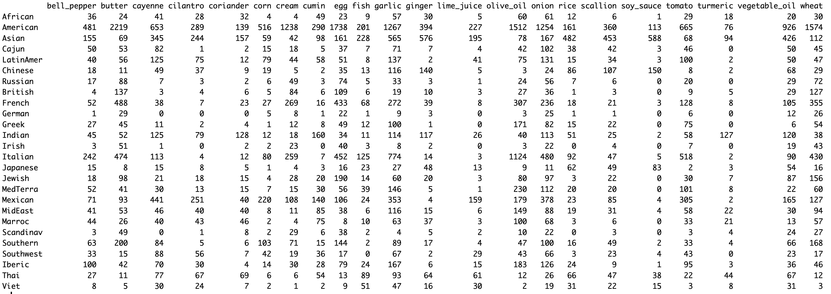
Another practical example
Consider the foodOfTheWorld dataset
We get a contingency table with 26 rows (country) and 22 columns (ingredients)
position (i, j) indicates how many recipes of the country i had the ingredient j
Notes:
The r

Slide 59
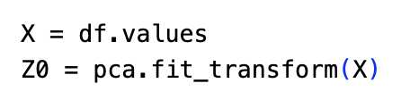
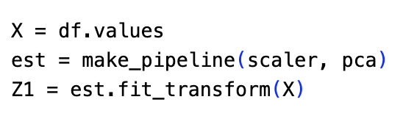
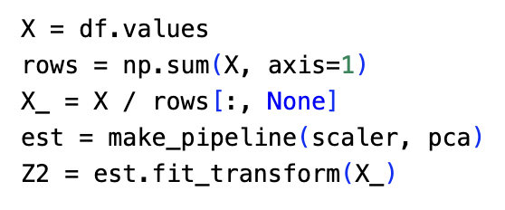
Another practical example
Consider the foodOfTheWorld dataset
Notes:
The r

Slide 60
Another practical example
Consider the foodOfTheWorld dataset
Notes:
The r

Slide 61
Another practical example
Consider the foodOfTheWorld dataset
Notes:
The r

Slide 62
Another practical example
PC2
PC1
Notes:
The r

Slide 63
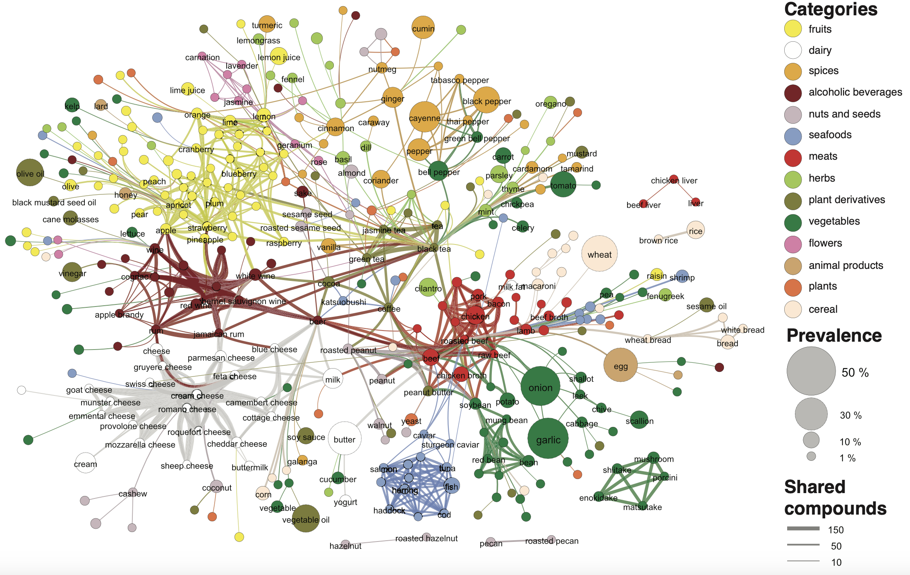
Some practical issues
Consider the foodOfTheWorld dataset available here:
https://github.com/HerveAbdi/data4PCCAR/blob/master/data/foodOfTheWorld.rda
If you want to delve further in this dataset, see blog post using R to explore the dataset
https://www.r-bloggers.com/2015/12/a-visualization-of-world-cuisines/
Or even this article studying how similar flavors combine
Ahn et al. “Flavor network and the principles of food pairing” (2011)
Notes:
The r

