Slide 1
Introduction to Statistical Learning with Applications
TD5: Questions from previous exams
Pedro L. C. Rodrigues

Slide 2
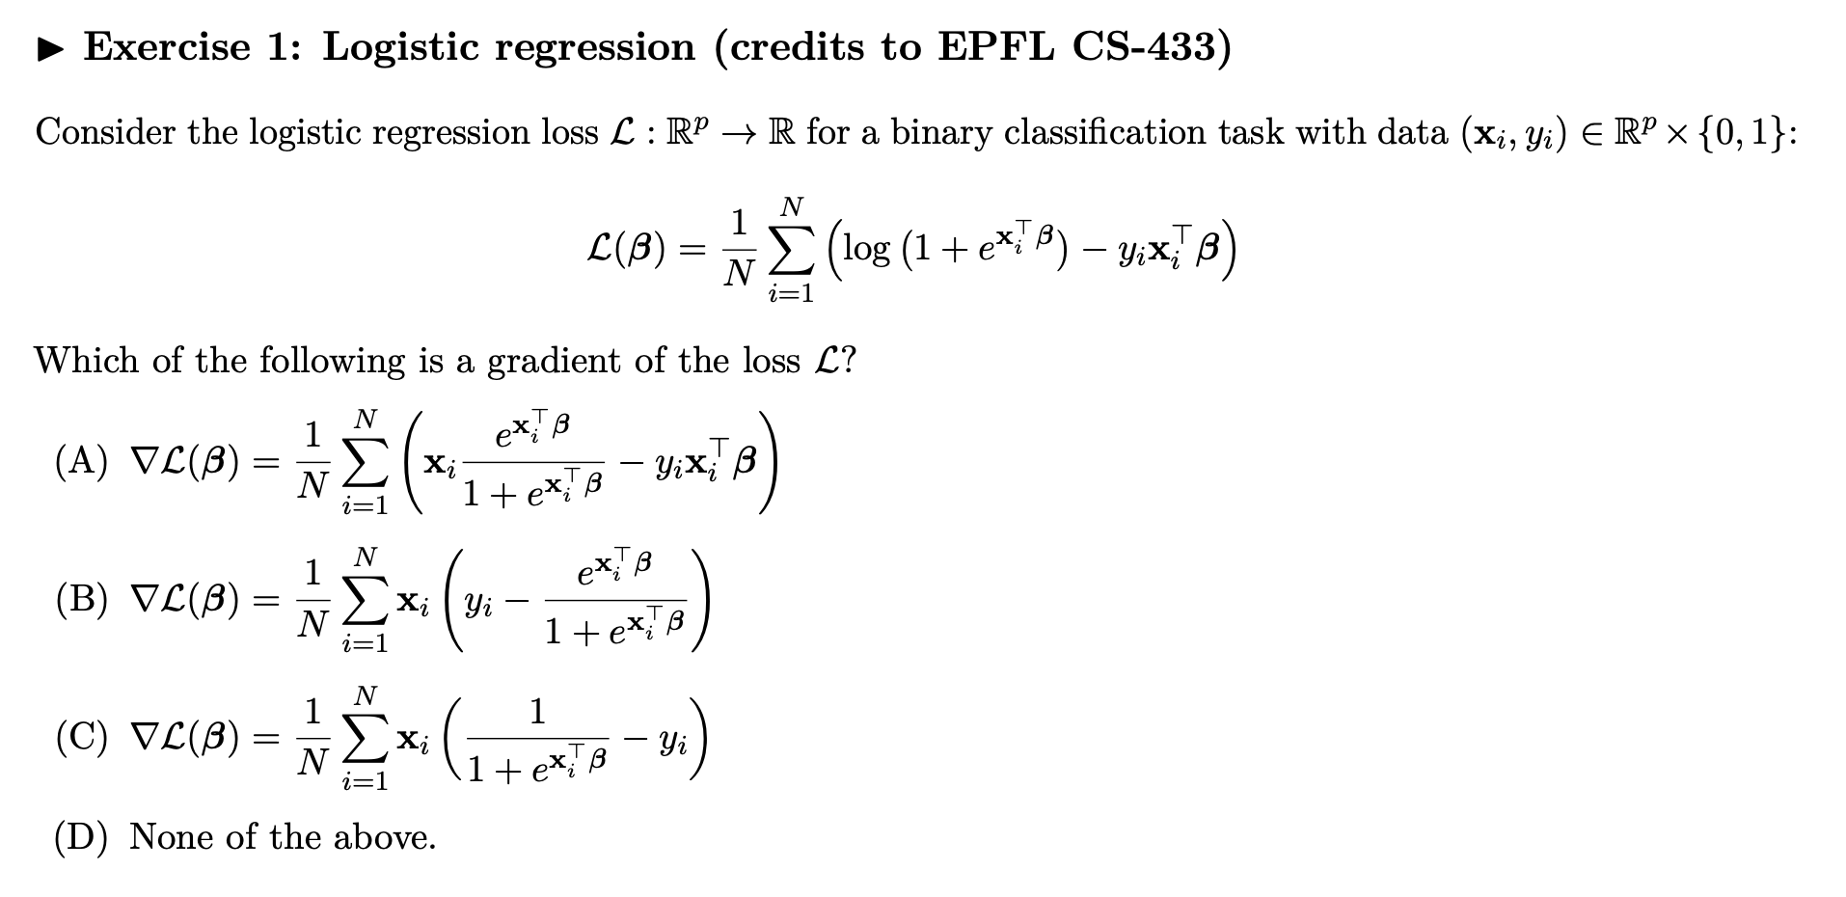
Exercise 1
Notes:
The r

Slide 3
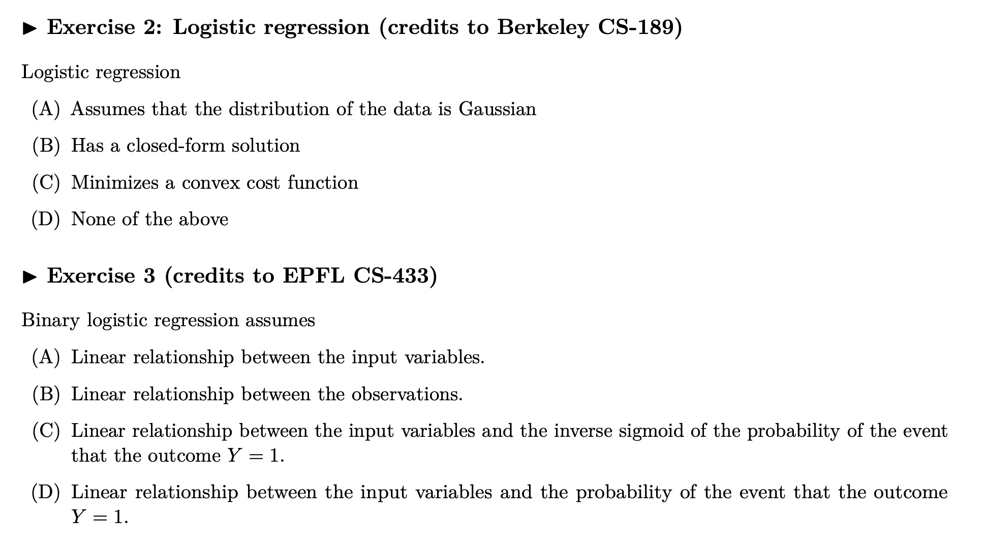
Exercises 2 and 3
Notes:
The r

Slide 4
Exercises 2 and 3
Notes:
The r

Slide 5
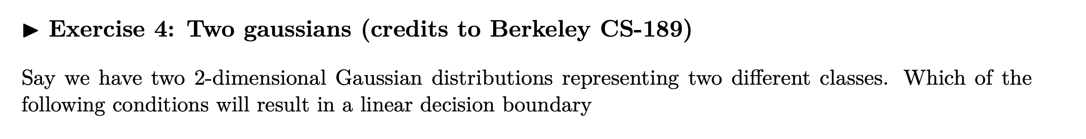
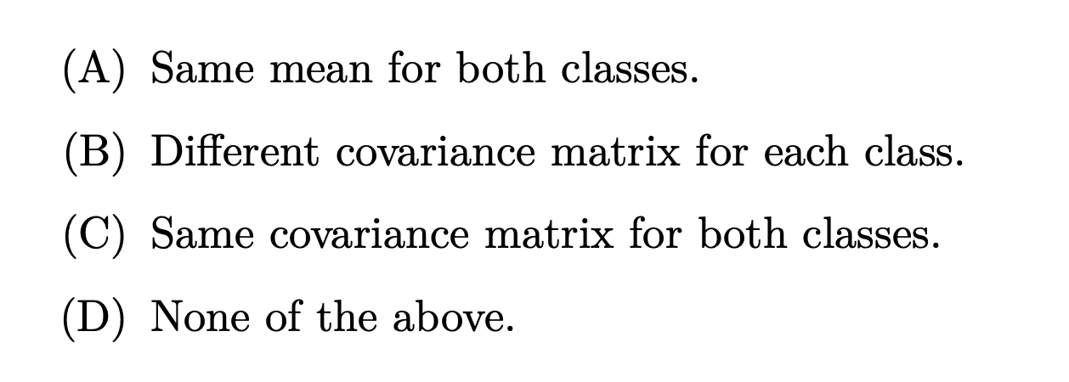
Exercises 4 and 5
Notes:
The r

Slide 6
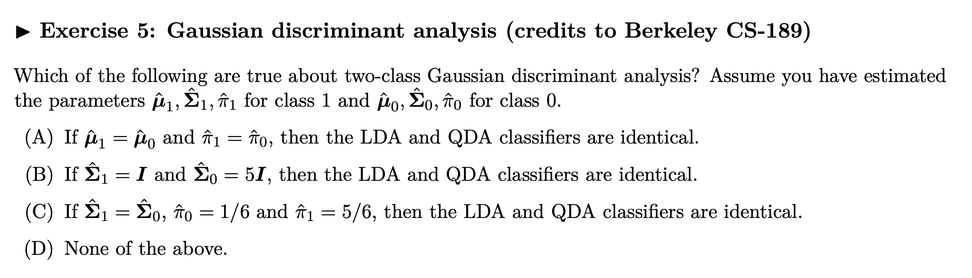
Exercises 4 and 5
Notes:
The r

Slide 7
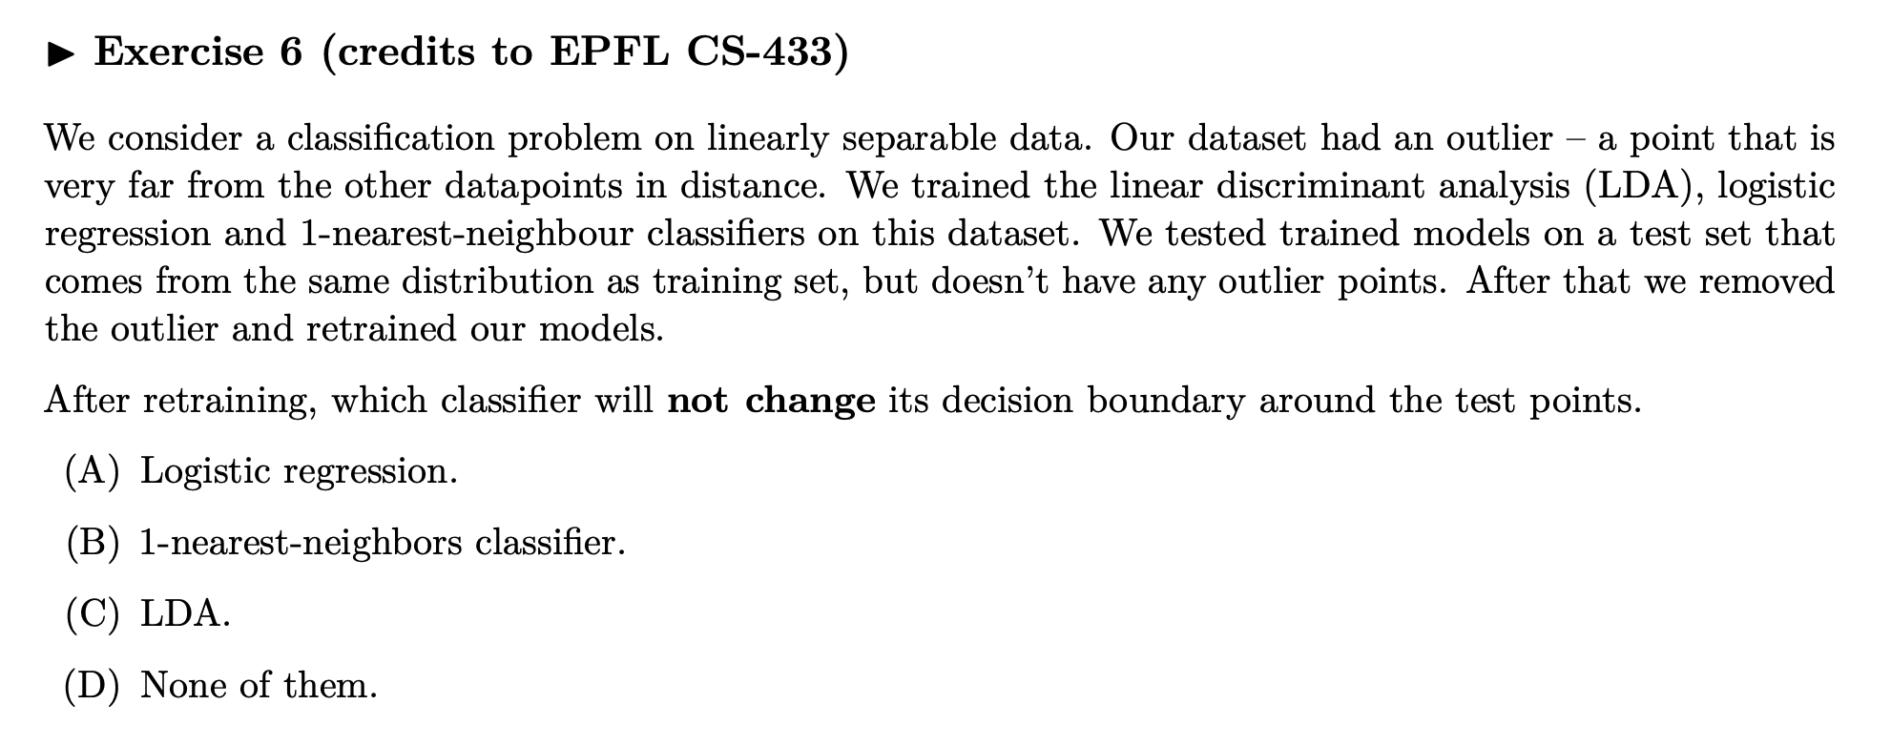
Exercise 6
Notes:
The r

Slide 8
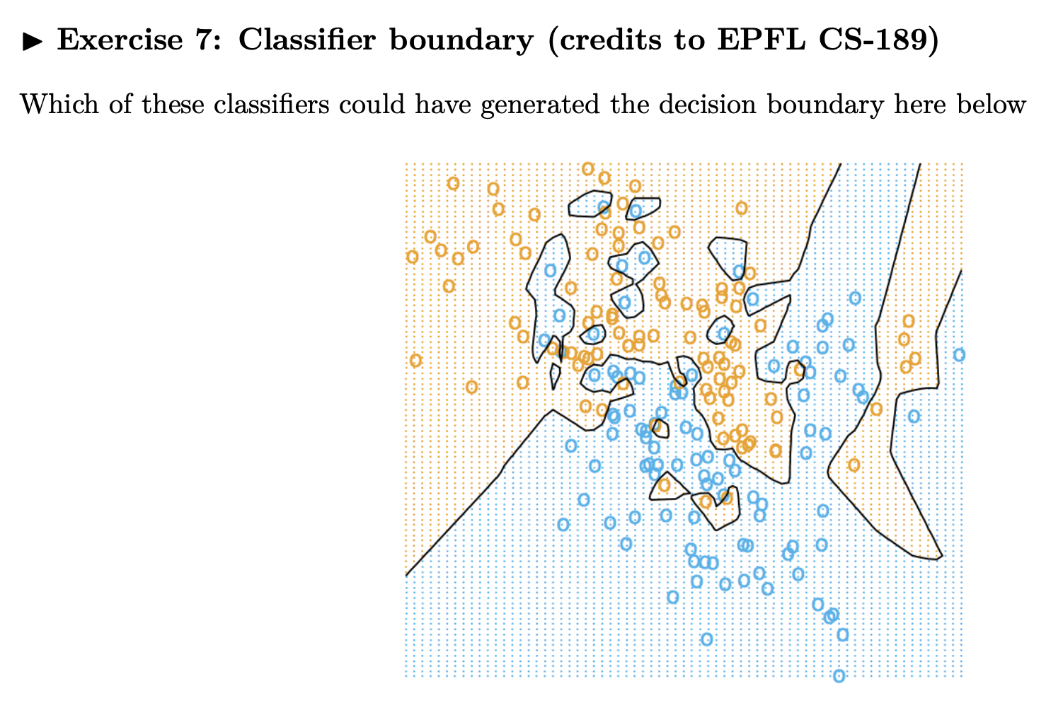
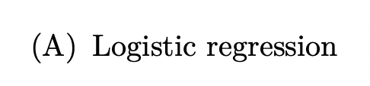
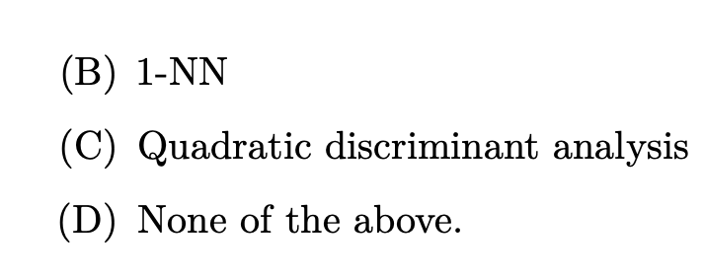
Exercise 7
Notes:
The r

Slide 9
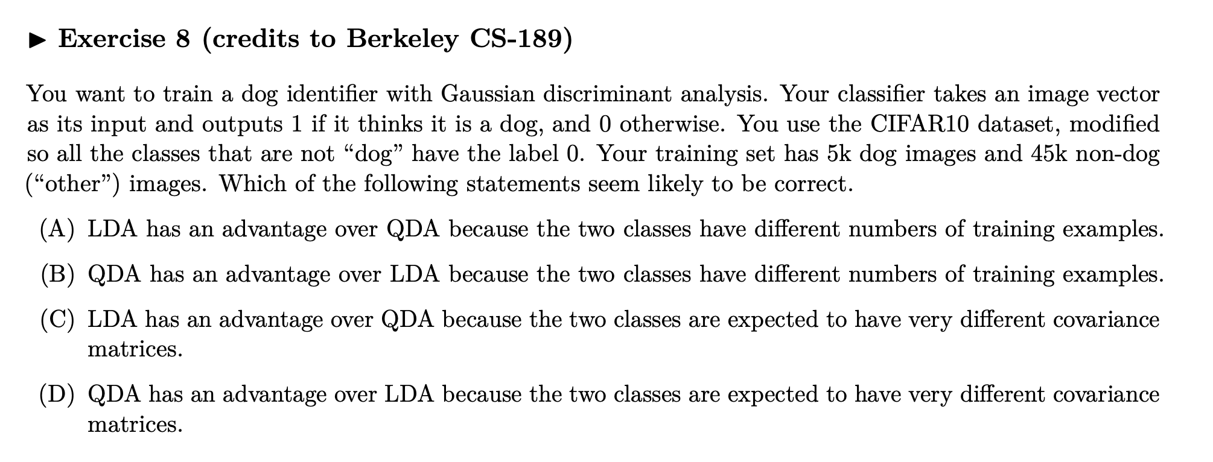
Exercise 8
Notes:
The r

Slide 10
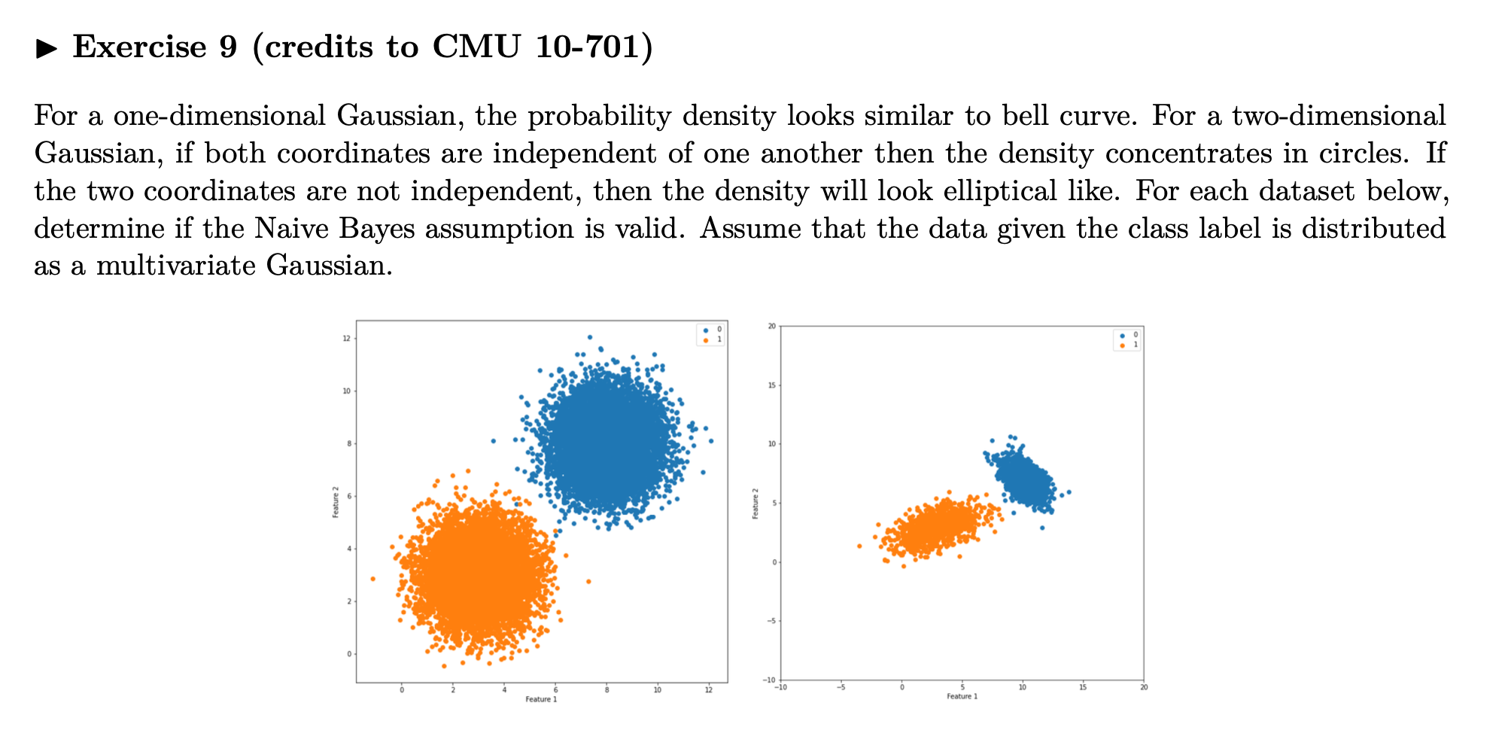
Exercise 9
Notes:
The r

Slide 11
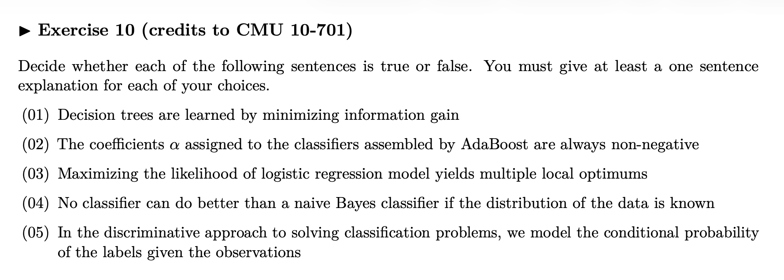
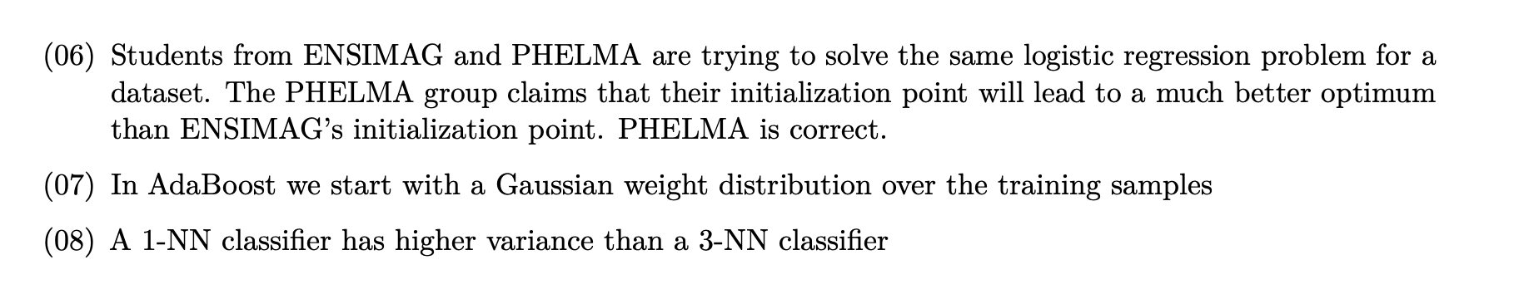
Exercise 10
Notes:
The r

