Slide 1
Introduction to Statistical Learning with Applications
CM5: Linear classifiers – Part 1
Pedro L. C. Rodrigues

Slide 2
Motivation
We are once again interested in supervised methods, but with an important novelty
Problems with observations defined in a set are called classification problems
GOAL
Decide the value of given
In ISLA, we will focus on the fundamentals of classification methods

Slide 3

Important tools from Probability
The Bayes classifier
Discriminative approaches
Some practical issues

Slide 4
Important tools from probability theory
We will be needing several concepts from your classes in probability and statistics
For any set
and a pdf we have that

Slide 5
Important tools from probability theory
We will be needing several concepts from your classes in probability and statistics
For any set
and a pdf we have that
For any function
and joint pdf we have that

Slide 6
Important tools from probability theory
The conditional probability we will be using most often is written as
with
data likelihood
Note that we are very careful when mixing continuous and discrete objects!

Slide 7
Important tools from probability theory
The conditional probability we will be using most often is written as
with
data likelihood
Note that we are very careful when mixing continuous and discrete objects!
The probability in a small ball of radius centered around is

Slide 8
Important tools from probability theory
The rigorous (and correct) way of expressing something like
The probability of Y being equal to 1 given that X is x₀
is to write

Slide 9
Important tools from probability theory
The rigorous (and correct) way of expressing something like
The probability of Y being equal to 1 given that X is x₀
is to write
For continuous random variables we always consider their probability to be in a set
But most books, articles, etc, will simply write 😟

Slide 10
Important tools from Probability
The Bayes classifier
Discriminative approaches
Some practical issues

Slide 11
The Bayes classifier
We want to find a function
such that it minimizes the probability error

Slide 12
The Bayes classifier
We want to find a function
such that it minimizes the probability error
we can focus on what is going on inside the expectation over

Slide 13
The Bayes classifier
We want to find a function
such that it minimizes the probability error
Note that for each
two things can happen:
which contributes with
to the loss function
which contributes with
to the loss function
The optimal discriminant function for a test observation is therefore
which is also known as the Bayes classifier

Slide 14
The Bayes classifier
Example on a simulated dataset
The data points are defined in
and they are sampled as per
with

Slide 15
The Bayes classifier
Example on a simulated dataset
The data points are defined in
and they are sampled as per
with

Slide 16
The Bayes classifier
Example on a simulated dataset
The conditional probability for small is
ball centered around x₀
And the Bayes classifier is written as
The boundary region is defined as

Slide 17
The Bayes classifier
Example on a simulated dataset
The error rate of the Bayes classifier is the minimal value that one may expect for any classifier applied to the dataset.
Is the problem solved then?

Slide 18
The Bayes classifier
Example on a simulated dataset
The error rate of the Bayes classifier is the minimal value that one may expect for any classifier applied to the dataset.
Is the problem solved then?
NO
😔
We never know the true data distributions
So we end up approximating things…

Slide 19
Important tools from Probability
The Bayes classifier
Discriminative approaches
Some practical issues

Slide 20
Discriminative approaches
There are many strategies for approximating the Bayes classifier.
In this course we will focus on:
K-nearest neighbours (kNN)
Discriminative approaches
Logistic regression
Linear and quadratic discriminant analysis
Generative approaches
Naïve Bayes classifier
Random forests
Ensembling approaches
Gradient boosted trees

Slide 21
Discriminative approaches
K-nearest neighbours (kNN)
Note first that for any test point we can always write

Slide 22
Discriminative approaches
K-nearest neighbours (kNN)
Note first that for any test point we can always write
with
In kNN we approximate i.e. the set of K nearest neighbours of
This approximation is good when the data points are densely distributed

Slide 23
Discriminative approaches
K-nearest neighbours (kNN)
In kNN we approximate i.e. the set of K nearest neighbours of
kNN is a nonparametric classifier: it makes no assumptions about the data
It can be very flexible but not optimal when we know something about the data
It works well in low dimensions, but suffers from the curse of dimensionality
You will see more of this with Razan
The hyper-parameter K is usually chosen via cross-validation

Slide 24
Discriminative approaches
K-nearest neighbours (kNN)
The classifier boundary gets smoother when K increases (Why?)
However, it does not look that much like the Bayes classifier boundary…

Slide 25
Discriminative approaches
K-nearest neighbours (kNN)
The error of kNN usually evolves with the choice of K as below

Slide 26
Discriminative approaches
What about a parametric approach?
First, note that if we had and
with then
Therefore, the Bayes classifier is

Slide 27
Discriminative approaches
Logistic regression
It sounds reasonable to propose a parametric approximator as
where we will consider
and denote
Note that we have a quantity that is in [0, 1]
What if we had used linear regression instead?

Slide 28
Discriminative approaches
Logistic regression
Despite being nonlinear in the parameters, the classification boundary of logistic regression is linear
Which is why it is a linear classifier!
defines a separating hyperplane

Slide 29
Discriminative approaches
Logistic regression
How do we estimate in general?
Our goal is to have an approximator such that
Note that since we’re in the binary case, we can write
and
We will look for parameters capable of minimizing a statistical divergence, i.e.
The approximator should be close to the target in average for every data point X

Slide 30
Discriminative approaches
Logistic regression
How do we estimate in general?
Expanding, we get
Which can be rewritten to give
Where the data points are with
This is also what people very often call the cross-entropy loss

Slide 31
Discriminative approaches
Logistic regression
How do we estimate in general?
Remember that
Unfortunately, we no longer have a closed form solution for the parameters…
But we can proceed with a gradient descent procedure
where
which will converge to a global minimum since the loss function is concave

Slide 32
Important tools from Probability
The Bayes classifier
Discriminative approaches
Some practical issues

Slide 33
Some practical issues
What if we have more than just two classes?
The Bayes classifier is defined as before, but we compare the posteriors for all classes
For logistic regression with C classes we use a softmax operator as below
so we have a set of p parameters for each class. This is multinomial regression

Slide 34

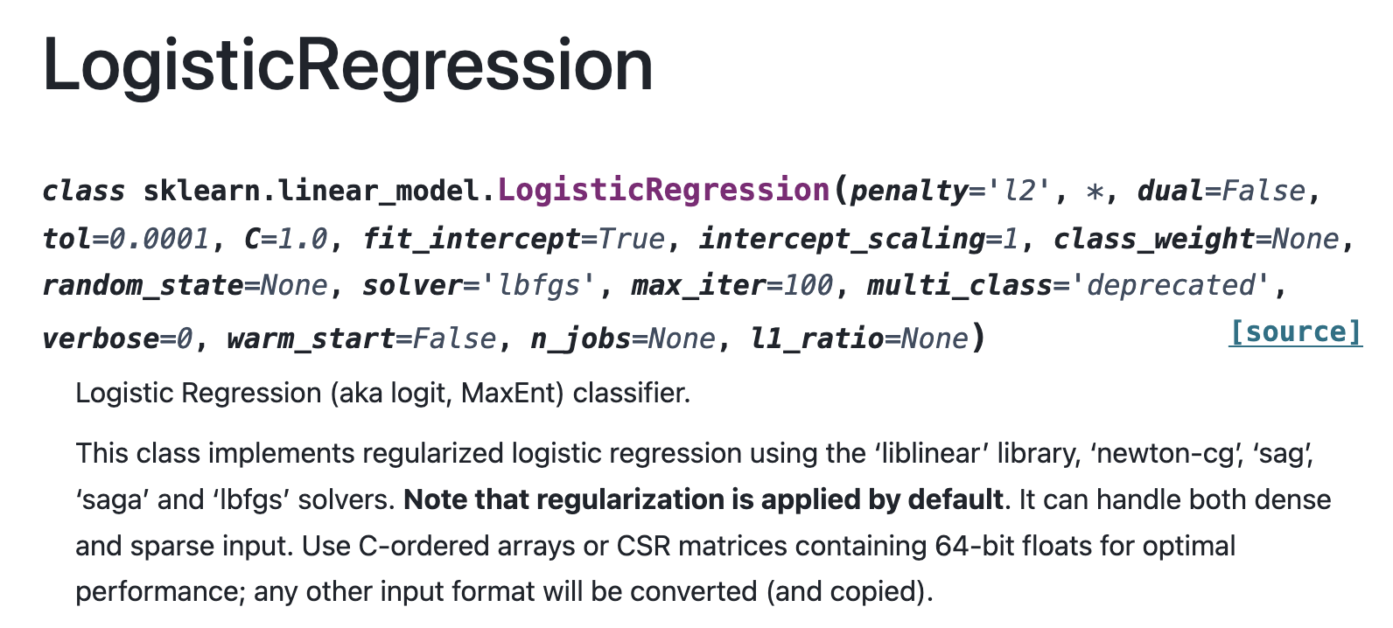
Some practical issues
How to use logistic regression in python?

Slide 35
Exercise from final exam in 2024
Consider a binary classification problem for which the data is generated as per
where
and
Denote a set of N data points as

Slide 36
Exercise from final exam in 2024
(a) Plot the data points in using different colors to indicate classes of each data point and different symbols to indicate whether a point is from the train or the test set
(b) What is the mathematical expression for the optimal Bayes classifier? And for its boundary region? Do you expect it to be linear?
(c) Estimate the error of the Bayes classifier on the
samples from . How do you expect this error to
change as a function of epsilon?
and

Slide 37

Exercise from final exam in 2024
(a) Plot the data points in using different colors to indicate classes of each data point and different symbols to indicate whether a point is from the train or the test set
(b) What is the mathematical expression for the optimal Bayes classifier? And for its boundary region? Do you expect it to be linear?
(c) Estimate the error of the Bayes classifier on the
samples from . How do you expect this error to
change as a function of epsilon?
and
Let’s do this! 🔥

