Slide 1
Introduction to Statistical Learning with Applications
CM6: Linear classifiers – Part 2
Pedro L. C. Rodrigues

Slide 2

Review from last lecture
Generative approach to classification
Comparisons between methods
Final remarks on classification

Slide 3
The Bayes classifier
We want to find a function
such that it minimizes the probability error
The optimal discriminant function for a test observation is the Bayes classifier
For example,

Slide 4
The Bayes classifier
We want to find a function
such that it minimizes the probability error
The optimal discriminant function for a test observation is the Bayes classifier
For example,

Slide 5
The Bayes classifier
We want to find a function
such that it minimizes the probability error
The optimal discriminant function for a test observation is the Bayes classifier
For example,

Slide 6
The Bayes classifier
We want to find a function
such that it minimizes the probability error
The optimal discriminant function for a test observation is the Bayes classifier
For example,

Slide 7
The Bayes classifier
Example: Consider the simple case in which
Show that the Bayes classifier is
where

Slide 8
The Bayes classifier
The problem of classification can be split into two separate stages
Data point
Prediction
INFERENCE
DECISION
Use training data to learn a model for
Use the learned posterior to make optimal class assignments
Discriminative approaches to classification approximate the posterior distribution
Generative approaches aim at modeling the full probability distribution of the data

Slide 9


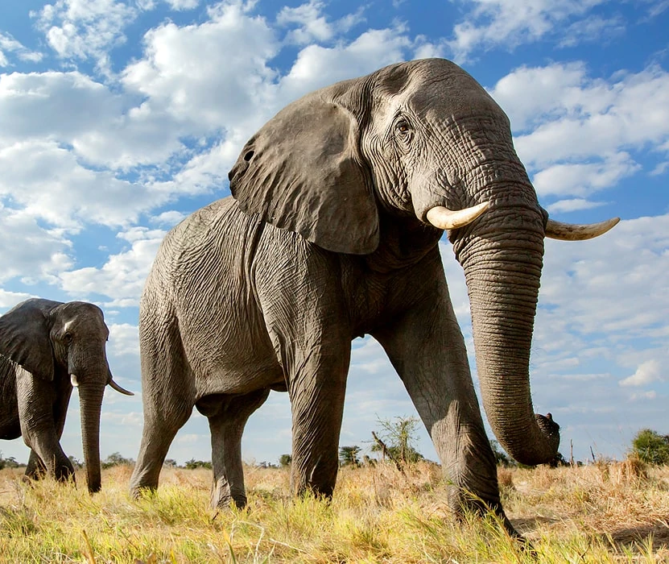


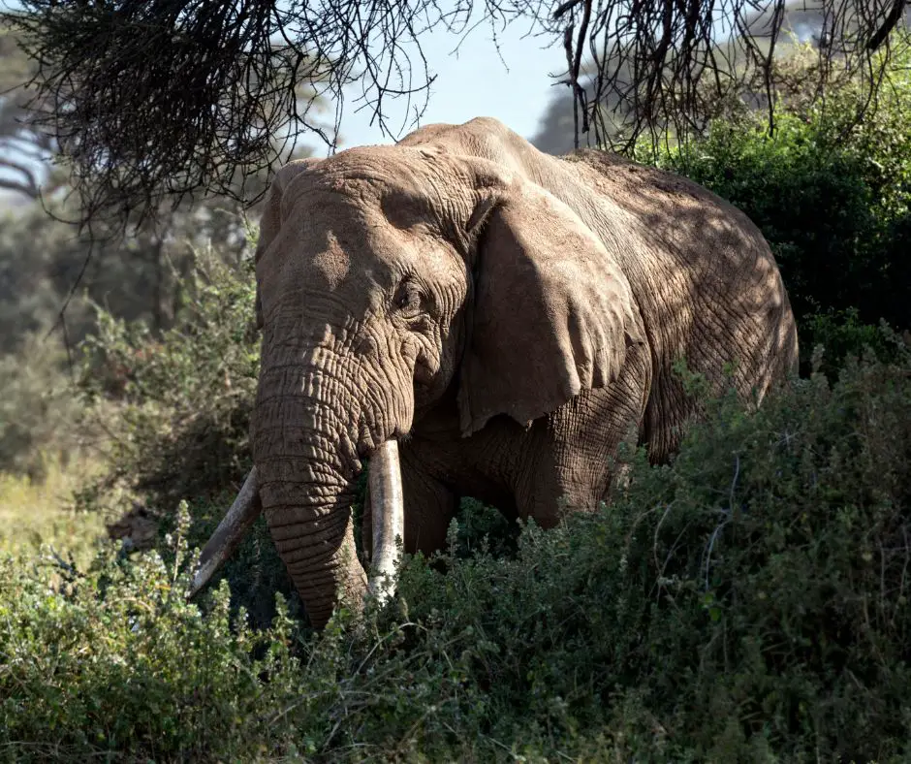
Classification
Suppose we want to learn how to classify photos of dogs versus elephants

Slide 10
Classification
Suppose we want to learn how to classify photos of dogs versus elephants
Discriminative approaches learn how to build the boundary

Slide 11
Discriminative approaches
k-nearest neighbours (kNN)
In kNN we approximate i.e. the set of K nearest neighbours of
Logistic regression
is a nonlinear activation function
bias
weight

Slide 13
Generative approaches
Suppose we want to learn how to classify photos of dogs versus elephants
Discriminative approaches learn how to build the boundary
Generative approaches learn the distribution of each class

Slide 14
Review from last lecture
Generative approach to classification
Comparisons between methods
Final remarks on classification

Slide 15
Generative approaches
Instead of modeling the posterior distribution of the classes, we could model both the
The prior distribution for each class
The conditional pdf of the predictors in each class
We can then use these quantities to define a classifier as follows
(note that it’s the same thing as the Bayes classifier)
Different generative methods will model the conditional pdf in a distinct way
We will consider Gaussian discriminant analysis and the naïve Bayes classifier today

Slide 16
Generative approaches
Gaussian discriminant analysis
In GDA, we suppose that the data from each class follows a Gaussian distribution
Focusing on the two-class case and assuming that
(shared covariance)
Linear discriminant analysis (LDA)
Two classes

Slide 17
Generative approaches
Gaussian discriminant analysis
In GDA, we suppose that the data from each class follows a Gaussian distribution
Focusing on the two-class case and assuming that
(shared covariance)
Linear discriminant analysis (LDA)
K classes

Slide 18
Generative approaches
Gaussian discriminant analysis
Posterior distribution for each class
Relaxing the shared covariance assumption gives quadratic discriminant analysis (QDA)

Slide 19
Generative approaches
Gaussian discriminant analysis
LDA and logistic regression are similar but different: They both yield a linear boundary between classes, but LDA leverages information from the prior distribution, which is not available for the logistic regression
Note that when the data is truly Gaussian in each class, the classifiers are equivalent
Making assumptions over the structure of can serve as a regularization in LDA
Gaussian discriminant analysis is, by definition, not adapted to qualitative predictors
We could, however, use Bernoulli or other discrete random variable to model the conditional pdfs as well
The parameters of logistic regression are estimated using an iterative optimization procedure based on MLE, whereas for LDA/QDA we can estimate directly from data

Slide 20
Generative approaches
Gaussian discriminant analysis
When should we choose LDA or logistic regression?
If data is Gaussian, then the posterior is a logistic function. The converse is not true.
Therefore, LDA makes stronger modeling assumptions about the data than logistic regression
When the assumptions are true, LDA will better fit the data than logistic regression
LDA is asymptotically efficient: for large N, there’s no better algorithm than LDA
By making weaker assumptions, logistic regression is more robust to deviations
Conclusion: it depends. But, in practice, logistic regression is used more often.

Slide 21
Generative approaches
Naïve Bayes classifier
In GDA, we make strong assumptions about data and estimate parameters
For logistic regression we have parameters to estimate
In Naïve Bayes, we assume that, for each class, the predictors are independent
We can, therefore, model just the marginal probabilities of the predictors
If the marginals are Gaussian, then this means that we have parameters to estimate
Do we actually expect the assumption of independence to be true? Not really…
But when working with lots of predictors, this is the only possible approach!

Slide 22
Generative approaches
Naïve Bayes classifier
The classifier can then be written as
Since the marginals are independent, we can model each predictor differently
Quantitative predictors can be modelled with Gaussian, Exponential, etc.
Qualitative predictors can be modelled with Bernoulli, Dirichlet, etc.
The Naïve Bayes classifier is often used in text classification, bioinformatics, etc.
Large dimensional predictors

Slide 23




Generative approaches
How do all this relate to “Generative AI” ?
Current ML researchers try to model and/or learn the distribution of a dataset

Slide 24


Generative approaches
How do all this relate to “Generative AI” ?
Current ML researchers try to model and/or learn the distribution of a dataset
Note, however, that it is often enough to just know how to sample from the distribution
The challenge then is knowing how to build function -- deep neural networks!

Slide 25
Review from last lecture
Generative approach to classification
Comparisons between methods
Final remarks on classification

Slide 26
Comparisons between methods
We consider the simulated benchmark presented in James et al. (2022)
The benchmark compares the performance of six classifiers
KNN-1 : K-nearest neighbours (kNN) with K = 1
KNN-CV : kNN with K obtained with cross-validation
LDA : Linear discriminant analysis
Logistic : Logistic regression
NBayes : Gaussian naïve Bayes
QDA : Quadratic discriminant analysis
Under six scenarios: the first three have linear boundary, the other three are non-linear

Slide 27
Comparisons between methods
We consider the simulated benchmark presented in James et al. (2022)
There were 20 training observations in each of two classes. The observations within each class were uncorrelated random normal variables with a different mean in each class.
Scenario 1
This ensures linear boundary
(The generalization error of the classifiers were assessed on large test datasets with new simulated samples)

Slide 28
Comparisons between methods
Scenario 1
LDA performed well in this setting, as one would expect since this is the model assumed by LDA.
Logistic regression also performed quite well, since it assumes a linear decision boundary.
KNN performed poorly because it paid a price in terms of variance that was not offset by a reduction in bias.
QDA also performed worse than LDA, since it fit a more flexible classifier than necessary.
The performance of naive Bayes was slightly better than QDA, because the naive Bayes assumption of independent predictors is correct.

Slide 29
Comparisons between methods
We consider the simulated benchmark presented in James et al. (2022)
Scenario 2
Same setup as Scenario 1, but predictors have correlation of -0.5
This ensures linear boundary

Slide 30
Comparisons between methods
Scenario 2
The performance of most methods is like the previous scenario. The notable exception is naive Bayes, which performs very poorly here, since the naive Bayes assumption of independent predictors is violated.

Slide 31
Comparisons between methods
Scenario 3
Same setup as in Scenario 2, but the predictors are generated from a t-distribution and N = 50
The decision boundary is still linear, and so fit into the logistic regression framework. The set-up violated the assumptions of LDA, since the observations were not drawn from a normal distribution.
Logistic regression outperformed LDA, and both methods were superior to the other approaches.
In particular, the QDA results deteriorated considerably because of non-normality.
Naive Bayes performed very poorly because the independence assumption is violated.

Slide 32
Comparisons between methods
We consider the simulated benchmark presented in James et al. (2022)
Scenario 4
Data is generated from a normal distribution with correlation 0.5 between the predictors in the first class, and correlation −0.5 between the predictors in the second class

Slide 33
Comparisons between methods
Scenario 4
Setup fits QDA assumptions, which yields quadratic decision boundaries.
We see that QDA outperformed all the other approaches.
The naive Bayes assumption of independent predictors is violated, so naive Bayes performs poorly.

Slide 34
Comparisons between methods
Scenario 5
Data generated from Normal distribution with uncorrelated predictors. Then responses sampled from the logistic function applied to a non-linear function of the predictors.
Both QDA and naive Bayes gave slightly better results than the linear methods,
The much more flexible KNN-CV method gave the best results.
But KNN with K = 1 gave the worst results out of all methods. This highlights the fact that even when the data exhibits a complex non-linear relationship, a non-parametric method such as KNN can still give poor results if the level of smoothness is not chosen correctly.

Slide 35
Comparisons between methods
The observations were generated from a normal distribution with a different diagonal covariance matrix for each class. However, the sample size was very small: just N = 6 in each class.
Naive Bayes performed very well, because its assumptions are met.
LDA and logistic regression performed poorly because the true decision boundary is non-linear, due to the unequal covariance matrices.
QDA performed a bit worse than naive Bayes, because given the very small sample size, the former incurred too much variance in estimating the correlation between the predictors within each class.
KNN’s performance also suffered due to the very small sample size.
Scenario 6

Slide 36
Comparisons between methods
CONCLUSION
We see that no method dominates all others in every situation.
When the true decision boundaries are linear, the LDA and logistic regression approaches tend to perform well.
When the boundaries are moderately non-linear, QDA or naive Bayes may give better results.
For much more complicated decision boundaries, a non-parametric approach such as KNN can be superior. But the level of smoothness for a non-parametric approach must be chosen carefully.

Slide 37
Review from last lecture
Generative approach to classification
Comparisons between methods
Final remarks on classification

Slide 38
Final remarks
What if the data is not balanced between each class?
Suppose you’re doing your internship in a bank
💰
You train a classifier on data from customers so to detect when they will default
i.e. not pay their debt
You get a 2.75% error rate
💪🏻
Should they hire you straightaway?
CONFUSION MATRIX

Slide 39
Final remarks
What are other approaches for classifications that we have not discussed?
Remember that the problem of classification can be split into two separate stages
Data point
Prediction
INFERENCE
DECISION
Using discriminant functions bypasses the above procedure and ignores probabilities
Support vector machines (SVM), perceptrons, and neural networks are examples
It is also very common to combine classifiers so to leverage their diversity
Some strategies are random forests, bagging, and boosting

Slide 40

Final remarks
Feature engineering
Consider a brain-computer interface (BCI)
LEFT-HAND TRIALS
RIGHT-HAND TRIALS
RECORDING
DIMENSION 1
DIMENSION 2
ENCODING

Slide 41
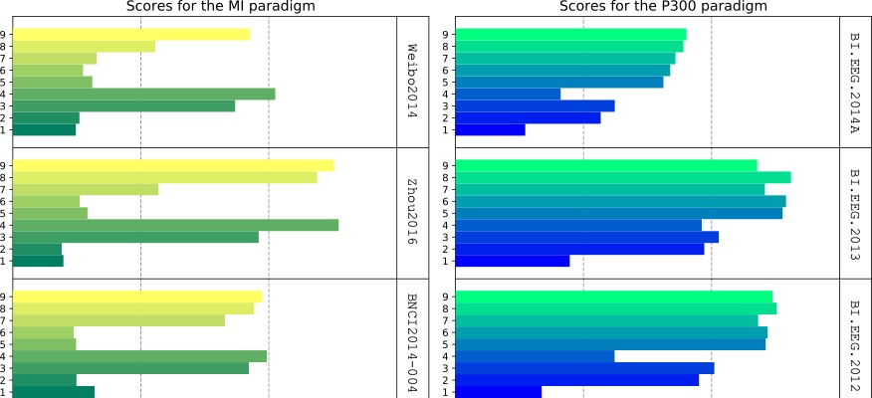
Final remarks
Feature engineering
Consider a brain-computer interface (BCI)
Different encoding strategies yield different performances

Slide 42
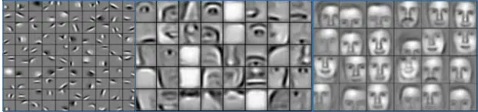
Final remarks
Feature engineering
The traditional workflow in machine learning is to have
PREPROCESSING
FEATURE EXTRACTION
CLASSIFIER
DATA
PREDICTION
but deep neural networks changed everything by learning features from data
Example of a convolutional neural networks learning features to represent images from a dataset
Layer 1
Layer 2
Layer 3

Slide 43
Final remarks
Differential programming
Recall the objective function for logistic regression
The parameters are obtained via a gradient descent :
This can be rather easily calculated by hand
But what if we want to use a data-driven transformation on the data points?
The gradients can start to become quite cumbersome to calculate…

Slide 44



Final remarks
Differential programming
A deep neural network is nothing more than this…
Where
And the training follows something similar (not quite exactly) gradient descent…
Lucky for us, there has been a lot of development in automatic differentiation

Slide 45
Final remarks
Transfer Learning
One of the main hypothesis of learning classifiers and regressors is that
The statistical distribution of data in training set
=
The statistical distribution of data in test set
In other words: “we train our tools on the same type of data on which we apply them”
But, what if this assumption is violated? Lots of research on the topic!
Coping with statistical drifts in real data (e.g. subject fatigue)
Green machine learning
Explore invariant aspects of datasets

