Slide 1
Introduction to Statistical Learning with Applications
CM7: Decision trees
Pedro L. C. Rodrigues

Slide 2
About challenge #1
⚠️
There was a problem with the challenge : it was possible to find y_test online 🤡
Our solution ensure grading as fair as possible (in less than ideal circumstances)
top 3 scores
top 25% scores
did submissions
did not participate
0 pts
10 pts
15 pts
20 pts
send me your code to validate

Slide 3
Introduction to Statistical Learning with Applications
CM7: Decision trees
Pedro L. C. Rodrigues

Slide 4
Discriminative approaches
There are many strategies for approximating the Bayes classifier.
We have seen so far:
K-nearest neighbours (kNN)
Discriminative approaches
Logistic regression
Linear and quadratic discriminant analysis
Generative approaches
Naïve Bayes classifier
In the following lectures, we will see
Random forests
Ensembling approaches
Gradient boosted trees

Slide 5
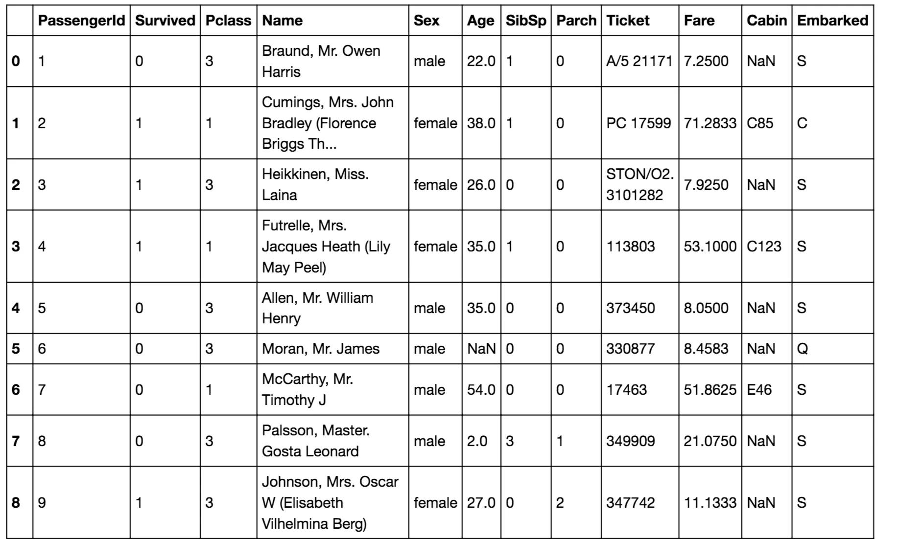

Decision trees
There are many strategies for approximating the Bayes classifier.
Random forests
Ensembling approaches
Gradient boosted trees
Both rely on decision trees and can be used for regression and classification
Example: The Titanic survival dataset

Slide 6
Decision trees
There are many strategies for approximating the Bayes classifier.
Random forests
Ensembling approaches
Gradient boosted trees
Both rely on decision trees and can be used for regression and classification
Example: The Titanic survival dataset
Gender
male
female
Age
SURVIVED
≤ 9.5
> 9.5
SURVIVED
DIED

Slide 7
Decision trees
But first, we will talk again about k-nearest neighbours (kNN)
In kNN we approximate i.e. the set of K nearest neighbours of

Slide 8
Decision trees
But first, we will talk again about k-nearest neighbours (kNN)
In kNN we approximate i.e. the set of K nearest neighbours of
kNN is a nonparametric classifier: it makes no assumptions about the data
It can be very flexible, but sub-optimal when we know something about the data
It works well in low dimensions, but suffers from the curse of dimensionality
The hyper-parameter K is usually chosen via cross-validation

Slide 9
Decision trees
But first, we will talk again about k-nearest neighbours (kNN)
In kNN we approximate i.e. the set of K nearest neighbours of
kNN is a nonparametric classifier: it makes no assumptions about the data
It can be very flexible, but sub-optimal when we know something about the data
It works well in low dimensions, but suffers from the curse of dimensionality
The hyper-parameter K is usually chosen via cross-validation

Slide 10
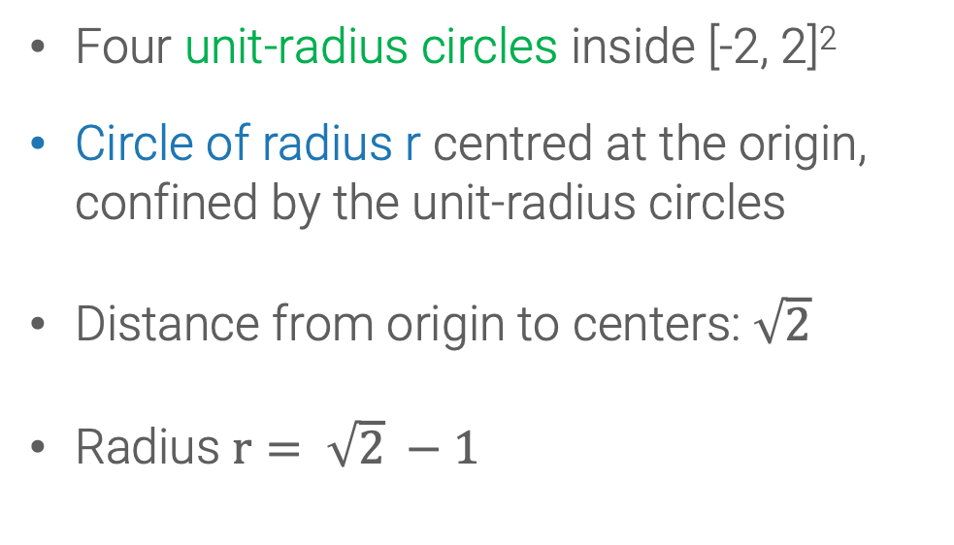
Decision trees
It works well in low dimensions, but suffers from the curse of dimensionality
Example of failure of intuition in high-dimensions
In two-dimensional space R²
Four unit-radius circles inside [-2, 2]²
Circle of radius r centred at the origin, confined by the unit-radius circles
Distance from origin to centers: $\sqrt{2}$
Radius $r= \sqrt{2} −1$
Example from JM Steele “The Cauchy-Schwarz master class”

Slide 11
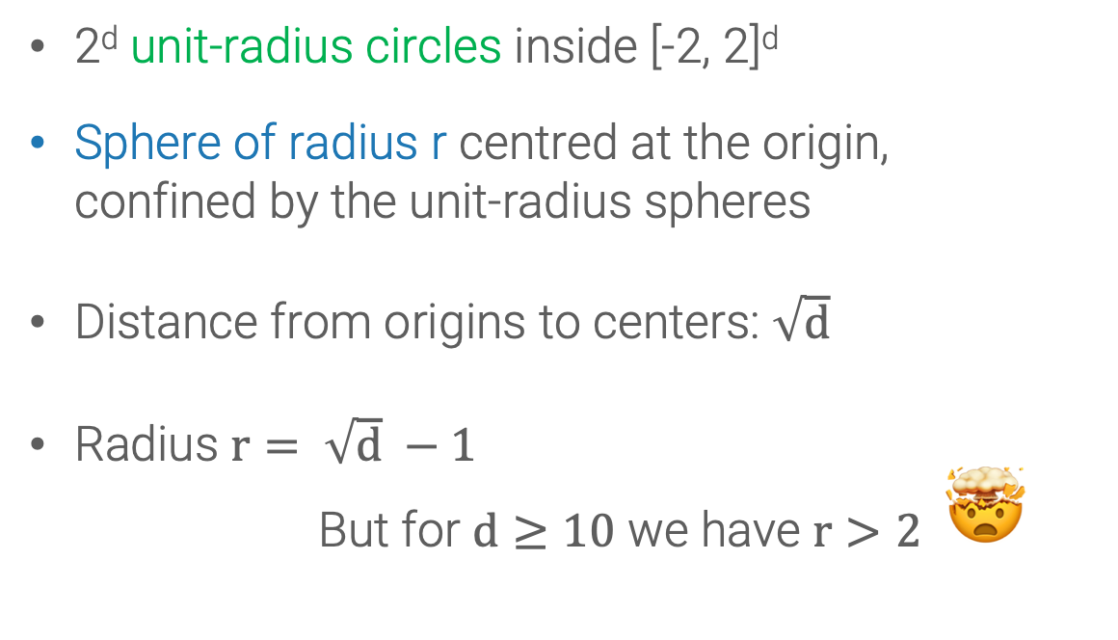
Decision trees
It works well in low dimensions, but suffers from the curse of dimensionality
Example of failure of intuition in high-dimensions
In d-dimensional space R^{d}
2^{d} unit-radius circles inside [-2, 2]^{d}
Sphere of radius r centred at the origin, confined by the unit-radius spheres
Distance from origins to centers: $\sqrt{d}$
Radius $r= \sqrt{d} −1$
But for $d≥10$ we have $r>2$ 🤯
Example from JM Steele “The Cauchy-Schwarz master class”

Slide 12
Decision trees
It works well in low dimensions, but suffers from the curse of dimensionality
The Normal distribution in high-dimensions
Note that the pdf of the radius concentrates quite far from the origin!
Passing to polar coordinates
-- This is the marginal that we can get integrating on the angles

Slide 13
Decision trees
But first, we will talk again about k-nearest neighbours (kNN)
In kNN we approximate i.e. the set of K nearest neighbours of
kNN is a nonparametric classifier: it makes no assumptions about the data
It can be very flexible, but sub-optimal when we know something about the data
It works well in low dimensions, but suffers from the curse of dimensionality
The hyper-parameter K is usually chosen via cross-validation

Slide 14
Decision trees
The hyper-parameter K is usually chosen via cross-validation

Slide 15
Decision trees
But first, we will talk again about K-nearest neighbours (kNN)
Q: How exactly do we classify a point?

Slide 16
Decision trees
But first, we will talk again about K-nearest neighbours (kNN)
Q: How exactly do we classify a point?
(1) For each point find its K nearest neighbours
(2) Assign the class with most representatives

Slide 17
Decision trees
But first, we will talk again about K-nearest neighbours (kNN)
Q: How exactly do we classify a point?
(1) For each point find its K nearest neighbours
(2) Assign the class with most representatives
For N samples, do N(N-1) operations
Can we do better?

Slide 18
Decision trees
But first, we will talk again about K-nearest neighbours (kNN)
Q: How exactly do we classify a point?
(1) For each point find its K nearest neighbours
(2) Assign the class with most representatives
For N samples, do N(N-1) operations
Can we do better? Yes, with
Using KD-Trees (aka binary trees)!

Slide 19
Decision trees
But first, we will talk again about K-nearest neighbours (kNN)
Split the population in half
Can we do better? Yes, with
Using KD-Trees (aka binary trees)!
(A)
(C)
X₁
(B)
≤ 1.25
> 1.25
(D)
X₂
X₂
> 0.8
≤ 0.8
> 0.0
≤ 0.0
(A)
(B)
(C)
(D)
Run kNN in each smaller group of data points

Slide 20
Decision trees
In decision trees we simply assign the majority label to all points in each region
Split the population in half
X₁
(A)
(C)
≤ 1.25
> 1.25
X₂
X₂
(B)
> 0.8
≤ 0.8
> 0.0
≤ 0.0
(D)
👍
This avoids storing the whole training dataset and repeating nearest-neighbour searches
👎
But maybe the splits should be done differently?

Slide 21
Decision trees
In decision trees we simply assign the majority label to all points in each region
X₁
(A)
(B)
≤ 1.0
> 1.0
X₂
> -0.8
≤ -0.8
(C)
But what is a good criterium to split the data?
➞ Aim for homogeneous splits!

Slide 22
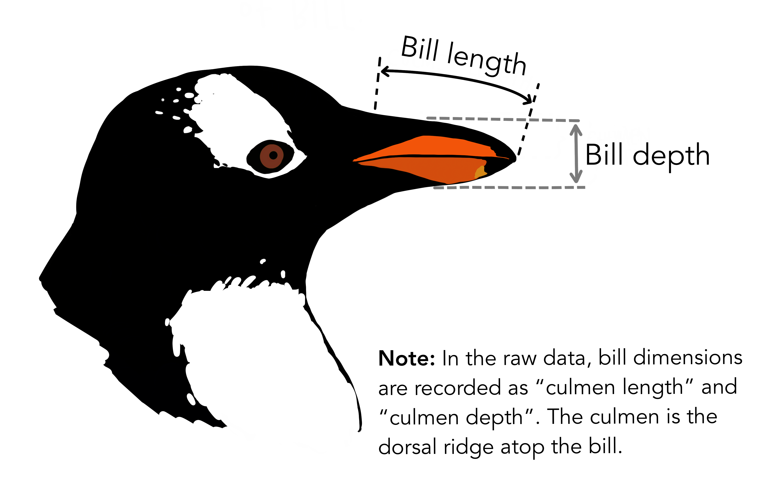
Decision trees
When splitting a feature, we want the partitions to be homogeneous
Take for example the penguins dataset
We will look for a split in terms of bill depth
Adelie
Gentoo

Slide 23
Decision trees
When splitting a feature, we want the partitions to be homogeneous
_{BILL DEPTH}
≤ t
> t
0.07
0.95
t = 16.7
0.93
0.05
These are the proportions of each class in the left region
Adelie
Gentoo

Slide 24
Decision trees
When splitting a feature, we want the partitions to be homogeneous
_{BILL DEPTH}
≤ t
> t
0.07
0.95
t = 16.7
0.93
0.05
0.00
0.80
t = 15.5
1.00
0.20
Adelie
Gentoo

Slide 25
Decision trees
When splitting a feature, we want the partitions to be homogeneous
_{BILL DEPTH}
≤ t
> t
0.07
0.95
t = 16.7
0.93
0.05
0.00
0.80
t = 15.5
1.00
0.20
0.47
1.00
t = 19.0
Adelie
0.53
0.00
Gentoo

Slide 26
Decision trees
When splitting a feature, we want the partitions to be homogeneous
One common way of assessing the homogeneity of a set is via its entropy
For a given dataset with classes and we define:
where is the proportion of data points in of the class
This is a well known measure of disorder used in Physics, Information theory, etc.
The entropy is maximized when the probabilities for each class are the same. Why?
In the case of decision trees we would like to have splits that have minimum entropy.

Slide 27
Decision trees
When splitting a feature, we want the partitions to be homogeneous
_{BILL DEPTH}
H = 0.68
≤ t
> t
0.07
0.95
H = 0.28
t = 16.7
H = 0.19
0.93
0.05
0.00
0.80
H = 0.00
t = 15.5
H = 0.51
1.00
0.20
0.47
1.00
H = 0.69
t = 19.0
H = 0.00
Adelie
0.53
0.00
Gentoo

Slide 28
Decision trees
When splitting a feature, we want the partitions to be homogeneous
We can build a single criterium based on entropy called information gain
These terms ensure that the entropies are comparable
where the input argument t is the threshold value that defines how to split the dataset

Slide 29
Decision trees

Slide 30
Decision trees

Slide 31
Decision trees

Slide 32

Decision trees
The algorithm for growing a tree is therefore:
Start with dataset with N points of P dimensions and K classes
For each feature P_{i} :
For each possible split S_{j} :
Calculate each one of the K probabilities p_{k}
Calculate the entropies of each side
Get the feature P_{i} and split S_{j} that yield maximum information gain
Split the dataset according to these values
Continue recursively (stop criterium can be depth of tree, number of points in each leaf, etc)
The algorithm complexity is
but can be improved

Slide 33

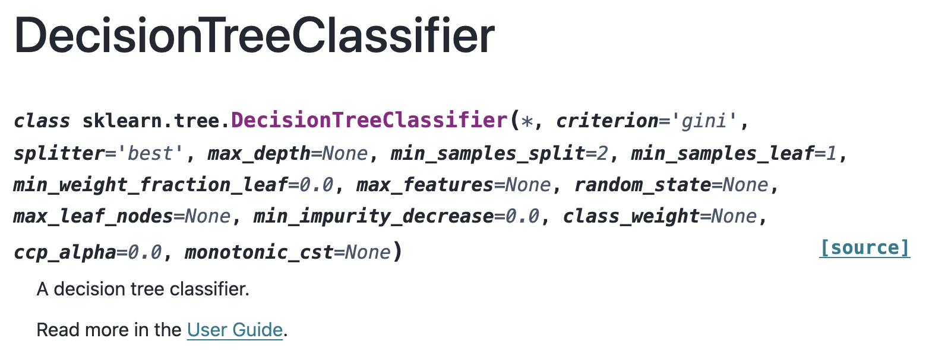
Decision trees
Using
Note that the default criterion for splitting is based on gini index
number of classes

Slide 34
Decision trees
Note that a decision tree classifier can be written as a sum of indicator functions
Number of regions in feature space
Class of all data points in region R_{j}
The same formulation could be used to describe a decision tree regressor.
-- Instead of assigning a class to a region, we associate a real number.
-- However, the splitting criterium must change… though we still aim for homogeneity
Mean of the observations in region

Slide 35
Decision trees
The same formulation could be used to describe a decision tree regressor.

Slide 36
Decision trees
Decision trees can also be used for regression
There are basically two steps involved:
Divide predictor space into J distinct and non-overlapping regions R₁, … , R_{J}
For every observation that falls into the region R_{j} make the same prediction
For each predictor j and candidate for splitting value s, we define two regions:
and calculate
We use the same recursive binary splitting from before to construct the regions

Slide 37
Decision trees
The algorithm for growing a tree is therefore:
Start with dataset with N points of P dimensions and K classes
For each feature P_{i} :
For each possible split S_{j} :
Calculate each one of the K probabilities p_{k}
Calculate the variances of each side
Get the feature P_{i} and split S_{j} that yield minimum total variance
Split the dataset according to these values
Continue recursively (stop criterium can be depth of tree, number of points in each leaf, etc)
The algorithm complexity is
but can be improved

Slide 38
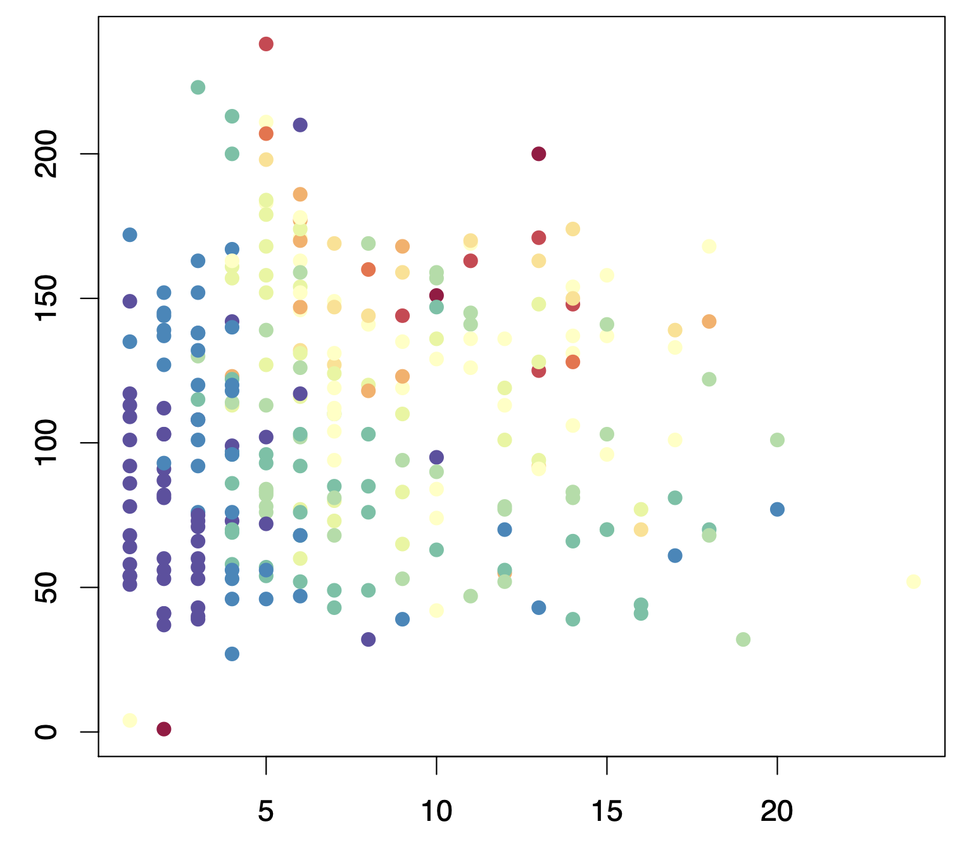
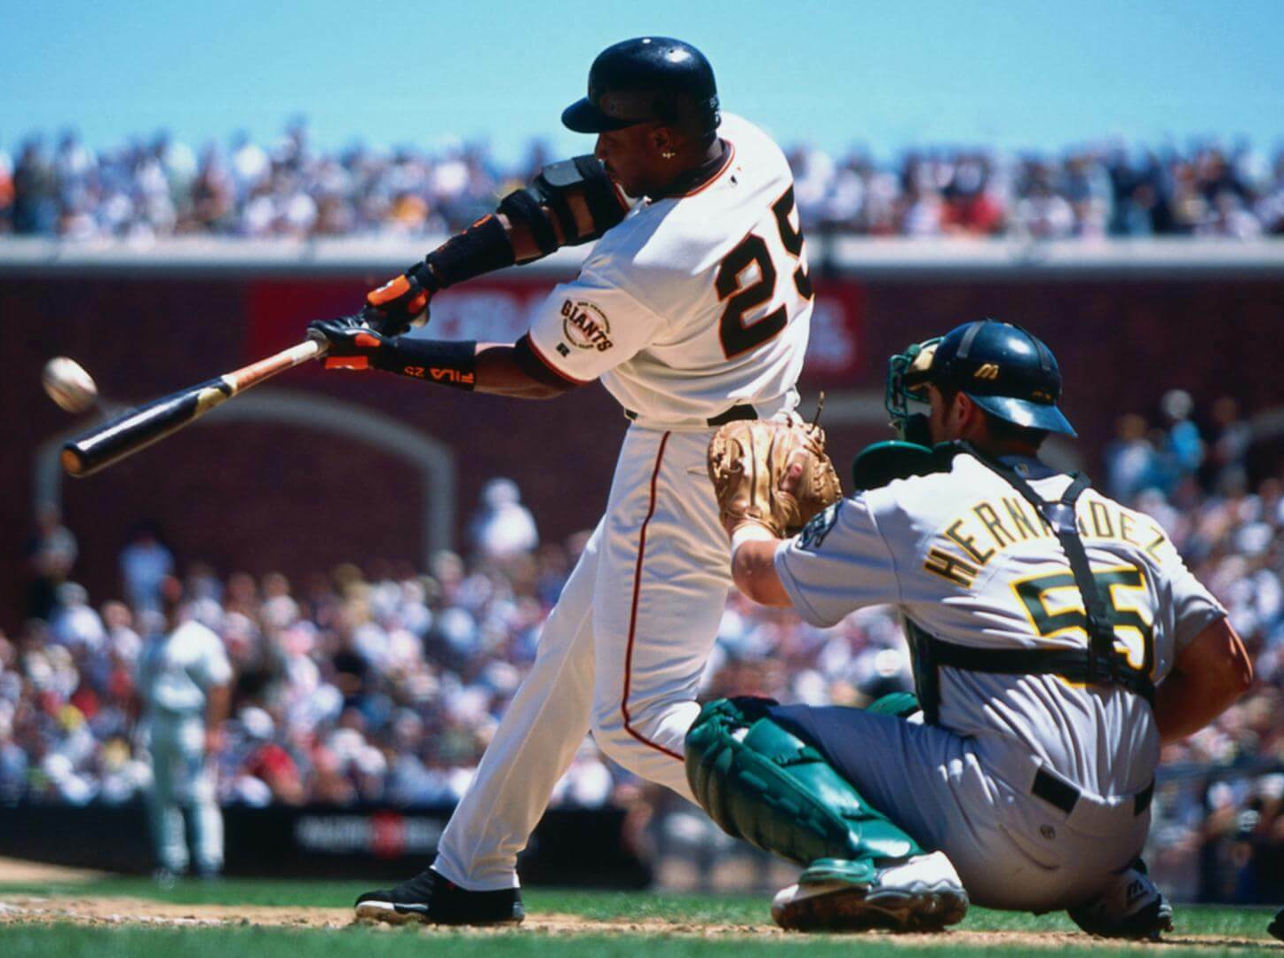
Decision trees
Decision trees can also be used for regression
Take for example the hitters dataset in which we try to predict the salary of a baseball player based on
The number of years that he has played in major leagues and
The number of hits that he made in the previous year
Salaries are color-coded from
low (blue) to high (red)
HITS
YEARS

Slide 39
Decision trees
Decision trees can also be used for regression
Take for example the hitters dataset in which we try to predict the salary of a baseball player based on
The number of years that he has played in major leagues and
The number of hits that he made in the previous year
NB: we took the log of the salaries

Slide 40
Decision trees
In summary, decision trees have many advantages vs other approaches we’ve seen
Trees are very easy to explain to people, even more than regression!
Some say that decision trees mirror more closely human decision-making
Trees can be displayed graphically
Trees can easily/naturally handle categorical predictors

Slide 41
Decision trees
In summary, decision trees have many advantages vs other approaches we’ve seen
Trees are very easy to explain to people, even more than regression!
Some say that decision trees mirror more closely human decision-making
Trees can be displayed graphically
Trees can easily/naturally handle categorical predictors
However, they also have some important disadvantages
They do not have the same level of accuracy as other approaches we’ve seen
Trees can be very non-robust to small changes in the training set

Slide 42
Decision trees
Consider the two moons dataset.
Simulate three different training datasets with 200 points and one test set with 1000.
The scatter dots are points from the test set and the boundary is for a Decision Tree

Slide 43
Ensemble methods
Note that the variance of an estimator along different training sets is
Note that we could try to reduce the variance by proposing a meta-estimator given by
where the are IID realizations of the distribution generating the dataset
Question:
How can we do this in practice if we have a fixed training dataset?
Splitting the dataset would yield IID sub-datasets, but would not work well -- Why ?

Slide 44
Ensemble methods
We use bootstrap : generate M datasets by sampling with replacement
datasets of the same size
=
…
=
=
Estimator will reduce the variance, but slower than IID case
(Why?)

