Slide 1
Introduction to Statistical Learning with Applications
CM8: Ensemble methods
Pedro L. C. Rodrigues

Slide 2

Recap
Ensemble methods
Bagging
Boosting

Slide 3
Discriminative approaches
There are many strategies for approximating the Bayes classifier.
In this course we will focus on:
K-nearest neighbours (kNN)
Discriminative approaches
Logistic regression
Linear and quadratic discriminant analysis
Generative approaches
Naïve Bayes classifier
Random forests
Ensembling approaches
Gradient boosted trees

Slide 4
Decision trees
Decision trees split the space according to thresholds learnt from the data
(R₁)
(R₃)
X₁
≤ 1.25
> 1.25
X₂
X₂
(R₂)
> 0.8
≤ 0.8
> 0.0
≤ 0.0
(R₄)
They are very fast to build so it is not too expensive to make several of them

Slide 5
Decision trees
Decision trees split the space according to thresholds learnt from the data
Mathematically, they can be written as
(R₁)
(R₃)
(R₂)
Where each c(j) corresponds to :
The label Y of points in R_{j} for classification
The average of Y in R_{j} for regression
(R₄)

Slide 6
Decision trees
Decision trees have many advantages vs other approaches we’ve seen before
Trees are very easy to explain to people, even more than regression!
Some say that decision trees mirror more closely human decision-making
Trees can be displayed graphically
Trees can easily handle qualitative predictors
However, they also have some important disadvantages
They don’t have the same prediction accuracy as other approaches we’ve seen
Trees can be very non-robust to small changes in the training set

Slide 7
Decision trees
Consider the two moons dataset.
Simulate a training dataset three times with 200 points and one test set with 1000.
The scatter dots are points from the test set and the boundary is for a decision tree

Slide 8
Decision trees
Consider the two moons dataset.
Simulate a training dataset three times with 200 points and one test set with 1000.
The scatter dots are points from the test set and the boundary is for a kNN (k=10)

Slide 9
Decision trees
Consider the two moons dataset.
Simulate a training dataset three times with 200 points and one test set with 1000.
The scatter dots are points from the test set and the boundary is for a logistic reg

Slide 10
Recap
Ensemble methods
Bagging
Boosting

Slide 11
Ensemble methods
Consider the following example taken from Freund and Shapire (1999)
A horse-racing gambler wants to maximize his winnings and creates a computer program that will accurately predict the winner of a horse race based on the usual information (number of races recently won by each horse, betting odds for each horse, etc.)

Slide 12
Ensemble methods
Consider the following example taken from Freund and Shapire (1999)
A horse-racing gambler wants to maximize his winnings and creates a computer program that will accurately predict the winner of a horse race based on the usual information (number of races recently won by each horse, betting odds for each horse, etc.)
To create such a program, he asks a highly successful expert gambler to explain his betting strategy. However, the expert is unable to articulate a grand set of rules for selecting a horse.

Slide 13
Ensemble methods
Consider the following example taken from Freund and Shapire (1999)
A horse-racing gambler wants to maximize his winnings and creates a computer program that will accurately predict the winner of a horse race based on the usual information (number of races recently won by each horse, betting odds for each horse, etc.)
To create such a program, he asks a highly successful expert gambler to explain his betting strategy. However, the expert is unable to articulate a grand set of rules for selecting a horse.
On the other hand, when presented with the data for a specific set of races, the expert has no trouble coming up with a “rule of thumb” for that set of races (such as, “Bet on the horse that has recently won the most races” or “Bet on the horse with the most favoured odds”).

Slide 14
Ensemble methods
Consider the following example taken from Freund and Shapire (1999)
A horse-racing gambler wants to maximize his winnings and creates a computer program that will accurately predict the winner of a horse race based on the usual information (number of races recently won by each horse, betting odds for each horse, etc.)
To create such a program, he asks a highly successful expert gambler to explain his betting strategy. However, the expert is unable to articulate a grand set of rules for selecting a horse.
On the other hand, when presented with the data for a specific set of races, the expert has no trouble coming up with a “rule of thumb” for that set of races (such as, “Bet on the horse that has recently won the most races” or “Bet on the horse with the most favoured odds”).
Although such a rule of thumb, by itself, is obviously very rough and inaccurate, it is not unreasonable to expect it to provide predictions that are at least a little bit better than random guessing. Furthermore, by repeatedly asking the expert’s opinion on different collections of races, the gambler is able to extract many rules of thumb.

Slide 15
Ensemble methods
To use these rules of thumb, there are two problems faced by the gambler:
First, how should he choose the collections of races presented to the expert so as to extract rules of thumb from the expert that will be the most useful?
Second, once he has collected many rules of thumb, how can they be combined into a single, highly accurate prediction rule?
The answer to these questions is of fundamental importance in machine learning and the category of algorithms that try to address them are called ensemble learning methods. Some examples of strategies are
VOTING
STACKING
BOOSTING
BAGGING
BLENDING
Etc.

Slide 16
Ensemble methods
Remember that the generalization error can be decomposed as
=
+
+
ERROR
NOISE
BIAS
VARIANCE
Ensemble methods reduce the bias and/or variance using several predictors
Different techniques will have different strategies for choosing the
The predictors are trained on different versions of the training dataset
(chosen wisely but randomly)
In bagging the weights are fixed and boosting the follow a scheduling strategy

Slide 17
Recap
Ensemble methods
Bagging
Boosting
Many slides are inspired (or taken) from U. Luxburg’s materials on Statistical Machine Learning

Slide 18
Bagging
Note that the variance of a classifier among different training sets is
Note that we could try to reduce the variance by proposing a meta-classifier given by
where the are IID realizations of the distribution generating the dataset
Question:
How can we do this in practice if we have a fixed training dataset?
Splitting the dataset would yield IID sub-datasets, but would not work well -- Why ?

Slide 19
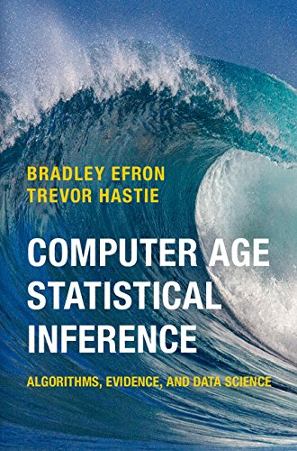
Bagging
Consider the method of cross-validation:
We want to estimate the test error of a classifier.
Take random subsets for training, and another random set for testing.
To get a more reliable result, we repeat several times and take the average.
In (computational) statistics there are many methods that follow the same principle, such as jacknife, bootstrap, conformal prediction, boosting, etc.
“Computer Age Statistical Inference”
Efron and Hastie
https://hastie.su.domains/CASI/

Slide 20
Bagging
The Bootstrap method:
Assume you have a sample and obtain an estimate
You would like to know the statistical distribution of this estimate. For example, because you want to construct confidence intervals or test its statistical significance.
You now draw a subsample of m points of the original sample (with or without
replacement) and on this new sample you compute a new estimate of the parameter
You repeat this procedure B times to obtain and construct statistics

Slide 21
Bagging
Bagging stands for “Bootstrap aggregating” and reduces variance of the predictions
=
…
=
=
The classifier will reduce the variance, but slower than IID case
(Why?)

Slide 22
Bagging
But how do we choose a base classifier?
Since this is an expensive mechanism from a computational point of view, it makes sense to use a reasonably simple baseline algorithm for training
Bagging reduces more the variance if there is none or very little correlation between the individual classifiers. This is what we need.
If the classifier have a strong bias, then bagging cannot do anything about it
A standard choice is decision trees + aggregate to make a forest.
Each tree is constructed randomly: on a random sample from the training dataset and by selecting the next splitting dimension from a random subset of all dimensions

Slide 23
Random forests
The algorithm for building a random forest is therefore:
For b = 1 to B
Draw a bootstrap sample of size N from the training dataset
Grow a random-forest tree T_{b} to the bootstrapped data, by recursively repeating:
Select m variables at random out of the p predictors
Pick the best variable/split-point amont the m possible choices
Split the node into two daughter nodes
Output the ensemble of trees T_{b} with b = 1 to B
To make a prediction at a new point simply do

Slide 24
Random forests
Example 1
Classification test error on the heart dataset

Slide 25
Random forests
Example 2
“Why do tree-based models still outperform deep learning on tabular data?”
Grinsztajn et al. (2022)

Slide 26
Random forests
Regarding the parameters:
The size of subsample should be reasonably large and can be with or without replacement (but often it is the former). The number m of dimensions of which we pick the best one is typically p/3. The number B of trees should be large.
However, random forests are known to be quite robust to these choices!
Random forests have been invented by Leo Breinman in 2001
They are a simple yet successful class of algorithms for classification and regression
Always consider Random Forests as a baseline when you work on new ML problems

Slide 27
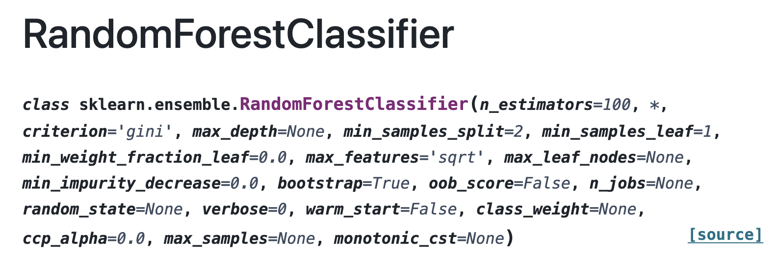
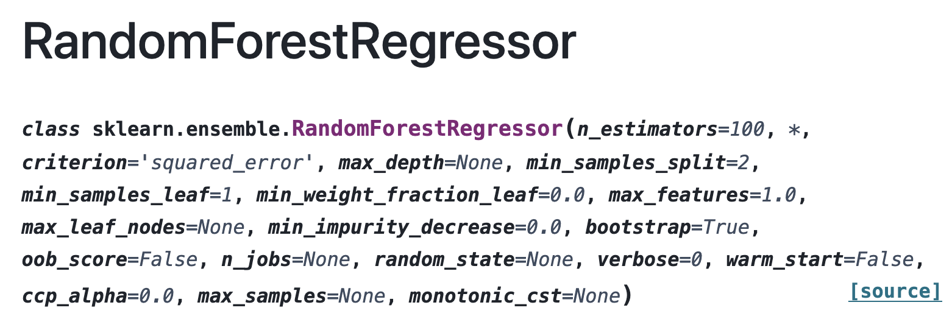
Random forests

Slide 28
Recap
Ensemble methods
Bagging
Boosting

Slide 29
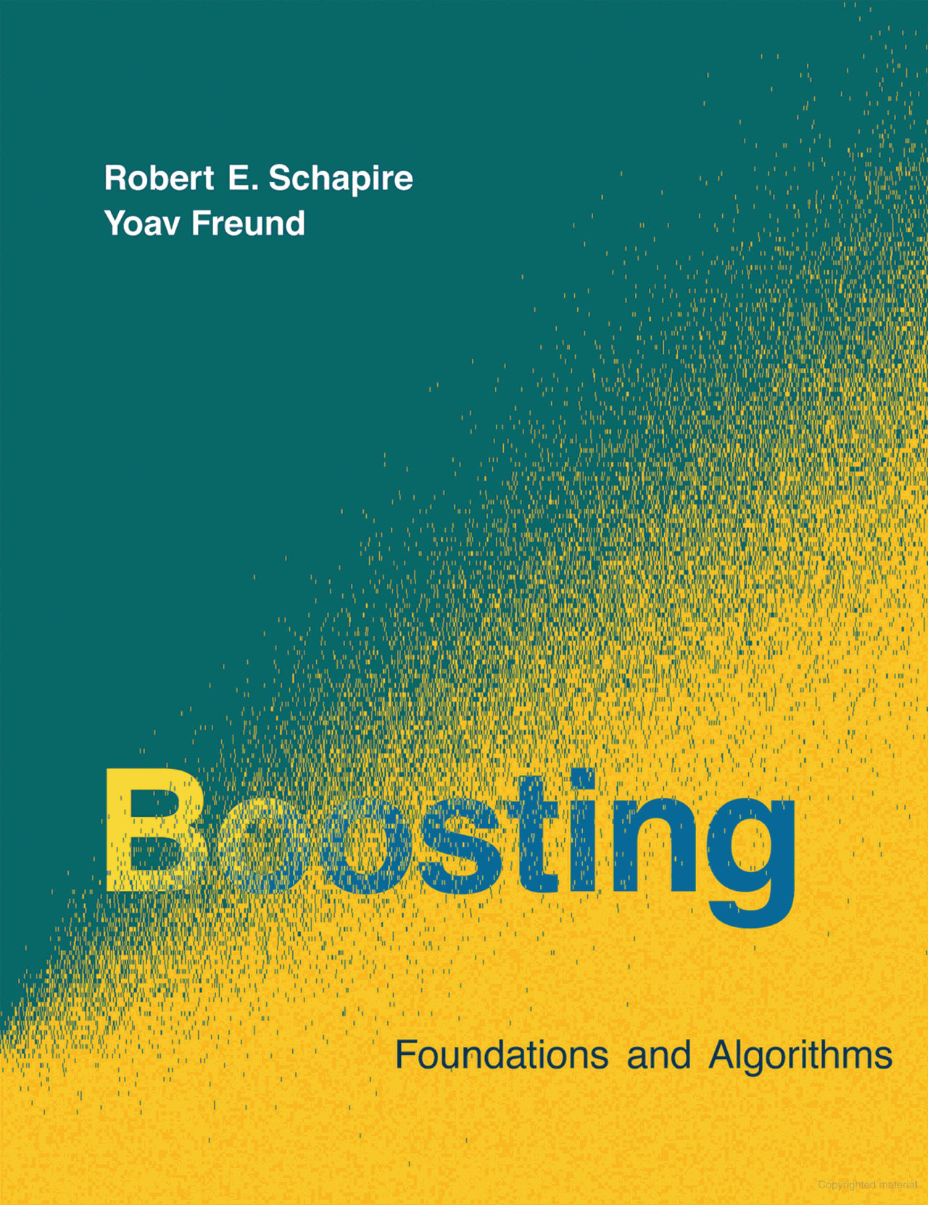
Boosting
The goal of machine learning is to build strong learners. In the context of classification, this means having a small generalization error.
However, they are often hard to construct.
A weak learner is an algorithm that is just slightly better than random guessing. For example, in a binary classification problem this would means a test error of 0.5-ε.
The idea of boosting is to combine many weak learners to obtain a strong learner.
“Boosting: Foundations and algorithms”
Schapire and Freund

Slide 30
Boosting
The outline of a classical boosting algorithm for classification (AdaBoost) is :
Given a training set of n points (x_{i}, y_{i}) the algorithm proceeds in T+1 rounds
Training points have weights that change from round to round. They add up to one.
In each round, we train a weak classifier on the training points with the current weights
For point x_{i} that was missclassified, we increase its weight w_{i}
For point x_{i} that was correctly classified, we decrease its weight w_{i}
The final classifier uses a weighted sum of the weak classifiers of each round

Slide 31
Boosting
Example: Consider a toy model with 10 examples labelled as + or –
Missclassified
Our base classifier is a decision stump on the vertical or horizontal axis

Slide 32
Boosting
Example: Consider a toy model with 10 examples labelled as + or –
Our base classifier is a decision stump on the vertical or horizontal axis

Slide 33
Boosting
Example: Consider a toy model with 10 examples labelled as + or –
Our base classifier is a decision stump on the vertical or horizontal axis

Slide 34
Boosting
Example: Consider a toy model with 10 examples labelled as + or –

Slide 35
Boosting
The AdaBoost algorithm

Slide 36
Boosting
The AdaBoost algorithm… but why would it be plausible for it to work?
Assume the final classifier makes an error on some training point x
Because it is a weighted majority vote over all weak classifiers, it can only get x wrong if most of the weak classifiers classified x wrongly themselves
This means that the weight of x has been increased very often, so it must be still large after the final round of boosting
But there can only be a few points with large weights, since they all add to 1
So there can only be few points that get classified wrong by the final classifier

Slide 37
Boosting
But what about gradient boosting?

Slide 38
Boosting
Boosting is a strategy for answering the question :
“Can we combine a set of weak learners so to generate a strong learner with low bias?”
The answer is yes and the procedure goes as follows:
Suppose we have trained a learner (i.e. a classifier or regressor) to minimize
We could try to improve predictions by training a new learner so that
Boosting adds several learners so to get a final strong predictor

Slide 39
Boosting
In boosting we approximate the change in the loss function for a small perturbation as
1st order Taylor expansion
so that the minimization problem becomes
The gradient of the functional looks scary, but note that

Slide 40
Boosting
Generic boosting (aka AnyBoost):
Start with dataset and train
Form new dataset with
Train new predictor
Note this new parameter!
Combine the predictors to get
Continue iterating to get more and more predictors in the sum

Slide 41
Boosting
If we’re dealing with regression using MSE we get a very nice interpretation…
So that
residuals
Conclusion:
Learner is trained using the residuals of the previous learner
This means that the new regressors are trained on the errors from the previous round
PS: We will see in TD how to derive these results and particularize it to decision trees

Slide 42
Boosting
Boosting algorithm for regression:
Start with dataset and train
Form new dataset with
Train new predictor
Note this new parameter!
Combine the predictors to get
Continue iterating to get more and more predictors in the sum

Slide 43
Boosting
Put very simply, every boosting algorithm does the following:
At round T fit an additive model
In each new round T+1, train a weak learner to compensate shortcomings of
In AdaBoost, shortcomings are identified by high-weight data points
In gradient boosting they are identified by gradients
Invent AdaBoost, the first successful boosting algorithm (Freund 1996)
Formulate AdaBoost as a gradient descent with a special loss function (Breiman 1998)
Generalize AdaBoost to Gradient Boosting to handle other loss functions (Friedman 2000)

Slide 44
Boosting
Gradient boosting has a story of much success with some famous implementations
XGBoost [Chen & Guestrin, Arxiv 2016] (w. Apple, NVidia)
LightGBM [Ke et al., Proc. NIPS 2017] (by Microsoft)
CatBoost [Prokhorenkova et al. Arxiv 2017] (by Yandex)
sklearn.ensemble.HistGradientBoostingClassifier (v0.21)
You can check this video with some nice extra practical explanations:
https://www.youtube.com/watch?v=o6seqpMJSTI

Slide 45
Boosting
We see some of these implementations in the curves

Slide 46


Boosting
XGBoost: eXtreme gradient boosting
Proposed in Chen and Guestrin (2016) – arxiv.org/abs/1603.02754
XGBoost uses a 2nd Order Taylor approximation of the cost function
XGBoost has a regularization term to control the size of the trees
Several tricks to make the algorithm scale to very large datasets
Approximate splitting via feature binning
Parallel implementation
Cache-aware access

Slide 47
Boosting
XGBoost: Approximate splitting via feature binning
Remember that when growing a tree, we had to do for each of P features:
1) Sort the values of the data points on that feature O(n.log n)
2) For every possible split point O(n)
2.1) Evaluate the split
3) Pick the best split
Final complexity : O(D.n.log n + n)
-- Q: What if we could avoid having to sort?

Slide 48
Boosting

Slide 49
Boosting
XGBoost: Approximate splitting via feature binning
Remember that when growing a tree, we had to do for each of P features:
1) Sort the values of the data points on that feature O(n.log n)
2) For every possible split point O(n)
2.1) Evaluate the split
3) Pick the best split
Final complexity : O(D.n.log n + n)
-- Q: What if we could avoid having to sort?

Slide 50
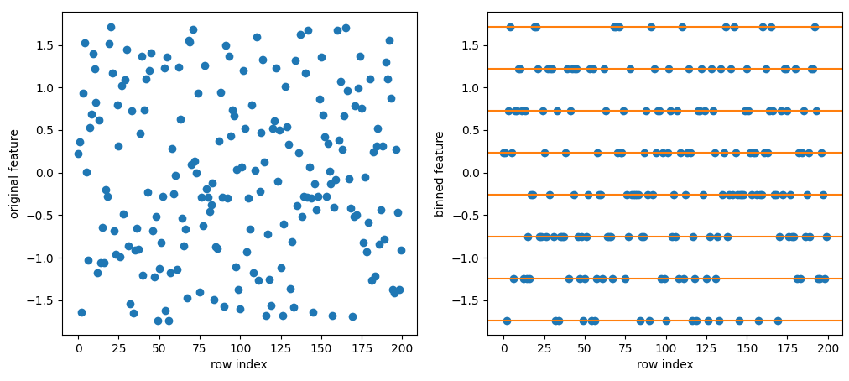
Boosting
XGBoost: Approximate splitting via feature binning
-- Q: What if we could avoid having to sort? -- A: We can bin the feature values and create a histogram!

Slide 51
Boosting
XGBoost: Approximate splitting via feature binning
Remember that when growing a tree, we had to do for each of P features:
1) Construct a histogram O(n)
2) For every possible split point O(n_bins)
2.1) Evaluate the split
3) Pick the best split
Final complexity : O(D.n_bins + n)

Slide 52
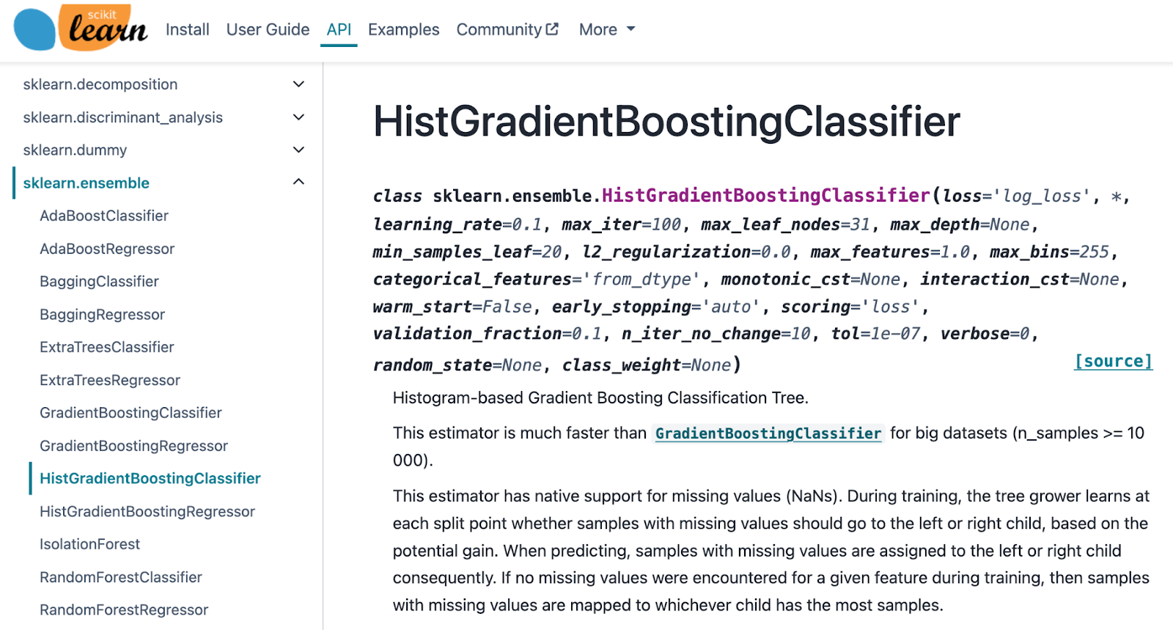
Boosting

Slide 53
Boosting
Overview of the gradient boosting with regression trees
1) If large-scale dataset : bin data for each feature
2) Make initial predictions with f₀ – it could be simply constants
3) Calculate gradients of the loss
4) Grow trees for boosting:
4.1) Find best splits
4.2) Add tree to predictors 4.3) Update de gradients and hessians

Slide 54
Conclusion
In summary, the two main methods that we’ve seen today can be compared as below
BAGGING
BOOSTING
Resamples data points
Weight of each classifier is the same
Only variance reduction
Reweight data points
Weight is dependent of performance
Both variance and bias are reduced

