Slide 1
Introduction to Statistical Learning with Applications
CM9: ML competitions, metrics, etc.
Pedro L. C. Rodrigues

Slide 2

The Netflix prize (2006 to 2009)
See more details at: https://www.thrillist.com/entertainment/nation/the-netflix-prize

Slide 3
The Netflix prize (2006 to 2009)
480k users
M =
17k movies
Only 100M of the cells are known, i.e. we only know 1.2% of the ratings given by users
GOAL: Propose a recommandation algorithm that beats Netflix’s by at least 10%
according to a score provided by the company

Slide 4

The Netflix prize (2006 to 2009)
The winning solution was good… but it was way too complicated to deploy
Nevertheless, it contained some interesting ideas that became standard in ML

Slide 5

Data science competitions
Performance metrics

Slide 6
Data science competitions
Data science competitions are always supervised problems
(Why?)
The goal is to obtain a function for which every yields prediction
Such predictions should be close to the observations, i.e.
The data
Every challenge contains at least three files to download:
x_train
the data on which participants will elaborate and train their model to learn the prediction function
y_train
x_test
the data used for evaluation

Slide 7

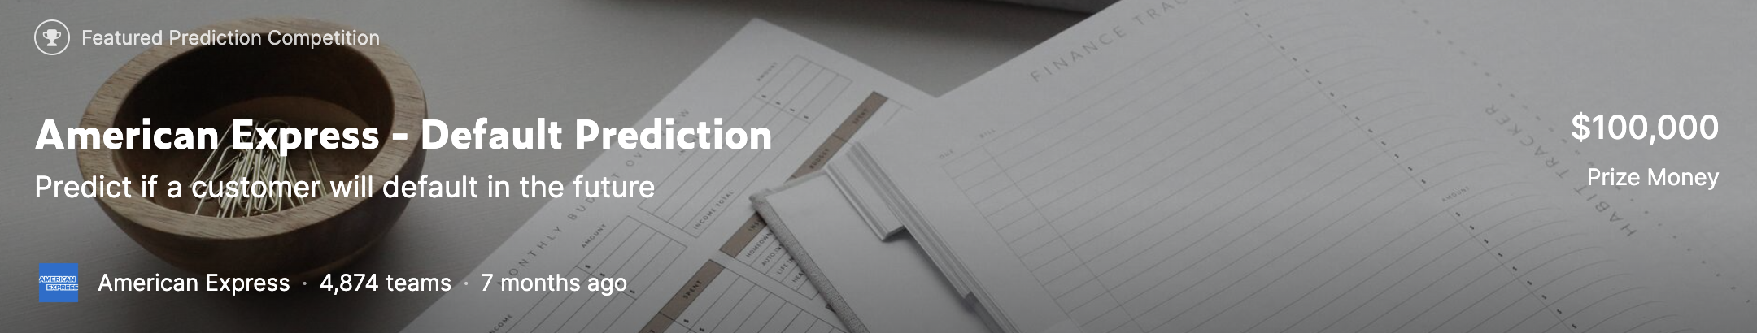
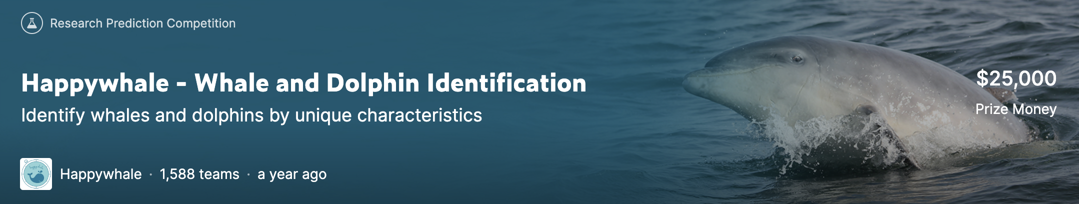
https://www.kaggle.com/competitions/mayo-clinic-strip-ai/overview
https://www.kaggle.com/competitions/amex-default-prediction
https://www.kaggle.com/c/happy-whale-and-dolphin

Slide 8
Data science competitions
The score
The error between prediction and observation is evaluated with
The goal is to minimize the average score on the inputs. The actual calculation of the score depends of the competition and is always explained in its presentation.
These may be MSE, Cross Entropy, R2 score, AUROC, F1 score, other custom losses
Test set separation and overfitting
The test set is split in two halves, the public and private test sets.
The Public score is computed on the public set. It is provided after each submission
The Private score is obtained on the private set and is provided by the end of the competition.
This split prevents participants from overfitting the whole test set, as they can’t see how their solution behaves on the entire test set. (Why ?)

Slide 9
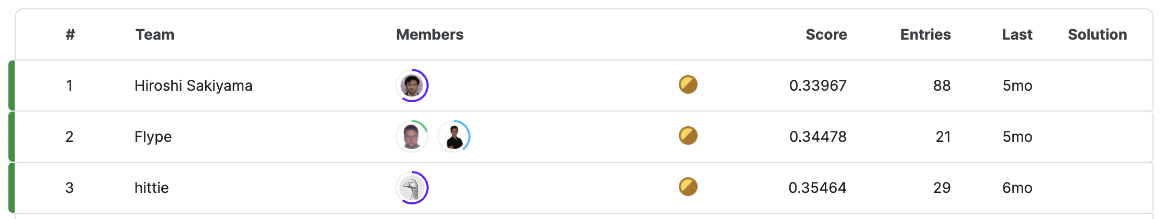
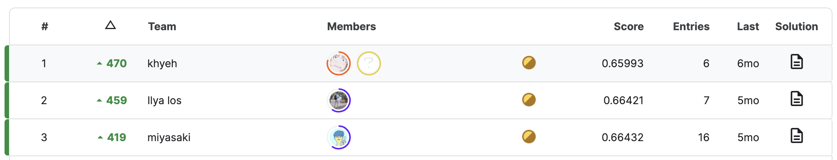
More often than not, assessing a method’s score is one of the the most important parts in a competition…
IRL it would be data cleaning
https://www.kaggle.com/competitions/mayo-clinic-strip-ai/overview
PUBLIC
leaderboard
PRIVATE
leaderboard

Slide 10
Data science competitions
Doing data competitions is a very practical skill that is hard to teach in class.
Two very good places to start are:
Titanic dataset: predicting whether a person died or not on the Titanic accident
https://www.kaggle.com/competitions/titanic
Houses dataset: predicting the price of a house given several features
https://www.kaggle.com/competitions/house-prices-advanced-regression-techniques/overview
Another good reference are the videos (in French) from S. Mallat’s course @ CdF
https://www.youtube.com/watch?v=8IAcJmP9bdU – Pierre Courtiol “S’attaquer à une competition de ML”
Hint: Most competitions are won using bagging, boosting, and regularization…

Slide 11
Data science competitions
Performance metrics

Slide 12
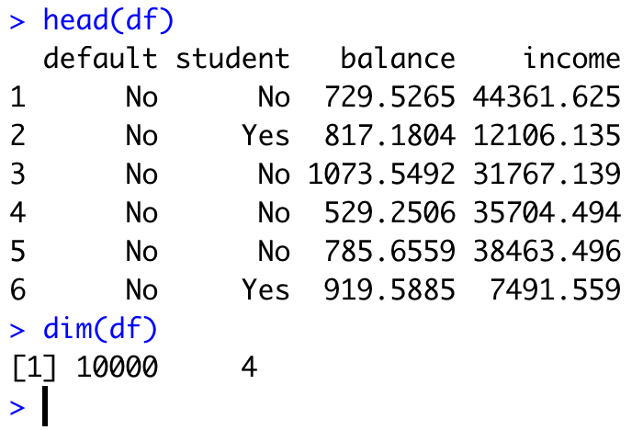
Performance metrics
So far we have measured the quality of our predicted models based on
The mean squared error (MSE) for regression
Accuracy for classification
But in many situations these metrics may not be the most informative ones
Example
Consider the default dataset from the James et al. (2022) book
The dataset has three predictors and binary labels
We can fit a logistic regression model and do
classify as YES
classify as NO

Slide 13
Performance metrics -- Classification
Example
Consider the default dataset from the James et al. (2022) book
The classifier has 97.1% of accuracy
💪🏻
🤡
But the data set has 3.3% of labels YES and 96.7% of labels NO
TRUE OBSERVATIONS
FALSE
TRUE
FALSE
9627
228
PREDICTED OBSERVATIONS
TRUE
40
105
The confusion matrix gives all the information we need

Slide 14
Performance metrics -- Classification
Example
Consider the default dataset from the James et al. (2022) book
The classifier has 97.1% of accuracy
💪🏻
🤡
But the data set has 3.3% of labels YES and 96.7% of labels NO
TRUE OBSERVATIONS
FALSE
TRUE
TN = true negative
TP = true positive
FP = false negative
FN = false positive
TN
FN
ACC = TN + TP
FALSE
9627
228
TN + TP + FN + FP
PREDICTED OBSERVATIONS
FP
TP
TRUE
40
105
The confusion matrix gives all the information we need

Slide 15
Performance metrics -- Classification
Example
Consider the default dataset from the James et al. (2022) book
TRUE OBSERVATIONS
FALSE
TRUE
TN = true negative
TP = true positive
FP = false negative
FN = false positive
TN
FN
TPR = TP
FALSE
9627
228
TP + FN
PREDICTED OBSERVATIONS
FP
TP
TRUE
40
105
If we were interested in checking how well the classifier detected clients that were really in default, we would prefer to check the quantity called "True Positive Rate"
Another quantity that might be of interest is how many clients the bank think will be in default when in fact they are not. This is what we call the "False Positive Rate"

Slide 16
Performance metrics -- Classification
Example
Consider the default dataset from the James et al. (2022) book
TRUE OBSERVATIONS
FALSE
TRUE
TN = true negative
TP = true positive
FP = false negative
FN = false positive
TN
FN
TPR = TP
FALSE
9627
228
TP + FN
PREDICTED OBSERVATIONS
FPR = FP
FP
TP
TN + FP
TRUE
40
105
If we were interested in checking how well the classifier detected clients that were really in default, we would prefer to check the quantity called "True Positive Rate"
Another quantity that might be of interest is how many clients the bank think will be in default when in fact they are not. This is what we call the "False Positive Rate"

Slide 17
Performance metrics -- Classification
In the end of the day, we want a large TPR and a small FPR
Note that depending of the context it might be preferable to invest on one or the other
For banks, it is more costly to have a weak true positive rate (TPR) than a slightly larger false positive rate
In the case of radars in a cold war, a high false positive rate could have catastrophic consequences
If we change our definition of the classifier, we can change the error rates
classify as YES
classify as NO
For smaller values of gamma, the classifier will have more tendency to consider data points as from YES, meaning that we would more easily detect clients that defaulted. Thus, we would have a higher TPR. However, this comes at a cost: we also get a larger FPR. We need to find a balance.

Slide 18
Performance metrics -- Classification

Slide 19
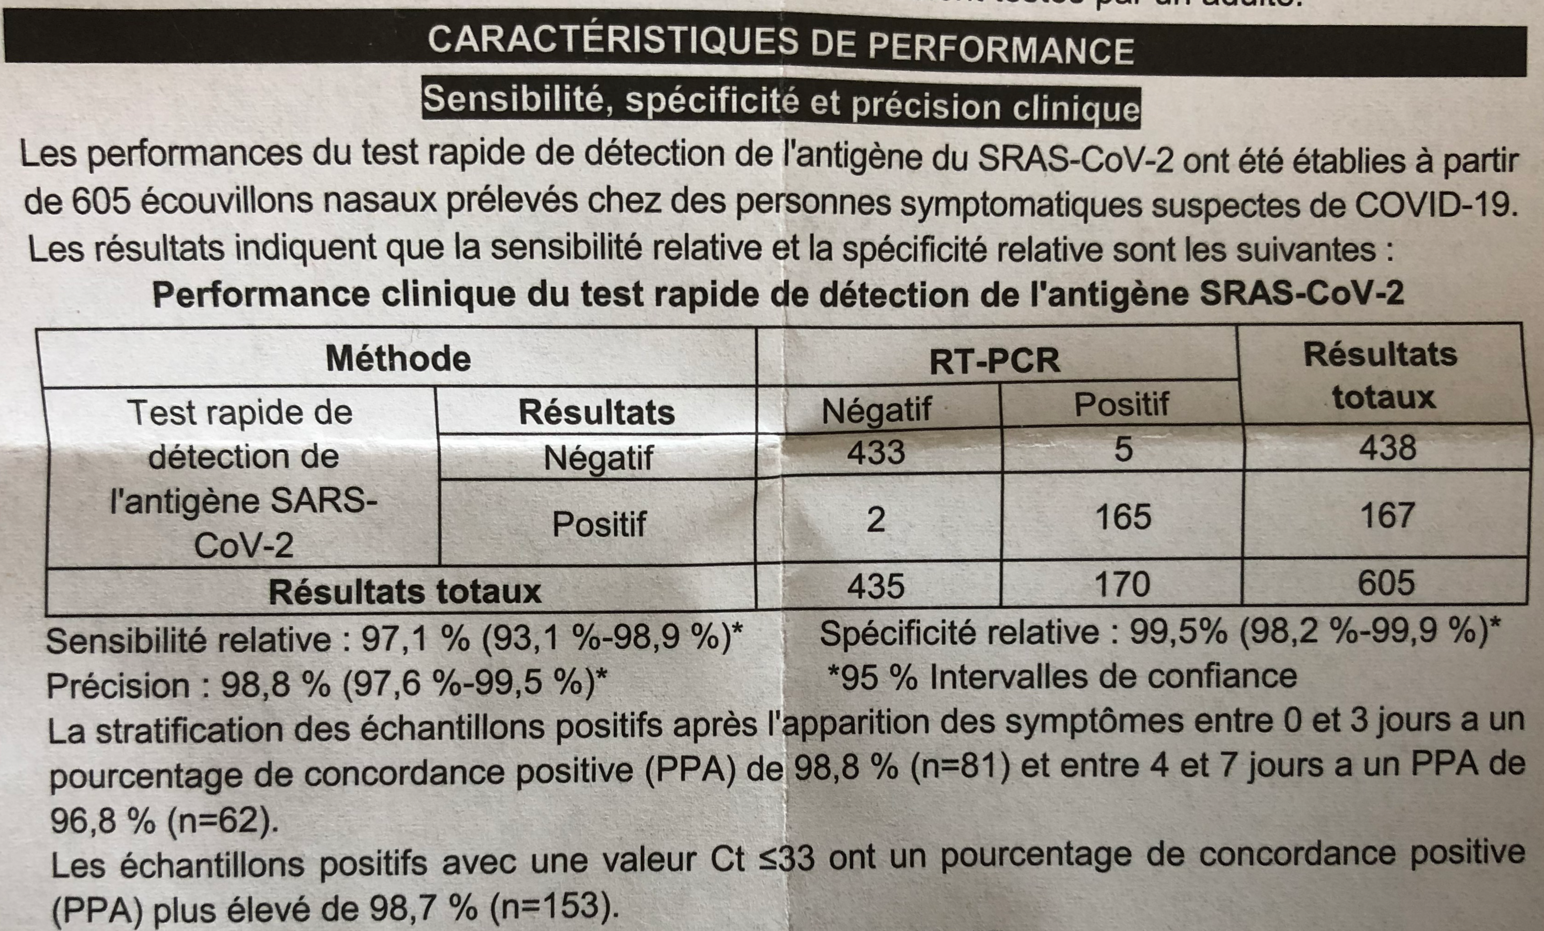
Performance metrics -- Classification
In certain applications, it might be preferable to speak in terms of other quantities

Slide 20
Performance metrics -- Classification
In certain applications, it might be preferable to speak in terms of other quantities
In medical tests, it is common to use
sensitivity = TP
specificity = TN
TP + FN
TN + FP
In information retrieval, it is common to use
precision = TP
among all positive predictions from our classifier, how many of them were correct.
TP + FP
recall = TP
how many of the truly positive observations were indeed detected by our classifier
TP + FN

Slide 21
Performance metrics -- Regression
Consider now a simple regression with one predictor X and one observed variable Y

Slide 22
Performance metrics -- Regression
Consider now a simple regression with one predictor X and one observed variable Y

Slide 23
Performance metrics -- Regression
Consider now a simple regression with one predictor X and one observed variable Y
The outliers contribute a lot to the minimization!

Slide 24
Performance metrics -- Regression
Consider now a simple regression with one predictor X and one observed variable Y

Slide 25
Performance metrics -- Regression
Consider now a simple regression with one predictor X and one observed variable Y
Ref: https://medium.com/data-science

Slide 26
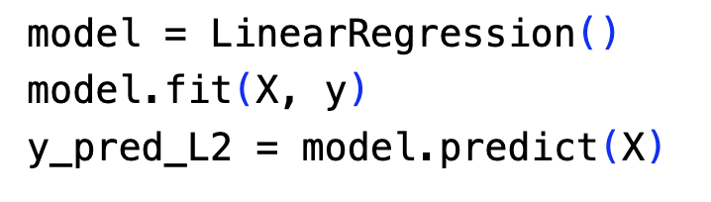
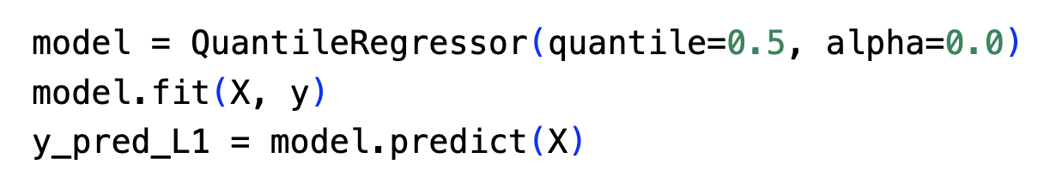
Performance metrics -- Regression
Consider now a simple regression with one predictor X and one observed variable Y
Why take the QuantileRegressor ?

Slide 27
Performance metrics -- Regression
There are many other metrics for regression, such as
(ensure a scale-free property to the metric)
(this metric penalizes an under-prediction more than an over-prediction)

