Slide 1
Introduction to Statistical Learning with Applications
CM10: Tabular Foundational Models
Pedro L. C. Rodrigues

Slide 2

Introduction
From point prediction to distributions
Gaussian processes
Conditional neural processes
Tabular foundational models

Slide 3
Introduction
Today we will talk about a completely new paradigm in machine learning
Tabular Foundational Models

Slide 4
Introduction
Today we will talk about a completely new paradigm in machine learning
Tabular Foundational Models
But first of all… what are tabular data?
X (n x p)
y (n x p)
It is the most common type of data that you will see when working as data scientist…

Slide 5
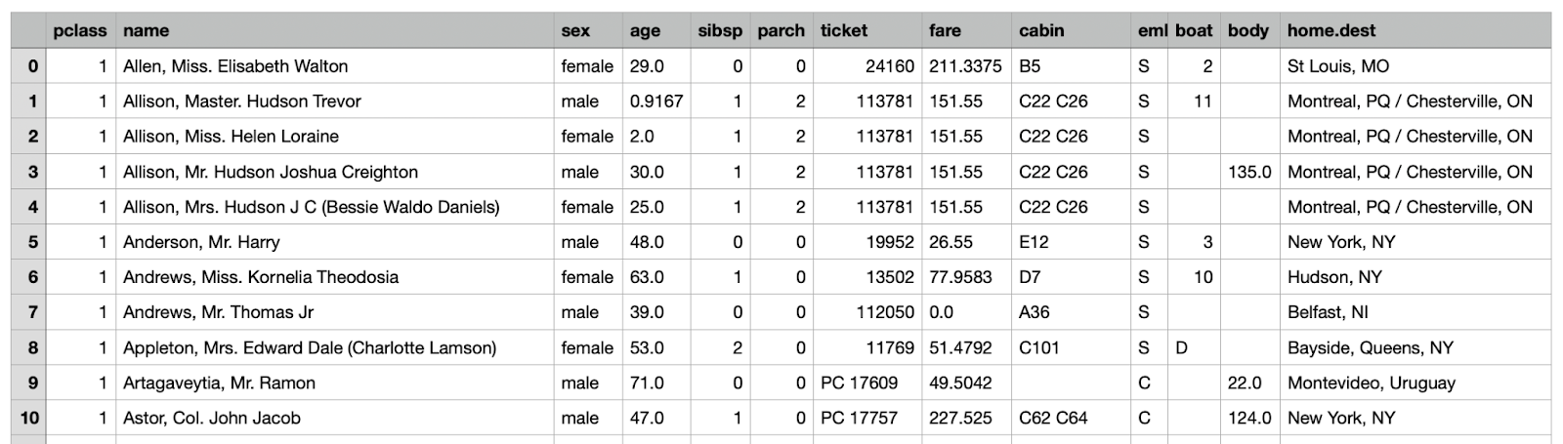
Introduction
Today we will talk about a completely new paradigm in machine learning
Tabular Foundational Models
But first of all… what are tabular data?
The titanic dataset
It is the most common type of data that you will see when working as data scientist…

Slide 6

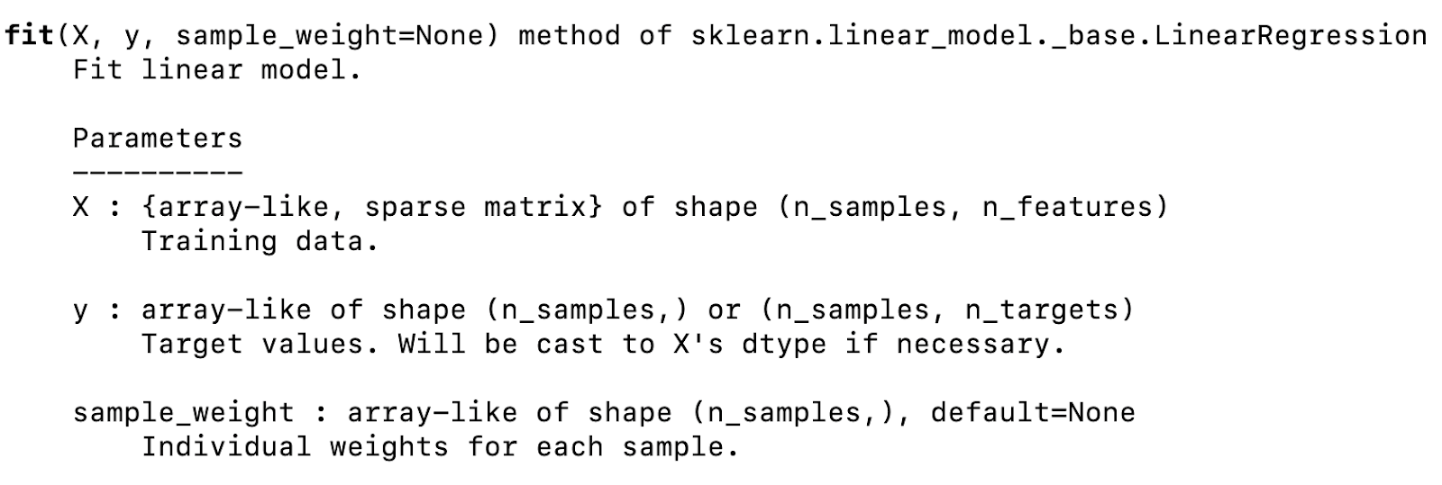
Introduction
Today we will talk about a completely new paradigm in machine learning
Tabular Foundational Models
But first of all… what are tabular data?
It is the most common type of data that you will see when working as data scientist…

Slide 7
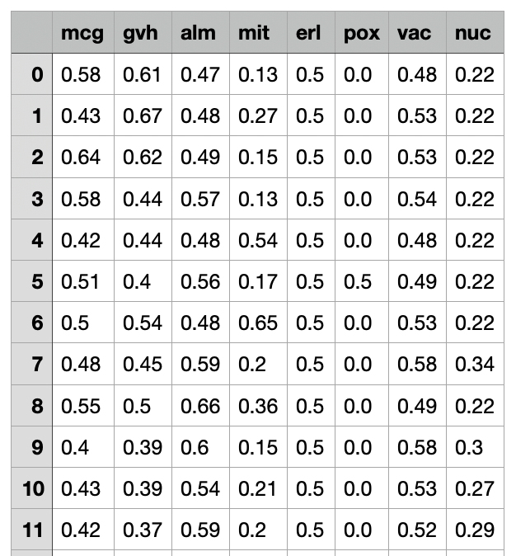
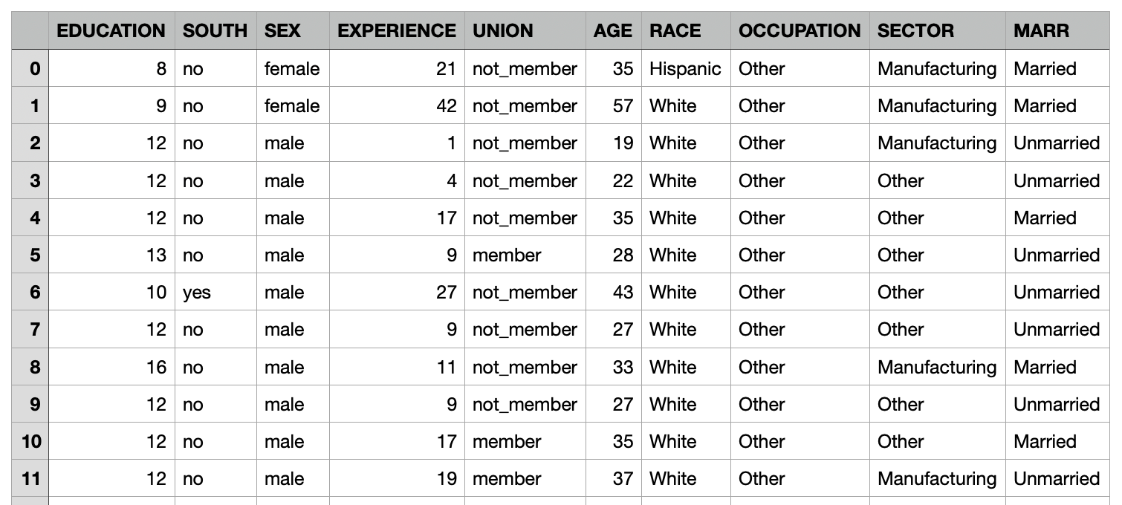
Introduction
Neural networks used to struggle with tabular data because of…
Heterogeneity between datasets

Slide 8
Introduction
Neural networks used to struggle with tabular data because of…
Heterogeneity between columns within a dataset
features with different scales, with different types : boolean, categorical, ordinal, integer, floating point; imbalance or missing data; unimportant features; outliers

Slide 9
Introduction
Neural networks used to struggle with tabular data because of…
Column names actually convey information!

Slide 10
Introduction
Neural networks used to struggle with tabular data because of…
Nevertheless, research kept going 💪
Because it would be cool to:
Leverage modern deep learning infrastructure (e.g. GPUs)
Have a differentiable pipeline for end-to-end learning
Multimodal processing with text and images
And in 2022…

Slide 11
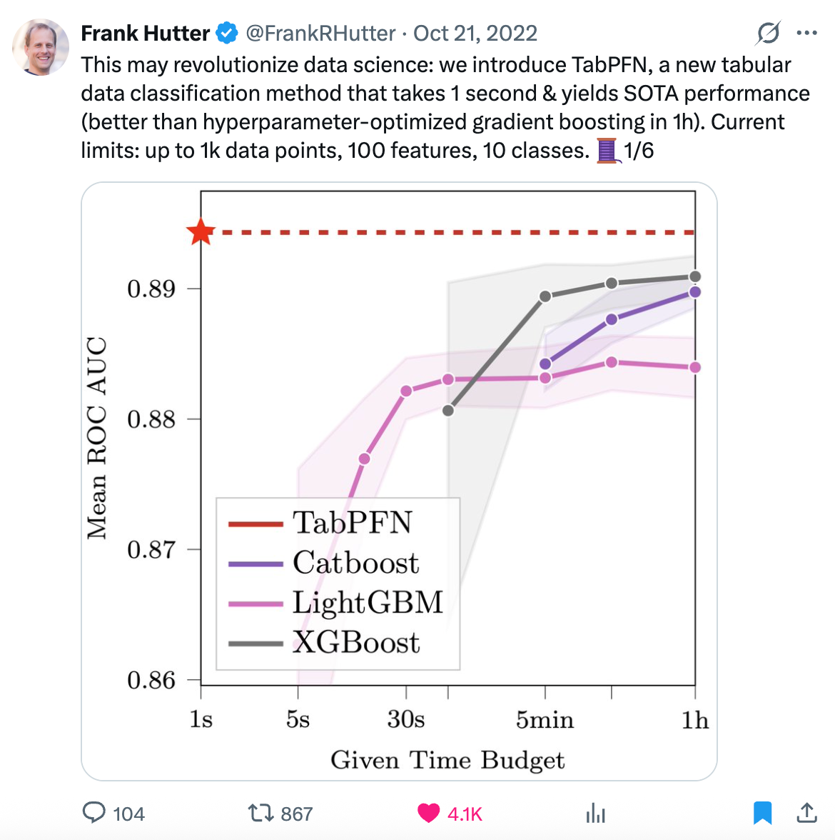
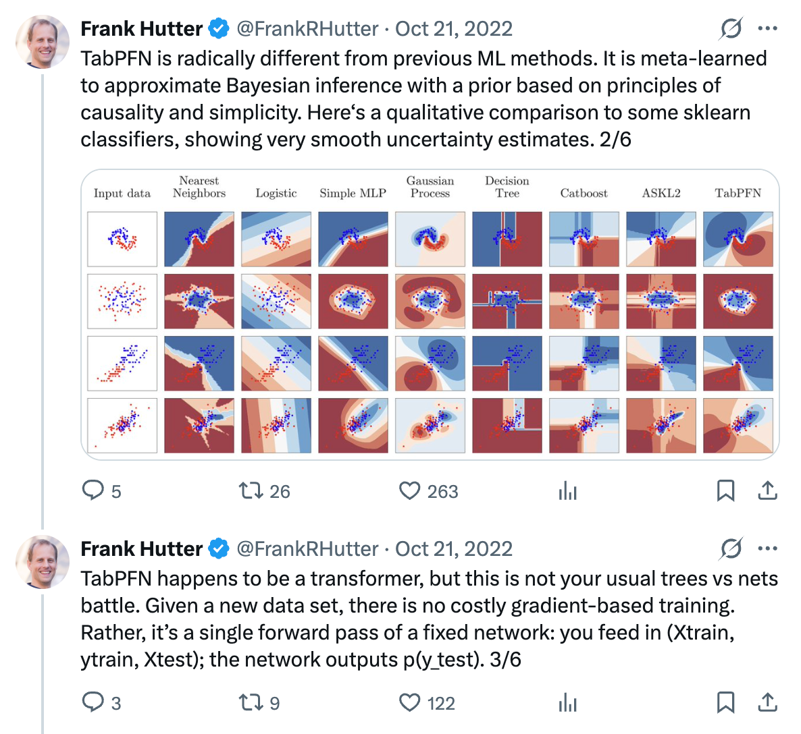
Introduction
https://x.com/FrankRHutter/status/1583410845307977733

Slide 12
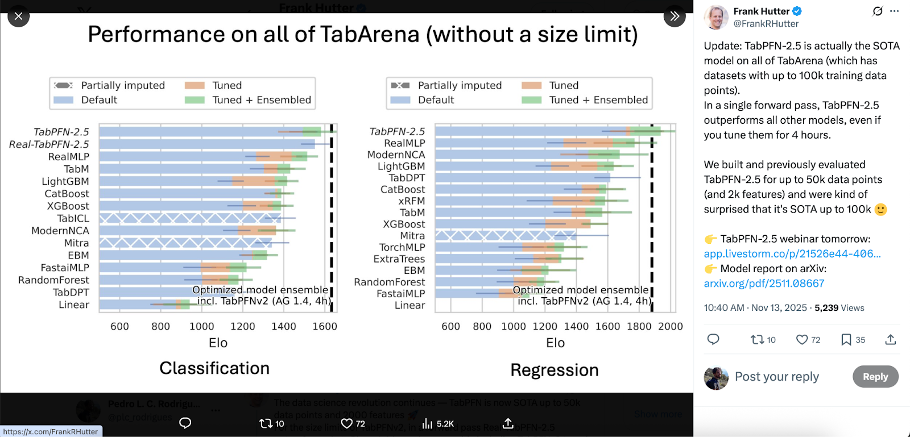
Introduction

Slide 13
Introduction
Today we will talk about a completely new paradigm in machine learning
Tabular Foundational Models
What is a foundational model?
📙
Large-scale models (e.g., BERT, DALL-E, GPT-3) trained on broad data that can be adapted to a wide range of downstream tasks
And a tabular foundational model (TFM)?
📙
A model trained on broad tabular data that can be adapted to a wide range of downstream tasks

Slide 14
Introduction
In practice, this means that for a fixed pre-trained neural network we can
handle datasets of different sizes and natures
The model learns to adapt at inference time! But how?
context

Slide 15
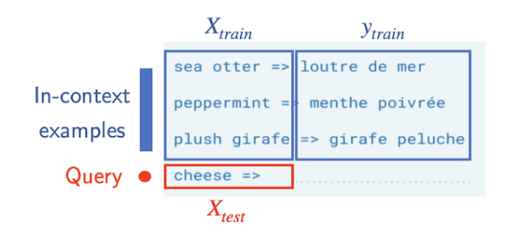
Introduction
🔑 Key concept: TFMs leverage in-context learning (ICL)
For a given dataset
Supervised learning
In-context learning
Train with
Directly predict
Predict on
estimator pre-trained on several datasets
context
ICL is an emergent property that appears in very large transformer-based neural networks when training of very big datasets. It allows a model to performs tasks by analyzing prompts containing input-output pairs, without explicit training or parameter updates

Slide 16
Introduction
🔑 Key concept: TFMs leverage in-context learning (ICL)
For a given dataset
Supervised learning
In-context learning
Train with
Directly predict
Predict on
estimator pre-trained on several datasets
context
💡 The cost of training this very large model is amortized
We will see later how we can “teach” this ICL feature to the network…

Slide 17
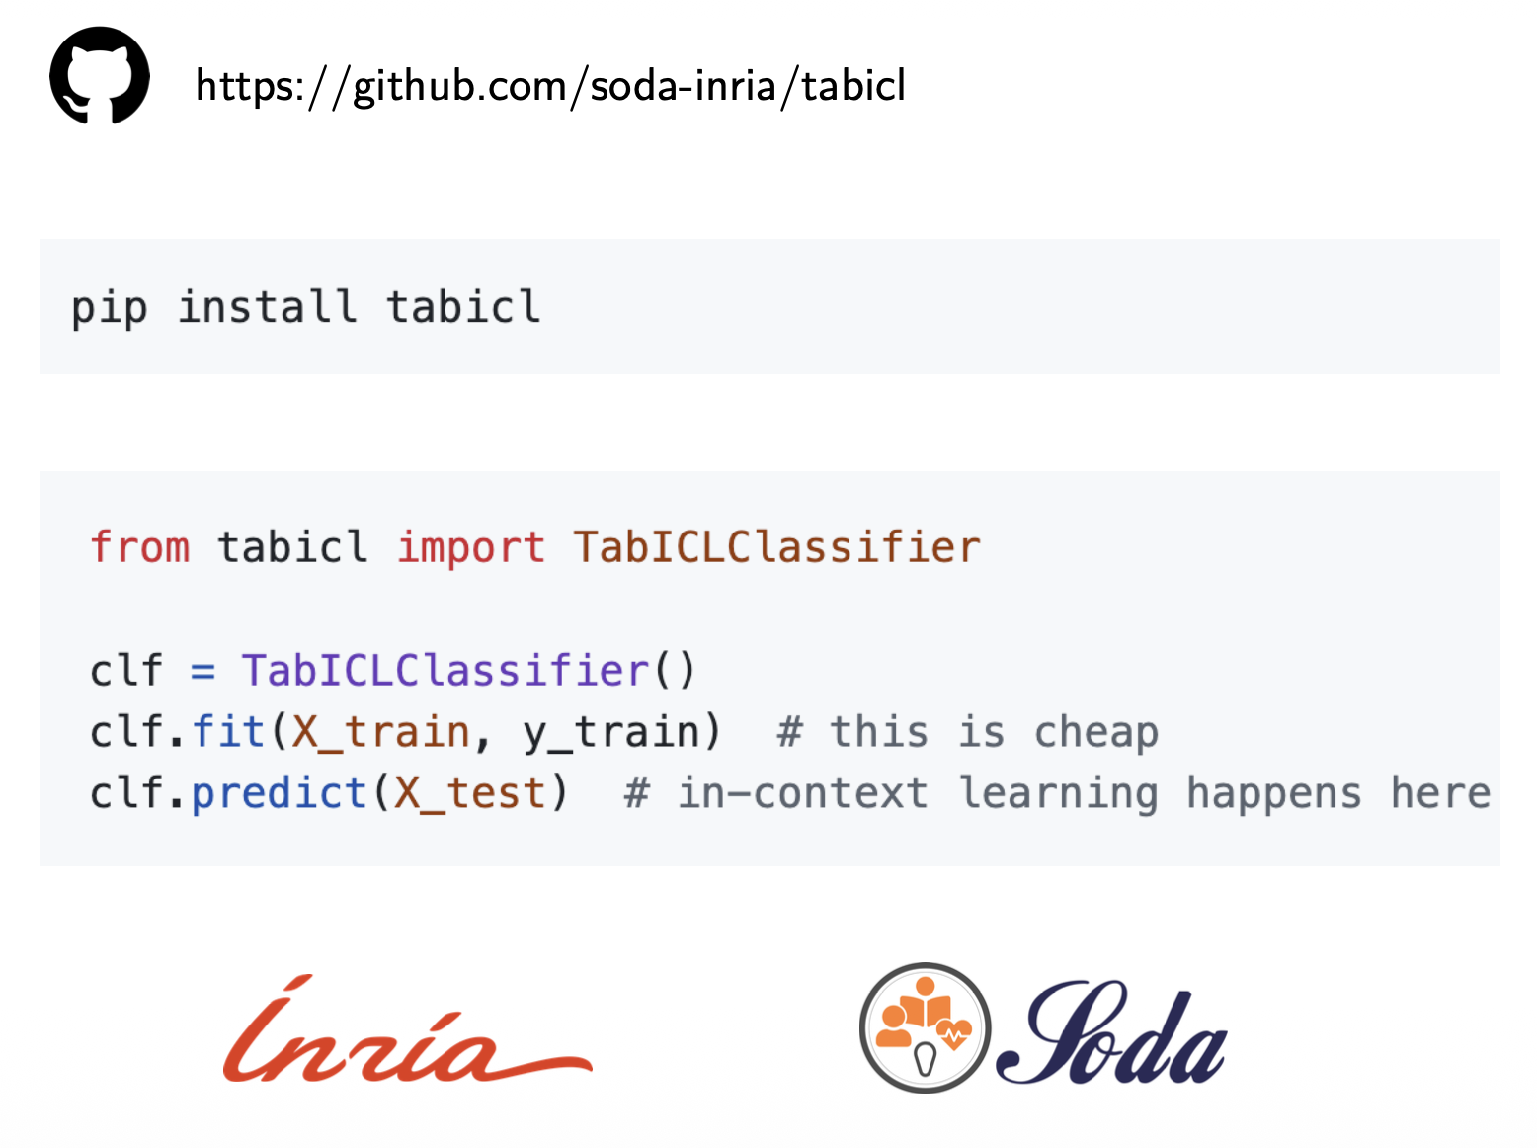
Introduction
But first, let’s play a little bit…

Slide 18
Introduction
Roadmap of today’s lecture…
ordinary linear regression
1

Slide 19
Introduction
Roadmap of today’s lecture…
ordinary linear regression
Bayesian linear regression
defining the context as
impose a prior on
to get uncert. quantif.
1
2

Slide 20
Introduction
Roadmap of today’s lecture…
ordinary linear regression
Bayesian linear regression
defining the context as
impose a prior on
to get uncert. quantif.
1
2
we have a function turning dataset into parameters
posterior predictive distribution
(PPD)
3

Slide 21
Introduction
Roadmap of today’s lecture…
ordinary linear regression
Bayesian linear regression
defining the context as
impose a prior on
to get uncert. quantif.
1
2
we have a function turning dataset into parameters
posterior predictive distribution
(PPD)
3
considering a richer feature representation we have and a similar expression for PPD
4

Slide 22
Introduction
Roadmap of today’s lecture…
ordinary linear regression
Bayesian linear regression
defining the context as
impose a prior on
to get uncert. quantif.
1
2
we have a function turning dataset into parameters
posterior predictive distribution
(PPD)
3
considering a richer feature representation we have and a similar expression for PPD
4
when we can use the kernel trick to write and still get a closed-form PPD as per
gaussian processes
5
which is what we call a Gaussian process

Slide 23
Introduction
Roadmap of today’s lecture…
ordinary linear regression
Bayesian linear regression
defining the context as
impose a prior on
to get uncert. quantif.
1
2
we have a function turning dataset into parameters
posterior predictive distribution
(PPD)
3
considering a richer feature representation we have and a similar expression for PPD
4
when we can use the kernel trick to write and still get a closed-form PPD as per
gaussian processes
5
which is what we call a Gaussian process; however, inverting n-by-n matrices is costly and choosing a kernel annoying, so we use neural networks
conditional neural processes
trainable parameters
6

Slide 24
Introduction
Roadmap of today’s lecture…
Inverting n-by-n matrices is costly and choosing a kernel annoying, so we use neural networks
conditional neural processes
trainable parameters
context set
query point
encoder
PPD
aggregation
decoder
Tabular foundational models use a very similar architecture, but with three important differences:
The aggregator uses an attention mechanism instead of a simple average
The decoder uses a softmax operator so to include classification problems on top of regression
The training relies on a carefully designed generator of synthetic tabular datasets that go beyond smooth functions as in gaussian processes

Slide 25
Introduction
From point prediction to distributions
Gaussian processes
Conditional neural processes
Tabular foundational models

Slide 26
From point prediction to distributions
Let us start from the very beginning : ordinary multiple linear regression ❤️
You receive a training dataset and
The OLS estimator is
Calling LinearRegression().fit(X, y).predict(x_star)
returns which is a point prediction w/o uncertainty quantification
However, we would like to work with the posterior predictive distribution (PPD)
Ok, but why? 🤷🏻

Slide 27
From point prediction to distributions
We would like to work with the posterior predictive distribution (PPD)
Because
Full description. A point estimate discards all uncertainty. The PPD encodes the full distribution of plausible outcomes — any summary (mean, quantiles, confidence bands) can be recovered from it.
Uncertainty quantification for free. The variance described by the PPD decomposes into epistemic uncertainty (reducible with more data) and aleatoric uncertainty (irreducible noise) — essential for responsible deployment in high-stakes settings.
Natural target for meta-learning. The PPD is the unique prediction that optimally combines the prior learned during meta-training with the evidence in the context. Minimising its negative log-likelihood is the right training objective

Slide 28
From point prediction to distributions
Bayesian linear regression
Supposing that the parameter vector has a prior distribution
and that observations are generated as per
We have that
with and
NB: Note what happens when
context

Slide 29
From point prediction to distributions
The PPD is obtained by marginalizing out the coefficients as in
Gaussian integral
which can be simplified to
Note that to compute the prediction we first convert the context into a pair of parameters which is then used to calculate the prediction
This can be seen as a primitive kind of meta-estimator taking datasets as input.

Slide 30
From point prediction to distributions
It is natural to want to consider richer features than the linear case
with
which also yields a closed-form expression for PPD
Interestingly, we can rewrite this expression only in terms of inner products as per
and
with
The choice of features can therefore be turned into a choice of kernel

Slide 31
Introduction
From point prediction to distributions
Gaussian processes
Conditional neural processes
Tabular foundational models

Slide 32
Gaussian processes
We are interested in situations for which the data is generated as per
Note that when fixing a prior over we’re also fixing a prior over the function values!
with
and
So that
and
Therefore,
meaning that the function values are characterized directly by the kernel

Slide 33
Gaussian processes
Note that when taking the taking the dimension of the features to
the vector becomes infinite-dimensional and can no longer be written!
However, the joint pdf over the function values is still perfectly well-defined
We call this object a Gaussian process and denote it as
The function k is called the covariance kernel; choosing it is equivalent to choosing a prior over functions: it encodes beliefs about what the function looks like before seeing any data.

Slide 34
Gaussian processes
Given context , the PPD for a Gaussian process write just as before:
This is exact and closed-form. No approximation. No optimization.
Limitations: 1. Computational cost: inverting n-by-n matrix costs O(n³) time and O(n²) memory
2. The kernel has to be (well) chosen by hand, which is not obvious at all in practice
Key insight: the GP is the Bayesian posterior predictive that you get when the features as infinite-dimensional and the only choice you make is the kernel.

Slide 35
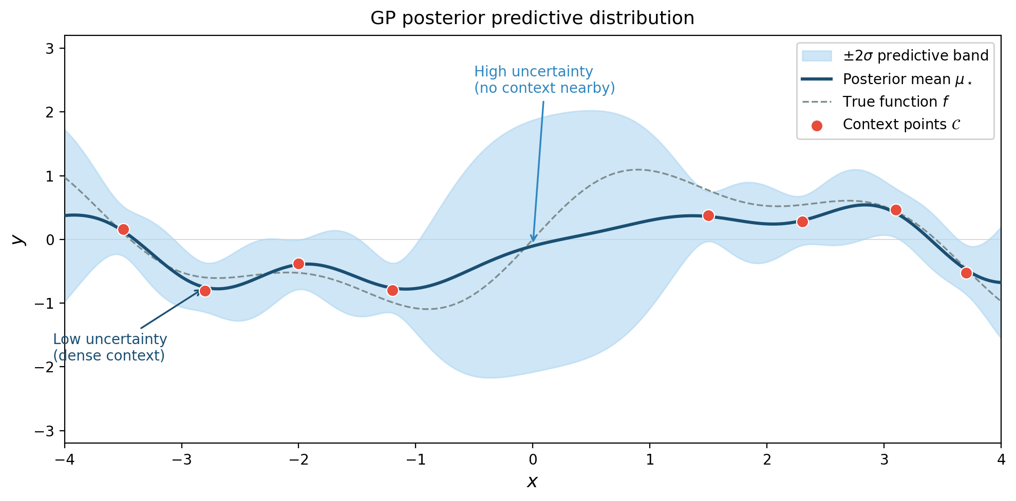
Gaussian processes in practice – Example 1

Slide 36
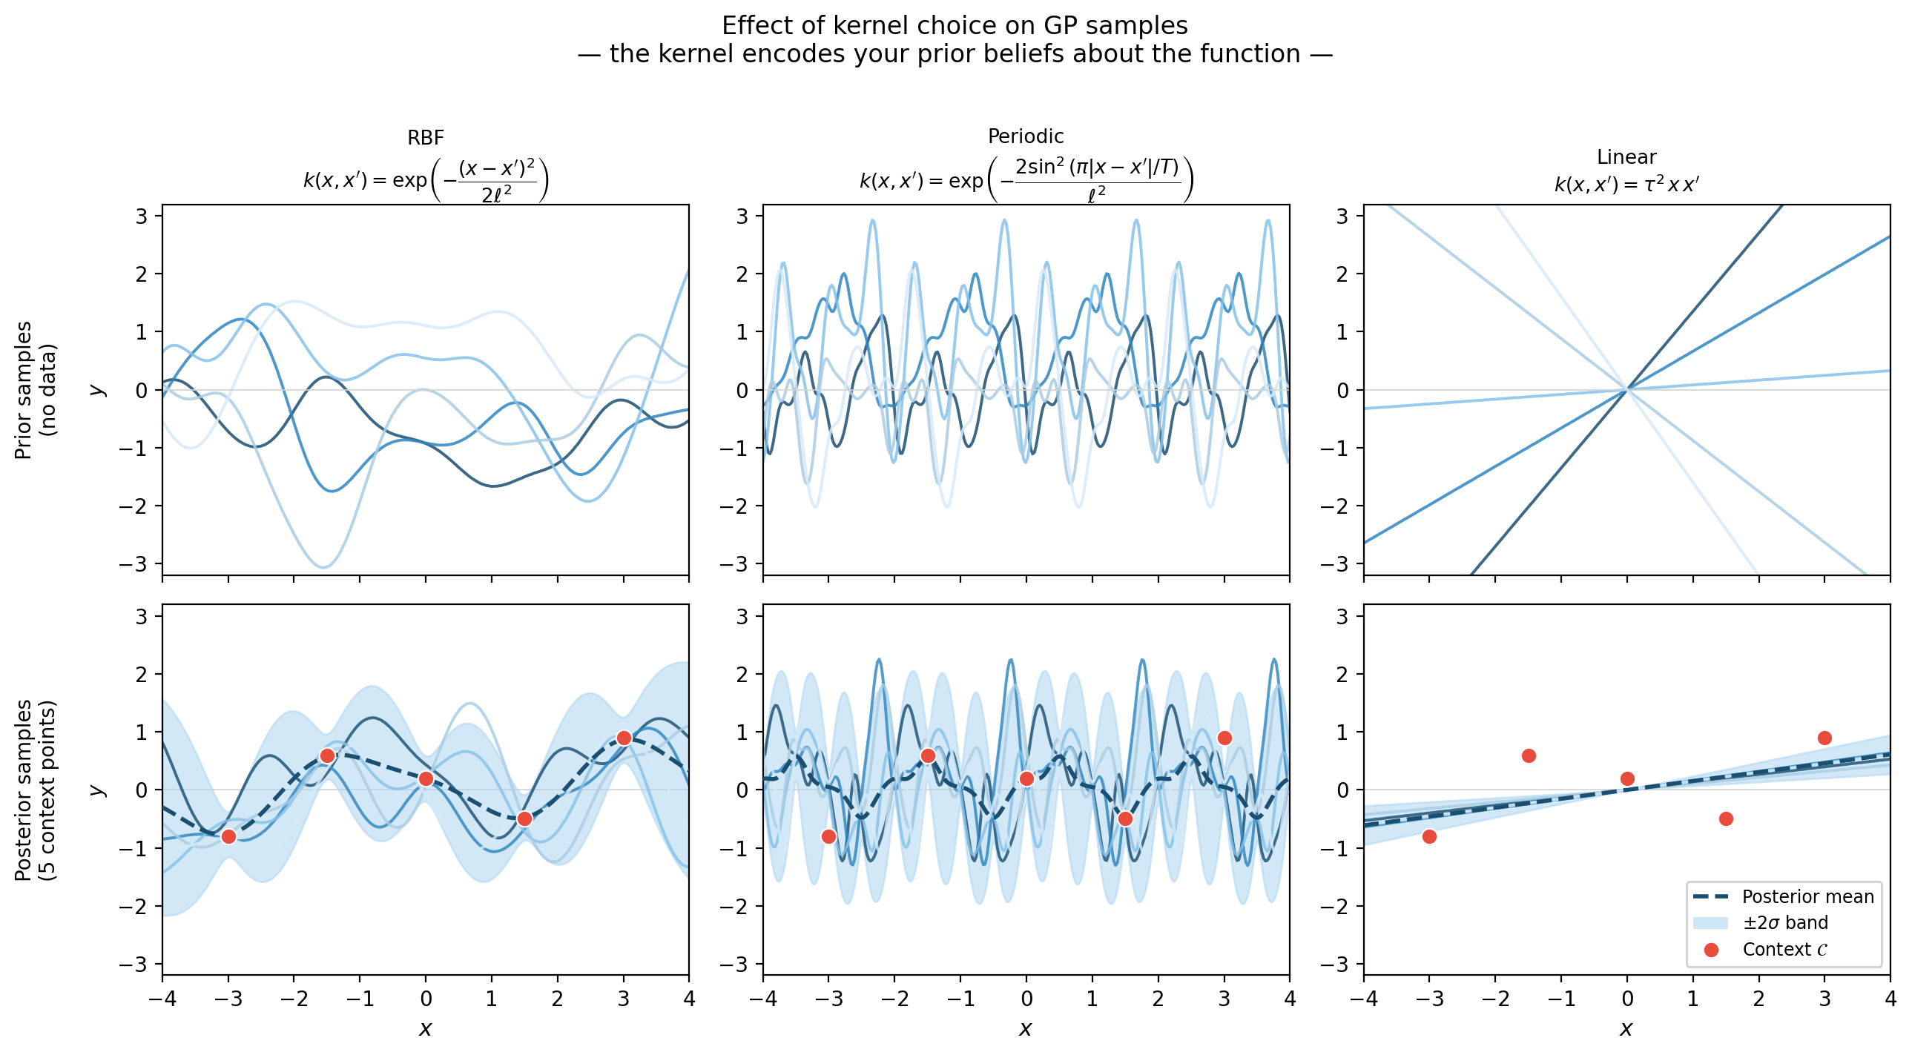
Gaussian processes in practice – Example 2

Slide 37
Introduction
From point prediction to distributions
Gaussian processes
Conditional neural processes
Tabular foundational models

Slide 38
Conditional neural processes
The Gaussian process gives us the exact posterior predictive distribution (PPD), but
at O(n³) cost and
with a hand-chosen kernel
Q: Can we do better with a neural network?
Note that we need a neural network capable of doing the same mapping as a GP, i.e.
context set
PPD
Neural Network
query point

Slide 39
Conditional neural processes
Conditional neural processes (Garnelo et al. 2018) approximate the PPD with a neural network composed of three components :
embedding independent of the index
1) Encoder
A trainable function is
applied to each context pair
preserves permutation-invariance
2) Aggregator
The individual representations
are averaged into a single global
3) Decoder
A trainable function outputs the parameters of a predictive Gaussian for the PPD

Slide 40
Conditional neural processes
Q: OK, but how do we train a CNP?
Note that we have two parameters to estimate : and
Related to the encoding
Related to the decoding
We need a loss function depending on both parameters as per
so that we can use gradient descent:
New question: which loss function to use then?

Slide 41
Conditional neural processes
New question: which loss function to use?
Suppose you have a model that outputs not just a prediction ​ but a full Gaussian distribution for the values of
How do you measure whether this predicted distribution is good or bad?

Slide 42
Conditional neural processes
New question: which loss function to use?
Suppose you have a model that outputs not just a prediction ​ but a full Gaussian distribution for the values of
How do you measure whether this predicted distribution is good or bad?
With a point prediction this would be easy – compute the squared error
For a whole distribution, we ask: how much probability did your distribution assign to the value that actually happened?
good model for that data point
bad model for that data point

Slide 43
Conditional neural processes
New question: which loss function to use?
For a dataset containing several IID query points
we can write the loss function as
(Note that the parameters being opimized appear impliclity in the calcuation of the means and variances)
and specifically for the Gaussian model case we get

Slide 44
Conditional neural processes
Q: OK, but how do we train a CNP?
We use a meta-learning procedure
1
Sample a function from a meta-training distribution, e.g.
2
Sample N input locations and evaluate
3
Randomly split into context set and target set
4
Run the CNP forward pass on the context to obtain a for each
run several episodes like this
5
Compute the negative log-likelihood loss
6
Calculate the gradient of the loss and do a gradient step

Slide 45
Conditional neural processes
After millions (!) of steps in the meta-learning procedure, the network will have learned a general strategy for predicting functions from partial observations in a context.
context set
query point
encoder
PPD
aggregation
decoder
Compared to a GP, we have a O(n) complexity and a supervised data-driven kernel

Slide 46
Conditional neural processes
Reference: https://yanndubs.github.io/Neural-Process-Family/text/CNPF.html

Slide 47
Conditional neural processes
Reference: https://yanndubs.github.io/Neural-Process-Family/text/CNPF.html

Slide 48
Introduction
From point prediction to distributions
Gaussian processes
(Conditional) neural processes
Tabular foundational models

Slide 49
Tabular foundational models
Despite their elegance, conditional neural processes have important weaknesses

Slide 50
Tabular foundational models
Despite their elegance, conditional neural processes have important weaknesses
Lossy aggregator: the mean pooling throws away all information about which y came from which x. If two context points have very different y values at nearby x locations, the mean r cannot represent this. The model underfits local structure.
1
preserves permutation-invariance
Aggregator
The individual representations
are averaged into a single global

Slide 51
Tabular foundational models
Despite their elegance, conditional neural processes have important weaknesses
Lossy aggregator: the mean pooling throws away all information about which y came from which x. If two context points have very different y values at nearby x locations, the mean r cannot represent this. The model underfits local structure.
The prior over functions is not sufficiently rich: the CNPs are good at smooth regressions functions but know nothing about tabular classification and regression problems with heterogeneous features, mixed scales, class imbalance, etc.
1
2
recall the first two steps of meta-learning
1
Sample a function from a meta-training distribution, e.g.
2
Sample N input locations and evaluate

Slide 52
Tabular foundational models
Despite their elegance, conditional neural processes have important weaknesses
Lossy aggregator: the mean pooling throws away all information about which y came from which x. If two context points have very different y values at nearby x locations, the mean r cannot represent this. The model underfits local structure.
The prior over functions is not sufficiently rich: the CNPs are good at smooth regressions functions but know nothing about tabular classification and regression problems with heterogeneous features, mixed scales, class imbalance, etc.
A Gaussian model is hardly enough: the Gaussian output for a CNP is not enough for regression problems with multimodal, skewed, or heavy-tailed noise. Also, we simply can’t apply it to classification where the y are discrete labels.
1
2
3

Slide 53
Tabular foundational models
Fix 1 : Use an attention mechanism for context
In CNP, a representation is the same for every target query.
For instance, when predicting for a given that is near to context point
the model cannot give extra weight to since all points contribute equally.

Slide 54
Tabular foundational models
Fix 1 : Use an attention mechanism for context
In CNP, a representation is the same for every target query.
For instance, when predicting for a given that is near to context point
the model cannot give extra weight to since all points contribute equally.
We can fix this by using a a context representation that is query-specific.
with
keys are learned projections of the context representations
values are learned projections of the context representations
the query is a learned projection of the target input

Slide 55
Tabular foundational models
Fix 1 : Use an attention mechanism for context
In CNP, a representation is the same for every target query.
For instance, when predicting for a given that is near to context point
the model cannot give extra weight to since all points contribute equally.
We can fix this by using a a context representation that is query-specific.
with
This is cross-attention: the query comes from target, the keys+values from context
We get an embedding that is constructed focusing on the parts of the context that are most relevant for predicting that location
↳

Slide 56
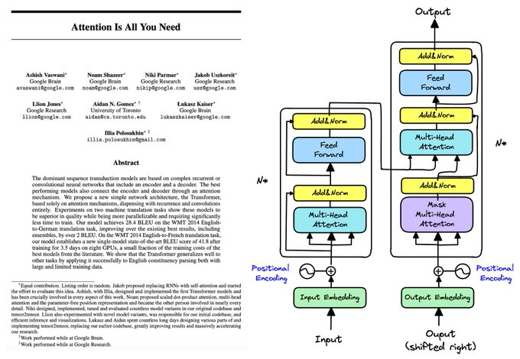
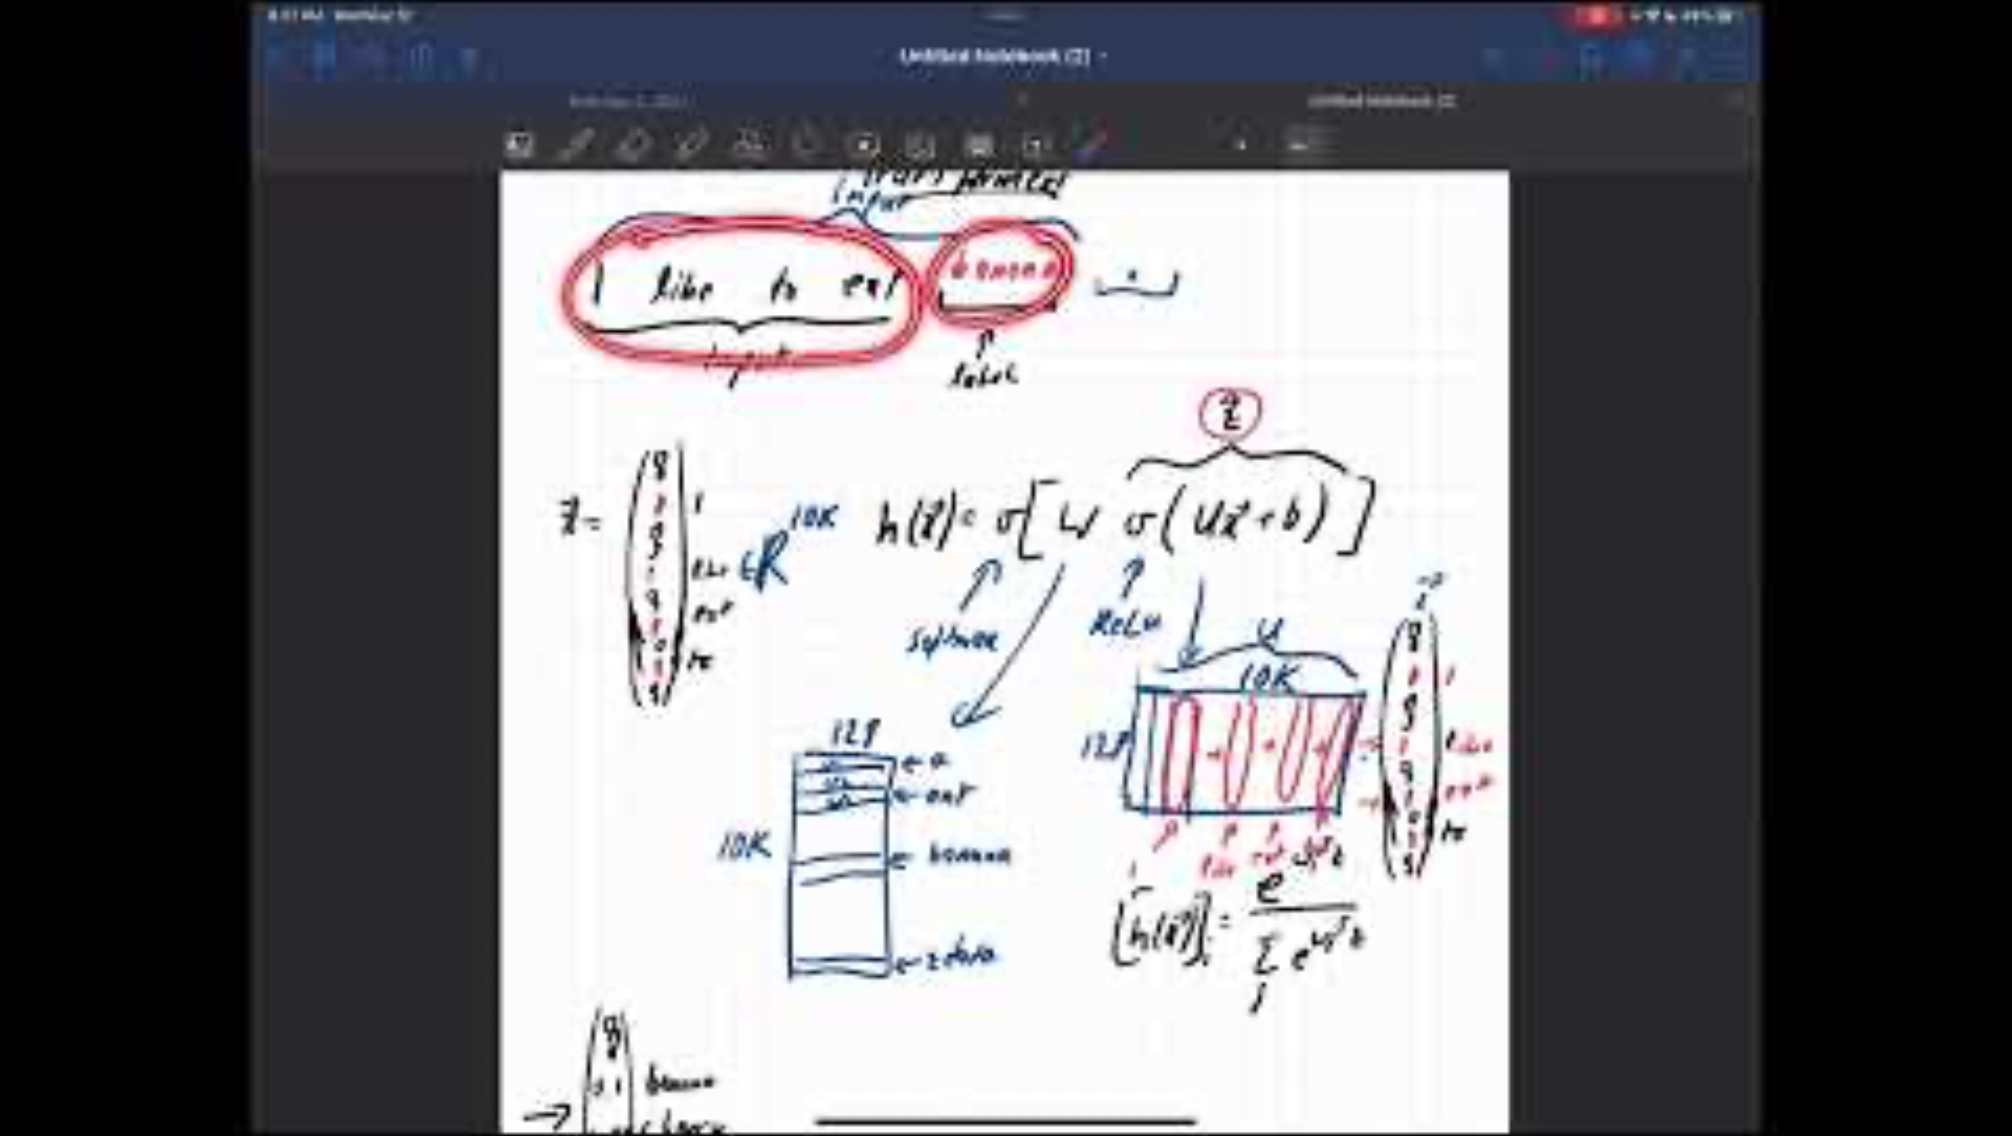
Tabular foundational models
Parenthesis: some good places to read and learn about the attention mechanism
Original paper by Google researchers
Excellent video on attention and transformers
https://www.youtube.com/watch?v=Nu7VZeW5TaE

Slide 57
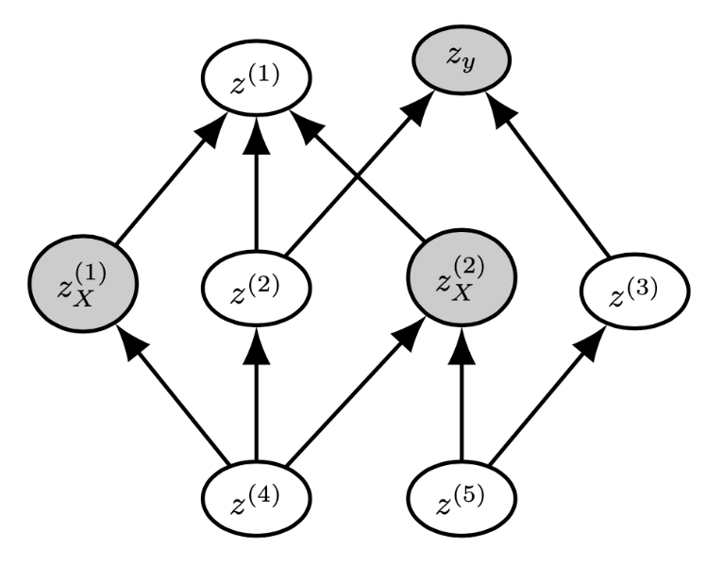
Tabular foundational models
Fix 2 : Leverage synthetic data to get a better prior
We want a prior that covers the diversity of real tabular datasets: heterogeneous features, nonlinear dependencies, mixed scales, class imbalance, etc.
💡 Sample datasets from a structured causal model (SCM), which consists of
1. A set of variables
2. A directed acyclic graph (DAG) specifying which variables influence which
3. A function form for each variable

Slide 58
Tabular foundational models
Fix 2 : Leverage synthetic data to get a better prior
To sample one synthetic dataset we: 1. Sample a DAG structure (number of nodes, edge probabilities, etc)
2. Sample random functional form f_{j} (linear, polynomial, etc.)
3. Sample random noise distribution
4. Sample n realisations from this SCM to get a dataset (X, y)
Each sampled SCM defines a different task. The distribution over SCMs defines a prior over tasks. By varying the DAG structure, the functional forms, the noise distributions, number of features, etc., we cover a very broad class of tabular tasks

Slide 59
Tabular foundational models
Fix 3 : Richer output distribution
The decoder of a CNP (i.e. its output) is a Gaussian distribution approximating the PPD
However, if the target variables are discrete in a classification task it won’t work…

Slide 60
Tabular foundational models
Fix 3 : Richer output distribution
The decoder of a CNP (i.e. its output) is a Gaussian distribution approximating the PPD
However, if the target variables are discrete in a classification task it won’t work…
What we do is to consider a C-dimensional vector of logits defined as
and
output of the cross-attention layer
softmax operation
(note that W_{out} and b_{out} are both learnable parameters!)

Slide 61
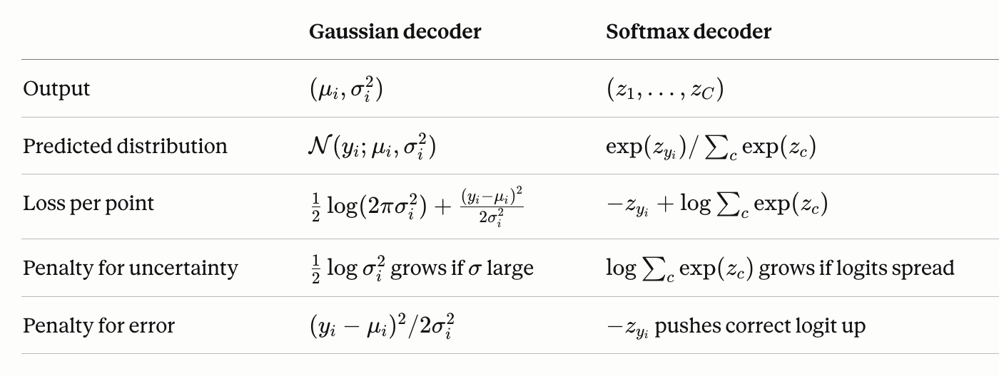
Tabular foundational models
Fix 3 : Richer output distribution
The new loss function for classification tasks becomes the cross-entropy loss

Slide 62
Tabular foundational models
Putting it all together, we get a tabular foundational model
The two most popular architectures are TabPFN and TabICL, which are somewhat more complicated, but fundamentally what we have seen.
context set
query point
encoder
PPD
aggregation
decoder

Slide 63
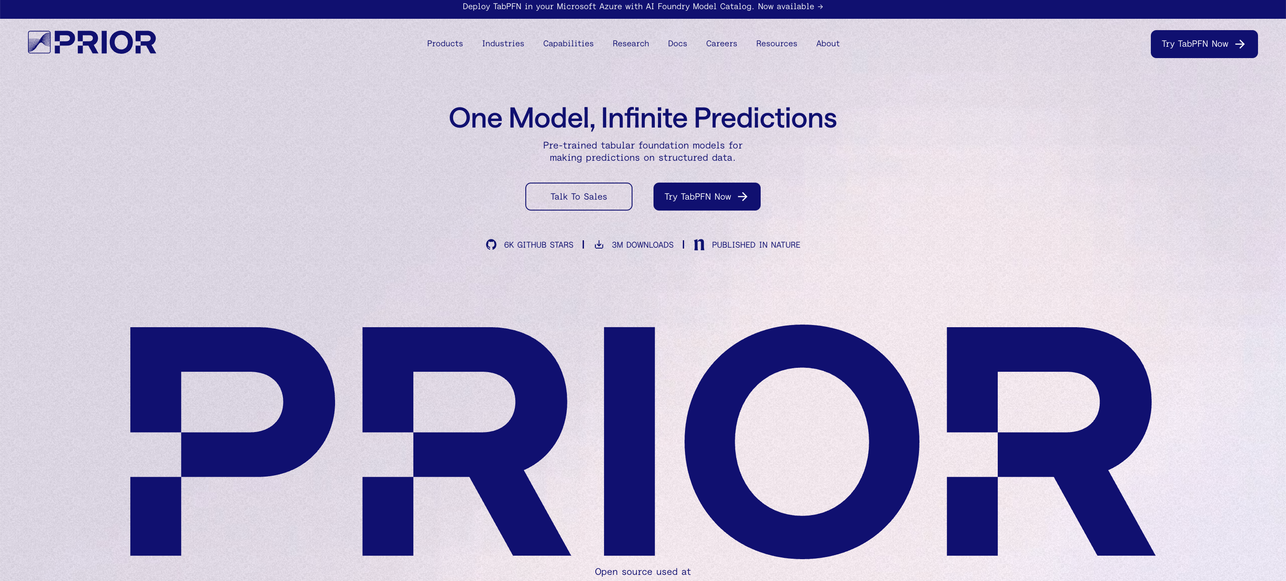

Tabular foundational models
There’s a lot of $$ going around this area…
Which is why many ideas and implementations are not open-source
TLDR: tabular foundational models are changing data science jobs profoundly

