Slide 1
Predicting electricity spot price
Ville Pirsto, Emil Tigerstedt, Ahsan Abbas

Slide 2
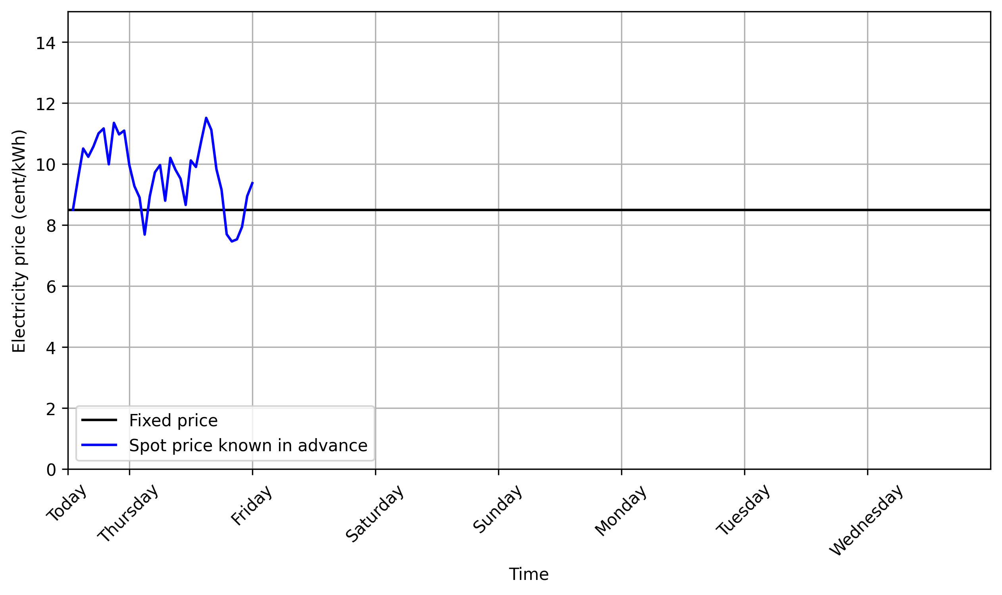
Spot price contract for electricity
30% of Finnish households have spot electricity price contract

Slide 3
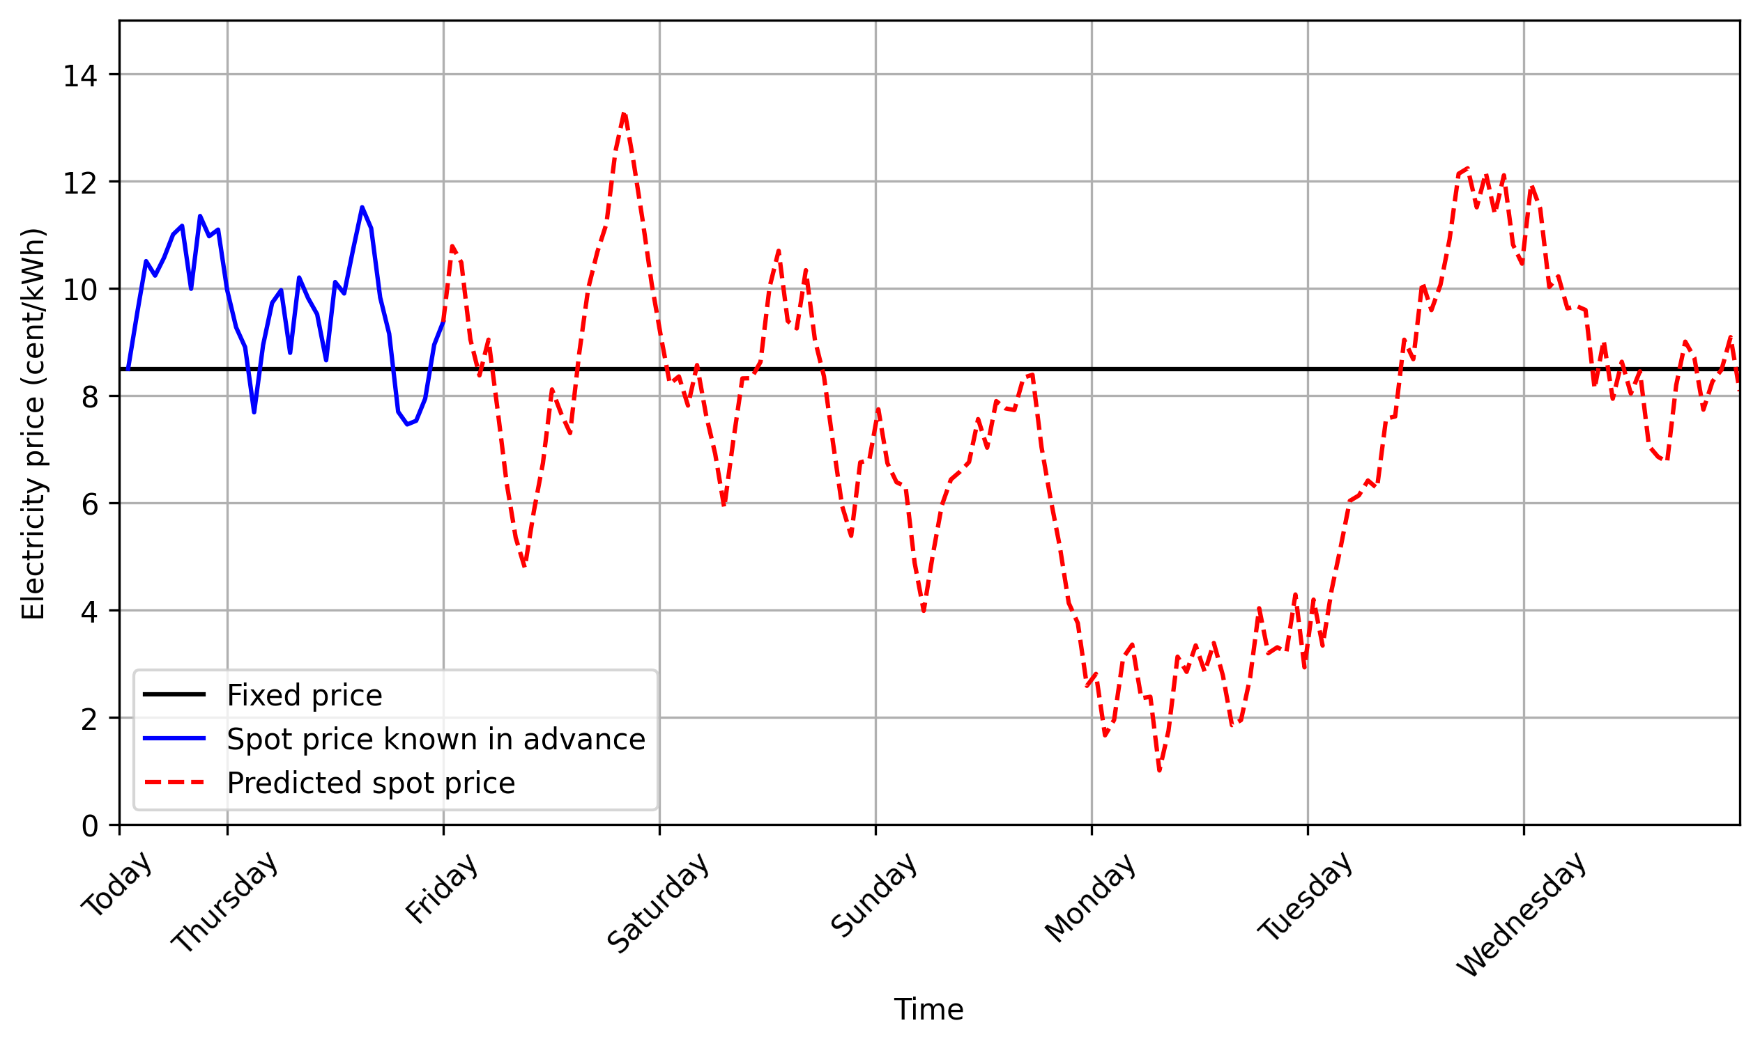
Predicting spot prices
Maybe one bullet here? dunno

Slide 4
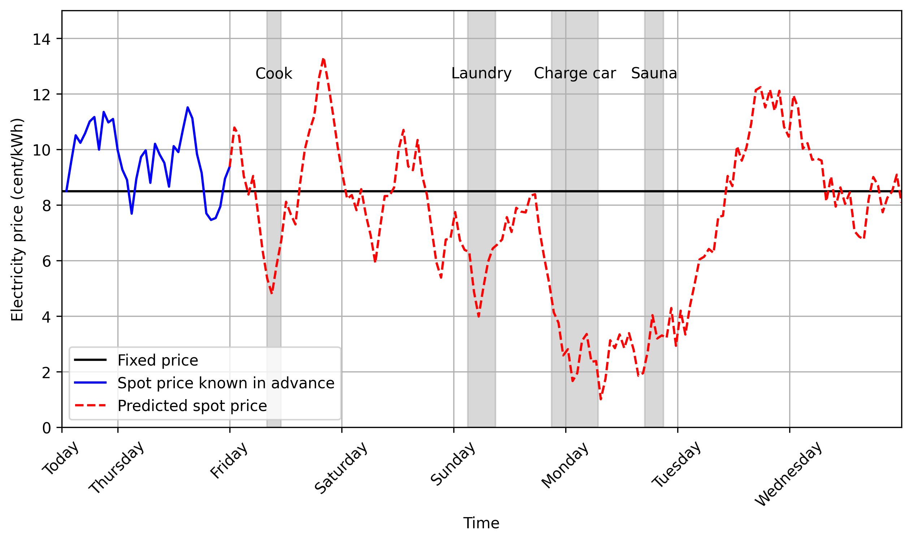
Long-term prediction enables savings
Maybe one bullet here? dunno

