Slide 1
Phishing Attacks & Safety
Detect, prevent, and respond to email and web-based phishing threats.

Slide 2

Introduction
Phishing attacks exploit trust to steal data or install malware. This module explains how to recognize phishing, understand social engineering, and adopt practical prevention measures.
Learners will review real examples and complete interactive quizzes to build measurable resilience against targeted email and web attacks.

Slide 3
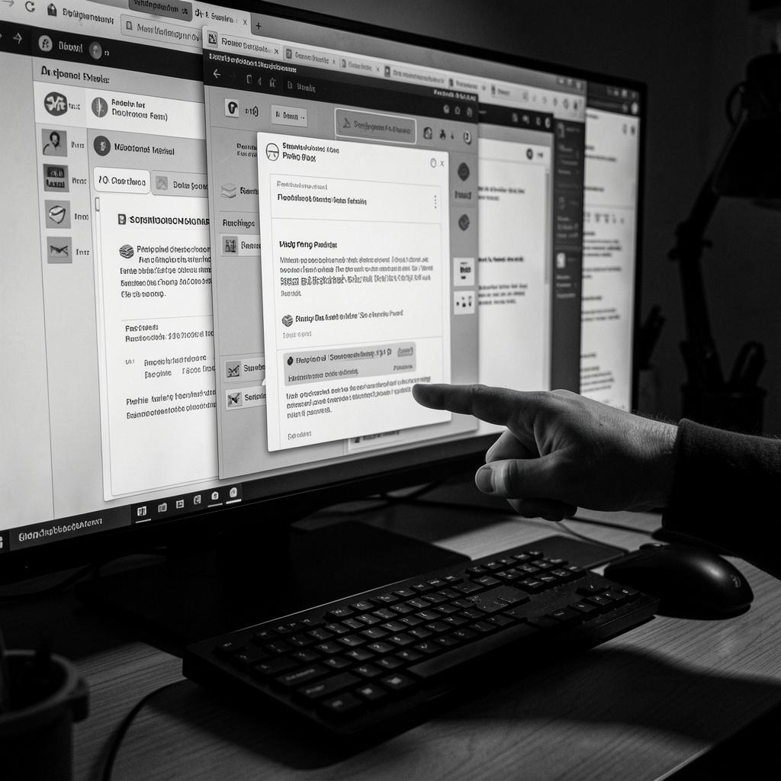
01
Phishing Identification

Slide 4
Recognizing Emails
Watch for unexpected senders, urgent requests, or inconsistent branding. Inspect the sender address and hover links before clicking.
Do not enable macros or open unknown attachments. The core rule: verify via a known channel and treat urgent account requests with caution.

Slide 5
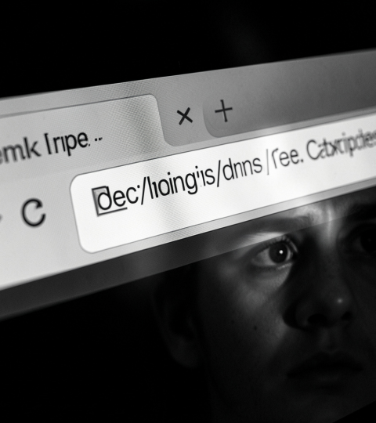
Fake Websites
Check URLs for typos, subdomains, and mismatched domains. Confirm the presence of HTTPS and valid certificates, but don’t rely on padlocks alone.
When in doubt, navigate to the site manually or contact the organization directly. Use password managers to detect credential-harvesting pages.

Slide 6
Social Engineering Tactics
Attackers exploit human trust via persuasion, urgency, and authority impersonation to obtain credentials or secrets.
Recognize common vectors: pretexting, baiting, and quid pro quo. Validate unusual requests and verify identities through independent channels.

Slide 7

02
Prevention & Training

Slide 8
Best Practices
Use strong, unique passwords and enable multi-factor authentication everywhere possible.
Verify senders, hover to inspect links, and never enable macros from unknown sources. Report suspicious messages immediately.

Slide 9
Real‑World Examples
The WhatsApp "APK" Loan Scam
A technical evolution of phishing that bypasses traditional email filters by using social messaging.
The Hook: A WhatsApp message promising an "Instant 0% Interest Loan" with a link to download an app.
The Method: Instead of a website, the victim downloads an APK file. Once installed, the app requests permissions to read SMS, Contacts, and Screen.
The Kill: The app steals OTPs in real-time, allowing the scammer to drain the victim#39;s bank account or take over their social media.
This is Malware-as-Phishing; the phone itself becomes the "insider threat."

Slide 10
Conclusions
Recurrent training and practical exercises build resilience against phishing and social engineering.
Adopt verification habits, technical controls, and a reporting culture to reduce organizational risk.

Slide 11
THANK YOU

