Slide 1
Machine Learning
Principal Authors: Piruz Alemi & Steve Li
Team members: Zhongping Yang, Mike Fonseca
Columbia University
The Fu School of Engineering and applied Science
https://bootcamp.cvn.columbia.edu/
April 18th, 2020

Slide 2
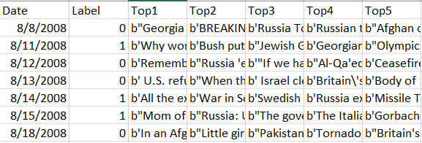
Dataset Information
Kaggle Dataset
https://www.kaggle.com/aaron7sun/stocknews
Data Structure
Date
(From 2008-8-8 to 2016-6-24)
Label (0 or 1 )
25 Articles / Day
Top Ranking Articles

Slide 3
Data Processing Steps
Step 1: Pre-process cleaning
Step 2: Split raw dataset
dNews – Daily News
Train (80%)
Test (20%)
Validation Data
Step3 : Establish the Stock labels (0,1) for Training
Step 4: Feed the data into:
Supervised: Linear & Non-Linear Regression Models of Choice
Unsupervised K-Means Clustering (e.g.
Stop Words
Tokenization
Lemmatization
N-Gram, Skip-Gram
Create Document-Word Matrix (Count Vectorizer)

Slide 4
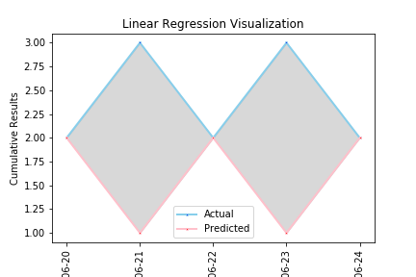
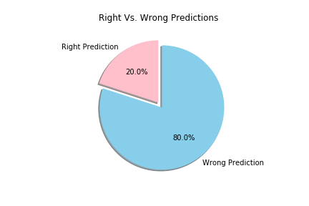
Linear Regression
Score on test dataset – 55%
Score on validation dataset – 20%

Slide 5
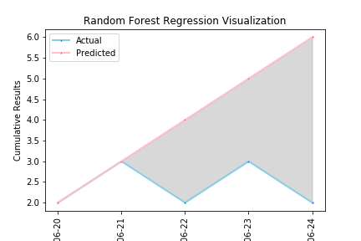
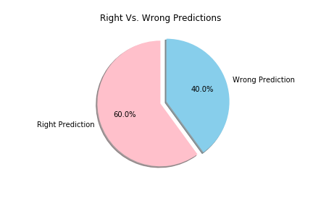
Random Forest Regression
Score on test dataset – 53.6%
Score on validation dataset – 60%

Slide 6
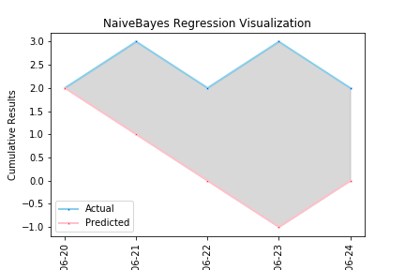
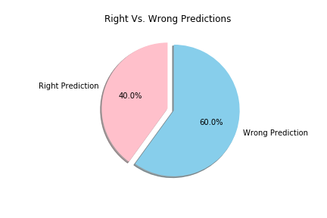
Naïve Bayes Regression
Score on test dataset – 51%
Score on validation dataset – 40%

Slide 7

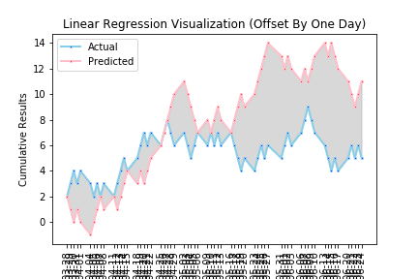
Offset by One Day

Slide 8
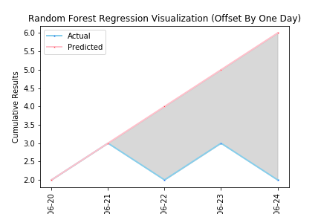

Random Forest Regression Offset By One Day
Score on test dataset – 53.6%
Score on validation dataset – 60%
Score on validation dataset offset – 60%

Slide 9
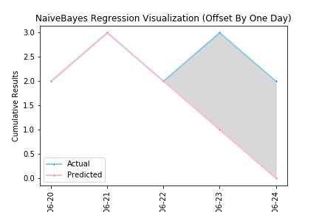
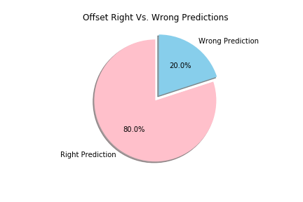
Naïve Bayes Regression Offset By One Day
Score on test dataset – 51%
Score on validation dataset – 40%
Score on validation dataset offset – 80%

Slide 10
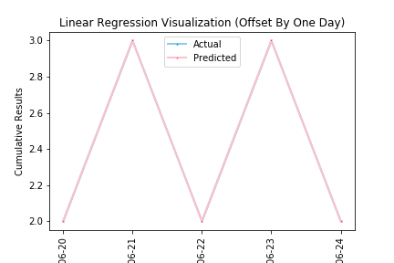
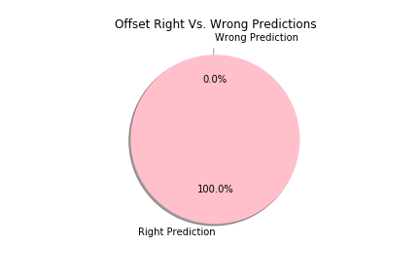
Linear Regression Offset By One Day
Score on test dataset – 55%
Score on validation dataset – 20%
Score on validation dataset offset – 100%

Slide 11
Unsupervised Learning

Slide 12
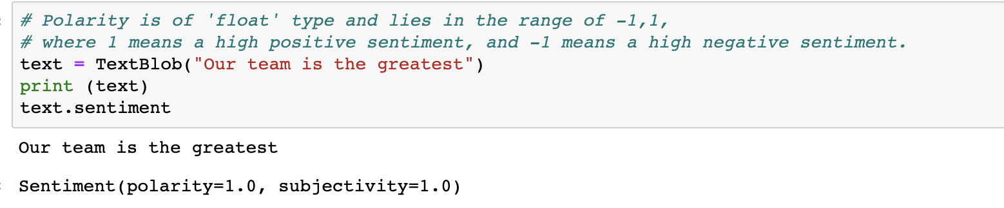
Significant in our analysis is the analysis of Text (News) by: 1. Sentiment 2. Context

Slide 13

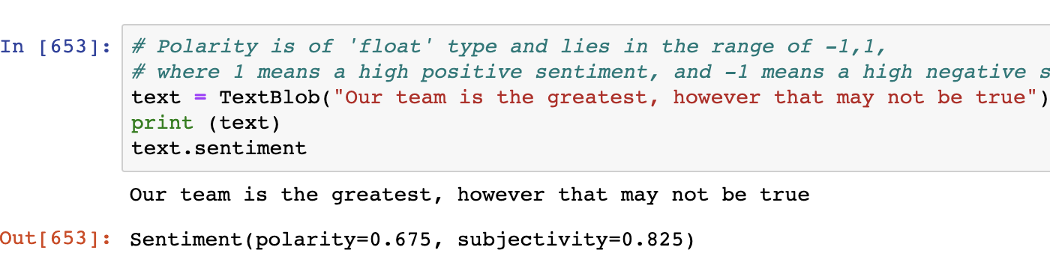
Sentiment Analysis

Slide 14
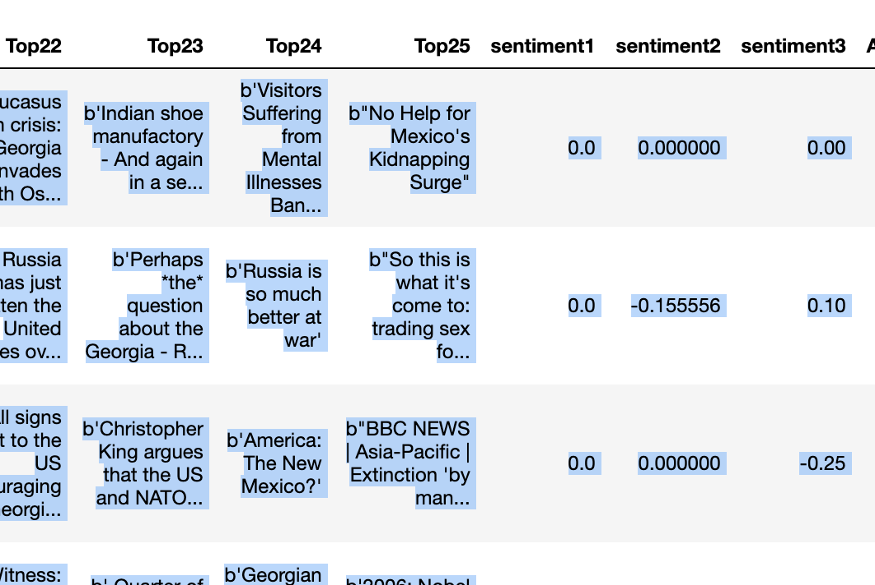
Sentiment as a column Feature

Slide 15
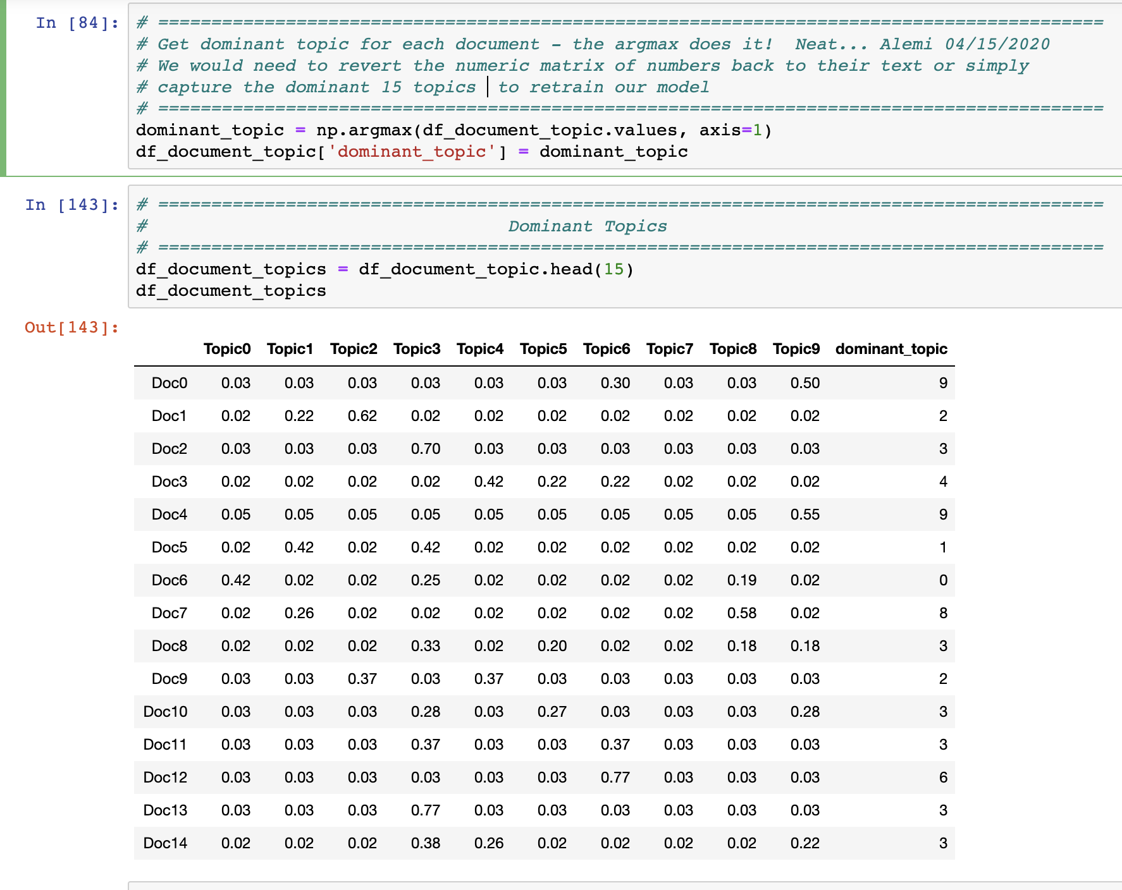
LDA*: From News to numeric bags by Topic
* Latent Dirichlet Allocation:
Model’s Score:
Log Likelihood: - 95912.04113658932
Perplexity:
225.66814792477965

Slide 16
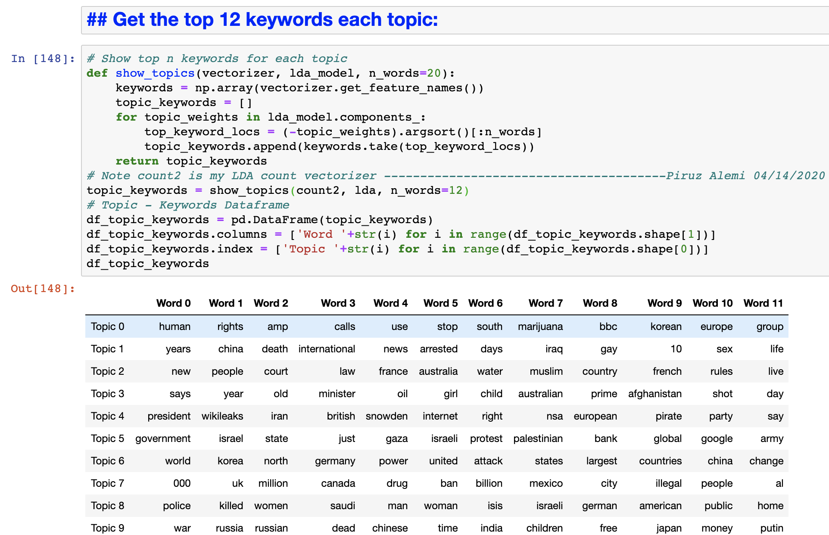
Extraction of 12 key words from numeric
An Extract from LDA Model, hyper-parameter is n_words

Slide 17
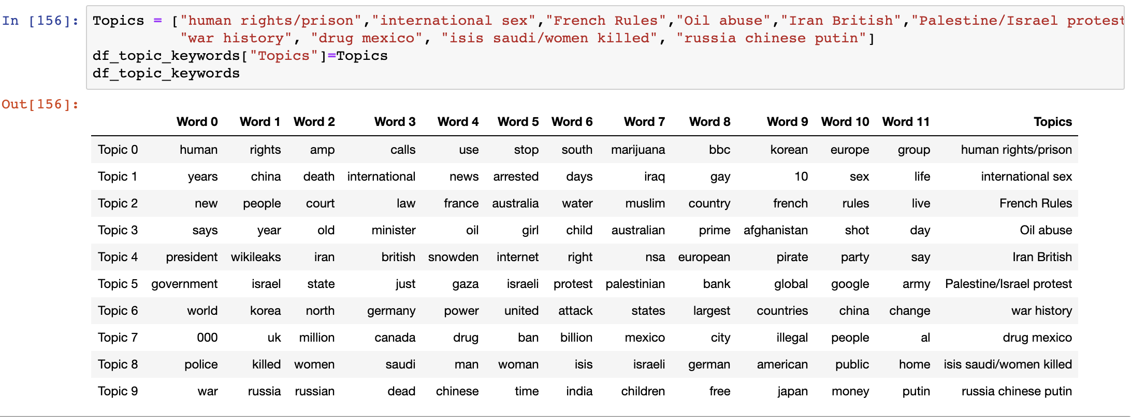
Stop! Assign your classification to the model’s classification
Check out the Topics!

Slide 18

Construct the k-means clusters

Slide 19
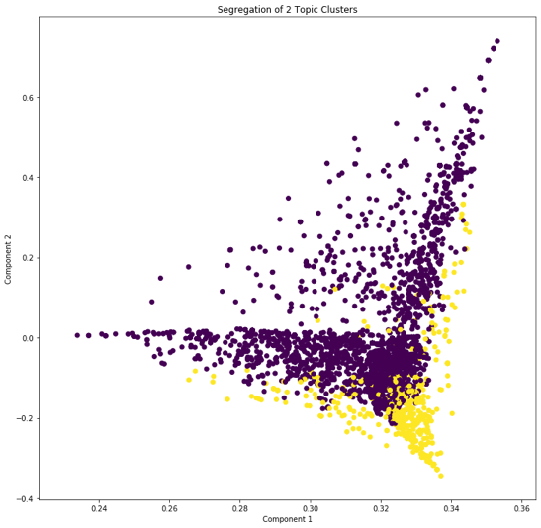
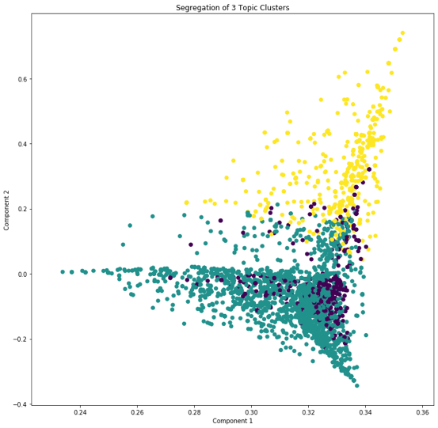
K-Means: 2 vs. 3 Topics

Slide 20
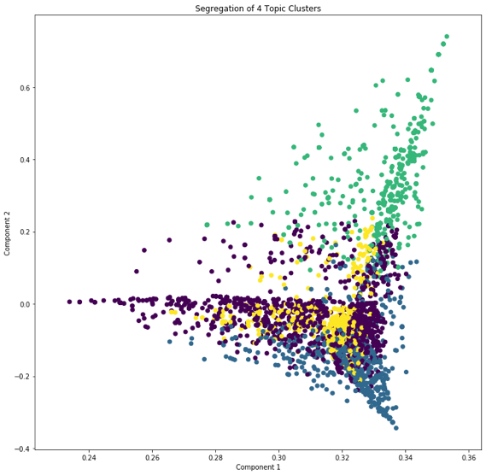
K-Means: 3 vs. 4 Topics

Slide 21
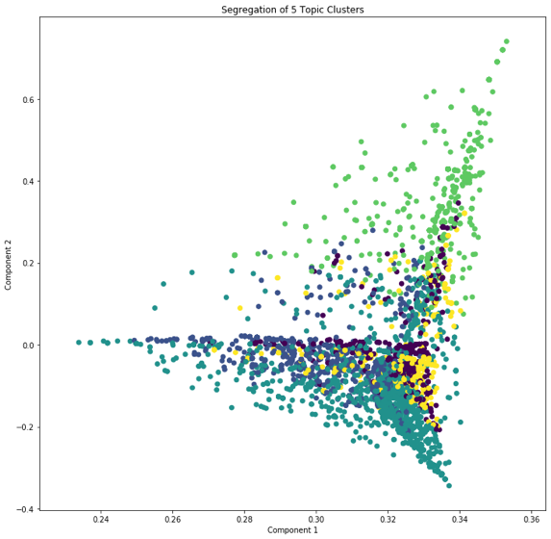
K-Means: 4 vs. 5 Topics

Slide 22
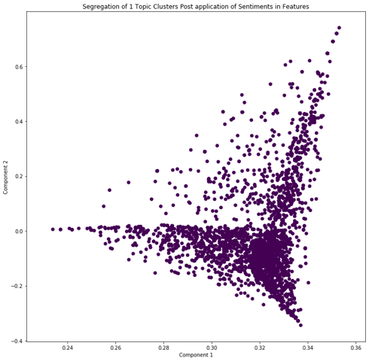
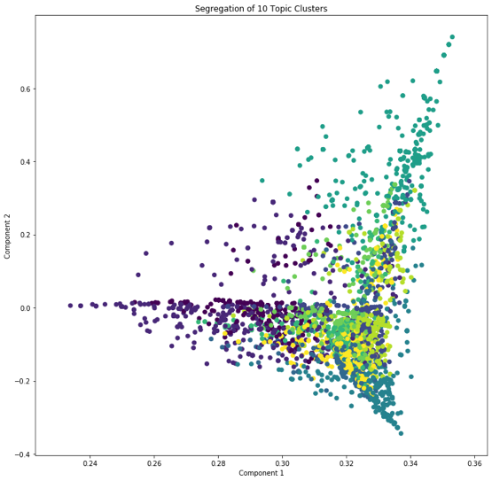
1 vs. LDA: Recommends 10 component

Slide 23

So What? Shallow vs. Deep Learning:
Given these new linguistic classifications we created new features
New features were then looped back into our original models.
Learning not from the features of the training but from the output of preceding layers = Deep Learning
We are now training our model on S&P500 2020 stock crash, first shallow then deep, for the “pandemic” was first taken as shallow and is now tragically deep!

Slide 24
Conclusion:
We recommend the application of Alemi_Li Model in FinTech:
The model:
Is an ensemble of Supervised and Unsupervised Machine Learning
Is highly adaptive to what dominates the news.
Allows human intervention to give its features further context
Provides confidence levels for non-normal distributions.
Is being validated on U.S. Pandemic News & Stock market crash.

Slide 25
With special Thanks! to our A+ support team:
Ilya Alshteyn
Terry Huang
Jason Lin
Ju Chen
Lori Harris
Brendan Connelly
Nicholas Michaud
Isaac Mollinedo

