Slide 1
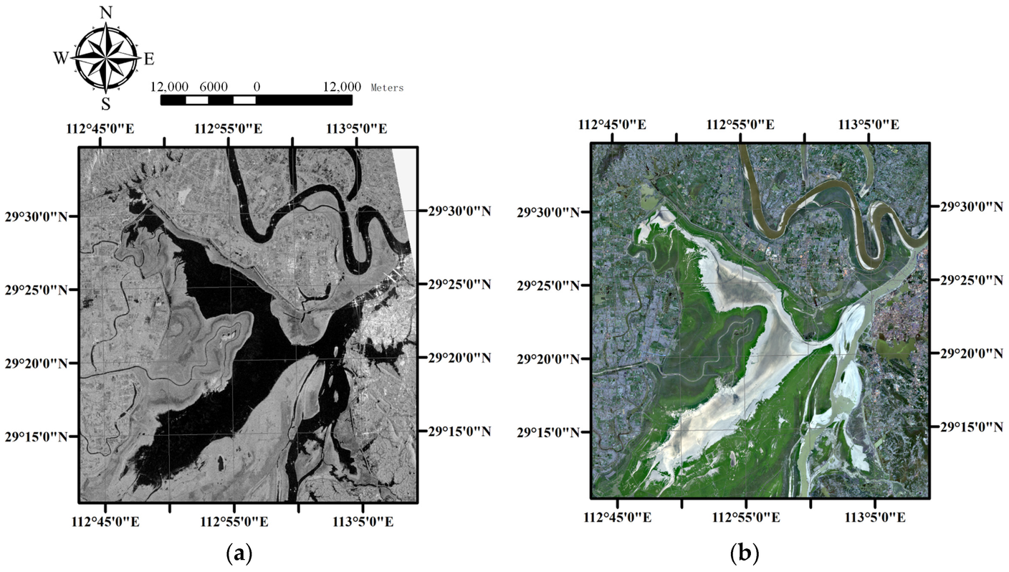
Satellite Water Body Segmentation using U-Net++
Mini Project – Computational
Intelligence ( CS354N )
Group Members:
Aman Pratap singh
220001007
Shivraj Rathore
220001075
PriyanshVerma
220001062

Slide 2
Problem Statement
Objective :
To design and develop a deep learning-based system capable of automatically
detecting and segmenting water bodies (such as lakes, rivers, ponds) from satellite
images, thereby assisting in efficient environmental monitoring and resource .
Approach :
We collected and preprocessed satellite images
used U-Net and U-Net++ models for accurate segmentation of water bodies. The
system was trained and validated to generate water body masks automatically.
Goal :
The goal is to create an automated, scalable, and accurate system to detect and
segment water bodies from satellite imagery, helping in efficient monitoring,
conservation, and management of water resources..

Slide 3
Data Collection & Processing
.
“Source: Satellite Imagery Dataset from kegal”
.
“Processing”
.
“Image Resizing”
.
.
“Normalization”
.
“Manual Annotation (for supervised learning)”
“Data Split: 80% Training, 20% Testing”

Slide 4
Algorithm
1.Algorithm for Water Body Detection and Segmentation Input Acquisition:
2.
Preprocessing: Resize to 256x256, normalize pixel values, and augment if needed.
Feature Extraction
3.
4
Segmentation: Use a U-Net or U-Net++ model to perform pixel-wise classification.
Post-processing: Apply thresholding to smoothen the segmentation mask,
5.
remove noise, and refine boundaries.
6
Output Generation: Generate a final segmented image highlighting the water bodies.

Slide 5
U-Net Architecture
U-Net Model for Water Body Segmentation
.
Structure: U-Net follows an encoder-decoder architecture, where the encoder
extracts features and the decoder reconstructs the segmented image.
.
Skip Connections: Connect corresponding encoder and decoder layers to recover
fine spatial details, crucial for accurate segmentation.
.
Strength: U-Net is highly efficient for small datasets and provides precise
pixel-wise classification of water regions.

Slide 6
U-Net++ Architecture
U-Net++ Model Enhancements
.
Dense Skip Connections: Unlike basic U-Net, U-Net++ uses nested and dense
skip pathways improve gradient flow and feature reuse.
.
Architecture: Multiple convolution blocks at each level provide deeper supervision
during training.
.
Performance: U-Net++ achieves higher segmentation accuracy and better boundary
delineation compared to the vanilla U-Net, especially in complex scenes.

Slide 7
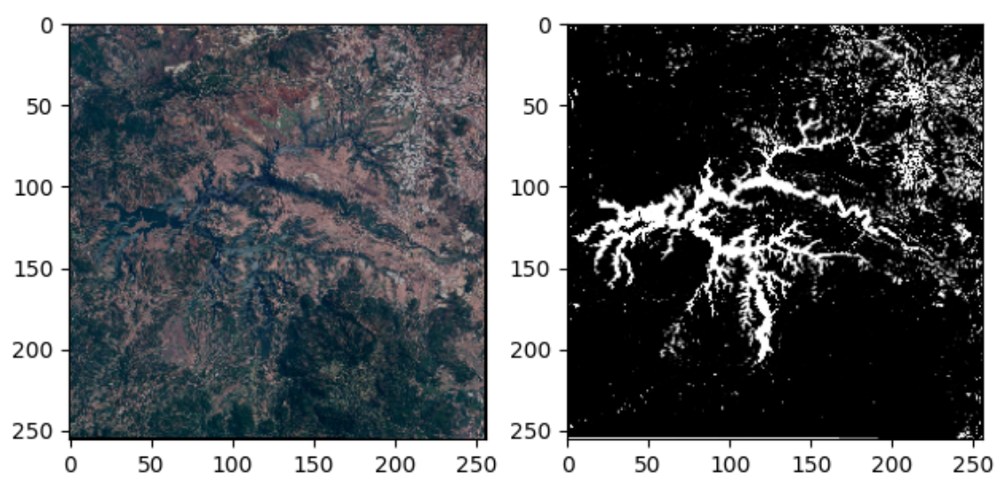
SAMPLE IMAGES AND CORRESPONDING OUTPUTS

Slide 8
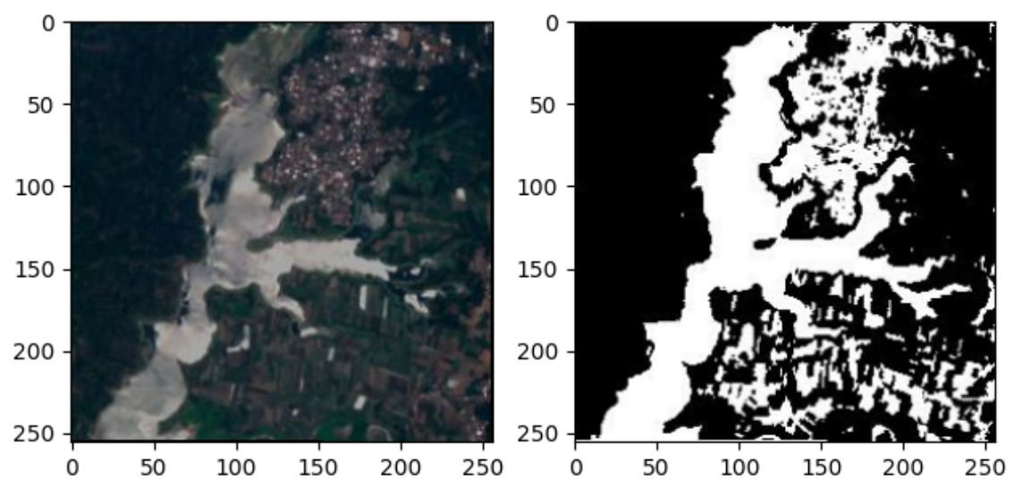

Slide 9
Results
.
U-Net Model: Achieves good segmentation performance, with clear detection
of major water bodies.
.
U-Net++ Model: Further improves performance by refining edges, enhancing
boundary detection, and reducing false positives.

Slide 10
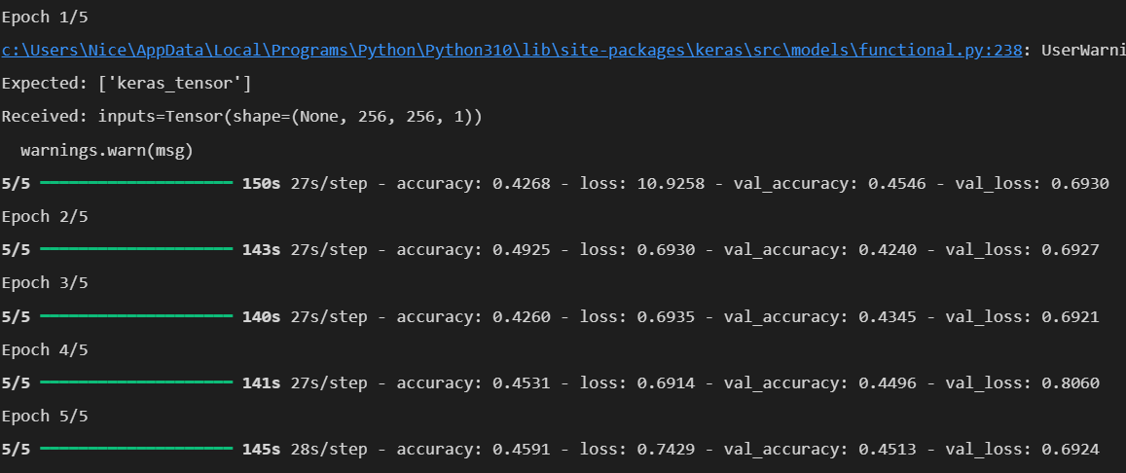
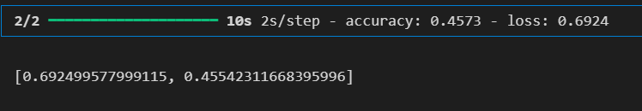

Slide 11
Conclusion & Future Work
• U-Net++ outperforms traditional methods for water segmentation
• Future improvements:
• Use larger, diverse datasets
• Optimize hyperparameters
• Deploy model for real-time monitoring.

Slide 12
THANK YOU

