Slide 1
Archaeological textures segmentation
A Pointnet based textures detector
Computer Graphics & 3D exam
University of Florence, Italy
10 October 2019
Lorenzo Pisaneschi

Slide 2
Introduction
Archaeological textures segmentation aims to segment relief patterns in archaeological fragments 3D images
It is based on Pointnet architecture
The idea is to summarize information directly from point clouds

Slide 3
WHAT IS A POINT CLOUD?
Point cloud is an unordered set of vectors
It is represented as a set of 3D points
Each point $P_{i}$ is a set of its 3D coordinates (x, y, z) plus extra feature channels
Each point 𝑷_𝒊 is a set of its 3D coordinates (x, y, z) plus extra feature channels

Slide 4
How does pointnet work?
Pointnet directly takes point clouds as input
The network outputs class labels per each point
Pointnet architecture consists in three layers: a simmetry function, a global and local features aggregator and a join aligment network.

Slide 5
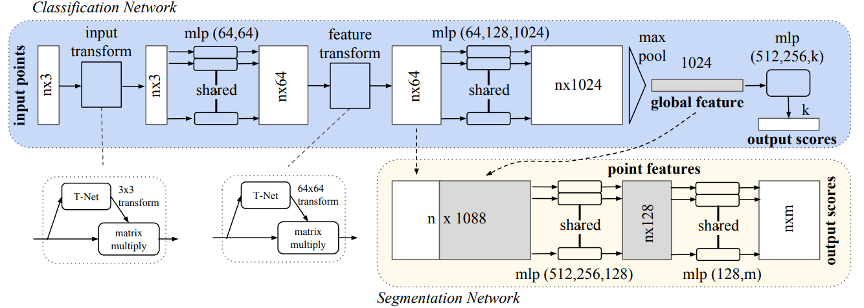
POINTNET ARCHITECTURE
The network manipulates input and obtains global features informations
Segmentation Network is a Classification Network extension

Slide 6
Pointnet 3d object part segmentation
For relief patterns detection, Pointnet object part segmentation has been choosen
Part segmentation has been formulated as a per-point classification problem
The task is to assign a part label to each point
The evaluation metric are mIoU (mean Intersection over Union) and Accuracy

Slide 7
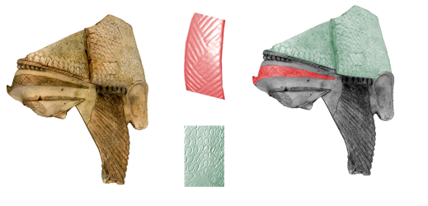
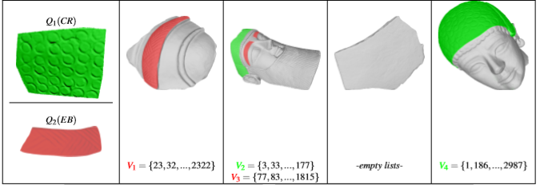
PROJECT GOALS
Understand if Pointnet can be used as geometric textures detector
Understand how the dataset examined has to be manipulated to be used as Pointnet input
Analyze test results

Slide 8
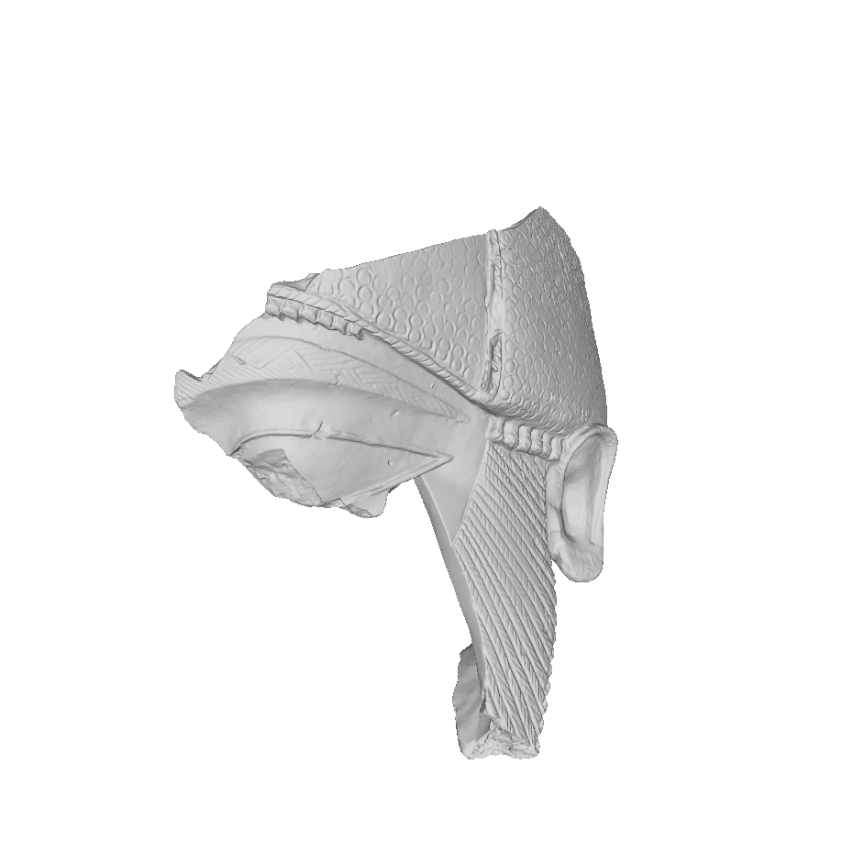
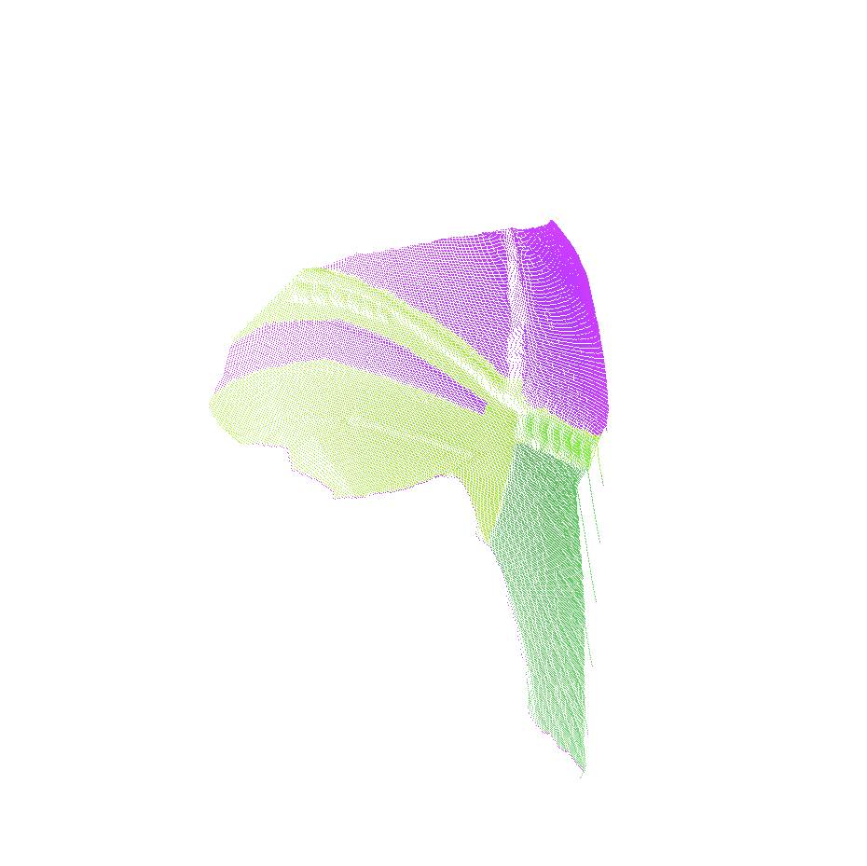
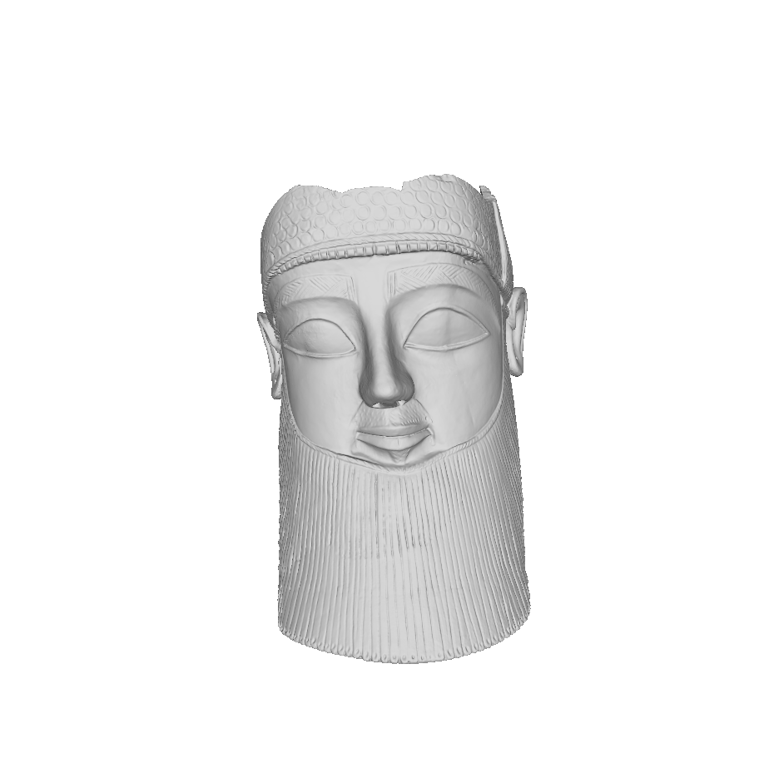
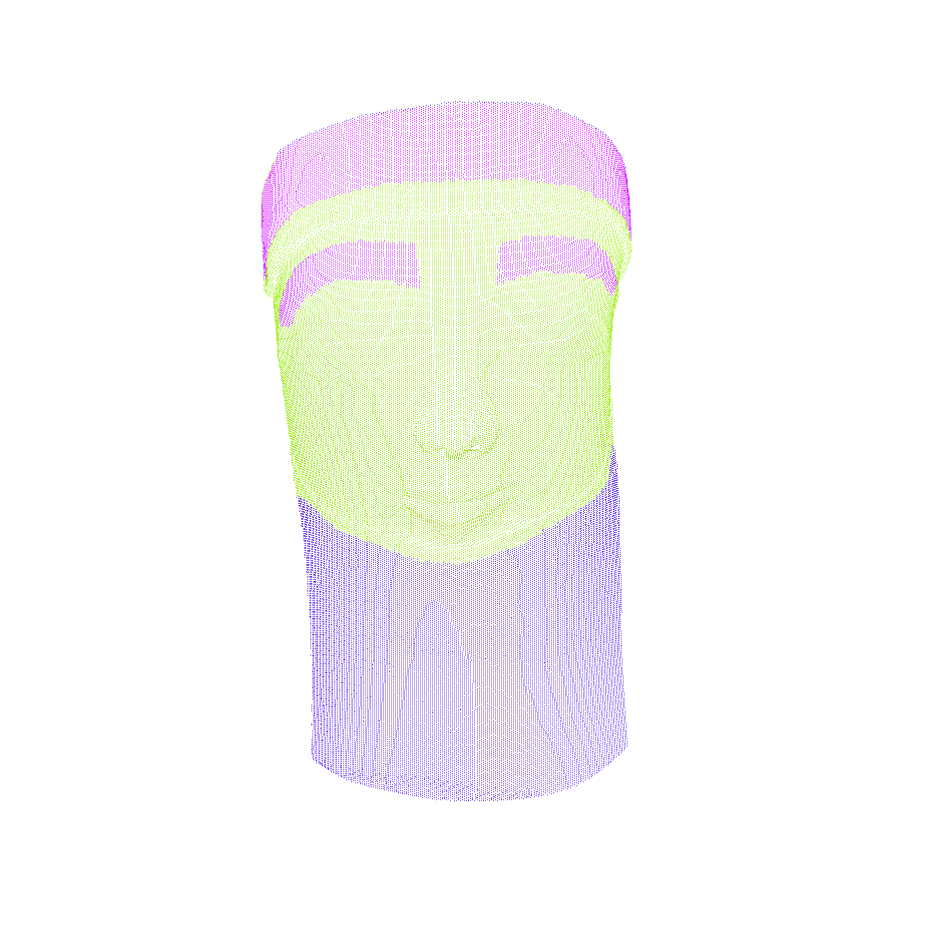
DATASET
Dataset consists in 10 3D images taken from the SHREC’18 one
Obviously, points are used instead of meshes

Slide 9
textures specifications
There are 12 differents detectable geometric textures
Each image may contain from 2 to 5 different geometric textures
One geometric textures may appear on multiple models

Slide 10
Relief pattern recognition problems
Same object’s fragments could be very different
It’s difficult to define a pattern
Data acquisition is a challenging task
Data size is a problem
It’s not simply to obtain a consisting dataset for learning

Slide 11
Original dataset files
Original dataset is a set of 10 .mat files, one for each image
Each file contains vertices coordinates, facets and labels
The labels, essential for project tasks, refers to facets, not points
It has been necessary work on dataset for Pointnet compatibility

Slide 12
Operations on dataset files
Filelists containing vertices labels were created as .seg files
Respectives .ply files were created for 3D visualization
.pts files containing simply vertices coordinates were created for testing

Slide 13
Final dataset
Since Pointnet runs working with 256, 512, 1024 or 2048 points, it has been necessary splitting off the images
Furthermore, the images have different number of vertices, ranging from 9037 up to 99828
So for each images were created different datasets with .seg, .pts and .ply files

Slide 14
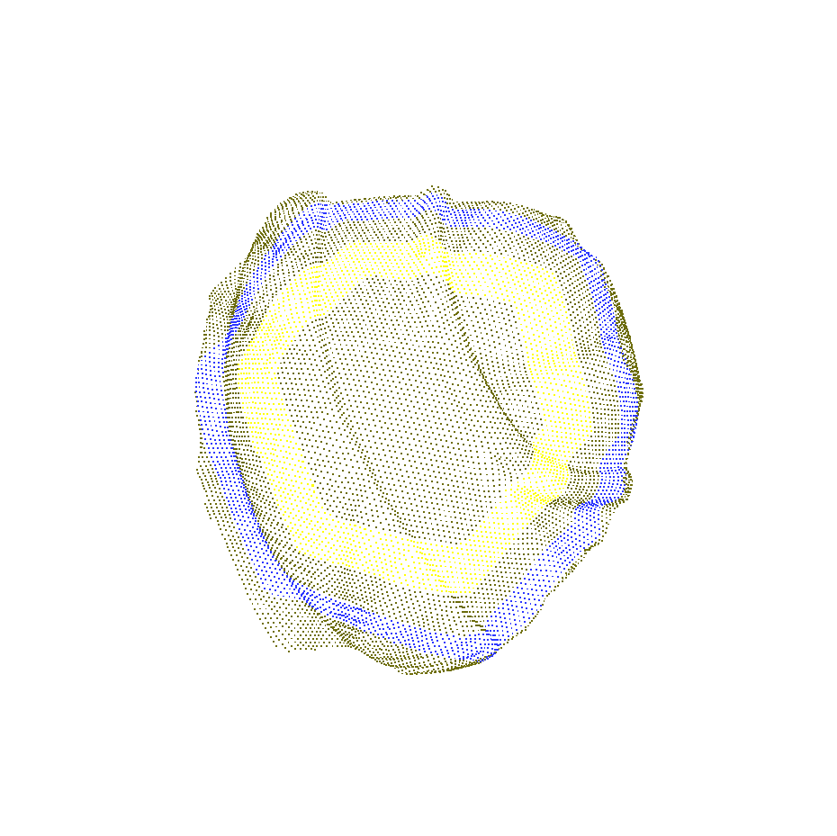
FINAL DATASET EXAMPLE
Eyebrow
It’s possible to distinguish splitted models obtained from eybrow 3D image. Each model is a .ply file.
-3.721 -4.171 7.082
-3.713 -4.068 7.043
-3.705 -3.962 6.992
-3.690 -3.855 6.946
..
-3.650 -3.632 6.859
-3.629 -3.540 6.825
-3.610 -3.466 6.802
3
3
3
3
..
0
0
0
This is the .seg file which contains the points labels.
This is the .pts file which contains the points coordinates.

Slide 15
test
The test has been done to evaluate Pointnet on Archaeological Textures Segmentation tasks
The test have been done on a single image at time
The network has been fed with a single image dataset of different points number at time
Every image has been splitted in 256, 512, 1024, 2048 sub-models in order to feed the network

Slide 16
Test: network setting
A specific Tensorflow model has been created for the Archaeological Textures Segmentation project
EPOCHS FOR TRAINING: 100
BATCH SIZE: 4

Slide 17
RESULTS
There is a table that summarizes test results.
 | 256 points | 512 points | 1024 points | 2048 points
EgyptFace2 | Acc: 54% IoU: 21% | Acc: 61% IoU: 41% | Acc: 30% IoU: 33% | Acc: 44% IoU: 24%
EgyptFaceDense | Acc: 47% IoU: 73% | Acc: 72% IoU: 80% | Acc: 46% IoU: 74% | Acc: 37% IoU: 50%
Eyebrow | Acc: 36% IoU: 50% | Acc: 72% IoU: 82% | Acc: 64% IoU: 72% | Acc: 35% IoU: 50%
face | Acc: 52% IoU: 76% | Acc: 94% IoU: 95% | Acc: 52% IoU: 76% | Acc: 52% IoU: 76%
face3 | Acc: 55% IoU: 77% | Acc: 57% IoU: 63% | Acc: 48% IoU: 50% | Acc: 49% IoU: 51%
Surface1 | Acc: 68% IoU: 84% | Acc: 31% IoU: 64% | Acc: 13% IoU: 51% | Acc: 67% IoU: 83%
Surface4 | Acc: 42% IoU: 71% | Acc: 42% IoU: 71% | Acc: 40% IoU: 70% | Acc: 40% IoU: 70%
Surface5 | Acc: 78% IoU: 61% | Acc: 78% IoU: 59% | Acc: 77% IoU: 53% | Acc: 43% IoU: 50%
Surface6 | Acc: 23% IoU: 60% | Acc: 78% IoU: 50% | Acc: 0% IoU: 50% | Acc: 0% IoU: 50%
Surface7 | Acc: 32% IoU: 70% | Acc: 38% IoU: 69% | Acc: 38% IoU: 69% | Acc: 0% IoU: 50%

Slide 18
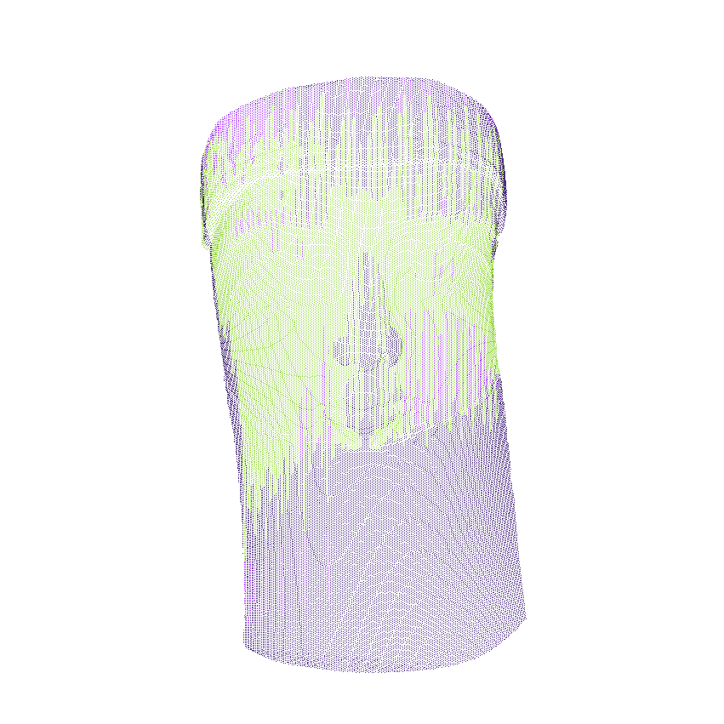
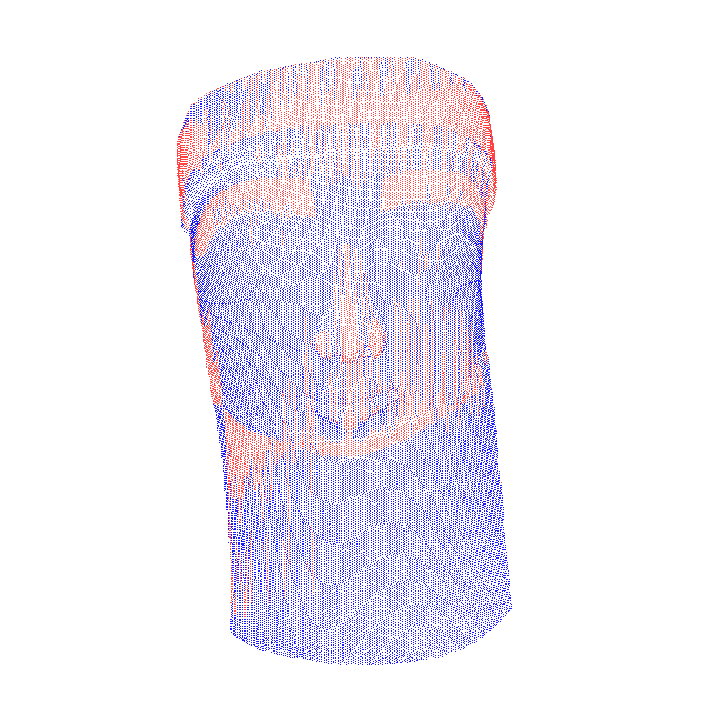
RESULTS
Here is an example of computation results (EgyptFaceDense): GT, PRED, DIFF files from 512 points dataset

Slide 19
conclusion
It has been found that 512 points sampling works better then other sampling criteria
The system works good if the network is fed with a good image partition
It could be possibile to add other points features in order to obtain a better segmentation

Slide 20
references
Charles R. Qi, Hao Su, Kaichun Mo, Leonidas J. Guibas (2016). “Pointnet: Deep Learning on Point Sets for 3D Classification and Segmentation”
Silvia Biasotti, Elia Moscoso Thompson, Loic Barthe, Stefano Berretti et al. (2018). “SHREC’18 track: Recognition of geometric patterns over 3D models”.
Claudio Tortorici, Stefano Berretti, Naoufel Werghi (2019). “Convolution operations for Relief Pattern Retrieval, Segmentation and Classification on Mesh Manifolds”.
Lorenzo Pisaneschi. Archaeological Textures Segmentation. www.github.com/pisalore/Archaeological-TexturesSegmentation.

Slide 21
THANKS FOR YOUR ATTENTION !

