Slide 1
MeanShift algorithm: a GPU implementation with CUDA
Parallel computing Course
Mid-term project
Lorenzo Pisaneschi
Firenze, 30 gennaio 2020

Slide 2
Parallel Computing exam
Part I
Firenze, 01/30/2020
The Mean Shift algorithm
Mean Shift is a non parametric clustering algorithm
It can classify dataset points, clustering them into groups without knowing clusters number
It is based on KDE (Kernel Density Estimation) which calculates peaks and clusters consequentely
At each step points will be shifted to their nearest peak
1

Slide 3
Parallel Computing exam
Part I
Firenze, 01/30/2020
Kernel Density Estimation
KDE is a method to estimate the underlying distribution (the probability density function) for a set of data.
Given an N points dataset, at each iteration a point will be processed by a Kernel function
This operation will generate a probability surface according to which each point will be clustered

Slide 4
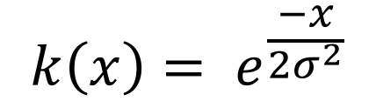

Parallel Computing exam
Part I
Firenze, 01/30/2020
The Gaussian Kernel
The most popular kernel function is the Gaussian Kernel:
$$k\left(x\right)= e^{\frac{−x}{2σ^{2}}}$$
Where:
x is the d – dimensional point to be processed by the kernel
$σ$ is the variance. We also call $σ$ band-width
The bandwidth is the only one input parameter for the Mean Shift algorithm

Slide 5
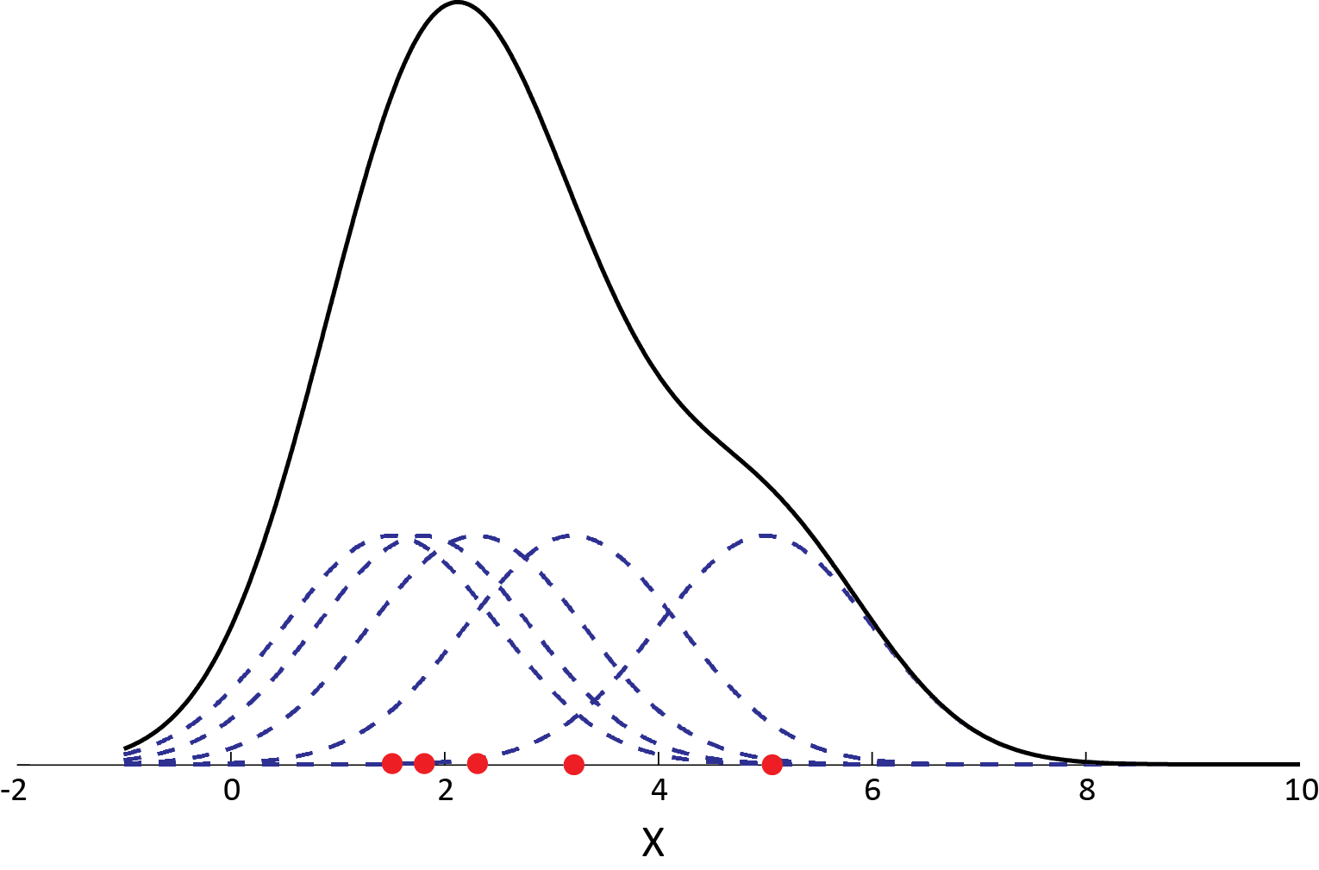
Parallel Computing exam
Part I
Firenze, 01/30/2020
The Gaussian Kernel - example
This is an 1-d example on how each point contribuites on generate the probability surface during the Mean Shift computation

Slide 6
Parallel Computing exam
Part I
Firenze, 01/30/2020
MeanShift – Further details [1]
At each iteration, each point is processed by a Shift function
The Shift operation works using the kernel function k(x) and the bandwith parameter
This operation computes means and weights shifting points gradually closer to their clusters

Slide 7
Parallel Computing exam
Part I
Firenze, 01/30/2020
MeanShift – Further details [2]
Is the calculated estimation of the weighted mean of the density determined by 𝐾, 𝑚(𝑥)
Is the mean shift
Is the provided algorithm updated unitl ther is not convergence or max iteration limit it’s reached

Slide 8
Parallel Computing exam
Part I
Firenze, 01/30/2020
MeanShift execution
N d-dimensional point
Bandwidth value
Centroids updating using the kernel function
Keep going until procedure did not converges

Slide 9

Parallel Computing exam
Part I
Firenze, 01/30/2020
MeanShift – Analysis
Mean shift is an expensive algorithm: $O(Tn^{2}$)
Where:
n: dataset dimension (n d-dimensional points)
T: max iterations number
In a traditional CPU implementation, this algorithm could be very slow
On the other hand, each point could be processed indipendentely by the others

Slide 10
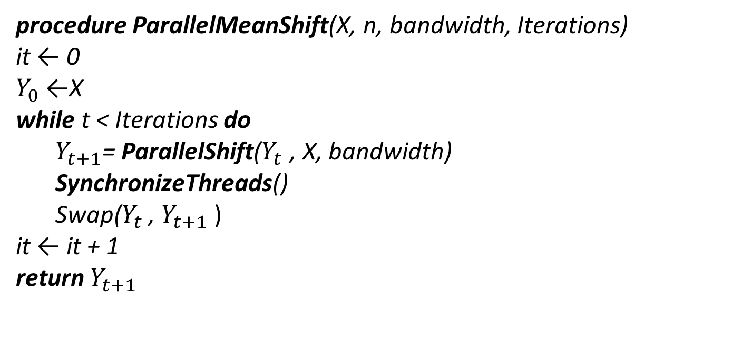
Parallel Computing exam
Part I
Firenze, 01/30/2020
Parallel MeanShift
procedure ParallelMeanShift(X, n, bandwidth, Iterations)
it ← 0
$Y_{0}$ ←X
while t < Iterations do $Y_{t+1}$= ParallelShift($Y_{t}$ , X, bandwidth)
SynchronizeThreads()
Swap($Y_{t}$ , $Y_{t+1}$ )
it ← it + 1
return $Y_{t+1}$

Slide 11
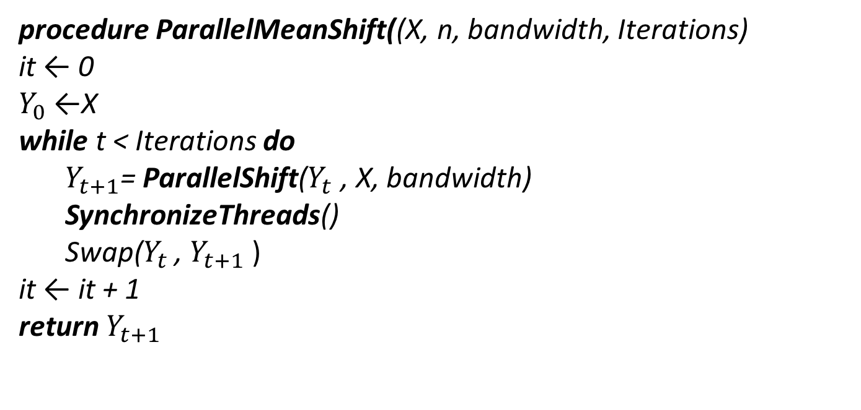
Parallel Computing exam
Part I
Firenze, 01/30/2020
Parallel MeanShift
procedure ParallelMeanShift((X, n, bandwidth, Iterations)
it ← 0
$Y_{0}$ ←X
while t < Iterations do $Y_{t+1}$= ParallelShift($Y_{t}$ , X, bandwidth)
SynchronizeThreads()
Swap($Y_{t}$ , $Y_{t+1}$ )
it ← it + 1
return $Y_{t+1}$
Each mean will be computed thanks to point indipendent processing
All threads work must to be synchronized!!!

Slide 12
Parallel Computing exam
Part I
Firenze, 01/30/2020
Parallel MeanShift with CUDA
Since each point could be processed individually, MeanShift can be implemented using parallel programming
Furthermore, it could be implemented exploiting GPU power
In a traditional CPU implementation, this algorithm could be very slow
CUDA (Compute Unified Device Architecure) is perfect in order to reach this goal
Memory management: thrust library

Slide 13
Parallel Computing exam
Part I
Firenze, 01/30/2020
CUDA SIMT paradigm
SIMT: Single Instruction Multiple Threads
It differs from SIMD (Single istruction Multiple Data) because in SIMT, threads can be executed asynchronously and indipendentely
In CUDA SIMD paradigm is ensured by the fact that threads are concurrently scheduled enteering the same program

Slide 14
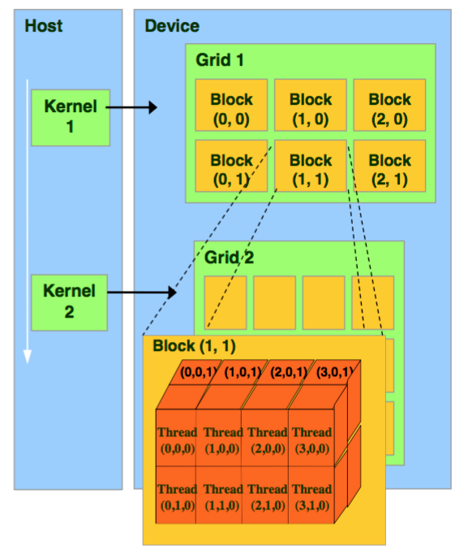
Parallel Computing exam
Part I
Firenze, 01/30/2020
CUDA: GPU organization
CUDA organizes threads in blocks which belongs to grids that are executed when a kernel function is called. Groups of 32 threads with consecutive indices are executed at same time concurrentely into warps using SM (Stream Multiprocessors) where the CUDA cores are. Blocks are distribuited to different SM.

Slide 15

Parallel Computing exam
Part I
Firenze, 01/30/2020
MeanShift GPU organization
The dataset is stored using an Array of Structure, an array where each element is a structure of the same type.
𝑋 = [ (𝑥1 , 𝑦1 ), (𝑥2 , 𝑦2 ), . . . , ( $x_{n},y_{n}$) ]
BLOCK_DIM 32
Grid dimension: [n / BLOCK_DIM ].
A general thread is accessed with this formula:
𝑖𝑛𝑑𝑒𝑥 = (𝐵𝑙𝑜𝑐𝑘𝐷𝑖𝑚 ∗ 𝐵𝑙𝑜𝑐𝑘𝐼𝑑𝑥 + 𝑡𝑥) ∗ 𝑘
Coalescing pattern

Slide 16

Parallel Computing exam
Part I
Firenze, 01/30/2020
Shared Memory
A further optimization is reached using CUDA Shared Memory
__global__ void cuda_MeanShift_2D
Shared Memory is smaller than global memory but faster
Threads which belong to same block can cooperate thanks to shared memory: TILING PATTERN can help so that if BLOCK_DIM = TILE_WIDTH there will be $O(n/$ TILE_WIDTH ) memory acceses.
__synchthreads() must be called

Slide 17
Parallel Computing exam
Part I
Firenze, 01/30/2020
Experiments and Results
A comparison between sequential and parallel MeanShift is presented
The experiments have been executed on a machine equipped with:
Intel(R) Core i7-8550U CPU @ 1.80GHz 4 Cores, 8 Threads
RAM 16 GB DDR4 2400Mhz
GPU "GeForce GTX 1050" 4GB with CUDA 10.2
(5 SM 640 CUDA cores)

Slide 18
Parallel Computing exam
Part I
Firenze, 01/30/2020
Dataset generation
Experiments were conducted using datasets of different dimensions (1000 up to 100k points)
Points are 2-dimensional (x, y)
Points have been generetaed using:
std::default_random_engine (which generates pseudo-casual numbers)
std::normal_distribution (which generates random numbers according to normal distribuition)

Slide 19
Parallel Computing exam
Part I
Firenze, 01/30/2020
Parallel MeanShift SpeedUps
Dataset dimension | CPU Time | GPU Time w/ Tiling | Speedup
1000 | 0.28784s | 0.27812s | 1,086x
5000 | 5.84816s | 0.14012s | 5,073x
10000 | 28.4357s | 3.67366s | 6,507x
20000 | 91.4664s | 16.3537s | 5,22x
30000 | 204.659s | 37.7643s | 5,199x
40000 | 480.582s | 68.6471s | 6,801x
50000 | 600.642s | 108.553s | 4,35x
60000 | 841.745s | 199.829s | 4,1366x
70000 | 1113.37s | 214.159s | 5,1182x
80000 | 1448.34s | 278.723s | 5,173x
90000 | 1932.42s | 353.804s | 5,450x
100000 | 2358.56s | 434.847s | 5,333x

Slide 20
Parallel Computing exam
Part I
Firenze, 01/30/2020
Performances comparison

Slide 21
Parallel Computing exam
Part I
Firenze, 01/30/2020
Tiling with different TILE WIDTH

Slide 22
K Means Algorithm: comparison between CPU and GPU implementation using OMP and CUDA
Parallel computing Course
Mid-term project
Lorenzo Pisaneschi
Firenze, 30 gennaio 2020

Slide 23
Parallel Computing exam
Part II
Firenze, 01/30/2020
The k-Means algorithm
K-Means is one of the most used unsupervised machine learning algorithms in order to classify a set of data
The goal is to assign each point to one of the k cluster, where k is an input parameter (clusters number)
A cluster is a group of similar points
Centroids define clusters
Similarity between points is calculated according to a chosen metric
22

Slide 24
Parallel Computing exam
Part II
Firenze, 01/30/2020
The k-Means: steps
Initializing phase: k centroids are chosen according to some initialization criteria
At each iteration distances are calculated between each points and centroids accumulating coordinates and counting the number of points belonging to each cluster
Means are calculated, averaging the accumulated coordinates values with the corrisponding conter
Then centroids coordinates are updating
23

Slide 25
Parallel Computing exam
Part II
Firenze, 01/30/2020
The k-Means: stop criteria
K-Means stops when max iteration is reached or the procedure converges (there are not further centroids updating)
k parameter is crucial as the initialization phase: different results could be reached
24

Slide 26
Parallel Computing exam
Part II
Firenze, 01/30/2020
Sequential k-Means
k-Means (inputPoints, clusters, maxIterations)
it ← 0
isNotConvergence ← false while t < maxIterations & isNotConvergence do
CalculateAllDistances(inputPoints, clusters)
isNotConvergence = FindNewCentroids(𝑐𝑙𝑢𝑠𝑡𝑒𝑟𝑠)
it ← it + 1

Slide 27

Parallel Computing exam
Part II
Firenze, 01/30/2020
K-Means – Consideration
$${argmin}_{S} \sum_{i=1}^{k}{\sum_{x ε S_{i}}{{|\left|x− µ_{i}\right||}^{2}}}$$
Set of d-dimensional observations $(x_{1}, x_{2}$, $…,x_{n}$)
Metric: here Euclidean distance
K-Means aims to partition n-observations into k <<< n clusters so as to minimize the whitin-cluster sum of squares (WCSS, i.e. variance)

Slide 28

Parallel Computing exam
Part II
Firenze, 01/30/2020
K-Means – Analysis
K-Means is $O(knd$)
Where:
k: clusters number
n: dataset dimension (n d-dimensional points)
d: point dimension
K-Means algorithm is widely used
However, finding the optimal solution is NP-hard in general Euclidean-space; local minima solution could produces wrong results

Slide 29
Parallel Computing exam
Part II
Firenze, 01/30/2020
Parallel K-Means
K-Means is an expensive algorithm: for each point at each iteration k distances are calculated
It’s possibile to implement k-Means using parallel and GPU programming since distances can be calculated separately like accumulators and counters can be updated one indipendentely by the other
In the follow OMP and CUDA k-Means implementations are discussed and presented

Slide 30
Parallel Computing exam
Part II
Firenze, 01/30/2020
OMP
OMP is an API which supports multi-platform shared memory multiprocessing programming in C++
With OMP is possibile to use multithreading by using some simple directives that indicates parallel region and how variables must be shared among threads
Eneteering in a parallel region, a main thread (master) is created; fork-join model is followed.
The parallel execution mode is SPMD

Slide 31
Parallel Computing exam
Part II
Firenze, 01/30/2020
OMP k-Means
Implicit barrier is provided by main thread (for synchronization)
Each thread have to know dataset dimension and clusters number
Each thread has its own clusterindex and minDistance variables

Slide 32
Parallel Computing exam
Part II
Firenze, 01/30/2020
OMP k-Means implementation
#pragma omp parallel
#pragma omp parallel default(shared) private(minDistance, clusterIndex) firstprivate(pointsSize, clustersSize)
#pragma omp for schedule(static)
Parallel region definition
Variables sharing directives
Assignment of work loads to threads is controlled
#pragma omp critical
if (distance < minDistance) { minDistance = distance;
clusterIndex = j;
}
Critical section for
minDistance update

Slide 33
Parallel Computing exam
Part II
Firenze, 01/30/2020
OMP k-Means considerations
Sequential consistency is respected
Bernstein’s condition is respected
Operations are correctly executed an data are shared in the right way improving execution performances
Critical section is fundamental for the correct distance updated; however, it influences needed execution time
Threads number can be chosen varying setting OMP_THREADS_NUM

Slide 34
Parallel Computing exam
Part II
Firenze, 01/30/2020
CUDA
Another k-Means parallel version has been implemented using CUDA
GPU architectures, as seen for MeanShift, fits perfectly also k-Means algorithm
GPGPU programming using the SIMT paradigm could help in boosting application pourpose
In the follow CUDA occupancy is analyzed deeper
Memory management: thrust library

Slide 35
Parallel Computing exam
Part II
Firenze, 01/30/2020
CUDA k-Means implementation
The followig CUDA kernels are provided:
__global__void cuda_kMeans_CalculateDistances
__global__ void cuda_kMeans_updateCentroids
__global__ cuda_kMeans_clearAll
The Euclidean Distance is the chosen metric:
__device__ float euclideianDistance

Slide 36
Parallel Computing exam
Part II
Firenze, 01/30/2020
Experiments and Results
The aim is to comparate the k-Means sequential version with the OMP and CUDA ones
OMP k-Means: the goal is to show performance variation varying OMP_THREADS_NUM
CUDA k-Means: the goal is to show performance variation varying BLOCK_DIM
The experiments have been executed on a machine equipped with:
Intel(R) Core i7-8550U CPU @ 1.80GHz 4 Cores, 8 Threads
RAM 16 GB DDR4 2400Mhz
GPU "GeForce GTX 1050" 4GB with CUDA 10.2
(5 SM 640 CUDA cores)

Slide 37
Parallel Computing exam
Part II
Firenze, 01/30/2020
Parallel OMP k-Means SpeedUps
Dataset size | CPU Time | OMP Time | Speedup
1000 | 0,0087537s | 0,0309955s | -
10000 | 0,0714324s | 0,0618166s | 1,898x
100000 | 0,7779713s | 0,2858521s | 1,155x
500000 | 3,5961935s | 1,3595931s | 2,645x
1MLN | 6,7640652s | 2,1600539s | 3,131x
10MLN | 13,387533s | 3,5475999s | 3,773x

Slide 38
Parallel Computing exam
Part II
Firenze, 01/30/2020
#Threads variation

Slide 39
Parallel Computing exam
Part II
Firenze, 01/30/2020
Parallel CUDA k-Means SpeedUps
Dataset size | CPU Time | CUDA Time | Speedup
1000 | 0,0087537s | 0,0013126s | 66,721x
10000 | 0,0714324s | 0,0018166s | 39,464
100000 | 0,7779713s | 0,0102352s | 76,274x
500000 | 3,5961935s | 0,0440193s | 81,727x
1MLN | 6,7640652s | 0,0871926s | 77,657x
10MLN | 13,387533s | 0,1686117s | 81,408x

Slide 40
Parallel Computing exam
Part II
Firenze, 01/30/2020
Block size variation

Slide 41
Parallel Computing exam
Part II
Firenze, 01/30/2020
OMP-CUDA k-Means performances comparison

Slide 42
Parallel Computing exam
Part II
Firenze, 01/30/2020
Considerations and conslusion – [1]
Clustering is a widely used technique in various fields
Medical research, custom service, e-commerce; clustering algorithm can be used also in image processing tasks like image segmentation
In general, clustering algorithm can retrieve information from dataset

Slide 43
Parallel Computing exam
Part II
Firenze, 01/30/2020
Considerations and conslusion – [2]
K-Means and Mean Shift alogorithms exploit the same task
However, they differ for input parameters, computational costs, implementation strategies
K-Means is faster than MeanShift, while Meanshift is more adactable in real world applications
An important suggestion could be the follow: combine MeanShift and k-Means clistering in order to obtain a powerful clustering algorithm

Slide 44
THANKS FOR YOUR ATTENTION!

Slide 45
Parallel Computing exam
Part II
Firenze, 01/30/2020
Resources
Code is available on Github
Sequential and OMP version (k-Means):
https://github.com/pisalore/kMeans_OMP
Parallel version with CUDA (k-Means):
https://github.com/pisalore/kMeans_CUDA
Sequential and OMP version (MeanShift):
https://github.com/pisalore/MeanShift_sequentialCPP
Parallel version with CUDA (MeanShift):
https://github.com/pisalore/MeanShift_CUDA

Slide 46
Parallel Computing exam
Part II
Firenze, 01/20/2020
References
D. Comaniciu and P. Meer. Mean shift analysis and applications. In Proceedings of the Seventh IEEE International Conference on Computer Vision, volume 2, pages 1197–1203 vol.2, Sep. 1999. Authors. The frobnicatable foo filter, 2006. ECCV06 submission ID 324. Supplied as additional material eccv06.pdf.
K.Fukunaga and L.D.Hostetler. The estimation of the gradient of a density function, with applications in pattern recognition. IEEE Trans. Information Theory, 21:32–40, 1975.
NVIDIA. Cuda documentation. https://docs. nvidia.com/cuda/, 2019. [Online; accessed 16-12-2019].
D. B. Kirk and W-M. W. Hwu, Morgan Kaufman. Programming Massively Parallel Processors: A Hands-on Approach. Morgan Kaufmann Publishers Inc., San Francisco, CA, USA, 1st edition, 2010.
Lloyd, Stuart P. "Least squares quantization in PCM." Information Theory, IEEE Transactions on 28.2 (1982): 129-137.
MacQueen, James. "Some methods for classification and analysis of multivariate observations." Proceedings of the fifth Berkeley symposium on mathematical statistics and probability. Vol. 1. No. 14. 1967.
Wikipedia k-means clustering. https://en.wikipedia.org/wiki/K-means_clustering. [Online; accessed 6-01-p2020].
Thomas Dauber and Gudula Rünger, Springer. ” Parallel Programming for Multicore and Cluster Systems”, - Chapt. 6
NVIDIA. Cuda documentation. https://docs. nvidia.com/cuda/, 2019. [Online; accessed 16-012019].
D. B. Kirk and W-M. W. Hwu, Morgan Kaufman. “Programming Massively Parallel Processors: A Hands-on Approach”- 2nd edition - Chapt. 1-2-5
D.T. Marr, F. Binus, D.L. Hill, G. Hinton, D.A. Konfaty, J.A. Miller, and M. Upton. Hyperthreading technology architecture and microarchitecture. Intel Technology Journal, 6(1): 4–15, 2002.

