Slide 1

SHELL PETROLEUM - Investment in Region according to Prediction on Fuel Type and Market Demand Sales
SAURABH SHEKHAR PISAL -A20403781-GROUP-166

Slide 2
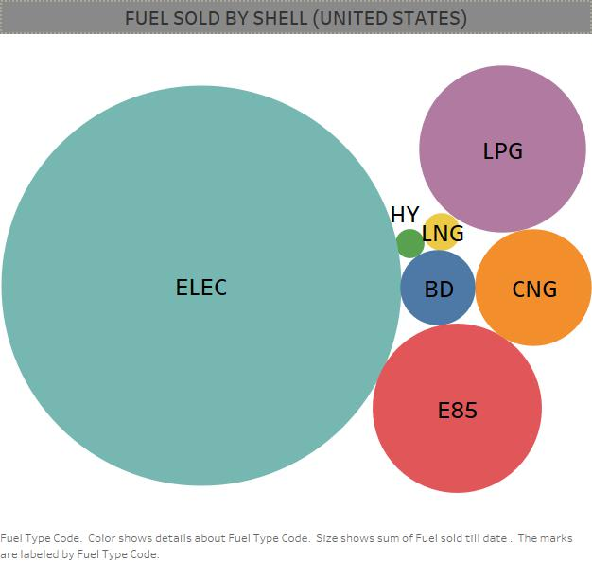
TYPES OF FUEL SOLD BY THE COMPANY

Slide 3
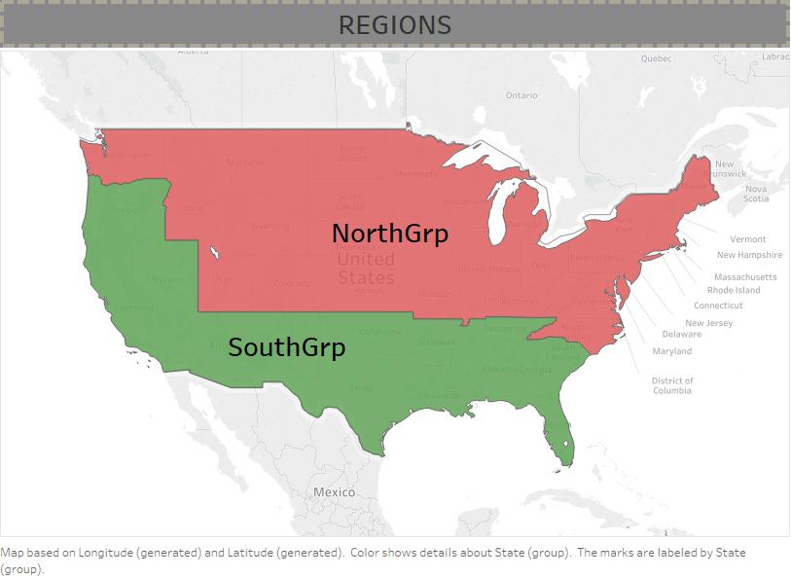
The company calculates Revenue collected based on Region

Slide 4
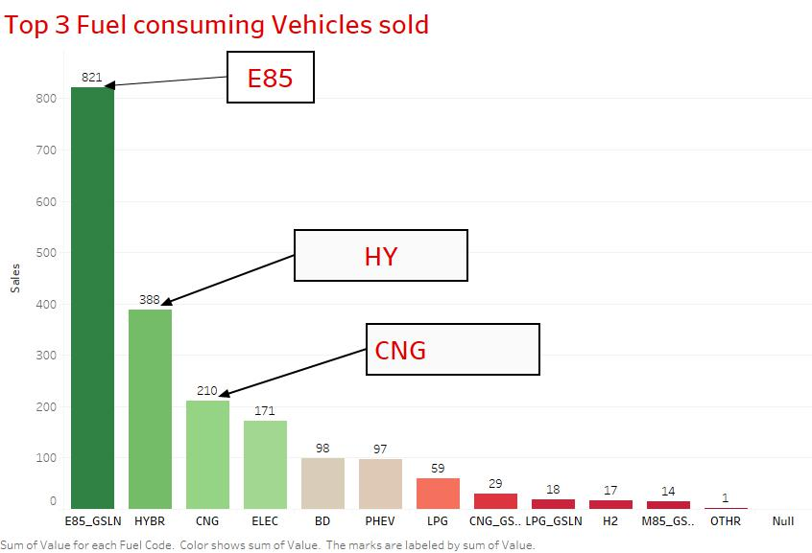
TOP 3 FUEL CONSUMED OVER USA(BASED ON CARS SALES DATA)
Demand of Fuel in the Current Market based on Cars sold

Slide 5
Company wants to know Impact of the top 3 – Fuel type sold E85,HY,CNG on their revenue in Both the North and South Regions

Slide 6
How will a Model help ?
Impact of the top 3 fuel E85,HY,CNG on their revenue
Determine Strategies for Marketing, Transportation and Supply based on the predictions
FOCUS and INVEST in the Region, where the requirement is more and the supply is less

Slide 7
Multiple Linear Regression - 10-fold Cross Validation To Build a Model We will be using the Top 3 Fuel types sold by Shell to determine its influence on the Revenue

Slide 8
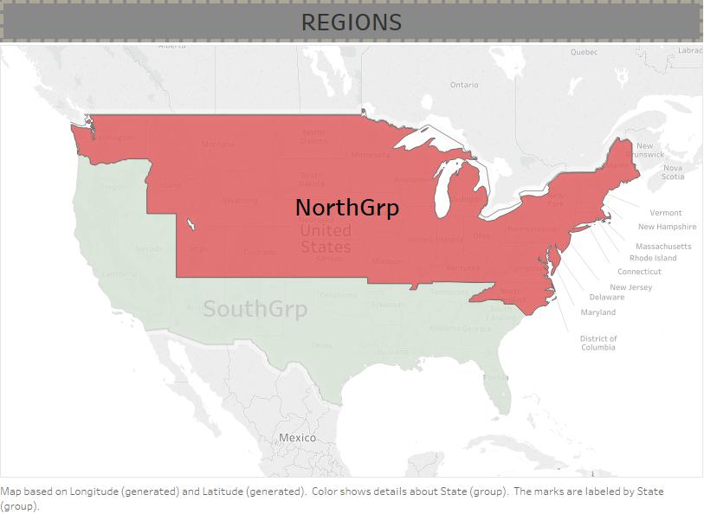
NorthGroup Multiple Linear Regression Model 10-Fold Cross Validation

Slide 9
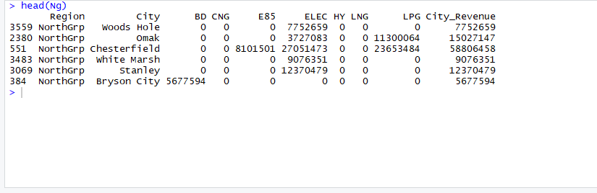
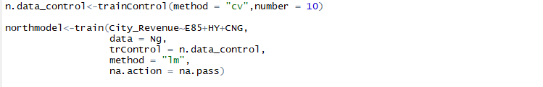
NorthGroup – Data Preview

Slide 10
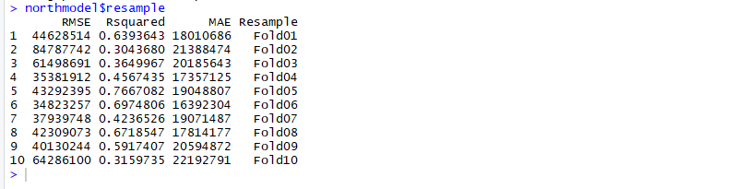
Resample Output – EACH FOLD RMSE

Slide 11
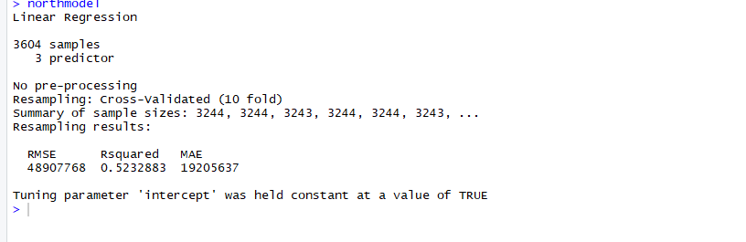
Linear Regression output – SAMPLE SIZES
Final Model is selected based on the AVG of all the Resample rounds

Slide 12
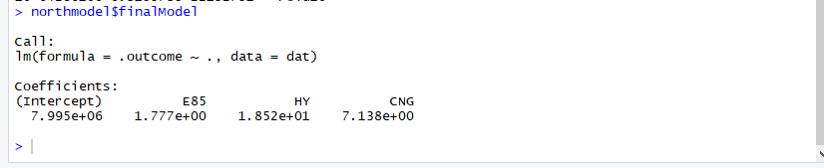
Final Model Selected For NorthGroup
NorthRegion_Revenue= 7.995x10⁶ + 1.777 * [E85] + 18.52*[HY] + 7.138*[CNG] + e

Slide 13
Multicollinearity Identification for Final Model
VIF values are well below 5

Slide 14
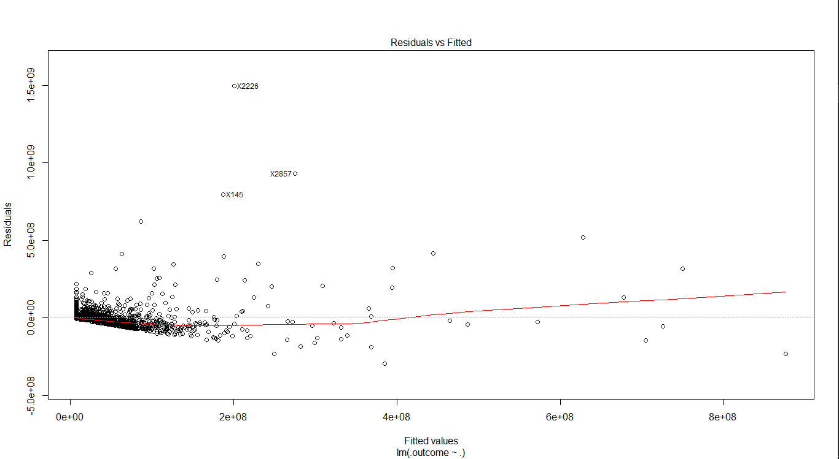
North-GroupFinal Model - RESIDUAL PLOT
The distribution is fairly parallel

Slide 15
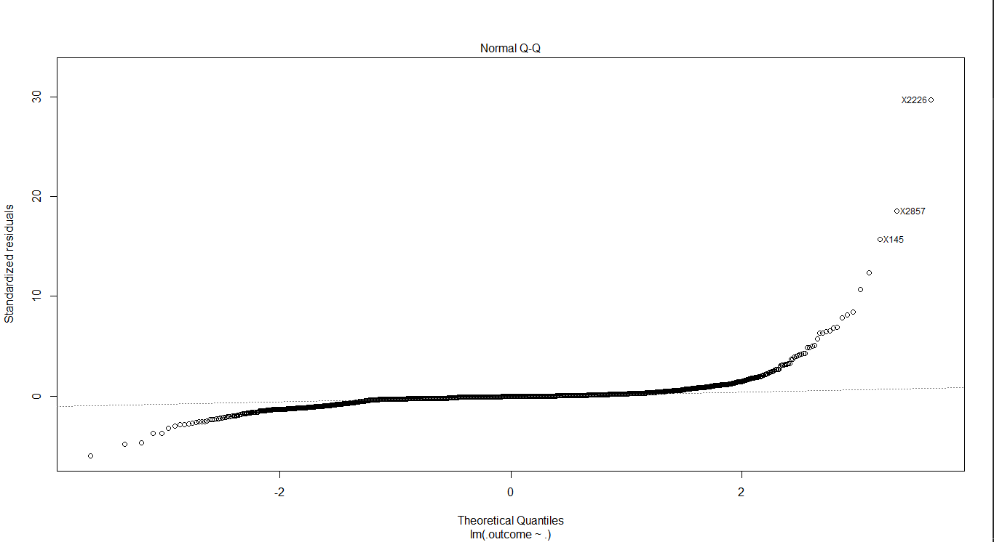
Northgroup QQplot
Most of the points are on the line: Hence model displays Normal Distribution

Slide 16
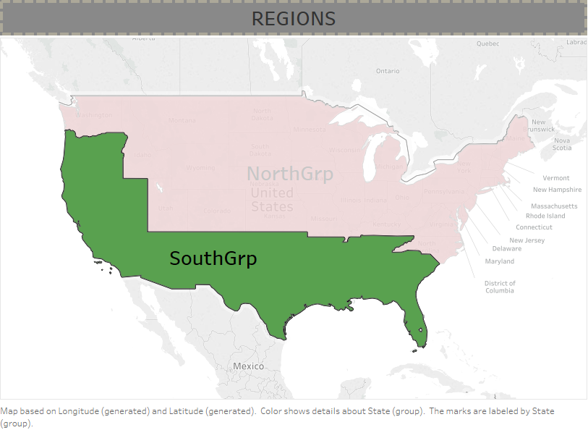
SouthGroup Multiple Linear Regression Model 10-Fold Cross Validation

Slide 17
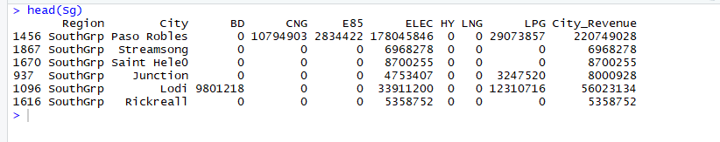
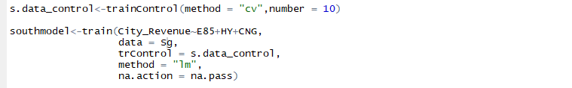
South-Group Data Preview

Slide 18
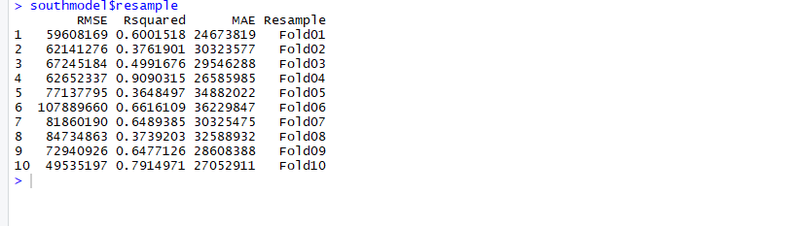
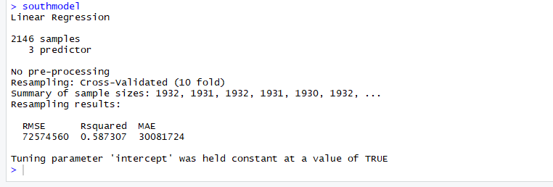
Resample Output – EACH FOLD RMSE

Slide 19
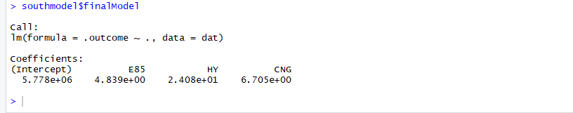
Linear Regression output – SAMPLE SIZES
SouthRegion_Revenue= 5.778x10⁶ + 4.839 * [E85] + 24.08*[HY] + 6.705*[CNG] + e

Slide 20

Multicollinearity Identification for Final Model
VIF values are well below 5

Slide 21
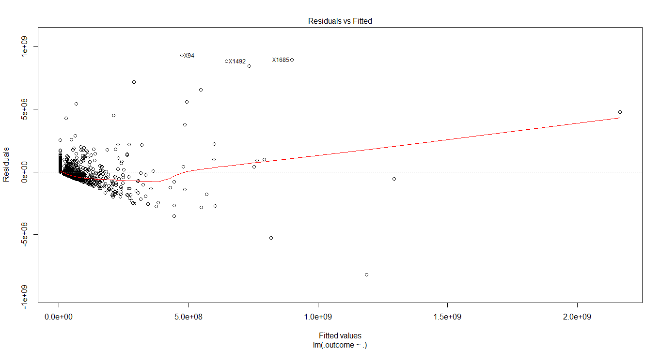
South-GroupFinal Model - RESIDUAL PLOT

Slide 22
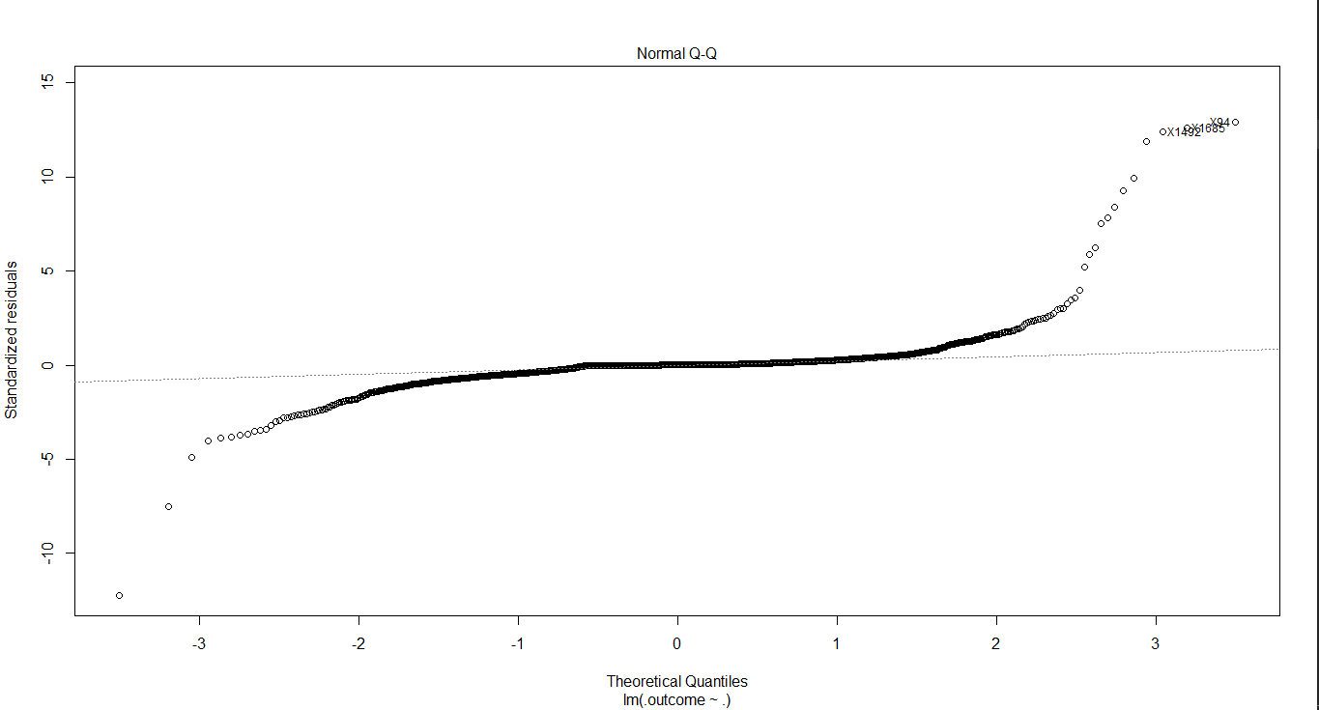
QQ Plot
Most of the points are on the line , hence suggests normal distribution for the final model

Slide 23
Conclusion
NorthGroup - Model
SouthGroup - Model
NorthRegion_Revenue= 7.995x10⁶ + 1.777 * [E85] + 18.52*[HY] + 7.138*[CNG] + e
SouthRegion_Revenue= 5.778x10⁶ + 4.839 * [E85] + 24.08*[HY] + 6.705*[CNG] + e
As it can be seen that, the contribution of E85, which is in higher demand in the market has very less contribution towards the Revenue of Shell Petroleum in both North and South Region

Slide 24
The models can help determine the companies’ strategie towards future investment

Slide 25
The company wants to know if there is a difference in means between the Sales generated by E85 in North-Group and South-Group

Slide 26
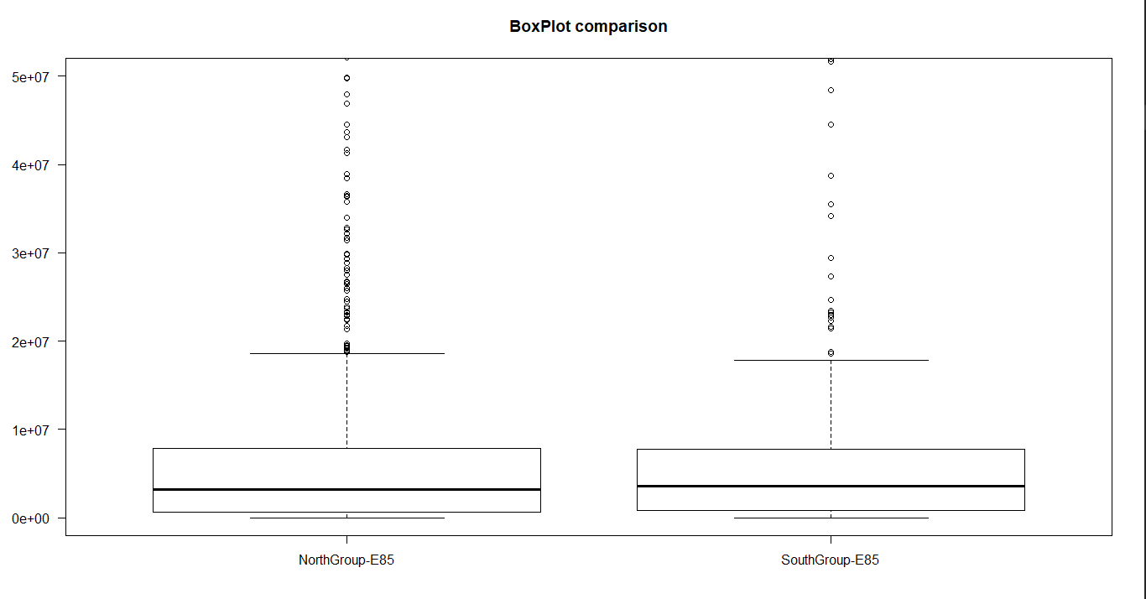
Box Plot – for visual analysis

Slide 27
Hypothesis Testing between the highest fuel sold(E85) in States

Slide 28
Two Sample Independent Hypothesis testing AS SAMPLE SIZE IS DIFFERENT
H0=the sale of E85 in NorthGrp and SouthGroup is the same #difference in mean Sales is Zero
Ha=but we don't think so #Difference is not equal to Zero
level of significance = 0.05(95% confidence level)

Slide 29
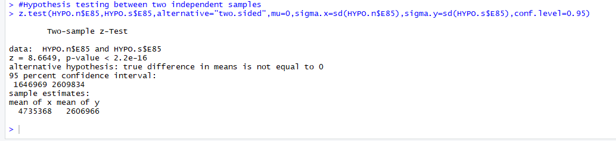
Result of hypothesis testing
From the above result we can see that Alternative hypothesis is TRUE, which means that There Is a difference in the mean sale of the Fuel is not equal to Zero.

Slide 30
Thank You
Group - 166

