Slide 1
CSS 497
C++ NemoLib
By: Zachary A Brader
Faculty Advisor: Wooyoung Kim

Slide 2
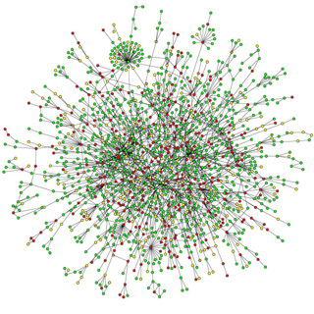
Biological Networks
Computable Way to Express Interactions Between Nodes
Undirected and Directed
Computationally Expensive

Slide 3
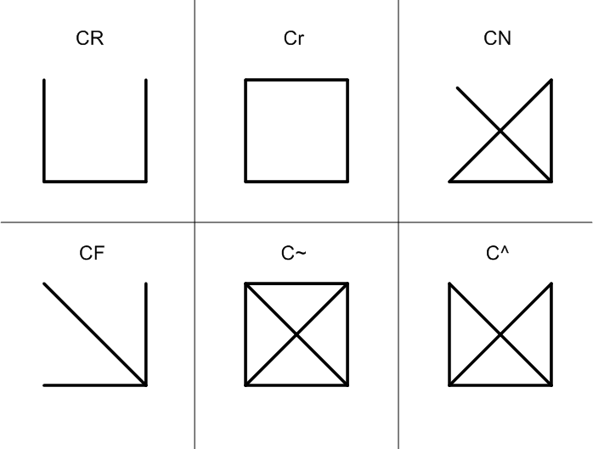
Network Motifs
Statistically Relevant Subgraphs Inside Networks
Subgraphs are Patterns
Uses P-values and Z-scores to determine significance
Significantly frequency determines what is a Network Motif
This shows different possible non-isomorphic 4-node subgraphs for an undirected graph.

Slide 4
Application
Predicting Protein Interactions
Determining Protein Functions
Detecting Breast-Cancer Susceptibility Genes
Network Motif Profiles for Distance Measurements

Slide 5
Problem
Network Analysis
Process is expensive
Larger Networks Take Exponentially Greater Time
Competitors
C++ Version Not Competitive Compared too Other Tools
Lack of Functionality in Market -- Can’t Collect Instances
Not Many Tools are Made with the Idea of Extensibility

Slide 6
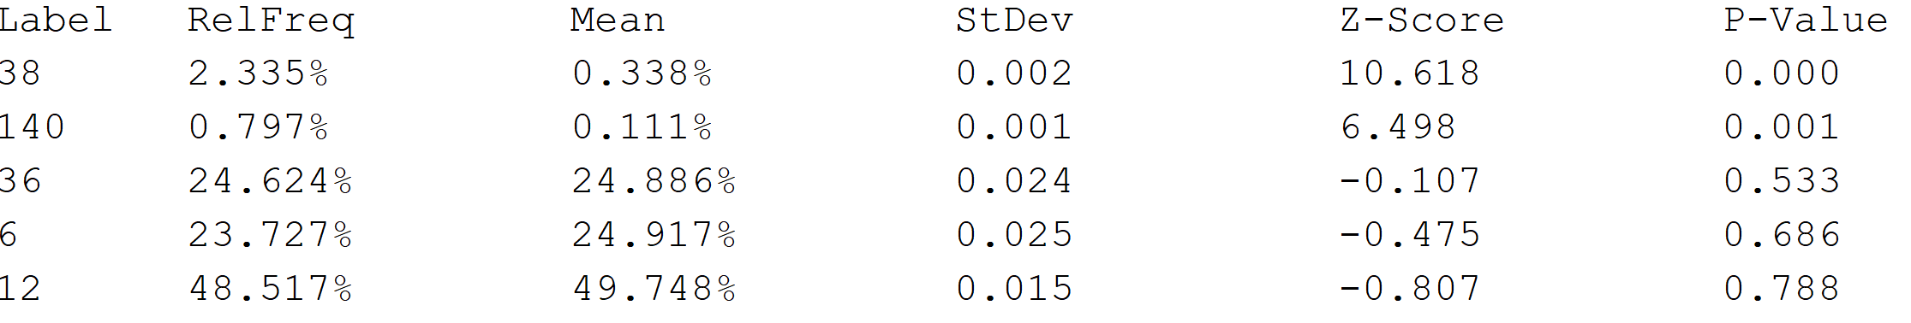
NemoLib - Tool For Network Analysis
Improved Speed Over Competitors
Multiple Versions: Java, C++, Python
NemoCount - Subgraph Patterns’ Frequencies
NemoProfile - Nodes’ Participation in Subgraph Patterns
NemoCollection - Instances of Subgraph Patterns

Slide 7

Project - C++ Version
Increasing Performance
Researching Best Ways for Enhancement
Make it on par with Java version
Extending Functionality
NemoProfile
NemoCollection

Slide 8
Goal
Enhance C++ Version
As good, if not better than Java Version
Increase Functionality
Add Lacking Functionality
Extensibility
Easy to use libraries API calls in other applications

Slide 9
Process
Research
Identify the best way to reduce overhead and improve performance
Optimization
Implement improvements into code
Extension
Implement NemoProfile and NemoCollection as possible options
Validation
Ensure that C++ version provides accurate results
Release
Available on Github!

Slide 10


Tools
Main Tools:
NetBeans: Java IDE
Github: Version Control
Putty: SSH
FANMOD: Network Analysis Verification

Slide 11
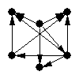
Testing
Used Three Different Networks
Real World Data
Each Representing Networks of Different Sizes
Tested each using 10 random subgraphs
Recorded Each Version’s Results
Compared the Java and C++ versions, as well as FANMOD
Tested for validity of results, as well as runtime of operations

Slide 12
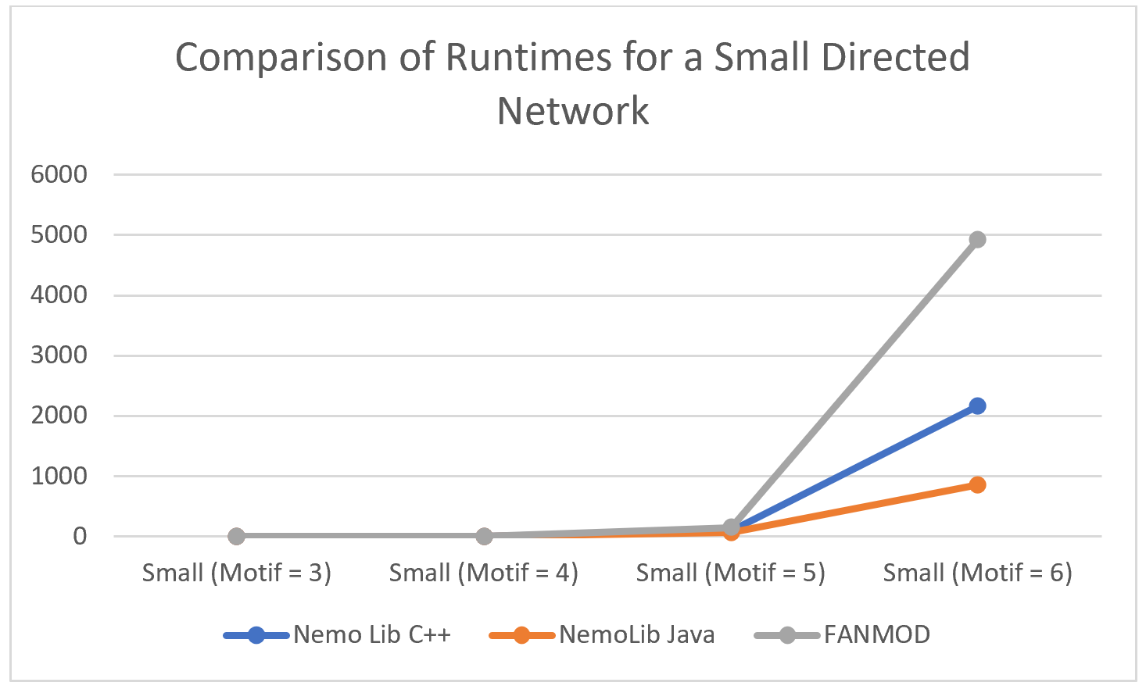
Result
Increased Performance of C++
Functionality
NemoProfile
NemoCollection
Performance Results
Comparisons
Verifying Results

Slide 13
Challenges
Unfamiliarity With Linux
Spent Early Days trying to quickly familiarize myself with it
Set Myself Behind Originally Trying to Figure out how To Properly Run Some Versions
Variable Performance Available with School’s Linux Computers
Provided Wildly Changing Results for Performance Metrics
Unable to Finish Processes in Some Cases

Slide 14
Helpful Courses
CSS343
Sorting Methods and Complex Data Structures
CSS430 - OS
Understanding Computer’s -- Especially helpful for knowing about optimization
CSS483 – Bioinformatics Algorithms
Introduction to Bioinformatic tools -- How I ended up finding out about this project

Slide 15
Q&A

Slide 16


