Slide 1
TableSafe Internship
By Kaib Cropley

Slide 2
Internship Objectives
Transfer skills and knowledge from UWB to real world production
Understand the pros and cons of architecture and design choices while developing a system
Learn to write an event driven customer facing application
Experience working on a large scale production system
Narrow down the position I want to work towards throughout my career

Slide 3

TableSafe
TableSafe is a startup that develops a Pay-at-the-Table device called the RAIL and several back-end management and data analysis applications.
Headquartered in Kirkland WA
Founded in 2011 as ViableWare, changing its name to TableSafe in 2015
Over 80 full time employees
Operating in over 250 sit down style restaurants across the US

Slide 4
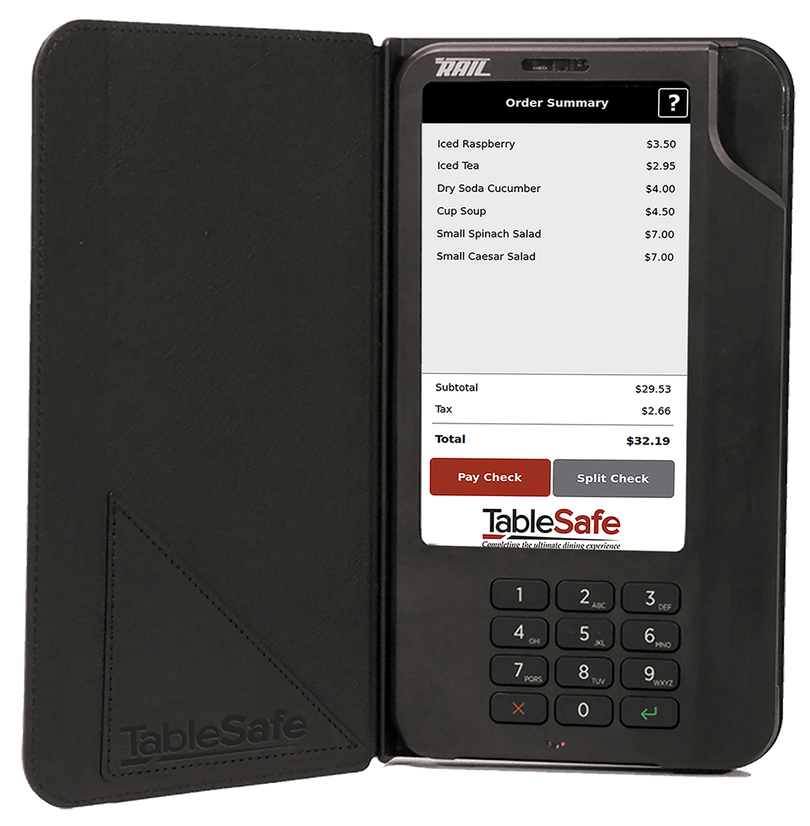
The RAIL
The RAIL is a secure touchscreen payment device targeted at the restaurant and hospitality industry. The RAIL is developed by TableSafe’s embedded team, where I spent the majority of my internship.
Accepts Debit, Credit, gift card and cash payments
Offers a survey for customers to give quick feedback to restaurants
Displays restaurant specific advertisements during checkout

Slide 5




The RAIL Development
OS and Kernel: C
Back-end Processing: Bash scripts
Back-end of applications: C++ using the Qt framework
Front-end: QML and JavaScript

Slide 6
As the RAIL is in use it sends out reports detailing its current status and the severity of any actions the user does.
Error Reporting Improvements

Slide 7
Error Reporting Improvements
Problem
Solution
TableSafe’s customer support representatives were having issues sorting through the large amounts of data to find specific types of messages that were useful in aiding a customer.
Decided to create a category/subcategory system for accurate searches
Implemented a low impact system to easily set a messages category and subcategory that is available throughout all of the RAILs applications
Assigned each message within the RAIL it’s category and subcategory based on its function and the state of the system at that time

Slide 8
An Offline Transaction is a transaction that is processed without a connection to either the restaurants POS system or the TableSafe Data Center.
Offline Transaction Storage Redesign

Slide 9
Offline Transaction Storage Redesign
Problem
Solution
All offline transactions were being held in single file as a large JSON object that had to constantly be opened, read, parsed into JSON, and rewritten
Separating payments and transactions into multiple files to reduce read and write times, this decreased average memory usage for processing multiple transactions by a minimum of 50%
Rewrote how the RAIL applications interact with the file system to make it more modular and reusable

Slide 10


Offline Transaction Storage Redesign
Solution Cont.
Defining a directory structure to implicitly tell the state of each transaction file without requiring it to be opened and read, this presorted all data and allowed for high priority transactions to be processed first
Pending
Partial failure
Unknown state

Slide 11
Project Outcomes
Developed my knowledge of building the architecture of a system with limited performance capabilities
Learned how to develop a UI for customer-facing applications
Experienced working in a fast paced startup environment using a agile development methodology
Discovered what I enjoy within Software Engineering and how I can turn that into a career path

Slide 12
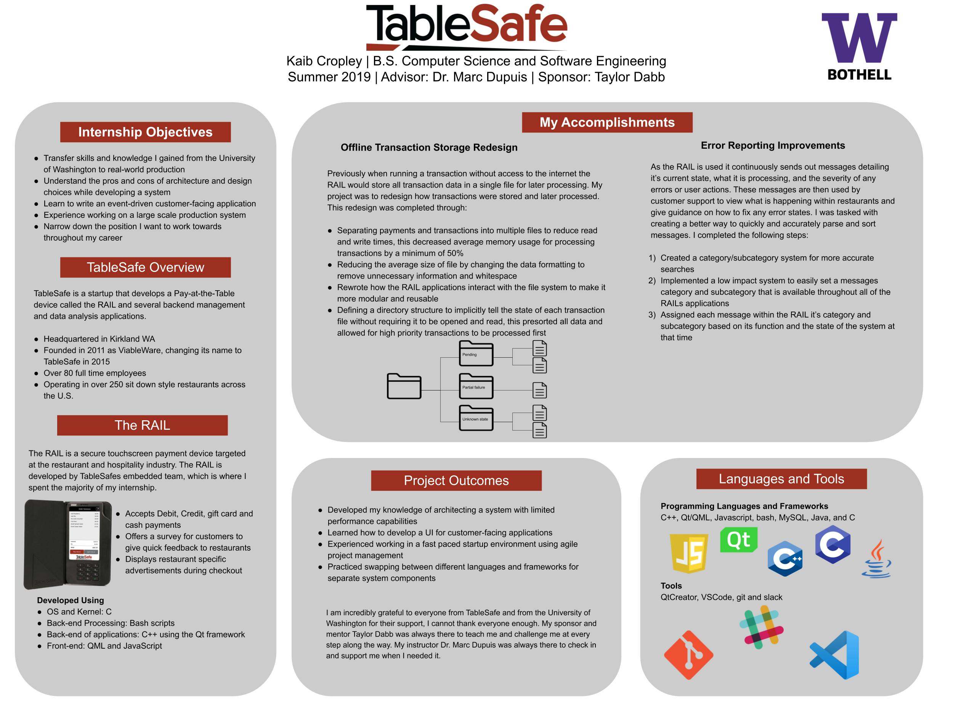

Slide 13
Questions?

