Slide 1
Web Application to Remotely Access Electrical Engineering Labs
Presenter: Jakob Delzer
Faculty Advisor : Min Chen
CSS497 Winter 2020

Slide 2
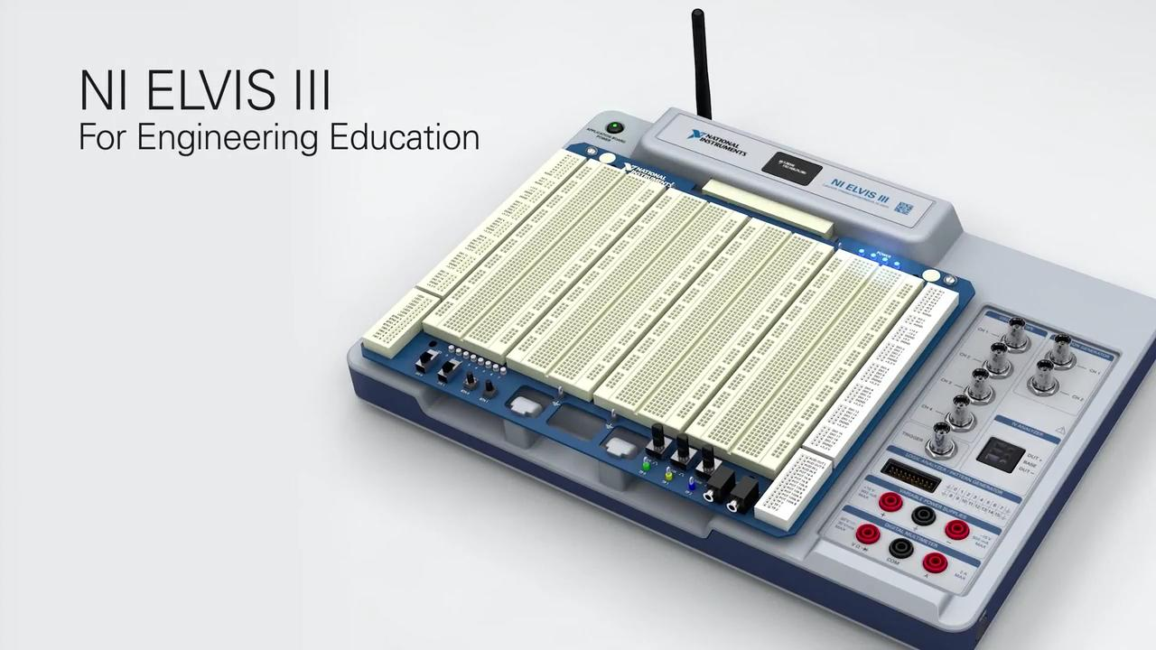
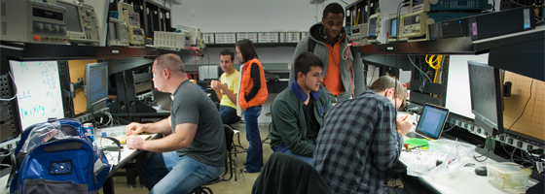
Background
EE students have lab homework assignments
Labs need NI ELVIS machine
Professor Berger is working with multiple capstone groups

Slide 3

Purpose
Allow UWB students to work from home
Provide more ways to complete lab assignments
Create a scheduling website that can create appointments and provide remote access to the reserved pc

Slide 4
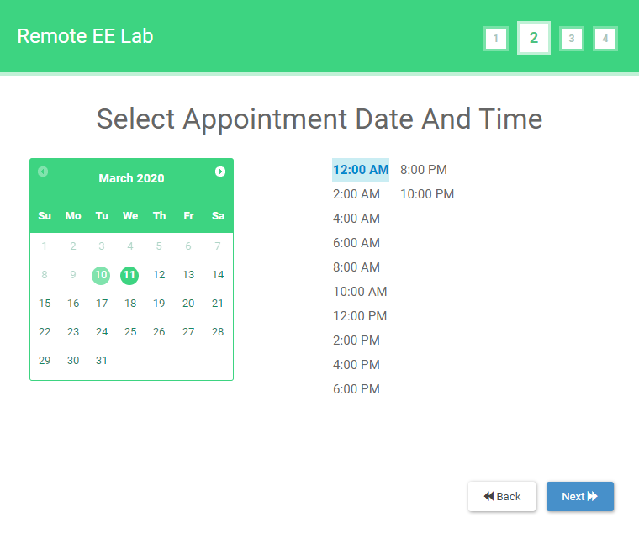
Approach
Website with calendar to select appointment date and time
UW NetID only access
Downloads RDP file to correct PC
Emails user with confirmation
Multiple computers and multiple labs

Slide 5
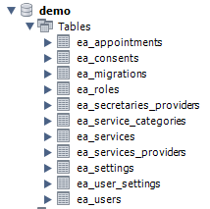
Database
MySQL 5.6 Server
Stored on UWB machine in the EE Lab
Used by website and Lab machines
Stores Appointments, Users, Labs, and Computer information
Website, Database, and Lab computers all on same UWB network

Slide 6
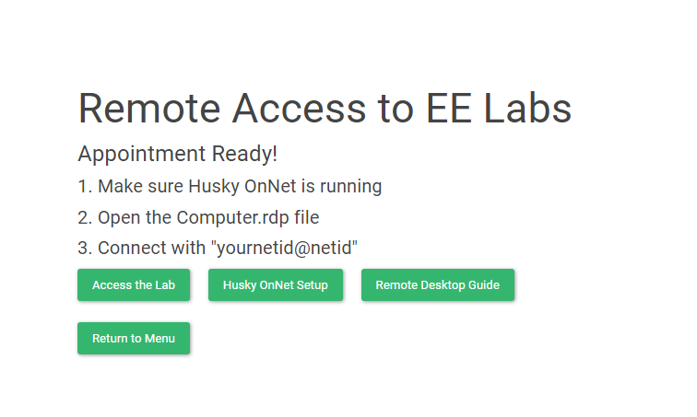
Remote Desktop
Husky OnNet and .RDP file to remotely connect to correct computer
Powershell scripts with Task Scheduler
Check for User - Every 1 minute
Remove Users - Every 2 hours
Warnings - Every 2 hours
Users are only warned and removed if there is an upcoming appointment for that computer

Slide 7
Next Steps
Documentation for future students working with this website
EE students are working on creating more labs for the remote Lab Machines
Continue testing and improving website to handle many students

Slide 8
Learning from Project
HTML and PHP
Working with the database, MySQL
Database on Azure
PowerShell scripts and commands
Windows Task scheduler

Slide 9

Tools

Slide 10

Related Courses
CSS 475- Database Systems
CSS 390- Scripting Languages
CSS 498- Independent study/Creating Websites with HTML/CSS

Slide 11
Demo
https://students.washington.edu/delzer/

