Slide 1
Sofy.AI Software Development Internship
Emir Dzaferovic
Faculty Advisor: Munehiro Fukuda

Slide 2

Company Overview
Sofy.AI is one of the industry’s leading autonomous software testing platforms
Sofy.AI automates the entire process of software test case development and execution
Sofy.AI leverages machine learning to identify missing test coverage and execute tests
Startup based in Bellevue, Washington

Slide 3
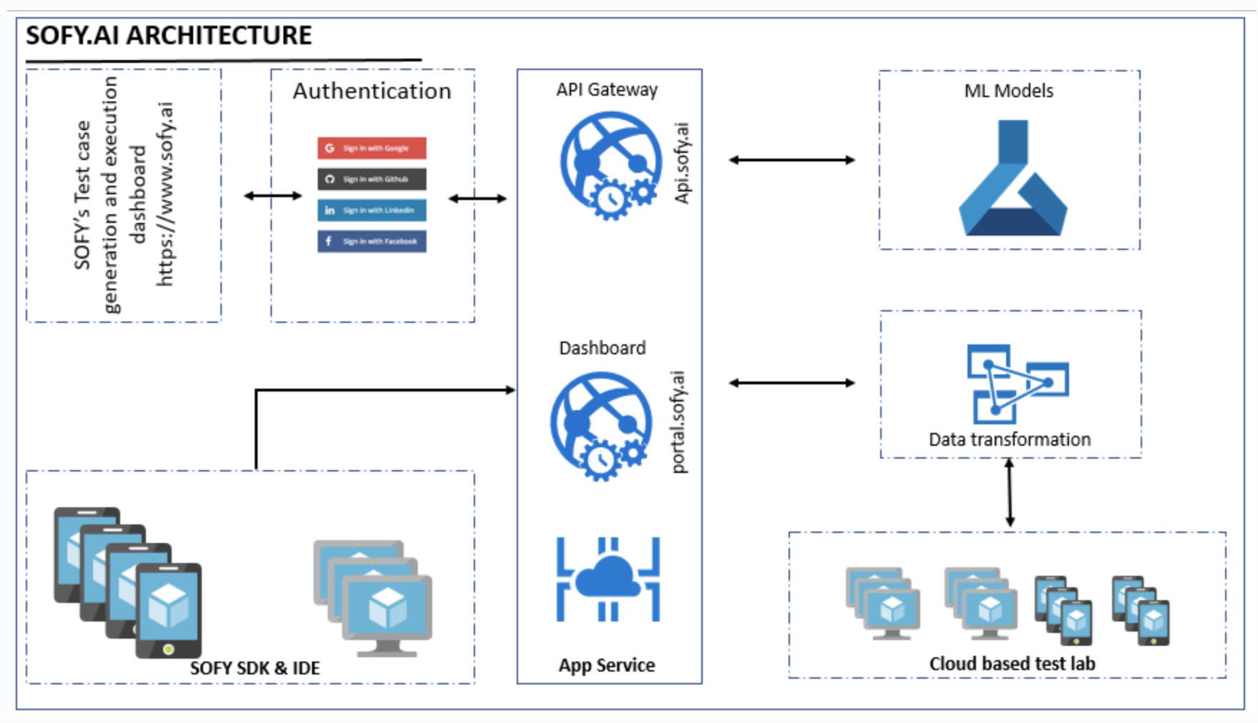

Slide 4
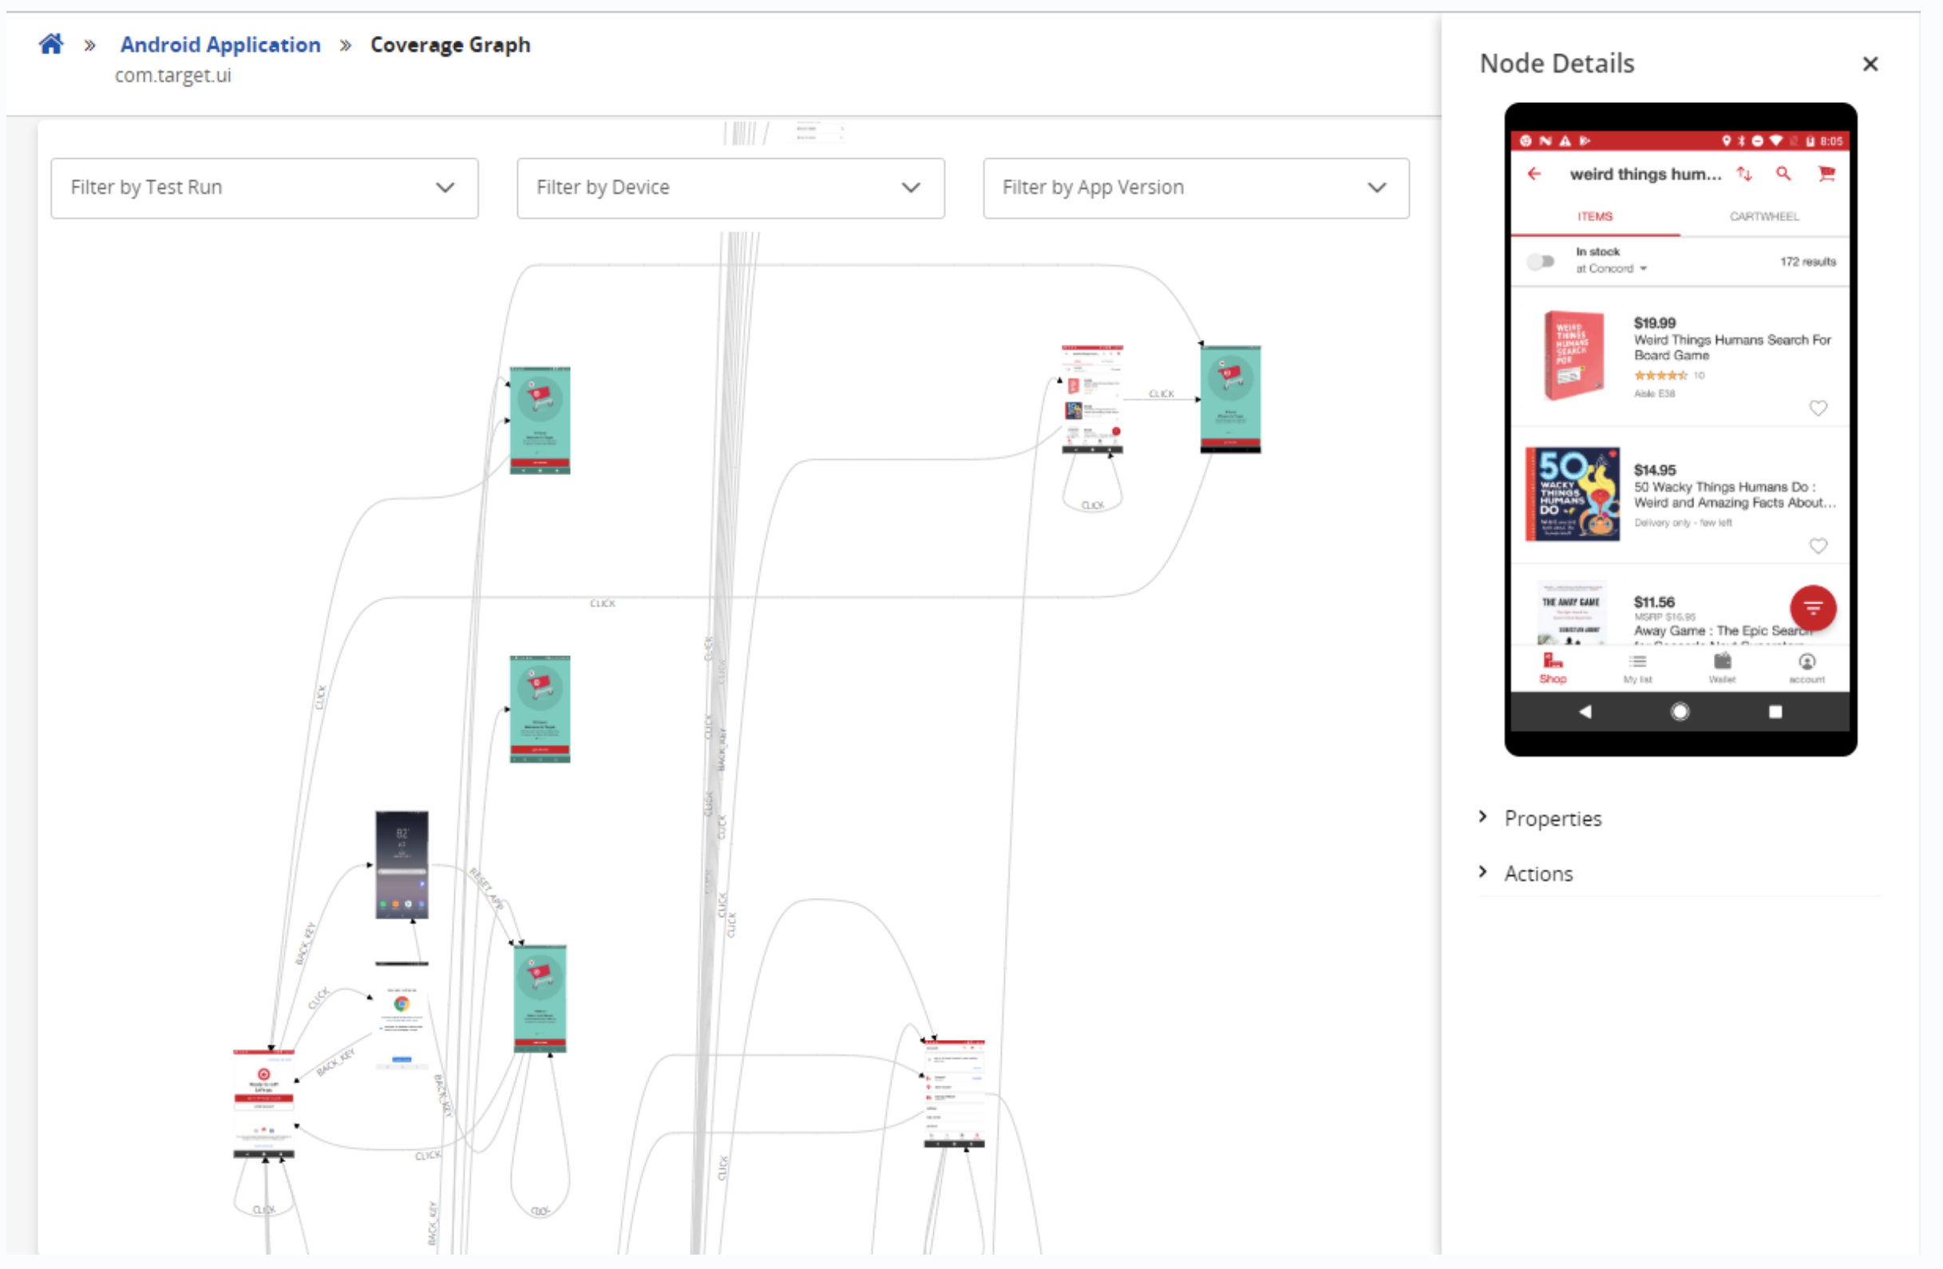
What I Did
Automated web APK testing and gathering data
Ran and worked on web crawler on several retail mobile applications to collect app data
Create weekly updates of progress on script for automated mobile application testing

Slide 5
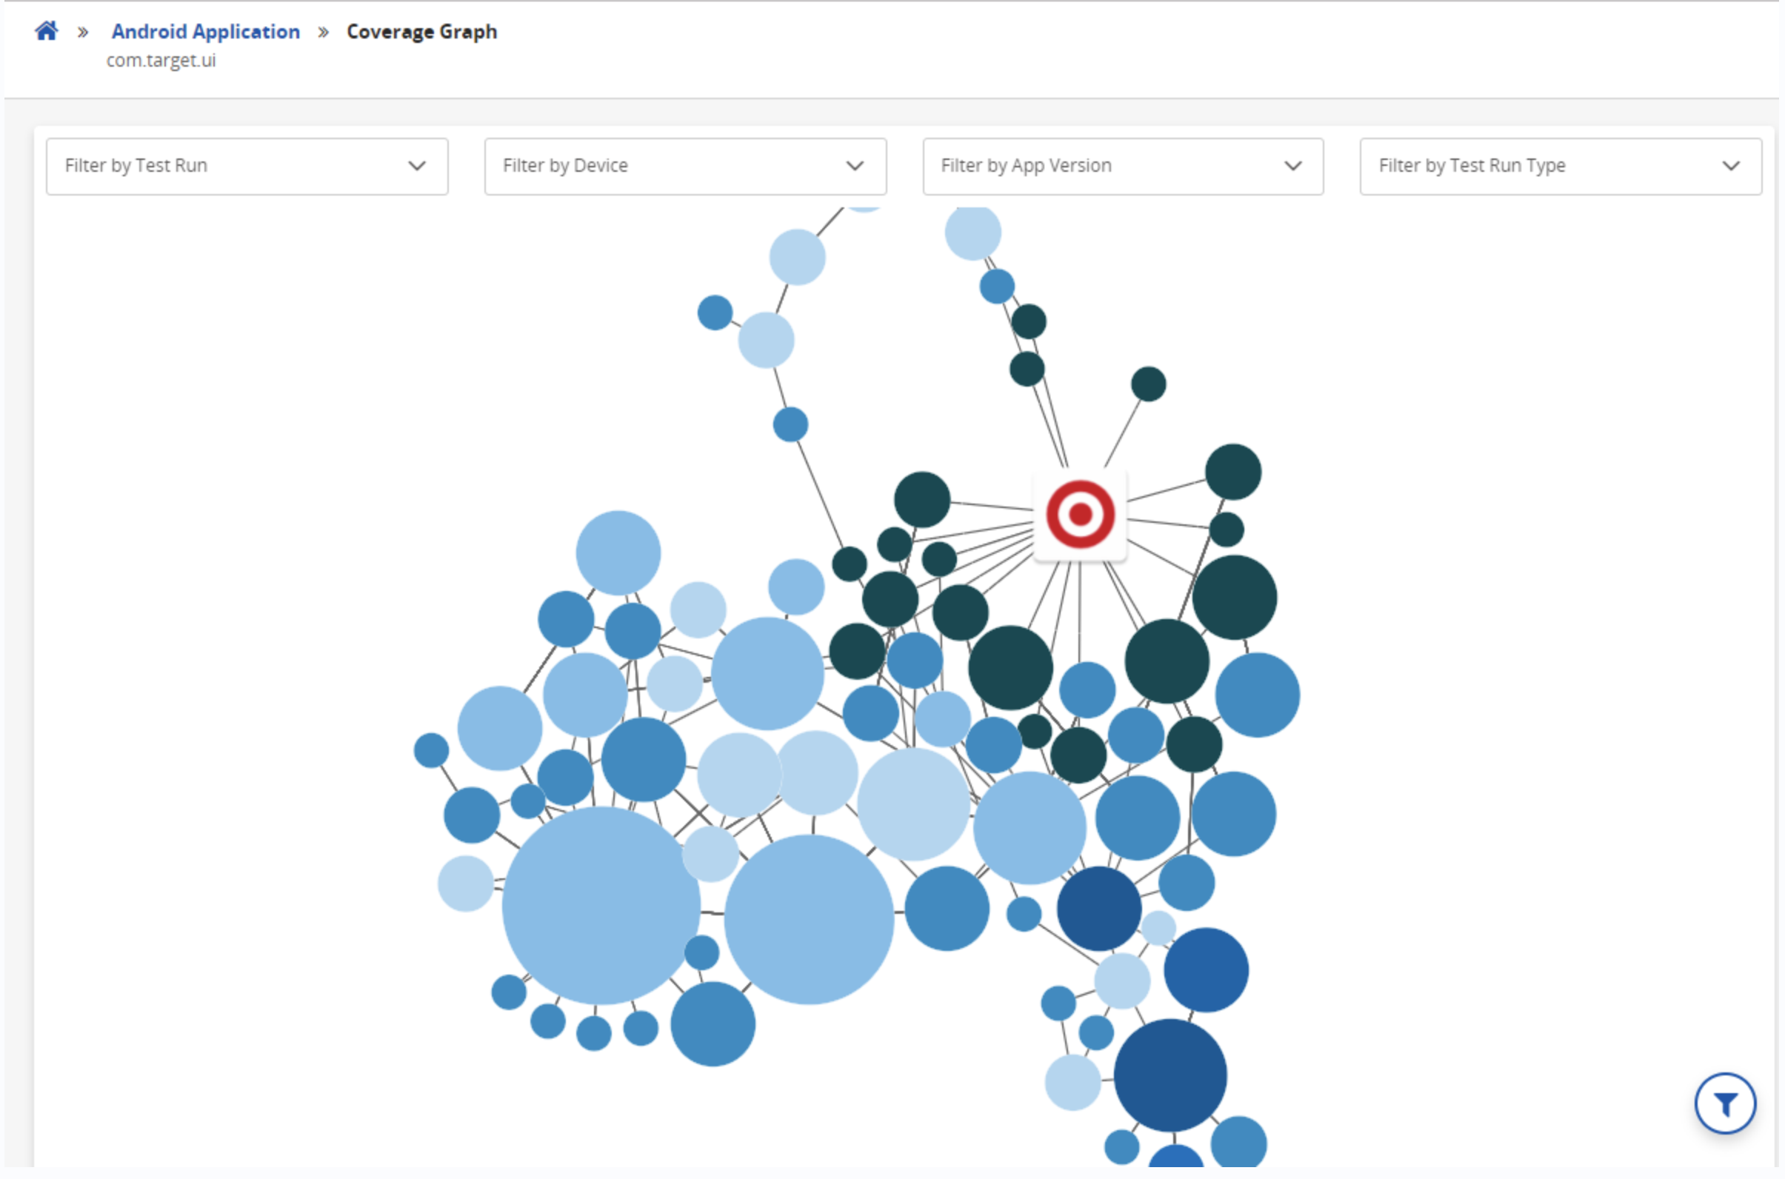
Web/App Crawler

Slide 6
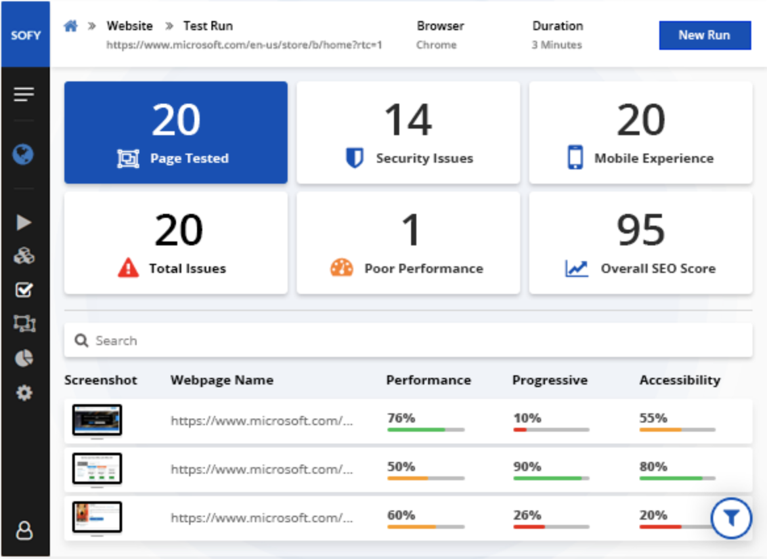
Sofy.AI Client Interface

Slide 7
What I Learned
Building RESTful services
Interacting with the cloud and leveraging it
The impact of software testing and its importance in the SDLC
Technologies
Machine Learning methodologies
Postman
Selenium
Google Lighthouse
Adjusting to a startup environment and working with people remotely

Slide 8
Challenges
Number of new technologies to learn
Selenium, Postman, Machine Learning methodologies
Startup environment with fast pace
Weekly updates, fast-moving pace, “just do it” mentality
Remotely working with another intern
My partner for this summer internship was not located in WA, so we worked together remotely

Slide 9



Technologies Used
RESTful APIs
Postman
PyCharm
Selenium

Slide 10
Parts of the capstone I liked
I really enjoyed learning about cloud computing and machine learning
I enjoyed working with the other intern and finding new ways to solve complex problems

Slide 11
Relevant CSS Courses
CSS 301 – Helped me create weekly reports
CSS 370 – Helped me with System Design
CSS 436 – Understand cloud computing concepts
CSS 340 – Taught me Python

Slide 12
Thank you
Thank you to my mentor, Syed Hamid, for allowing me this internship. Thank you also to my faculty advisor, Dr. Munehiro Fukuda, for his guidance over the summer.
Thank you to the entire UW Bothell Faculty for providing me with an environment that promotes learning and achieving excellence.

