Slide 1


User Interface Development with React.js
Shelby Mirziteh, BS CSSE
Advisor: Laurie Anderson, PhD.

Slide 2
Organization and Opportunity

Slide 3
Digital Skills for All
“Our mission is to break down cultural and systemic social barriers that prevent youth and young adults of all ethnicities, genders, and abilities from exploring computer science as a potential career and field of study. We work to create career pathways for youth to engage with and thrive in the field of technology.”
DigitalSkillsforAll.org

Slide 4
The Project
Connect aspiring entry-level technology professionals to job opportunities
Give users tools to research and explore career paths
Provide only entry-level & internship opportunities
Use Indeed.com to source job listings
Design the platform top be accessible and simple to use

Slide 5
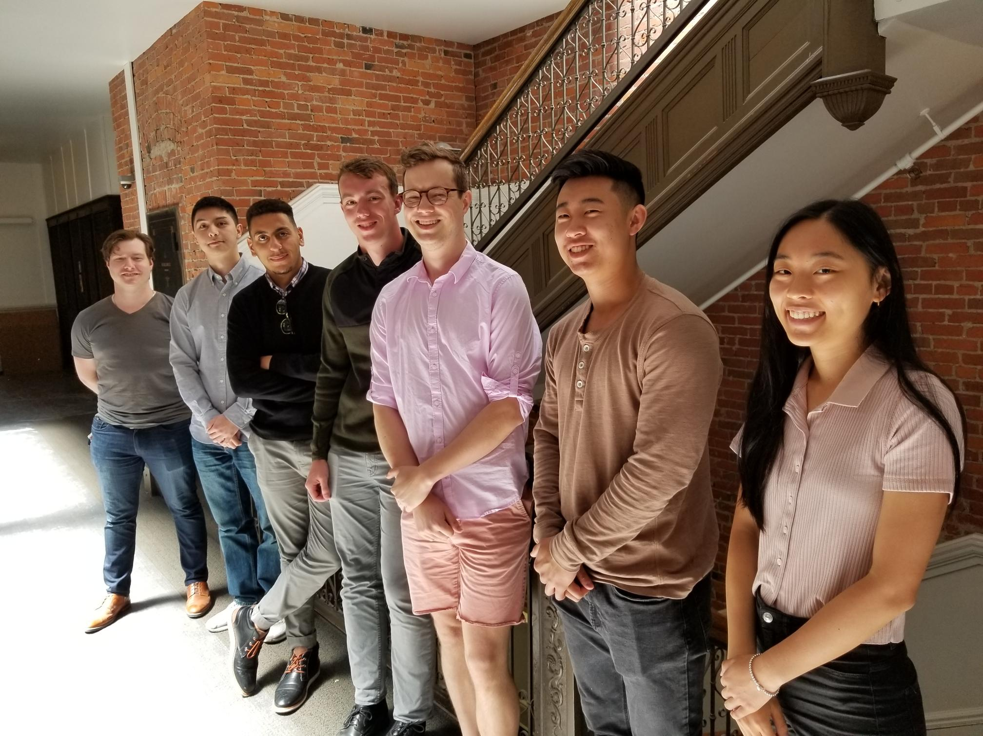
The Team
UX/UI
Front-end
Back-end
Data Science

Slide 6
Design & Development

Slide 7
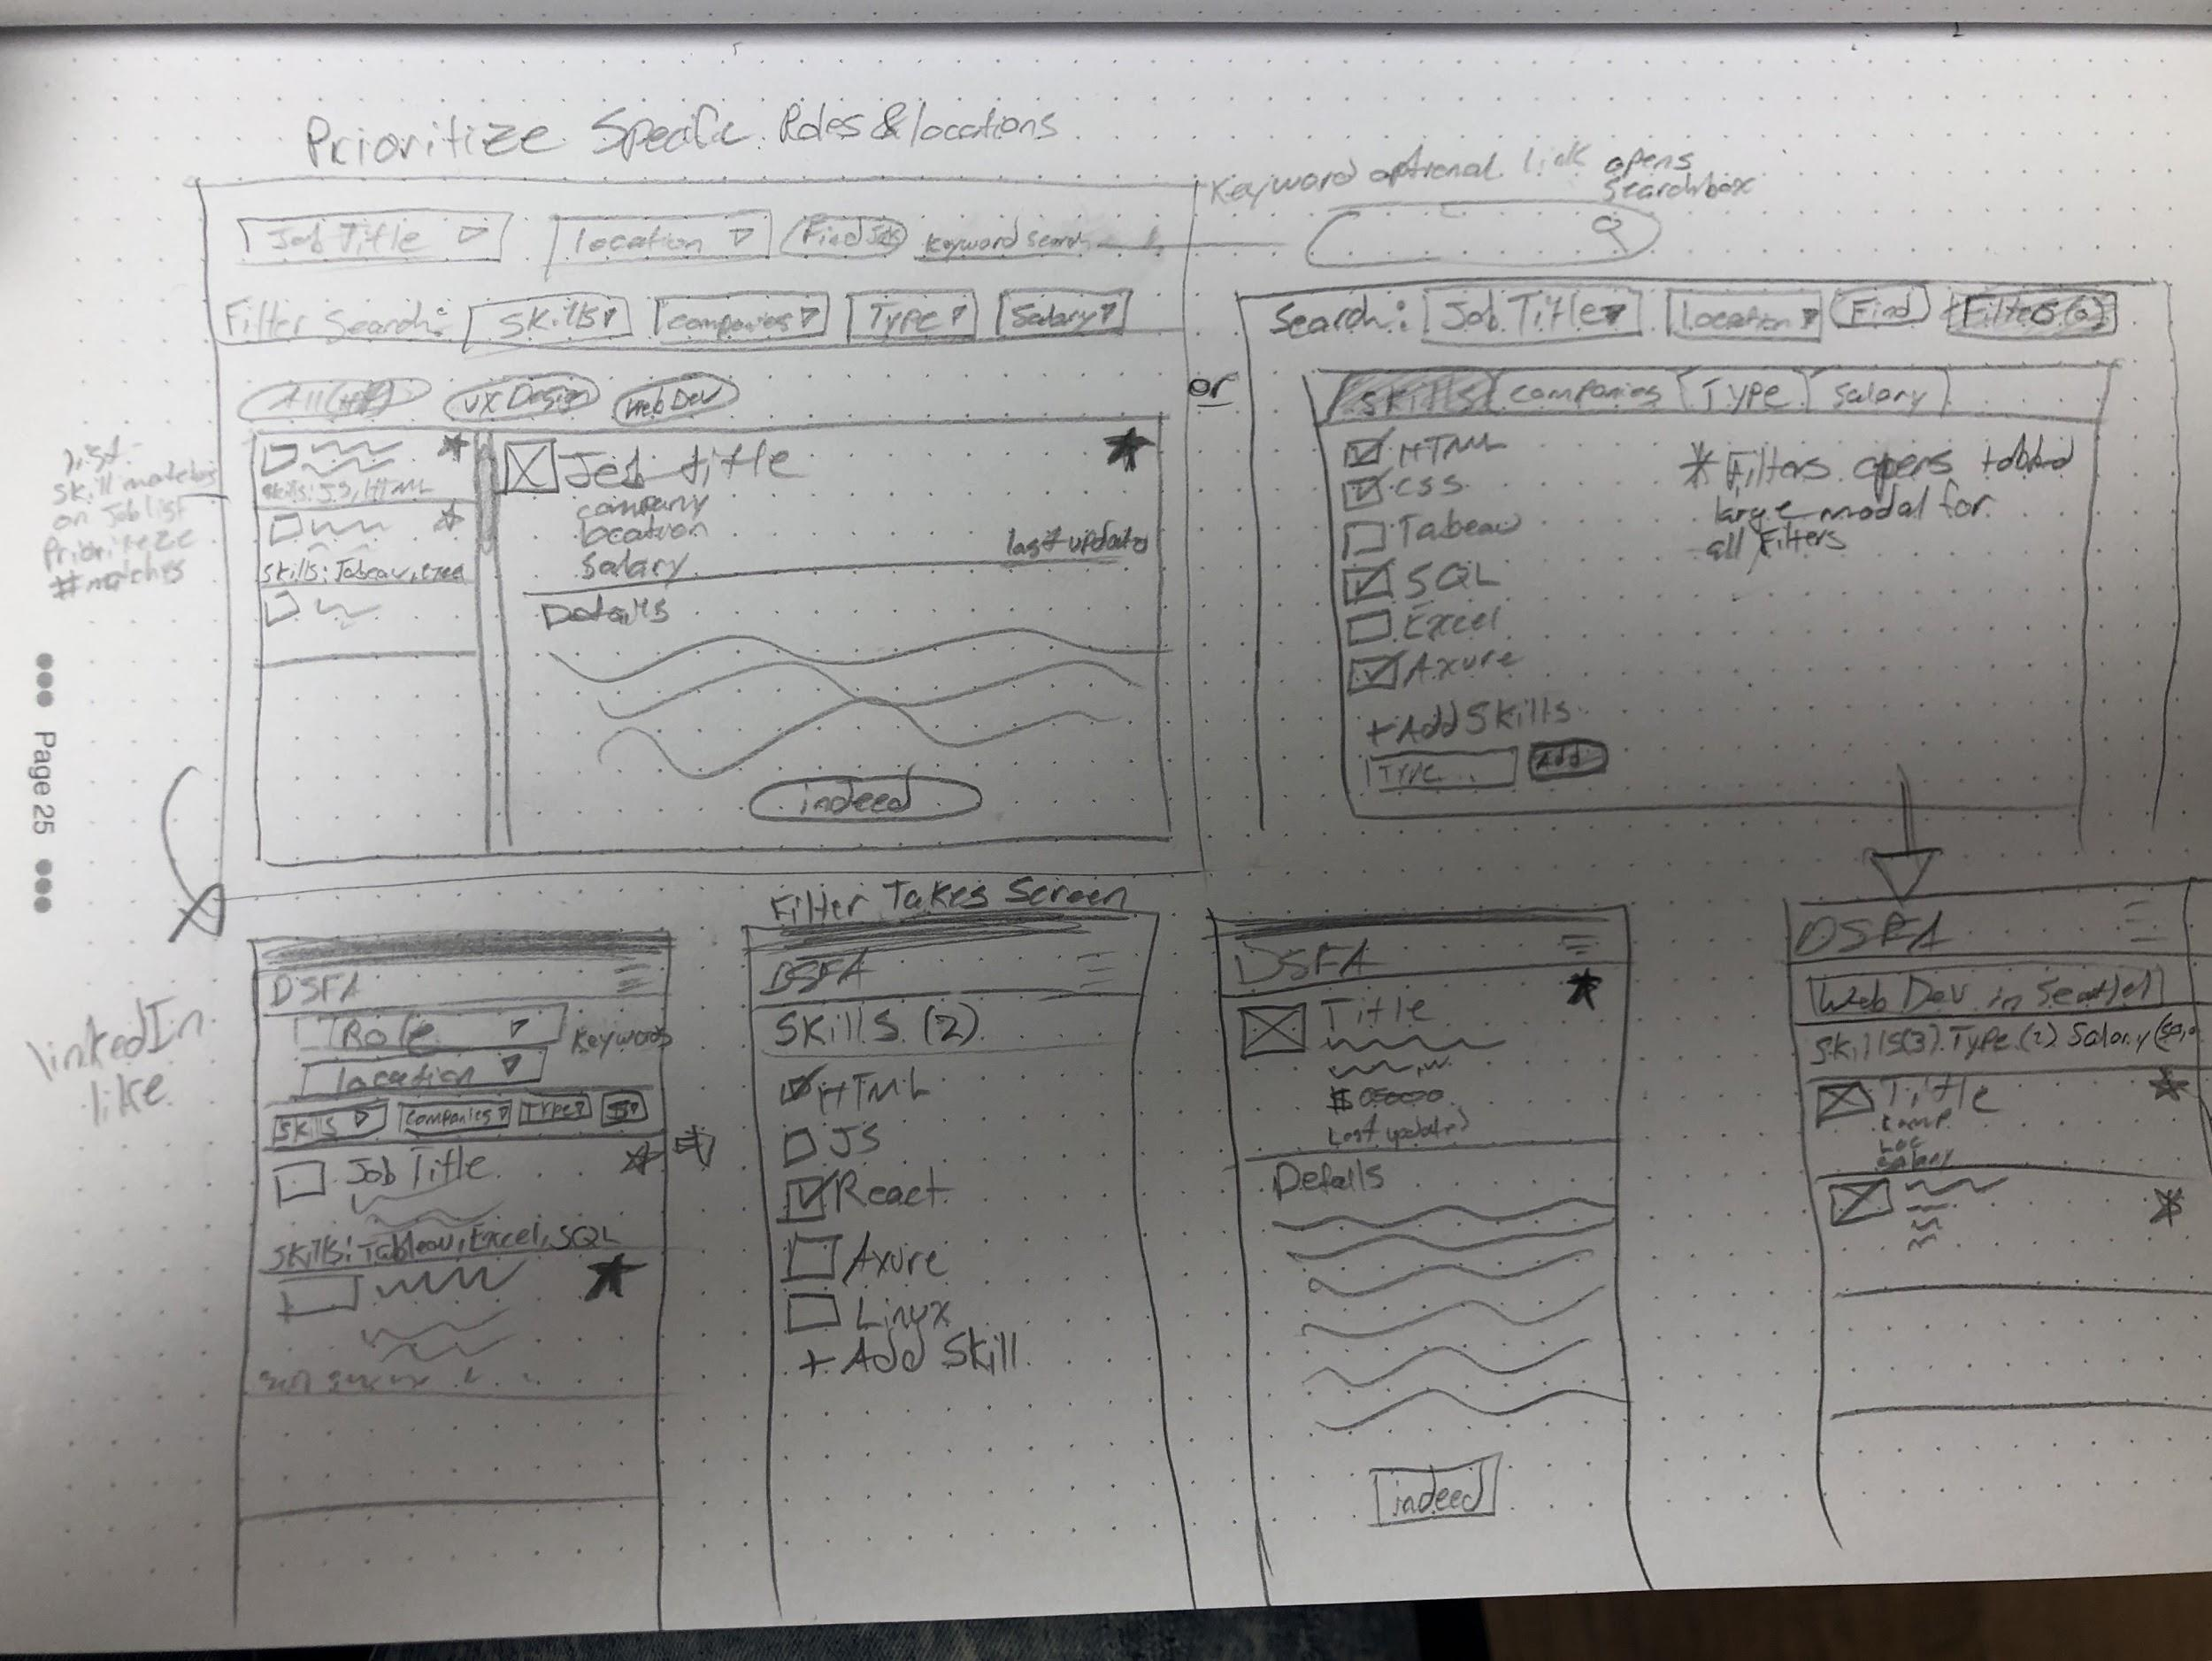
UX/UI Design
Sketching
Low Fidelity
Rapid Development
Feature Ideas
General Placement

Slide 8
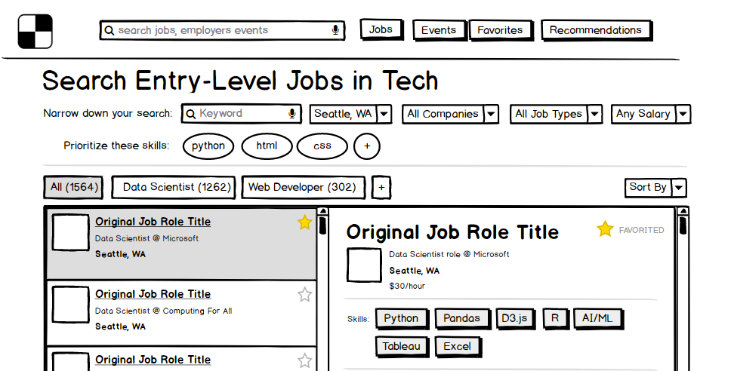
UX/UI Design
Wireframing
Low Fidelity
Feature consolidation
Informational Hierarchy
User Experience

Slide 9
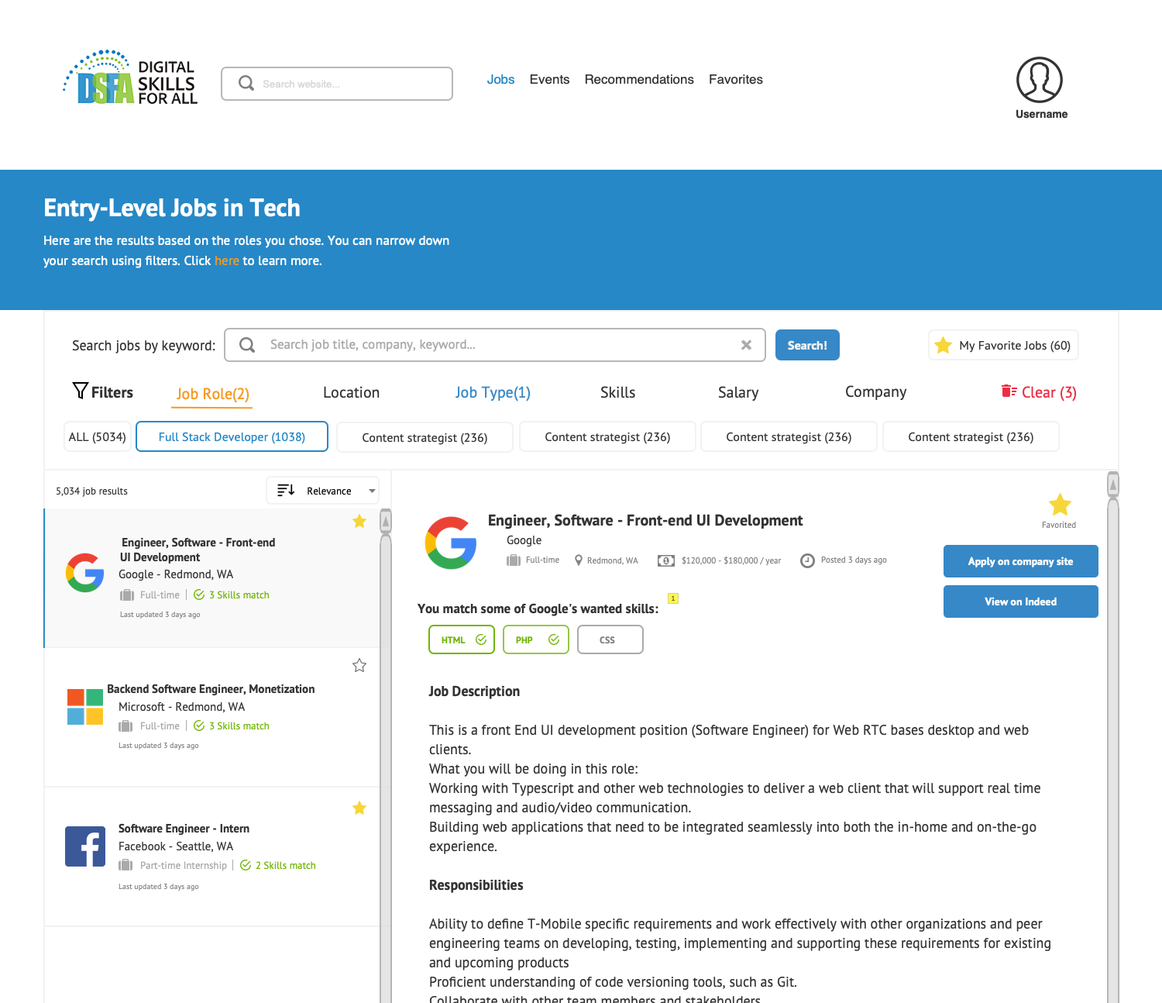
UX/UI Design
Mock-ups
High Fidelity
Color & shapes
Final placement
Ready for Development

Slide 10
Technical Development

Slide 11
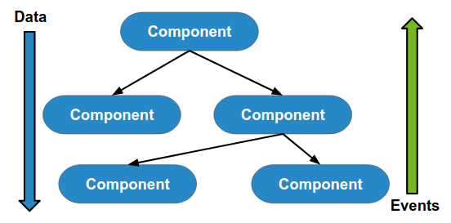
React.js
Component based UI
App “state”
Events & Data
Development Challenges

Slide 12
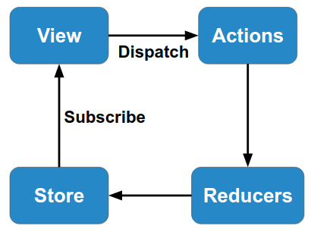
Redux
Helps React.js manage app state
Easy flow of data to components
Setup Challenges

Slide 13
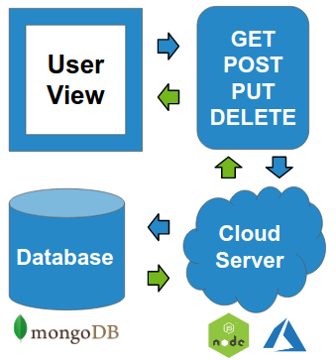
RESTful API
HTTP request/response cycle
Standardized methods
Collaboration with the back-end team

Slide 14
Personal & Professional Growth

Slide 15
Strengths Found
Communication
Learning new technologies
Researching solutions
Organization
Friendly and easy to work with
Giving valuable project input
Asking for help when in needed

Slide 16
New Professional Trajectory
Combine my broad interest and skill set
Work at a higher level of technical development
Manage product and projects
Continue learning about new technologies and approaches

Slide 17
Conclusion

Slide 18
