Slide 1

Designing A Mobile Food Truck App
Dewey Nguyen
CSS497
Faculty Advisor: Professor Nancy Kool
Notes:
Add industry advisor
Before completion of the CSS 497 project all students must complete an abstract. The abstract should highlight the major topics/themes in your project and concisely describe the nature of your work. The abstract must be turned in prior to completion of your 10 credits of CSS 497 in order to receive a grade.
The abstract is limited to 200-400 words describing the nature of the project and the results obtained. This abstract is due prior to submission of your final report to your faculty advisor.
The CSS 497 abstract is a statement that summarizes the important points of your project including the conclusion. If you have written a report about the project you may find that you can glean the main ideas from your report to create a concise description of your project. In developing your PowerPoint presentation for the CSS Colloquium you will need to uses these same central themes. An abstract should summarize three things: the basic information about the problem(s) to be solved, the reason why you chose a certain method to produce a solution, and a conclusion.
There are a couple of websites that give more details on how to approach writing an abstract. The people who developed these websites take different perspectives so look through all of the websites to assemble the best help. Don't forget the UW Bothell Writing Center can also help you write an abstract.

Slide 2
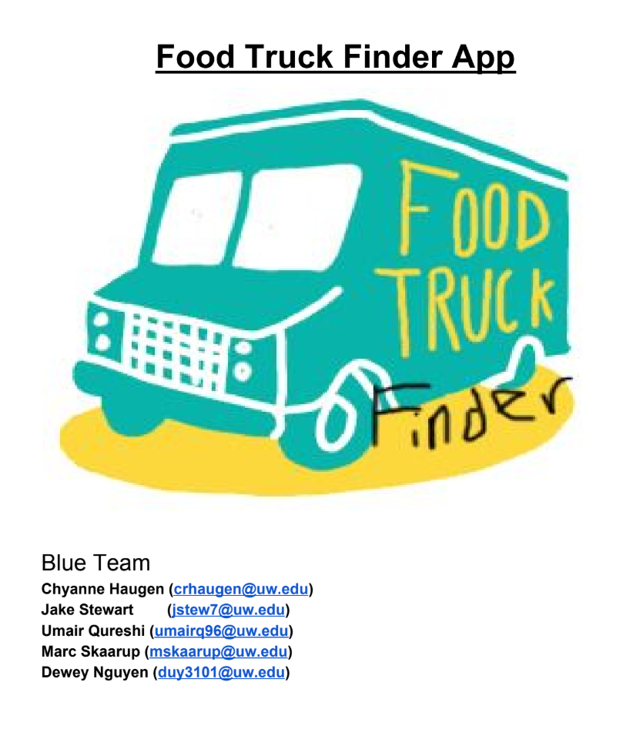
Background
A localized app that can track food trucks within 2 miles of the user
Targeted toward food truck owners and eaters
My team in CSS 370 came up with the initial idea and design.

Slide 3
Scope
An Android App (Java!)
A login system
Keeps track of personal information
Upload pictures
A map that tracks eaters and food truck owners in real-time
A simple user-interface (UI)
Navigation system

Slide 4






Tools
Development Environment
Frameworks
Cloud Services

Slide 5
Project Timeline
Summer 2019
Fall 2019
Winter 2020
Learning the tools
User Account Information
Database
Basics of Map Tracking
Low-fidelity UI
Refined Map Tracking
Synchronization
Testing
Finish up backend
Upload
Improved UIs
More Testing
Prep for poster and presentation
Notes:
Summer 2019: learning the tools, beginning development
Fall 2019: low-fidelity UIs, finishing development, testing
Winter 2019: UIs improvements, testing, start working on poster and presentation

Slide 6
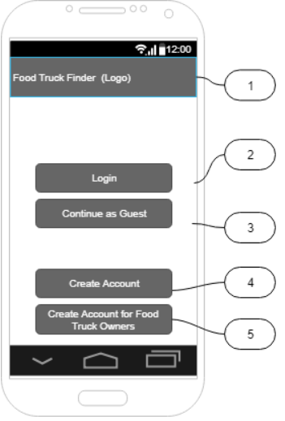
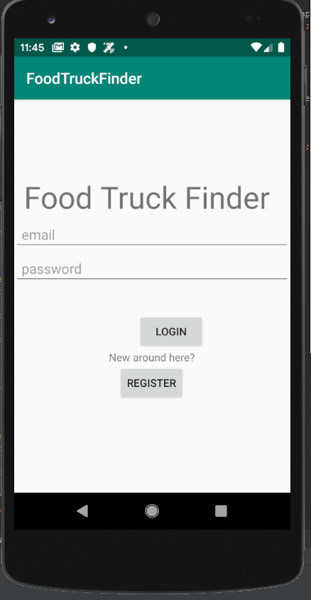
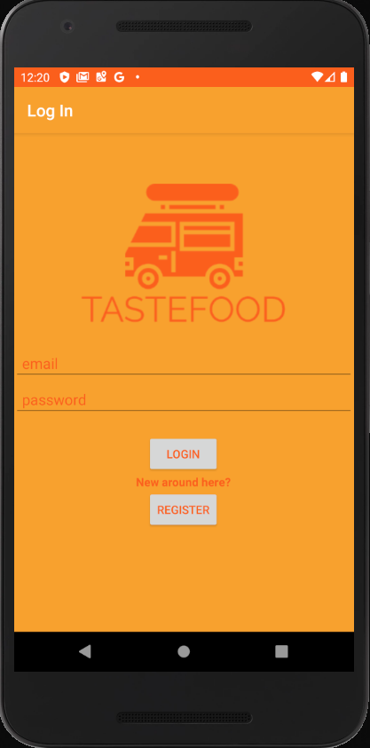
Design (Login)
Phase 1: Planning
Phase 2: Low-fidelity
Phase 3: High-fidelity

Slide 7
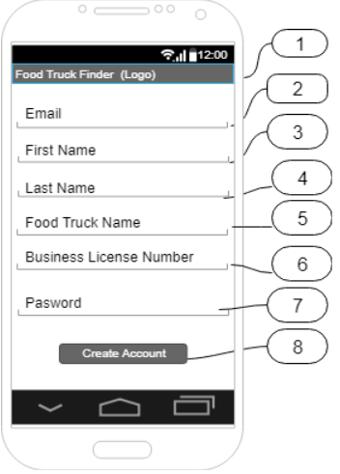
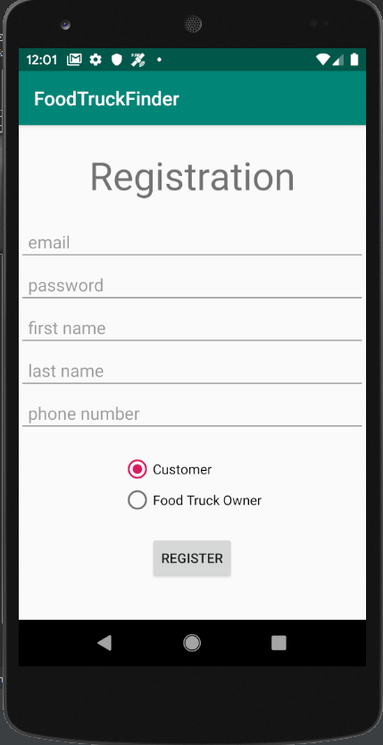
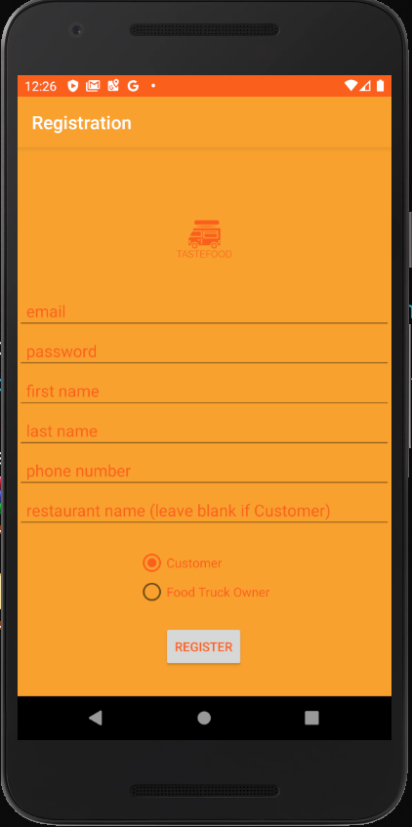
Design (Registration)
Phase 1: Planning
Phase 2: Low-fidelity
Phase 3: High-fidelity

Slide 8
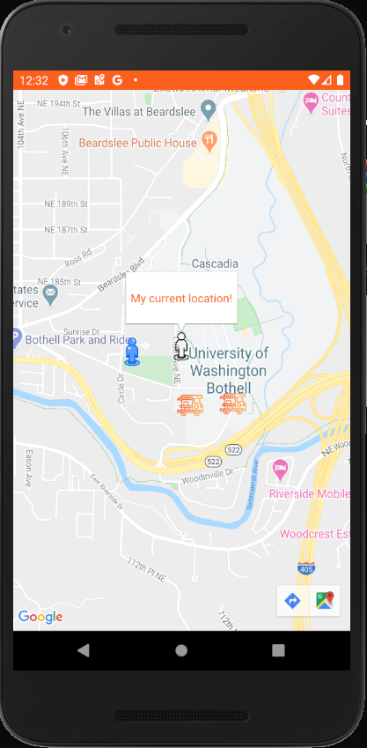
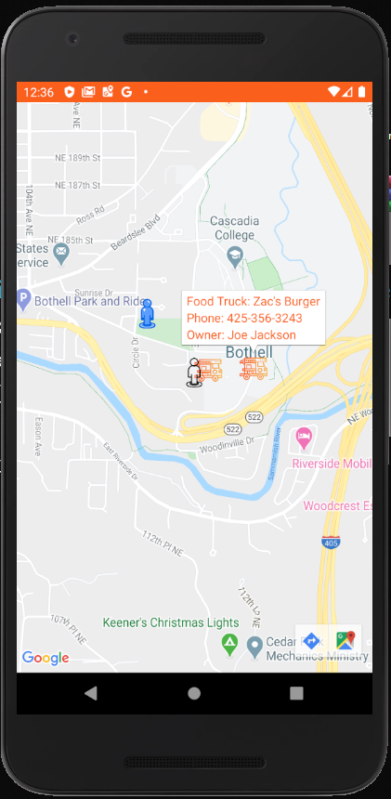
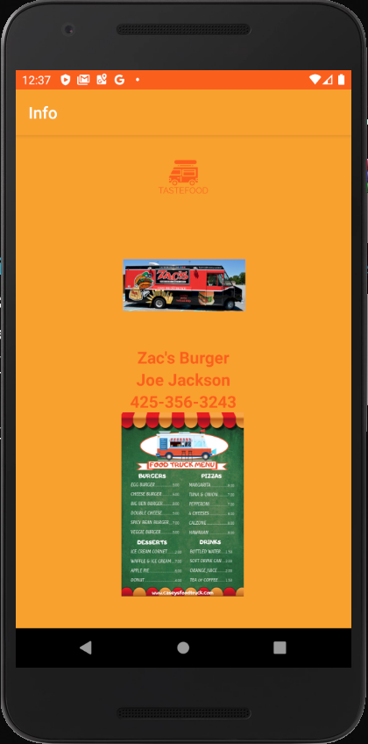
Design (Map)

Slide 9
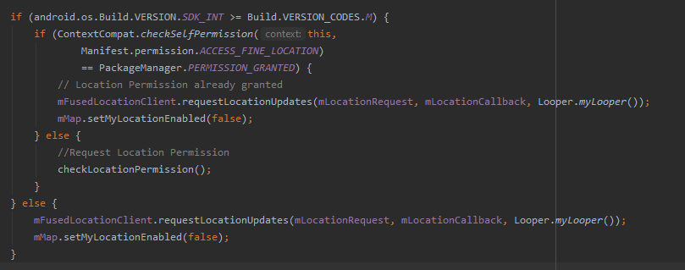
Design (Map)
Using Google Map SDK
Notes:
The first conditionial statement check for what android OS the user is using
mFusedLocationClient is a map tracking client by Google Map SDK, it a request object, a callback object and a loop object
Then, it request user location (every 5 or 10 or whatever seconds is set)
It do a callback function (place the marker)
Looper responsible for updating every x second

Slide 10
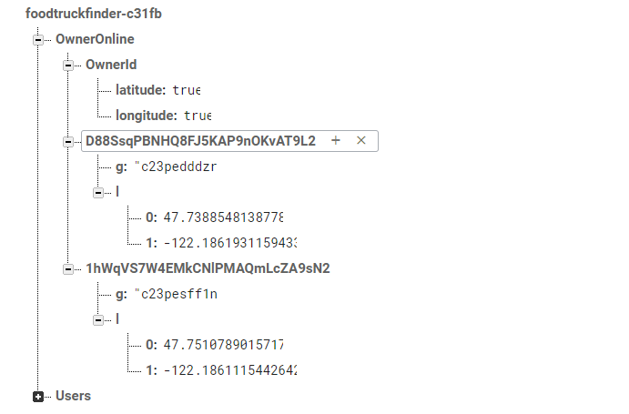
Database (Map)
Using Google Firebase Realtime Database

Slide 11
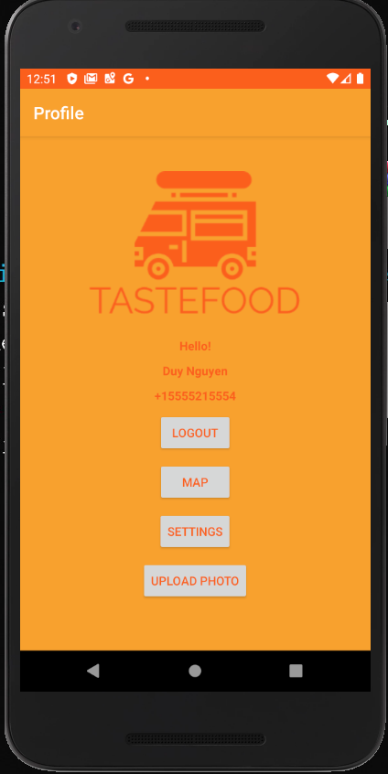
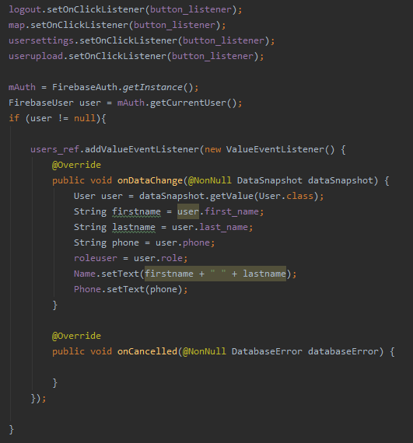
Design (Profile)
Profile (Frontend)
Profile (Backend)

Slide 12
Phase 1 (Summer 2019)
Challenges:
Choosing what tools to use (time-consuming)
Connection between activities (Activity Diagram)

Slide 13
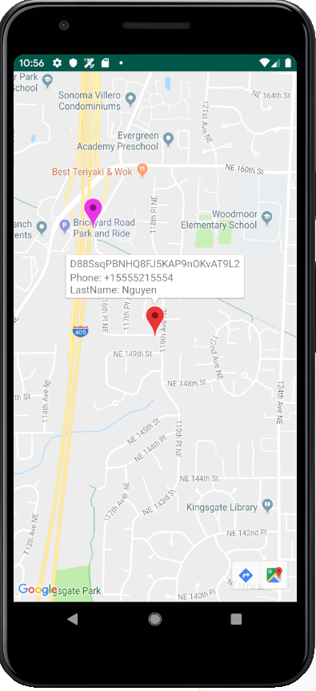
Phase 2 (Fall 2019)
Challenges:
Map Tracking Algorithm
Scalability
Synchronization
Notes:
It do a callback function (place the marker)
Looper responsible for updating every x second

Slide 14
Phase 3 (Winter 2020)
Challenges:
Synchronization
Making the UI
Android Activity Lifecycle
Testing

Slide 15
Useful Courses
CSS 343 Data Structures, Algorithms, and Discrete Mathematics II
CSS 370 Analysis and Design
CSS 430 Operating Systems
CSS 480 Principles of Human-Computer Interaction

Slide 16
Next Steps
Adding a Favorites feature
Adding a Rating feature
Adding a Comments feature
Notes:
Spaces

Slide 17
Thank You!

