Slide 1
Privacy-Preserving Mobile Video Sharing using Fully Homomorphic Encryption

Slide 2
Researchers
Utsav Goswami - Undergraduate researcher
Kevin Wang - Undergraduate researcher
Gabriel Nguyen - Graduate researcher
Brent Lagesse - Associate professor, researcher

Slide 3
Abstract
People want to share videos of an event, but only to certain people who were co-present at the event.
Need a method for proving co-presence without revealing information.
Compare two videos without revealing the contents of either video.
Similarity of Simultaneous Observation (SSO) technique for detecting hidden webcams.

Slide 4
Introduction
Enhance the ability for users to share videos with people, but only if those people were co-present when the video was taken.
Preserve data privacy while verifying co-presence.

Slide 5
Scenario
Alice and Bob attend a party, but did not see each other there.
Both Alice and Bob take videos of the festivities.
Later, Alice is looking for videos of the party to make a collage.
Bob does not want to send the video if she was not at the party.
Bob checks if Alice has proof of her co-presence.
If Alice has sufficient proof, Bob can choose to send the video.
Bob does not need to see Alice’s video to confirm this.
Alice’s video is still private.

Slide 6
Design
Similarity of Simultaneous Observation (SSO)
Algorithms to determine if two videos are of the same scene at the same time.
Kullback-Liebler Divergence (KLD)
Other options: Bhattacharyya coefficient, Cramer distance, ML model
Fully Homomorphic Encryption (FHE)
Allows execution of algorithms on encrypted data without decrypting.
Many functions not available under an FHE cryptosystem.

Slide 7
Implementation
Proof of Presence Video Sharing (PoP-Share)
Encrypt data and send with context
Compute similarity
Return results
Decrypt and decide
Send video

Slide 8
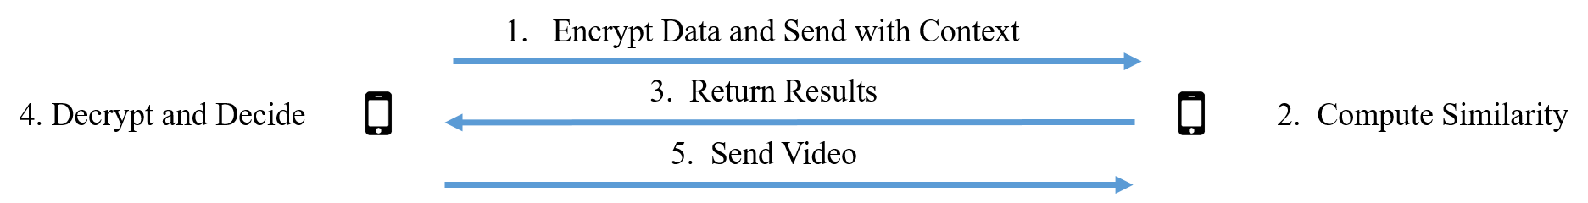
FHE Workflow

Slide 9
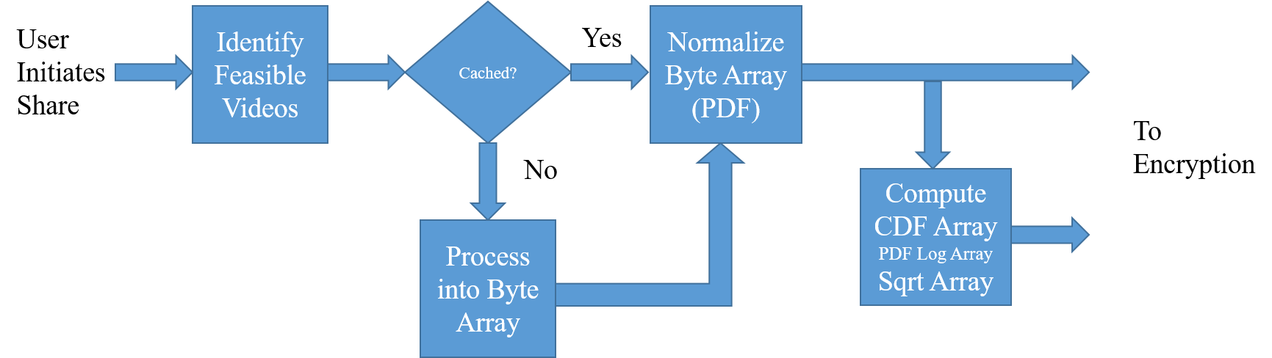
FHE Workflow

Slide 10
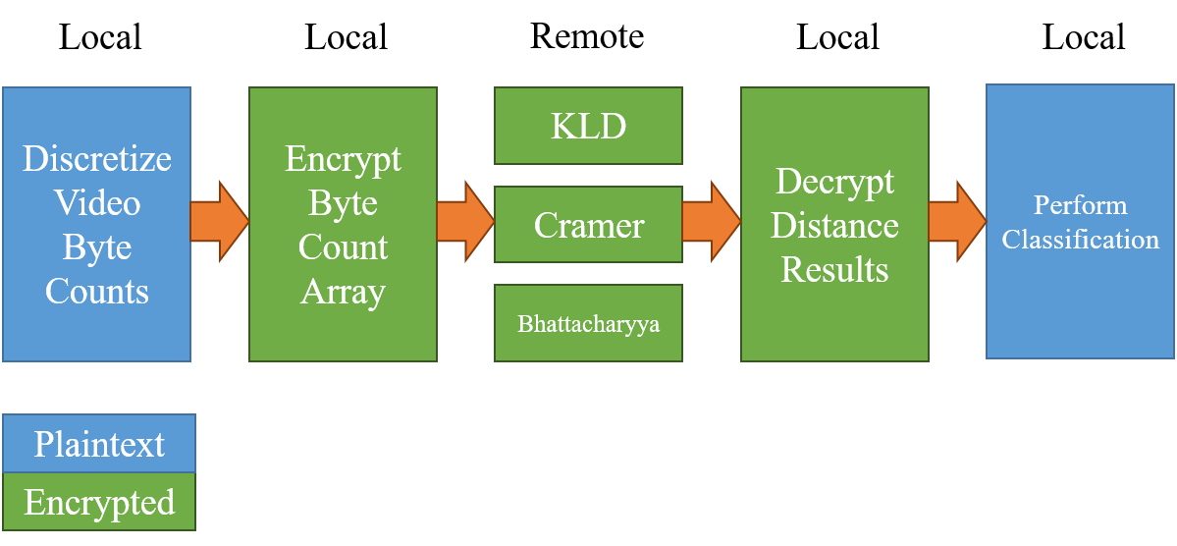
FHE Workflow

Slide 11



Tools Used
> Python
PySEAL
SciPy
Hachoir
> Kivy
> Firebase
Google Authentication
Realtime Database

Slide 12
Demonstration

Slide 13
Conclusion
Similarity of Simultaneous Observation (SSO) has more applications beyond detecting hidden cameras.
Fully homomorphic encryption allows complex operations on encrypted data without compromising the privacy of the data.
Proof of Presence Video Sharing (PoP-Share) is a possible method to verify co-presence and securely share videos between users.

Slide 14
Acknowledgments
Wu, Kevin and Brent Lagesse (2019, January). Do You See What I See? Detecting Hidden Streaming Cameras Through Similarity of Simultaneous Observation. Retrieved from https://faculty.washington.edu/lagesse/publications/SSO.pdf

