Slide 1
LINUX TRAINING
Introduction

Slide 2
Software
Software is set of computer instructions to receive input values and to manipulate them to produce the desired results according to the user.

Slide 3
The Importance of Software
Software packs and delivers the most important product of our time-Information
Hardware is general-purpose, software is application-specific.
Software is often costlier than the hardware it runs on.
Software is crucial for business success

Slide 4
Evolution of Software Engineering
In 1970’s software development was typified by programming team. Generally software was developed either by a single developer or by a small team.
In 1980’s software team size became big due to complexity of the software. From 1980’s to 1990’s next phase was introduced by the software companies where a set of standard rules were applied for developing software.
Object-Oriented development was emerged during this phase
2000’s was the production era, in which object oriented development and software reuse was started.
Software evolves due to changes. Changes occur due to correction, adaptation and enhancement.

Slide 5
Issues involved in Software Engineering:
Software Crisis: Software crisis include the problems with functioning of software, development of software and maintaining existing software.
Software Myths: erroneous beliefs about software and the process that is used to build it. The myth can be grouped into three groups
Management Myths
Customer myths
Practitioner’s myths

Slide 6
Software Crisis
The Y2K problem was the major problem of last century. It was simply using only the last two digits of the year. The developer faced problem to identify the year 2000.
Early software development was ‘personalized’.
As complexity of applications grew, programs increase in size then maintenance of complexity became difficult.
Software was costing a lot more to develop than initially estimated budget.
Bugs and Errors found by the customer were extremely difficult to trace and fix.
There was a communication gap between customer and developer.
Software used to take long time to develop.
Software was intangible and it becomes difficult to see different faces of software development without proper documentation control.

Slide 7
Management Myths
Managers with software responsibility, like managers in most disciplines, are often under pressure to maintain budgets, keep schedules from slipping, and improve quality.
If we get behind schedule, we can add more programmers and catch up.
In reality: adding people to a late software project makes it later.
We already have a book that’s full of standards and procedures for building software. Won’t that provide my people with everything they need to know? The reality: Is it used, are practitioners aware of it’s existence?, Does it reflect modern software engineering practice? Is it complete? Is it adaptable? … … the answer to all of these questions is “no.”

Slide 8
Customer myths
Customers’ Myths lead to false expectations (by the customer) and, ultimately, dissatisfaction with the developer.
A general statement of objectives is sufficient to begin writing programs—we can fill in the details later. Reality: Unambiguous requirements are developed only through effective and continuous communication between customer and developer.
Software requirements continually change, but change can be easily accommodated because software is flexible. Reality: It is true that software requirements change, but the impact of change varies with the time at which it is introduced. When it’s early the cost is relatively small. However, as time passes, the cost impact grows rapidly.

Slide 9
Practitioner’s myths
Myths that are still believed by software practitioners have been fostered by over 50 years of programming culture.
Once we write the program and get it to work, our job is done. Reality: Industry data indicate that between 60 and 80 percent of all effort expended on software will be expended after it is delivered to the customer for the first time.
Until I get the program “running” I have no way of assessing its quality. Reality: One of the most effective software quality assurance mechanisms can be applied from the inception of a project.

Slide 10
Practitioner’s myths (Continue):
The only deliverable work product for a successful project is the working program. Reality: A working program is only one part of a software configuration that includes many other elements such quality product, maintainable product ….
Software engineering will make us create voluminous and unnecessary documentation and will invariably slow us down. Reality: Software engineering is not about creating documents. It is about creating a quality product. Better quality leads to reduced rework. And reduced rework results in faster delivery times.
CCL: Recognition of software realities is the first step toward formulation of practical solutions for software engineering.

Slide 11
Software Applications
Software may have a number of applications. Software may be useful in any situation where already procedural steps have been defined. Software Applications are grouped into different areas for convenience and these are:
Business software (eg: payroll)
Artificial Intelligence software (eg: voice recognition)
Embedded Software
Personal Computer System
Real Time Software (Eg: Weather Forecasting)
System Software (eg: compiler, OS)
Scientific Software (CAD, MATLAB)
Web based Software

Slide 12
Software Engineering Concepts
Software engineering is according to Stephen Schach “a discipline whose aim is the production of quality software, software that is delivered on time, within budget and that satisfies its requirements”
According to IEEE glossary of Software Engineering Terminologies- “Software Engineering is the application of a systematic, disciplined, quantifiable approach to the development, operation and maintenance of software; i.e., the application of engineering to software”.

Slide 13
Modeling the Process and life cycle

Slide 14
Software development life cycle (SDLC)
In the IEEE standard Glossary of Software Engineering Terminology, the Software Life Cycle is:
“The period of time that starts when a software product is conceived and ends when the product is no longer available for use. The software life cycle typically includes a requirement phase, design phase, implementation phase, test phase, installation and check out phase, operation and maintenance phase and sometime retirement phase”.

Slide 15
SDLC – Strength and weakness
Strength:
1. Monitoring large projects.
2. Explain step by step.
3. Sufficient documentation is provided.
4. Ease of maintenance
Weakness:
1. Need more time for development
2. Development cost is more
3. Sometimes user input is limited.
4. Difficult to estimate cost.

Slide 16
Software Development Lifecycle Models
A lifecycle model, also called as "process model", is an abstract description of the software development and modification process. Here are some process models:
Waterfall Model
Evolutionary Process Model
Prototype Model
Incremental Process Model
Spiral Model
RAD Model
Generic Process model
Specialized Process model
Agile Development
Unified Process
Extreme programming
Scrum

Slide 17
1 Waterfall Model
Waterfall Model suggests a systematic, sequential approach to software development that may continue through different phases:
Requirement and Specification
Design Phase
Implementation and Unit testing Phase
Integration and System testing Phase
Maintenance Phase

Slide 18
Waterfall Model – phases
1. Requirement and Specification: Requirement analysis defines the required information for software, required function, behavior, performance and interfaces.
Requirements are group of functionalities and constraints.
At the end, a requirement specification document is created for the guidelines of the next phase of the model.
2. Design: Design part is the critical of phases, it is important to understand what we are going to create and what it should look like?
System design is prepared after studying all the requirements.
Software design focuses on defining overall system architecture, interface representation and structural and algorithmic detail of system.
3. Implementation and unit testing: Implementation phase is also called coding phase.
After preparing the design of system, the work is divided into modules/units and development part is started.
The system is developed in small units and then integrated in unit testing.

Slide 19
Waterfall Model – phases (cont .)
4. Integration and system testing phase: The testing phase focuses on the logical parts of the software.
In the integration phase whole units are combined together as a complete system and tested to check the coordination between all the units.
Different test cases are applied to check the errors and after final testing by ensuring the actual results, software is delivered to the customer (deployment).
5. Maintenance phase: This phase of “Waterfall Model” is never ending phase.
After delivering the software to the customer problems with developed system is started,
e.g changes occur due to new operating system. So the problems related to the software are solved during maintenance phase.

Slide 20
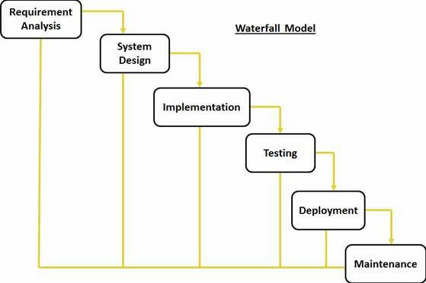
Waterfall Model
Waterfall Model is used when
Requirements are very well known
Product definition is stable
Technology is understood
New version of an existing product
Porting an existing product to a new platform.

Slide 21
Waterfall Model – advantages and disadvantages
Advantages
It is simple, step-by-step procedure and easy to understand.
Large modules are divided into unit phases, and each phase deal with a separate logic.
It is straightforward and work well in means of quality without considering cost and time slots.
It is good for managerial control in sense of tracking and planning.
Milestones are well understood.
Disadvantages
It assumes that all requirements are upfront but it is not possible for all systems.
At the end of each phase formal document is required.
It follows “big-bang” approach, which is “all or nothing” value proposition. Customer cannot interact with the system in between of development.
The development team doesn't understand the politics of the customer's organization.

Slide 22
2 Evolutionary Process Model
Evolutionary Prototyping Model developers build a prototype during the requirements phase which is evaluated by end users.
The traditional waterfall life cycle has been the mainstay for software developers for many years. For software products that do not change very much once they are specified, the waterfall model is still viable. However, for software products that have their feature sets redefined during development because of user feedback and other factors, the traditional waterfall model is no longer appropriate.

Slide 23
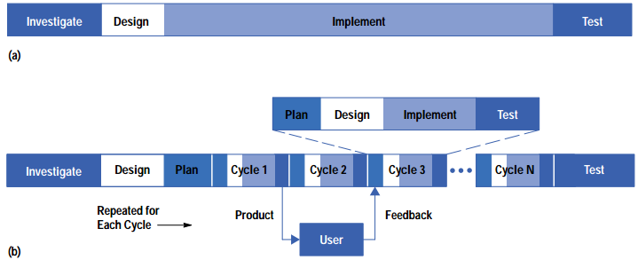
Evolutionary Process Model
(a) Traditional waterfall model. (b) Evolutionary (EVO) development model.
Two of the most evolutionary development models are
Prototype Model and Spiral Model.

Slide 24
Evolutionary Prototyping Strengths
Customers can “see” the system requirements as they are being gathered
Developers learn from customers
A more accurate end product
Unexpected requirements accommodated
Allows for flexible design and development
Steady, visible signs of progress produced
Interaction with the prototype stimulates awareness of additional needed functionality

Slide 25
Evolutionary Prototyping Weaknesses
Bad reputation for “quick-and-dirty” methods
Overall maintainability may be overlooked
The customer may want the prototype delivered.
Process may continue forever (scope creep)

Slide 26
3 Prototype Model
In Prototyping model, the programmer first develops a prototype of the system before the development of actual software.
The client will check this prototype and after evaluating this prototype he can ask for modifications and additions to produce a final result.
The developer and the customer together define the overall objective for the software, identify the requirements that are known and outline area for further definition.

Slide 27
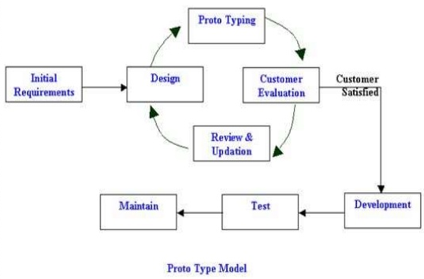

Slide 28
Process of prototyping
1. Identify basic requirements: For the development of software product, first phase is to identify the requirements.
2. Develop Initial Prototype: The initial prototype is developed that includes only user interfaces. Developers prepare a prototype based on different sets of modules and presented to client for their review.
3. Review: The customer, including end-users, examine the prototype and provide feedback on changes and explains their expectations on it.
4. Revise and Enhancing the Prototype: Both the developer and client discuss on the refinement of project. Using the feedback both the specifications and the prototype can be improved.

Slide 29
Prototyping – Advantages and Disadvantages
Advantages:
It provides better understanding of client expectations. Client’s involvement increases.
It is useful in the development of large projects.
Prototyping can improve the quality of requirements and specifications provided to developers.
The prototyping model has less technical risks
Disadvantages:
User may get confused in between prototype and finished system.
Developing the system may become never ending.
Sometimes prototype has to be discarded, and then costs argue may arise.

Slide 30
4 Incremental Process Model
Increment model construct a partial implementation of a system.
It prioritizes requirement of system and divided into groups for further implementation.
New functionalities are increased slowly to the previous release of system, until all the functionalities have been implemented.
Increment model is used in case of large projects.
In some books, increment model is divided into two types: Prototype model and RAD model.

Slide 31
Incremental Process Model
Advantages:
Disadvantages:
Each release delivers an operational product.
Customer can respond to each implementation.
Uses “divide and conquer” rule for implementation of system.
Initial product delivery is faster
Changing requirements risk is reduced
Need of strong planning and design
Well-defined module interfaces are required (some will be developed long before others)
Total cost of the complete system may go out of budget.

Slide 32
5 Spiral Model
New model originally proposed by Barry Boehm [Boe88],
The spiral model is an evolutionary software process model that couples the iterative nature of prototyping with the controlled and systematic aspects of the waterfall model.
With the Spiral model Barry Boehm tried to incorporate the “project risk” factor into life cycle model.
The spiral model is planned for large, expensive, and complicated projects.

Slide 33
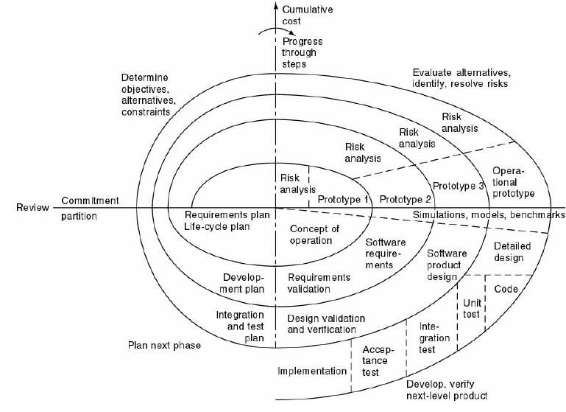
Each loop of the spiral from X axis clockwise through 360º represents one phase.

Slide 34
Spiral model - sectors
Spiral Quadrant Determine objectives, alternatives and constraints are laid down.
Spiral Quadrant Evaluate alternatives, identify and resolve risks
Spiral Quadrant Develop next-level product: creating and reviewing the design, development and testing the code.
Spiral Quadrant Plan next phase

Slide 35
Spiral Model - use
Spiral model is used when:
Creation of a prototype is appropriate
Costs and risk evaluation is important
For medium to high-risk projects
Users are unsure of their needs
Requirements are complex

Slide 36
Spiral Model - Advantages
Each lifecycle step is completed with a review of users.
It provides mechanism to cope up with changes done by users.
Users provide feedback frequently; it may easy to judge how much test cases have to apply.
Useful for high risk projects.
Reuse of existing software.

Slide 37
Spiral Model - Disadvantages
As this model is relatively new to all so it is not used widely.
Time spent for evaluating risks become large for small or large projects.
Extra time spent on planning, resetting objectives and doing risk analysis.
This model is useful for large scale projects only.
Highly customized limiting re-usability

Slide 38
6 RAD model
Rapid Application Development (RAD) model was developed by IBM in 1980’s
RAD is a methodology for analyzing, designing, building, and test phases into a series of short, iterative development cycles.
RAD projects are developed with small integrated teams comprised of developers, end users, and IT technical resources.
RAD is an incremental software development process model that highlights short development cycle.

Slide 39
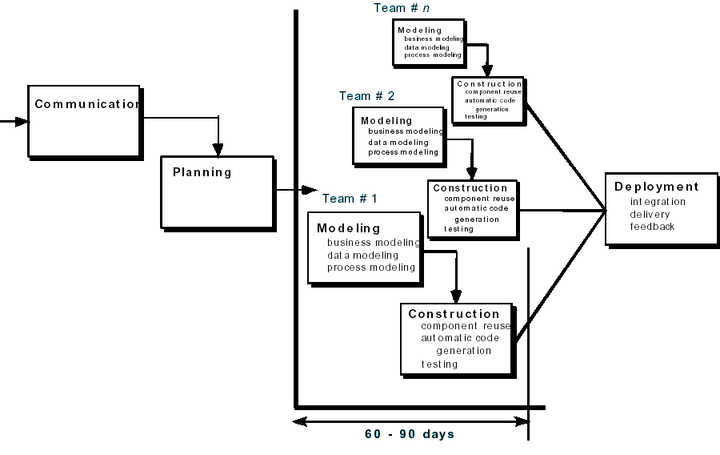
RAD Model

Slide 40
RAD model – phases
Business Modeling: The information flow among business functions like what information drives the business process, what information is generated, who generates it, where does the information go, who process it and so on.
Data Modeling: The information gathered from business modeling is refined into a group of data objects that are needed to support the business.
Process Modeling: Processing details are created for adding, modifying, deleting or retrieving a data object.
Application Generation: Automated tools are used to facilitate construction of the software; even they use the 4th GL techniques.
Testing and Turn over: Many of the programming components have already been tested since RAD emphasis reuse. This reduces overall testing time.

Slide 41
RAD - use
RAD is used when:
Reasonably well-known requirements
User involved throughout the life cycle
Project can be time-boxed
Functionality delivered in increments
High performance not required
Low technical risks
System can be modularized

Slide 42
RAD Model
Advantages:
Disadvantages:
RAD reduces the development time and reusability of components help to speed up development.
Productivity with lower cost
All functions are divided into modules for easy processing.
It is useful for short period of time.
All types of applications are not applicable for RAD model.
Only a large system can be modularized.
RAD approach may not work when technical risks are high.
Human resources are required for large and medium projects.

Slide 43
8 Generic Process model
a generic process framework for software engineering defines five framework activities:
Communication: Gathering requirements
Planning: describing the technical tasks to be conducted, the risks that are likely, the resources that will be required, the work products to be produced, and a work schedule.
Modeling (Design/sketch) understand the big picture—what it will look like architecturally, how the constituent parts fit together, and many other characteristics
Construction (coding and testing)
Deployment: delivering the final product and maintain it.

Slide 44
Generic process -Aspect of software process flow
This aspect—called process flow—describes how the framework activities are organized
A linear process flow executes each of the five framework activities in sequence, beginning with communication and culminating with deployment (Figure a).
An iterative process flow repeats one or more of the activities before proceeding to the next (Figure b).
An evolutionary process flow executes the activities in a “circular” manner. Each circuit leads to a more complete version of the software (Figure c).
A parallel process flow (Figure d) executes one or more activities in parallel with other activities

Slide 45
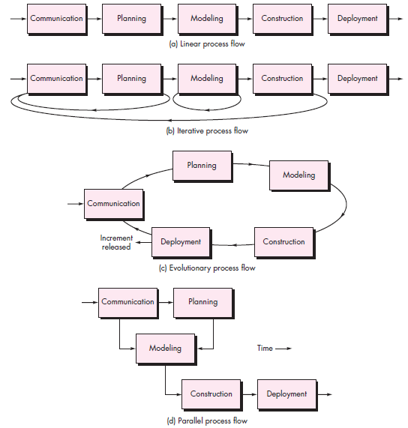

Slide 46
9 Specialized Process model
Specialized process models take on many of the characteristics of one or more of the traditional models presented. However, these models tend to be applied when a specialized or narrowly defined software engineering approach is chosen. Here are some specialized models:
Component base Development
Formal method
Aspect-Oriented Software Development

Slide 47
10 The Formal Methods Model
Formal methods enable you to specify, develop, and verify a computer-based system by applying a rigorous, mathematical notation.
Formal methods provide a mechanism for eliminating many of the problems that are difficult to overcome using other software engineering paradigms.
Ambiguity, incompleteness, and inconsistency can be discovered and corrected more easily —not through ad hoc review, but through the application of mathematical analysis.

Slide 48
11 Formal Methods Model (cont)
The formal methods model offers the promise of defect-free software. Yet, concern about its applicability in a business environment has been voiced:
The development of formal models is currently quite time consuming and expensive.
Because few software developers have the necessary background to apply formal methods, extensive training is required.
It is difficult to use the models as a communication mechanism for technically unsophisticated customers.

Slide 49
12 Unified process (UP)
The UP is a popular iterative and incremental software development process framework.
In some ways the UP is an attempt to draw on the best features and characteristics of traditional software process models, but characterize them in a way that implements many of the best principles of agile software development.
Today, the UP and UML are widely used on object-oriented projects of all kinds.

Slide 50
UP - features
The UP has the following key features:
It is component based, commonly being used to coordinate object oriented programming projects.
It uses UML.
The design process is anchored, and driven by, use-cases which help keep sight of the anticipated behaviors of the system.
It is architecture centric.
Design is iterative and incremental

Slide 51
UP - Phases
The Unified Process divides the project into four phases:
Inception
Elaboration(milestone)
Construction(release)
Transition(final production release)

Slide 52
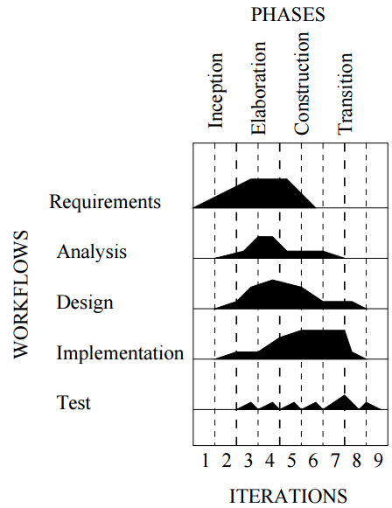
UP-Example

Slide 53
UP-Example
In previous slide we see a series of nine iterations covering the four phases described.
The pattern of workflow across iterations is shown by the graph for each activity (the volume beneath each graph giving the amount of effort)
for instance we can see that requirements specification ramps up during the inception phase; stays high during the elaboration phase; then drops during the construction phase, becoming negligible by the time we get to the transition phase.

Slide 54
13 Agile development
Agile software development is a set of software development methods in which requirements and solutions evolve through collaboration between self-organizing, cross functional team.
it encourages rapid and flexible response to change.

Slide 55
Agile development - Principles
The Agile Alliance defines 12 agility principles:
Our highest priority is to satisfy the customer through early and continuous delivery of valuable software.
Welcome changing requirements, even in late development.
Working software is delived frequently (weeks rather than months).
Business people and developers must work together daily throughout the project.
Build projects around motivated individuals. Give them the environment and support they need, and trust them to get the job done.

Slide 56
The most efficient and effective method of conveying information to and within a development team is face-to-face conversation.
Working software is the primary measure of progress.
Agile processes promote sustainable development. The sponsors, developers, and users should be able to maintain a constant pace indefinitely.
Continuous attention to technical excellence and good design enhances agility.
Simplicity—the art of maximizing the amount of work not done—is essential.
The best architectures, requirements, and designs emerge from self–organizing teams.
At regular intervals, the team reflects on how to become more effective, then tunes and adjusts its behavior accordingly.

Slide 59
Behavioral models
Behavioral models are models of the dynamic behavior of the system as it is executing.
They show what happens or what is supposed to happen when a system responds to a stimulus from its environment.
Here are two of those stimulus:
1. Data Some data arrives that has to be processed by the system.
2. Events Some event happens that triggers system processing. Events may have associated data but this is not always the case.

Slide 61
Unified Process
The Unified Process is a traditional “cathedral” style of incremental design driven by constructing views of a system architecture. It has the following key features:
It is component based, commonly being used to coordinate object oriented programming projects.
It uses UML - a diagrammatic notation for object oriented design - for all blueprints.
The design process is anchored, and driven by, use-cases which help keep sight of the anticipated behaviours of the system.
It is architecture centric.
Design is iterative and incremental - via a prescribed sequence of design phases within a cyclic process.

