Slide 1
Welcome !

Slide 2
Me,
Gökmen Göksel
a Pardus Developer
gokmen@pardus.org.tr

Slide 3
Let's start...

Slide 4
A new infrastructure.

Slide 5

COMAR
COnfiguration MAnageR

Slide 6
An amazing desktop environment.

Slide 7

KDE
K Desktop Environment

Slide 8
Merge them.

Slide 9

Pardus
A shiny distro.

Slide 10
What are common actions for a desktop computer user ?

Slide 11
Surfing the Internet, Listening music, Watching movies, Organizing files...
For a KDE Developer; Building KDE from SVN Git.

Slide 12
Who will provide a great solution for these actions and more ?

Slide 13
KDE
K Desktop Environment

Slide 14
So, What COMAR provides ?

Slide 15
System Management...

Slide 16
Network Management*, Service Management, User Management, Package Management, Bootloader Management, Firewall Management, Display Management...
* When we've done the Network Management thing, there were no such solution like KDE's Network Manager or GNOME...

Slide 17
These operations can be done via cli with Python API of COMAR...

Slide 18
But we need a graphical solutions ...

Slide 19
Solutions should be transparent to user.

Slide 20
All of Pardus Management tools are
KApplication

Slide 21
What are the benefits of using KApplication ?

Slide 22
Applications are similar...

Slide 23
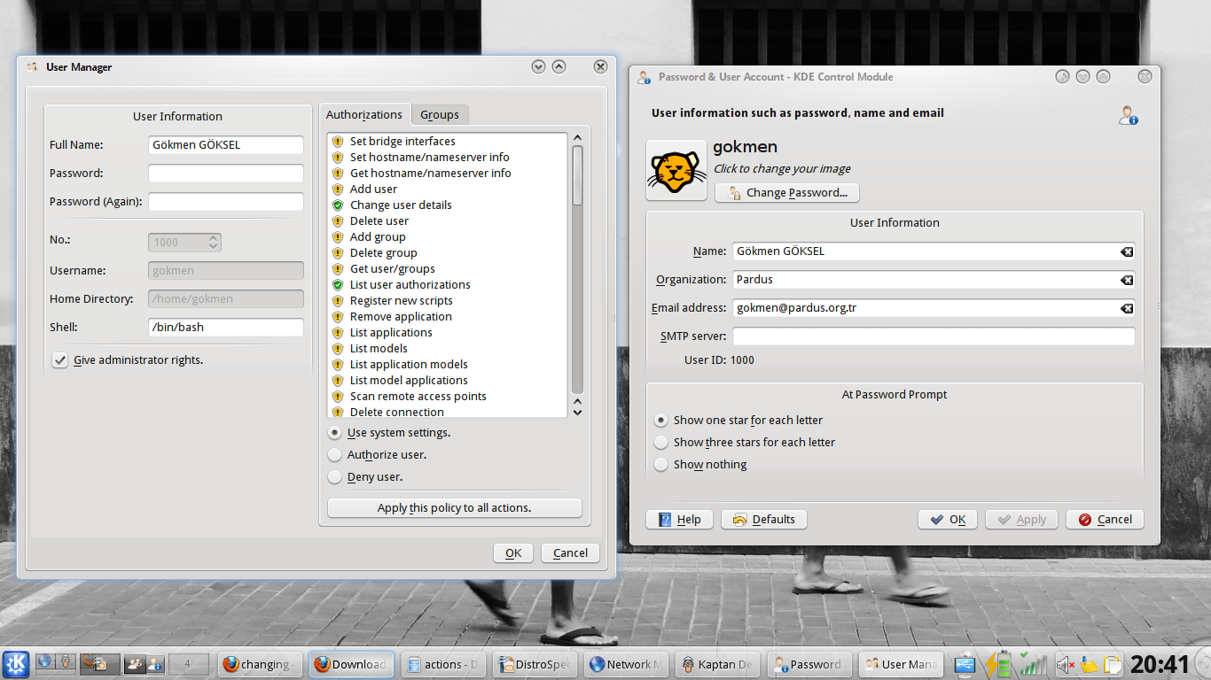

Slide 24
You can embed one application to another one...

Slide 25
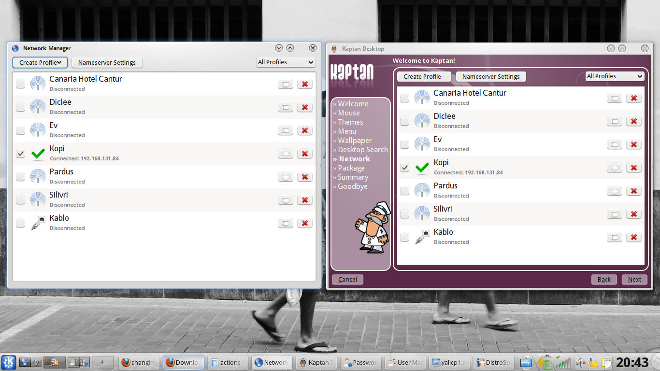

Slide 26
You can use them from KDE SystemSettings as KCModule...

Slide 27
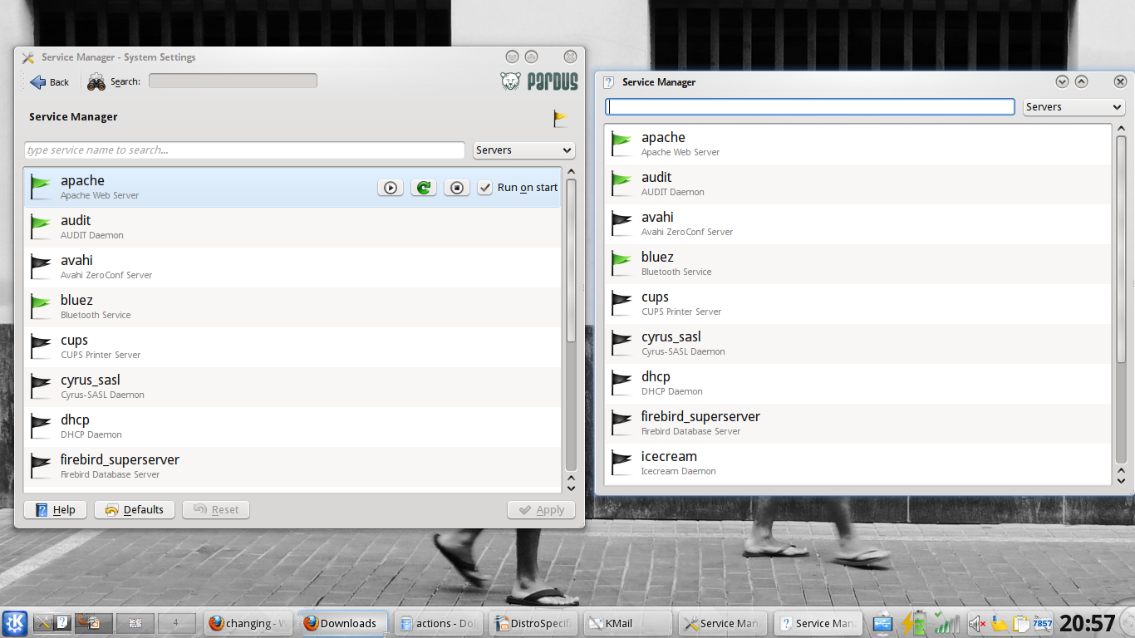

Slide 28
Notifications ...

Slide 29
Package Manager uses KNotification...

Slide 30
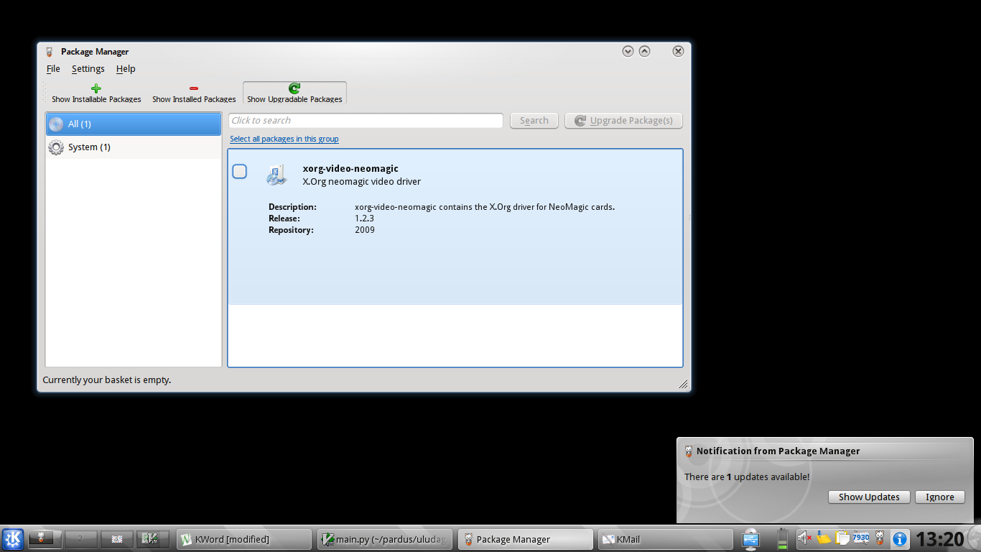

Slide 31
What about authentication ?

Slide 32
COMAR provides PolicyKit authentication for predefined atomic operations...

Slide 33
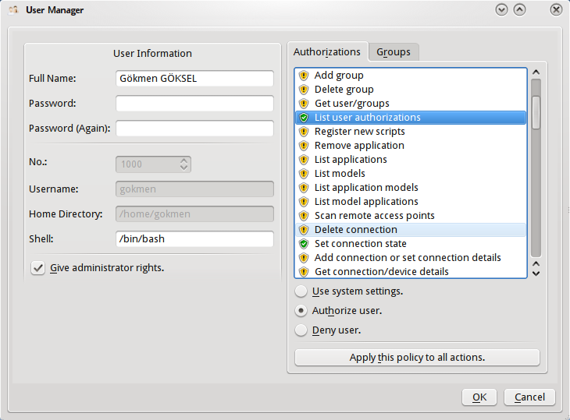

Slide 34
When needs an authentication, COMAR calls PolicyKitKDE...

Slide 35
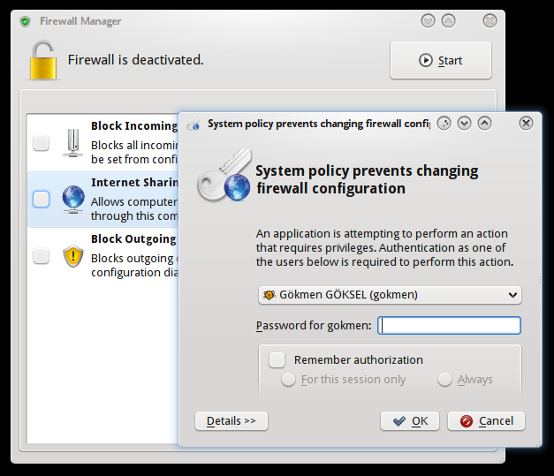

Slide 36
Is that all in COMAR side ?

Slide 37
Not, COMAR also sends a notification to client application when something changed in
low-level...

Slide 38
Removing a network device pings the Network Manager...

Slide 39
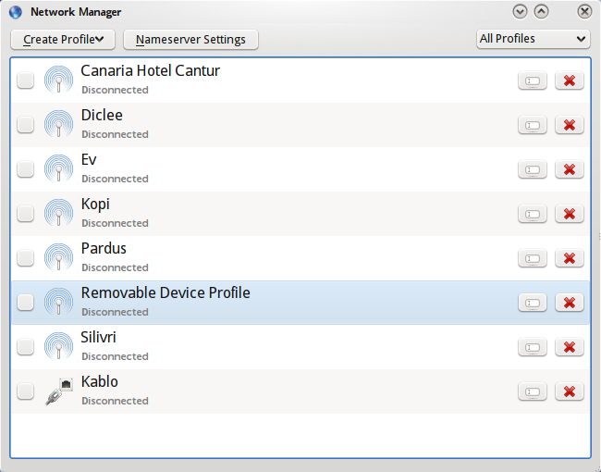
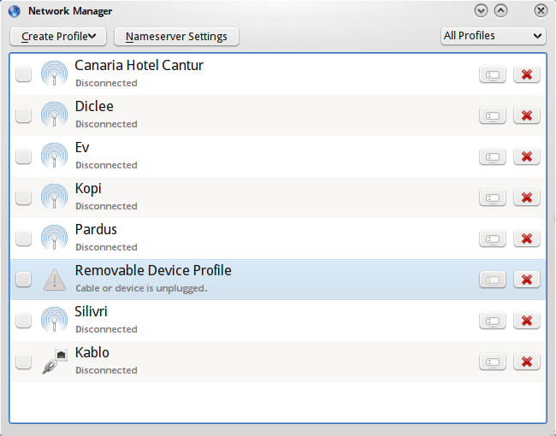

Slide 40
What about new technologies of KDE 4 ?

Slide 41
Plasmoids...

Slide 42
Network Manager Plasmoid ...

Slide 43
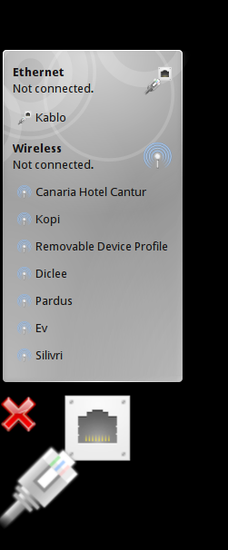
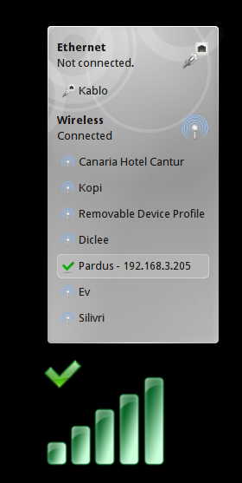

Slide 44
Service Manager Plasmoid ...

Slide 45
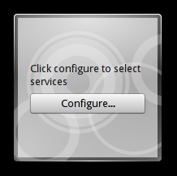
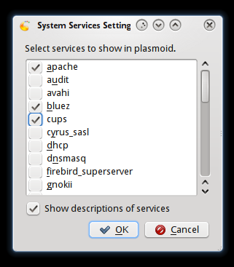
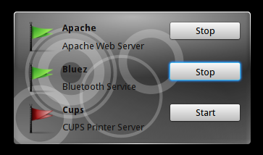

Slide 46
Each plasmoid connected to COMAR, so when something changed from a plasmoid, managers knows them...

Slide 47
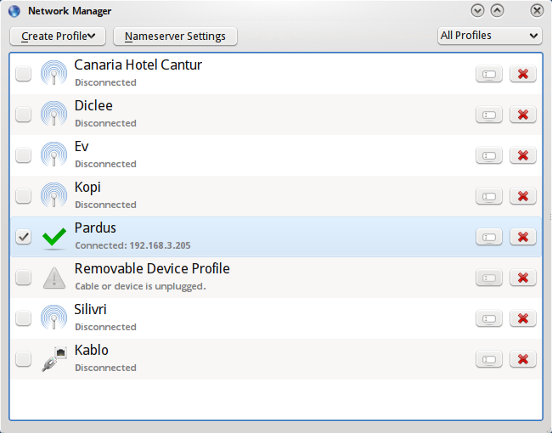
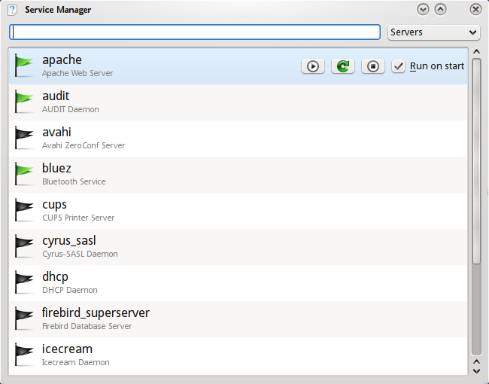
More than thousand word...
Comar

Slide 48
Solid Support

Slide 49
Solid::Networking for other KDE Applications

Slide 50
Solid::PowerManagement for Power Consumption

Slide 51
Show Time !

Slide 52
Thanks !
gokmen@pardus.org.tr
gokcen@pardus.org.tr

