Slide 1
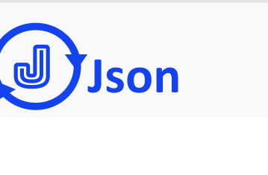
#1343EE

Slide 2
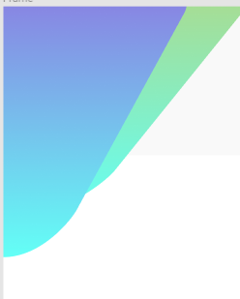
#D9C24A - #63FFF6
#9A4AD9 - #63FFF6

Slide 3
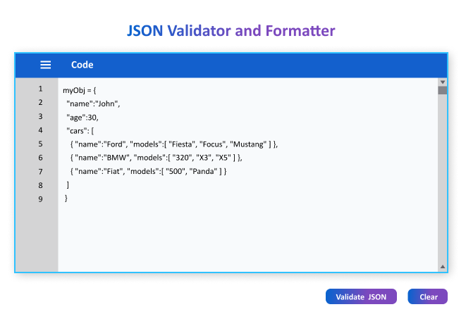
#0863CE - #7C49BD
#1343EE
#616168
#F8FAFC
#C4C4C4
#C4C4C4
#0863CE - #7C49BD

Slide 4
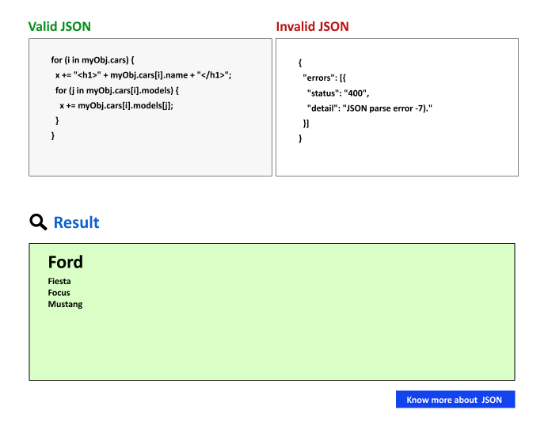
#BD1313
#068D1B
#EEEEEE 50% Transparency
#9FFF72 40 % Transparency

Slide 5
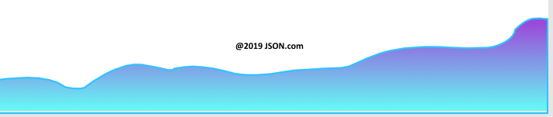
#9A4AD9 - #63FFF6

