Slide 1
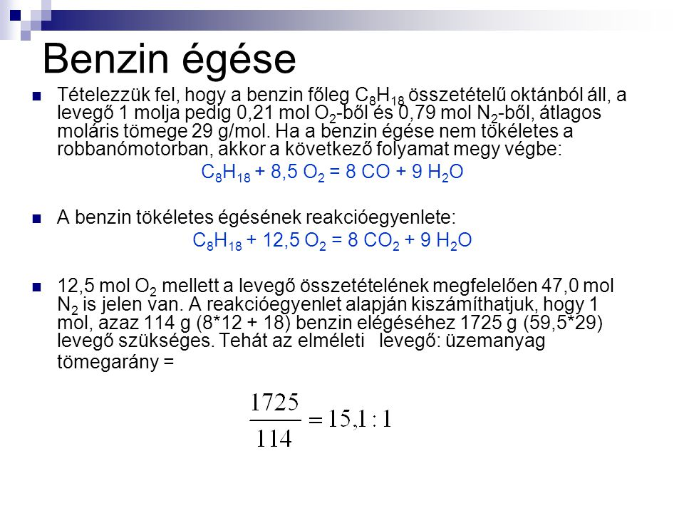
Burning of fuel

Slide 2
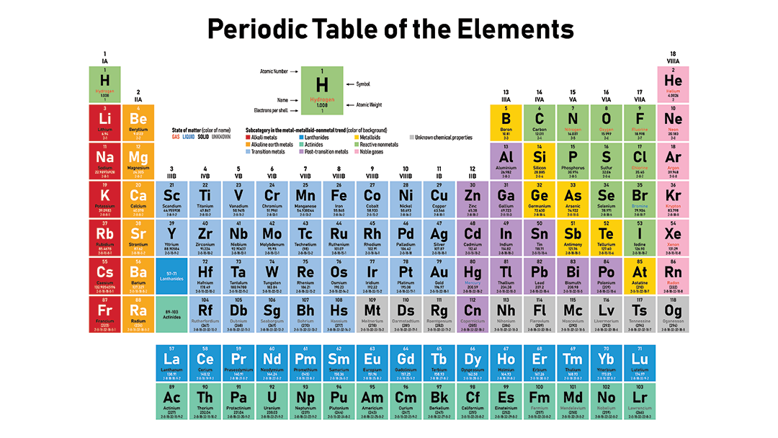

Slide 3
Burning
C₈H₁₈ + 12.5 O₂ → 8 CO₂ + 9 H₂O
Burning of 1 kg benzine (C₈H₁₈ ) how much kg water and carbon dioxide?
Let us see 1 mol
C – 12g, H – 1g, O – 16g
114g benzine and 400g oxygen burns to 352g carbon dioxide and 162g water

Slide 4
Greenhouse effect
https://en.wikipedia.org/wiki/Greenhouse_gas
Water vapour: 36-72% → 162g x 0.72 = 116.64
Carbon dioxide: 9-26% → 352g x 0.26 = 91.52

