Slide 1
The C Language
Prof. Stephen A. Edwards

Slide 2

The C Language
Currently, one of the most commonly-used high-level languages
“High-level assembly”
Very portable: compilers exist for virtually every processor
Easy-to-understand compilation
Produces efficient code
Fairly concise

Slide 3

C History
Developed between 1969 and 1973 along with Unix
Due mostly to Dennis Ritchie
Designed for systems programming
  Operating systems
  Utility programs
  Compilers
Evolved from B, which evolved from BCPL

Slide 4
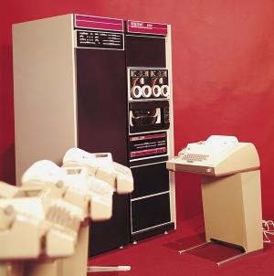
C History
Original machine (DEC PDP-11) was very small
  24K bytes of memory, 12K used for operating system
Written when computers were big, capital equipment
  A whole group would get one, develop new language, OS

Slide 5

Hello World in C
Preprocessor used to share information among source files
Clumsy
+ Cheaply implemented
+ Very flexible
#include <stdio.h>
void main()
{
printf(“Hello, world!\n”);
}

Slide 6
Hello World in C
Program mostly a collection of functions
“main” function special: the entry point
“void” qualifier indicates function does not return anything
#include <stdio.h>
void main()
{
printf(“Hello, world!\n”);
}
I/O performed by a library function: not included in the language

Slide 7

Euclid’s algorithm in C
This part lists number and type of arguments
Arguments are call-by-value
int gcd(int m, int n)
{
int r;
while ( (r = m % n) != 0) {
m = n;
n = r;
}
return n;
}

Slide 8
Euclid’s algorithm in C
int gcd(int m, int n)
{
int r;
while ( (r = m % n) != 0) {
m = n;
n = r;
}
return n;
}
Automatic variable
Storage allocated on stack when function entered, deallocated when it returns.
All parameters, automatic variables accessed w.r.t. frame pointer.
Extra storage needed while evaluating expressions also placed on the stack
Frame pointer
Stack pointer
r
caller’s frame pointer
return address
LC-3
Convention
return value
actual argument for m
actual argument for n

Slide 9
Euclid’s algorithm in C
int gcd(int m, int n)
{
int r;
while ( (r = m % n) != 0) {
m = n;
n = r;
}
return n;
}
Expression: C’s basic type of statement.
Arithmetic and logical
Assignment (=) returns a value, so can be used in expressions
% is remainder
!= is not equal

Slide 10
Euclid’s algorithm in C
int gcd(int m, int n)
{
int r;
while ( (r = m % n) != 0) {
m = n;
n = r;
}
return n;
}
High-level control-flow statement. Ultimately becomes a conditional branch.
Supports “structured programming”
Each function returns a single value, usually an integer.

Slide 11

Pieces of C
Types and Variables
  Definitions of data in memory
Expressions
  Arithmetic, logical, and assignment operators in an infix notation
Control Structure
  Sequence
  Conditional
  Iteration
Functions
  Groups of statements and variables invoked recursively

Slide 12
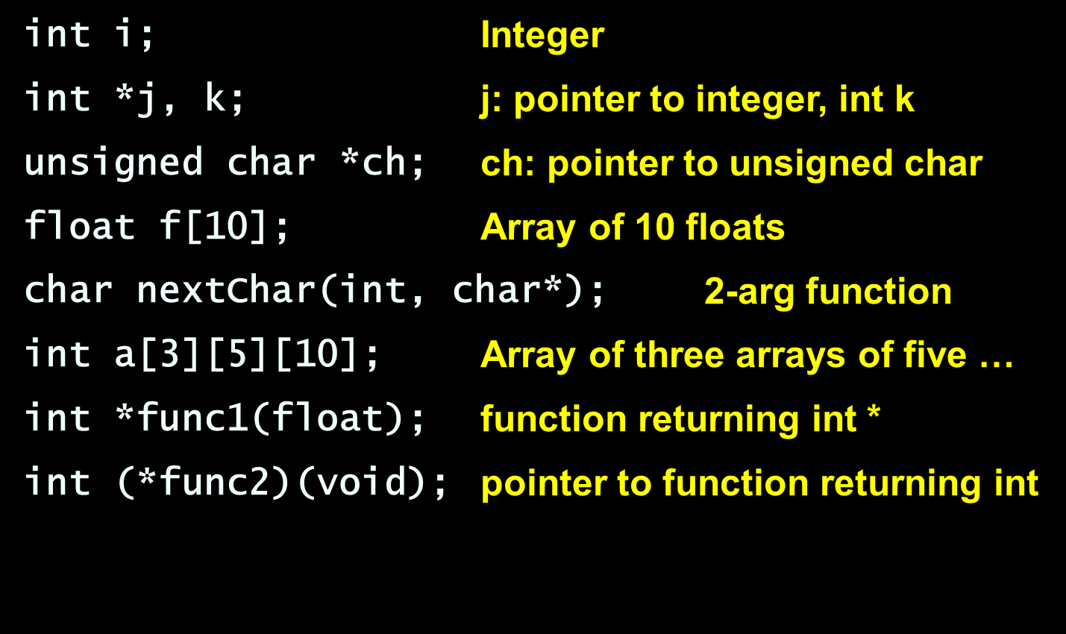
C Types
Basic types: char, int, float, and double
Meant to match the processor’s native types
  Natural translation into assembly
  Fundamentally nonportable
Examples

Slide 13
C Typedef
Type declarations recursive, complicated.
Name new types with typedef
Instead of
int (*func2)(void)
use
typedef int func2t(void);
func2t *func2;

Slide 14
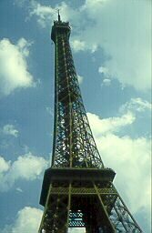
C Structures
A struct is an object with named fields:
struct {
char *name;
int x, y;
int h, w;
} box;
Accessed using “dot” notation:
box.x = 5;
box.y = 2;

Slide 15
C Storage Classes
Global. Allocated at fixed location
#include <stdlib.h>
int global_static;
void foo(int auto_param)
{
static int func_static;
int auto_i, auto_a[10];
double *auto_d = malloc(sizeof(double)*5);
}
Visible within func. Allocated at fixed location.

Slide 16
C Storage Classes
#include <stdlib.h>
int global_static;
static int file_static;
void foo(int auto_param)
{
static int func_static;
int auto_i, auto_a[10];
double *auto_d = malloc(sizeof(double)*5);
}
Space allocated on stack by caller.
Space allocated on stack by function.
Space allocated on heap by library routine.

Slide 17
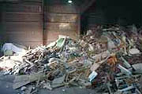
malloc() and free()
Library routines for managing the heap
int *a;
a = (int *) malloc(sizeof(int) * k);
a[5] = 3;
free(a);
Allocate and free arbitrary-sized chunks of memory in any order

Slide 18
malloc() and free()
More flexible than automatic variables (stacked)
More costly in time and space
  malloc() and free() use complicated non-constant-time algorithms
  Each block generally consumes two additional words of memory
    Pointer to next empty block
    Size of this block
Common source of errors
  Using uninitialized memory
  Using freed memory
  Not allocating enough
  Neglecting to free disused blocks (memory leaks)

Slide 19
malloc() and free()
Memory usage errors so pervasive, entire successful company (Pure Software) founded to sell tool to track them down
Purify tool inserts code that verifies each memory access
Reports accesses of uninitialized memory, unallocated memory, etc.
Publicly-available Electric Fence tool does something similar

Slide 20
Dynamic Storage Allocation
What are malloc() and free() actually doing?
Pool of memory segments:
Free
malloc(
)

Slide 21
Dynamic Storage Allocation
Rules:
  Each segment contiguous in memory (no holes)
  Segments do not move once allocated
malloc()
  Find memory area large enough for segment
  Mark that memory is allocated
free()
  Mark the segment as unallocated

Slide 22
Dynamic Storage Allocation
Three issues:
How to maintain information about free memory
The algorithm for locating a suitable block
The algorithm for freeing an allocated block

Slide 23
Simple Dynamic Storage Allocation
Three issues:
How to maintain information about free memory
  Linked list
The algorithm for locating a suitable block
  First-fit
The algorithm for freeing an allocated block
  Coalesce adjacent free blocks

Slide 24
Simple Dynamic Storage Allocation
First large-enough free block selected
Free block divided into two
Previous next pointer updated
Newly-allocated region begins with a size value
Next
Next
Size
Size
Size
Free block
Allocated block
malloc(
)

Slide 25
Simple Dynamic Storage Allocation
Appropriate position in free list identified
Newly-freed region added to adjacent free regions
free(a)

Slide 26
Dynamic Storage Allocation
Many, many variants
Other “fit” algorithms
Segregation of objects by sizes
  8-byte objects in one region, 16 in another, etc.
More intelligent list structures

Slide 27
Memory Pools
An alternative: Memory pools
Separate management policy for each pool
Stack-based pool: can only free whole pool at once
  Very cheap operation
  Good for build-once data structures (e.g., compilers)
Pool for objects of a single size
  Useful in object-oriented programs
Not part of the C standard library

Slide 28
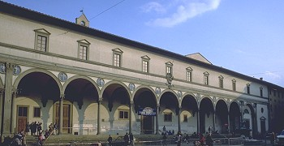
Arrays
Array: sequence of identical objects in memory
int a[10]; means space for ten integers
Filippo Brunelleschi, Ospdale degli Innocenti, Firenze, Italy, 1421
By itself, a is the address of the first integer
*a and a[0] mean the same thing
The address of a is not stored in memory: the compiler inserts code to compute it when it appears
Ritchie calls this interpretation the biggest conceptual jump from BCPL to C

Slide 29

Multidimensional Arrays
Array declarations read right-to-left
int a[10][3][2];
“an array of ten arrays of three arrays of two ints”
In memory
3
3
3
...
2
2
2
2
2
2
2
2
2
10
Seagram Building, Ludwig Mies van der Rohe,1957

Slide 30
Multidimensional Arrays
Passing a multidimensional array as an argument requires all but the first dimension
int a[10][3][2];
void examine( a[][3][2] ) { … }
Address for an access such as a[i][j][k] is
a + k + 2*(j + 3*i)

Slide 31
Multidimensional Arrays
Use arrays of pointers for variable-sized multidimensional arrays
You need to allocate space for and initialize the arrays of pointers
int ***a;
a[3][5][4] expands to *(*(*(a+3)+5)+4)
int ***a
The value
int **
int *
int

Slide 32
C Expressions
Traditional mathematical expressions
y = a*x*x + b*x + c;
Very rich set of expressions
Able to deal with arithmetic and logical manipulation

Slide 33
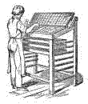
C Expression Classes
arithmetic: + – * / %
comparison: == != < <= > >=
bitwise logical: & | ^ ~
shifting: << >>
(lazy) logical: && || !
conditional: ? :
assignment: = += -=
increment/decrement: ++ --
sequencing: ,
pointer: * -> & []

Slide 34
Bitwise operators
and: & or: | xor: ^ not: ~ left shift: << right shift: >>
Useful for bit-field manipulations
#define MASK 0x040
if (a & MASK) { … } /* Check bits */
c |= MASK; /* Set bits */
c &= ~MASK; /* Clear bits */

Slide 35
Lazy Logical Operators
“Short circuit” tests save time
if ( a == 3 && b == 4 && c == 5 ) { … }
equivalent to
if (a == 3) { if (b ==4) { if (c == 5) { … } } }
Evaluation order (left before right) provides safety
if ( i <= SIZE && a[i] == 0 ) { … }

Slide 36
Conditional Operator
c = a < b ? a + 1 : b – 1;
Evaluate first expression. If true, evaluate second, otherwise evaluate third.
Puts almost statement-like behavior in expressions.

Slide 37
Side-effects in expressions
Evaluating an expression often has side-effects
a++ increment a afterwards
a = 5 changes the value of a
a = foo() function foo may have side-effects

Slide 38
Pointer Arithmetic
int *p, *q;
*(p+5) equivalent to p[5]
If p and q point into same array, p – q is number of elements between p and q.
Accessing fields of a pointed-to structure has a shorthand:
p->field means (*p).field

Slide 39
C Statements
Expression
Conditional
  if (expr) … else …
  switch (expr) {case c1: case c2: …}
Iteration
  while (expr) … zero or more iterations
  do … while (expr) at least one iteration
  for ( init ; cond ; next ) …
Jump
  goto label
  continue; go to the start of loop
  break; exit loop or switch
  return expr; return from function

Slide 40

The Switch Statement
Performs multi-way branches
switch (expr) {
case 1: …
break;
case 5:
case 6: …
break;
default: …
break;
}
tmp = expr;
if (tmp == 1) goto L1
else if (tmp == 5) goto L5
else if (tmp == 6) goto L6
else goto Default;
L1: …
goto Break;
L5:;
L6: …
goto Break;
Default: …
goto Break;
Break:

Slide 41
The Macro Preprocessor
Symbolic constants
  #define PI 3.1415926535
File inclusion for sharing of declarations
  #include “myheaders.h”

Slide 42
Summary
Array-of-bytes model of memory permeates the language
C programs built from
  Variable and type declarations
  Functions
  Statements
  Expressions

Slide 43
Summary of C types
Built from primitive types that match processor types
char, int, float, double, pointers
Struct aggregate heterogeneous objects
Arrays aggregate homogeneous objects
Three storage classes
  global, static (at fixed memory locations)
  automatic (on stack)
  heap (provided by malloc() and free() library calls)

Slide 44
Summary of C expressions
Wide variety of operators
  Arithmetic + - * /
  Logical && || (lazy)
  Bitwise & |
  Comparison < <=
  Assignment = += *=
  Increment/decrement ++ --
  Conditional ? :
Expressions may have side-effects

Slide 45
Summary of C statements
Expression (sequence)
Conditional
  if-else, switch
Iteration
  while, do-while, for(;;)
Branching
  goto, break, continue, return

Slide 46
The Main Points
Like a high-level assembly language
Array-of-cells model of memory
Very efficient code generation follows from close semantic match
Language lets you do just about everything
Very easy to make mistakes

