Slide 1
Object-based Storage : Massively scalable storage built for unstructured data
Dong In Shin
(dongin.shin@gmail.com)

Slide 2

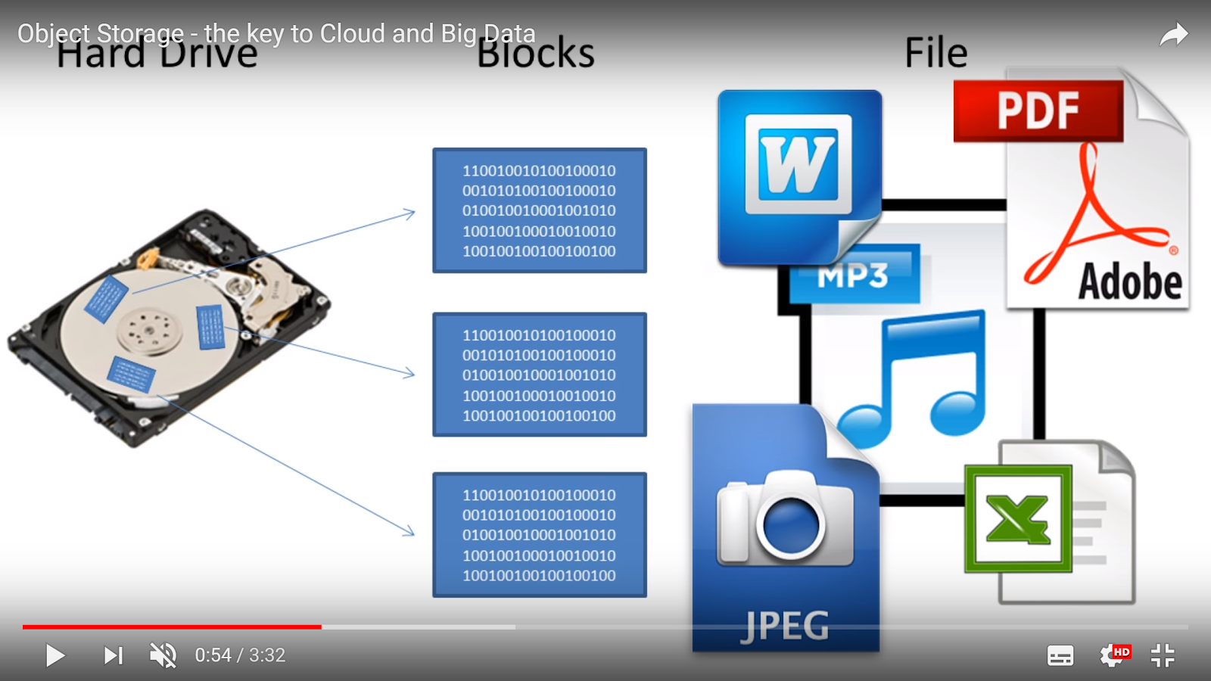

physical storage devices
(HDD, SSD)
Block storage
File storage
Blocks
Files

Slide 3
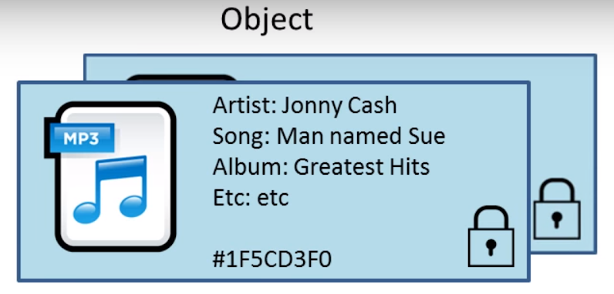
Object storage = storage represented with object
What is object?
object = data + metadata + (unique) key
? object = data with metadata (header)

Slide 4
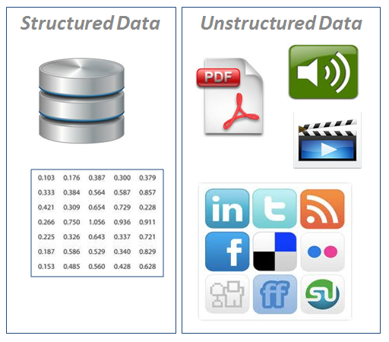

object = unstructured data
“Unstructured data (or unstructured information) is information that either does not have a pre-defined data model or is not organized in a pre-defined manner. (Wikipedia.com)
Object storage = storage represented with object = storage designed for unstructured data

Slide 5
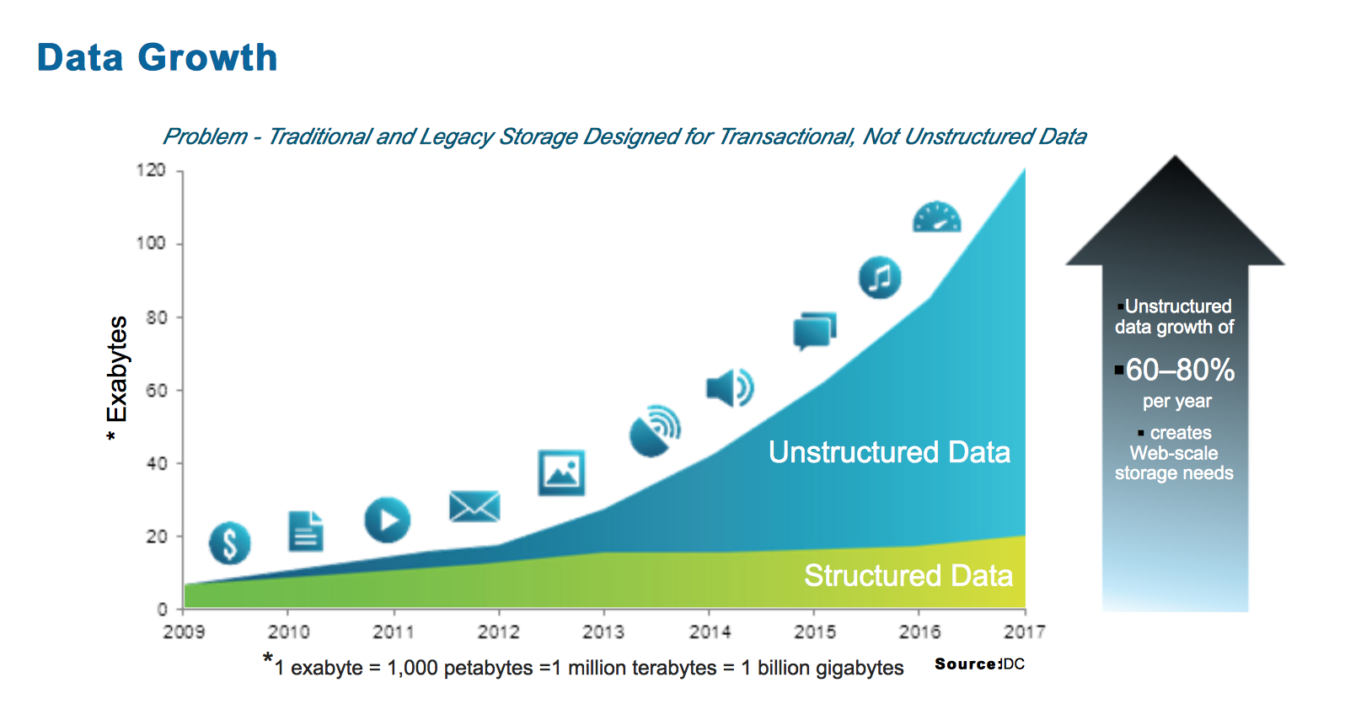

Slide 6
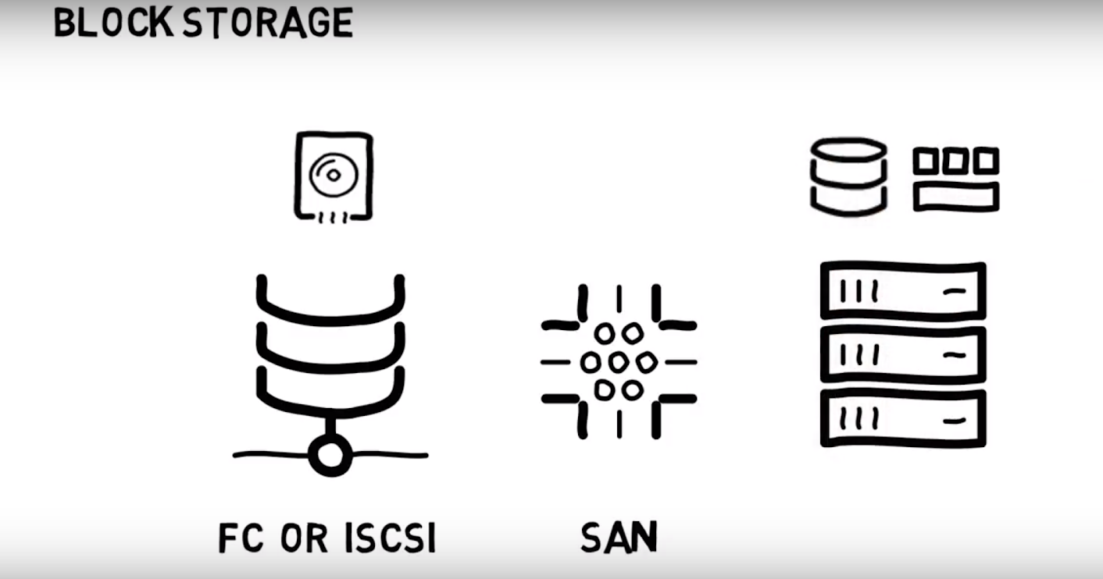
ALL FLASH
COMPLEX TO MANAGE AT SCALE (<1PB)
HARDWARE-BASED
HIGH Performance
Expensive ($$$$$)
Inflexible

Slide 7
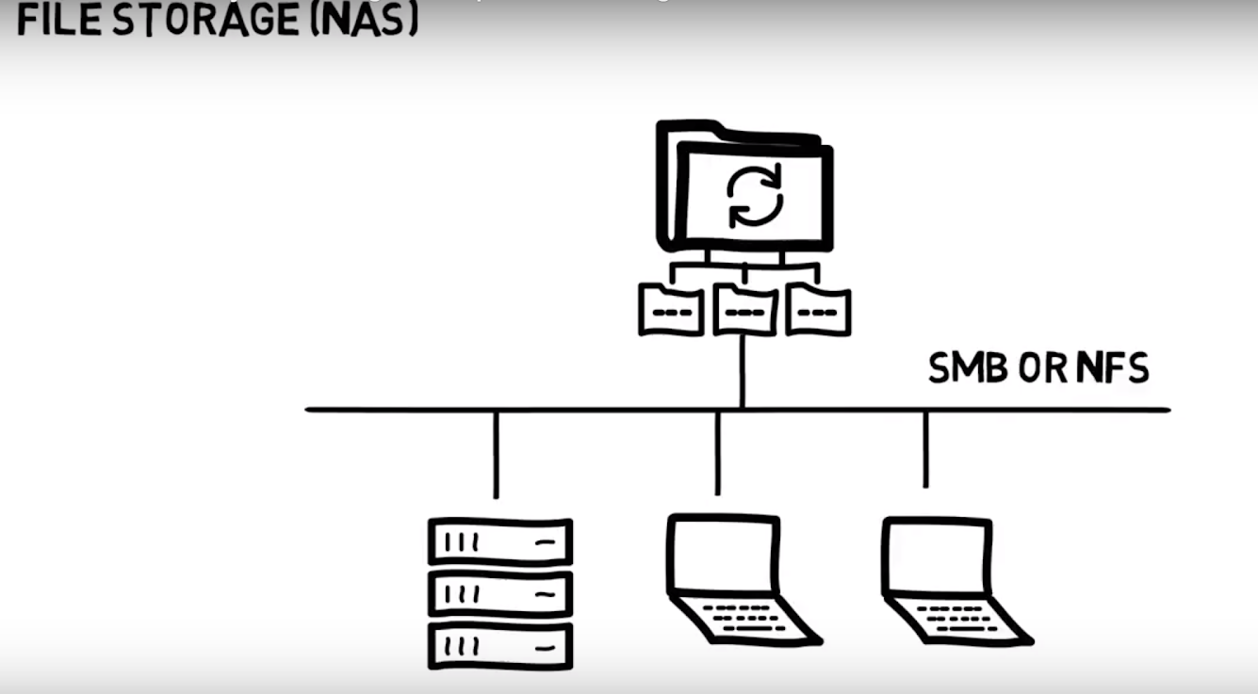
SOFTWARE-BASED
HIGH LATENCY, HIGH THROUGHPUT
LIMITED SCALE-OUT
NOT CHEAP ($$$)
FLASH + HDD
COMPLEX TO MANAGE AT SCALE

Slide 8
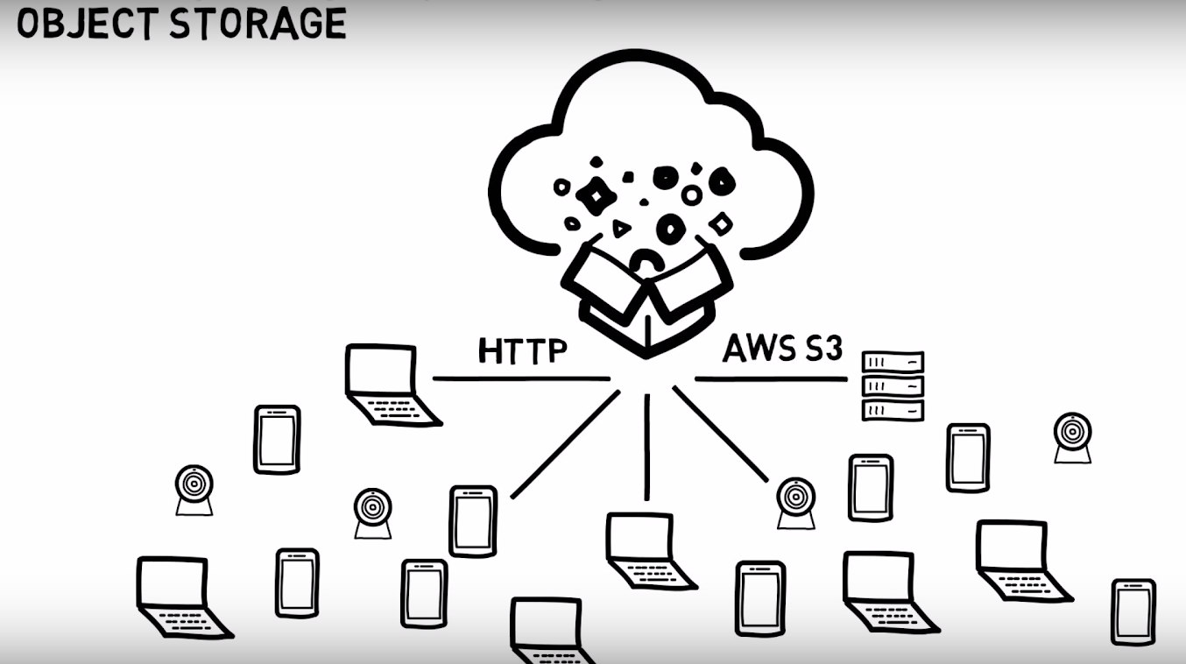
HIGH LATENCY, HIGH THROUGHPUT
CHEAP ($)
HIGHLY SCALABLE
STRONG MULTI-TENANCY

Slide 9
Theory in Object-based Storage

Slide 10
Overall Architecture
Application Layer
HTTP RESTAPI(GET, PUT, DELETE, HEAD, POST …)
Access Layer
protocol handling
data dispersion
data manipulation
computing intensive
Storage Layer
networked shared-data system
IO-intensive

Slide 11
Consistency – “All data see the same data at the same time."
PUT {“record”: “Bar”
“timestamp”: 1:01}
GET → {“record”: “Foo”}
PUT {“record”: “Foo”
“timestamp”: 1:02}

Slide 12
Availability – “Every client gets a response (success or failure), regardless of the state of any individual node in a distributed system."
PUT {“record”: “Bar”}
GET → {“record”: ???}
PUT {“record”: “Foo”}

Slide 13
Partition tolerance – “System continues to run, despite the number of messages being delayed by the network between nodes.”
PUT {“record”: “Bar”
“timestamp”: 1:01}
PUT {“record”: “Foo”
“timestamp”: 1:02}

Slide 14
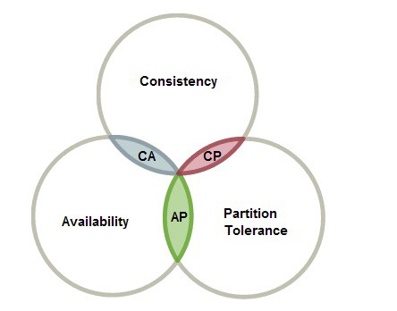
CAP theorem – “Distributed shared-data system can only have 2 of 3”
When a partition occurs, the system blocks.
Some data may not be accessible when a partition occurs, but the rest is still consistent/accurate. (read-after-write consistency)
System is available under partitioning, but some of data can be inaccurate when a partition occurs. (eventual consistency)

Slide 15
Eventual consistency – Many object storage implementations (not all) follow eventual consistency to support a massive number of concurrent requests.
Amazon S3 consistency model - provides read-after-write consistency for PUTS of new objects, eventual consistency for overwrite PUTS and DELETES.
PUT {“record”: “Bar”
“timestamp”: 1:01}
PUT {“record”: “Foo”
“timestamp”: 1:02}
PUT {“record”: “Foo”
“timestamp”: 1:02}
GET → {“record”: “Bar”}
can be temporarily
GET → {“record”: “Foo”}
eventually
send update messages
PUT {“record”: “Foo”
“timestamp”: 1:02}

Slide 16

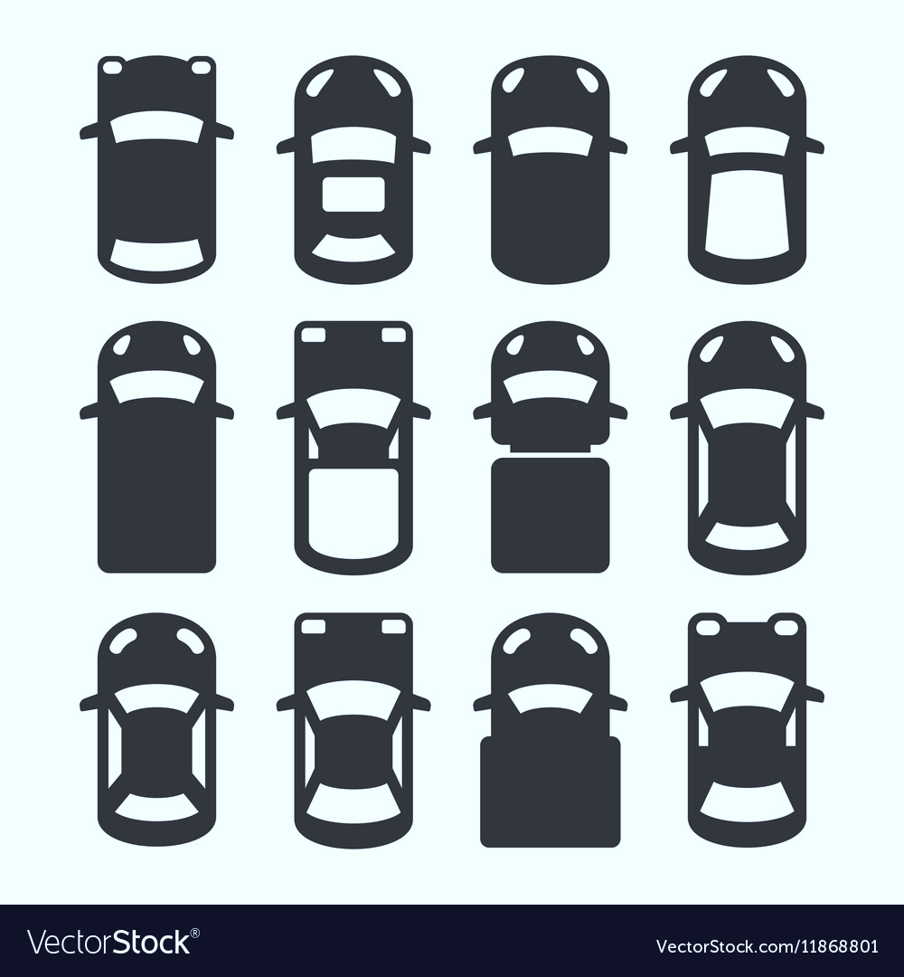
Mapping file to physical location
Parking lot design compared
park my car: A/B/C/mycar (with a congestion)
find my car: A/B/C/mycar (with a long walk)
D
➔ Limited scalable mapping in distributed filesystem.
entrance/exit
A
B
C

Slide 17
Mapping object to physical location
Parking lot design compared
My car number starts with “C”
park my car: container C/mycar (without a congestion)
find my car: Just remember your first car number!
entrance/exit
A
B
C
D

Slide 18

Design and Implementation of Open-source Object-based Storage

Slide 19
A storage URL in Swift for an object
https://swift.example.com/v1/account/container/object

Slide 20
Swift Architecture
Proxy server (access layer)
- provides the API, coordinates HTTP requests to storage servers
Account server (storage layer)
- account metadata
- store container list
Container server (storage layer)
container metadata
store object list
Object server (storage layer)
- store object data and metadata

Slide 21
A storage URL in Swift for an object
https://swift.example.com/v1/account/container/object
proxy-server address
storage location
API version

Slide 22
Swift HTTP API (HTTP verbs)
HTTP verbs | Description
GET | downloads objects (object server) lists the contents of containers or accounts (account/container server)
PUT | uploads objects (object server) creates containers, overwrites metadata headers (container server)
POST | creates containers if they don't exist, updates metadata (account or container server) overwrites metadata (object server)
DELETE | deletes objects and containers that are empty
HEAD | retrieves header information for the account, container or object

Slide 23
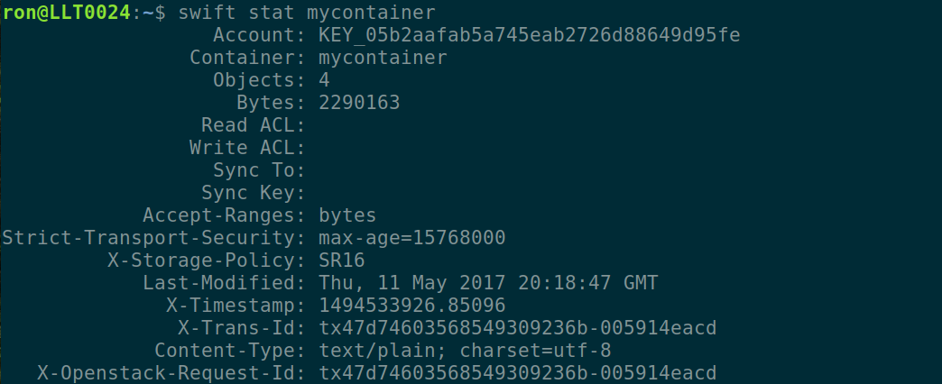
Downloading an object
curl –x GET https://swift.example.com/v1/account/container/object
Listing objects in a container
curl –x GET https://swift.example.com/v1/account/container
retrieving container information
curl –x HEAD https://swift.example.com/v1/account/container

Slide 24
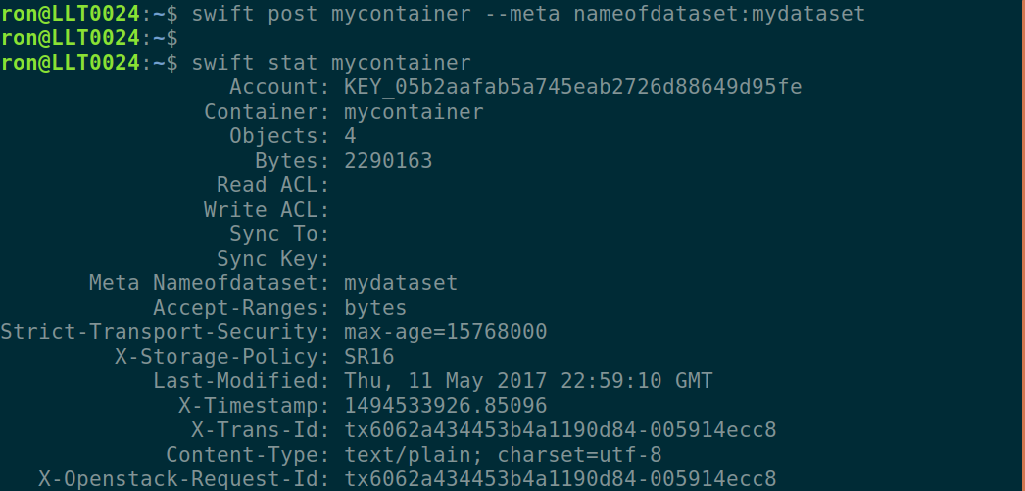
setting my own metadata for containers

Slide 25
High Availability with Replicas in Swift
Swift stores objects into multiple replicas (by default, 3 replicas)
Swift returns a success after a quorum have successfully been written (e.g., The quorum is 2 when there are 3 replicas.)
In order to ensure eventual consistency, Replicator does
Active replication : Asks other servers if they have a copy of this object.
Replicator push the missing objects into object replicas.

Slide 26
Achieve eventual consistency in Swift
Proxy server (access layer)
- send put request into nodes as a quorum.
PUT {“record”: “Bar”
“timestamp”: 1:01}
PUT {“record”: “Foo”
“timestamp”: 1:02}
quorum : 2
{“record”: “Bar”}
Object server (storage layer)
- has 3 replicas
{“record”: “Foo”}
{“record”: “Foo”}
{“record”: “Foo”}
Replicator
Replicator
Replicator
have {“record”: “Foo”, timestamp: 1:02}?
Yes, but mine is different from yours and older than you.
push {“record”:”Foo”, timestamp: 1:02}

Slide 27
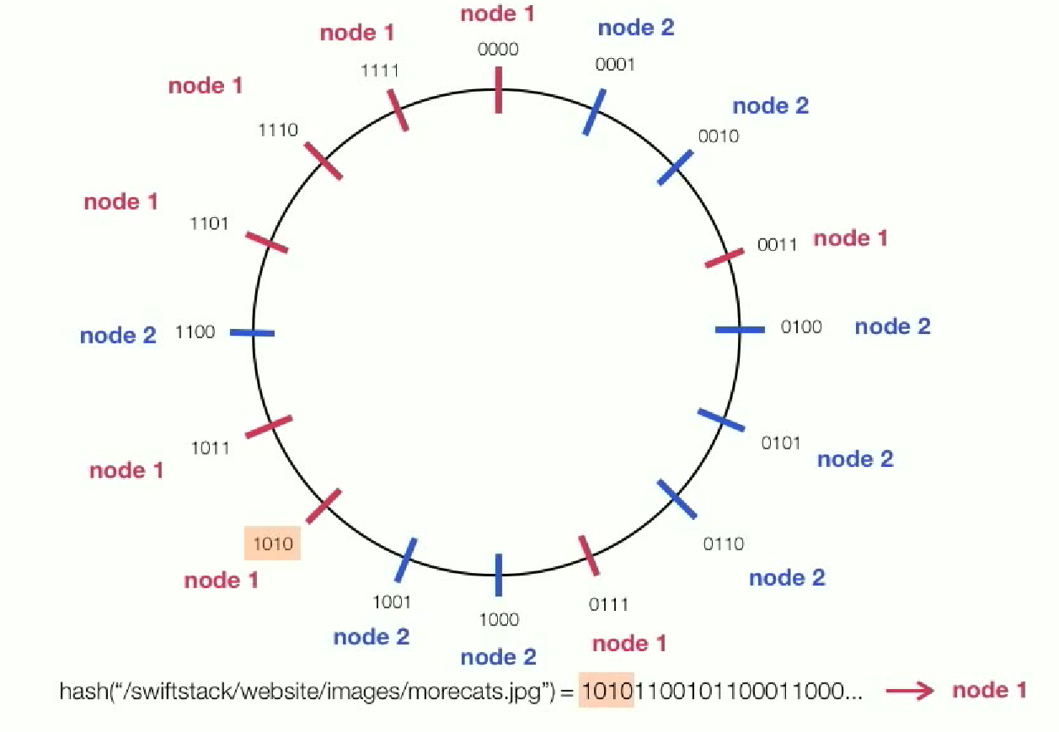
Swift RING : Mapping object to physical storage location
hash(path) = md5(path + per-cluster suffix)
= (128bits bit string)
MSB n bits : partition number
LSB (128-n) bits : object id in storage device.
Total number of partitions in a ring : 2^part_power.
part_power : Immutable once chosen as a configuration option.
bigger part_power → bigger rings → objects can be dispersed more evenly. → more memory used.
part_power = 4
# of partitions = 16

Slide 28
Create object ring with part_power=10 (# of partitions = 1024), # of replicas = 3
# swift-ring-builder object.builder create 10 3 1
Add each storage node to the ring
# swift-ring-builder object.builder add \ --region 1 --zone 1 --ip 10.0.0.51 --port 6002 --device sdb --weight 100
Device d0r1z1-10.0.0.51:6002R10.0.0.51:6002/sdb_"" with 100.0 weight got id 0
# swift-ring-builder object.builder add \ --region 1 --zone 1 --ip 10.0.0.51 --port 6002 --device sdc --weight 100
Device d1r1z2-10.0.0.51:6002R10.0.0.51:6002/sdc_"" with 100.0 weight got id 1
# swift-ring-builder object.builder add \ --region 1 --zone 2 --ip 10.0.0.52 --port 6002 --device sdb --weight 100
Device d2r1z3-10.0.0.52:6002R10.0.0.52:6002/sdb_"" with 100.0 weight got id 2
# swift-ring-builder object.builder add \ --region 1 --zone 2 --ip 10.0.0.52 --port 6002 --device sdc --weight 100
Device d3r1z4-10.0.0.52:6002R10.0.0.52:6002/sdc_"" with 100.0 weight got id 3

Slide 29
Verify the ring contents
# swift-ring-builder object.builder
object.builder, build version 4
1024 partitions, 3.000000 replicas, 1 regions, 2 zones, 4 devices, 100.00 balance, 0.00 dispersion
The minimum number of hours before a partition can be reassigned is 1
The overload factor is 0.00% (0.000000)
Devices: id region zone ip address port replication ip replication port name weight partitions balance meta
0 1 1 10.0.0.51 6002 10.0.0.51 6002 sdb 100.00 0 -100.00
1 1 1 10.0.0.51 6002 10.0.0.51 6002 sdc 100.00 0 -100.00
2 1 2 10.0.0.52 6002 10.0.0.52 6002 sdb 100.00 0 -100.00
3 1 2 10.0.0.52 6002 10.0.0.52 6002 sdc 100.00 0 -100.00
Rebalance the ring
# swift-ring-builder object.builder rebalance
Reassigned 1024 (100.00%) partitions.
Balance is now 0.00. Dispersion is now 0.00

Slide 30
Swift RING Internals
_devs : array of device dicts
{ ‘id’ : 4, ‘weight’: 3000, ‘zone’: 1, ‘ip’: ‘10.1.2.3’, ‘device’: ‘sdf’, …}
_replica2part2dev
array of arrays mapping replicas and partition to dev id
_replica2part2dev[2][7926] = device for 3rd replica of partition 7926

Slide 31
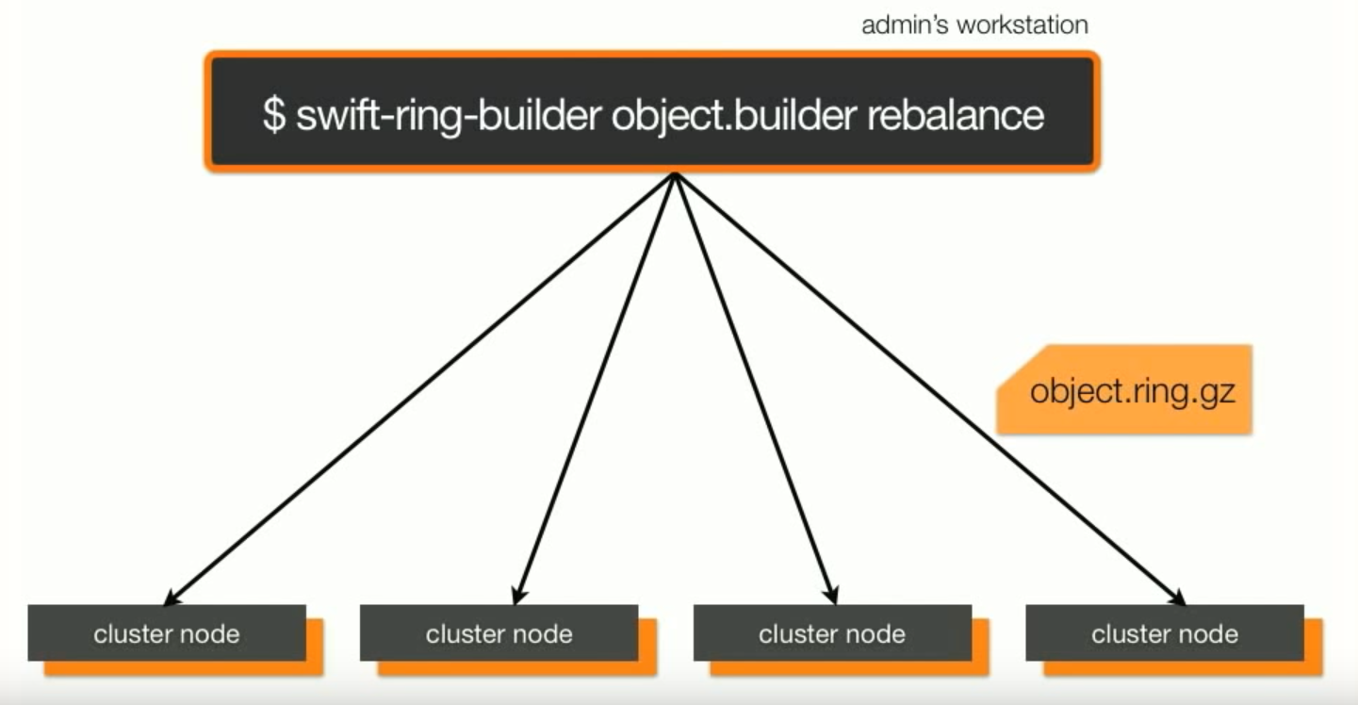
Swift RING build

Slide 32
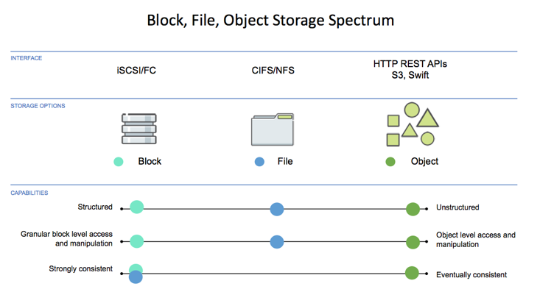

Slide 33
Theory in Object-based Storage
Eventual consistency for scalability
Remote data Replication for high availability
Flat address namespace for scalable object mapping
OpenStack Swift in Summary
choose eventual consistency for unlimited scalability.
achieve high availability from remote replication.
provide simple HTTP API
Swift Ring architecture maximizes durability and scalability by
Keep replicas far apart (different region, different zone, different device)
Expensive ring computations done offline, results distributed in a static file.

Slide 34
OpenStack Swift in Summary
choose eventual consistency for unlimited scalability.
achieve high availability from remote replication.
provide simple HTTP API
Swift Ring architecture maximizes durability and scalability by
Keep replicas far apart (different region, different zone, different device)
Expensive ring computations done offline, results distributed in a static file.

Slide 35
More Readings
Erasure coding in Swift
https://docs.openstack.org/swift/latest/overview_erasure_code.html
Swift deployment guide
https://docs.openstack.org/swift/latest/deployment_guide.html
Ceph
https://ceph.com/ceph-storage/object-storage/
RADOS gateway
Vendor solutions
Amazon S3, openio, cloudian, caringo, swiftstack, scality

