Slide 1
Bus Interconnect for HW-HW Communication (Week 10)
May 19, 2020
Sungjoo Yoo
Computing Memory Architecture Lab.
CSE, SNU
http://cmalab.snu.ac.kr

Slide 2
Weekly Schedule
W1 17 Application (deep learning on FPGA)/SW app (MNIST/CIFAR)
W2 25 Verilog 1 Basics/Vivado tutorial (verification level of HW design)
W3 31 Verilog 2 Combinational circuits (Video pre-view homework + TA Q&A)/Simple adder using dsp (V+V, Verilog intro)
W4 4/7 Verilog 3 Sequential circuits/V*V processing element (PE) design 1
W5 14 Verilog 4 Design example & synthesizable code/V*V processing element (PE) design 2
W6 21 Convolution lowering and matrix multiplication accelerator/Convolution lowering (V0)
W7 28 Intro to Zynq & MV accelerator design/Zynq FPGA & synthesis, continue VV design & start MV accelerator design
W8 5/5 (Children’s day) Optional lab session is provided in lecture and lab hour
W9 12 Main memory (physical & virtual)/OS+FPGA (HOST~DEVICE) communication & MV design 2
W10 19 Bus and DMA (Video pre-view + TA Q&A)/custom IP & MV design 3
W11 26 Advanced deep learning #1 quantization for low precision computation/V0+DMA+8b
W12 6/2 Advanced deep learning #2 zero skipping/V0+DMA+8b+zero-skipping 1
W13 9 Lecture summary/V0+DMA+8b+zero-skipping 2
W14 16 Final exam/Term project (V0+DMA+8b+zero) submission
Notes:
From this we will start to work on the baseline MV accelerator.

Slide 3
Agenda
Lecture
How can hardware components communicate with each other?
AXI bus
Introduction to the lab on Week 10

Slide 4


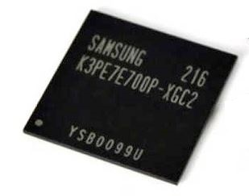
Lab in Week 10: Custom IP and MV Design
PS-DRAM
Component
Xilinx Zynq (XC7Z020)
Processing System
(PS, ARM Co-A9)
Programmable Logic
(PL, Xilinx Artix-7)
Core #1
My IP
Core #2
Memory interface
AXI master
BRAM

Slide 5
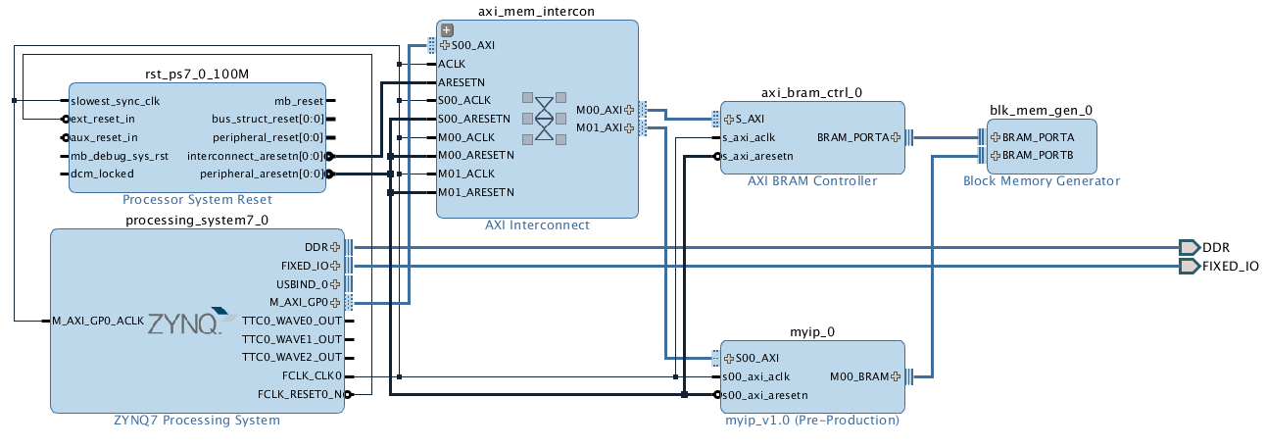
How Can HW Blocks Communicate with Each Other?
Notes:
This week, we study custom IP design and hardware-hardware communication on the bus interconnect.
As the red region shows in the figure, we have two hardware components, BRAM controller and myip, connected to the bus interconnect (axi_mem_intercon in the slide).
myip is our custom IP.

Slide 6
IP Design Overview
What is IP core or IP block?
IP = intellectual property
IP core or block = hardware component which can be reused in other designs
CPU, cache, codec, image signal processor, display/camera controller, wireless controller, …
Types – the extent of customization
Soft IP (= Verilog code)
RTL/HDL
Gate-level netlist
Hard/Firm IP (= a part of chip layout)
Post-P&R implementation
Transistor layout
IP providers for Zynq
Xilinx, Third-party, DIY, …
Notes:
We call a hardware design an intellectual property (IP) block, in short, an IP.
An IP block is designed once and reused many times.
IP plays a very important role in today’s FPGA and embedded system industry, allowing system designers to pick-and-choose from a wide array of pre-developed design blocks. This has a number of advantages in terms of development time, as well as providing guaranteed functionality without the need for extensive testing
What is IP core?
a hardware specification that can be used to configure the logic resources of an FPGA or, for other silicon devices, physically manufacture an integrated circuit
Two types of IP cores
Soft IP
Soft IP cores allow the end user to customise the IP to a certain degree. The extent of the customisation is dependent on the exact format that the IP is delivered in. The highest level of customisation is available when the soft core is provided as synthesisable RTL, i.e. the source HDL code is provided. For those familiar with software programming, this is equivalent to a computer program being provided in high-level source code, such as C/C++. The user is free to make modifications to the HDL source code before synthesising (or compiling, to continue the software comparison) it for implementation on a target device. It is worth noting that most IP vendors will offer no support or warranty for IP designs which have been modified. In order to provide protection against modification, RTL can be provided in encrypted source form. Although the source files can not be modified, the IP can still be customised through the use of parameters.
Another format which soft cores can be provided in, is as a gate-level netlist. This means that the IP vendor has partially synthesised the individual IP component and will provide you with a logic gate implementation of the IP’s functionality. This, although still customisable, makes any changes to the functionality of the IP harder to implement. As such, IP delivered as a netlist provides the IP vendor with a certain degree of protection from revealing the underlying algorithms and processes. This is somewhat analogous to a software developer compiling the C source code and providing an assembly code listing; the code is still modifiable, but it must be done at a lower level
Hard IP, Firm IP
Hard IP cores, on the other hand, are provided in formats that permit no realistic method of modification by the end user, and in some cases the functionality of the IP is realised in the silicon of a device at manufacture
One method of delivery for hard IP which is targeted at FPGA/ASIC implementation, is to provide a design which has already undergone full synthesis and place and route design flows. This is also sometimes referred to as firm IP. As the IP has already undergone the place and route stage of the design flow, each individual IP must be targeted at a specific end devices, or family of devices, and cannot be easily ported to another device. There is also the disadvantage that a specific area of the device must be used for the IP implementation. Although this has the disadvantage that the functionality of the IP cannot be customised in any way, it also brings with it the advantage that there is a high level of predictability in terms of timing performance and required hardware area
Another method of delivery for the implementation of hard IP in silicon is to provide a transistor-layout. This is a format which is only compatible with the process design rules of a specific foundry, and therefore hard IP delivered for use in one foundry cannot be used in another without undergoing a difficult porting process. Some larger foundry operators even go as far as to provide hard IP cores which specifically target their own foundry process design rules in order to ensure that customers must use their services. This form of hard IP delivery is not applicable to FPGAs
IP Providers for Zynq
Xilinx provides an extensive catalogue of soft IP cores for the Zynq-7000 AP family which are optimised to provide efficiency in terms of both performance and hardware area. Functionality ranges from building blocks, such as FIFOs and arithmetic operators, all the way up to fully functional processor blocks, such as the MicroBlaze processor core
Third-party IP is also available, both commercially and from the open-source community. Third-party IP comes in two forms: vendor-specific and generic. Vendor-specific IP should require little-to-no modification to integrate with your chosen Zynq device. Generic IP, however, may require modifications in order to make them conform with certain HDL naming conventions.
The final option for obtaining IP for your design is to create it yourself. The traditional method of IP generation is for it to be developed in HDLs, such as VHDL or Verilog. More recently, other methods of IP creation have been introduced to the Xilinx tool suite, such as System Generator model-based design or Vivado HLS. Other third-party tools also exist

Slide 7
MV Accelerator (myip)
Notes:
Let’s see our IP, myip.

Slide 8
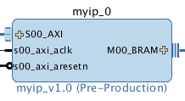
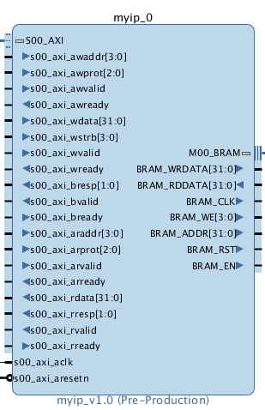
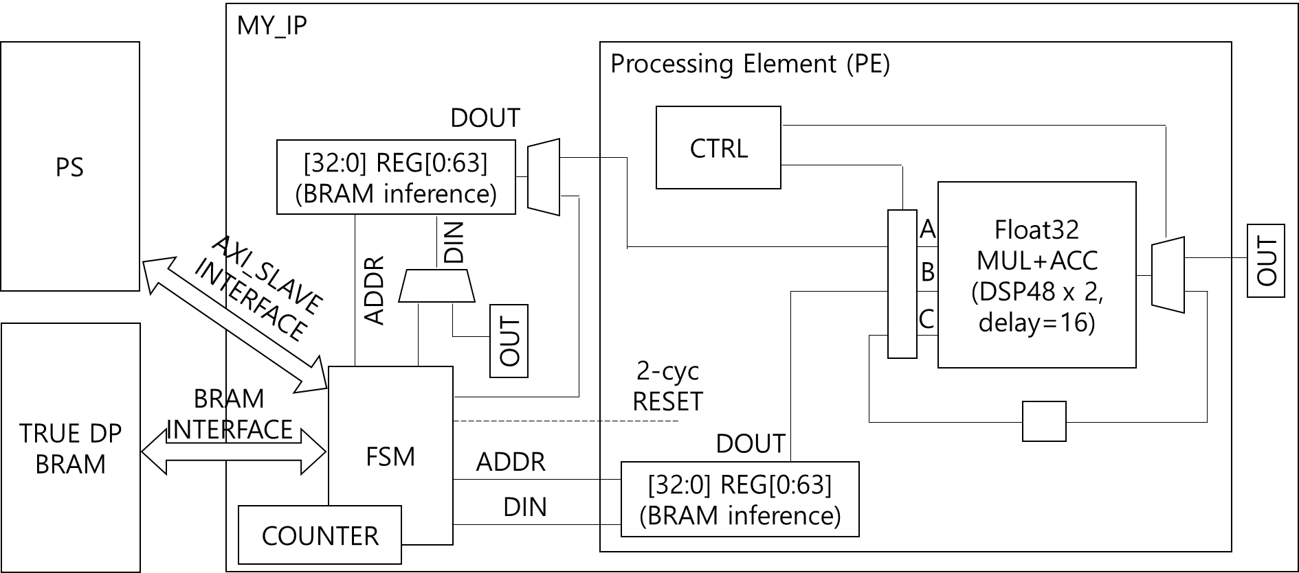
Interface of My IP
MY_IP
1x AXI-Lite Interface
1x BRAM Interface
Nx Processing Elements (N=64 in our lab)
Notes:
Myip has interface on both left and right-hand sides.
On the left-hand side, it has AXI-Lite interface and, on the right-hand side, an interface to BRAM.
In the slides, the AXI-Lite interface is highlighted.

Slide 9
Slave Interface for SW to HW Data Transfer, i.e., Store Instruction
always @( posedge S_AXI_ACLK )
if ( S_AXI_ARESETN == 1'b0 )
axi_awready <= 1'b0;
else
if (~axi_awready && S_AXI_AWVALID && S_AXI_WVALID)
axi_awready <= 1'b1;
else
axi_awready <= 1'b0;
Write Address Channel
Notes:
As you can see on the right, the AXI-Lite interface has a set of input/output (I/O) signals called write address channel.
On the left, you can see Verilog code of myip related with this write address channel.
In the following slides, we will have a brief overview of AXI-Lite interface and related Verilog code.
You don’t have to worry about the Verilog code because you will soon understand it after we will study the basics of AXI protocol.

Slide 10
Slave Interface for SW to HW Data Transfer, i.e., Store Instruction
always @( posedge S_AXI_ACLK )
if ( S_AXI_ARESETN == 1'b0 )
axi_wready <= 1'b0;
else
if (~axi_wready && S_AXI_AWVALID && S_AXI_WVALID)
axi_wready <= 1'b1;
else
axi_wready <= 1'b0;
Write Data Channel
Notes:
We have another set of I/O signals called write data channel on the right and the related Verilog code on the left.

Slide 11
My IP Receives the Data when Valid & Ready are ‘1’
always @( posedge S_AXI_ACLK )
if ( S_AXI_ARESETN == 1'b0 || run_complete)
slv_reg0 <= 0;
else
if (axi_wready && S_AXI_WVALID
&& axi_awready && S_AXI_AWVALID)
slv_reg0 <= S_AXI_WDATA;
Write Data Channel
Notes:
This Verilog code is also related with write data channel.
Let me mention again that you don’t have to worry about the Verilog code for the moment.
We will come back to this slide after studying the basics of AXI bus.
Then, you can easily understand the meaning of the Verilog code.

Slide 12
My IP Gives a Response for the Write Request
always @( posedge S_AXI_ACLK )
if ( S_AXI_ARESETN == 1'b0)
axi_bvalid <= 0;
else
if (~axi_bvalid
&& axi_wready && S_AXI_WVALID
&& axi_awready && S_AXI_AWVALID)
axi_bvalid <=1’b1;
else if (S_AXI_BREADY && axi_bvalid)
axi_bvalid <=1’b0;
Write Response Channel
Notes:
We have another set of I/O signals called write response channel and its related Verilog code.

Slide 13
My IP Receives a Read Request
always @( posedge S_AXI_ACLK )
if ( S_AXI_ARESETN == 1'b0 )
axi_arready <= 1'b0;
else
if (~axi_arready && S_AXI_ARVALID)
axi_arready <= 1'b1;
else
axi_arready <= 1'b0;
Read Address Channel
Notes:
We also have read address channel and

Slide 14
My IP Gives the Required Data
always @( posedge S_AXI_ACLK )
if ( S_AXI_ARESETN == 1'b0 )
axi_rvalid <= 1'b0;
else
if (~axi_rvalid axi_arready && S_AXI_ARVALID)
axi_rvalid <= 1'b1;
else if (axi_rvalid && S_AXI_RREADY)
axi_rvalid <= 1'b0;
always @( * )
axi_rdata <= slv_reg0;
Read Data Channel
Notes:
read data channel.

Slide 15
Agenda
Lecture
How can hardware components communicate with each other?
AXI bus
Introduction to the lab on Week 10

Slide 16
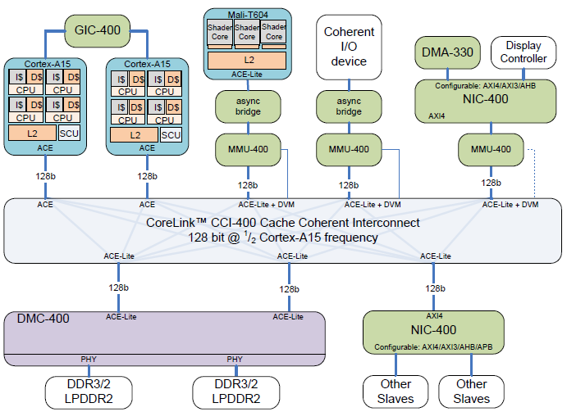
On-Chip Bus or Interconnect
[Stevens, 2011]
Hardware components are connected to this for communication
Notes:
This slides shows a simplified architecture of mobile application processor (AP) chip. It consists of CPUs (Cortex-A15’s in this case), mobile GPU (Mali-T604), and hardware components, e.g., DDR3/2 controller, display controller, etc. They are connected to the bus interconnect (in the dashed box). Note that the bus interconnect is also a hardware block. All the hardware components communicate with each other via the bus interconnect. They use a communication protocol called ARM AMBA3 AXI, in short, AXI.

Slide 17
AMBA3 AXI Protocol
[Source: AXI Spec]
Advanced eXtensable Interface (AXI)
Variable-length bursts
From 1 to 16 data transfers (called beats) per burst
Bursts with a transfer size of 8-1024 bits
Wrapping, incrementing, and non-incrementing bursts
Atomic operations (exclusive or locked accesses)
System-level caching and buffering control
Secure and privileged access
Five channels
Read: Address read (AR) and read (R) data channels
Write: Address write (AW), write (W) data, and response (R) channels
Notes:
This slides shows the functions of AXI protocol.
In the following slides, we will study the key functions.

Slide 18
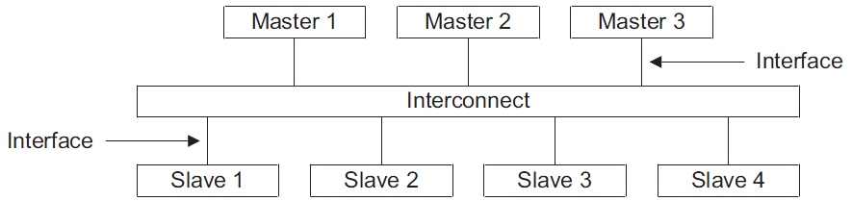
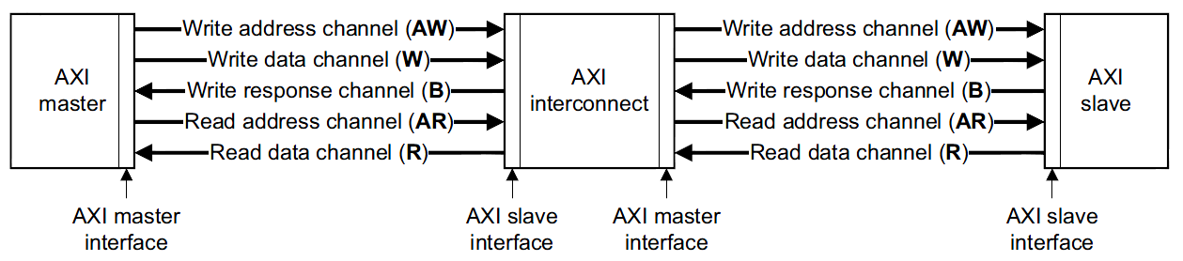
Interconnect, Interface & Channel
[Source: AXI Spec]
CPU with L2 cache
Memory controller
for DRAM
Memory controller
for DRAM
CPU with L2 cache
Notes:
On the top of this slide, a hardware block (Master 1, e.g., CPU) is connected to the bus interconnect.
The bus interconnect is also connected to a hardware block (Slave 1, e.g., memory controller for main memory).
We call a hardware block which issues a bus request, i.e., read or write request, a master block.
We call a hardware block which serves the request, a slave block, e.g., memory controller which serves the read/write request of CPU.
At the bottom of the slide, we can see how Master 1 (AXI master in the slide) is connected to the interconnect.
There are five channels that we already saw in the precious slides.
Note that the interface of the master block is called master interface as shown in the slide.
The interface of interconnect connected to the master block is called slave interface.
On the bottom right, we can see the connection between the interconnect and Slave 1 (memory controller).
The interface of slave block is called slave interface as shown in the figure.
The interface of bus interconnect connected to the slave interface of slave block is called master interface.
The master interface of bus interconnect actually performs communication on behalf of the master block
by forwarding the request coming from the master block to the slave block and
forward the associated response (or data) coming from the slave block to the master block.

Slide 19
Split Transaction
Address, data, and response are handled separately.
AXI
Master
Write Address/Control
AXI
Slave
AWREADY
Write data
WREADY
Response
BREADY
Read Address/Control
ARREADY
Read data
RREADY
Notes:
In order to realize multiple outstanding requests, we utilize five channels in AXI bus.
As shown in the slides, there are five channels between the master and slave blocks.
We have three write-related and two read-related channels.

Slide 20
Split Transaction: Write (1/3)
Master issues address
AXI
Master
Write Address/Control
AXI
Slave
AWREADY
Write data
WREADY
Response
BREADY
Read Address/Control
ARREADY
Read data
RREADY
Notes:
In case of write request, the master block first sends a write request on the write address channel.

Slide 21
Split Transaction: Write (2/3)
AXI
Master
Master gives data
AXI
Slave
Write Address/Control
AWREADY
Write data
WREADY
Response
BREADY
Read Address/Control
ARREADY
Read data
RREADY
Notes:
The master block sends the write data (associated with the write request in the previous slide) over the write data channel.

Slide 22
Split Transaction: Write (3/3)
AXI
Master
Write Address/Control
AXI
Slave
AWREADY
Slave acknowledges
Write data
WREADY
Response
BREADY
Read Address/Control
ARREADY
Read data
RREADY
Notes:
The slave block receives both write request and data. Then, it sends to the master block a response over the write response channel to acknowledge the completion of write operation or an error message.

Slide 23
Split Transaction: Read (1/2)
AXI
Master
Write Address/Control
AXI
Slave
AWREADY
Write data
WREADY
Response
Master issues address
BREADY
Read Address/Control
ARREADY
Read data
RREADY
Notes:
The master block can send a read request over the read address channel.

Slide 24
Split Transaction: Read (2/2)
AXI
Master
Write Address/Control
AXI
Slave
AWREADY
Write data
WREADY
Response
BREADY
Slave returns data
Read Address/Control
ARREADY
Read data
RREADY
Notes:
The slave block, e.g., memory controller, gives the desired data to the master block over the read data channel.
Please note that the five channels run (almost) independently and the events on the five channels can occur at the same cycle.
For instance, at cycle t, the master block can send a write request to address 0x100 over write address channel, write data bound for 0x100 at write data channel and receive a write response (of one of the previous write request) via write response channel.
At the same cycle, the master block can send a read request to address 0x200 on read address channel while receiving data (of the previous read request) via read data channel.
Five channels split write and read operations into request, data and response and let the split operations run in parallel.
Thus, we call such a write/read operation split transation.

Slide 25
Wire Counts
Address 32b, data 32b bus case: 184~204
AW: 52~56, W: 39~43, B: 4~8, AR: 52~56, R: 37~41
AXI
Master
Write Address/Control
AXI
Slave
52~56
AWID[3:0] write addr ID (0~4 bits)
AWADDR[31:0] write addr ID
AWLEN[3:0] burst length
AWSIZE[2:0] burst size
AWBURST[1:0] burst type
Payload
AWLOCK[1:0] lock info
AWCACHE[3:0] cache type
AWPROT[2:0] protection type
AWVALID write address valid
Handshake
signals
AWREADY write address ready
Write data
39~43
WID[3:0] write ID tag, AWID = WID (0~4 bits)
WDATA[31:0] write data
WSTRB[3:0] write strobes
WLAST write last
WVALID write valid
WREADY write ready
Notes:
Multiple channels enable parallel transfers of request, data and response at a cost of more wire usage.
This slide shows I/O signals of write address and write data channels.
For instance, in this example, we use 32-bit address and 32-bit data.
As the slide shows, the write address channel consists of 52~56 I/O signals.
They include 32-bit address, AWADDR, and other information, e.g., burst length, related with the write request.
Please note that two handshake signals, Valid and Ready play a key role in transferring information from master to slave side.
Simply speaking, the write request is transferred from master to slave side at the clock rising edge
only when both Valid and Ready signals are ‘1’.
This is the key contents we need to remember when we re-view the Verilog code of the previous slides.
I will elaborate on this in the following slides.

Slide 26

On-Chip Bus for Multiple-Byte Data Transfer
On-chip bus ~ Road with multiple lanes
1 lane
1 lane
1 lane
1 lane
1 lane
1 lane
1 lane
1 lane

Slide 27

On-Chip Bus for Multiple-Byte Data Transfer
A byte on the bus ~ a car on the road
1 lane
1 lane
1 lane
1 lane
1 lane
1 lane
1 lane
1 lane

Slide 28
On-Chip Bus for Multiple-Byte Data Transfer
Four 8-byte data are transferred
1 byte
MSB
1 byte
1 byte
1 byte
1 byte
1 byte
1 byte
1 byte
LSB
1 byte

Slide 29
Burst and Data Bus: Size and Length
ARSIZE= b011 (8 bytes), ARLEN=b0011 (4 data)
MSB
1 byte
1 byte
1 byte
1 byte
1 byte
1 byte
1 byte
LSB
1 byte

Slide 30
Burst and Data Bus: Size and Length
ARSIZE= b011 (8 bytes), ARLEN=b0011 (4 data)
LENgth = 4
MSB
1 byte
1 byte
1 byte
SIZE = 8
1 byte
1 byte
1 byte
1 byte
LSB
1 byte

Slide 31
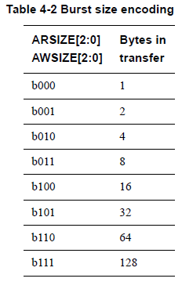
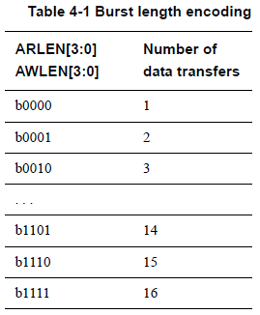
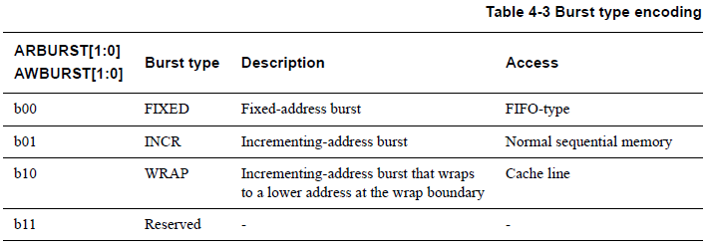
Burst Length, Size and Type

Slide 32
Burst and Data Bus: Size and Length
ARSIZE= b011 (8 bytes), ARLEN=b0001 (2 data)
LENgth = 2
MSB
1 byte
1 byte
1 byte
SIZE = 8
1 byte
1 byte
1 byte
1 byte
LSB
1 byte

Slide 33
Burst and Data Bus: Size and Length
ARSIZE= b010 (4 bytes), ARLEN=b0000 (1 data)
MSB
1 byte
1 byte
1 byte
LENgth = 1
1 byte
1 byte
1 byte
SIZE = 4
1 byte
LSB
1 byte

Slide 34
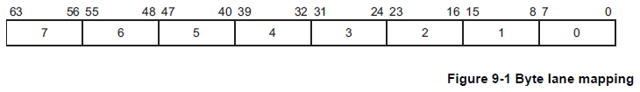
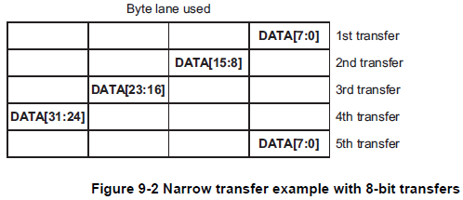
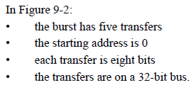
Data Bus
Write strobe
Narrow transfer
Incrementing burst case

Slide 35
Burst and Data Bus: Size and Length
ARSIZE= b010 (4 bytes), ARLEN=b0001 (2 data)
LENgth = 2
MSB
1 byte
1 byte
1 byte
1 byte
1 byte
1 byte
SIZE = 4
1 byte
LSB
1 byte

Slide 36
Burst and Data Bus: Size and Length
ARSIZE= b010 (4 bytes), ARLEN=b0010 (3 data)
LENgth = 3
MSB
1 byte
1 byte
1 byte
1 byte
1 byte
1 byte
SIZE = 4
1 byte
LSB
1 byte

Slide 37
Narrow Transfer
ARSIZE= b000 (1 byte), ARLEN=b0001 (2 data)
MSB
1 byte
1 byte
1 byte
1 byte
1 byte
1 byte
LENgth = 2
1 byte
SIZE = 1
LSB
1 byte

Slide 38
Narrow Transfer
ARSIZE= b000 (1 byte), ARLEN=b0011 (4 data)
MSB
1 byte
1 byte
1 byte
LENgth = 4
1 byte
1 byte
1 byte
1 byte
SIZE = 1
LSB
1 byte

Slide 39
Wide Transfer
ARSIZE= b011 (8 bytes), ARLEN=b0011 (4 data)
MSB
1 byte
1 byte
1 byte
1 byte
1 byte
1 byte
1 byte
LSB
1 byte

Slide 40
Wide vs. Narrow Transfer
ARSIZE= b011 (8 bytes) vs. b000 (1 byte)
ARLEN= b011 (4 data)
MSB
1 byte
1 byte
1 byte
1 byte
1 byte
1 byte
1 byte
LSB
1 byte

Slide 41
Aligned Transfer
AW=000, ARSIZE= b010 (8 bytes), ARLEN=b0011 (4 data)
MSB
1 byte
7
1 byte
6
1 byte
5
1 byte
4
1 byte
3
1 byte
2
1 byte
1
9
LSB
1 byte
0
8
16
24

Slide 42
Unaligned Transfer
AW=001, ARSIZE= b010 (8 bytes), ARLEN=b0011 (4 data)
MSB
1 byte
7
1 byte
6
1 byte
5
1 byte
4
1 byte
3
1 byte
2
1 byte
1
9
LSB
1 byte
8
16
24

Slide 43
Line Fill Buffer in Cache
Line fill buffer is used to store in-transit cache line(s)
Only when the next cache miss occurs, the contents of line fill buffer is copied to its location in the cache
Tag
Index
Block
Offset
On the next cache miss, e.g., 0x200
Cache miss on 0x100!
t
k
b
V
Tag
Data Block
Line fill buffer
2^{k}
lines
t
=
HIT
Data Word or Byte
Read the cache line (e.g., 64B)
at 0x100 from L2 cache or DRAM

Slide 44
Stop-and-Wait
Request and Acknowledge
Sender
Receiver
Req + Data
Clock 0
Clock 1
Ack
Req + Data
Clock 2
Clock 3
Ack
Req + Data
Clock 4
Clock 5
Ack
Req + Data
Clock 6
Clock 7
Ack
Time
Notes:
In the current and next slides, I will explain how communication occurs on each channel of AXI bus utilizing Valid and Ready signals.
Let’s assume that we have two sides of communication, sender and receiver.
They utilize control signals Request (corresponding to Valid in AXI bus) and Acknowledge (Ready in AXI bus) for communication.
For instance, as shown in the slide, when the sender tries to send a data, it places the data on the data bus and raises Request (Req) signal to ‘1’ at clock cycle 0.
At cycle 1, the receiver takes the information and set its Acknowledge (Ack) signal to ‘1’.
At cycle 2, the sender knows that the previous request and data were successfully received by the receiver and tries to send the next data by placing the data on the data bus and raising Ack ‘1’.
The communication continues in this way.
This scenario has a problem in communication performance, i.e, bandwidth (=# transfered data/cycles).
It allows for one data transfer every two clock cycles.
AXI bus protocol tries to resolve this problem and aims to achieve one data transfer every cycle.

Slide 45
Single Credit-based Flow Control
e.g., AMBA3 protocol. Ack = Credit
Sender
Receiver
Sender
Receiver
Req + Data
Req + Data
Ack
Ack
Req + Data
Ack
Req + Data
Req + Data
Ack
Ack
Req + Data
Ack
Req + Data
Ack
Req + Data
Ack
Notes:
On the left-hand side of this slide, we can see the communication scenario of the previous slide.
On the right-hand side, you can see how AXI bus enables one data transfer per cycle.
The key difference is that ‘Acknowledge’ signal (=Ready in AXI) is used as a credit.
If Ready is ‘1’, the sender (master) can send its request or data and, most importantly, the receive guarantees that the request or data is successfully received at the same cycle.
When the master raises Valid signal to ‘1’, if the Ready signal is already ‘1’, then the sender knows that the current request or data will be successfully received by the slave at the current cycle.
Thus, the master can send the next request or data in the next cycle, which enables one data (or request) transfer per cycle as shown on the right-hand side of this slide.
Recall that when both Valid and Ready are ‘1’ at the clock rising edge, the communication from master to slave happens.

Slide 46
CPU, Cache, and Main Memory
In case of cache miss
Cache
Main memory
SRAM
DRAM
Bus
Mem
Ctrl
CPU
load r1, 0x100
Request
15ns
ACT
15ns
RD
Data
8ns @ 500MHz DDR, BL16
Cache miss penalty = 40~50ns
Notes:
The AXI bus is one example of modern buses which support multiple outstanding requests.
From now on, I will first explain what multiple outstanding requests mean and then try to explain how five channels (write address/data/response and read address/data) realize multiple outstanding requests.
First, let’s take a look at the current slide which shows a typical memory sub-system.
When there is a cache miss on the cache, a read request is sent to the main memory via bus and memory controller.
The main memory gives the desired data to the CPU via memory controller and bus.
Typically, a cache miss takes at least 40~50 nano-seconds, which amounts to upto 200 cylces of 4GHz CPU.
Such a long latency of cache miss, called cache miss penalty, can significantly degrade the performance of our program.
Thus, it is crucial to reduce the cache miss penalty.

Slide 47
Non-blocking Caches to Reduce Stalls on Misses
[Source: J. Kubiatowicz, 2000]
MSHR (miss state handling register) allows for “hit under miss” which reduces the effective miss penalty by working during miss
Read 0x200
Read 0x100
Miss request to memory or L2/3
CPU
Cache
w/ MSHR
Send the data at 0x100
During 100 cycles
Read hit!
Send the data at 0x200
Notes:
Fortunately, the modern cache has two important solutions to resolve the performance degradation problem due to long cache miss penalty. The first solutions is a non-blocking cache.
I hope you will see this slide in animation mode.
(In animation mode)
CPU tries to read, from cache, data at address 0x100 and a cache miss occurs.
The cache sends a read request to main memory (or a larger cache).
The modern CPU can execute multiple instructions in a single cycle, in short, multi-threaded.
Thus, the CPU can continue to execute other instructions while waiting for the data of cache miss.
The CPU tries to read data at address 0x200 and there is a cache hit.
In such a case, the cache provides the CPU with the data at 0x200
even though the previous read request on 0x100 has not yet been completed.
Simply speaking, the cache does not block the service of next request even though the previous one incurred a cache miss.
We call such a cache non-blocking cache and such a hit “hit under miss”.

Slide 48
Non-blocking Cache Issues Multiple Outstanding Requests to Reduce Average Miss Penalty
[Source: J. Kubiatowicz, 2000]
“hit under multiple miss” or “miss under miss” may further lower the effective miss penalty by overlapping multiple misses
Penalties of multiple misses are
overlapped!!!
CPU
Cache
w/ MSHR
Effective miss penalty becomes
much less than 400 cycles
Notes:
The non-blocking cache can serve multiple cache misses as this slides shows.
The benefit of serving multiple cache misses is to reduce the average cache miss penalty (=total cache miss penalty of four cache misses/4 in this example).
The non-blocking cache can also serve cache hits even while serving multiple cache misses (hit under multiple misses).
In short, the modern cache can issue multiple requests to the memory (or the larger caches)
even though the previous requests have not yet been completed.
We call such multiple requests “multiple outstanding requests”.
The cache is one example of hardware block which generates multiple outstanding requests.
Other hardware blocks, e.g., video codec, neural processing unit, etc. can generate multiple outstanding requests to reduce average memory access latency by overlapping the service of multiple requests.

Slide 49
One Address for Burst
ADDRESS
A11
A21
A31
DATA
D11
D12
D13
D14
D21
D22
D23
D31
Separation of address and data channel
Master provides the start address of burst
Slave needs to generate the remaining addresses based on burst type (FIXED, INCR, WRAP)
Notes:
In a few slides from now on, I will try to explain how multiple outstanding requests are handled.
First, a request can be a read or write request.
A read or write request can cover the transfer of multiple data items which is called burst.
For instance, the cache sends a read request of its cache block of 64 bytes.
In this case, we need a single read request which represents the data transfer of 64 bytes.
The read request often contains the start address of 64 bytes.
Thus, as shown in the slide, the master sends a single request on the address channel, e.g., A11 in the slide.
Multiple data belonging to the same burst can be transferred over data channel as shown in the slide.
Note: one request (containing an address) represents a burst of data transfer.

Slide 50
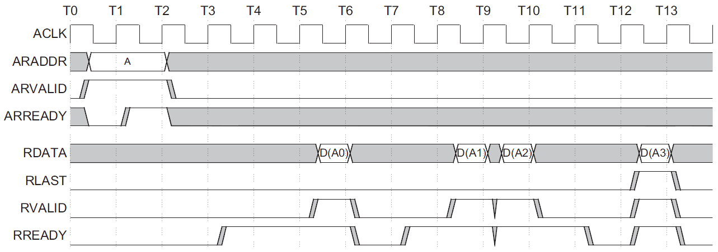
Read Burst Operation
Read request
is initiated
Data read
is ready
1st data
is transferred
The last data
is transferred
Read request
is accepted
Note: data transfer only when valid = ready = 1
Notes:
This slide exemplifies a read operation where two channels, read address channel and read data channel are involved.
There are two groups of signals.
The signals of read address channel have prefix ‘AR’ while those of read data channel have ‘R’ as the prefix.
At time T1, the master places an address on the address signal, ARADDR while raising Valid (ARVALID) to ‘1’.
However, Ready (ARREADY) is not ‘1’. Thus, there is no communication at this cycle.
At time T2, ARREADY (raised by slave) becomes ‘1’. Thus, the read request (issued at T1) is now accepted by the slave.
The slave will run to serve the read request, which takes some clock cycles.
At time T4, the master raises its Ready (RREADY) signal to ‘1’, which means the master is ready to receive the data (belonging to the read request).
However, at T4, the slave is not ready to send the read data.
At time T6, the slave raises its Valid (RVALID) signal to ‘1’ and places the first data of the burst, D(A0), i.e., the data at address A0, on the data I/O signal (RDATA).
Since both RVALID and READY are ‘1’, this data is successfully received by the master.
Note that, in case of read operation, the master receives the read data while the slave sends it to the master on read data channel.
At times T9 and T10, the second and third data are transferred, respectively.
At time T13, the last data of the read burst is transferred.

Slide 51
Non-blocking Caches to Reduce Stalls on Misses
[Source: J. Kubiatowicz, 2000]
“hit under multiple miss” or “miss under miss” may further lower the effective miss penalty by overlapping multiple misses
Penalties of multiple misses are
overlapped!!!
CPU
Cache
w/ MSHR
Effective miss penalty becomes
much less than 400 cycles
Notes:
As mentioned before with this slide, the hardware block can send multiple requests even though the previous requests have not yet been completely served and we call those requests multiple outstanding requests.
In the following slides, we will see how AXI bus handles multiple outstanding read requests.
The main benefit of multiple outstanding request is to reduce the total communication latency, i.e., the average latency, by overlapping the service of multiple requests.

Slide 52
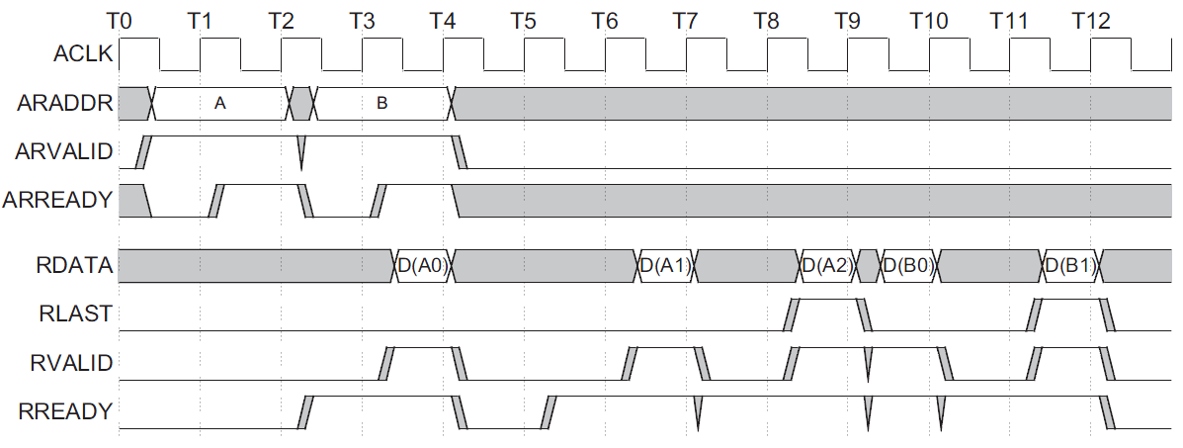
Overlapping Read Bursts
Read request A
is accepted
Read request B
is accepted via AR channel
while data A(0) is
transferred via R channel
Notes:
In this scenario, we will see how two read requests are issued consecutively.
At time T2, the master sends a read request to address ‘A’.
At time T4, the master sends the next read request to address ‘B’.
Note that, at time T4, the service of the previous read request to address ‘A’ has not been completed.
As shown in this example, the next request can be issued while the previous one(s) is not yet served.
At time T4, two events happen at the same time.
On the read address channel, the master sends the second read request.
On the read data channel, the master receives the first data of the first read request.
As shown in this example, AXI bus overlaps the service of multiple requests.
Such an overlapping can reduce the total communication latency of the two requests, i.e., average latency.
Such an overlapping is possible because we split request and data transfer, i.e., we have two separate channels, one for address, and the other for data.

Slide 53
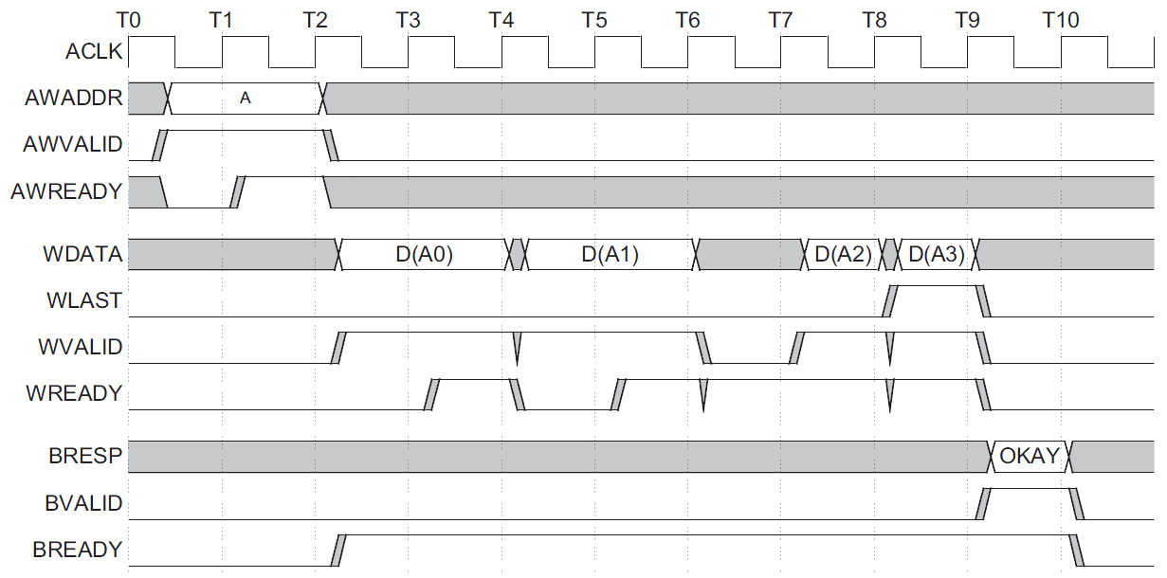
Write Burst Operation
Write request A
is accepted
Response completes
write operation
Notes:
This slides shows how write request is served.
In the case of write request, the slave sends a response on write response channel (signals having prefix ‘B’) to notify the master of the completion of service.

Slide 54
Interface of My IP
MY_IP
1x AXI-Lite Interface
1x BRAM Interface
Nx Processing Elements (N=64 in our lab)
Notes:
Now, we know the basics of AXI bus protocol and, I think, we can try to understand the Verilog code of the previous slides.
See the right-hand side of this slide.
Now you can better understand the AXI interface of myip.
You can find signals of write address channel, e.g., awaddr.
You can also differentiate signals belonging to different channels, e.g., wdata and rdata.
You can also find that each channel has its own valid and ready signals, e.g., rvalid and rready vs. arvalid and arready.

Slide 55
Slave Interface for SW to HW Data Transfer, i.e., Store Instruction
always @( posedge S_AXI_ACLK )
if ( S_AXI_ARESETN == 1'b0 )
axi_awready <= 1'b0;
else
if (~axi_awready && S_AXI_AWVALID && S_AXI_WVALID)
axi_awready <= 1'b1;
else
axi_awready <= 1'b0;
Write Address Channel
Notes:
Let’s try to understand the Verilog code corresponding to the slave side of write address channel.
Note that CPU executes store instruction to write data to myip, a slave block (via bus interconnect).
As we know, a transfer of request or data occurs only when both Valid and Ready are ‘1’.
Thus, we check to see if this condition is met in the if statement (in red).

Slide 56
My IP Receives the Data when Valid & Ready are ‘1’
always @( posedge S_AXI_ACLK )
if ( S_AXI_ARESETN == 1'b0 || run_complete)
slv_reg0 <= 0;
else
if (axi_wready && S_AXI_WVALID
&& axi_awready && S_AXI_AWVALID)
slv_reg0 <= S_AXI_WDATA;
Write Data Channel
Notes:
On write data channel, the slave checks the condition of data transfer (both WVALID and WREADY are ‘1’). If it is met, the slave takes the data on the data bus, S_AXI_WDATA and store it on its internal register, slv_reg0.

Slide 57
My IP Gives a Response for the Write Request
always @( posedge S_AXI_ACLK )
if ( S_AXI_ARESETN == 1'b0)
axi_bvalid <= 0;
else
if (~axi_bvalid
&& axi_wready && S_AXI_WVALID
&& axi_awready && S_AXI_AWVALID)
axi_bvalid <=1’b1;
else if (S_AXI_BREADY && axi_bvalid)
axi_bvalid <=1’b0;
Write Response Channel
Notes:
When both AWVALID and WVALID are ‘1’, myip sets the Valid signal of write response channel, axi_bvalid to ‘1’.
Ideally, we need to check the completion of data transfer before raising bvalid signal.
In our design, the burst size is 1. In such a case, if WVALID is ‘1’, the slave can complete the burst by receiving the current data on the write data channel. Thus, if WVALID is ‘1’, then the burst transfer can be completed and the write response can be given.

Slide 58
My IP Receives a Read Request
always @( posedge S_AXI_ACLK )
if ( S_AXI_ARESETN == 1'b0 )
axi_arready <= 1'b0;
else
if (~axi_arready && S_AXI_ARVALID)
axi_arready <= 1'b1;
else
axi_arready <= 1'b0;
Read Address Channel
Notes:
The slave checks to see if ARVALID is ‘1’.
If so, the slave sets its arready signal to ‘1’ to receive the read request.

Slide 59
My IP Gives the Required Data
always @( posedge S_AXI_ACLK )
if ( S_AXI_ARESETN == 1'b0 )
axi_rvalid <= 1'b0;
else
if (~axi_rvalid axi_arready && S_AXI_ARVALID)
axi_rvalid <= 1'b1;
else if (axi_rvalid && S_AXI_RREADY)
axi_rvalid <= 1'b0;
always @( * )
axi_rdata <= slv_reg0;
Read Data Channel
Notes:
My IP can give the read data at any time as the last always statement shows as follows.
always @( * )
axi_rdata <= slv_reg0;
Thus, if ARVALID becomes ‘1’, it sets rvalid to ‘1’.

Slide 60
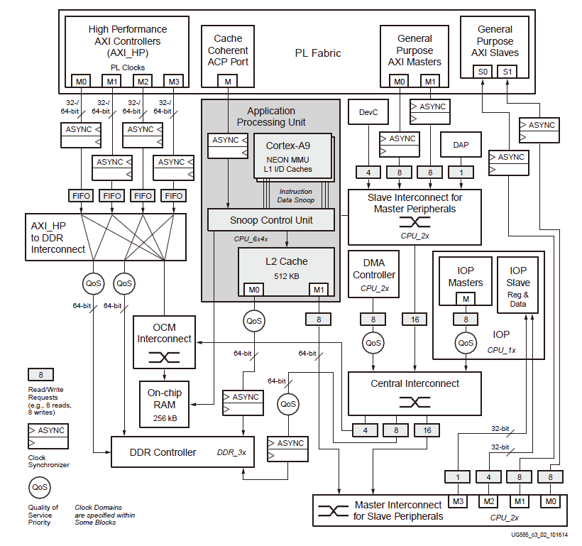
Interconnects
[UG585 Zynq TRM, 2016]
Interconnect switches
Central Interconnect
Master Interconnect
Slave Interconnect
Memory Interconnect
OCM Interconnect
Notes:
Zynq FPGA contains multiple AXI interconnect blocks.
My IP is connected to Master Interconnect via its General Purpose AXI Slave interface.

Slide 61
On-Chip Bus Implementation
[Stevens, 2011]
AMBA3 or 4 is a protocol
There can be different implementations

Slide 62
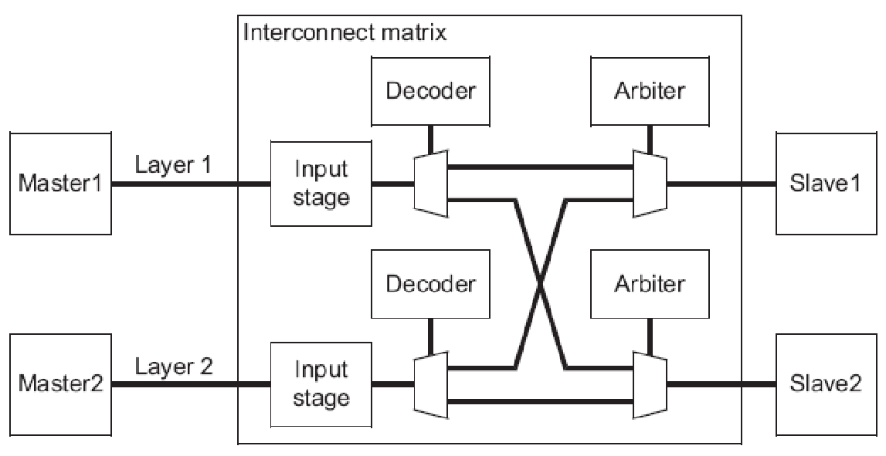
AXI Crossbar Bus ARM PrimeCell PL301
PL301: PrimeCell High Performance Matrix
Slave Interface
(SI)
Master Interface
(SI)

Slide 63
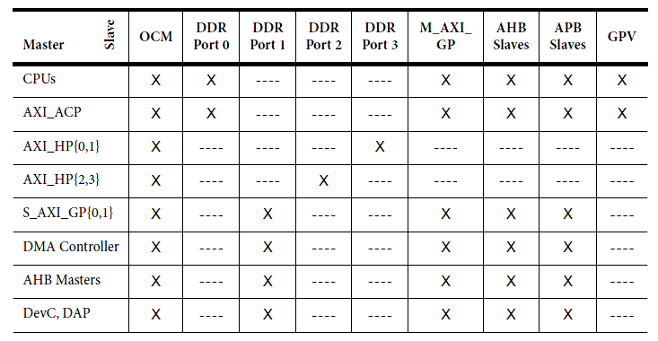
Connectivity in Zynq
[UG585 Zynq TRM, 2016]
Not a full cross-bar!
Notes:
Interconnect Masters
CPUs
ACP
AXI_HP[3:0]
AXI_GP[1:0]
DMA controller
AHB masters – I/O Peripherals (IOPs) with local DMA units
Device Configuration (DevC) and Debug Access Port (DAP)
Interconnect Slaves
M_AXI_GP[1:0]
OCM
DDR DRAM
Global Programmers View (GPV) – programmable registers of the interconnect
AHB slaves – IOPs with local DMA units
APB slaves – programmable registers in various modules

Slide 64
AXI Crossbar Bus ARM PrimeCell PL301
PL301: PrimeCell High Performance Matrix
X
Slave Interface
(SI)
Master Interface
(SI)

Slide 65
Connectivity in Zynq
[UG585 Zynq TRM, 2016]
What if multiple masters access the same slave at the same time?
Notes:
Interconnect Masters
CPUs
ACP
AXI_HP[3:0]
AXI_GP[1:0]
DMA controller
AHB masters – I/O Peripherals (IOPs) with local DMA units
Device Configuration (DevC) and Debug Access Port (DAP)
Interconnect Slaves
M_AXI_GP[1:0]
OCM
DDR DRAM
Global Programmers View (GPV) – programmable registers of the interconnect
AHB slaves – IOPs with local DMA units
APB slaves – programmable registers in various modules

Slide 66
Arbitration Scheme: Fixed Priority
High priority
Low priority

Slide 67
Starvation Problem of Fixed Priority Scheme
Starvation
Requests from low priority masters can be delayed due to high priority requests
In the worst case, low priority masters cannot send their requests to the slave, which will finally make the system fail
How to resolve the starvation problem?
Fair arbitration?

Slide 68
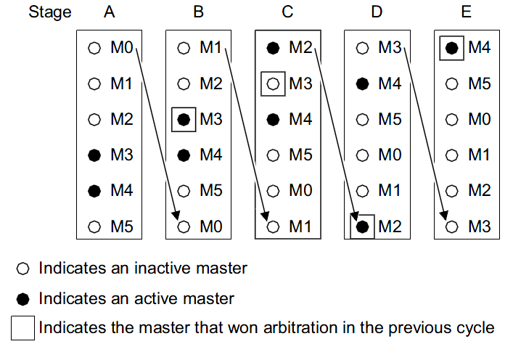
Arbitration Scheme: Round Robin
[Source: PL301 TS]

Slide 69
Arbitration Scheme: Hybrid
Combination of round robin and fixed priority

Slide 70
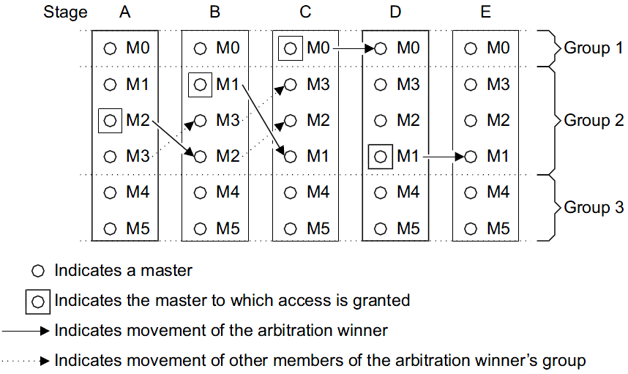
Arbitration Scheme
[Source: PL301 TS]
LRG (least recently granted) scheme

Slide 71
Interconnects
[UG585 Zynq TRM, 2016]
Interconnect switches
Central Interconnect
Master Interconnect
Slave Interconnect
Memory Interconnect
OCM Interconnect
Notes:
Zynq FPGA contains multiple AXI interconnect blocks.
My IP is connected to Master Interconnect via its General Purpose AXI Slave interface.

Slide 72
Agenda
Lecture
How can hardware components communicate with each other?
AXI bus
Introduction to the lab on Week 10

Slide 73
Appendix

Slide 74
Starvation Problem of Fixed Priority Scheme
Starvation
Requests from low priority masters can be delayed due to high priority requests
In the worst case, low priority masters cannot send their requests to the slave, which will finally make the system fail
How to resolve the starvation problem?
Fair arbitration?
Urgent requests, e.g., CPU cache miss, Camera/Display data, etc., still need high priority. How to serve them?
General solution
The starvation problem is incurred by the policy that guarantees high priority to some masters indefinitely
Basic idea: Guarantee of minimum level of request service (per request or master) called quality of service (QoS)
E.g., a hardware component, codec needs to utilize 50% of main memory bandwidth
E.g., every 100 cycles, at least one CPU cache miss can be served as high priority
What happens if 10 or 1000 cycles are used instead of 100 cycles?

Slide 75
A Simple QoS-based Arbitration
We try to guarantee that master A can utilize at least 50% of slave 1’s resource, e.g., main memory bandwidth
Slave 1 can receive, i.e., serve max 8 read requests
>=50% is guaranteed
Bus
Master A
Can receive max 8 requests
Master B
Slave 1

Slide 76
A Simple QoS-based Arbitration
The bus manages a counter for master B
Whenever master B sends a request to slave 1, its counter is incremented
50% is guaranteed
Bus
Master A
Can receive max 8 requests
Master B
counter_B++
Slave 1

Slide 77
A Simple QoS-based Arbitration
If the counter is larger than 4, i.e., if we cannot guarantee minimum 50% for master A, then the bus blocks requests from master B
Master A’s requests can still reach slave 1
50% is guaranteed
Bus
Master A
Can receive max 8 requests
Master B
X
Slave 1
if counter_B > 4

Slide 78
A Simple QoS-based Arbitration
Whenever master B receives a response (e.g., read data or write response) from slave 1, its counter is decremented
Master B’s blocked requests can now be served if the counter gets smaller than the threshold
50% is guaranteed
Bus
Master A
Can receive max 8 requests
Master B
counter_B--
Slave 1

Slide 79
QoS in Bus
[Stevens, 2011]
Who and How to assign QoS to each hardware component?
System designer assigns QoS by setting the registers (on physical memory address space) of on-chip bus
Codec
50% memory BW
CPU
1 high priority token/100 cycles

Slide 80
Interconnect in Zynq
[UG585 Zynq TRM, 2016]
Not a full cross-bar!
Arbitration schemes with QoS
Notes:
Interconnect Masters
CPUs
ACP
AXI_HP[3:0]
AXI_GP[1:0]
DMA controller
AHB masters – I/O Peripherals (IOPs) with local DMA units
Device Configuration (DevC) and Debug Access Port (DAP)
Interconnect Slaves
M_AXI_GP[1:0]
OCM
DDR DRAM
Global Programmers View (GPV) – programmable registers of the interconnect
AHB slaves – IOPs with local DMA units
APB slaves – programmable registers in various modules

