Slide 1

Hardware System Design (Week 3) Verilog Design 2
March 31, 2020
Sungjoo Yoo
Computing Memory Architecture Lab.
CSE, SNU
http://cmalab.snu.ac.kr

Slide 2
Agenda
Lecture
Verilog basics #2
Bus interface basics (to understand the interface of multiplier IP)
Introduction to the lab on Week 3
Utilizing a floating point multiplier IP (intellectual property) block on Vivado

Slide 3

Weekly Schedule
W1 17 Application (deep learning on FPGA)/SW app (MNIST/CIFAR)
W2 25 Verilog 1 Basics/Vivado tutorial (verification level of HW design)
W3 31 Verilog 2 Combinational circuits (Video pre-view homework + TA Q&A)/Simple adder using dsp (V+V, Verilog intro)
W4 4/7 Verilog 3 Sequential circuits/V*V processing element (PE) design 1
W5 14 Verilog 4 Design example & synthesizable code/V*V processing element (PE) design 2
W6 21 Intro to Zynq & MV accelerator design/Zynq FPGA & synthesis, continue VV design & start MV accelerator design
W7 28 Mid-term exam/No practice
W8 5/5 (homework lecture) Main memory (physical & virtual)/OS+FPGA (HOST~DEVICE) communication & MV design 2
W9 12 Bus and DMA (Video pre-view + TA Q&A)/custom IP & MV design 3
W10 19 Convolution lowering and matrix multiplication accelerator/Convolution lowering (V0)
W11 26 Advanced deep learning #1 quantization for low precision computation/V0+DMA+8b
W12 6/2 Advanced deep learning #2 zero skipping/V0+DMA+8b+zero-skipping 1
W13 9 Lecture summary/V0+DMA+8b+zero-skipping 2
W14 16 Final exam/Term project (V0+DMA+8b+zero) submission
Notes:
In our schedule, we design the hardware accelerator for four weeks as the blue part shows.

Slide 4
Final Project Overview: Matrix Multiplication IP
W5
MY_IP
PS
(ARM)
W4
Processing Element (PE)
DOUT
CTRL
[32:0] REG[0:127] (BRAM inference)
W2~W3
Float32 MUL+ACC
DIN
A
OUT
AXI_SLAVE INTERFACE
B
ADDR
OUT
C
TRUE DP
BRAM
2-cyc
RESET
BRAM
INTERFACE
FSM
Shift(16)
DOUT
ADDR
[32:0] REG[0:127] (BRAM inference)
DIN
COUNTER
Notes:
In the four weeks, we will design our MV accelerator in a bottom up manner.
As this slide shows, in Weeks 2 and 3, we design the core of PE, called MAC unit, which consists of multiplier and accumulator.
Then, in Week 4, we design the entire PE which consists of MAC unit, output buffer (connected to Dout) and control logic.
In Week 5, we use multiple PEs and connect them.
We also design the buffer BRAM to keep the input.
Our design, named MY_IP, communicates with the ARM processor in PS (processing subsystem) in two ways for control and data.
The software program running on the CPU sends, to the MV accelerator, control information, e.g., start of MV accelerator via AXI_slave interface (a bus interface).
The CPU software program also sends input data to BRAM (True DP DRAM in the slide) and the MV accelerator reads the data from the BRAM via BRAM interface (between FSM and True DP BRAM in the slide).
The MV accelerator, after computation, writes its output to the True DP BRAM.
Later, the CPU software program reads the output from the True DP BRAM.
This week, we will learn synthesis on FPGA by synthesizing the multiplier.

Slide 5
Block-based Matrix-Vector Multiplication Example
1st clock cycle: Broadcast ‘1’ to two PEs and each PE multiplies the broadcast vector element by its own weight and updates accumulator
Matrix (M)
Vector (V)
a
b
1
a
1
c
1
c
d
5
x
x
+
+
Accumulator
Accumulator
Notes:
On FPGA, we run multiple multiplications in parallel. Thus, we will implement multiple multipliers on FPGA.

Slide 6
This Week’s Practice and Class
Practice: Designing, simulating and synthesizing a multiplier IP block (intellectual property block) utilizing Vivado
Class
Basic Verilog grammar 2
Generate statement
Structural and behavioral modeling
Synthesizable code
Understanding bus interface
The generated multiplication IP has bus interface
Notes:
In order to implement a multiplier on Xilinx FPGA, we will use Vivado tool. Specifically, we will select and configure an existing hardware design (called intellectual property, IP) to design a multiplier.
We will simulate the operation of multiplier in Verilog.
Finally, we will synthesize the multiplier on FPGA.
We will use Vivado for all these steps.
In the lecture material, we will try to cover topics related to the practice like generate statement and structural/behavioral modeling.
Specifically, we will study how to code Verilog to obtain synthesizable design.
We will also study the basics of bus protocol which is required to understand the configuration of multiplication IP for the bus interface.
That is, we remove ready signals in the configuration. We will try to understand why we do that by studying the basics of bus protocol.

Slide 7
Basic Logic Design With Verilog Ⅱ
- Basic syntax and combinational logic

Slide 8
while Statement
Syntax
while (condition_expr) statement;
while (count < 12) count <= count + 1;
while (count <= 100 && flag) begin
// put statements wanted to be carried out here
end
Notes:
While and for statements are almost the same as the ones in C language.

Slide 9
An Example: while Statement
// count the zeros in a byte
integer i, out;
always @(data) begin
out = 0; i = 0;
while (i <= 7) begin // simple condition, complex conditions also possible
if (data[i] == 0) out = out + 1;
i = i + 1;
end
end
Q: Can the if … be replaced with out = out + ~data[i] ? → Yes
Notes:
This is one example of while statement.

Slide 10
An Example: for Statement
// count the zeros in a byte
integer i;
always @(data) begin
out = 0;
for (i = 0; i <= 7; i = i + 1) // simple condition
if (data[i] == 0) out = out + 1;
end
Notes:
This is an example of for statement.

Slide 11
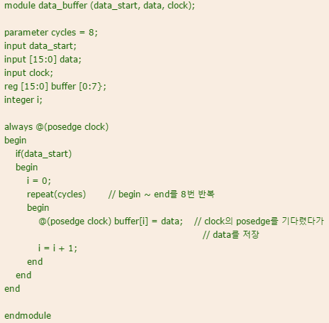
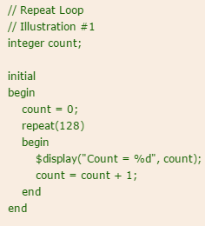
repeat Statement
Syntax
repeat (counter_expr) statement;
Only for fixed value
Notes:
Repeat is a unique statement in Verilog.
It repeats the execution of the statements by the number of specified iterations, counter_expr in the slide.
For instance, in the code on the left-hand side, two sentences of $display and count update are executed 128 times.
When the number of iterations is fixed, repeat statement is a good method.

Slide 12
generate Block Structures
The keywords used
genvar for index
generate and endgenerate are optional
// convert Gray code into binary code
parameter SIZE = 8;
input [SIZE-1:0] gray;
output [SIZE-1:0] bin;
genvar i;
generate for (i = 0; i < SIZE; i = i + 1) begin: bit
assign bin[i] = ^gray[SIZE-1:i];
end endgenerate
See another example at https://chocoamond.tistory.com/149
Notes:
In the case of repeat statement, the same set of statements is repeated.
Generate statement is more flexible in repeating the statement execution.
Generate statement has the effect of loop unrolling in the conventional code optimization.
The example code of generate statement in this slide actually unrolls the loop while assigning appropriate index values as follows.
assign bin[0] = ^gray[SIZE-1:0];
assign bin[1] = ^gray[SIZE-1:1];
assign bin[2] = ^gray[SIZE-1:2];
assign bin[3] = ^gray[SIZE-1:3];
assign bin[4] = ^gray[SIZE-1:4];
assign bin[5] = ^gray[SIZE-1:5];
assign bin[6] = ^gray[SIZE-1:6];
assign bin[7] = ^gray[SIZE-1:7];
Thus, by Generate statement, we can avoid writing such a long code.

Slide 13
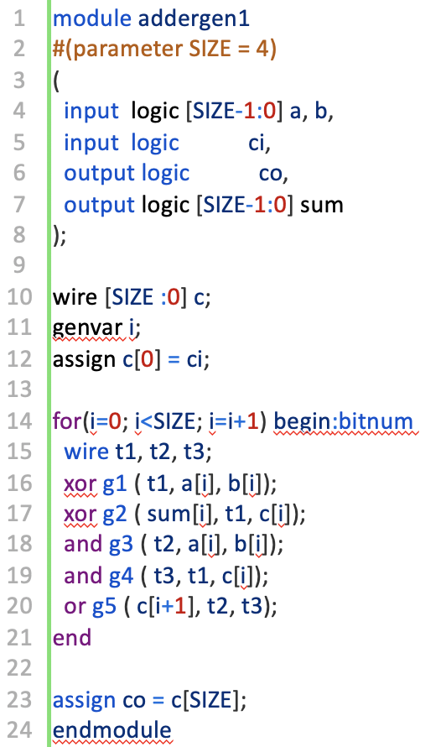
Example: Instantiating Multiple Modules
[Verilog-2005 LRM]
// Hierarchical gate instance names are:
// xor gates: bitnum[0].g1 bitnum[1].g1 bitnum[2].g1 bitnum[3].g1
// bitnum[0].g2 bitnum[1].g2 bitnum[2].g2 bitnum[3].g2
// and gates: bitnum[0].g3 bitnum[1].g3 bitnum[2].g3 bitnum[3].g3
// bitnum[0].g4 bitnum[1].g4 bitnum[2].g4 bitnum[3].g4
// or gates: bitnum[0].g5 bitnum[1].g5 bitnum[2].g5 bitnum[3].g5
// Gate instances are connected with nets named:
// bitnum[0].t1 bitnum[1].t1 bitnum[2].t1 bitnum[3].t1
// bitnum[0].t2 bitnum[1].t2 bitnum[2].t2 bitnum[3].t2
// bitnum[0].t3 bitnum[1].t3 bitnum[2].t3 bitnum[3].t3
Notes:
Generate statement is useful especially when instantiating multiple modules for a datapath of a wide bit-width.
In this example, the combinational circuit of 4-bit data path is generated by Generate statement.
As shown on the right of the slide, each instance can be named with a hierarchical name.
For instance, xor g2 for i=2 is named bitnum[2].g2 where bitnum is the module name.

Slide 14
Full Adder
// define a full adder at dataflow level.
module full_adder(x, y, c_in, sum, c_out);
// I/O port declarations
input x, y, c_in;
output sum, c_out;
// Specify the function of a full adder.
assign {c_out, sum} = x + y + c_in;
endmodule
Notes:
In the following slides, there are a few examples of generate statement which generates multiple instances of this full adder.
I hope you will try to fill in the blanks.

Slide 15
Design n-bit Full Adder – Example 1
module adder_nbit(x, y, c_in, sum, c_out);
…
genvar i;
wire [N-2:0] c; // internal carries declared as nets.
generate for (i = 0; i < N; i = i + 1) begin: adder
if (i == 0) // specify LSB
full_adder fa (___________________________);
else if (i == N-1) // specify MSB
full_adder fa (___________________________);
else // specify other bits
full_adder fa (___________________________);
end endgenerate
Used for module instance and can be used within if/else & case

Slide 16
The generate Condition Statement: An n-Bit Adder
module adder_nbit(x, y, c_in, sum, c_out);
…
genvar i;
wire [N-2:0] c; // internal carries declared as nets.
generate for (i = 0; i < N; i = i + 1) begin: adder
if (i == 0) // specify LSB
full_adder fa (x[i], y[i], c_in, sum[i], c[i]);
else if (i == N-1) // specify MSB
full_adder fa (x[i], y[i], c[i-1], sum[i], c_out);
else // specify other bits
full_adder fa (x[i], y[i], c[i-1], sum[i], c[i]);
end endgenerate
Used for module instance and can be used within if/else & case
Notes:
In order to be able to fill in the blanks,
We’d better focus on the most general case first.
It is
full_adder fa (x[i], y[i], c[i-1], sum[i], c[i]);
And then, we can consider special cases like i = 0 and I = N-1.
When I = 0, we need to use c_in.
Thus, we have c_in in the followings.
full_adder fa (x[i], y[i], c_in, sum[i], c[i]);
When I = N-1, we need to consider c_out as follows.
full_adder fa (x[i], y[i], c[i-1], sum[i], c_out);

Slide 17
Design n-bit Full Adder – Example 2
module adder_nbit(x, y, c_in, sum, c_out);
…
genvar i;
wire [N-2:0] c; // internal carries declared as nets.
generate for (i = 0; i < N; i = i + 1) begin: adder
if (i == 0) // specify LSB
assign {___________} = x[i] + y[i] + c_in;
else if (i == N-1) // specify MSB
assign {___________} = x[i] + y[i] + c[i-1];
else // specify other bits
assign {___________} = x[i] + y[i] + c[i-1];
end endgenerate
Hint: Recall the full adder with a single sentence, assign {cout, sum} = x + y + c_in.

Slide 18
The generate Condition Statement: An n-Bit Adder
module adder_nbit(x, y, c_in, sum, c_out);
…
genvar i;
wire [N-2:0] c; // internal carries declared as nets.
generate for (i = 0; i < N; i = i + 1) begin: adder
if (i == 0) // specify LSB
assign {c[i], sum[i]} = x[i] + y[i] + c_in;
else if (i == N-1) // specify MSB
assign {c_out, sum[i]} = x[i] + y[i] + c[i-1];
else // specify other bits
assign {c[i], sum[i]} = x[i] + y[i] + c[i-1];
end endgenerate
Notes:
The most common case will be
assign {c[i], sum[i]} = x[i] + y[i] + c[i-1];
When I = 0, we consider c_in as follows.
assign {c[i], sum[i]} = x[i] + y[i] + c_in;
While we consider c_out when I = N-1 as follows.
assign {c_out, sum[i]} = x[i] + y[i] + c[i-1];

Slide 19
Design n-bit Full Adder – Example 3
module adder_nbit(x, y, c_in, sum, c_out);
…
genvar i;
reg [N-2:0] c; // internal carries declared as nets.
generate for (i = 0; i < N; i = i + 1) begin: adder
if (i == 0) // specify LSB
always @(*) {___________} = x[i] + y[i] + c_in;
else if (i == N-1) // specify MSB
always @(*) {___________} = x[i] + y[i] + c[i-1];
else // specify other bits
always @(*) {___________} = x[i] + y[i] + c[i-1];
end endgenerate
Hint: always @(*) block is equivalent to combinational circuit which runs all the time.

Slide 20
The generate Condition Statement: An n-Bit Adder
module adder_nbit(x, y, c_in, sum, c_out);
…
genvar i;
reg [N-2:0] c; // internal carries declared as nets.
generate for (i = 0; i < N; i = i + 1) begin: adder
if (i == 0) // specify LSB
always @(*) {c[i], sum[i]} = x[i] + y[i] + c_in;
else if (i == N-1) // specify MSB
always @(*) {c_out, sum[i]} = x[i] + y[i] + c[i-1];
else // specify other bits
always @(*) {c[i], sum[i]} = x[i] + y[i] + c[i-1];
end endgenerate
Notes:
The difference between this example and the previous one
generate for (i = 0; i < N; i = i + 1) begin: adder
if (i == 0) // specify LSB
assign {c[i], sum[i]} = x[i] + y[i] + c_in;
else if (i == N-1) // specify MSB
assign {c_out, sum[i]} = x[i] + y[i] + c[i-1];
else // specify other bits
assign {c[i], sum[i]} = x[i] + y[i] + c[i-1];
end endgenerate
is that this example uses always block.
Thus, “assign wire = …”, assignment to wire is not allowed and a simple block assignment to register and output port was used as follows.
{c[i], sum[i]} = x[i] + y[i] + c[i-1];

Slide 21
Module Modeling Styles
Structural style
Gate level
Dataflow style
Behavioral or algorithmic style
Mixed style
RTL = synthesizable behavioral + dataflow constructs
Notes:
We can describe hardware design in different modeling styles including structural, dataflow and behavioral ones.
In reality, we tend to mix the styles.

Slide 22
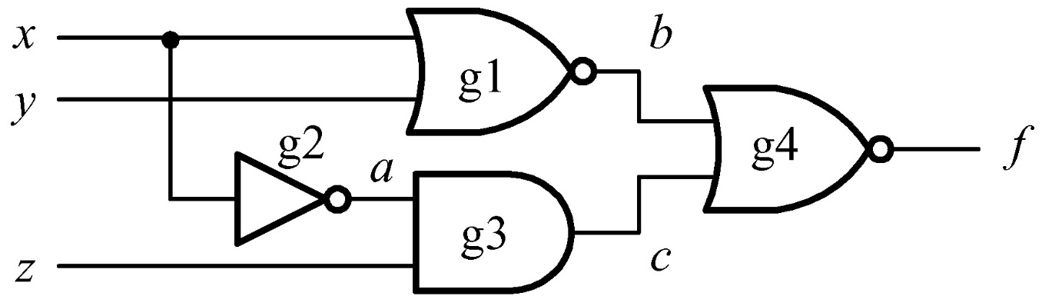
Instantiation of Basic Gates
To instantiate and/or gates
gatename [instance_name](output, input1, input2, ..., inputn);
instance_name is optional
module basic_gates (x, y, z, f) ;
input x, y, z;
output f ;
wire a, b, c;
// Structural modeling
nor g1 (b, x, y);
not g2 (a, x);
and g3 (c, a, z);
nor g4 (f, b, c);
endmodule
Optional
Notes:
This slide exemplifies a structural description.
As you can see, the four gates are instantiated and connected to each other to build a larger complex module called basic_gates.
The instantiation uses positional port association.
Note that the instance names such ahs g1, g2, g3 and g4 are optional.

Slide 23
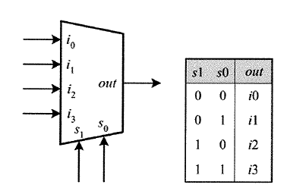
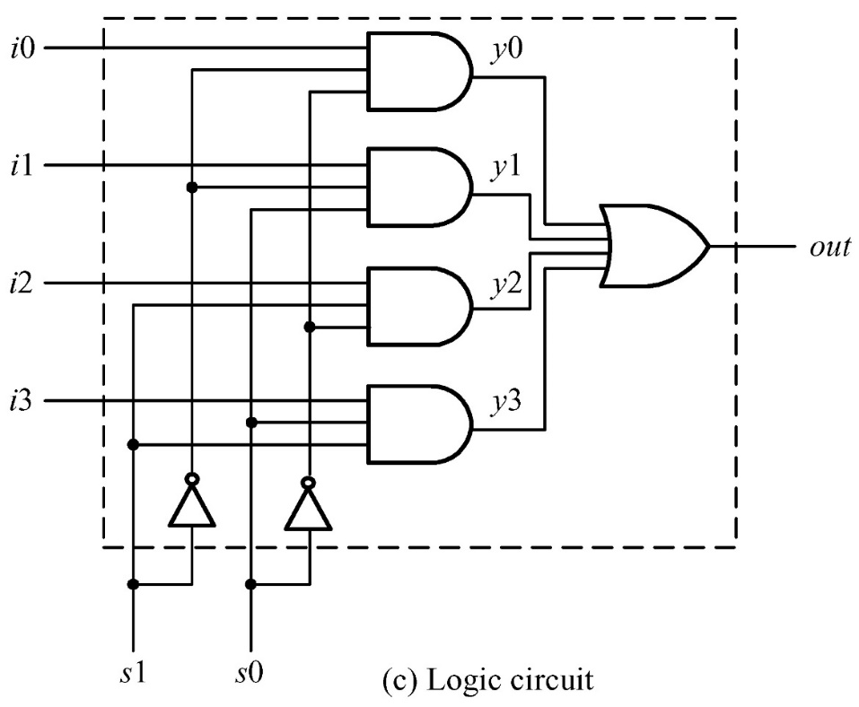
An Example: A 4-to-1 Multiplexer
module mux4_to_1_structural (i0, i1, i2, i3, s1, s0, out);
input i0, i1, i2, i3, s1, s0;
output out;
wire s1n, s0n; // Internal wire
wire y0, y1, y2, y3;
// Gate instantiations
not (s1n, s1); // Create s1n and s0n signals
not (s0n, s0);
and (y0, i0, s1n, s0n);
and (y1, i1, s1n, s0);
and (y2, i2, s1, s0n);
and (y3, i3, s1, s0);
or (out, y0, y1, y2, y3);
endmodule
Notes:
This is another example of structural model.

Slide 24
Array of Instances
Array instantiations may be a synthesizer dependent!
Suggestion: check this feature before using the synthesizer
wire [3:0] out, in1, in2;
// basic array instantiations of nand gate.
nand n_gate[3:0] (out, in1, in2);
// this is equivalent to the following
nand n_gate0 (out[0], in1[0], in2[0]);
nand n_gate1 (out[1], in1[1], in2[1]);
nand n_gate2 (out[2], in1[2], in2[2]);
nand n_gate3 (out[3], in1[3], in2[3]);
Notes:
We often need to instantiate an array of instances especially for datapath with large bit-width.
In case of simple array of instances, as you can see in the first part of this example,
We have only to add array index information.
Specifically, in order to instantiate four nand gates, we have only to name the instance name with array information,
e.g., n_gate[3:0]
Note that the associated wires need the same dimension (# of bits) as that of array.
In this example, the three wires, out, in1, and in2 have the same dimension, e.g., 4 in this example.
Array instantiation can make your code compact and easy to debug compared with the case that we instantiate each instance separately, as shown at the bottom of the example code,

Slide 25

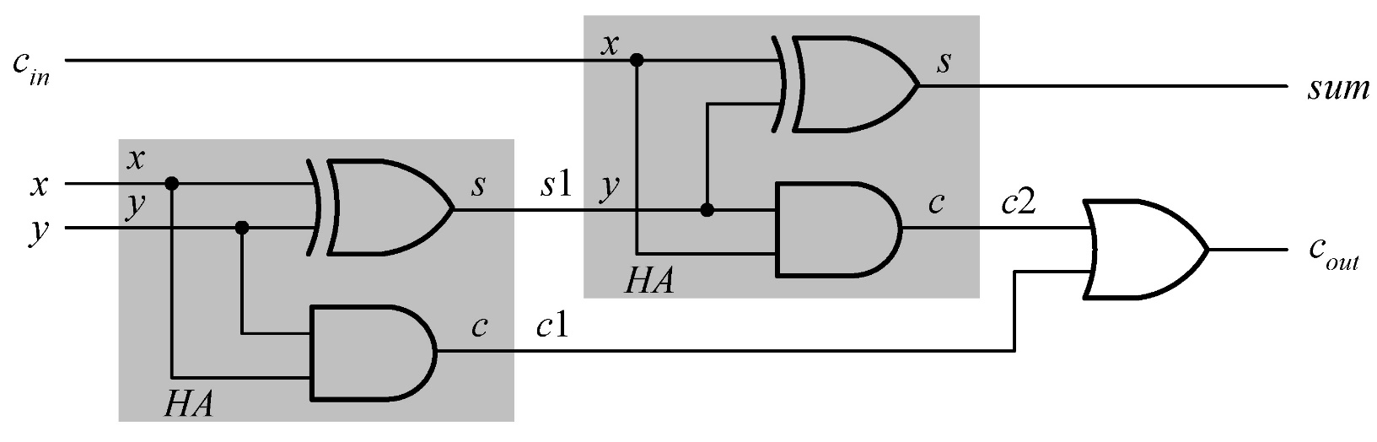
An Example: A 1-Bit Full Adder
module full_adder_structural(x, y, c_in, sum, c_out);
// I/O port declarations
input x, y, c_in;
output sum, c_out;
wire s1, c1, c2;
// Structural modeling of the 1-bit full adder.
xor xor_s1(s1, x, y); // compute sum.
xor xor_s2(sum, s1, c_in);
and and_c1(c1, x, y); // compute carry out.
and and_c2(c2, s1, c_in);
or or_cout(c_out, c1, c2); // can be xor
endmodule
Notes:
This is another example of structural modeling style.
As you can see in this slide, we can build a larger module, named full_adder_structural, by instantiating existing modules and connecting them.

Slide 26
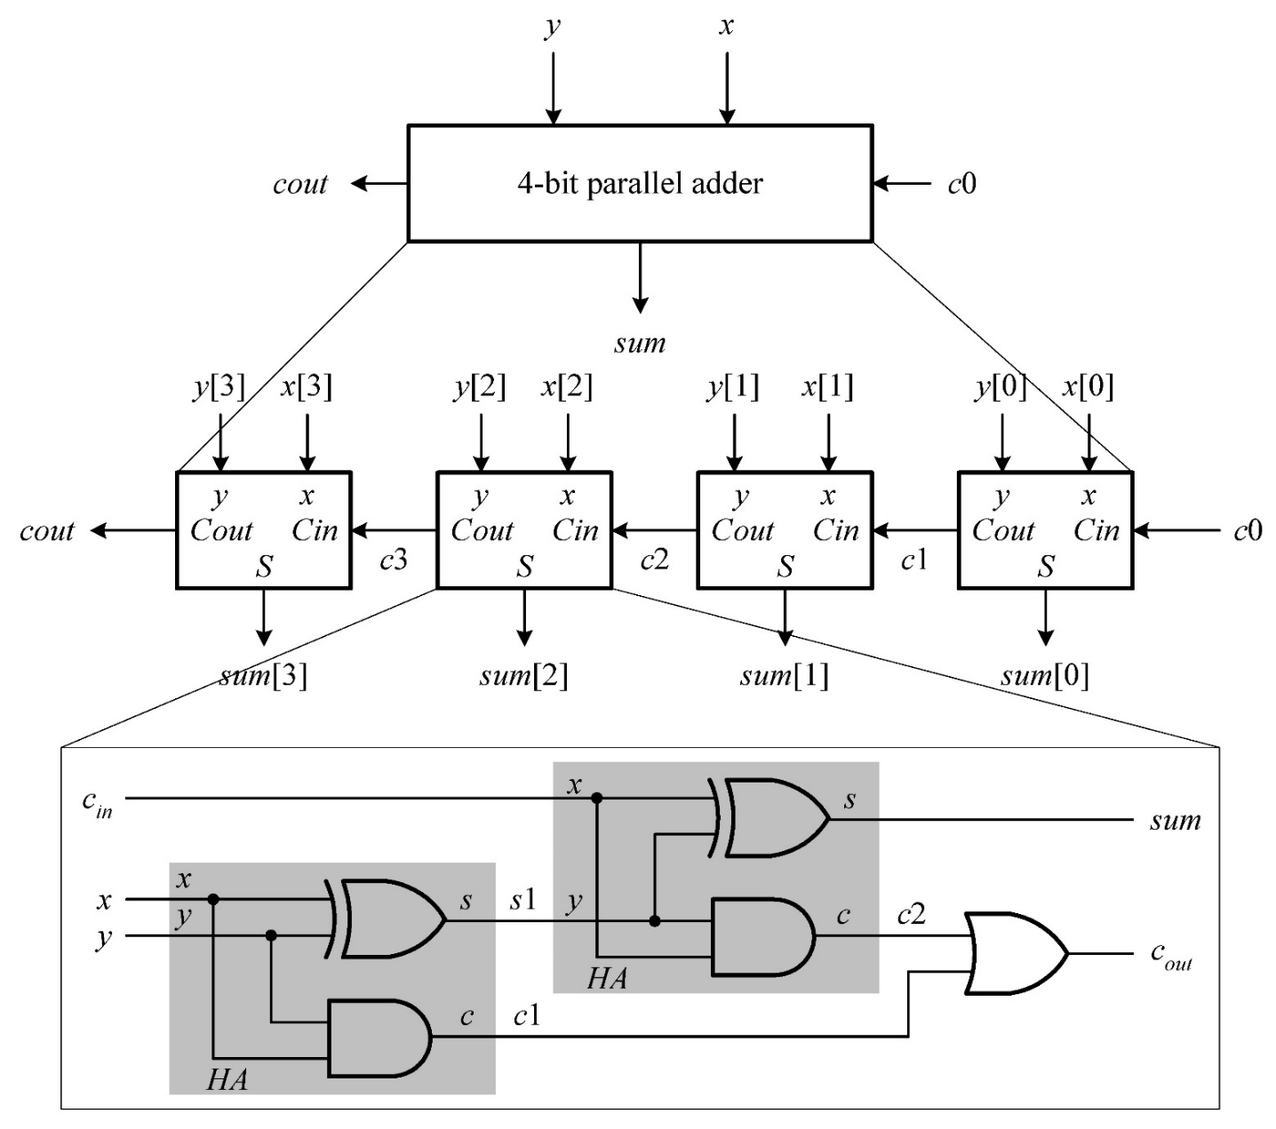
Hierarchical Design
Notes:
This is an example of hierarchical design consisting of four 1-bit full adders.
As shown at the bottom of this slide, the 1-bit full adder is also constructed by instantiating smaller gates like AND, OR and XOR gates and connecting them.
In terms of hierarchy level, this 4-bit adder has three levels, top level (4-bit adder), an intermediate level (where 1-bit full adders are found), and bottom level (where basic gates are utilized).
By building modules in a hierarchical manner like this example, larger and more complex modules can be designed.

Slide 27
Module Modeling Styles
Structural style
Gate level
Dataflow style
Behavioral or algorithmic style
Mixed style
RTL = synthesizable behavioral + dataflow constructs

Slide 28
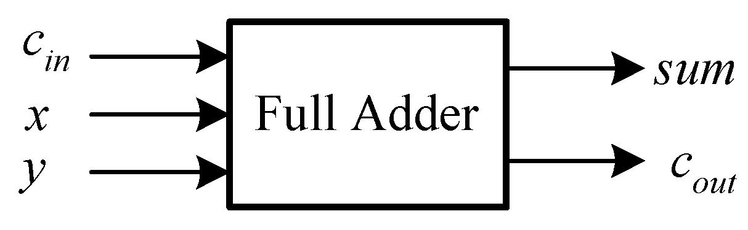
Dataflow Modeling
module full_adder_dataflow(x, y, c_in, sum, c_out);
// I/O port declarations
input x, y, c_in;
output sum, c_out;
// specify the function of a full adder
assign {c_out, sum} = x + y + c_in;
endmodule
Notes:
Dataflow modeling is to describe computation.
As shown in this slide, the full adder outputs, sum and c_out can be obtained by ‘computing’ additions on the right-hand side of the assignment statement.

Slide 29
Design n-bit Comparator - Example
// an N-bit comparator module example
parameter N = 4; // default size
input [N-1:0] a, b;
output cgt, clt, ceq;
assign cgt = __________;
assign clt = __________;
assign ceq = __________;
Notes:
This is an example of utilizing relational operators in dataflow modeling.

Slide 30
An Example: A Simple Comparator
// an N-bit comparator module example
parameter N = 4; // default size
input [N-1:0] a, b;
output cgt, clt, ceq;
assign cgt = (a > b);
assign clt = (a < b);
assign ceq = (a == b);
Notes:
Note that the input signals have multiple (N=4) bits.

Slide 31
An Example: A Cascadable Comparator
parameter N = 4;
// I/O port declarations
input Iagtb, Iaeqb, Ialtb;
input [N-1:0] a, b;
output Oagtb, Oaeqb, Oaltb;
// dataflow modeling using relation operators
assign Oaeqb =_______________________; // =
assign Oagtb =_______________________; // >
assign Oaltb =_______________________; // <
Notes:
We can design more complex functions using dataflow modeling as shown in this example.
The desired function is that we set some of three inputs, Iagtb, Iaeqb, and Ialtb,
In order to determine which operation to perform.
For instance, if we want to obtain the result of “A is equal to B”, then we set laeqb to 1.
Then, the corresponding output, Oaeqb gives the result of relation operation.

Slide 32
An Example: A Cascadable Comparator
parameter N = 4;
// I/O port declarations
input Iagtb, Iaeqb, Ialtb;
input [N-1:0] a, b;
output Oagtb, Oaeqb, Oaltb;
// dataflow modeling using relation operators
assign Oaeqb = (a == b) && (Iaeqb == 1); // =
assign Oagtb = (a > b) || ((a == b)&& (Iagtb == 1)); // >
assign Oaltb = (a < b) || ((a == b)&& (Ialtb == 1)); // <

Slide 33
An Example: A Cascadable Comparator
Notes:
This is the result of synthesizing the previous dataflow model code.
As you can see here, the synthesis result is a netlist where components including logic gates are connected with each other.
That is, the synthesis takes as input the dataflow model code and as output produces a structural model, i.e., a netlist..

Slide 34
Module Modeling Styles
Structural style
Gate level
Dataflow style
Behavioral or algorithmic style
Mixed style
RTL = synthesizable behavioral + dataflow constructs
Notes:
Behavioral or algorithmic style is very similar to the conventional software program in C language.

Slide 35
Behavioral Modeling
module full_adder_behavioral(x, y, c_in, sum, c_out);
// I/O port declarations
input x, y, c_in;
output sum, c_out;
reg sum, c_out; // need to be declared as reg types, output reg
// specify the function of a full adder
always @(x, y, c_in) // always @(*) or always@(x or y or c_in)
{c_out, sum} = x + y + c_in;
endmodule
Similar to C-code
Notes:
In general, behavioral modeling includes dataflow modeling by additionally including control function.
Thus, there is no practical need to differentiate the modeling styles between the two.
In this slide, the example utilizes the previous sentence of dataflow modeling,
{c_out, sum} = x + y + c_in;
In addition, this example shows an additional part,
always @(x, y, c_in)
which monitors signals x, y and c_in
and, whenever there is an event on any of these signals,
triggers the execution of the following statement.
{c_out, sum} = x + y + c_in;

Slide 36
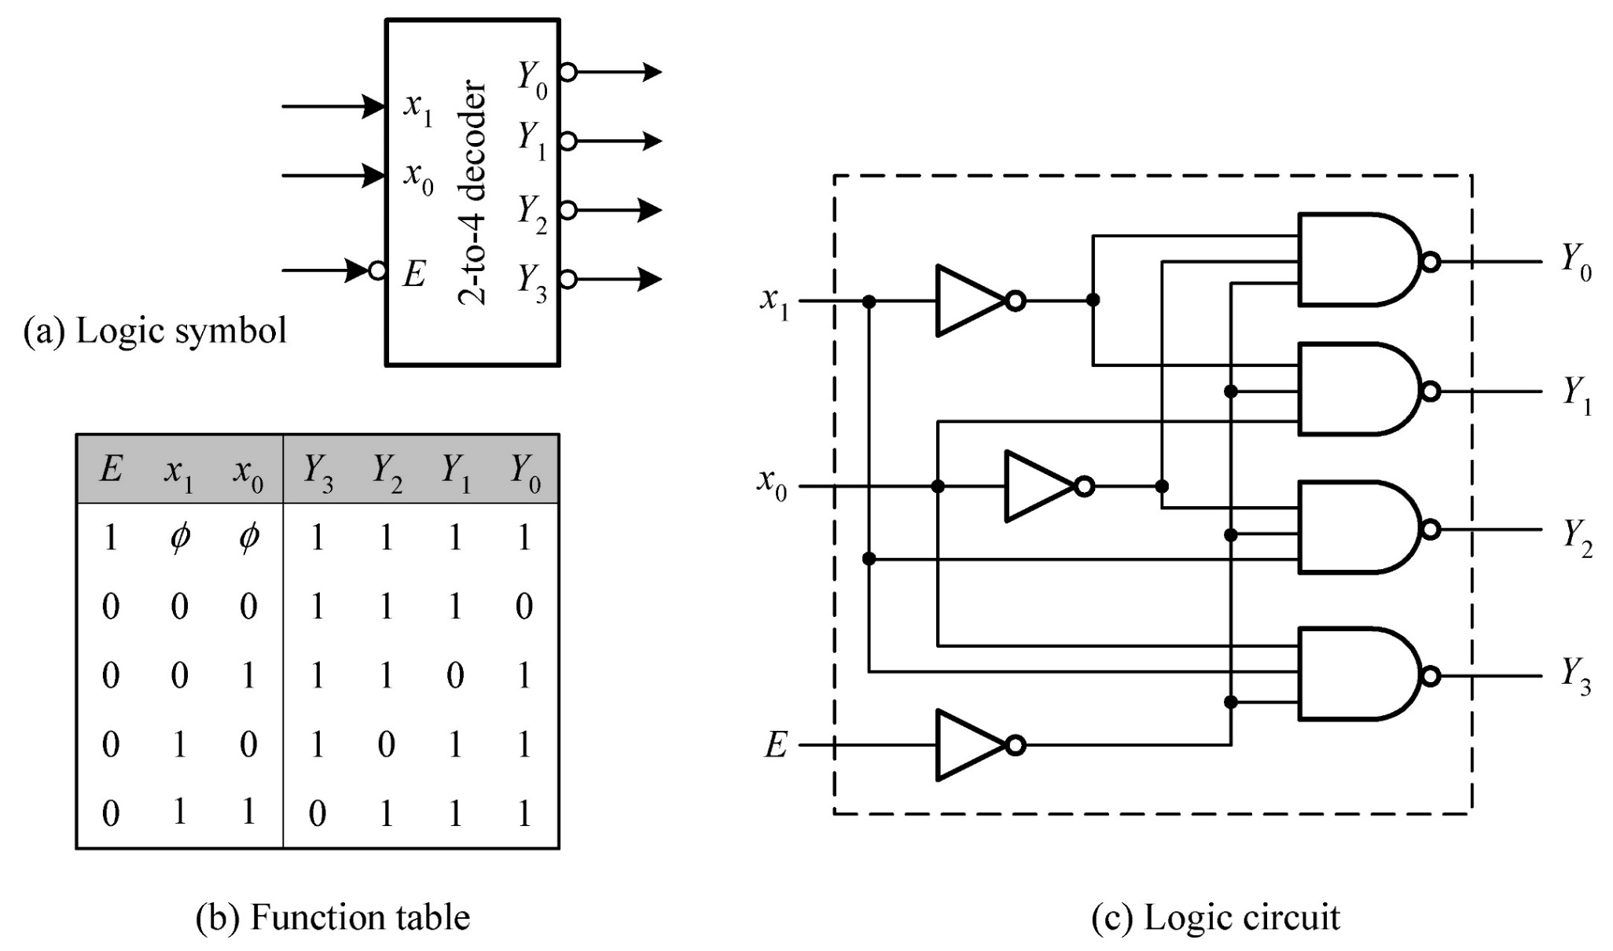
An Example: A 2-to-4 Decoder
Notes:
In order to understand the relationship between structural and behavioral modeling,
let’s see a 2-to-4 decoder.
On the right, you can see a structural model of 2-to-4 decoder consisting of instantiated logic gates.

Slide 37
An Example: A 2-to-4 Decoder
// a 2-to-4 decoder with active low output
always @(x or enable_n)
if (enable_n)
y = 4'b1111;
else
case (x)
2'b00 : y = 4'b1110;
2'b01 : y = 4'b1101;
2'b10 : y = 4'b1011;
2'b11 : y = 4'b0111;
default : y = 4'b1111;
endcase
Notes:
We can implement, in the behavioral modeling style, the same function as that in the previous slide.
As shown on the left, this always statement and the following if, else, and case statements also implement a 2-to-4 decoder.
When enable_n is low, this works as a 2-to-4 decoder. Otherwise, it gives as output a constant value, 4’b1111.
Synthesizing this code on Vivado, you can obtain a logic circuit like the one on the right.
If you compare this circuit and that on the previous slide,
they are different in terms of logic gate usage and connection while providing the same function.

Slide 38
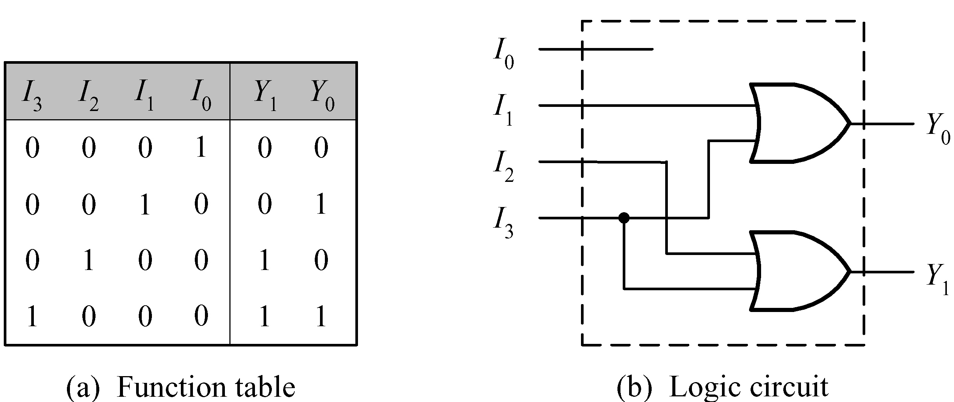
An Example: A 4-to-2 Encoder
Notes:
This example is a 4-to-2 encoder.
You can see we need only two OR gates as shown on the right.

Slide 39
An Example: A 4-to-2 Encoder
// a 4-to-2 encoder using if ... else structure
always @ (in) begin
if (in == 4'b0001) y = 0;
else if (in == 4'b0010) y = 1;
else if (in == 4'b0100) y = 2;
else if (in == 4'b1000) y = 3;
else y = 2'bx;
end
Notes:
On the left, we can see the behavioral code of 4-to-2 encoder.
The synthesis result, shown on the right, looks much more complex, i.e., expensive than the one in the previous slide.
Synthesis often gives worse results than manual optimized designs as exemplified in this case.

Slide 40
An Example: A 4-to-2 Encoder
// a 4-to-2 encoder using case structure
always @ (in)
case (in)
4'b0001 : y = 0;
4'b0010 : y = 1;
4'b0100 : y = 2;
4'b1000 : y = 3;
default : y = 2'bx;
endcase
Notes:
The behavioral model code can be designed in a more compact way by utilizing case statement as shown on the left.
However, the synthesis result is the same as the previous one.

Slide 41
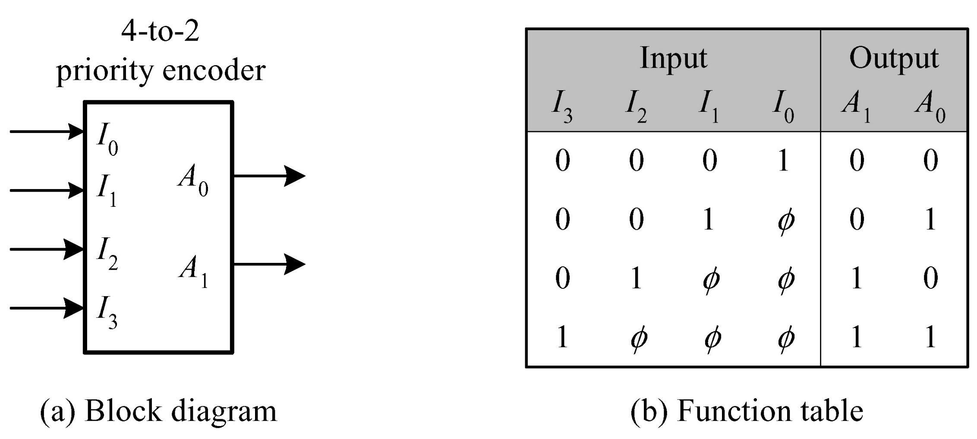
An Example: A 4-to-2 Parity Encoder

Slide 42
An Example: A 4-to-2 Parity Encoder
// using if ... else structure
assign valid_in = |in;
always @(in) begin
if (in[3]) y = 3;
else if (in[2]) y = 2;
else if (in[1]) y = 1;
else if (in[0]) y = 0;
else y = 2'bx;
end
Notes:
This is a 4-to-2 parity encoder.
Note that valid_in is obtained by a reduction OR operation on in.
Note also that each of the if statements checks only one bit of signal in[ ].
For instance, if in[3] is ‘1’, then y = 3.
In such a case, we don’t care the values of the other bits like in[2], in[1], and in[0].

Slide 43
An Example: A 4-to-2 Parity Encoder
// using casex structure
assign valid_in = |in;
always @ (in)
casex (in)
4'b1xxx: y = 3;
4'b01xx: y = 2;
4'b001x: y = 1;
4'b0001: y = 0;
default: y = 2'bx;
endcase
Notes:
Thus, we can modify the behavioral modeling code in a different way utilizing casex statement as shown in this slide.
Note that, in casex statement, we perform case equality operation
Which performs bit-wise comparing considering ‘x’ values to be valid.

Slide 44
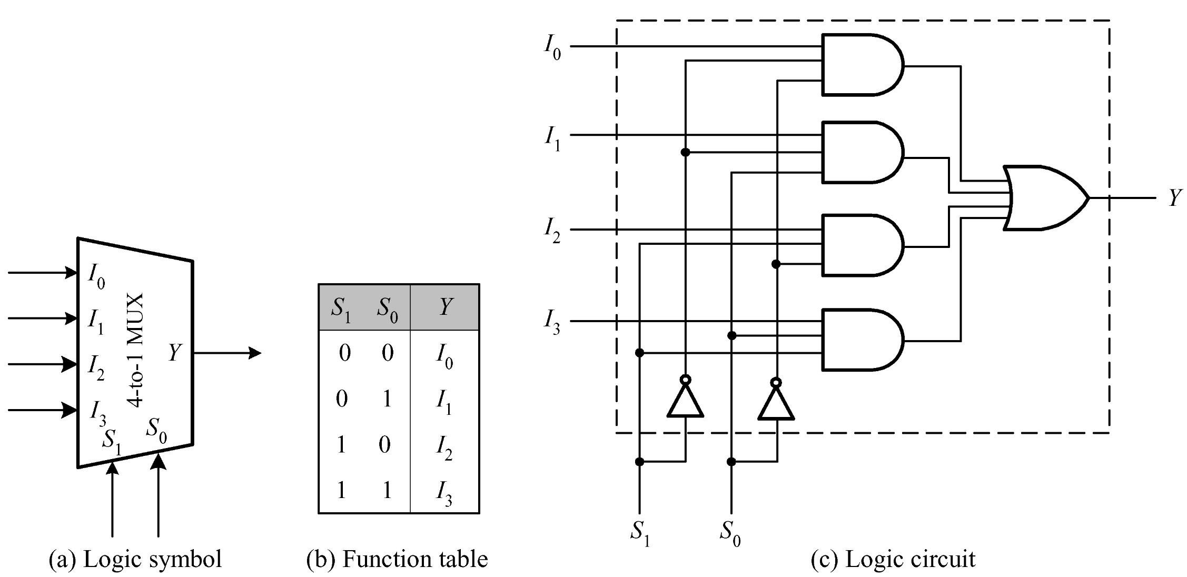
An Example: A 4-to-1 Multiplexer

Slide 45
An Example: An n-Bit 4-to-1 Multiplexer
// an N-bit 4-to-1 multiplexer using conditional operator
parameter N = 4; //
input [1:0] select;
input [N-1:0] in3, in2, in1, in0;
output [N-1:0] y;
assign y = select[1] ?
(select[0] ? in3 : in2) :
(select[0] ? in1 : in0) ;
Notes:
This example is a 4-to-1 multiplexer for n-Bit data (in3 ~ in0 in the code).
Conditional operators ( ? : ) are suitable for this function.

Slide 46
An Example: An n-Bit 4-to-1 Multiplexer
// an N-bit 4-to-1 multiplexer with enable control
parameter N = 4;
input [1:0] select;
input enable;
input [N-1:0] in3, in2, in1, in0;
output reg [N-1:0] y;
always @(select or enable or in0 or in1 or in2 or in3)
if (!enable) y = {N{1’b0}};
else y = select[1] ?
(select[0] ? in3 : in2) :
(select[0] ? in1 : in0) ;
Notes:
This example enhances the one in the previous slide by supporting enable control, i.e., new input enable.

Slide 47
An Example: An n-Bit 4-to-1 Multiplexer
// an N-bit 4-to-1 multiplexer using case structure
parameter N = 8;
input [1:0] select;
input [N-1:0] in3, in2, in1, in0;
output reg [N-1:0] y;
always @(*)
case (select)
2’b11: y = in3 ;
2’b10: y = in2 ;
2’b01: y = in1 ;
2’b00: y = in0 ;
default:y = N{1’b0};
endcase
Notes:
Instead of using the conditional operator, we can realize the multiplexer with case statement as shown in this slide.
Note that always @(*) is used and it practically makes a combinational circuit.

Slide 48
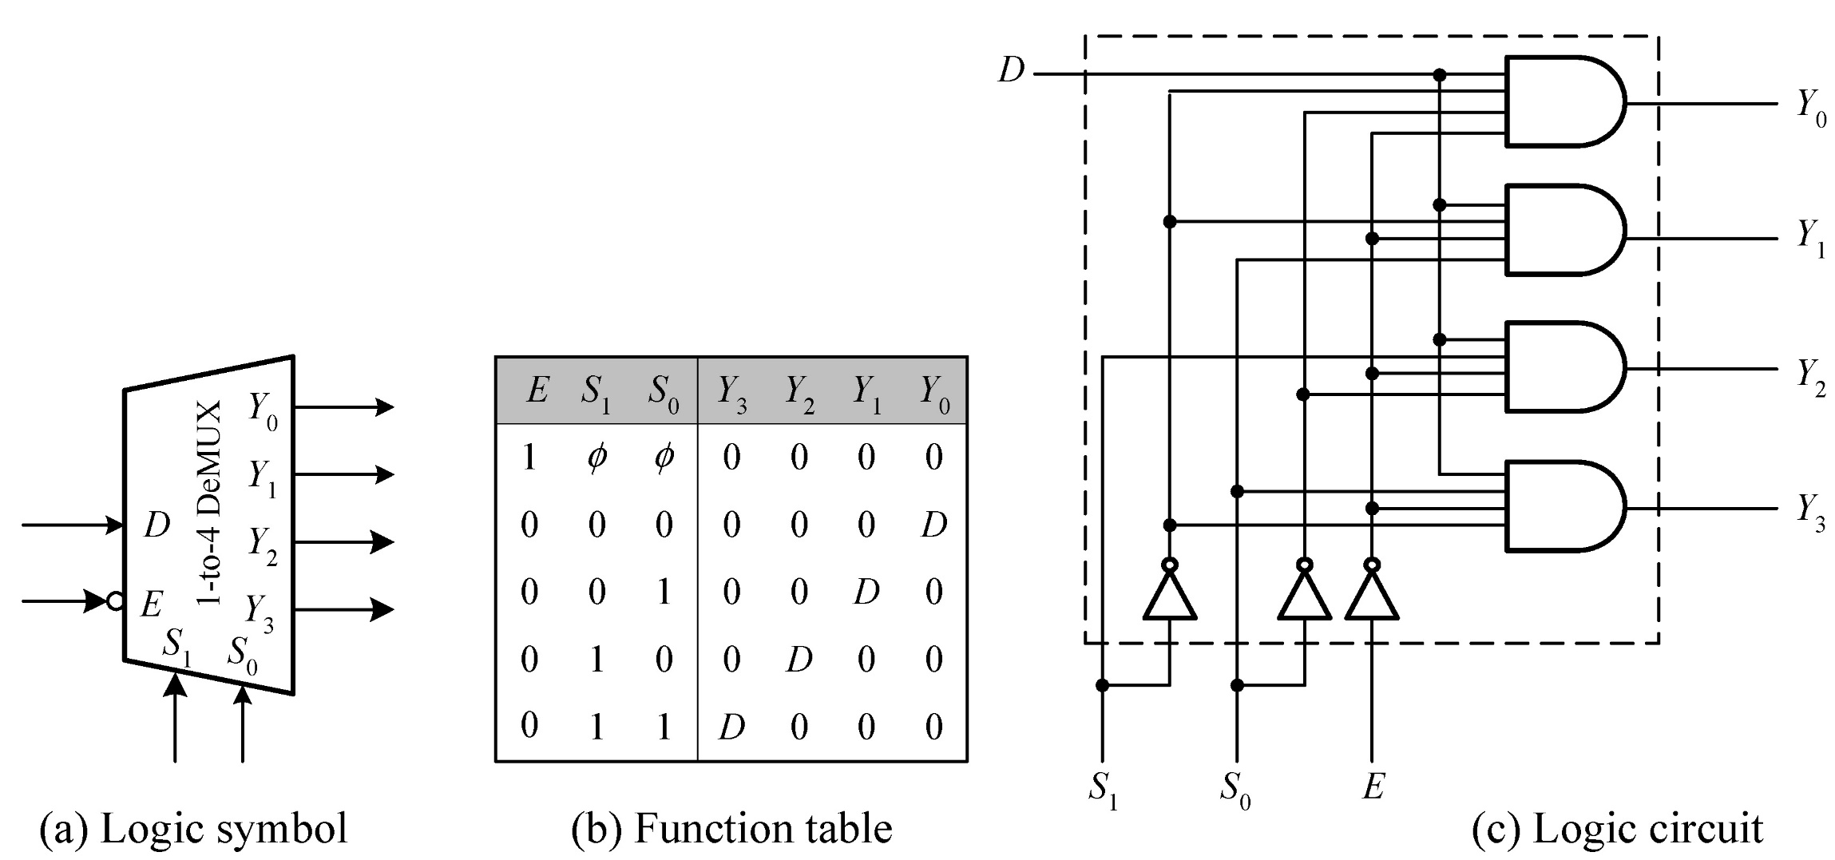
An Example: A 1-to-4 Demultiplexer

Slide 49
An Example: A 1-to-4 Demultiplexer
// an N-bit 1-to-4 demultiplexer using if ... else structure
parameter N = 4; // default width
input [1:0] select;
input [N-1:0] in;
output reg [N-1:0] y3, y2, y1, y0;
always @(select or in) begin
if (select == 3) y3 = in; else y3 = {N{1'b0}};
if (select == 2) y2 = in; else y2 = {N{1'b0}};
if (select == 1) y1 = in; else y1 = {N{1'b0}};
if (select == 0) y0 = in; else y0 = {N{1'b0}};
end

Slide 50
An Example: A 1-to-4 Demultiplexer
// an N-bit 1-to-4 demultiplexer with enable control
parameter N = 4; // Default width
…
output reg [N-1:0] y3, y2, y1, y0;
always @(select or in or enable) begin
if (enable) begin
if (select == 3) y3 = in; else y3 = {N{1'b0}};
if (select == 2) y2 = in; else y2 = {N{1'b0}};
if (select == 1) y1 = in; else y1 = {N{1'b0}};
if (select == 0) y0 = in; else y0 = {N{1'b0}};
end
else begin
y3 = {N{1'b0}}; y2 = {N{1'b0}}; y1 = {N{1'b0}}; y0 = {N{1'b0}}; end
end
Notes:
This is a 1-to-4 demultiplexer with enable control.
Note also that the data have multiple bits (N=4).

Slide 51
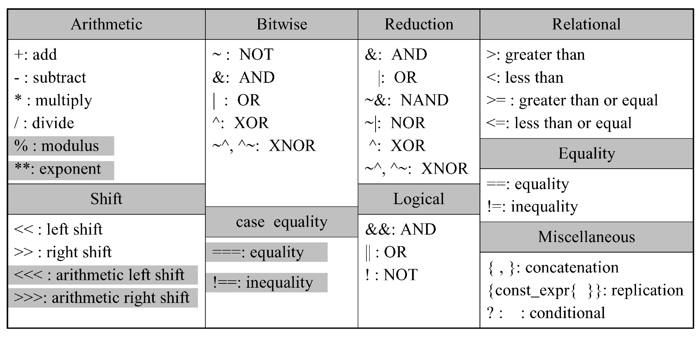
Synthesizable Operators
Notes:
As we know, there are some operators which are not synthesized.

Slide 52
Synthesizable if … else Statement
Usually synthesize into a 2-to-1 multiplexer
Nested if-else → priority-encoded, cascaded combination of multiplexers
For combinational logic
Completely specified?
For sequential logic
Completely specified?
Synthesis tool will remove the redundant expression
always @(enable or data)
if (enable) y = data; //infer a latch
always @(posedge clk)
if (enable) y <= data;
else y <= y; // a redundant expression
Notes:
In order to avoid synthesis issue, Verilog code needs to be completely specified.
For instance, If you write the following code,
always @(enable or data)
if (enable) y = data;
Although you may have tried to design a combinational circuit, 2-to-1 mux or a gating function enabled by ‘enable’ signal,
the synthesis result will contain a latch, i.e., a storage element.
It is because you have not specified the function when the if condition is false.
If the condition is false, the contents of signal y will be the same (over time), which may not be the desired function.
In order to keep the same value over time, we need a storage element like a latch.
Thus, in order to avoid unintended use of latch, i.e., a design bug,
if you design a combinational circuit with if statements (including case statement),
you need to specify the desired behavior for all the cases.
However, in the case of sequential circuit design,
you can exploit the fact that the unspecified case will create a latch.
In the following code example,
always @(posedge clk)
if (enable) y <= data;
else y <= y; // a redundant expression
“else y <= y;” can be removed.
It is because you are specifying a flip-flop (by always @(posedge clk) and assignment to y).
If you write the else statement as in the example, it will be removed by the compiler.

Slide 53
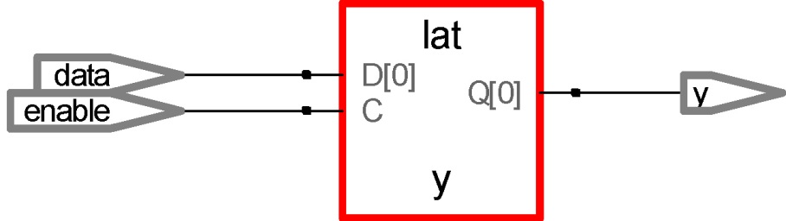
Latch Inference – Incomplete if-else Statements
// creating a latch
module latch_infer_if(enable, data, y);
input enable, data;
output reg y;
always @(enable or data)
if (enable) y = data; // infer a latch for y
Notes:
If you synthesize the code on this slide,
You can find that a latch is really used, which may not be desired.

Slide 54
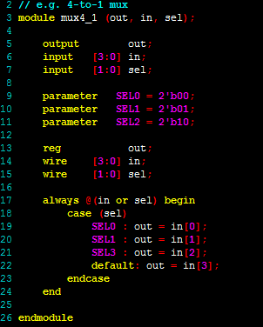
case Statement
Syntax
case (expr)
item_1,… , item_n : stmt1;
item_n+1, …, item_m: stmt2;
..
default: default_stmt;
endcase
Notes:
As I mentioned before, we need to completely specify all the cases in the case statement to avoid latch inference.

Slide 55
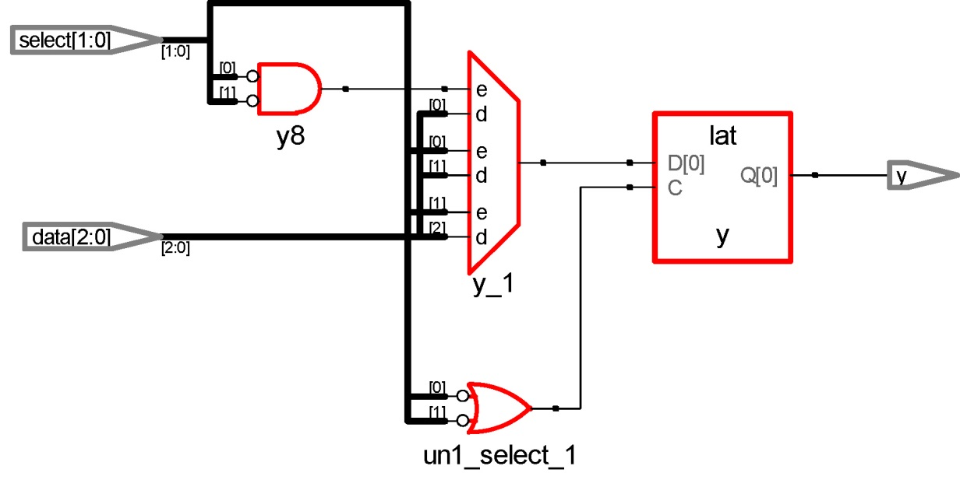
Latch Inference – Incomplete case Statements
// Creating a latch
module latch_infer_case(select, data, y);
…
output reg y;
always @(select or data)
case (select)
2'b00: y = data[select];
2'b01: y = data[select];
2'b10: y = data[select];
// default: y = 2'b11;
endcase
Notes:
In this example, the case statement is not complete because the behavior of default case is omitted.
Thus, as shown on the right, a latch was inferred in the synthesis result.

Slide 56
This Week’s Practice and Class
Practice: Designing, simulating and synthesizing a multiplier IP block (intellectual property block) utilizing Vivado
Class
Basic Verilog grammar 2
Generate statement
Structural and behavioral modeling
Synthesizable code
Understanding bus interface
The generated multiplication IP has bus interface
Notes:
In the following slides, we will study the basics of bus protocol which is required in this week’s lab.

Slide 57
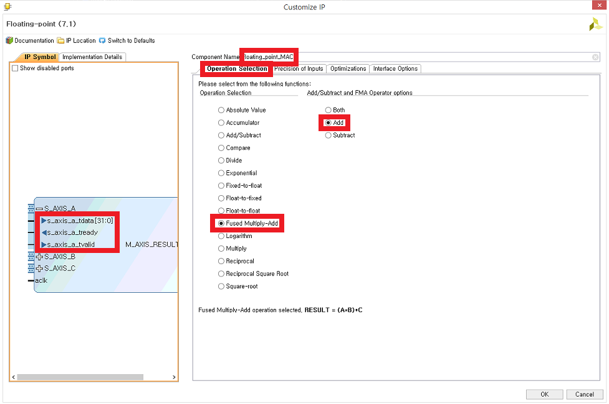
How to use IP catalog
Configuration
Notes:
In this week’s practice, you will use Vivado to generate a floating-point multiplier.
Specifically, as you can see in this slide, you will choose an existing hardware design and configure it in Vivado.

Slide 58
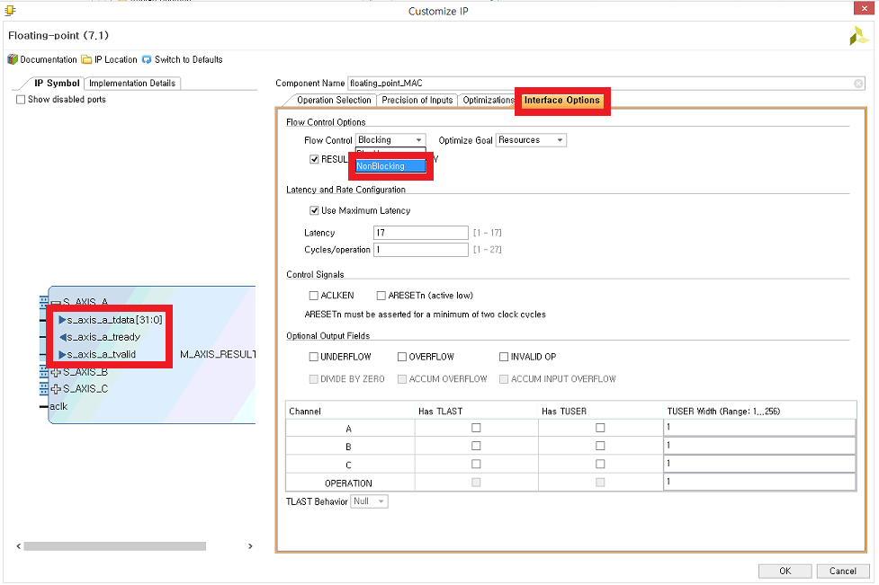
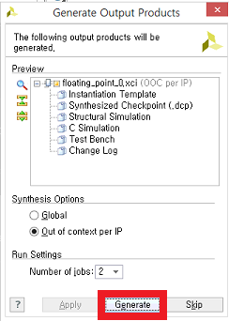
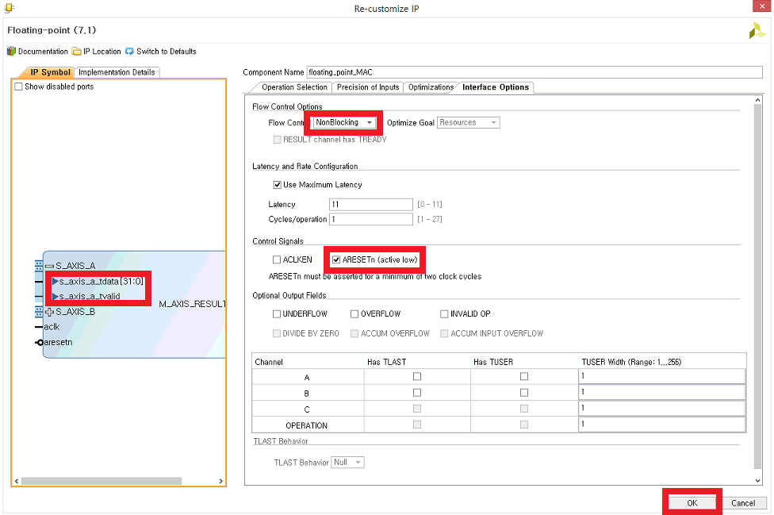
How to use IP catalog
Remove redundant pins
Notes:
When configuring the existing hardware design (called intellectual property, IP) of floating point multiplier, in order to simplify your design,
You will remove some redundant pins of the existing hardware design.
Specifically, you will use only a few signals of bus interface by doing configuration shown in this slide.
You will set ‘Non Blocking’ in the flow control option of interface option as shown in the slide.
By doing that, you will not use some bus signals, i.e., ready signals, thereby simplifying the bus interface of your floating point multiplication IP.
In the following slides, I will explain what blocking exactly means and the effect of selecting non blocking in the bus interface.

Slide 59
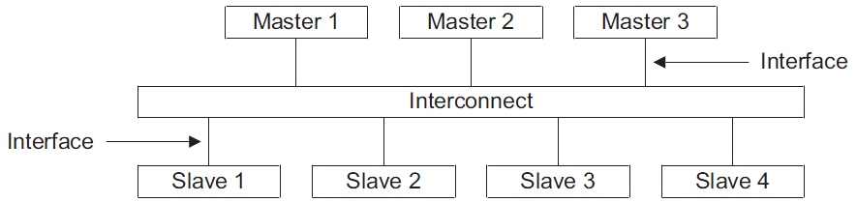
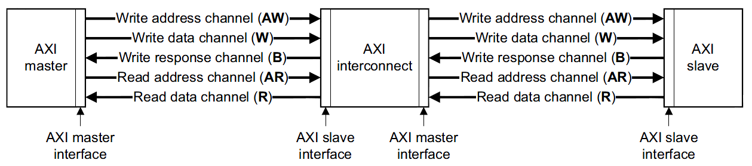
Interconnect, Interface & Channel
[Source: AXI Spec]
Notes:
This slide shows a simplified diagram of bus interconnect.
Typically, the computer system consists of processor, bus, memory and peripherals.
The bus (interconnect in this slide) connects them.
The other components communicate with each other through the bus.
The processor reads/writes data from/to memory through the bus.
The component initiating communication by raising a request, like a read request, is called master.
The processor is a typical master.
The memory component serves the request, e.g., serves a read request by sending the required data to the processor via the bus.
Such a component which serves the request is called slave.
In the slide, we have 3 masters and 4 slaves connected by a bus.
In our practice, we use ARM AMBA AXI bus which is the most popular bus on silicon chips.
For instance, all of silicon chips in your smartphones utilize this bus.
At the bottom of the slide, you can see the details of a connection between a master, e.g., a processor like ARM CPU and the bus and
that of another connection between the bus and a slave, e.g., a memory or a hardware component like our floating point multiplier.
Between a master and the bus, there are five channels, three of them are for write operation, e.g, writing a data from the processor to the memory,
and two for read operation.
For instance, when the processor reads data from the memory.
The processor, i.e., the master can send a read request, on read address channel (AR) on the slide,
by sending to the bus a read address and other information, e.g., number of read data.
Upon receiving the read request, the bus sends the same request to the corresponding slave
via another read address channel (AR) between the bus and the slave.
After receiving the read request, the slave like our floating point multiplication IP, prepares the requested data, e.g., the multiplication result.
Then, the slave sends the requested data via read data channel.
The bus receives the data from the read data channel between the slave and the bus.
Then, the bus forwards the data to the original master via the read data channel between the master and the bus.

Slide 60
Channel Example
AXI
Master
Write Address/Control
AXI
Slave
52~56
AWID[3:0] write addr ID (0~4 bits)
AWADDR[31:0] write addr ID
AWLEN[3:0] burst length
AWSIZE[2:0] burst size
AWBURST[1:0] burst type
Payload
AWLOCK[1:0] lock info
AWCACHE[3:0] cache type
AWPROT[2:0] protection type
AWVALID write address valid
Handshake
signals
AWREADY write address ready
Write data
39~43
WID[3:0] write ID tag, AWID = WID (0~4 bits)
WDATA[31:0] write data
WSTRB[3:0] write strobes
WLAST write last
WVALID write valid
WREADY write ready
Notes:
This slide exemplifies in detail two channels, write address and write data channels between master and slave.
Each channel has the information to transfer from one side to the other.
For instance, write address channel has address (AWADDR) and other information related with the write request, e.g., length (# data), size (bit width), etc.
Master and slave communicate with each other utilizing a simple handshake protocol using two signals, valid and ready.
In order to send the information, the sender (typically, master) needs to place the information on the associated signals, e.g., AWADDR.
At the same time or later, the sender needs to raise valid signal to inform the receiver of the new information.
At every clock, the receiver receives all the information from the sender and checks to see if the valid signal is ‘1’.
If the valid signal is ‘1’, the receiver utilizes the information received at the current clock.
If the valid signal is ‘0’, the receiver discards the information of the current clock.
The slave controls the ready signal.
If it is ready to receive information from the master, it sets the ready signal to ‘1’.
Thus, the communication from the master to the slave occurs at a clock rising edge when both valid (set by master) and ready (set by slave) are ‘1’.

Slide 61
Handshaking and Flow Control
Valid and ready signals are used for handshaking and flow control
At every clock cycle, sender and receiver perform the followings
Sender
If there is any information to send, then it places information to send on the associated signals by raising valid signal
If the receiver raised ready signal, the sender considers that the information of the current cycle (that the sender placed on the bus signal) will be received by the receiver. Thus, the sender considers the communication of the current information is completed.
Receiver
The receiver receives all the information and stores it temporarily.
If the receiver is busy, then it sets its ready signal to ‘0’ and ignore the information received from the master.
If the receiver is ready, then it sets its ready signal to ‘1’.
The receiver receives the information from the master only when both valid and ready are ‘1’.

Slide 62
Handshaking and Flow Control
Ready signal (raised by the receiver) plays a role of flow control.
It is because if the ready signal is ‘0’, the sender cannot further send the information to the receiver. Only after the ready signal becomes ‘1’, the sender can send the info to the receiver.
We call the flow control ‘Blocking’ flow control.
In our practice, we set ‘Non Blocking’ in the flow control option of interface option. In such a case, we set ready signal to ‘1’ all the time by connecting the signal to supply voltage of the circuit. By doing that, you will not care about ready signals, thereby simplifying the bus interface of your floating point multiplication IP.
Note that the sender is not blocked by ready signal and can send the info at any time. In order not to lose any information sent by the sender, the receiver should be able to process the request at any clock cycle.

Slide 63
Agenda
Lecture
Verilog basics #2
Bus interface basics (to understand the interface of multiplier IP)
Introduction to the lab on Week 3
Utilizing a floating point multiplier IP (intellectual property) block on Vivado

