Slide 1
Hardware System Design (Week 7) Introduction to Zynq FPGA & Starting MV Accelerator Design
April 28, 2020
Sungjoo Yoo
Computing Memory Architecture Lab.
CSE, SNU
http://cmalab.snu.ac.kr

Slide 2
Weekly Schedule
W1 17 Application (deep learning on FPGA)/SW app (MNIST/CIFAR)
W2 25 Verilog 1 Basics/Vivado tutorial (verification level of HW design)
W3 31 Verilog 2 Combinational circuits (Video pre-view homework + TA Q&A)/Simple adder using dsp (V+V, Verilog intro)
W4 4/7 Verilog 3 Sequential circuits/V*V processing element (PE) design 1
W5 14 Verilog 4 Design example & synthesizable code/V*V processing element (PE) design 2
W6 21 Convolution lowering and matrix multiplication accelerator/Convolution lowering (V0)
W7 28 Intro to Zynq & MV accelerator design/Zynq FPGA & synthesis, continue VV design & start MV accelerator design
W8 5/5 (Children’s day) Optional lab session is provided in lecture and lab hour
W9 12 Main memory (physical & virtual)/OS+FPGA (HOST~DEVICE) communication & MV design 2
W10 19 Bus and DMA (Video pre-view + TA Q&A)/custom IP & MV design 3
W11 26 Advanced deep learning #1 quantization for low precision computation/V0+DMA+8b
W12 6/2 Advanced deep learning #2 zero skipping/V0+DMA+8b+zero-skipping 1
W13 9 Lecture summary/V0+DMA+8b+zero-skipping 2
W14 16 Final exam/Term project (V0+DMA+8b+zero) submission
Notes:
In our schedule, we design the hardware accelerator for four weeks as the blue part shows.

Slide 3
Agenda
Lecture
Zynq FPGA
MV accelerator design
Introduction to the lab in Week 7

Slide 4
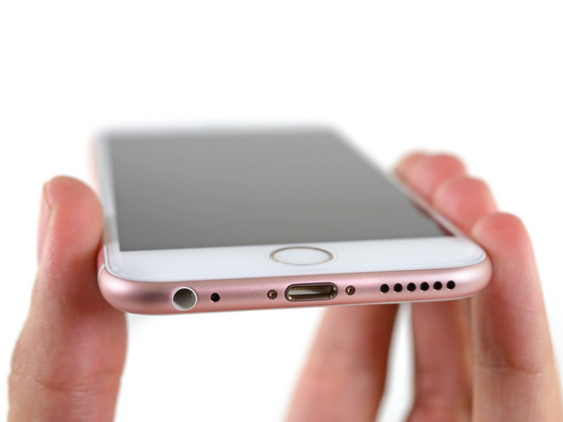
iPhone Teardown
[iFixit]

Slide 5
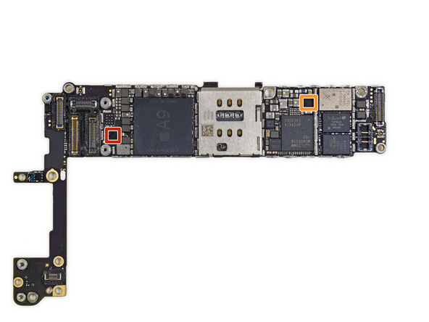
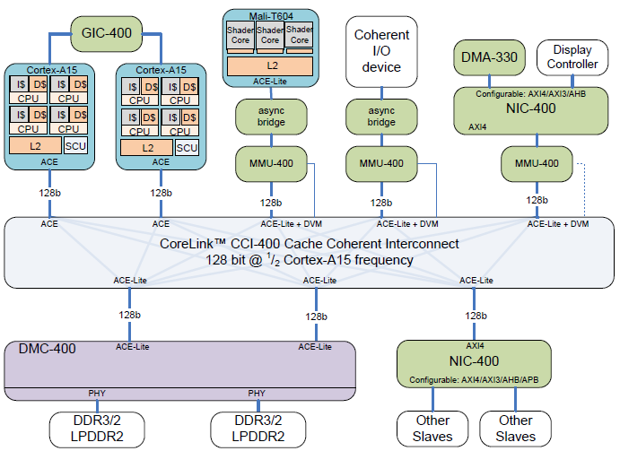
Silicon Chip for Smartphone
[iFixit][ARM]
GPU
Codec, ISP, …
Mobile AP
(application processor)
Notes:
On the left, we see the main board of smartphone. We have a CPU chip at the center of the board.
We often call it application processor because we run applications here.
On the right, we see the internal structure of mobile AP chip.
On the left, we have ARM CPUs.
At the top center, we have mobile GPU, ARM Mali and hardware accelerators for video processing like codec and image signal processing, ISP.
As you can see in this structure, the mobile AP consists of hardware functions as well as CPU.
Let’s first consider why we use hardware functions.

Slide 6
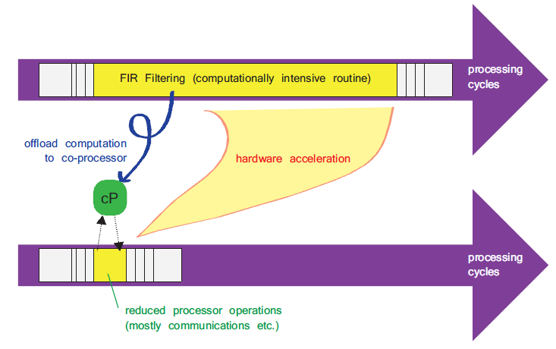
Why Hardware? Performance & Power!
[The Zynq Book, 2014]
Notes:
Compared with a software implementation, the benefit of hardware implementation is performance and power.
Let’s assume that we run a function called FIR filter. As we can see here, the FIR filtering takes a long time in yellow in software.
By implementing the FIR filtering in hardware, we can significantly reduce the runtime and power consumption.
Here, cP represents coprocessor which implements the FIR filtering in hardware.
We also call such coprocessor hardware accelerator.

Slide 7
Hardware Acceleration is Becoming More and More Popular
[iFixit][ARM]
GPU
Codec, ISP, …
Mobile AP
(application processor)
Notes:
Hardware acceleration is becoming more and more popular.
In the case of mobile devices, it is mainly due to power consumption.
In the case of server and high-end embedded systems like self-driving cars, it is mainly due to performance.

Slide 8
4+ Smartphones with NPU
Neural processing unit (NPU) accelerates neural network execution like our MV accelerator
Apple
A12 and A13 bionic chip has a neural processing unit
Huawei 980
Cambricon-X provides the NPU
Samsung
Galaxy S10 and new versions have an NPU
We will study this later when we discuss our practice of zero skipping function
Google
Pixel 3 and 4 have a Visual core which provides on-device AI

Slide 9
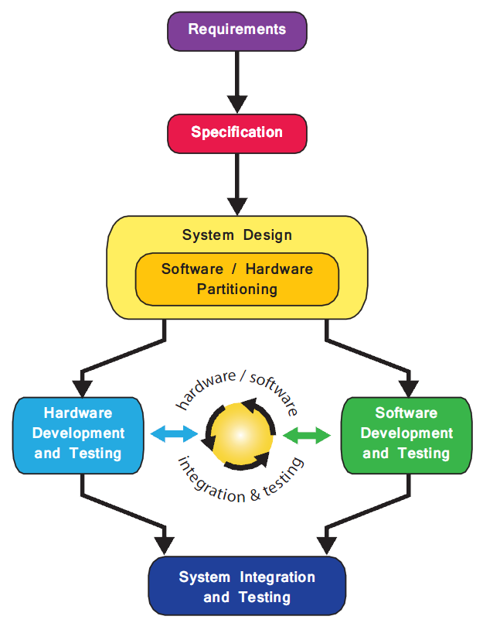
Software/Hardware Design Flow
[The Zynq Book, 2014]
System requirements, e.g., face recognition
Specification, e.g., 99.9% accuracy
Software/Hardware partitioning
Based on performance estimation of key functions
Hardware: convolution acceleration
After partitioning, software and hardware functions are designed in parallel
Integration
Software <-> Hardware communication via device driver or load/store instruction
Specifically in the term project
Hardware design, simulation, implementation, and debugging on FPGA
Software (OS/APP) – hardware communication
Notes:
This figure on the right shows a simplified flow of software/hardware system design.
The starting point is system requirements.
Let’s assume that we want to design a face recognition system and image data is available from a camera system.
Specification is to fix the target in numbers like 99% accuracy in face recognition.
Given a specification, we estimate the performance and power estimation of the system on a candidate hardware choice, e.g., ARM Cortex-A9 CPU, 14nm silicon technology, etc.
Based on the estimation, we determine which function to implement in hardware while implementing the others in software.
In the case of face recognition, convolution, which is the most time-consuming part, can be chosen for hardware accelerator.
After partitioning, software and hardware functions are designed in parallel.
After obtaining software and hardware designs, we integrate them.
For the integration, software and hardware need to communicate with each other via device driver or load/store instruction.
In our class, we focus on these two parts in red, hardware design including FPGA implementation and debugging and software-hardware communication.

Slide 10
Two Ways in Hardware Design
Dedicated chip or FPGA design
Dedicated chip design
E.g., Samsung Exynos AP (application processor), Apple A12, Qualcomm Snapdragon, Google TPU (tensor processing unit)
Pros: Low cost in mass production / low power / high performance
Cons: High cost in small # of devices, very long design time (>1.5 year)
Design cost is >$10M for modest size chip design @ 7nm
Notes:
There are two ways to implement our function in hardware, dedicated chip design and FPGA design.
There are many dedicated chip designs in smartphones.
In the case of server, Google designed their chip dedicated for deep learning that we will see in the next slide.
The benefit of dedicated chip design is low cost.
Chip design cost itself is very high now, more than $10M for mobile AP chip.
However, if you can fabricate them in mass production, then unit price can get reduced down to tens of dollars in the case of mobile AP.
Dedicated chips provide low power and high performance as well.
The negative point of dedicated chip design is that
if the total number of chips is small, due to the high design cost, unit price is also high.
Another negative point is long design time.
Typically it takes at least 1.5 years from specification to chip.

Slide 11

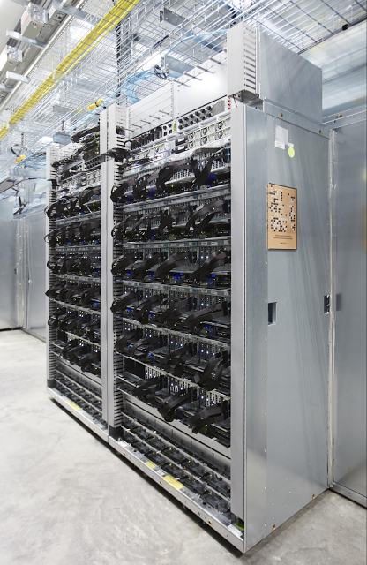
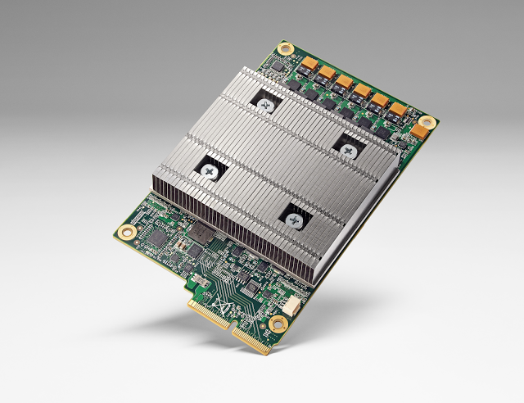
Notes:
Let’s see Google case. When Lee Sedol and AlphaGo had a match last year, AlphaGo ran on this dedicated chip.
As you can see on the right picture, they put Go board on their rack.
According to Google’s blog on the left of this slide,
They considered designing hardware accelerator chip several years ago.
They started to use it since 2015, which means they started to design it in year 2013.
Google’s main reason to design TPU chip is performance, specifically, latency.
We can run deep neural networks on typical GPUs because GPUs provide high performance.
However, in terms of latency, GPU gives long latency.
Thus, in case of real-time and user interactive programs, GPU cannot meet the small latency constraint.

Slide 12
Two Ways in Hardware Design
Dedicated chip design
E.g., Samsung Exynos AP (application processor), Apple A12, Qualcomm Snapdragon, Google TPU (tensor processing unit), …
Pros: Low cost in mass production / low power / high performance
Cons: High cost in small # of devices, very long design time (~1.5 year)
Design cost is >$10M for modest size chip design @ 7nm
FPGA (or programmable system-on-chip, SoC)
E.g., Xilinx Zynq
Pros: (Relatively) low cost in small # of devices, fast design time (~hours)
Doable in University class!
Cons: Low performance and high power w.r.t. dedicated chip design
Notes:
Another way of hardware design is FPGA design.
The benefit of FPGA is relatively low cost in small volume.
Another benefit is fast design time.
When your synthesizable Verilog code is ready,
it takes hours to see your hardware design work.
That’s why we use FPGA in our practice class.
However, compared with dedicated chip designs, FPGA gives lower performance and higher power consumption.

Slide 13
Goal and Questions in Our Class
Understanding hardware to better design our software
Basic questions
How can software communicate with hardware? As a device or as a part of physical memory space?
How can I design my own hardware function and make it communicate with my software code?
More specific questions
What is the hardware system to run my software code?
What are the components in the hardware system?
How are the hardware components connected?
Important questions for our class
What hardware function do I design?
What is my software code which works with the hardware function?
Notes:
Our goal in this class is understanding hardware in order to better design our software.
When we think about software/hardware design,
a typical question will be
from the software point of view,
how can software communicate with hardware?
Hardware functions can be accessed as a device using device driver or as a part of physical memory space using load/store instructions.
From the hardware point of view, a typical question will be
how can I design my own hardware function and make it communicate with my software code?
There are more specific questions like
What is the hardware system to run my software code?
What are the components in the hardware system?
How are the hardware components connected?
How do they communicate with CPU where my software code runs?
And, important questions for our class will be
What hardware function do I design?
What is my software code working with the hardware function?
I will give you short answers to these questions at the end of today’s lecture.

Slide 14
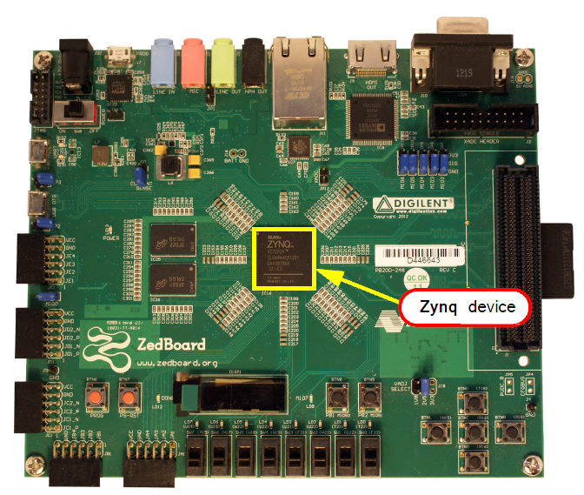
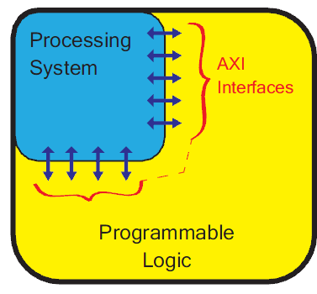
Zynq: Programmable SoC
[The Zynq Book, 2014]
Zynq architecture
Processing System (PS)
Programming Logic (PL)
Zynq
ZedBoard
Notes:
In our practice and term project, we will use Zed board as the hardware system.
We have an FPGA called Zynq on this.
Zynq FPGA consists of two parts, processing system in short PS and programmable logic in short PL.
We will run our software code here on PS and the hardware function on PL.

Slide 15


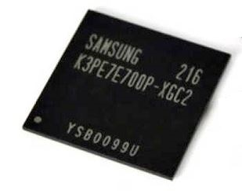
Hardware Overview in Our Term Project
PS-DRAM
Component
Xilinx Zynq (XC7Z020)
Processing System
(PS, ARM Co-A9)
Programmable Logic
(PL, Xilinx Artix-7)
Core #1
Matrix-Vector Multiplication Custom IP
Core #2
Memory interface
AXI master
BRAM
Notes:
This figure shows PS and PL in more detail for our practice and term project.
Linux runs on ARM CPU called Cortex-A9.
We run our software code on Linux.
On the PL, we will implement our own hardware function which does matrix-vector multiplication.
The software code on PS communicates with the hardware function on the PL via a memory component called block RAM (BRAM).

Slide 16
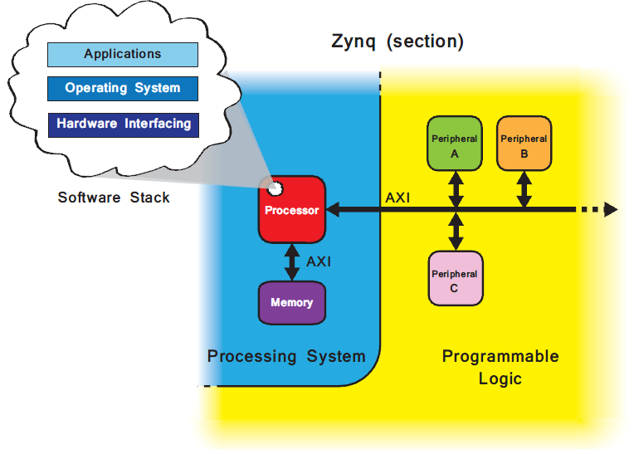
PS and PL in More Detail
[The Zynq Book, 2014]
Notes:
This slide shows a more detailed view of PS and PL.
PS consists of CPU and memory. We run our software on this CPU.
PL has hardware components. They are connected with the CPU via the bus called AXI bus.
We will implement our function as one of hardware components on PL.

Slide 17
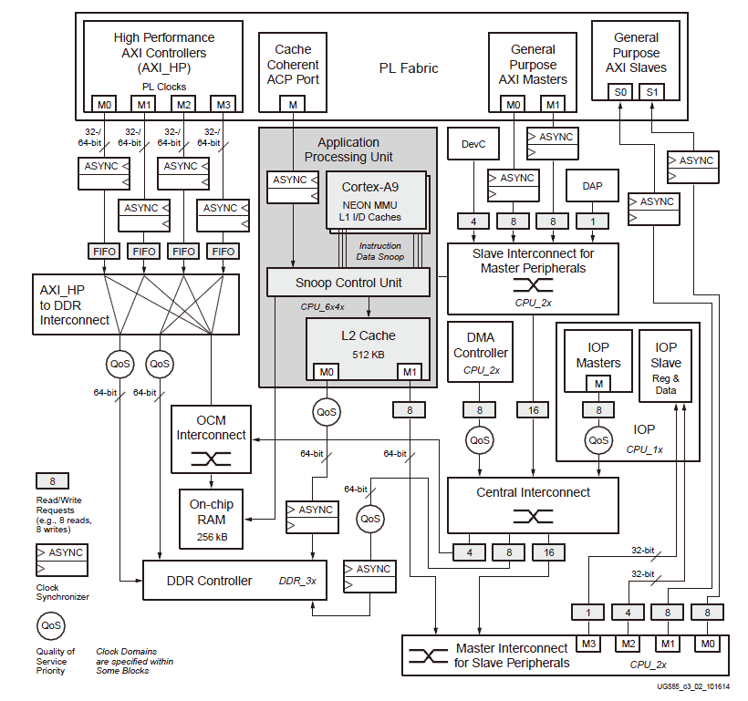
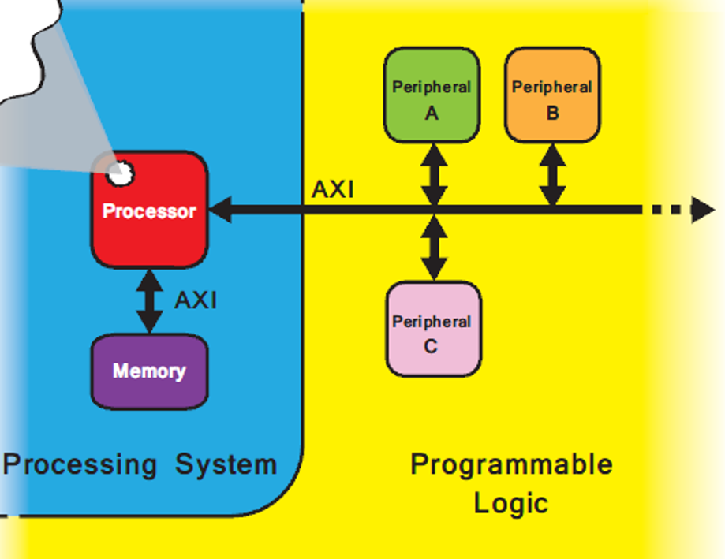
[UG585 Zynq TRM, 2016]
AXI interface
APU System View Diagram
Notes:
This slide gives a much more detailed view of PS.
At the top, we have PL (in yellow) and AXI interface.
The blue area corresponds to PS.

Slide 18
PS = APU + Main Memory + Peri Logic
Application Processing Unit (APU)
Cortex-A9 CPUs, L2 cache, …
Main memory
DDR controller
External interface logic for peripherals
Interconnects
Notes:
Processing system consists of application processing unit, main memory, external interface logic and interconnects to connect them.

Slide 19
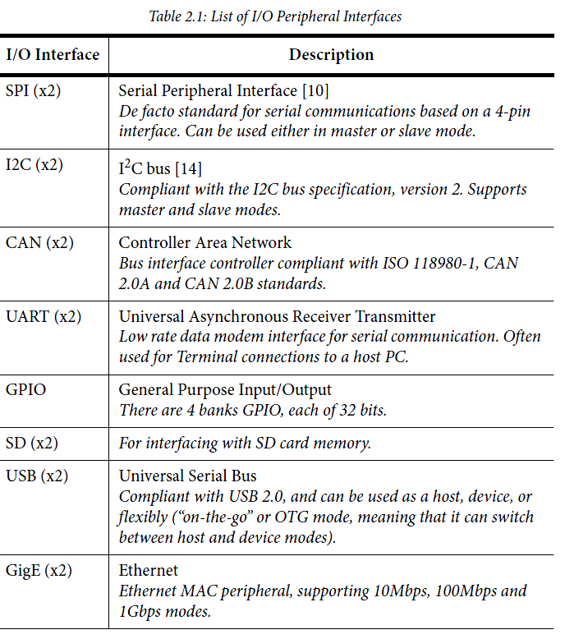
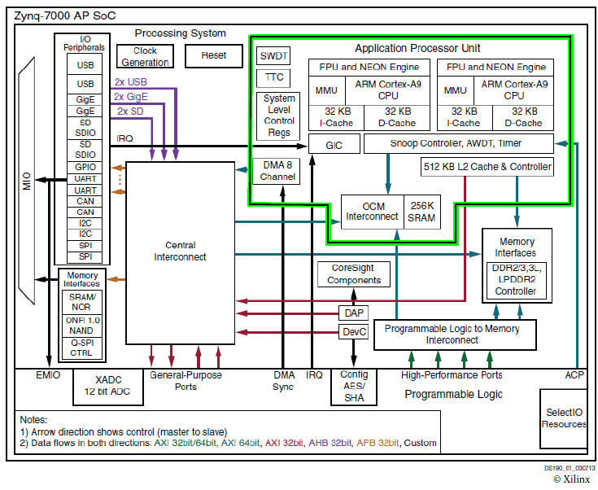
Peripheral I/O in Zynq PS
[The Zynq Book, 2014]
Notes:
Zynq board has many input and output devices such as SD card, USB, Ethernet, etc.
The control logic for these devices is implemented inside of Zynq PS in this dashed red box.

Slide 20
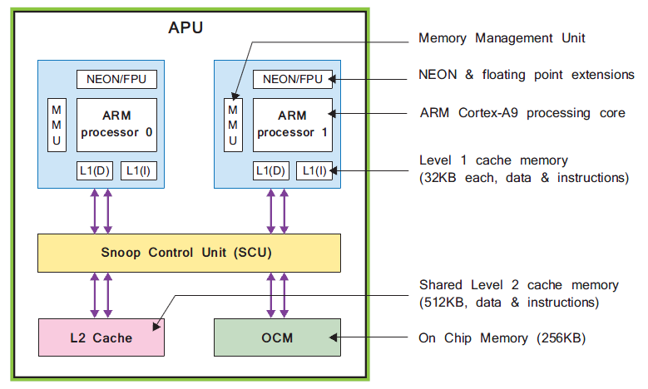
APU in Zynq PS
[The Zynq Book, 2014]
Notes:
APU, application processing unit, is the core part of Zynq.
It consists of two ARM Cortex-A9 processors.
Each processor has its own level 1 (L1) caches for instruction and data.
Two processors share the level 2 (L2) cache.
In addition to the L2 cache, APU has on-chip memory, OCM which is also called scratch pad memory.

Slide 21
DRAM on Zed Board
[The Zynq Book, 2014]
DRAM (main memory)
ZedBoard
Notes:
In PS, we have an important component, main memory.
On the right, we can locate two main memory (DRAM) chips on the Zed board.
On the left, inside of Zynq FPGA, we have a memory controller
which is connected to the main memory chips and controls the data transfer between the main memory and PS.

Slide 22
Programmable Logic (PL)
The logic fabric
where we will implement our design
PS-PL Interface
The AXI standard interface
ACP (accelerator coherence port) interface
Notes:
We will implement our hardware function in the programmable logic part of Zynq FPGA.
Between PL and PS, we have two types of interface, AXI and ACP interface.
The majority of those interfaces is based on AMBA AXI protocol we will study in the next class.

Slide 23
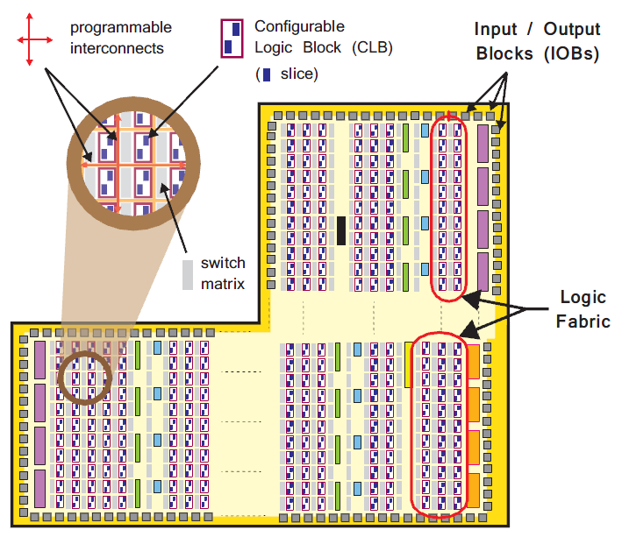
Zynq PL
[The Zynq Book, 2014]
Logic fabric
CLB, switch matrix, interconnect
Input/Output block (IOB)
Special blocks
DSP48E1
BRAM (block RAM)
DSP48E1
BRAM
Notes:
Zynq PL has logic fabric, input/output blocks and special blocks.
Logic fabric consists of configurable logic blocks, CLB in short, switch matrix and interconnect among CLBs.
You can implement any hardware logic on CLBs.
Two special blocks, DSP and BRAM are very important in our term projects.

Slide 24
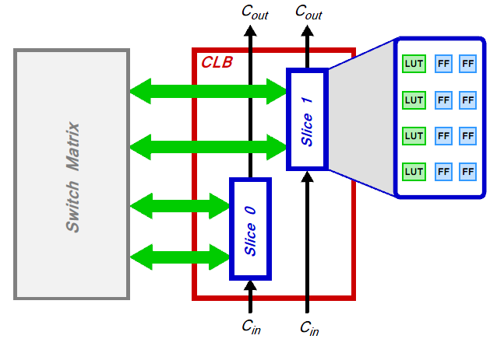
Memory Implements Combinational Circuit
LUT (look up table) = small memory implementing a logic function
F0 = A' B' C + A B' C' + A B' C
F1 = A' B' C + A' B C' + A B C
F2 = A' B' C' + A' B' C + A B' C'
F3 = A' B C + A B' C' + A B C'
A B C F0 F1 F2 F3
0 0 0 0 0 1 0 0 0 1 1 1 1 0 0 1 0 0 1 0 0 0 1 1 0 0 0 1
1 0 0 1 0 1 1
1 0 1 1 0 0 0
1 1 0 0 0 0 1
1 1 1 0 1 0 0
Memory 8 words x 4 bits/word
A B C F0 F1 F2 F3
address
outputs
truth table
block diagram
Notes:
In FPGA, we implement combinational circuit using memory.
Let’s see this example of combinational circuit having three inputs, A, B, and C which gives four outputs, F0 to F3.
Given a truth table, we can implement the circuit function using a memory by considering the input as an address and the output as the contents in the memory.
In FPGA, we adopts memory-based implementation because it is easy to reprogram the contents of memory for different functions.

Slide 25
CLB (Configurable Logic Block)
[The Zynq Book, 2014]
Slice
4 LUTs and 8 F/Fs
An LUT has 6 inputs
Switch matrix
Slice-to-slice connection
CLB-to-CLB or IOB connection
Carry signals
Useful in implementing carry propagation logic, e.g., ripple carry adder
Notes:
Configurable Logic Block (CLB) consists of two slices.
Each slice has 4 lookup tables (LUTs) and 8 F/Fs.
An LUT typically has 5-6 inputs and its output can be stored in the F/Fs.
Slices are connected via switch matrix on the left.
Switch matrix provides a flexible routing (i) between elements within a CLB; and (ii) from one CLB to other resources on the PL.
These carry signals, Cin and Cout are useful in implementing carry propagation logic like a ripple carry adder.

Slide 26
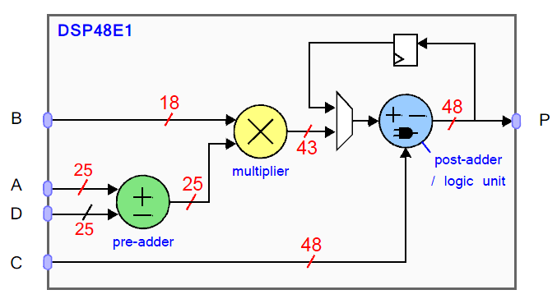
CLB and DSP
[The Zynq Book, 2014]
CLB
DSP
Notes:
CLB is for generation functions.
The Zynq FPGA has a special type of slice, DSP slice, in the PL.
DSP48E1 is very useful implementing arithmetic functions.
As you can see on the right, it has two adders and one multiplier.
These components are implemented with dedicated logic circuits.
Thus, they run much faster than the same function implemented in the LUT.
In our practice and term project, we will exploit DSP slices.

Slide 27
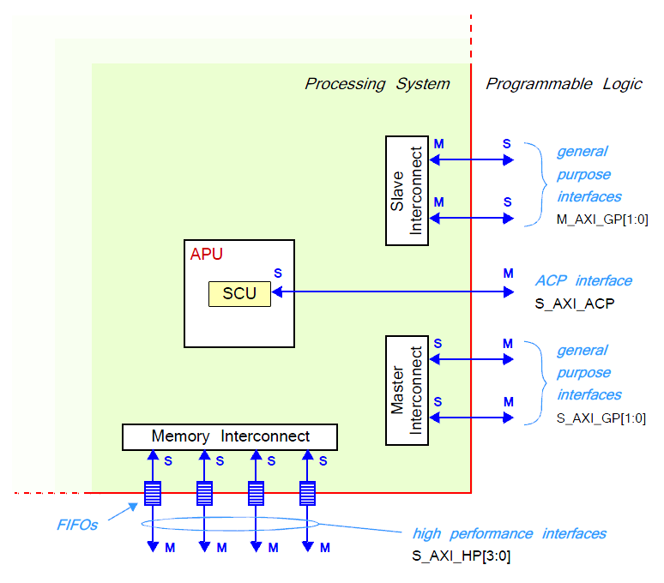
[UG585 Zynq TRM, 2016]
AXI interface
APU System View Diagram
Notes:
The interface between PS and PL is based on AMBA bus called AXI.

Slide 28
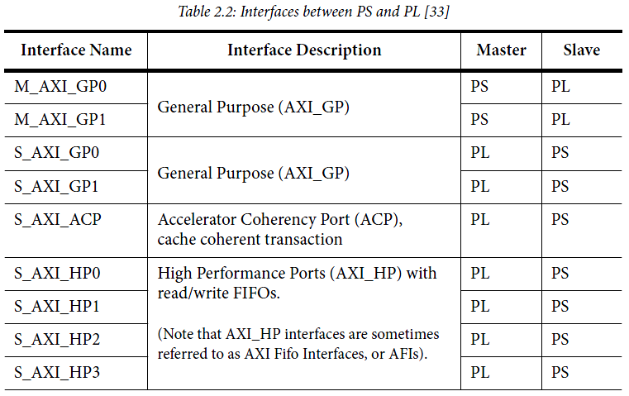
Zynq PS-PL Interface
[The Zynq Book, 2014]
The AXI Standard Interface
M_GP, ACP, S_GP, S_HP
Other Interfaces
EMIO, interrupts, ...
Notes:
AMBA AXI is the standard bus used in almost all digital chips these days.
By studying it, we can learn communication between hardware components.
We will study the key contents of general AXI bus in the next class.
Today, we will check only the interface between PS and PL.
On the right figure, we have a boundary in red between PS and PL.
There are several connections across the boundary.
In communication, we usually have two participants.
In AXI, we call them master and slave ports.
Master port initiates communication.
Slave port accepts the communication request from the master port and handles it.
For instance, we see 4 master ports (M) here at the bottom.
Hardware components in PL can access main memory in PS via these master ports.
To be specific, a hardware component can make a read request to the main memory through the first master port here. (animation)
Similarly, the software program running on the CPU in PS can make read or write request to the hardware component in PL using master ports here at the top. (animation)

Slide 29
Goal and Questions in Our Class
Understanding hardware to better design our software
Basic questions
How can software communicate with hardware? As a device or as a part of physical memory space?
How can I design my own hardware function and make it communicate with my software code?
More specific questions
What is the hardware system to run my software code?
What are the components in the hardware system?
How are the hardware components connected?
Important questions for our class
What hardware function do I design?
What is my software code which works with the hardware function?
Notes:
Before we go into the details of our FPGA system and hardware design on it,
let me give you short answers to those questions.

Slide 30
Short Answers to Questions in Our Class (1)
What is the hardware system to run my software code?
Zynq FPGA system where ARM Cortex A9 CPU runs your software code
What are the components in the hardware system?
Fixed components (e.g., CPU, SD card I/O) and programmable logic (where your hardware is implemented)
How are the hardware components connected?
Dedicated wires or bus (we study and use a very simple version of ARM AMBA3 AXI bus)
Notes:
We use Zynq FPGA system. We run our software code on ARM CPU in the FPGA.
The hardware part of FPGA consists of fixed function components like SD card interface and programmable logic.
We will implement our hardware on the programmable part.
The hardware components including CPU are connected via dedicated wires or bus.
We will study ARM AMBA3 AXI bus and use a simple version of AXI bus for our hardware function design.

Slide 31
Short Answers to Questions in Our Class (2)
How do they communicate with CPU where my code runs?
From software to hardware, memory access using pointers to registers/on-chip memory using mmap()
Hardware takes as input the contents of registers/on-chip memory and gives its outputs to registers/on-chip memory
Xilinx Zynq (XC7Z020)
Processing System
(PS, ARM Co-A9)
Programmable Logic
(PL, Xilinx Artix-7)
Core #1
Matrix-Vector Multiplication Custom IP
Core #2
Memory interface
AXI master
BRAM
Notes:
Hardware and software communicate with each other via registers and on-chip memory.
The registers of hardware function are accessed by the software code using pointers which is set by function, mmap().
The hardware takes as input the contents of registers/on-chip memory and gives its outputs to registers/on-chip memory.

Slide 32
Short Answers to Questions in Our Class (3)
What hardware function do I design?
Matrix-vector multiplication
The hardware design consists of multiply and accumulate (MAC) units, memory (BRAM), bus and control logic
What is my software code which works with the hardware function?
Simple neural network code which runs on ARM A9 CPU
Similar to your code in earlier practices
SW code sets memory (BRAM) for your MAC units, initiates them, and receives results from memory
Notes:
We will implement, as the hardware function, matrix-vector multiplication.
The hardware consists of multiply and accumulate units called MAC units, memory called BRAM, bus and control logic.
We will run software code which executes a small neural network.
The software code will initiate matrix-vector multiplication in hardware.

Slide 33
Weekly Schedule
W1 17 Application (deep learning on FPGA)/SW app (MNIST/CIFAR)
W2 25 Verilog 1 Basics/Vivado tutorial (verification level of HW design)
W3 31 Verilog 2 Combinational circuits (Video pre-view homework + TA Q&A)/Simple adder using dsp (V+V, Verilog intro)
W4 4/7 Verilog 3 Sequential circuits/V*V processing element (PE) design 1
W5 14 Verilog 4 Design example & synthesizable code/V*V processing element (PE) design 2
W6 21 Convolution lowering and matrix multiplication accelerator/Convolution lowering (V0)
W7 28 Intro to Zynq & MV accelerator design/Zynq FPGA & synthesis, continue VV design & start MV accelerator design
W8 5/5 (Children’s day) Optional lab session is provided in lecture and lab hour
W9 12 Main memory (physical & virtual)/OS+FPGA (HOST~DEVICE) communication & MV design 2
W10 19 Bus and DMA (Video pre-view + TA Q&A)/custom IP & MV design 3
W11 26 Advanced deep learning #1 quantization for low precision computation/V0+DMA+8b
W12 6/2 Advanced deep learning #2 zero skipping/V0+DMA+8b+zero-skipping 1
W13 9 Lecture summary/V0+DMA+8b+zero-skipping 2
W14 16 Final exam/Term project (V0+DMA+8b+zero) submission
Notes:
In our schedule, we design the hardware accelerator for four weeks as the blue part shows.

Slide 34
Desired MV Accelerator
Matrix M (N x N)
Input vector V
Result R
MV accelerator
TxT tile
Memory (BRAM)
w11
w12
v1
r1
w21
w22
v2
r1
r2
r2
C cycles
v1
v2
CPU
w11
w12
X
=
w21
w22
1
1
1
Buffer1
MAC1
Register
w11
w12
X
p1
w21
w22
X
p2
Buffer2
MAC2
Tile 1
Tile 2
Tile N/T
C cycles
T
T
Time
Total execution cycles of MV = ((N/T)*(C+T+T))*(N/T)

Slide 35
Desired MV Accelerator
Difficulty in handling multiple BRAM modules
Matrix M (N x N)
Input vector V
Result R
MV accelerator
TxT tile
Memory (BRAM)
w11
w12
v1
r1
w21
w22
v2
C cycles
BRAM0
r1
r2
r2
v1
v2
CPU
w11
w12
BRAM1
X
=
w21
w22
BRAM2
1
1
1
Buffer1
MAC1
Register
w11
w12
X
p1
w21
w22
X
p2
Buffer2
MAC2

Slide 36
Our MV Accelerator: Single BRAM Read Port for Matrix Elements
Storing Weights for Buffer 1
Matrix M (N x N)
Input vector V
Result R
MV accelerator
TxT tile
Memory (BRAM)
w11
w12
v1
r1
w21
w22
v2
r1
r2
r2
C cycles
v1
v2
CPU
w11
w12
X
=
w21
w22
1
1
Buffer1
MAC1
Register
w11
w12
X
p1
w21
w22
X
p2
Buffer2
MAC2
MAC
1
C cycles
T
Time
Tile 1

Slide 37
Our MV Accelerator: Storing Weights for Buffer 2
Additional T cycles are spent due to a single read port
Matrix M (N x N)
Input vector V
Result R
MV accelerator
TxT tile
Memory (BRAM)
w11
w12
v1
r1
w21
w22
v2
r1
r2
r2
C cycles
v1
v2
CPU
w11
w12
X
=
w21
w22
1
1
Buffer1
MAC1
Register
w11
w12
X
p1
w21
w22
X
p2
Buffer2
MAC2
MAC
2
C cycles
T
T
Time
Tile 1
Total execution cycles of MV = ((N/T)*(C+T*T+T))*(N/T)

Slide 38
Our MV Accelerator: Dot-Product by Vector Broadcasting
Dot product operation by broadcasting the vector elements
Matrix M (N x N)
Input vector V
Result R
MV accelerator
TxT tile
Memory (BRAM)
w11
w12
v1
r1
w21
w22
v2
r1
r2
r2
C cycles
v1
v2
CPU
w11
w12
X
=
w21
w22
1
1
Buffer1
MAC1
Register
w11
w12
X
p1
w21
w22
X
p2
Buffer2
MAC2
MAC
2
2 dot-product
operations in parallel
for 2 cycles in this example
C cycles
T
T
T
Time
Tile 1
Total execution cycles of MV = ((N/T)*(C+T*T+T))*(N/T)

Slide 39
Our VV Accelerator
Only one MAC unit performs dot-product to give one output
Matrix M (N x N)
Input vector V
Result R
MV accelerator
TxT tile
Memory (BRAM)
w11
w12
v1
r1
w21
w22
v2
r1
r2
r2
C cycles
v1
v2
CPU
w11
w12
X
=
w21
w22
1
1
Buffer1
MAC1
Register
w11
w12
X
p1
w21
w22
X
p2
Buffer2
MAC2
C cycles
T
T
{Row #1’s T elements} * {V’s T elements}
Time

Slide 40
Building Our MV Accelerator with VV: Adding Data Paths, {Buffer-MAC-Register}’s
Data transfer from BRAM to Buffer1 and then Buffer2
Matrix M (N x N)
Input vector V
Result R
MV accelerator
TxT tile
Memory (BRAM)
w11
w12
v1
r1
w21
w22
v2
r1
r2
r2
C cycles
v1
v2
CPU
w11
w12
X
=
w21
w22
1
1
Buffer1
MAC1
Register
w11
w12
X
p1
w21
w22
X
p2
Buffer2
MAC2
MAC
2
C cycles
T
T
Time
Tile 1
Total execution cycles of MV = ((N/T)*(C+T*T+T))*(N/T)

Slide 41
Our MV Accelerator
Matrix M (N x N)
Input vector V
Result R
MV accelerator
TxT tile
Memory (BRAM)
w11
w12
v1
r1
w21
w22
v2
r1
r2
r2
C cycles
v1
v2
CPU
w11
w12
X
=
w21
w22
1
1
Buffer1
MAC1
Register
w11
w12
X
p1
w21
w22
X
p2
Buffer2
MAC2
MAC
2
C cycles
T
T
T
Time
Tile 1
Total execution cycles of MV = ((N/T)*(C+T*T+T))*(N/T)

Slide 42
Agenda
Lecture
Zynq FPGA
MV accelerator design
Introduction to the lab in Week 7

