Slide 1
Bloomenergy
2017-12751 컴퓨터공학부 이동학

Slide 2
History
In 2001, Originally called Ion America, Bloom Energy, was founded.
In 2002, John Doerr, and Kleiner Perkins became the first Bloom Energy investors.
In early 2006 Bloom shipped its first 5kW field trial unit to the University of Tennessee, Chattanooga.
After two years of successful field trials in Tennessee, California, and Alaska, to validate the technology, the first commercial (100kW) products were shipped to Google in July 2008.

Slide 3
Mission
Bloom Energy's mission is to make clean, reliable, and affordable energy for everyone in the world.
Bloom’s Energy Server Platform is a stationary power generation platform built for the digital age and capable of delivering highly reliable, uninterrupted, 24x7 constant power that is also clean and sustainable.
Among the most efficient energy generators on the planet; our platform dramatically reduces electricity costs and greenhouse gas emissions.
Some of the largest companies in the world trust Bloom to provide their businesses with clean, reliable and resilient energy.

Slide 4
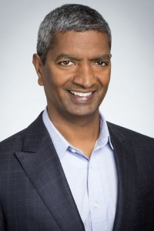
CEO
KR Sridhar
Director of the Space Technologies Laboratory (STL) at the University of Arizona.
Advisor to NASA and has led major consortia of industry, academia, and national labs.
Convert Martian atmospheric gases to oxygen for propulsion and life support.
Fortune Magazine: "one of the top five futurists inventing tomorrow, today”.

Slide 5
Solutions
Energy server platform
Integrated storage
Mission critical
Microgrid
Flexible financing

Slide 6
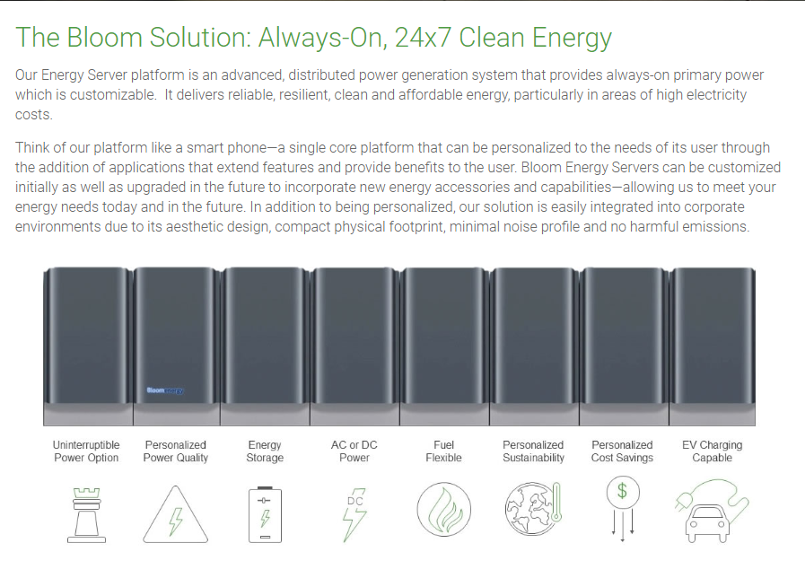
Energy server platform

Slide 7
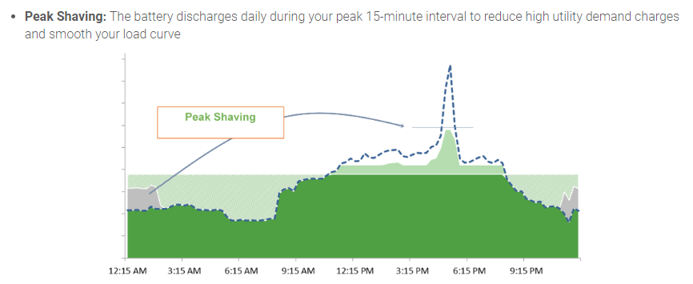
Integrated storage

Slide 8
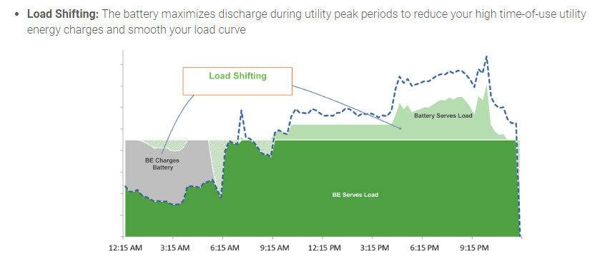
Integrated storage

Slide 9
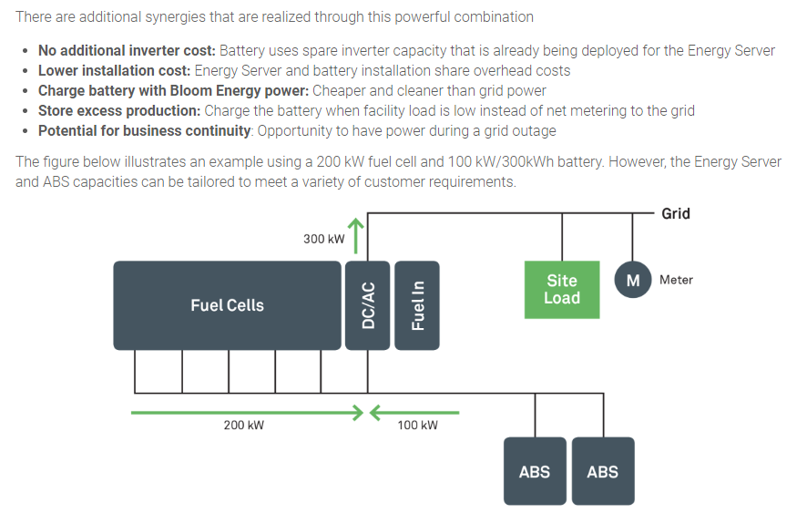
Integrated storage

Slide 10
Mission critical
Extended outage protection
Eliminates surges, sags or interference
Highly modular, scalable design
Predictable electricity costs
24 x 7 uninterruptible Power
Availability of the BE solution = 99.998%
Concurrently maintainable
Highly redundant design
Fault tolerant
Hot swappable field replacement units
Eliminates the risk of power over-provisioning
Displaces legacy equipment
etc…

Slide 11
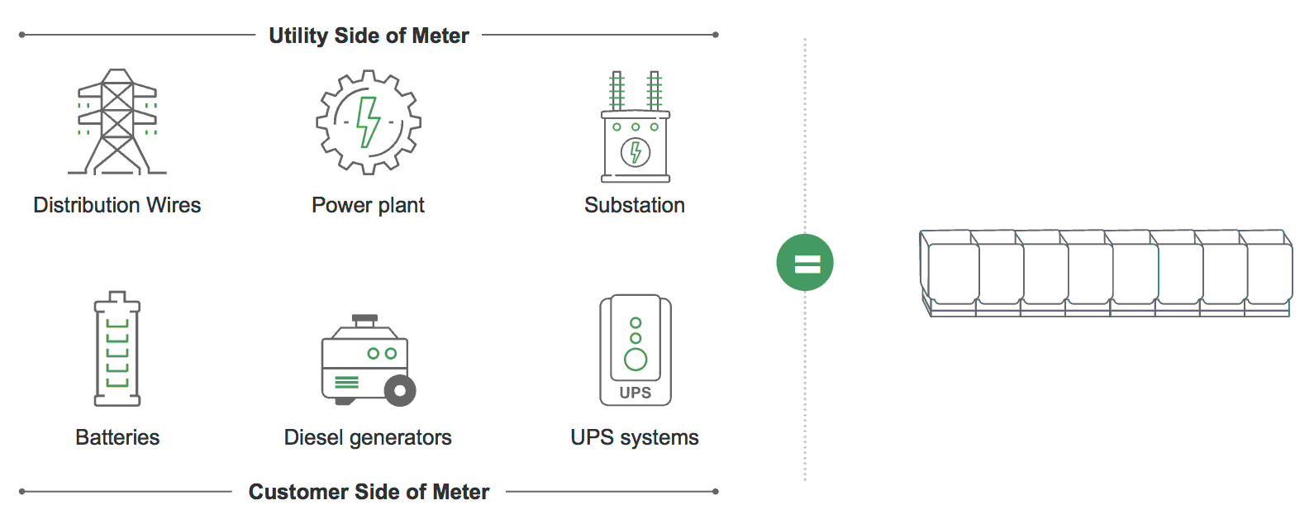
Mission critical

Slide 12
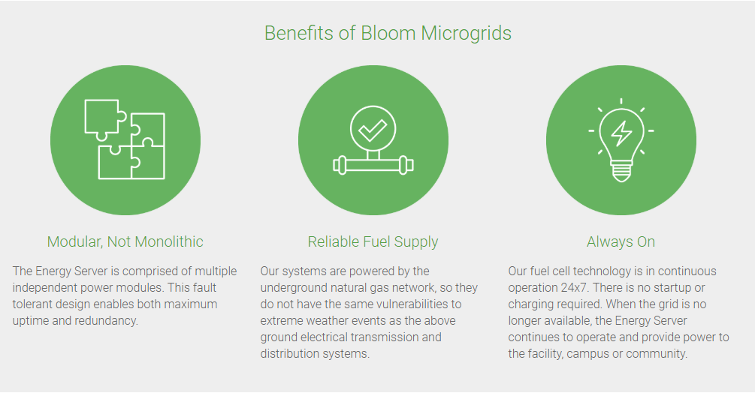
Microgrid

Slide 13
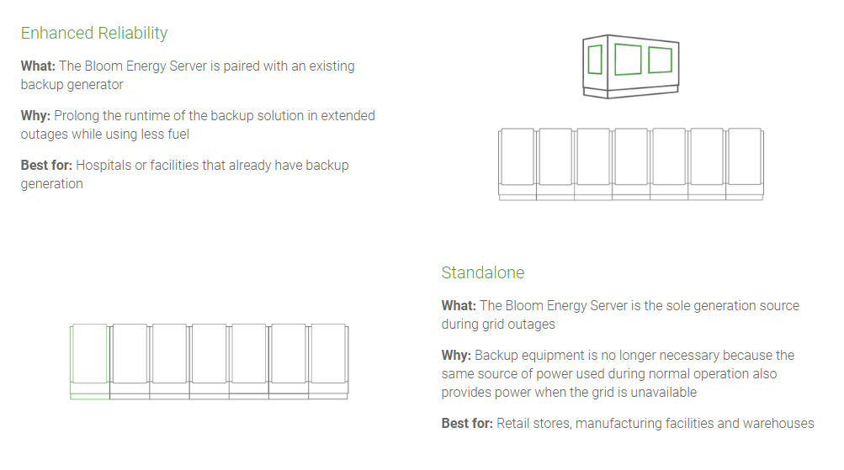
Microgrid

Slide 14
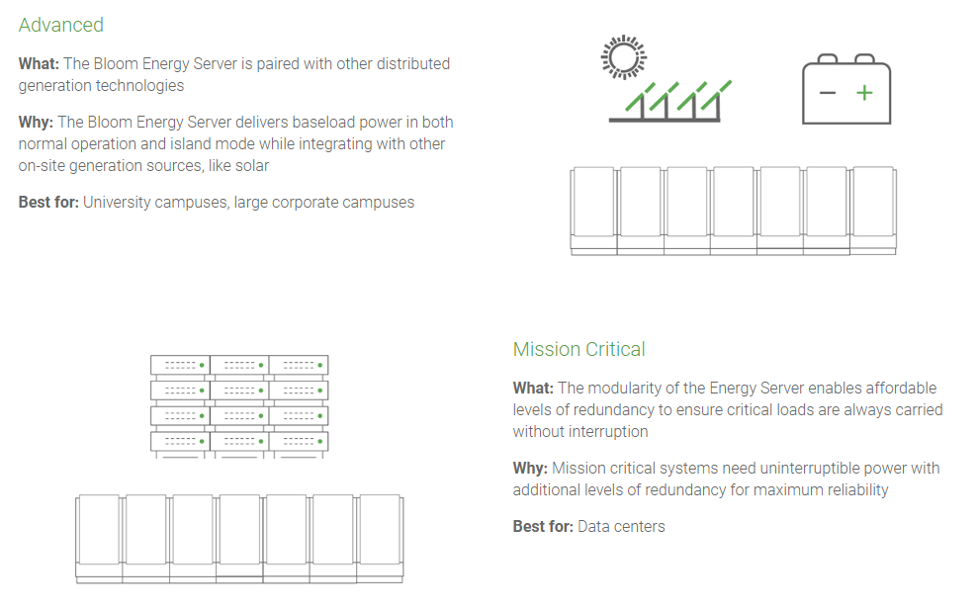
Microgrid

Slide 15
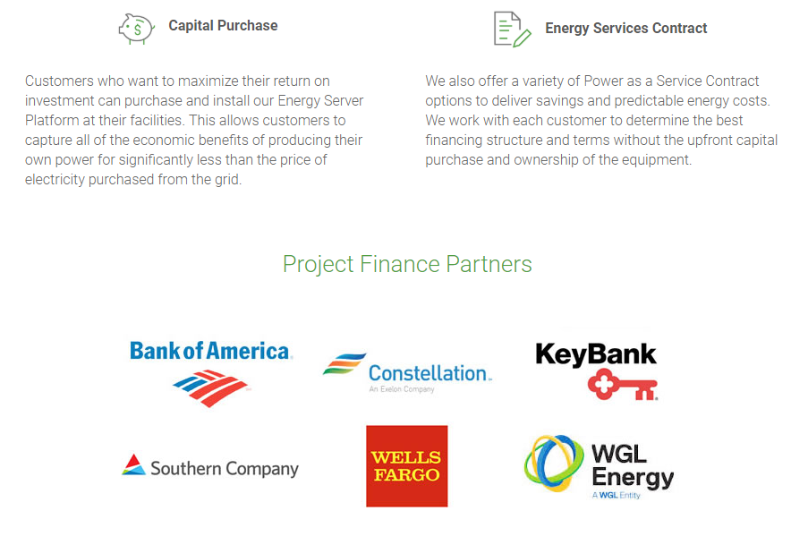
Flexible financing

Slide 16
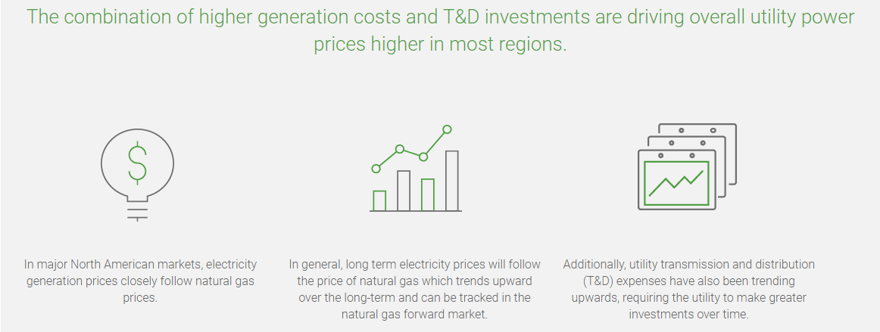
Cost predictability

Slide 17
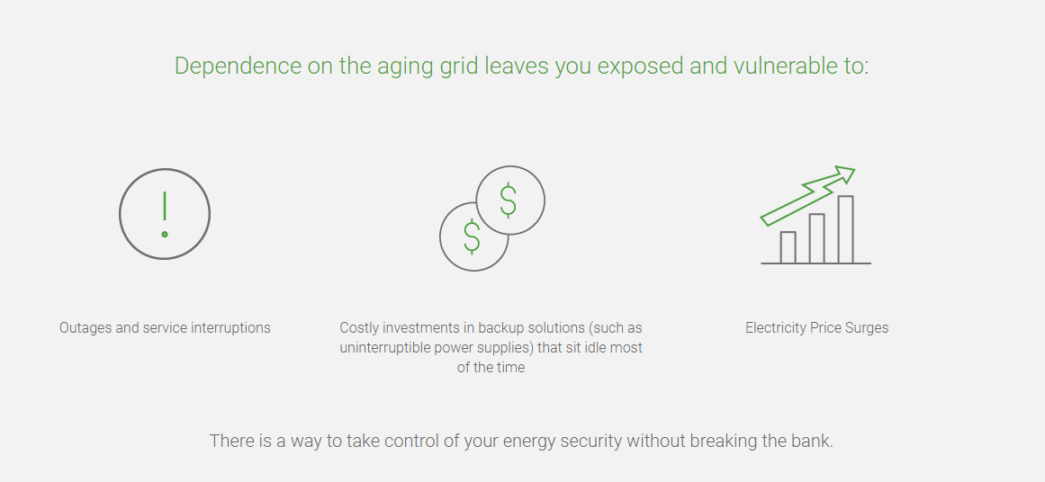
Reliability & Resiliency

Slide 18
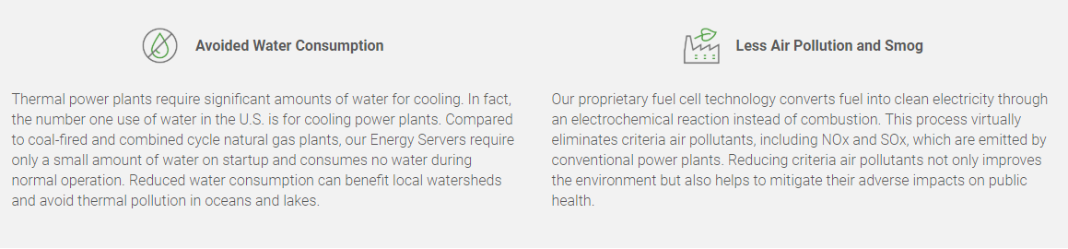
Sustainability

Slide 19
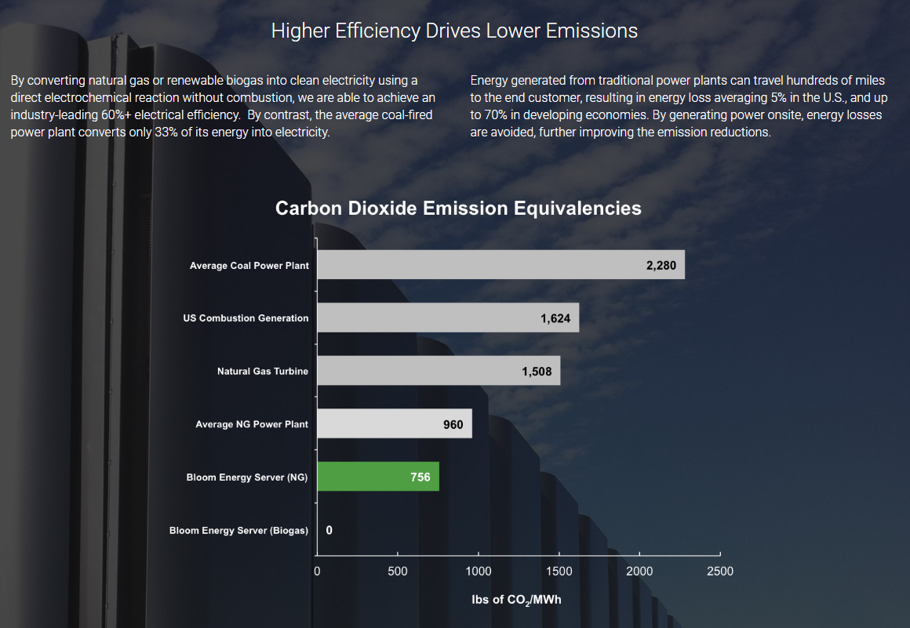
Sustainability

Slide 20
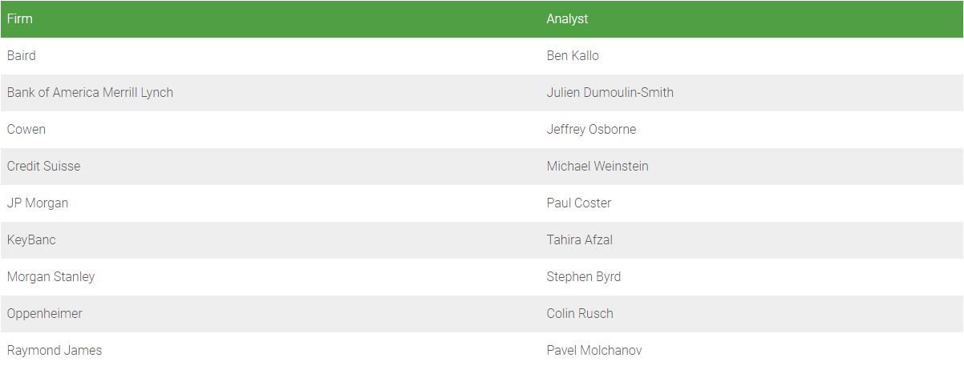
Investment

Slide 21
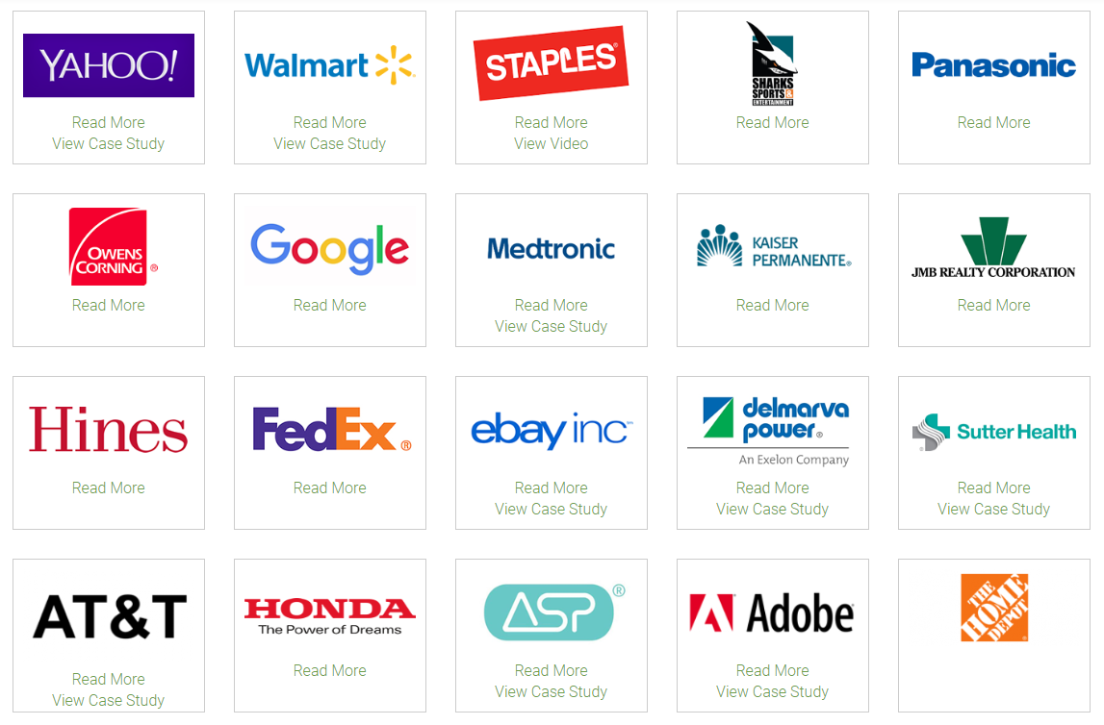
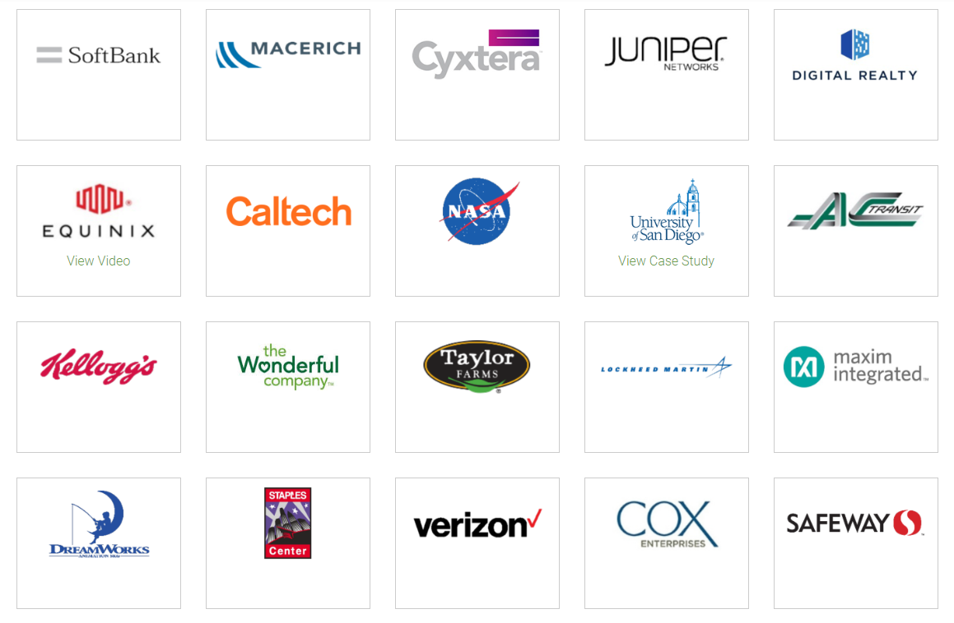
Customers

Slide 22
Personal opinion
Personalize energy
Foundation for next generation
Lower & predictable cost
Reduce carbon emissions

Slide 23
Thank you
Any questions?

