Slide 1
Lab. 03
Logic Design Lab.
Spring 2018
Prof. ChangGun Lee
(cglee@snu.ac.kr)
TA. Wonjae Jang
TA. Wonseok Lee
TA. Dongwan Kang
TA. Alena Kazakova
(ta@rubis.snu.ac.kr)

Slide 2
Contents
Two-bit comparator
Xilinx ISE
Universal Board
Lab

Slide 3
Course Information
Assignment (report)
Submission: ta@rubis.snu.ac.kr
Weekly task
Korean/English
Single file, no page limit, .pdf
Your report should include:
Lab result (proof/alibi)
Through discussion
Homework (if there is any)
Total size should be less than 15Mb (Do not use external download)
Due: Before start of next class (7:00pm)
- Late Policy: +24h: -20%, +48h: -50%, +72h: -100%
File name and e-mail title should be written correctly (See the details next slide)

Slide 4
Double check your e-mail/file format
LDLAB_YYMMDD_team#_NAME_StudentID
YYMMDD: Lab class date. Not the submission date.
Ex) e-mail: LDLAB_170321_31_홍길동_2017-77777
File : LDLAB_170307_31_홍길동_2017-77777.pdf
LDLAB_170307_31_GildongHong_2017-77777.pdf

Slide 5
Two Bit Comparator

Slide 6
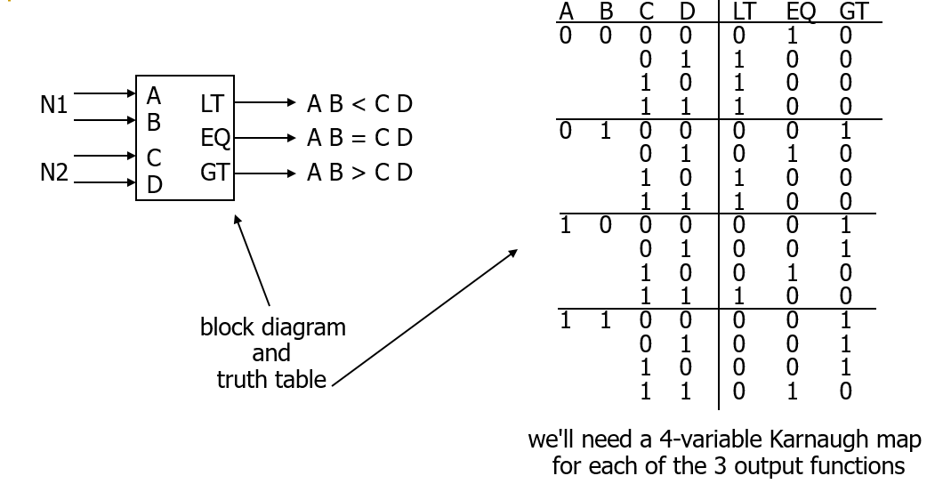
Block Diagram & Truth Table

Slide 7
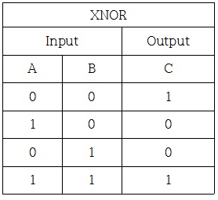
Karnaugh Map for EQ
A
1 0
0 1
0 0
0 0
A' B' C' D' + A' B C' D + A B C D + A B' C D’
D
0 0
0 0
1 0
0 1
= (A xnor C) • (B xnor D)
C
B
K-map for EQ

Slide 8
Design Example
Two alternative implementations of EQ
A B C D
ver. 1
A' B' C' D' + A' B C' D + A B C D + A B' C D’
EQ
XNOR is implemented with at least 3 simple gates
ver. 2
(A xnor C) • (B xnor D)
EQ

Slide 9
Xilinx ISE

Slide 10

Xilinx ISE Design Suite
Integrated Synthesis Environment(ISE)
Release 14.7, 2013
Features
Synthesis(compile) and analysis of HDL¹⁾ designs.
Timing analysis, RTL diagram
Xilinx FPGA programmer
1) HDL: Hardware Description Language

Slide 11
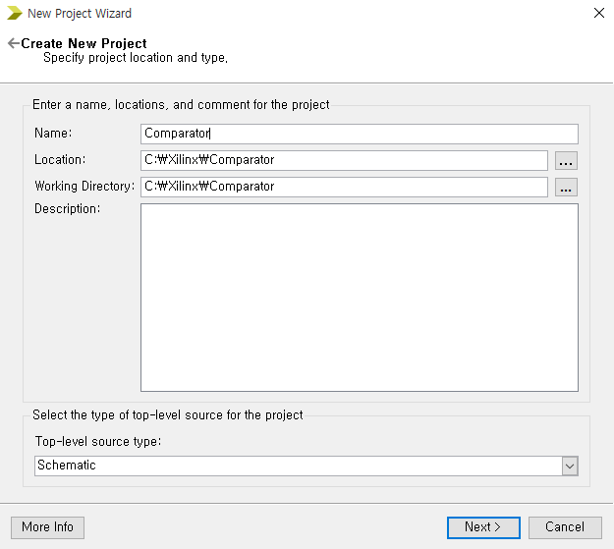
Creating New Project
Select File -> New Project
Specify Name, Location, Working Directory. Select Top-level source type as Schematic.

Slide 12
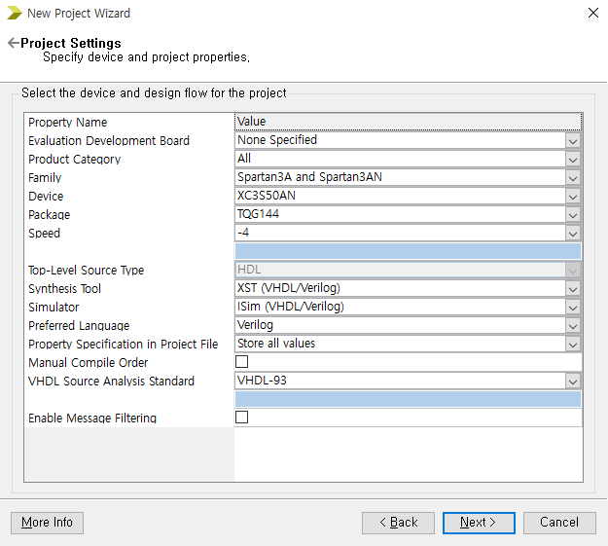
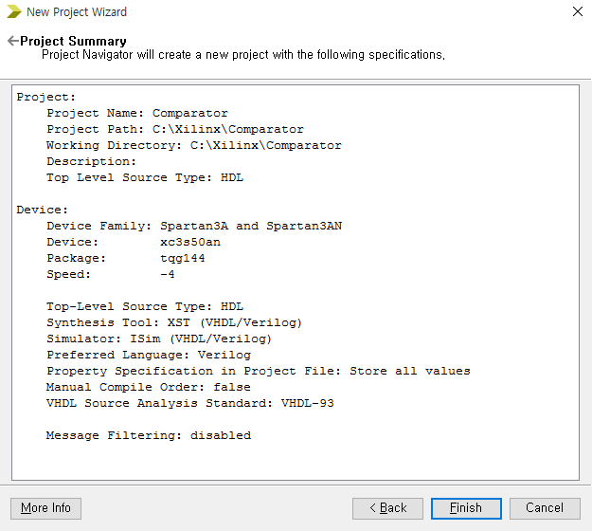
Project Settings
Set Project Settings as above
Click Next → Finish

Slide 13
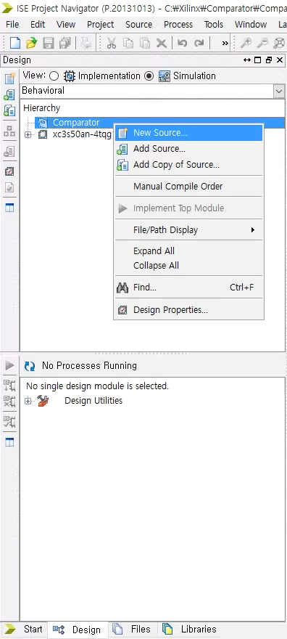
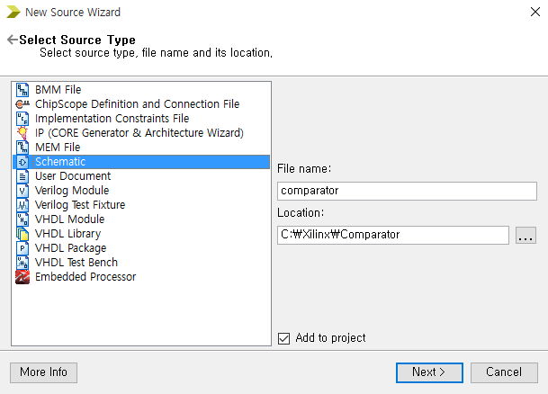
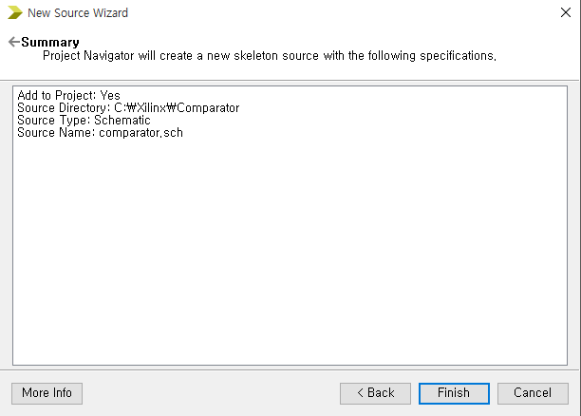
Creating Schematic
Right-Click anywhere in Hierarchy in Design tab, select New Source.
New Source Wizard window appears. Select Source Type window, select Schematic and type the File name. Ensure Add to project is checked.

Slide 14
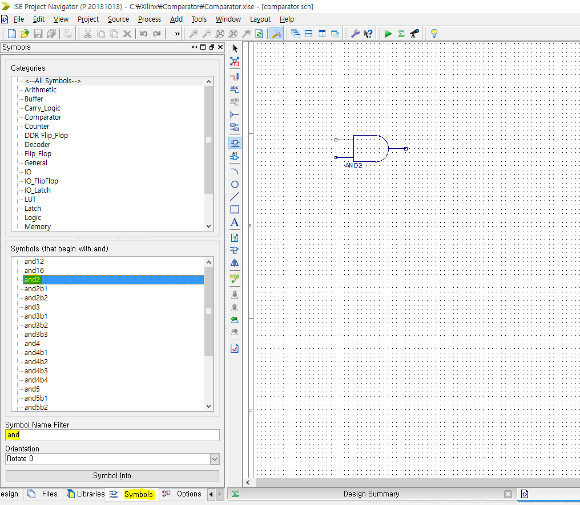
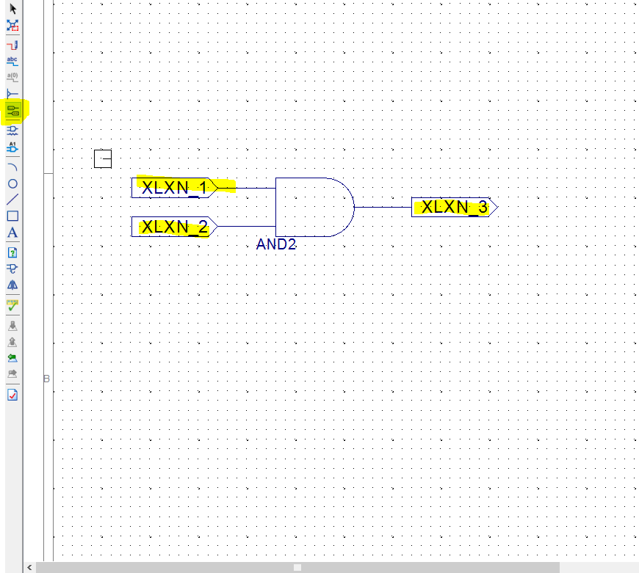
2-input-AND gate circuit (1)
In Symbols tab, type “and” under Symbol Name Filter.
Select and2 under Symbols, and place it on board.
Click I/O Marker button and you can add input/output markers to your circuit.

Slide 15
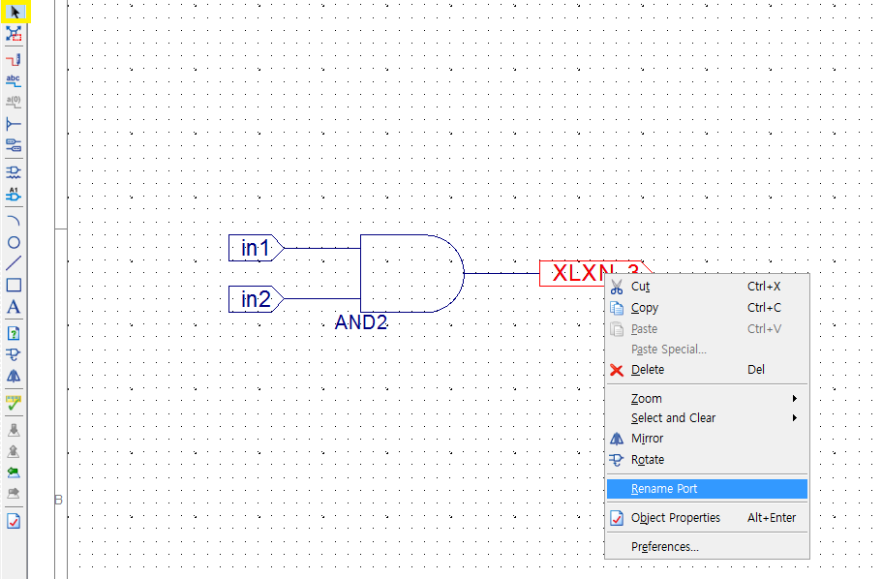
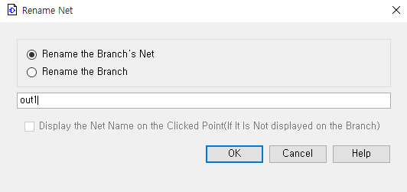
2-input-AND gate circuit (2)
Change the names of input/output symbols.
Save to apply changes

Slide 16
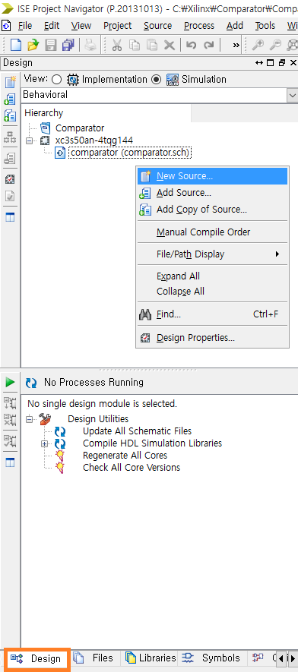
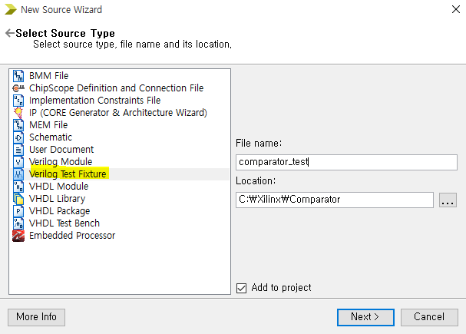
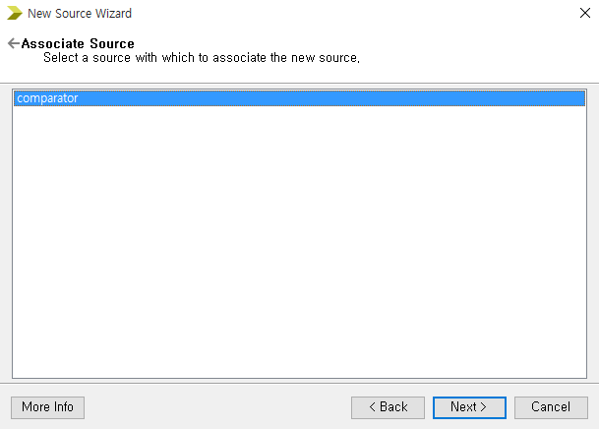
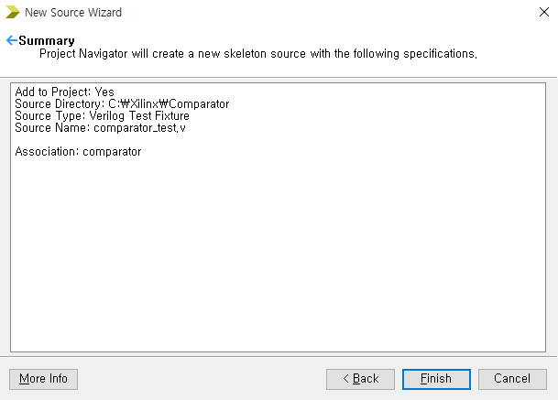
Creating Verilog Test Bench
Select New Source by right clicking inside Design tab.
Select Verilog Test Bench. Type the file name as above.

Slide 17
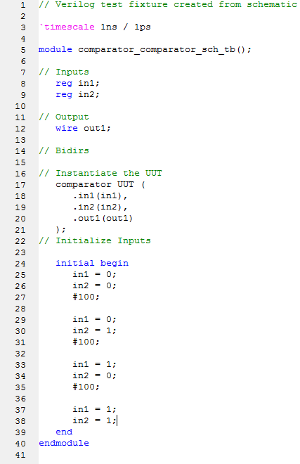
Schematic Simulation Code

Slide 18
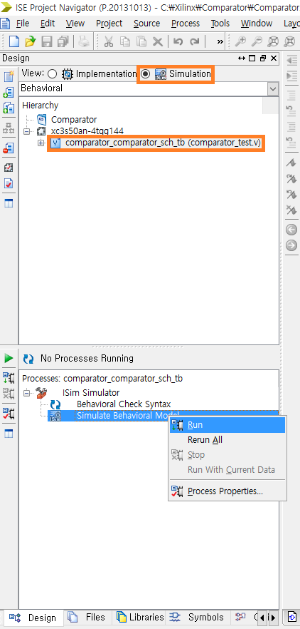
Simulate Behavioral Model
Save the project
Ensure that Design tab is selected, View is set to Simulation, and your simulation source code is clicked
Double click Behavioral Check Syntax for syntax check
Double click Simulate Behavioral Model

Slide 19
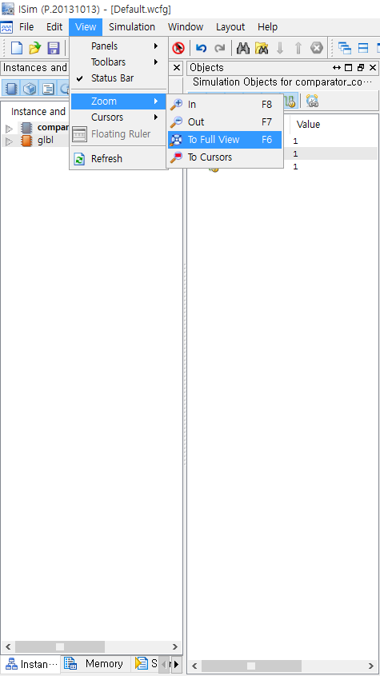
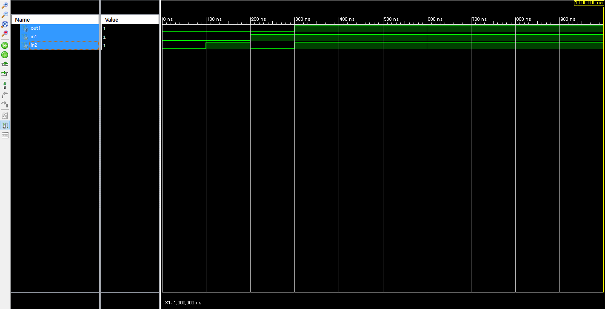
Simulation Result
To adjust the view, select View -> Zoom -> To Full View.

Slide 20
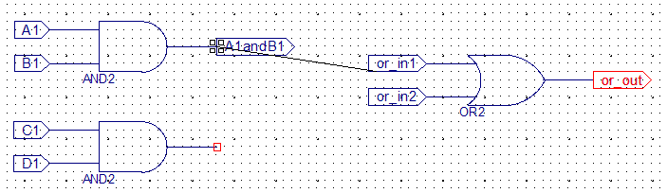
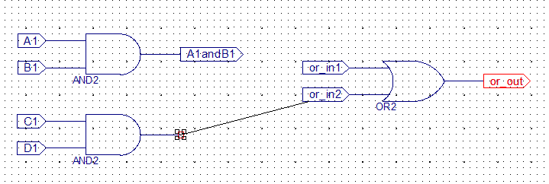
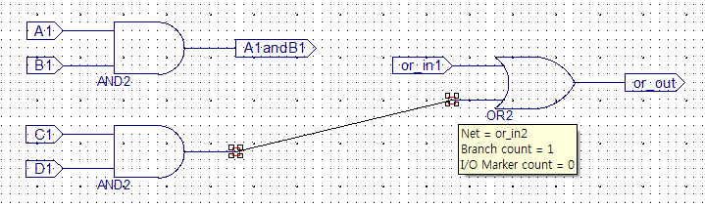
Tips: Connecting multiple gates
No!
No!
Yes!
When connecting multiple gates using ‘Add Wire’ button, make sure that both two ends don’t have I/O markers

Slide 21
Universal Board

Slide 22
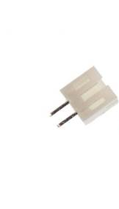
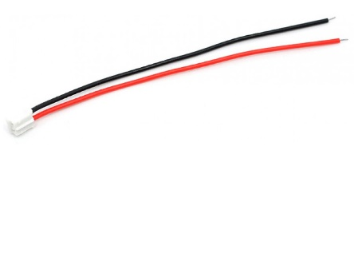
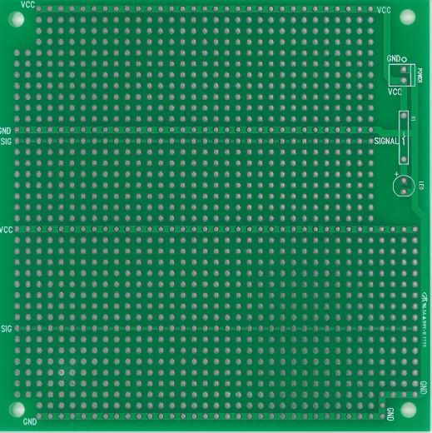

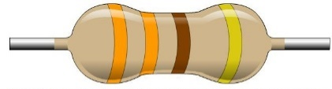

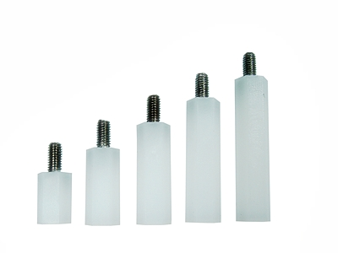
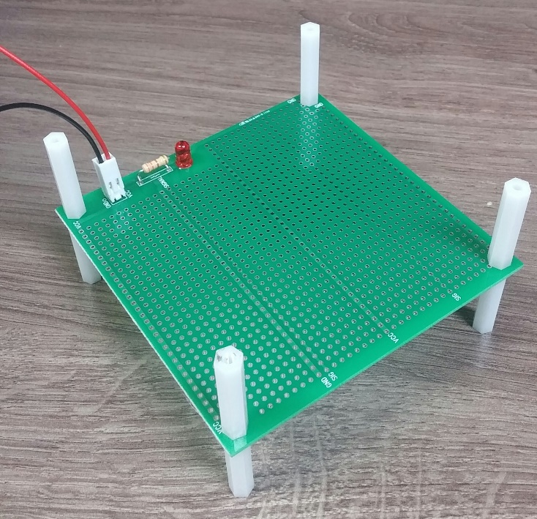
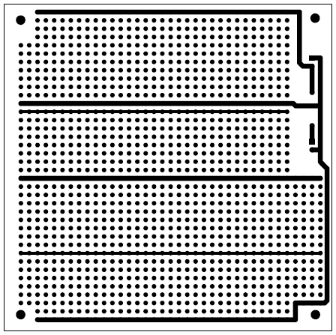
Custom-Made Universal Board
VCC
2-Pin Power Connector
GND
+
SIG
LED
(Electrically
connected
line)
-
PCB Support Plastic

Slide 23
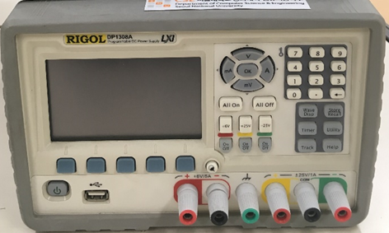
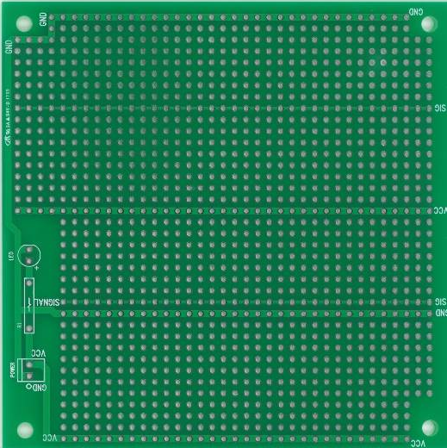
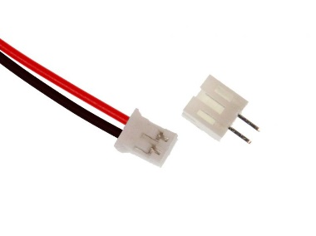
Turning it on using power supply
2
Set voltage to 5V
using this button
3
1
GND
VCC
4
Connect the
universal board
using power connecter

Slide 24
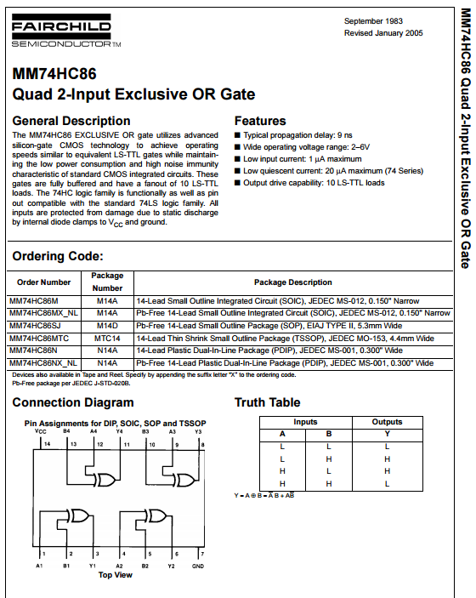
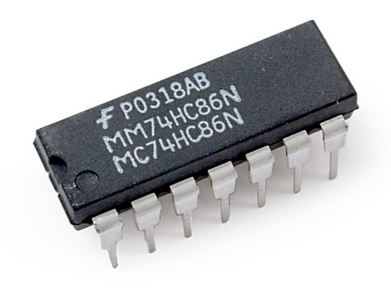
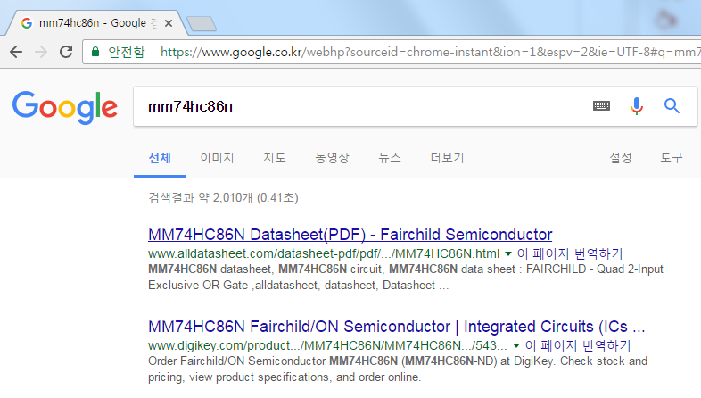
Tips: Look up the datasheet!
NEVER trust the sorted device boxes… Always check the product name to confirm that you picked the right one.
Always look up the datasheet online, double check its pin mapping.
7486 XOR gate

Slide 25
Lab

Slide 26
Today
Implement 2-bit comparator LT, EQ, GT using Xilinx ISE Schematic. Simulate its behavior using Xilinx test bench.

Slide 27
Homework
[TEAM]
Implement 2-bit comparator GT logic on the universal board, using DIP switch and primitive logic gates(INV, AND, OR, XOR, NAND…). Try your best to minimize the number of logic gates/chips used.

Slide 28
Report
Write a report
# of pages doesn’t matter
Documents should be submitted as PDF file.
All the files should be compressed to ZIP format.
The file size should be less than 15Mb.
Due : April, 3rd (Before class begins at 7:00pm)

