Slide 1
Lab. 05
Logic Design Lab.
Spring 2018
Prof. Chang-Gun Lee
(cglee@snu.ac.kr)
TA. WonJae Jang
TA. Wonseok Lee
TA. Alena Kazakova
TA. Dongwan Kang
(ta@rubis.snu.ac.kr)
RUBIS

Slide 2
Contents
BCD to 7-segment Decoder
Lab
Homework
RUBIS

Slide 3
BCD to 7-segment Decoder
RUBIS

Slide 4
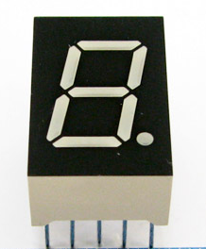
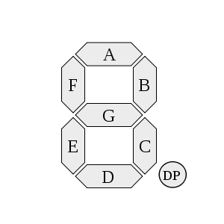
7-segment Display
G
F
A
B
VCC
or
GND
PIN
E
D
C
DP
A form of electronic display device for displaying decimal numerals that is an alternative to the more complex dot-matrix displays.
Widely used in digital clocks, electronic meters, and other electronic devices for displaying numerical information.
RUBIS

Slide 5
BCD to 7-segment Decoder
?
A
in0
BCD
Input
Signal
B
in1
in2
C
in3
D
7-segment
Outputs
E
F
G
We need a decoder like above
So we will make it
RUBIS

Slide 6
BCD to 7-segment Decoder (cont’d)
Step
Make a truth table with BCD and 7-segment outputs
Make Boolean expressions according to the table
Minimize them
Implement a decoder according to the expressions
RUBIS

Slide 7
Lab
RUBIS

Slide 8
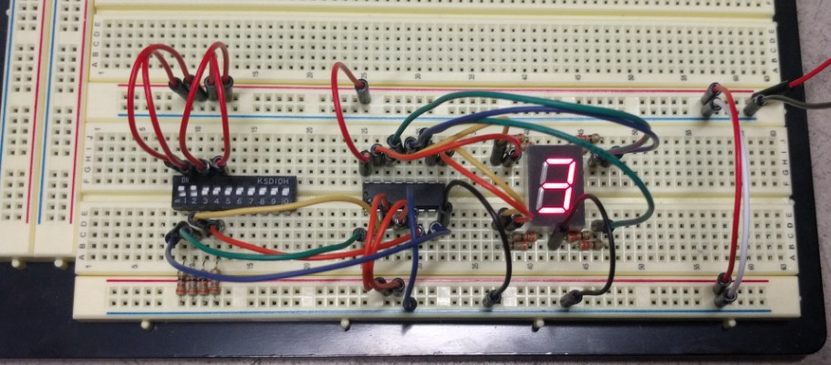
Today
Implement a 7-segment display on a universal board with a 7448 and a dip switch. Hint: 7448 (BCD to 7-segment Decoder) datasheet http://www.es.co.th/schemetic/pdf/hd74ls48.pdf
Implement BCD to 7-segment Decoder on Xilinx ISE in
1) structural description, 2) data-flow style description and
3) behavioral description and then simulate each of them.
RUBIS

Slide 9
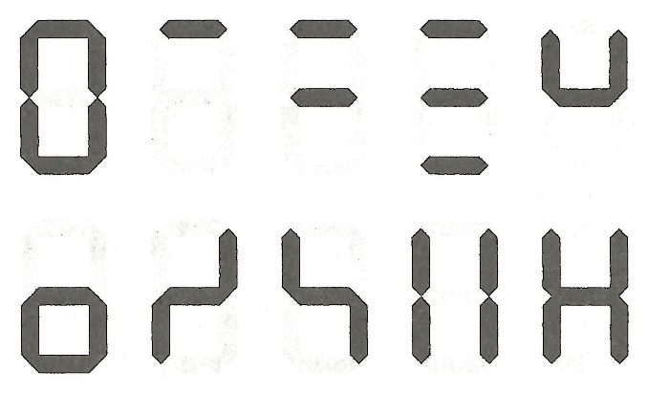
Homework
Implement ‘Klingon number system’ decoder for 7-segment on Xilinx ISE in 1) structural description, 2) data-flow style description and 3) behavioral description.
Pic. Klingon number system
RUBIS

Slide 10
Report
Write a report
  # of pages doesn’t matter
  Documents should be submitted as PDF file.
  All the files should be compressed to ZIP format.
  The file size should be less than 15Mb.
  Due : April, 24th (Before class begin at 7:00pm)
  NO class next week (Midterm Exam)
RUBIS

Slide 11
NOTICE!!!
SUBMISSION FORMAT
  MAIL TITLE : LDLAB_170328_조_이름_학번
    Ex > LDLAB_170328_01_홍길동_2017-12345
  ATTACHED FILE NAME : LDLAB_170328_조_이름_학번.pdf
    Ex > LDLAB_170328_01_홍길동_2017-12345.pdf
Attach
  your simulation screen captures,
  source codes of your implementation,
  source codes of your simulation,
  at a single pdf file !!!
RUBIS

