Slide 1
Lab. 07
Logic Design Lab.
Spring 2018
Prof. Chang-Gun Lee
(cglee@snu.ac.kr)
TA. WonJae Jang
TA. Wonseok Lee
TA. Alena Kazakova
TA. Dongwan Kang
(ta@rubis.snu.ac.kr)

Slide 2
Sequential logic

Slide 3
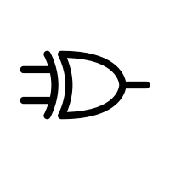
Sequential logic (1)
Output is determined by both of current state and input
To save current state, feedback is used to implement storage
Example > sequential logic
If input == 0 then hold current status, else if input == 1 then toggle current status.
Output is same as current status.
current_status | input | output
0 | 0 | 0
0 | 1 | 1
1 | 0 | 1
1 | 1 | 0
current_status
output
input

Slide 4
Sequential logic (2)
current_status
output
input
Taxonomy …
Never mind, always work (race O)
➔ Latch
Work only when it is enabled (race O)
➔ Gated latch
Work only when it is edge triggered (race X)
➔ Flip-flop

Slide 5
R-S Latch

Slide 6
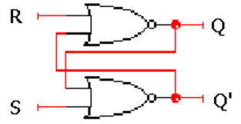
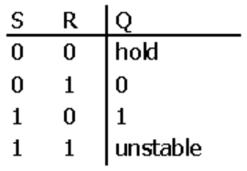
R-S Latch
R-S latch is a 1 bit memory with cross-coupled gates.
S R Q(t) Q(t+Δ) 0 0 0 0 0 0 1 1 0 1 0 0 0 1 1 0 1 0 0 1 1 0 1 1 1 1 0 X 1 1 1 X
hold
reset
set
not allowed
RS Q | 00 | 01 | 11 | 10
0 |  | 1 | X
1 | 1 | 1 | X
Notes:
가장 기본이 되는 컴포넌트. Q라는 state를 저장하는 역할을 한다. T+delta

Slide 7
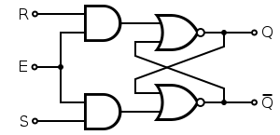
Gated R-S Latch
R and S(inputs) matter only when E(enable) = 1
Otherwise, hold current state
Notes:
Enable이 clock으로 대체하는것 자세히 설명. Nor게이트 and로 바꾸기

Slide 8
Clock

Slide 9
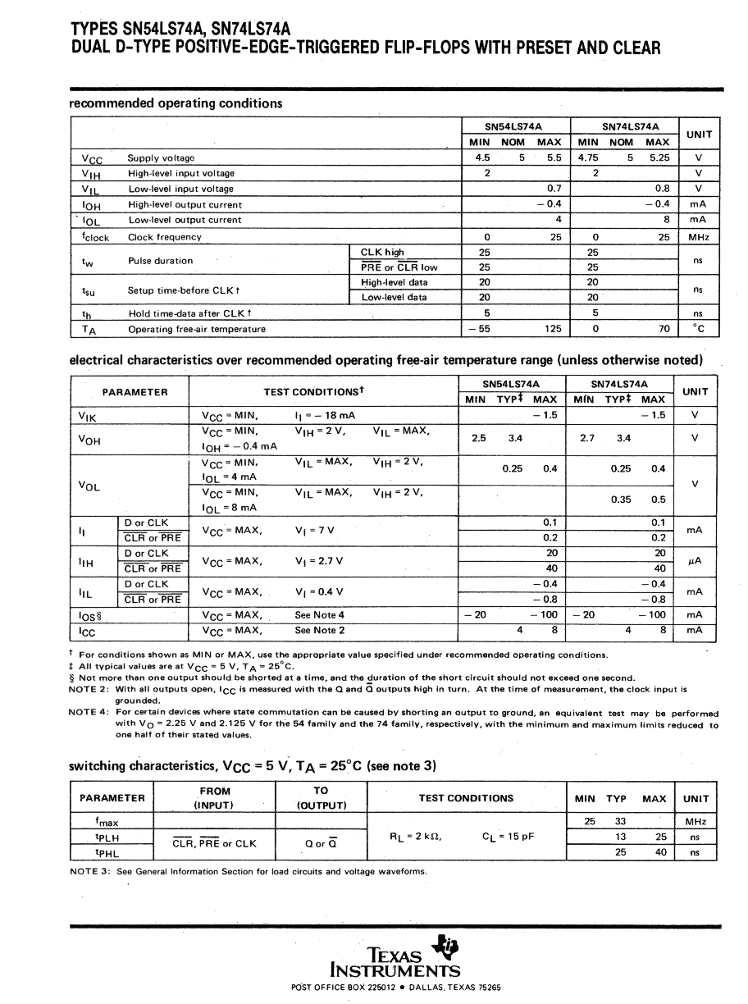
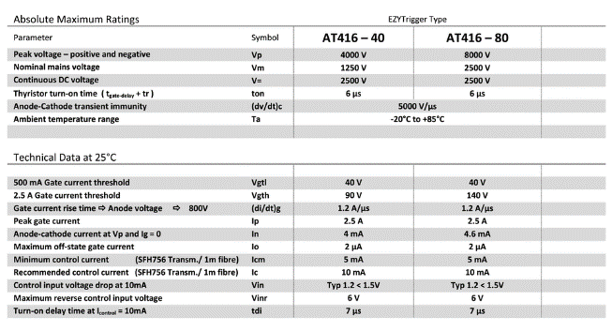
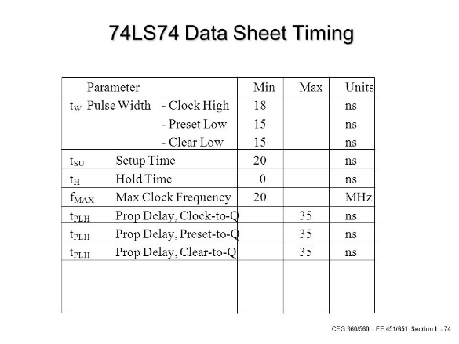
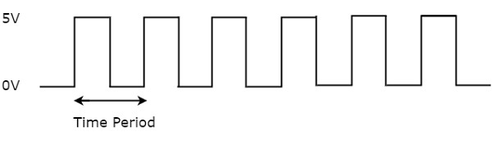
Clock
Provide timing to sequential logic (ex. Flip-Flop)
Notes:
State machine 설명. Timing이 state에 영향을 미침. 친숙한 ch3 oscillator 사용해서 설명. Wire사이 영향 미침
Timing을 동기화 시켜주는게 중요. Clock 개념

Slide 10
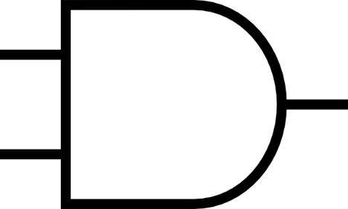
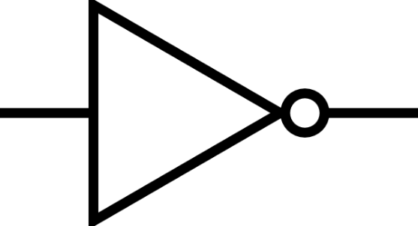
Simple Oscillator
ENABLE
#0
#5
FEEDBACK
How to implement gate delay ?
Example >
wire tmp;
assign #5 tmp = tmp & 1;
Notes:
State machine 설명. Timing이 state에 영향을 미침. 친숙한 ch3 oscillator 사용해서 설명. Wire사이 영향 미침
Timing을 동기화 시켜주는게 중요. Clock 개념

Slide 11
Lab

Slide 12
Today
Implement the following in Verilog and simulate the behavior.
(1) a R-S latch
(2) a gated R-S latch using (1)
(3) an simple oscillator

Slide 13
Report
Write a report
# of pages doesn’t matter
Documents should be submitted as PDF file.
The file size should be less than 15Mb.
Due : May, 8th (Before class begins at 7:00pm)

Slide 14
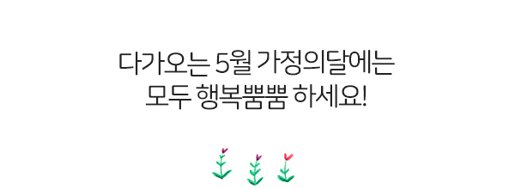
Homework
No Homework !

