Slide 1
Lab. 08
Logic Design Lab.
Spring 2018
Prof. Chang-Gun Lee
(cglee@snu.ac.kr)
TA. WonJae Jang
TA. Wonseok Lee
TA. Alena Kazakova
TA. Dongwan Kang
(ta@rubis.snu.ac.kr)

Slide 2
Notice
Your midterm exam score has been uploaded at below link.
https://rubis.snu.ac.kr/logic_design_2018_spring/3324177
Claim schedule:
2018.05.10 (THU) 12:00 - 13:30 at B301-R415
2018.05.11 (FRI) 15:00 - 17:00 at B301-R415
If you have another schedule on both of above schedules, please contact us ( ta@rubis.snu.ac.kr )

Slide 3
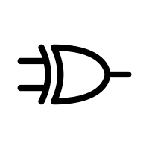
Flip-Flops (1)
current_status
output
input
RECAP (last week lab…)
Never mind, always work (race O)
➔ Latch
Work only when it is enabled (race O)
➔ Gated latch
Work only when it is edge triggered (race X)
➔ Flip-flop

Slide 4
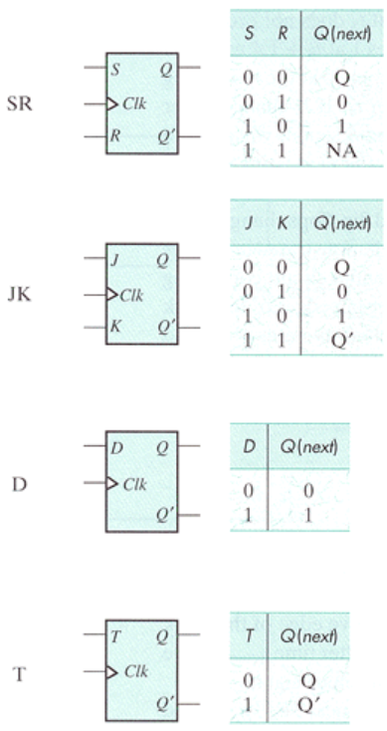
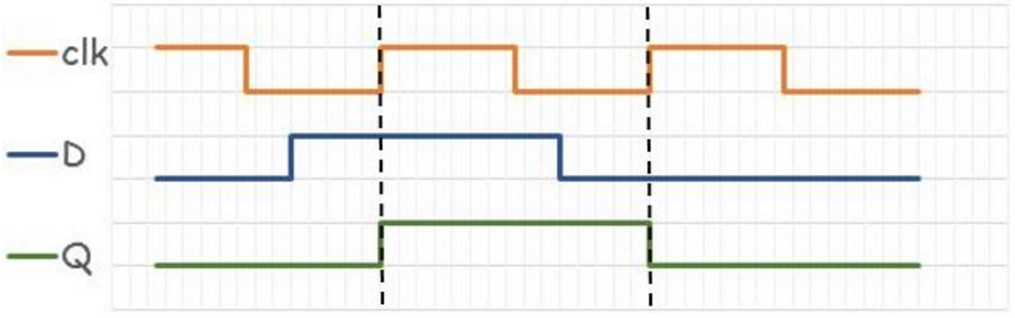
Flip-Flops (2)

Slide 5
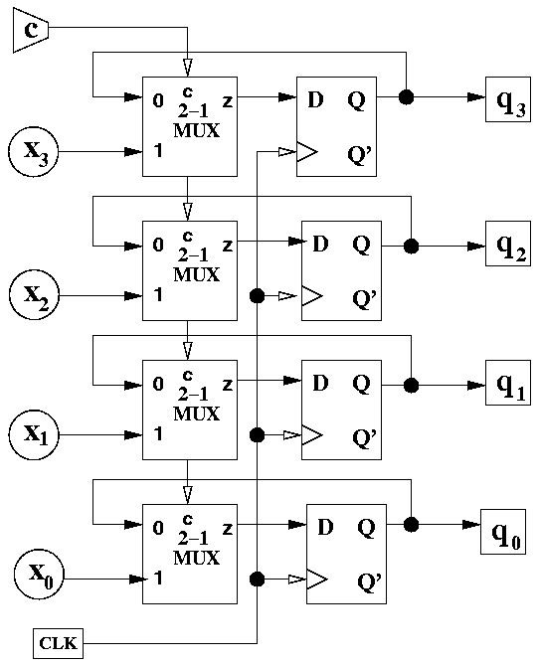
Registers (1)

Slide 6
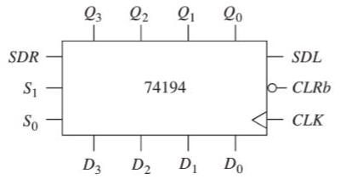
Registers (2)
CLRb | MODE |  | CLK | SERIAL |  | PARALLEL |  |  |  | PARALLEL
 | S1 | S0 |  | SDL | SDR | D3 | D2 | D1 | D0 | Q3(t+1) | Q2(t+1) | Q1(t+1) | Q0(t+1)
0 | X | X | X | X | X | X | X | X | X | 0 | 0 | 0 | 0 |  | // CLEAR
1 | X | X | - | X | X | X | X | X | X | Q3(t) | Q2(t) | Q1(t) | Q0(t) |  | // NO CHANGE
1 | 1 | 1 | ↑ | X | X | d3 | d2 | d1 | d0 | d3 | d2 | d1 | d0 |  | // PARALLEL LOAD
1 | 1 | 0 | ↑ | 0 | X | X | X | X | X | Q2(t) | Q1(t) | Q0(t) | 0 |  | // SHIFT LEFT
1 | 1 | 0 | ↑ | 1 | X | X | X | X | X | Q2(t) | Q1(t) | Q0(t) | 1
1 | 0 | 1 | ↑ | X | 0 | X | X | X | X | 0 | Q3(t) | Q2(t) | Q1(t) |  | // SHIFT RIGHT
1 | 0 | 1 | ↑ | X | 1 | X | X | X | X | 1 | Q3(t) | Q2(t) | Q1(t)
1 | 0 | 0 | ↑ | X | X | X | X | X | X | Q3(t) | Q2(t) | Q1(t) | Q0(t) |  | // HOLD

Slide 7
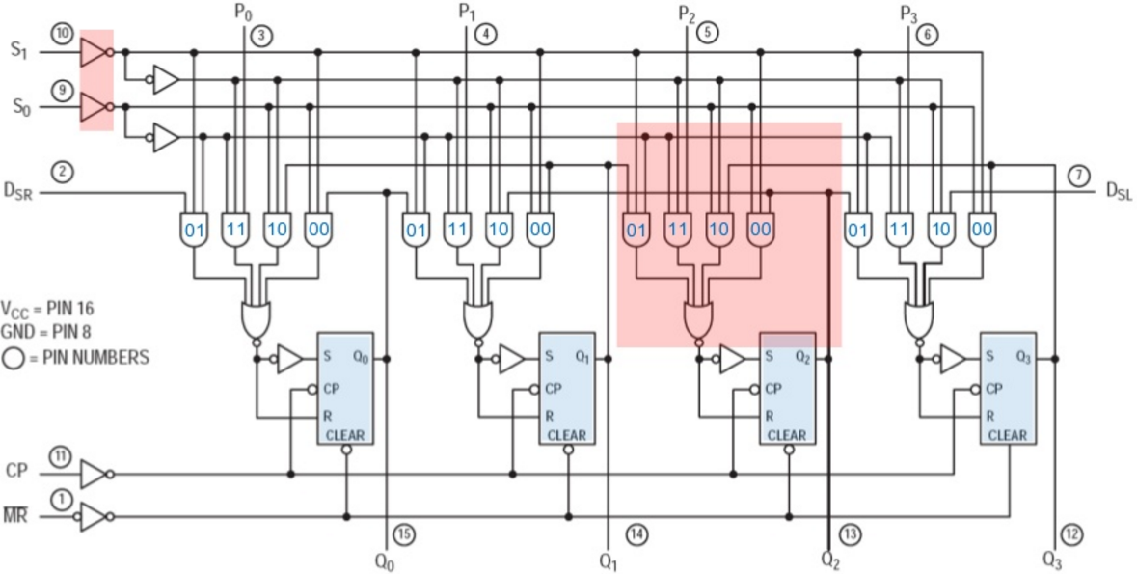
Registers (3)
Nobody want to implement above complex circuit !!!
Behavioral Model of Verilog will save us

Slide 8
Example (1)
CLRb | MODE |  | CLK | SERIAL |  | PARALLEL |  |  |  | PARALLEL
 | S1 | S0 |  | SDL | SDR | D3 | D2 | D1 | D0 | Q3(t+1) | Q2(t+1) | Q1(t+1) | Q0(t+1)
0 | X | X | X | X | X | X | X | X | X | 0 | 0 | 0 | 0 |  | // CLEAR
1 | X | X | - | X | X | X | X | X | X | Q3(t) | Q2(t) | Q1(t) | Q0(t) |  | // NO CHANGE
1 | 1 | 1 | ↑ | X | X | d3 | d2 | d1 | d0 | d3 | d2 | d1 | d0 |  | // PARALLEL LOAD
1 | 1 | 0 | ↑ | 0 | X | X | X | X | X | Q2(t) | Q1(t) | Q0(t) | 0 |  | // SHIFT LEFT
1 | 1 | 0 | ↑ | 1 | X | X | X | X | X | Q2(t) | Q1(t) | Q0(t) | 1
1 | 0 | 1 | ↑ | X | 0 | X | X | X | X | 0 | Q3(t) | Q2(t) | Q1(t) |  | // SHIFT RIGHT
1 | 0 | 1 | ↑ | X | 1 | X | X | X | X | 1 | Q3(t) | Q2(t) | Q1(t)
1 | 0 | 0 | ↑ | X | X | X | X | X | X | Q3(t) | Q2(t) | Q1(t) | Q0(t) |  | // HOLD
Let’s implement the above sequential logic (4-bit register) using Verilog
Step1. Implementing 4-bit register with asynchronous reset
Step2. Verifying logic through simulation

Slide 9
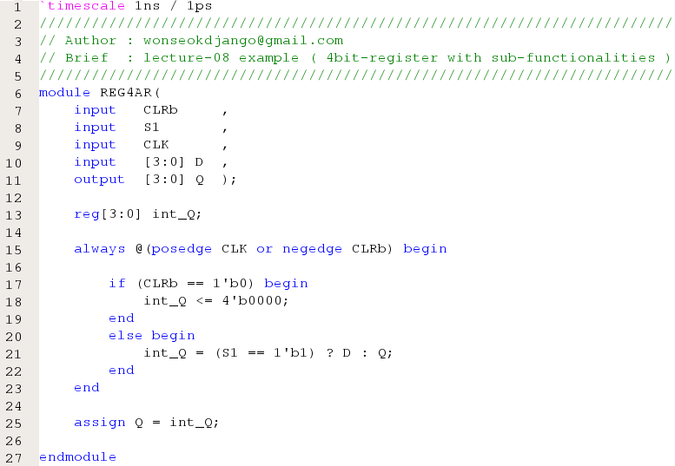
Example (2)
Step1. Implementing 4-bit register with asynchronous reset

Slide 10
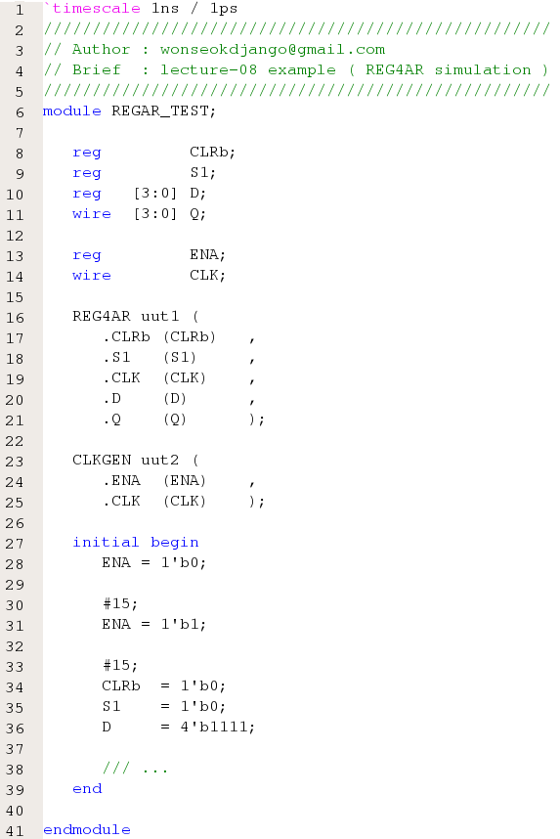
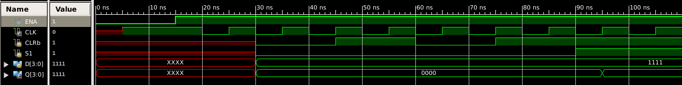
Example (3)
Step2. Verifying logic through simulation

Slide 11
Today’s Lab
With Verilog:
Implement 4-bit Universal Shift Register
Verify 4-bit Universal Shift Register through simulation
CLRb | MODE |  | CLK | SERIAL |  | PARALLEL |  |  |  | PARALLEL
 | S1 | S0 |  | SDL | SDR | D3 | D2 | D1 | D0 | Q3(t+1) | Q2(t+1) | Q1(t+1) | Q0(t+1)
0 | X | X | X | X | X | X | X | X | X | 0 | 0 | 0 | 0 |  | // CLEAR
1 | X | X | - | X | X | X | X | X | X | Q3(t) | Q2(t) | Q1(t) | Q0(t) |  | // NO CHANGE
1 | 1 | 1 | ↑ | X | X | d3 | d2 | d1 | d0 | d3 | d2 | d1 | d0 |  | // PARALLEL LOAD
1 | 1 | 0 | ↑ | 0 | X | X | X | X | X | Q2(t) | Q1(t) | Q0(t) | 0 |  | // SHIFT LEFT
1 | 1 | 0 | ↑ | 1 | X | X | X | X | X | Q2(t) | Q1(t) | Q0(t) | 1
1 | 0 | 1 | ↑ | X | 0 | X | X | X | X | 0 | Q3(t) | Q2(t) | Q1(t) |  | // SHIFT RIGHT
1 | 0 | 1 | ↑ | X | 1 | X | X | X | X | 1 | Q3(t) | Q2(t) | Q1(t)
1 | 0 | 0 | ↑ | X | X | X | X | X | X | Q3(t) | Q2(t) | Q1(t) | Q0(t) |  | // HOLD

Slide 12
Homework
With Verilog:
Implement & Simulate 8-bit Universal Shift Register
Write a report:
# of pages doesn’t matter
Documents should be submitted as PDF file.
The file size should be less than 15Mb.
Due : May, 15th (Before class begins at 7:00pm)
CLRb | MODE |  | CLK | SERIAL |  | PARALLEL |  |  |  |  |  |  |  | PARALLEL
 | S1 | S0 |  | SDL | SDR | D7 | D6 | D5 | D4 | D3 | D2 | D1 | D0 | Q7(t+1) | Q6(t+1) | Q5(t+1) | Q4(t+1) | Q3(t+1) | Q2(t+1) | Q1(t+1) | Q0(t+1)
0 | X | X | X | X | X | X | X | X | X | X | X | X | X | 0 | 0 | 0 | 0 | 0 | 0 | 0 | 0 |  | // CLEAR
1 | X | X | - | X | X | X | X | X | X | X | X | X | X | Q7(t) | Q6(t) | Q5(t) | Q4(t) | Q3(t) | Q2(t) | Q1(t) | Q0(t) |  | // NO CHANGE
1 | 1 | 1 | ↑ | X | X | d7 | d6 | d5 | d4 | d3 | d2 | d1 | d0 | d7 | d6 | d5 | d4 | d3 | d2 | d1 | d0 |  | // PARALLEL LOAD
1 | 1 | 0 | ↑ | 0 | X | X | X | X | X | X | X | X | X | Q6(t) | Q5(t) | Q4(t) | Q3(t) | Q2(t) | Q1(t) | Q0(t) | 0 |  | // SHIFT LEFT
1 | 1 | 0 | ↑ | 1 | X | X | X | X | X | X | X | X | X | Q6(t) | Q5(t) | Q4(t) | Q3(t) | Q2(t) | Q1(t) | Q0(t) | 1
1 | 0 | 1 | ↑ | X | 0 | X | X | X | X | X | X | X | X | 0 | Q7(t) | Q6(t) | Q5(t) | Q4(t) | Q3(t) | Q2(t) | Q1(t) |  | // SHIFT RIGHT
1 | 0 | 1 | ↑ | X | 1 | X | X | X | X | X | X | X | X | 1 | Q7(t) | Q6(t) | Q5(t) | Q4(t) | Q3(t) | Q2(t) | Q1(t)
1 | 0 | 0 | ↑ | X | X | X | X | X | X | X | X | X | X | Q7(t) | Q6(t) | Q5(t) | Q4(t) | Q3(t) | Q2(t) | Q1(t) | Q0(t) |  | // HOLD

