Slide 1
STRUCTURES

Slide 2
Structures
Array
  A derived type used to represent homogeneous data
Structure
  provides a means to aggregate variables of different types
  struct card {
  int pips; /* 1,2,3,…,13 */
  char suit; /* ‘c’, ’d’, ‘h’, and ‘s’ */
  };
a structure tag name
This declaration creates the derived data type struct card.
A user-defined type
Just a template, no storage allocated

Slide 3
Structures
  struct card {
  int pips;
  char suit;
  };
  struct card c1, c2;
  struct card {
  int pips;
  char suit;
  } c1, c2;
  struct card {
  int pips;
  char suit;
  };
  typedef struct card card;
  card c1, c2;
Notes:
Pips are small but easily countable items. The term is used to describe the dots on dominoes, dice, denote suits, and is the name for the small seeds of somefruits. It could be used as a synonym for dot in most situations, for example morse code.

Slide 4
Structures
The member access operator .
  structure_variable.member_name
  c1.pips = 3;
  c1.suit = ‘s’;
Structure assignment
  c1 = c2;
  struct card {
  int pips;
  char suit;
  } deck[52];
The identifier deck is declared to be an array of struct card.

Slide 5
Structures
Within a given structure, member names must be unique.
Members in different structures can have the same name.
  struct fruit {
  char *name;
  int calories;
  };
  struct vegetable {
  char *name;
  int calories;
  };
  struct fruit a;
  struct vegetable b;
  a.calories = 100;
  b.calories = 120;

Slide 6
Structures
If a tag name is not supplied, then the structure type cannot be used in later declarations.
  struct {
  int day, month, year;
  char day_name[4]; /* Mon, Tue, Wed, etc. */
  char month_name[4]; /* Jan, Feb, Mar, etc. */
  } yesterday, today, tomorrow;
  vs.
  struct date {
  int day, month, year;
  char day_name[4]; /* Mon, Tue, Wed, etc. */
  char month_name[4]; /* Jan, Feb, Mar, etc. */
  };
  struct date yesterday, today, tomorrow;

Slide 7
Structures
When using typedef to name a structure type, the tag name may be unimportant.
  typedef struct {
  float re;
  float im;
  } complex;
  complex a, b, c[100];

Slide 8
Accessing Members of a Structure
[class_info.h]
  #define CLASS_SIZE 100
  struct student{
  char *last_name;
  int student_id;
  char grade;
  };
[grade.c]
  #include “class_info.h”
  int main()
  {
  struct student tmp, class[CLASS_SIZE];
  tmp.grade = ‘A’;
  tmp.last_name = “Casanova”;
  tmp.student_id = 910017;
  …
  }

Slide 9
Accessing Members of a Structure
  /* Count the failing grades. */
  #include “class_info.h”
  int fail(struct student class[])
  {
  int i,cnt = 0;
  for (i=0; i<CLASS_SIZE; i++)
  cnt += class[i].grade == ‘F’;
  }
⇔ int fail(struct student *class)
⇔ cnt += (((class[i]).grade) == ‘F’);

Slide 10
Accessing Members of a Structure
The member access operator ->
  access the structure members via a pointer
    pointer_to_structure->member_name
  ⇔ (*pointer_to_structure).member_name
  *pointer_to_structure.member_name
  ⇔ *(pointer_to_structure.member_name)
! ERROR

Slide 11
Accessing Members of a Structure
[complex.h]
  struct complex{
  double re;
  double im;
  };
  typedef struct complex complex;
[2_add.c]
  #include “complex.h”
  void add(complex *a, complex *b, complex *c) /* a = b+c */
  {
  a->re = b->re + c->re;
  a->im = b->im + c->im;
  }

Slide 12
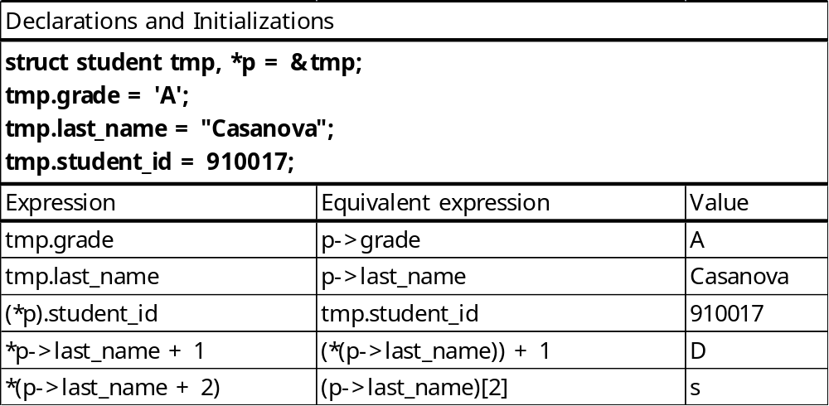
Accessing Members of a Structure

Slide 13
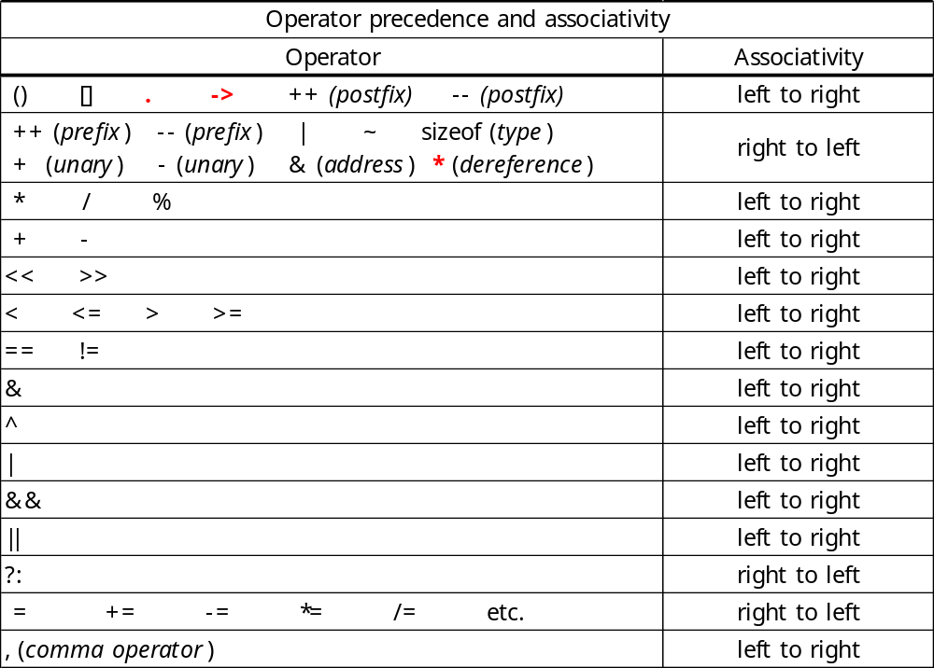
Operator Precedence and Associativity: A Final Look

Slide 14
Using Structures with Functions
When a structure is passed as an argument to a function, it is passed by value
  A local copy is made for use in the body of the function.
  If a structure member is an array, the array gets copied as well.
  relatively inefficient !!
  struct dept {
  char dept_name[25];
  int dept_no;
  }
  typedef struct {
  char name[25];
  int employee_id;
  struct dept department;
  struct home_address *a_ptr;
  double salary;
  ….
  } employee_data;

Slide 15
Using Structures with Functions
employee_data update(employee_data r)
{
….
printf(“Input the department number: “);
scanf(“%d”, &n);
r.department.dept_no = n;
….
return e;
}
employee_data e;
e = update(e);
void update(employee_data *p)
{
….
printf(“Input the department number: “);
scanf(“%d”, &n);
p->department.dept_no = n;
….
}
employee_data e;
update(&e);
⇔ (r.department).dept_no = n;
⇔ (p->department).dept_no = n;

Slide 16
Initialization of Structures
  card c = {13, ‘h’}; /* the king of hearts */
  complex a[3][3] = {
  {{1.0, -0.1}, {2.0, 0.2}, {3.0, 0.3}},
  {{4.0, -0.4}, {5.0, 0.5}, {6.0, 0.6}},
  }; /* a[2][] is assigned zeros */
  struct fruit frt = {“plum”, 150};
  struct home_address {
  char *street;
  char *city_and_state;
  long zip_code;
  } address = {“87 West Street”, “Aspen, Colorado”, 80526};
  struct home_address previous_address = {0};

