Slide 1
The Preprocessor

Slide 2
Preprocessor
C lang. uses the preprocessor to expend its power and notation
preprocessor directives
  lines beginning with a #
  communicates with the preprocessor
  #include
  #define

Slide 3
Use of #include
  #include <stdio.h>
  #include <stdlib.h>
    The preprocessor looks for the file only in other places and not in the current directory.
    Where the standard header files are stored is system-dependent.
  #include “filename”
    Search is made first in the current directory,
    and then in other system-dependent places

Slide 4
Use of #define
  #define identifier token_string_{opt}
    The preprocessor replaces every occurrence of identifier by token_string in the remainder of the file, except in quoted string.
  #define SECONDS_PER-DAY (60*60*24)
  #define PI 3.14159
  #define C 299792.458 /*speed of light in km/sec */
  #define EOF (-1) /*typical end-of-file value */
  #define MAXINT 2147483647 /*largest 4-byte integer */
  The use of simple #define can improve
    program clarity
    Program portability

Slide 5
Use of #define
Syntactic sugar
  alter the syntax of C toward users’ preference
    #define EQ ==
    while (i EQ 1) {
    …
⇒
    while (i == 1) {
    …

Slide 6
Macros with Arguments
#define can be used to write macro definitions with parameters
  #define identifier(identifier, …, identifier) token_string_{opt}
  #define SQ(x) ((x) * (x))
  SQ(7 + w)
  SQ(SQ(*p))
  #define SQ(x) x * x
  SQ(a + b)
  #define SQ(x) (x) * (x)
  4 / SQ(2)
⇒
    ((7 + w) * (7 + w))
⇒
    ((((*p) * (*p))) * (((*p) * (*p))))
    a + b * a + b ≠ ((a + b) * (a + b))
⇒
    4 / (2) * (2) ≠ 4 / ((2) * (2))
⇒

Slide 7
Macros with Arguments
  #define SQ (x) ((x) * (x))
  SQ(7)
  #define SQ(x) ((x) * (x)); /* a common error */
  x = SQ(y);
  if (x == 2)
  x = SQ(y);
  else
  ++x;
⇒
    (x) ((x) * (x)) (7)
⇒
    x = ((y) * (y));;
⇒
    x = ((y) * (y));;

Slide 8
Macros with Arguments
Macros are frequently used to replace function calls by inline code
  More Efficient !!!
  #define min(x, y) (((x) < (y)) ? (x) : (y))
  m = min(u, v);
  #define min4(a, b, c, d) min(min(a, b), min(c, d))
A macro definition can use both functions and macros in its body.
  #define SQ(x) ((x) * (x))
  #define CUBE(x) (SQ(x) * (x))
  #define F_POW(x) sqrt(sqrt(CUBE(x))) /* fractional power: 3/4 */
⇒
    m = (((u) < (v)) ? (u) : (v));

Slide 9
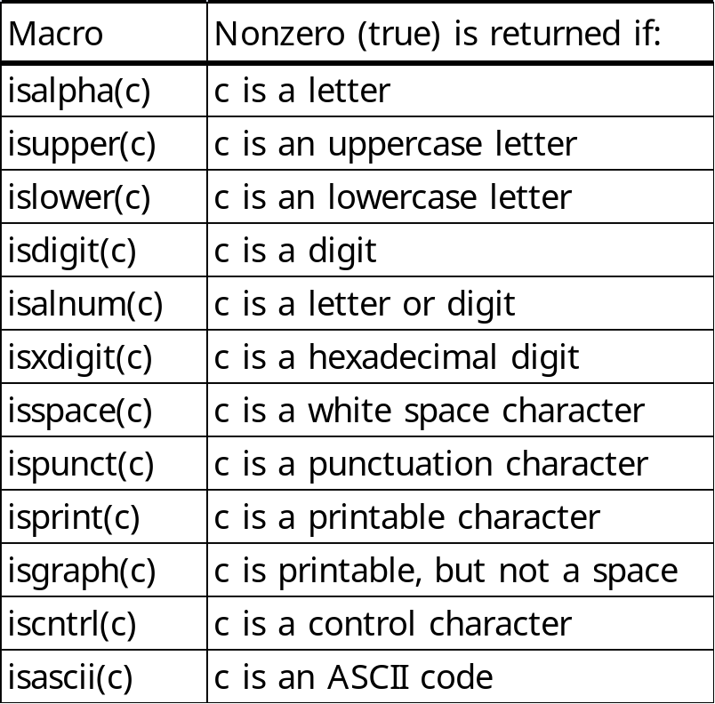
Macros in stdio.h and ctype.h
  [stdio.h]
  #define getchar() getc(stdin)
  #define putchar() putc((c), stdout)
    [ctype.h]

Slide 10
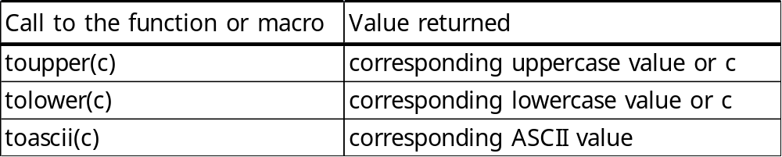
Macros in stdio.h and ctype.h
[ctype.h]
c is a variable of integral type, such as char or int.
The value of c stored in memory does not get changed

Slide 11
Conditional Compilation
#define DEBUG 1
#if DEBUG
printf(“debug: a=“%d”\n”, a);
#endif
#define DEBUG
#ifdef DEBUG
printf(“debug: a=“%d”\n”, a);
#endif

Slide 12
Conditional Compilation
Data Types and Operators. <number>
#if
#ifdef
#ifndef
#endif
#undef identifier

Slide 13
Conditional Compilation
Data Types and Operators. <number>
#if defined(HP9000)||defined(SUN4) && !defined(VAX)
/* machine-dependent code */
#endif
__linux__ Defined on Linux
__sun Defined on Solaris
__FreeBSD__ Defined on FreeBSD
__NetBSD__ Defined on NetBSD
__OpenBSD__ Defined on OpenBSD
__APPLE__ Defined on Mac OS X
__hpux Defined on HP-UX
__osf__ Defined on Tru64 UNIX (formerly DEC OSF1)
__sgi Defined on Irix
_AIX Defined on AIX

Slide 14
Predefined Macros (ANSI C)
Data Types and Operators. <number>
__DATE__ 매크로가 치환되는 순간의 날짜 (문자열)
__TIME__ 매크로가 치환되는 순간의 시간 (문자열)
__STDC__ ANSI 표준을 따르는지 여부 (0 또는 1)
__FILE__ 매크로가 포함된 source file
__LINE__ source file에서 line number
Notes:
current file name
current line number

