Slide 1
LEXICAL ELEMENTS & OPERATORS

Slide 2
C Compiler
Syntax of the language
  Rules for putting together words and punctuation to make correct
Compiler
  A program that checks on the legality of C code
  If errors, compiler prints error msg.s and stops
  If NO errors, compiler translates the code into object code

Slide 3
C Program
C program
  A sequence of characters that will be converted by a C compiler to object code
  Compilers first collects the characters of the C program into tokens
  6 kinds of tokens
    Keywords
    Identifiers
    Constants
    String constants
    Operators
    Punctuators

Slide 4
Characters used in a C Prog.
Lowercase letters
Uppercase letters
Digits
Other characters + - * / = ( ) { } [ ] < > ‘ ‘’
! # % & _ | ^ ~ \ . , ; : ?
White space characters blank, newline, tab, etc.

Slide 5
Comments
Arbitrary strings of symbols placed btwn /* and */
  /* comment */ /*** another comment ***/ /*****/
  /*
  * a comment can be written in this fashion
  * to set it off from the surrounding code
  */
  /**************************
  * If you wish, you can *
  * put commas in a box. *
  **************************/

Slide 6
Comments
Used by programmer as a documentation aid
Aim of documentation
  To explain clearly
    how the program works
    how it is to be used
Should be written SIMULTANEOUSLY with program text
  2 problems with inserting comments as a LAST step
    Once the prog. is running, the tendency is to either omit or abbreviate comments
    Ideally, the comments should serve as running commentary.
    They can not do this if they are inserted after finishing the coding

Slide 7
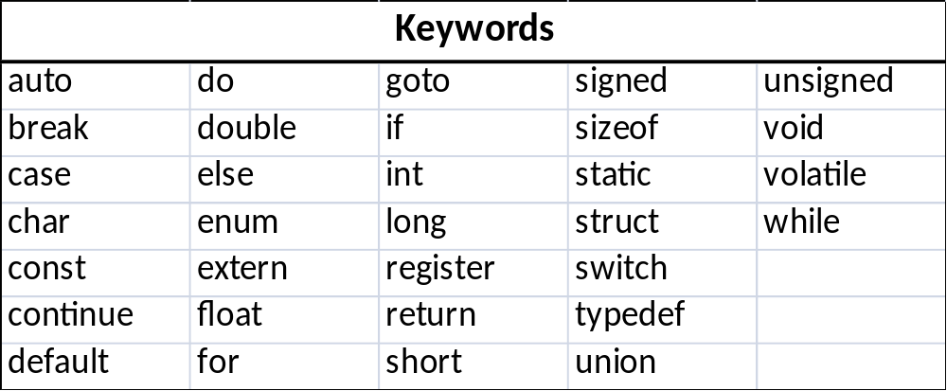
Keywords
Reserved words
  have a strict meaning as individual tokens in C
  can not be redefined or used in other contexts

Slide 8
Identifiers
Identifiers
  A token composed of a sequence of letters, digits, and the special character _ (underscore)
  A letter or underscore must be the first char. of an identifier
  Lower- and uppercase are distinct
  < Examples > < NOT Examples>
  k not#m2
  _id 101_south
  iamanidentifier2 -plus
  so_am_i

Slide 9
Identifiers
Give unique names to objects in a prog.
Keywords can be thought of as identifiers that are reserved to have special meaning
  e.g. printf
The identifier main is special.
Choose names that are meaningful!!
  tax = price * tax_rate
Identifier beginning with an underscore
  Usually used for system names. (e.g. _iob)
  Please do NOT begin with an undescore!

Slide 10
Constants
Integer constants
  0, 17
Floating constants
  1.0, 3.14159
Character constants
  Written btwn single quotes
    ‘a’, ‘b’, ‘c’
    closely related to integers
  Special character constants
    \n (newline)
    Backslash is the escape character (“escaping the usual meaning of n” )

Slide 11
Constants
Integer constants
  Decimal integers 0, 17
  Octal integers 017
  Hexadecimal integers 0x17
  How about -49 ? Constant expression

Slide 12
String Constants
A sequence of characters enclosed in a pair of double-quote marks
  “abc”
  collected as a single token
  ‘a’ and “a” are NOT the same.
  <Examples > <NOT Examples>
  “a string of text” /*”this is not a string”*/
  “” “and
  “ “ neither is this”
  “/* this is not a comment */”
  “a string with double quotes \” within”
  “a single backslash \\ is in this string”

Slide 13
Operators & Punctuators
Arithmetic Operators
  + , - , * , / ,%
  e.g. 5%3 has the value 2.
Operators can be used to separate identifiers
  a+b (or, a + b) /*an expression*/
  a_b /* a 3-character identifier*/
Some symbols have meanings that depend on context
  printf(“%d”, a);
  a = b % 7;

Slide 14
Operators & Punctuators
Punctuators
  parentheses, braces, commas, and semicolons
Operators and punctuators, along with white space, serve to separate language elements
  int main(void)
  {
    int a, b = 2, c = 3;
    a = 17 * (b + c);
    ……
Some special char.s are used in many different contexts
  a + b ++a a += b
    The parentheses following main are treated as an operator.
    The symbols “{“,”,”,”;”,”(“ and “)” are punctuators

Slide 15
Precedence and Associativity of Operators
Precedence: 연산의 우선순위
Associativity: 연산의 방향
Parentheses can be used to clarify or change the order in which operators are performed.
1 + 2 * 3 ⇔ 1 + (2 * 3)
(1 + 2) * 3
1 + 2 – 3 +4 – 5 ⇔ (((1+2) – 3) + 4) -5
Binary operators + and – have the same precedence, the associativity rule “left to right” is used.

Slide 16
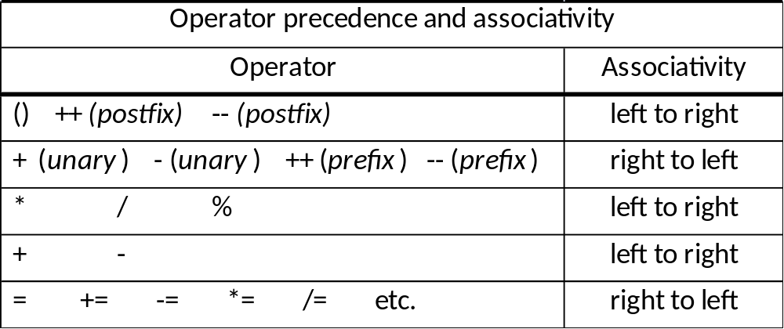
Precedence and Associativity of Operators
- a * b – c unary minus sign, binary subtraction
((- a) * b) – c

Slide 17
Increment and Decrement Operators
++ and –- are unary operators
<Examples> <NOT Examples>
++i 777++
cnt-- ++(a * b -1)

Slide 18
Increment and Decrement Operators
Difference btwn ++i and i++
  The expression ++i causes the stored value of i to be incremented first, with the expression then taking as its value the new stored value of i.
  The expression i++ has as its value the current value of i; then the expression causes the stored value of i to be incremented.
  int a, b, c = 0;
  a = ++c;
  b = c++;
  printf(“%d %d %d\n”, a, b, ++c); /* 1 1 3 is printed */

Slide 19
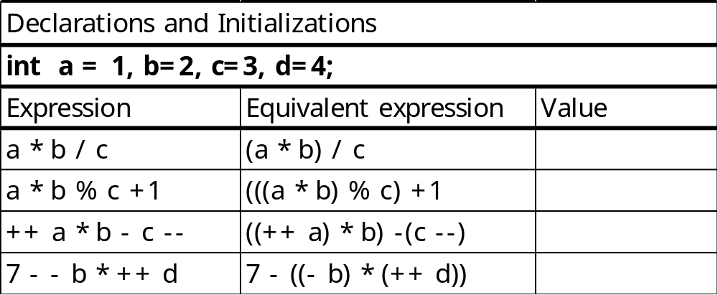
Increment and Decrement Operators
++ and –- cause the value of a variable in memory to be changed (side effect)
Other operators do NOT do this
  a + b
++i;
i++;
i = i + 1;
All three statements are equivalent.

Slide 20
Assignment Operators
  a = b + c; /* assignment statement */
= is treated as an operator
  Its precedence is lower than all others
  “right to left” associativity
Assignment expression
  variable = right_side
  right_side is itself expression
  The value of right_side is assigned to variable, and that value becomes the value of the assignment expression.

Slide 21
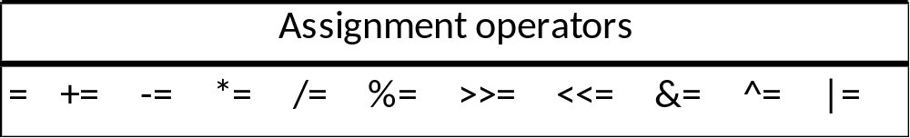
Assignment Operators
b = 2;
c = 3; ⇔ a = (b = 2) + (c = 3);
a = b + c;
a = b = c = 0; ⇔ a = (b = (c = 0));
k = k +2; ⇔ k += 2;
variable op= expression ⇔ variable = variable op (expression)
j *= k + 3; ⇔ j = j * (k+3); /* NOT j = j * k+3; */
int i = 1. j = 2, k = 3, m = 4;
i += j + k; ⇔ i += (j + k); ⇔ i = i + (j + k); /* 6 */
j *= k = m + 5; ⇔ j *= (k = (m + 5)); ⇔ j = j * (k = (m + 5)); /*18*/

